Slide 1
Chapter 1
Computer Abstractions and Technology
Notes:
Morgan Kaufmann Publishers
Chapter 1 — Computer Abstractions and Technology

Slide 2
The Computer Revolution
§1.1 Introduction
Progress in computer technology
  Underpinned by Moore’s Law
Makes novel applications feasible（切实可行）
  Computers in automobiles
  Cell phones
  Human genome project
  World Wide Web
  Search Engines
Computers are pervasive (无所不在，四处弥漫)
Chapter 1 — Computer Abstractions and Technology — <number>
Notes:
Morgan Kaufmann Publishers
Chapter 1 — Computer Abstractions and Technology

Slide 3
Classes of Computers
Personal computers
  General purpose, variety of software
  Subject to cost/performance tradeoff
Server computers
  Network based
  High capacity, performance, reliability
  Range from small servers to building sized
Chapter 1 — Computer Abstractions and Technology — <number>
Notes:
Morgan Kaufmann Publishers
Chapter 1 — Computer Abstractions and Technology

Slide 4
Classes of Computers
Supercomputers
  High-end scientific and engineering calculations
  Highest capability but represent a small fraction of the overall computer market
Embedded computers
  Hidden as components of systems
  A minimum performance with stringent (严格的，紧缩的) limitations on cost or power.
Chapter 1 — Computer Abstractions and Technology — <number>

Slide 5
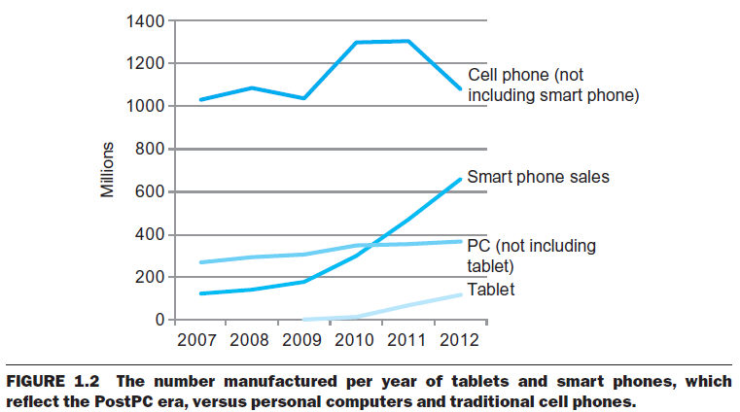
The PostPC Era
Chapter 1 — Computer Abstractions and Technology — <number>
Notes:
Morgan Kaufmann Publishers
Chapter 1 — Computer Abstractions and Technology

Slide 6
The PostPC Era
Personal Mobile Device (PMD)
  PMDs are battery operated with wireless connectivity to the Internet
  Cost: hundreds of dollars
  Smart phones, tablets, electronic glasses（电子眼镜）
Cloud computing
  Warehouse Scale Computers (WSC, 仓储级计算机 )
    WSC contains 100,000 servers in Amazon and Google.
  Software as a Service (SaaS)
  Portion of software run on a PMD and a portion run in the Cloud
  Amazon and Google
Chapter 1 — Computer Abstractions and Technology — <number>

Slide 7
What You Will Learn
How programs are translated into the machine language
  And how the hardware executes them
The hardware/software interface
What determines program performance
  And how it can be improved
How hardware designers improve performance
What is parallel processing
Chapter 1 — Computer Abstractions and Technology — <number>
Notes:
Morgan Kaufmann Publishers
Chapter 1 — Computer Abstractions and Technology

Slide 8
Understanding Performance
Algorithm
  排序算法有:插入排序、冒泡排序、归并排序、快速排序...
  Determines both numbers of source-level statements and I/O operations
Programming language, compiler, architecture
  Determines the number of computer instructions for each source-level statement
Processor and memory system
  Determine how fast instructions are executed
I/O system (including OS)
  Determines how fast I/O operations are executed
Notes:
Morgan Kaufmann Publishers
Chapter 1 — Computer Abstractions and Technology

Slide 9








Eight Great Ideas
Design for（面向） Moore’s Law (单芯片上的晶体管数目每18-24月翻一番）：to anticipate where the chip technology will be when the design finishes.
Use abstraction to simplify design:隐藏底层细节以提供给高层更简单的模型
Make the common case fast（加速经常性操作）
Performance via parallelism
Performance via pipelining
Performance via prediction
Hierarchy of memories
Dependability via redundancy
§1.2 Eight Great Ideas in Computer Architecture

Slide 10

Below Your Program（程序表象之下）
Application software
  Written in high-level language
System software
  Compiler: translates HLL(高级语言) code to machine code
  Operating System: service code
    Handling input/output
    Managing memory and storage
    Scheduling tasks & sharing resources
Hardware
  Processor, memory, I/O controllers
§1.3 Below Your Program
Notes:
Morgan Kaufmann Publishers
Chapter 1 — Computer Abstractions and Technology

Slide 11
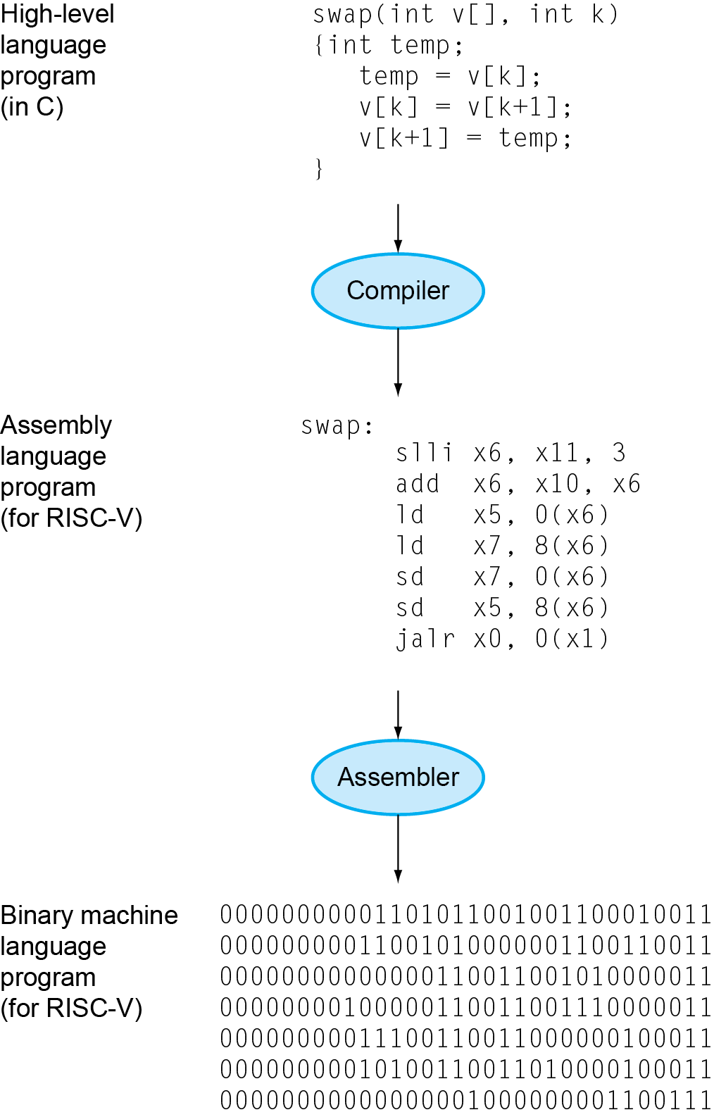
Levels of Program Code
High-level language
  Level of abstraction closer to problem domain（方便解决问题）
  Provides for productivity and portability（提供较高的生产率和好的移植性）
Assembly language
  Textual representation of instructions
Hardware representation
  Binary digits (bits)
  Encoded instructions and data
Chapter 1 — Computer Abstractions and Technology — <number>
Notes:
Morgan Kaufmann Publishers
Chapter 1 — Computer Abstractions and Technology

Slide 12

Components of a Computer
Same components for
all kinds of computer
  Desktop, server,
  embedded
Input/output includes
  User-interface devices
    Display, keyboard, mouse
  Storage devices
    Hard disk, CD/DVD, flash
  Network adapters
    For communicating with other computers
§1.4 Under the Covers
The BIG Picture
Chapter 1 — Computer Abstractions and Technology — <number>
Notes:
Morgan Kaufmann Publishers
Chapter 1 — Computer Abstractions and Technology

Slide 13
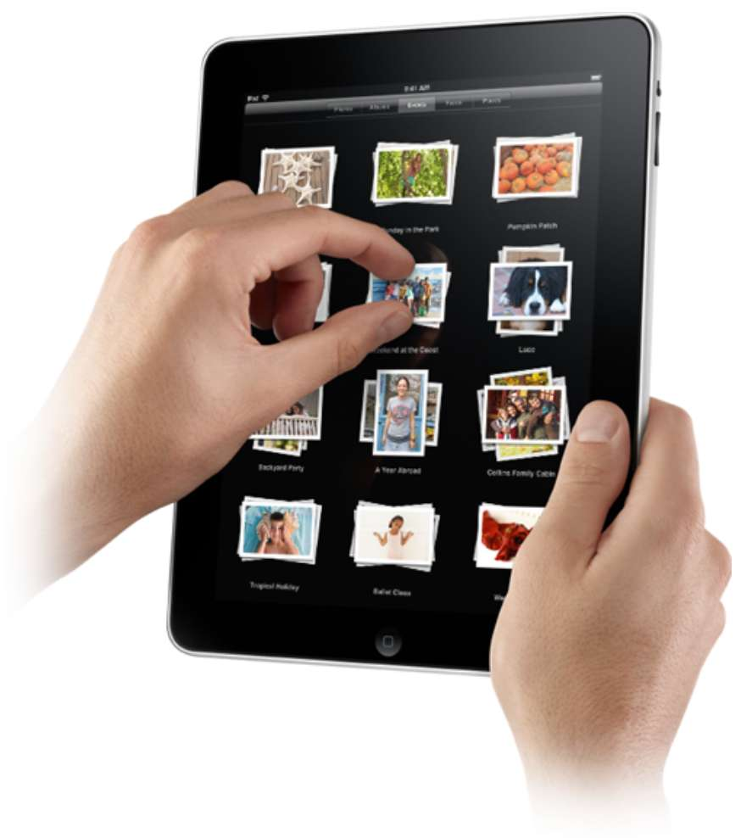
Touchscreen
PostPC（后PC时代） device
Supersedes（取代） keyboard and mouse
Resistive and Capacitive types
  Most tablets, smart phones use capacitive
  Capacitive allows multiple touches simultaneously
Chapter 1 — Computer Abstractions and Technology — <number>
Notes:
Morgan Kaufmann Publishers
Chapter 1 — Computer Abstractions and Technology

Slide 14

Through the Looking Glass（显示器）
LCD screen: picture elements (pixels)
  Mirrors content of frame buffer memory
Looking Glass：显示玻璃
Chapter 1 — Computer Abstractions and Technology — <number>
Notes:
Morgan Kaufmann Publishers
Chapter 1 — Computer Abstractions and Technology

Slide 15
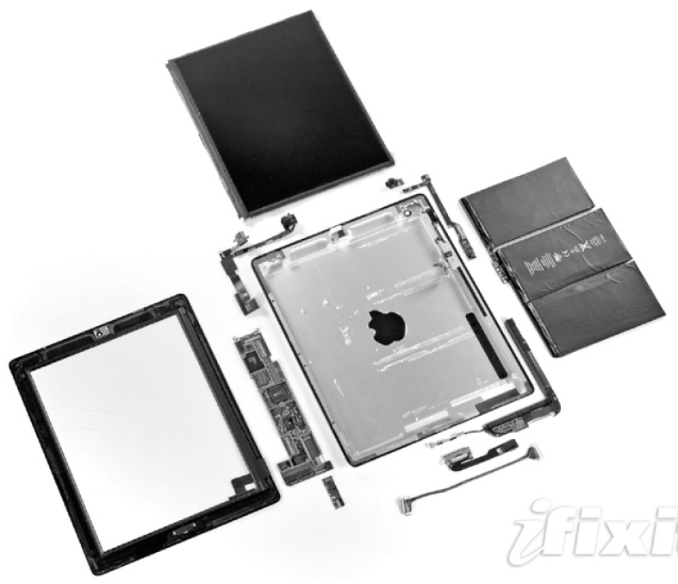
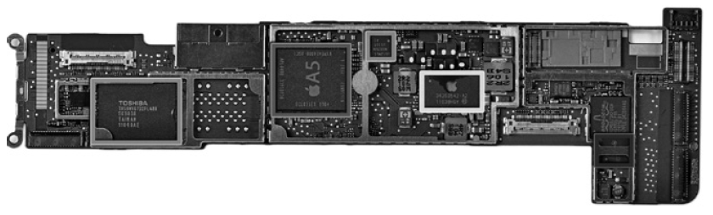
Opening the Box
Components of the Apple
iPad 2 A1395
Capacitive multitouch LCD screen
3.8 V, 25 Watt-hour battery
Computer board
Chapter 1 — Computer Abstractions and Technology — <number>
Notes:
Morgan Kaufmann Publishers
Chapter 1 — Computer Abstractions and Technology

Slide 16
Inside the Processor (CPU)
Datapath: performs operations on data
Control: sequences datapath, memory, ...
Cache memory
  Small fast SRAM memory for immediate access to data
Chapter 1 — Computer Abstractions and Technology — <number>
Notes:
Morgan Kaufmann Publishers
Chapter 1 — Computer Abstractions and Technology

Slide 17
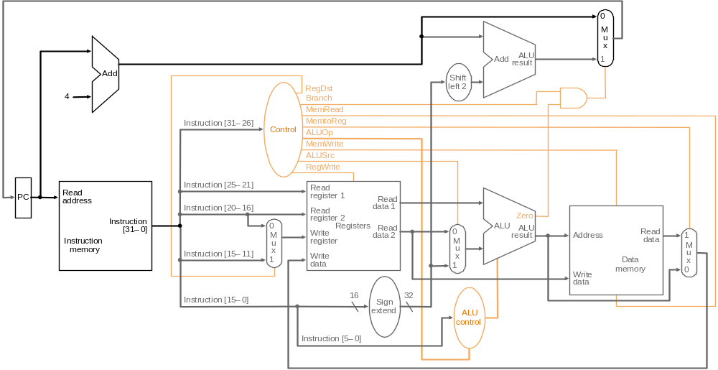
Inside the Processor (CPU)
Datapath: performs operations on data
Control
Cache memory
Chapter 1 — Computer Abstractions and Technology — <number>
Notes:
Morgan Kaufmann Publishers
Chapter 1 — Computer Abstractions and Technology

Slide 18
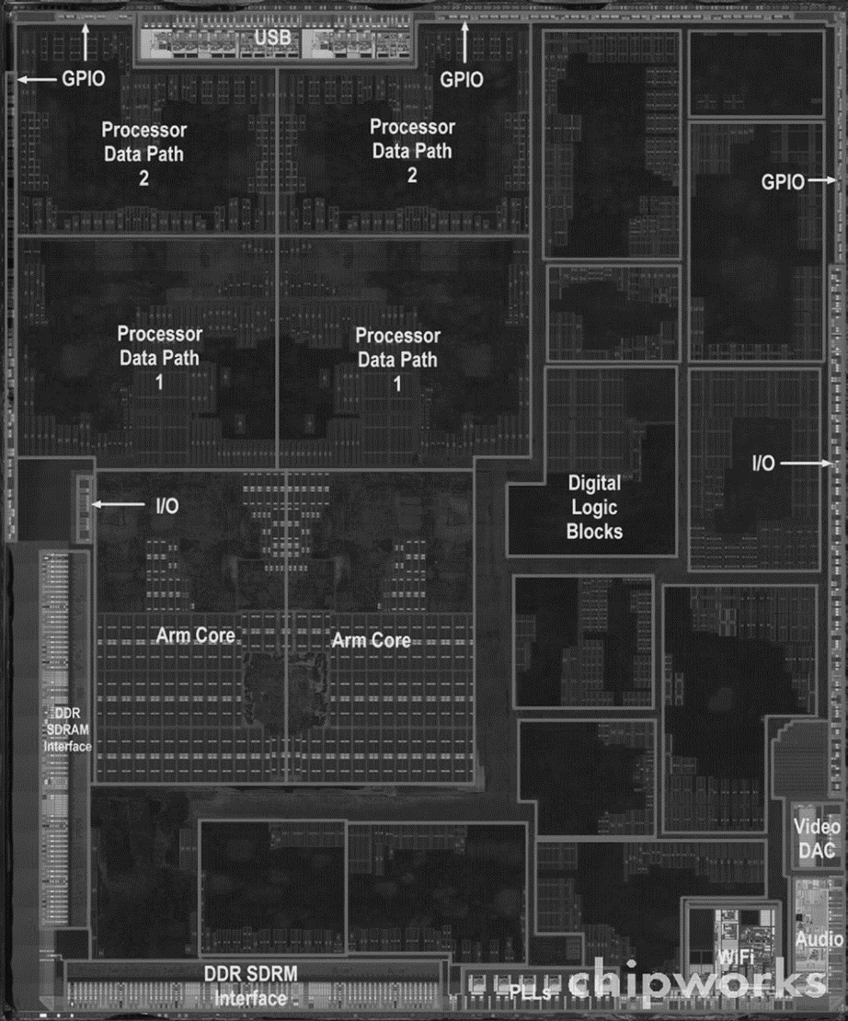
Inside the Processor
Apple CPU A5
Chapter 1 — Computer Abstractions and Technology — <number>
Notes:
Morgan Kaufmann Publishers
Chapter 1 — Computer Abstractions and Technology

Slide 19
Abstractions
Abstraction helps us deal with complexity
  Hide lower-level detail
One of abstraction is the interface between hardware and the lowest-level software.
  It is given a special name: Instruction set architecture (ISA).
  ISA includes instructions, I/O devices, and so on.
  微处理器的指令集架构（Instruction Set Architecture）常见种类如下： 复杂指令集计算（Complex Instruction Set Computing，CISC）；精简指令集计算（Reduced Instruction Set Computing，RISC） ；显式并行指令集计算（Explicitly Parallel Instruction Computing，EPIC）；超长指令字指令集计算（VLIW）
ABI--Application binary interface，应用程序二进制接口
  The basic instruction set and the operating system interface for application programmers
Notes:
Morgan Kaufmann Publishers
Chapter 1 — Computer Abstractions and Technology

Slide 20
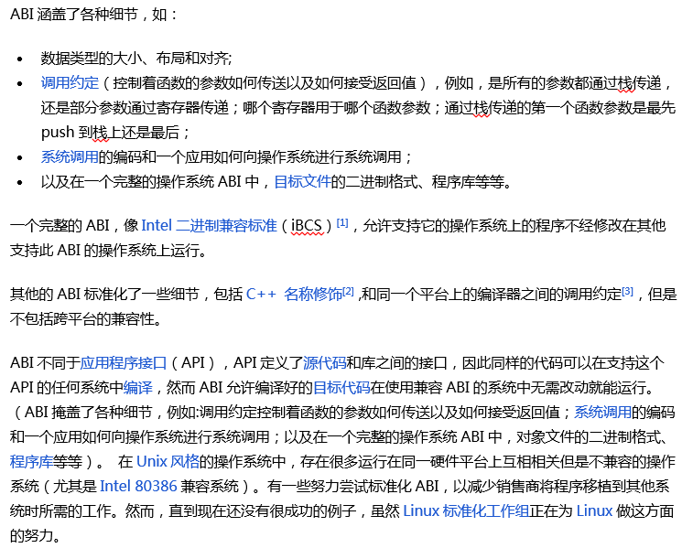
Chapter 1 — Computer Abstractions and Technology — <number>
Notes:
Morgan Kaufmann Publishers
Chapter 1 — Computer Abstractions and Technology

Slide 21




A Safe Place for Data
Volatile main memory
  Loses instructions and data when power off
Non-volatile secondary memory
  Magnetic disk
  Flash memory
  Optical disk (CDROM, DVD)
Chapter 1 — Computer Abstractions and Technology — <number>
Notes:
Morgan Kaufmann Publishers
Chapter 1 — Computer Abstractions and Technology

Slide 22


Networks
Communication, resource sharing, nonlocal access
Local area network (LAN): Ethernet
Wide area network (WAN): the Internet
Wireless network: WiFi, Bluetooth
Chapter 1 — Computer Abstractions and Technology — <number>
Notes:
Morgan Kaufmann Publishers
Chapter 1 — Computer Abstractions and Technology

Slide 23

Technology Trends
Electronics technology continues to evolve
  Increased capacity and performance
  Reduced cost
DRAM capacity, explain：1 chip
§1.5 Technologies for Building Processors and Memory
Year | Technology | Relative performance/cost
1951 | Vacuum tube | 1
1965 | Transistor | 35
1975 | Integrated circuit (IC) | 900
1995 | Very large scale IC (VLSI) | 2,400,000
2013 | Ultra large scale IC | 250,000,000,000
相对性价比
Chapter 1 — Computer Abstractions and Technology — <number>
Notes:
Morgan Kaufmann Publishers
Chapter 1 — Computer Abstractions and Technology

Slide 24
Semiconductor Technology
Silicon: semiconductor
Add materials to transform properties:
  Conductors
  Insulators
  Switch
Chapter 1 — Computer Abstractions and Technology — <number>

Slide 25

Manufacturing ICs
bond：焊接
die：晶片，小方片
Dice：切成方片
Patterned wafers: 带图案的圆晶片
Yield（正品产出率）: The percentage of good dies from the total number of dies on the wafer.
Notes:
Morgan Kaufmann Publishers
Chapter 1 — Computer Abstractions and Technology

Slide 26
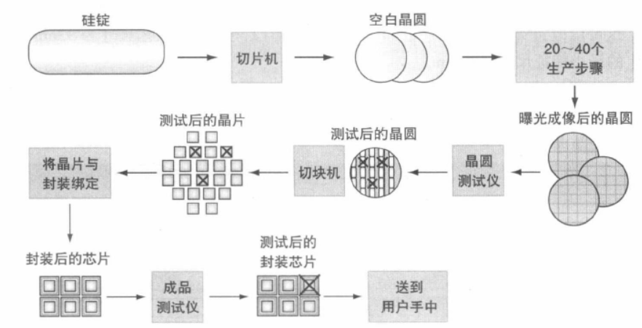
Chapter 1 — Computer Abstractions and Technology — <number>

Slide 27

Intel Core i7 Wafer
2021年9月15日苹果公司发布了iPhone 13，其搭载的 CPU芯片A15是基于台积电公司的5nm工艺。
2010年intel发布型号为Core i7的CPU（32nm工艺）
Intel Core i7
Intel CPU 酷睿 i7
300mm wafer, 280 chips, 32nm technology
Each chip is 20.7 x 10.5 mm
Chapter 1 — Computer Abstractions and Technology — <number>
Notes:
Morgan Kaufmann Publishers
Chapter 1 — Computer Abstractions and Technology

Slide 28

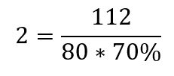

Integrated Circuit Cost
例如
左边公式是依据经验得出的，不是数学推导得出的
Nonlinear relation to area and defect rate（废品率）
  Wafer cost and area(面积) are fixed
  Defect rate determined by manufacturing process
  Die area determined by architecture and circuit design
Chapter 1 — Computer Abstractions and Technology — <number>
Notes:
Morgan Kaufmann Publishers
Chapter 1 — Computer Abstractions and Technology

Slide 29




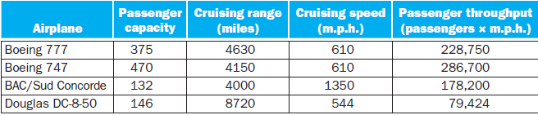
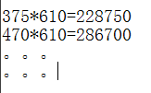
Defining Performance
考虑不同的性能度量，性能最佳的客机是不同的
Which airplane has the best performance?
§1.6 Performance
mph全称是mile per hour
Notes:
Morgan Kaufmann Publishers
Chapter 1 — Computer Abstractions and Technology

Slide 30
Response Time and Throughput
Response time
  How long it takes to do a task
Throughput
  Total work done per unit time
    e.g., tasks/transactions/… per hour
How are response time and throughput affected by
  Replacing the processor with a faster version?
  Adding more processors?
We’ll focus on response time for now…
Chapter 1 — Computer Abstractions and Technology — <number>
Notes:
Morgan Kaufmann Publishers
Chapter 1 — Computer Abstractions and Technology

Slide 31

Relative Performance
Define Performance = 1/Execution Time
“X is n time faster than Y” 本书中等价于 “X is n times as fast as Y” ，见教材P31
Example: time taken to run a program
  10s on A, 15s on B
  Execution Time_{B} / Execution Time_{A}
  = 15s / 10s = 1.5
  So A is 1.5 times faster than B
Chapter 1 — Computer Abstractions and Technology — <number>
Notes:
Morgan Kaufmann Publishers
Chapter 1 — Computer Abstractions and Technology

Slide 32
Measuring Execution Time
Elapsed time
  Total response time, including all aspects
    Processing, I/O, OS overhead, idle time
  Determines system performance
CPU time
  Time spent processing a given job
    Not includes I/O time and other process time in multiple processes environment
  Comprises (includes) user CPU time and system CPU time
  Elapsed time is different from CPU time.
Chapter 1 — Computer Abstractions and Technology — <number>
Notes:
Morgan Kaufmann Publishers
Chapter 1 — Computer Abstractions and Technology

Slide 33
CPU Clocking
Operation of digital hardware governed by a constant-rate clock
1 ps = 1 pico second = 1/1000 ns
Clock period
Clock (cycles)
Data transfer
and computation
Update state
Clock period: duration of a clock cycle
  e.g., 250ps = 0.25ns = 250×10^{–12}s
Clock frequency (rate): cycles per second
  e.g., 4.0GHz = 4000MHz = 4.0×10⁹Hz
Chapter 1 — Computer Abstractions and Technology — <number>
Notes:
Morgan Kaufmann Publishers
Chapter 1 — Computer Abstractions and Technology

Slide 34

CPU Time
CPU Time：这里指一个程序执行时CPU所化的时间; Clock cycles: 执行1个程序的总的时钟周期数
e.g. CPU Clock Cycles=10000, Clock Cycle Time=2ns, Clock Rate=0.5 GHz
CPU Time=10000*2ns=20000ns
Performance improved by
  Reducing number of clock cycles
  Increasing clock rate
  Hardware designer must often trade off(权衡) clock rate against cycle count
    把系统A重新设计为系统B，在执行同一程序时，有些技术在减少B的时钟周期数的同时，也会增加B的时钟周期的时长
Chapter 1 — Computer Abstractions and Technology — <number>
Notes:
Morgan Kaufmann Publishers
Chapter 1 — Computer Abstractions and Technology

Slide 35

CPU Time Example
Computer A: 2GHz clock, 10s CPU time to execute a program
Designing Computer B
  Aim for 6s CPU time (when executing the same program with A）
  Can do faster clock, but causes 1.2 × clock cycles
How fast must Computer B clock be?
CPU Time：这里指一个程序执行时CPU所化的时间
Clock cycles: 执行1个程序的总的时钟周期数
Chapter 1 — Computer Abstractions and Technology — <number>
Notes:
Morgan Kaufmann Publishers
Chapter 1 — Computer Abstractions and Technology

Slide 36

Instruction Count and CPI
这里Clock cycles指执行1个程序的总的时钟周期数。
ISA：Instruction Set Architecture
Instruction Count for a program
  Determined by program, ISA and compiler
Average cycles per instruction (Average CPI)
  Determined by CPU hardware
  If different instructions have different CPI
    Average CPI affected by instruction mix
Chapter 1 — Computer Abstractions and Technology — <number>
Notes:
Morgan Kaufmann Publishers
Chapter 1 — Computer Abstractions and Technology

Slide 37

CPI Example 1万条机器指令的同一个汇编语言程序在计算机A和B上运行，I=10000。
Computer A: Cycle Time = 250ps, CPI = 2.0
Computer B: Cycle Time = 500ps, CPI = 1.2
Same ISA
Which is faster?
A is faster…
computer A is 1.2 times as fast as computer B for this
program.
Chapter 1 — Computer Abstractions and Technology — <number>
Notes:
Morgan Kaufmann Publishers
Chapter 1 — Computer Abstractions and Technology

Slide 38
CPI Example
2 compiled code sequences using instructions in classes A, B, C, running in the same computer.
IC: Instruction Count
Class | A | B | C
CPI for class | 1 | 2 | 3
IC in sequence 1 | 2 | 1 | 2
IC in sequence 2 | 4 | 1 | 1
Sequence 1: IC = 5
  Clock Cycles
  = 2×1 + 1×2 + 2×3
  = 10
  Avg. CPI = 10/5 = 2.0
Sequence 2: IC = 6
  Clock Cycles
  = 4×1 + 1×2 + 1×3
  = 9
  Avg. CPI = 9/6 = 1.5
Chapter 1 — Computer Abstractions and Technology — <number>
Notes:
Morgan Kaufmann Publishers
Chapter 1 — Computer Abstractions and Technology

Slide 39
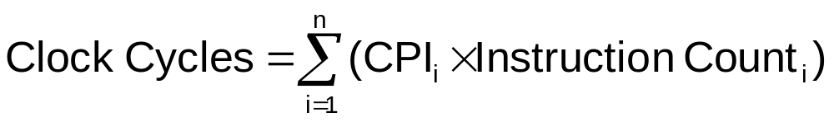

CPI in More Detail
If different instruction classes take different numbers of cycles, and total classes are n.
Weighted average CPI
Relative frequency
Chapter 1 — Computer Abstractions and Technology — <number>
Notes:
Morgan Kaufmann Publishers
Chapter 1 — Computer Abstractions and Technology

Slide 40

Performance Summary
Cycle time
The BIG Picture
Performance depends on
  Algorithm: affects IC, possibly CPI
  Programming language: affects IC, CPI
  Compiler: affects IC, CPI
  Instruction set architecture: affects IC, CPI, T_{c}
  T_{c：}time of one cycle
  IC：instruction counts
Chapter 1 — Computer Abstractions and Technology — <number>
Notes:
Morgan Kaufmann Publishers
Chapter 1 — Computer Abstractions and Technology

Slide 41

Power Trends
§1.7 The Power Wall
In CMOS IC technology
成正比符号：∝
30 = 0.75*0.2² * 1000
× 0.75
×30
新CPU的负载电容降到75%
5V → 1V
×1000
新CPU的功耗增到30倍
新CPU的电压降到1/5
新CPU的频率增到1000倍
Notes:
Morgan Kaufmann Publishers
Chapter 1 — Computer Abstractions and Technology

Slide 42

Reducing Power
Suppose a new CPU has
  85% of capacitive load of old CPU
  15% voltage and 15% frequency reduction
The power wall (功耗壁垒)
  We can’t reduce voltage further
  We can’t remove more heat
How else can we improve performance?
  Answer：Multicore microprocessors
Chapter 1 — Computer Abstractions and Technology — <number>
Notes:
Morgan Kaufmann Publishers
Chapter 1 — Computer Abstractions and Technology

Slide 43

Uniprocessor Performance
纵坐标是performance, VAX-11/780的性能为1（作为参考值）
§1.8 The Sea Change: The Switch to Multiprocessors
VAX-11/780
Constrained by power, instruction-level parallelism, memory latency
Chapter 1 — Computer Abstractions and Technology — <number>
Notes:
Morgan Kaufmann Publishers
Chapter 1 — Computer Abstractions and Technology

Slide 44
Multiprocessors
Multicore microprocessors
  More than one processor per chip
Requires explicitly parallel programming
  Compare with instruction level parallelism (pipelining) , 指令流水线的特点：
    Hardware executes multiple instructions at once
    Hidden from the programmer.(对程序员是不可见的)
  Hard to do （下面是并行编程难做的几件事）
    Programming for performance
    Load balancing
    Optimizing communication and synchronization（降低通信和同步的开销）
Chapter 1 — Computer Abstractions and Technology — <number>
Notes:
Morgan Kaufmann Publishers
Chapter 1 — Computer Abstractions and Technology

Slide 45
SPEC CPU Benchmark
Standard Performance Evaluation Corp (SPEC)
  Develops benchmarks for CPU, I/O, Web, …
SPEC CPU2006
  Elapsed time to execute a selection of programs
    Negligible I/O, so focuses on CPU performance
  Normalize(规格化)： [execution time of a reference processor] / [execution time of the evaluated computer].
    【SPECratio】=【Normalization result】 =【Execution time ratio】
    1# integer computing (Interpreted string processing)，【SPECratio1】=【Execution time ratio1】=9770/508=19.2
      execution time of reference machine: 9770 seconds,
      execution time of 【Core i7 920】（evaluated machine）: 508 seconds.
    2# integer computing （ Block-sorting compression），3# integer computing(GNU C compiler) ，依此类推
Benchmark：基准测试程序
geometric mean：几何平均
Notes:
Morgan Kaufmann Publishers
Chapter 1 — Computer Abstractions and Technology

Slide 46




CINT2006 for Intel Core i7 920
Summarize （规格化） as geometric mean of performance ratios: geometric mean =25.7=12个【Execution time ratio】相乘后开12次方的根号，结果如下（这里 12个【Execution time ratio】 依次是19.2, 15.4, …, 25.1 ）
Notes:
Morgan Kaufmann Publishers
Chapter 1 — Computer Abstractions and Technology

Slide 47

SPEC Power Benchmark
自学
Power consumption of server at different workload levels
  Performance: ssj_ops/sec
  Power: Watts (Joules/sec)
Chapter 1 — Computer Abstractions and Technology — <number>
Notes:
Morgan Kaufmann Publishers
Chapter 1 — Computer Abstractions and Technology

Slide 48
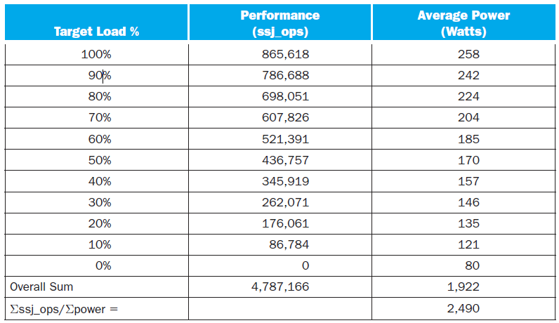
SPECpower_ssj2008 for Xeon X5650
自学
Chapter 1 — Computer Abstractions and Technology — <number>
Notes:
Morgan Kaufmann Publishers
Chapter 1 — Computer Abstractions and Technology

Slide 49
Pitfall: Amdahl’s Law
Factor: 倍数，因子
Corollary：推论，必然的结果
Amdahl：阿姆德尔
Pitfall: Improving an aspect of a computer and expecting a proportional improvement in overall performance
  100=80+20, 100/5 == 80/5+20 ? No!
§1.10 Fallacies and Pitfalls
Amdahl’s Law： Execution time after improvement
Example: a program take 100 seconds while multiply operations in it take 80 seconds in 100 seconds.
  How much should the multiply performance improve so that this program runs 5 times faster?
The idea of making the common case fast has a demoralizing(令人泄气的) corollary：让common case快n倍，不一定能让总体性能快m倍, 具体要视m而定(m=5不行，m=4则可以)。
  100/5=80/n+20 Can’t be done!
·
Chapter 1 — Computer Abstractions and Technology — <number>
Notes:
Morgan Kaufmann Publishers
Chapter 1 — Computer Abstractions and Technology

Slide 50

Pitfall: Amdahl’s Law
Factor: 倍数，因子
Corollary：推论，必然的结果
Amdahl：阿姆德尔
Pitfall: Improving an aspect of a computer and expecting a proportional improvement in overall performance
  100=80+20, 100/5 == 80/5+20 ? No!
§1.10 Fallacies and Pitfalls
Amdahl’s Law：
Example: a program take 100 seconds while multiply operations in it take 80 seconds in 100 seconds.
  How much should the multiply performance improve so that this program runs 5 times faster?
The idea of making the common case fast has a demoralizing(令人泄气的) corollary：让common case快n倍，不一定能让总体性能快m倍, 具体要视m而定。
  100/5=80/n+20 Can’t be done!
·
Chapter 1 — Computer Abstractions and Technology — <number>
Notes:
Morgan Kaufmann Publishers
Chapter 1 — Computer Abstractions and Technology

Slide 51
Fallacy: Low Power at Idle
Look back at i7 power benchmark
  At 100% load: 258W
  At 50% load: 170W (66%)
  At 10% load: 121W (47%)
Google data center
  Mostly operates at 10% – 50% load
  At 100% load less than 1% of the time
Consider designing processors to make power proportional to load（功耗与负载成比例，有节能环保效果）
Fallacy:谬论
Benchmark：基准测试， 基准测试程序
功耗与负载不成比例
Chapter 1 — Computer Abstractions and Technology — <number>
Notes:
Morgan Kaufmann Publishers
Chapter 1 — Computer Abstractions and Technology

Slide 52

Pitfall: MIPS as a Performance Metric
MIPS: Millions of Instructions Per Second
Here CPI is average CPI.
  CPI varies between programs on a given CPU
Chapter 1 — Computer Abstractions and Technology — <number>
Notes:
Morgan Kaufmann Publishers
Chapter 1 — Computer Abstractions and Technology

Slide 53
Concluding Remarks
不讲
Cost/performance is improving
  Due to underlying technology development
Hierarchical layers of abstraction
  In both hardware and software
Instruction set architecture
  The hardware/software interface
Execution time: the best performance measure
Power is a limiting factor
  Use parallelism to improve performance
§1.11 Concluding Remarks
Chapter 1 — Computer Abstractions and Technology — <number>
Notes:
Morgan Kaufmann Publishers
Chapter 1 — Computer Abstractions and Technology

