Slide 1
Chapter 3 Arithmetic for Computer

Slide 2
Arithmetic for Computers
§3.1 Introduction
Operations on integers
Addition and subtraction
Multiplication and division
Dealing with overflow
Floating-point real numbers
Representation and operations

Slide 3
Numbers
Binary numbers (base 2) 0000, 0001, 0010, 0011, 0100, 0101, 0110, 0111,
1000, 1001... decimal: 0...2^{n}-1
Of course it gets more complicated:
numbers are finite (overflow)
fractions and real numbers
negative numbers
How do we represent negative numbers? i.e., which bit patterns will represent which numbers?

Slide 4
Signed and Unsigned Numbers Possible Representations
Sign Magnitude 原码 One‘s Complement 反码 Two’s Complement 补码 000 = +0 000 = +0 000 = +0 001 = +1 001 = +1 001 = +1 010 = +2 010 = +2 010 = +2 011 = +3 011 = +3 011 = +3 100 = -0 100 = -3 100 = -4 101 = -1 101 = -2 101 = -3 110 = -2 110 = -1 110 = -2 111 = -3 111 = -0 111 = -1
Issues: number of zeros, ease of operations
Which representation is best? Why?
补码：两个正数的加法适用于正数加负数、负数加负数
补码：减法可以用加法来实现

Slide 5
2’s Complement
0000 0000 0000 0000 0000 0000 0000 0000_{two} = 0_{ten}
0000 0000 0000 0000 0000 0000 0000 0001_{two} = 1_{ten}
…
0111 1111 1111 1111 1111 1111 1111 1111_{two} = 2³¹-1
1000 0000 0000 0000 0000 0000 0000 0000_{two} = -2³¹
1000 0000 0000 0000 0000 0000 0000 0001_{two} = -(2³¹ – 1)
1000 0000 0000 0000 0000 0000 0000 0010_{two} = -(2³¹ – 2)
…
1111 1111 1111 1111 1111 1111 1111 1110_{two} = -2
1111 1111 1111 1111 1111 1111 1111 1111_{two} = -1
Note that the sum of a number x and its inverted representation x’ always
equals a string of 1s (-1). 下面的x和x’ 都是n位（例如32位）的补码表示的数，
很容易验证x=1和x’ =-2是正确的，x=0和x’ =-1也是正确的。
x + x’ = -1
x’ + 1 = -x … hence, can compute the negative of a number（取1个数
-x = x’ + 1 的负值）by inverting all bits and adding 1
Similarly, the sum of x and –x gives us all zeroes, with a carry of 1
In reality, x + (-x) = 2^{n} … hence the name 2’s complement

Slide 6
2’s Complement
0000_{two} = 0
0001_{two} = 1
0010_{two} = 2
…
1110_{two} = -2
1111_{two} = -1
Why is this representation favorable?
Consider the sum of 1 and -2 …. we get -1
Consider the sum of 2 and -1 …. we get +1
This format can directly undergo addition without any conversions!
下面对补码表示的4位2进制数x₃ x₂ x₁ x₀ ，简单证明：
x₃ x₂ x₁ x₀ = -x₃ 2³ + x₂ 2² + x₁ 2¹ + x₀ 2⁰
Reason: when x₃ is 0, the above formula is obviously correct;
When x₃ is 1, the number
=-[(1- x₂)* 2² + (1-x₁ )*2¹ + (1- x₀ )* 2⁰ +1]
(上面方括号内对补码表示的4位负数【1x₂x₁x₀】做“取反加1”操作，得到其绝对值)
=-1000 + x₂ 2² + x₁ 2¹ + x₀ 2⁰
= -x₃ 2³ + x₂ 2² + x₁ 2¹ + x₀ 2⁰

Slide 7
2’s Complement
0000 0000 0000 0000 0000 0000 0000 0000_{two} = 0_{ten}
0000 0000 0000 0000 0000 0000 0000 0001_{two} = 1_{ten}
0000 0000 0000 0000 0000 0000 0000 0010_{two} = 2_{ten}
…
0111 1111 1111 1111 1111 1111 1111 1111_{two} = 2³¹-1
1000 0000 0000 0000 0000 0000 0000 0000_{two} = -2³¹
1000 0000 0000 0000 0000 0000 0000 0001_{two} = -(2³¹ – 1)
1000 0000 0000 0000 0000 0000 0000 0010_{two} = -(2³¹ – 2)
…
1111 1111 1111 1111 1111 1111 1111 1110_{two} = -2
1111 1111 1111 1111 1111 1111 1111 1111_{two} = -1
Why is this representation favorable?
Consider the sum of 1 and -2 …. we get -1
Consider the sum of 2 and -1 …. we get +1
This format can directly undergo addition without any conversions!
Each number x₃₁ x_{30…} x₁ x₀ :
x₃₁ x_{30…} x₁ x₀ = -x₃₁ 2³¹ + x₃₀ 2³⁰ + x₂₉ 2²⁹ + … + x₁ 2¹ + x₀ 2⁰

Slide 8
Number formats
Sign and magnitude
2's complement
1's complement: + 0 & - 0
Biased notation (移码,本章后面浮点数部分会讲到)
Representation
Binary
Decimal
Hexadecimal

Slide 9
Example
Compute the 32-bit 2’s complement representations
for the following decimal numbers:
5, -5, -6
5: 0000 0000 0000 0000 0000 0000 0000 0101
-5: 1111 1111 1111 1111 1111 1111 1111 1011
-6: 1111 1111 1111 1111 1111 1111 1111 1010
Given -5, verify that inverting(按位取反) and adding 1
yields the number 5

Slide 10
Signed / Unsigned
The hardware recognizes two formats:
unsigned (corresponding to the C declaration unsigned int)
all numbers are positive, a 1 (of binary number) in the most significant bit just means it is a really large number
signed (C declaration is signed int or just int)
numbers can be +/- , a 1 (of binary number) in the MSB means the number is negative.
MSB----Most Significant Bit（最高位）
e.g. 8-bit binary number 1000 0100
As [unsigned int], it is 129_{ten}.
As [signed int], it is -124_{ten}, or -0111 1100_{two}

Slide 11
sign extension (lbu vs. lb)
书上无，不讲
lb x5, 40(x6) # sign extension: byte to doubleword (64 bits)
lbu x5,40(x6) # unsigned extension, high 56 bits of $x5 are all 0.
Sign extension: byte to word (32 bits)
Take the lower 8 bits
Copy the highest bit to the remaining 24 bits
1111 1110 → 254 (32 bits) , unsigned extension,
result: 0000 0000 0000 0000 0000 0000 1111 1110
1111 1110 → -2 (32 bits) , sign extension,
result: 1111 1111 1111 1111 1111 1111 1111 1110

Slide 12
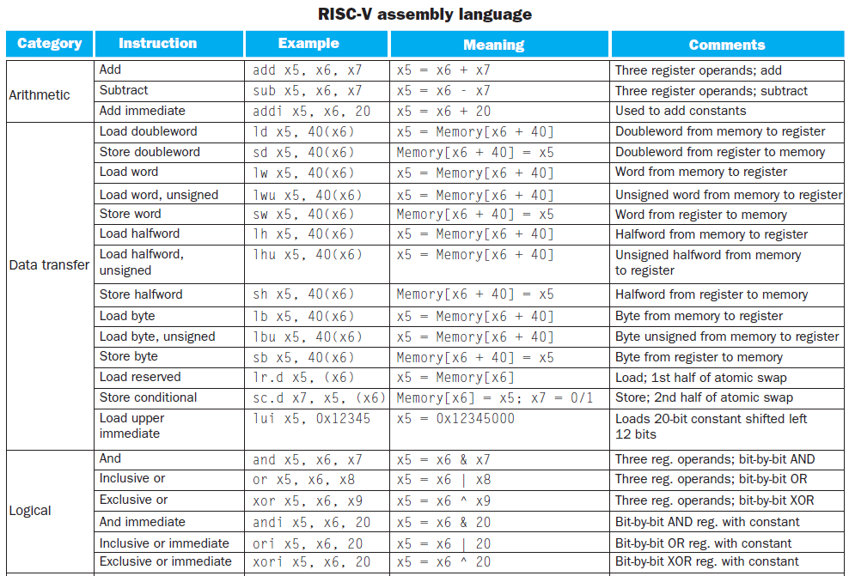

Slide 13
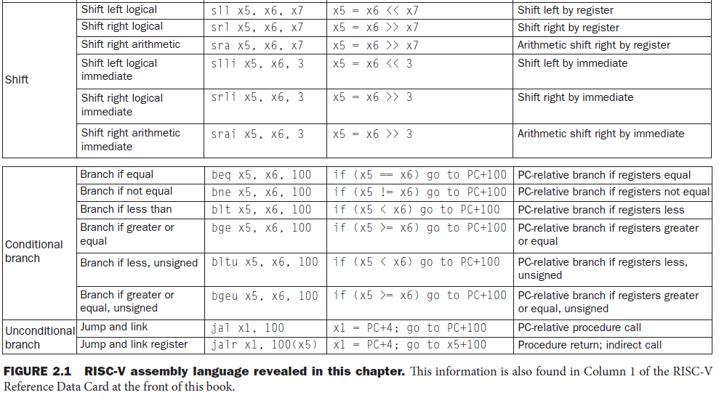

Slide 14
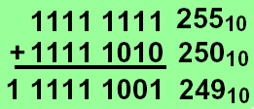
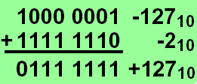
Overflow
Overflow occurs when the result of an operation can not be represented with the available hardware
The sum of two unsigned numbers can exceed hardware representation
The sum or difference of two signed numbers can exceed hardware representation

Slide 15
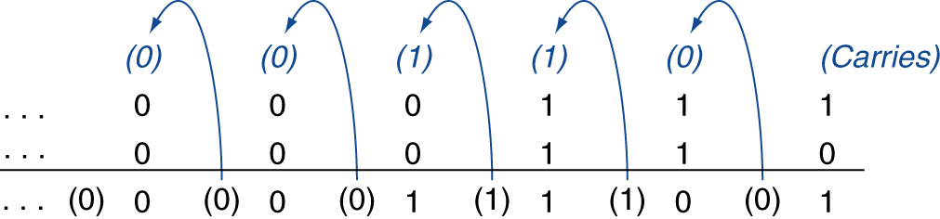
Integer Addition
Example: 7 + 6
§3.2 Addition and Subtraction
Overflow if result out of range
Adding positive and negative operands, no overflow
Adding two positive operands
Overflow if result sign is 1
Adding two negative operands
Overflow if result sign is 0
+ve: positive
-ve: negative

Slide 16
Integer Subtraction
Add negation of second operand
Example: 7 – 6 = 7 + (–6)
+7: 0000 0000 … 0000 0111 –6: 1111 1111 … 1111 1010 +1: 0000 0000 … 0000 0001
Overflow if result out of range
Subtracting of two +ve or two –ve operands, no overflow
Subtracting +ve from –ve operand
Overflow if result sign is 0
Subtracting –ve from +ve operand
Overflow if result sign is 1
+ve: positive
-ve: negative

Slide 17
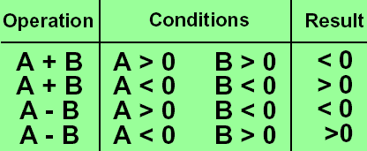
Overflow conditions
General overflow conditions for signed integer and 2’s complement
Reaction on overflow
Ignore? C and Java ignore integer overflow.
Ada and Fortran Signal to application
Today all computers have a way to detect overflow.

Slide 18
Arithmetic for multimedia operation
Saturating operations
On overflow, result is largest representable value.

Slide 19
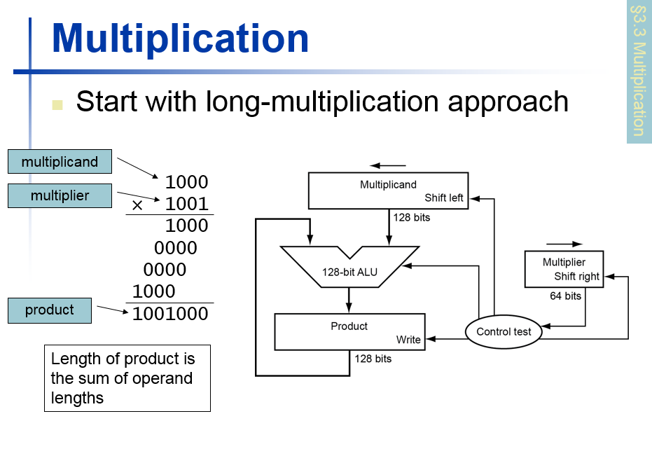
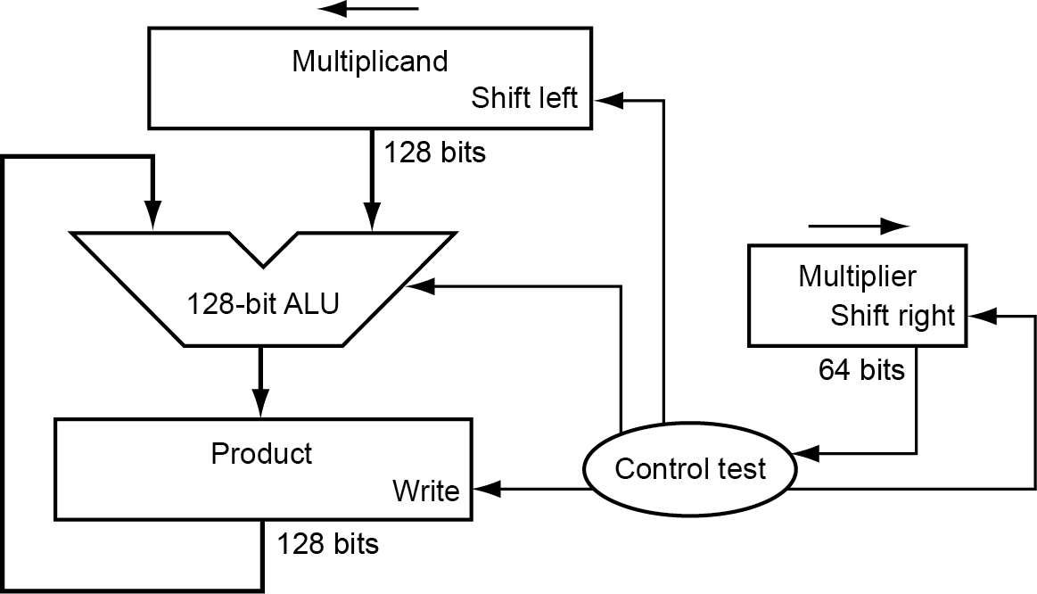
Multiplication
3.3 Multiplication (64 bit*64 bit)
§3.3 Multiplication
Start with long-multiplication approach
Unsigned integer multiply
multiplicand
1000
× 1001
1000
0000
0000
1000
1001000
multiplier
product
Length of product is the sum of operand lengths

Slide 20
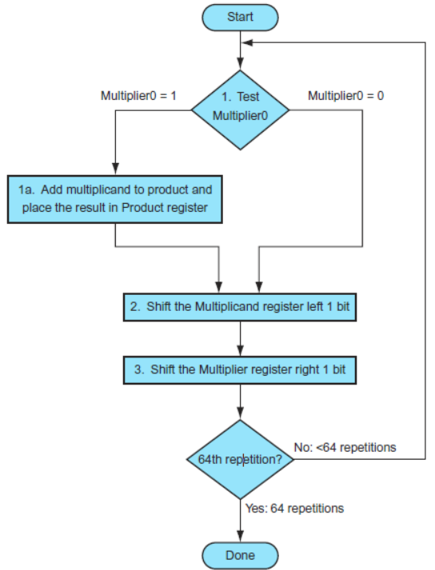
Multiplication Hardware
Initially 0
128-bit ALU has no 1-bit CF (carry flag),because no carry happens.

Slide 21
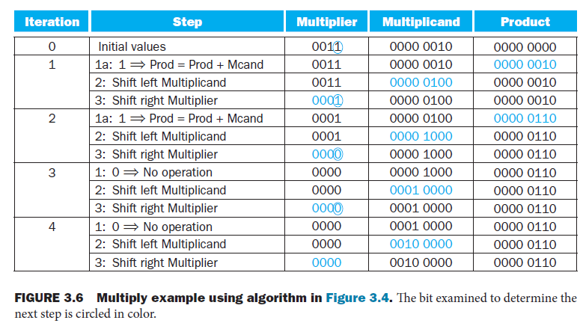
0010*0011=2*3=6
Multiplicand: 0010, Multiplier:0011

Slide 22
Multiplication Hardware
64 loops
Each loop contains 3 step (3 cycles):
If multipiler0==1 then multiplicand <= multiplicand + product
shift the multiplicand reg. left 1 bit
shift the multiplier reg. right 1 bit
Total cycles = 64*3 =192, almost 200 clock cycles
Time optimization:
The speed up comes from performing 3 steps in 1 cycle in parallel, i.e. simultaneously.
For 3 registers: multiplicand, multiplier , product, value of each reg. changes at the end of a clock cycle simultaneously.
192 cycles → 64 cycles

Slide 23
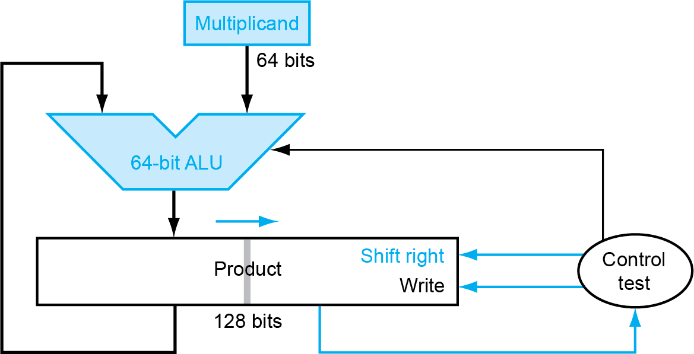
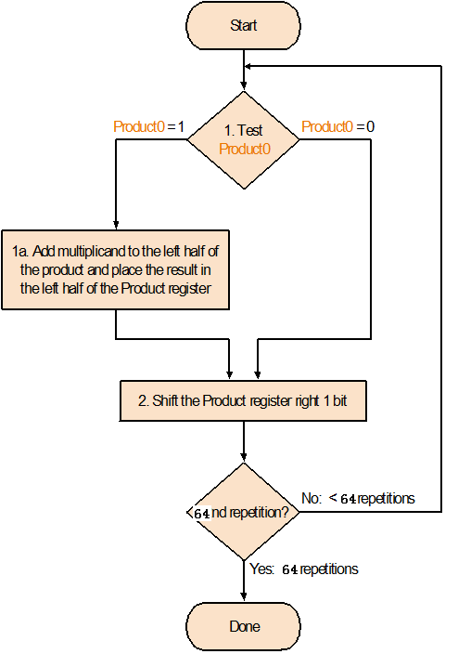
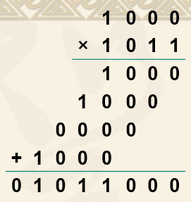
Optimized Multiplier: Less Register Size

Slide 24
Optimized Multiplier: Less Register Size
Total 129 bit including 1-bit CF
Put 64-bit multiplier into right half of product register.
64-bit ALU provides 64-bit sum and 1-bit CF (carry flag),total 65 bits
128-bit Product reg. also has 1 extra CF bit in the left, this CF also shift right into MSB of 128-bit product in each product right shift.
ALU CF line is used as input of product CF bit after each addition

Slide 25
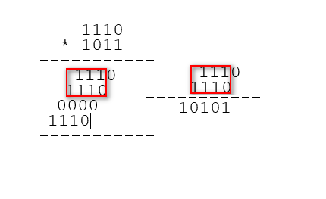
为什么64位加法器每次产生进位是可能的，必须放入乘积寄存器，不能忽略？
以4位2进制数1110*1011的乘法为例，下图红框中的2个4位数相加后有进位1，得到累加和10110， 10110的最高位1是进位，必须放入乘积寄存器，如果忽略这个进位， 1110*1011的乘积（最终位于乘积寄存器）就会出错。

Slide 26
Total 129 bit including 1-bit CF
following A1,A2,A3 are done simultaneously in 1 cycle.
Product reg. has 128 bits: P0, P1, P2, … P126, P127
Time optimization : Less Cycles
64 loops, each loop takes 1 cycle (originally each loop takes 3 cycles)
If multipiler0==1 then do :
A1:P126-P63 <= (multiplicand + upper 64-bit of product)
A2: P127 <= ALU-CF
A3: lower 64 bits of product reg. shift right 1 bit ( P63=>P62=>P61=>...P1=>P0)
else do:
128-bit of product reg. shifts right 1 bit logically (0=>P127=>P126=>P125=>...P2=>P1=>P0)

Slide 27
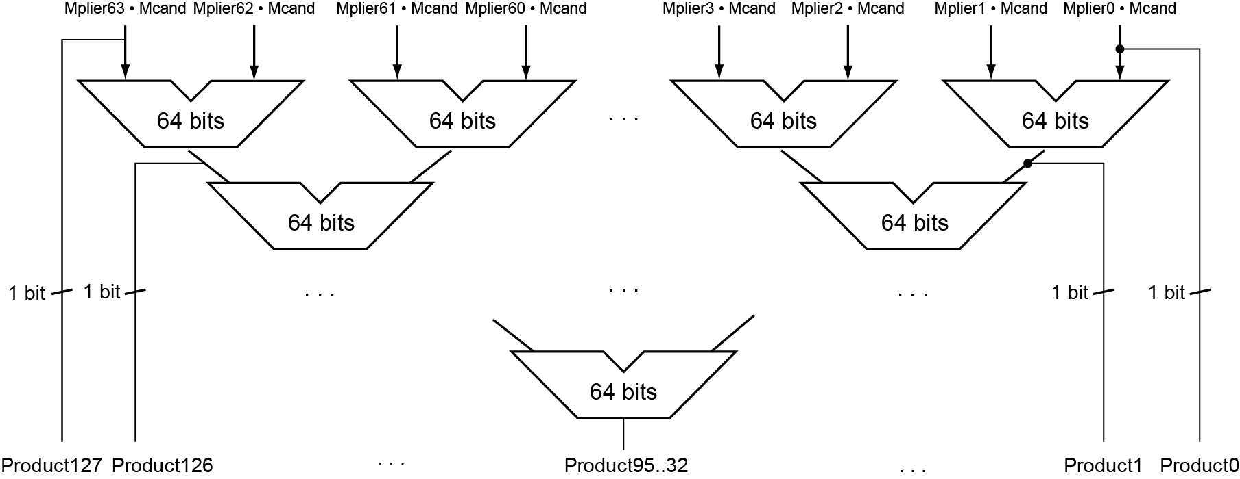
Faster Multiplier
Uses multiple adders
Cost/performance tradeoff
possible error
No error
Can be pipelined
Several multiplication performed in parallel

Slide 28
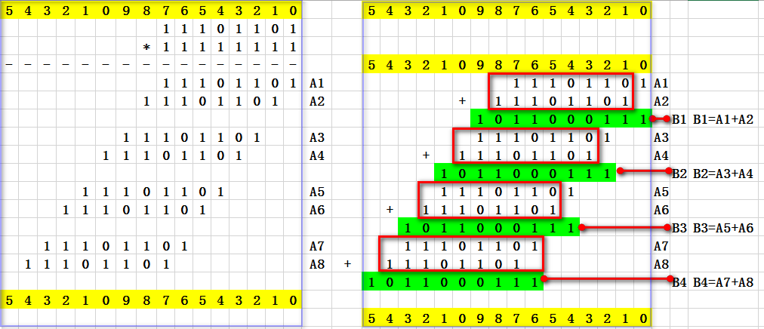

Slide 29
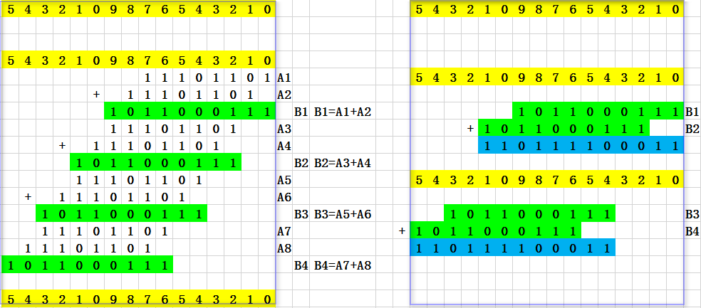
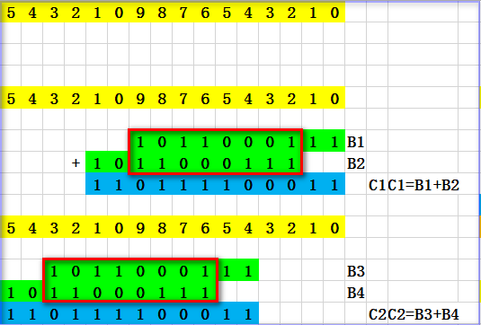

Slide 30
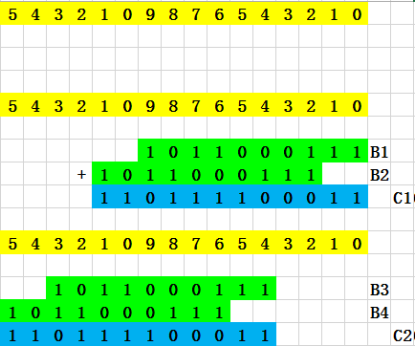
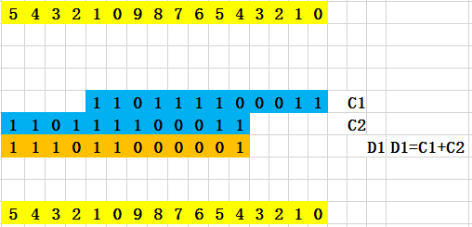

Slide 31
RISC-V Multiplication
Four multiply instructions:
mul: multiply
Gives the lower 64 bits of the product，lkj补充：这是带符号数乘法，还是无符号数乘法？答案：都适用且结果一样。
mulh: multiply high
Gives the upper 64 bits of the product, the operands are signed
mulhu: multiply high unsigned
Gives the upper 64 bits of the product, the operands are unsigned
mulhsu: multiply high signed/unsigned
Gives the upper 64 bits of the product, one operand is signed and the other unsigned
Use mulh result to check for 64-bit overflow

Slide 32
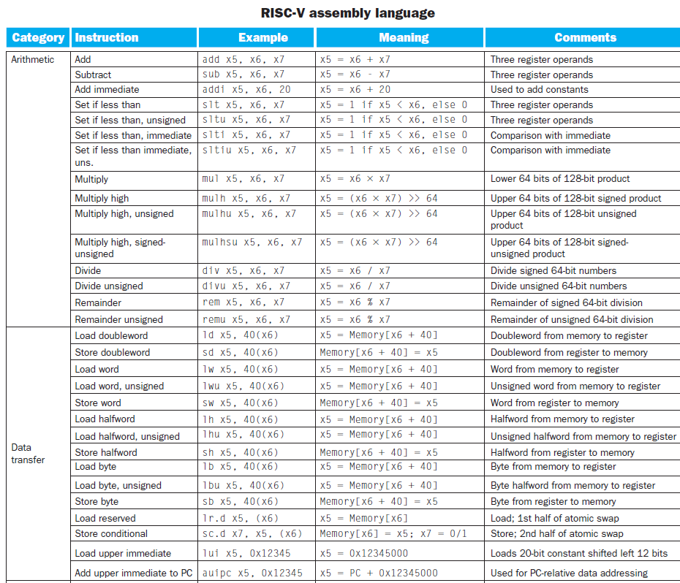
RISC-V Multiplication
32 64-bit registers: x0,x1,x2 …,x63
在书上P190

Slide 33
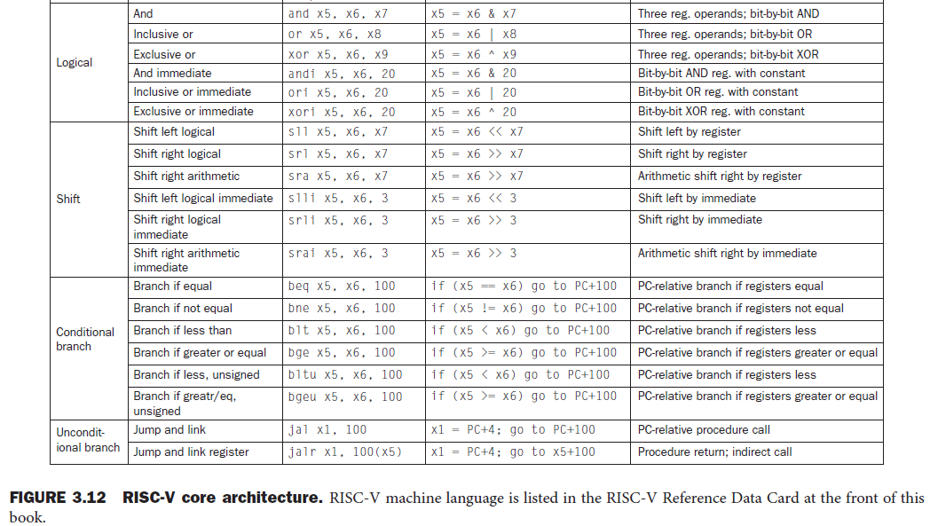
在书上P190

Slide 34
Mul指令：mul x5, x6, x7，适用于无符号数和补码表示的带符号数，
Case1：无符号数乘法：x5, x6, x7都是无符号数，x5是128位乘积（无符号数）的低64位U64（无符号数）。
Case2：带符号数乘法：x5, x6, x7都是带符号数，补码表示，x5是128位乘积（补码表示的带符号数）的低64位V64。
若Case1的X6与Case2的X6是相同的bit串，并且Case1的X7与Case2的X7是相同的bit串，则Case1和Case2的X5是相同的bit串。
举例1：上面的64位缩短到8位，A和B作为带符号数，并且都是负数, A=1011 1101=0xBD，B=1001 1110=0x9E，mul C, A，B
Case1：无符号数乘法：C, A, B都是无符号数，C是16位乘积（无符号数）的低8位（无符号数）, A*B=0xBD *0x9E =0X74A6, C=0xA6
Case2：带符号数乘法：C, A, B都是带符号数，补码表示，C是16位乘积（补码表示的带符号数）的低8位。A*B= -0x43 * -0x62= +0x19A6, C=0xA6
结论：A和B作为带符号数，并且都是负数时，结论正确：无符号数乘法和带符号数乘法的乘积的低8位C相同，都是0xA6。

Slide 35
举例2：上面的64位缩短到8位，A和B作为带符号数时是1正1负, 负数A = 1011 1101=0xBD，正数B=0001 1110=0x1E，mul C, A，B
Case1：无符号数乘法：C, A, B都是无符号数，C是16位乘积（无符号数）的低8位（无符号数）, A*B=0xBD *0x1E =0X1626, C=0x26
Case2：带符号数乘法：C, A, B都是带符号数，补码表示，C是16位乘积（补码表示的带符号数）的低8位。A*B= -0x43 *0x1E=-0x7DA, A*B的补码表示是0xF826，C=0x26
结论：A和B作为带符号数，并且1正1负时，结论正确：无符号数乘法和带符号数乘法的乘积的低8位C相同，都是0x26。

Slide 36
Signed multiplication
Basic approach:
Store the signs of the operands
Convert signed numbers to unsigned numbers
(most significant bit (MSB) = 0)
Perform multiplication
If sign bits of operands are equal
sign bit = 0, else
sign bit = 1

Slide 37
3.4 Division
Unsigned integer division
1001_{ten} Quotient
Divisor 1000_{ten} | 1001010_{ten} Dividend
-1000
0010
0101
1010
-1000
10_{ten} Remainder
本例十进制数字只用0和1，像二进制
64-bit divisor, at every step
shift divisor right and compare it with current dividend
if divisor is larger, shift left and set 0 in the low bit of the quotient
if divisor is smaller or equal, subtract to get new dividend, shift left and set 1 in the low bit of the quotient
Loop for 65 times
37
Notes:
37

Slide 38
Dividend = quotient × divisor + remainder
Remainder < divisor
Iterative subtraction, result:
Greater than 0: then we get a 1 as quotient bit
Smaller than 0: then we get a 0 as quotient bit

Slide 39
Division
1001_{ten} Quotient
Divisor 1000_{ten} | 01001010_{ten} Dividend
Dividend 01001010 01001010 00001010 00001010
Divisor 10000000-> 01000000-> 00100000-> 00010000
Quo: 0 01 010 0100
00001010 0010 --remainder
-> 00001000->
01001
At every step,
shift divisor right and compare it with current dividend
if divisor is larger, left shift quotient, set 0 as the lowest bit of the quotient
if divisor is smaller or equal, subtract to get new dividend and left shift quotient ,set 1 as the lowest bit of the quotient
39
39
Notes:
39

Slide 40
step0 step1 step2 step3
Dividend 01001010 01001010 00001010 00001010
Divisor 10000000-> 1000000-> 100000-> 10000
Quotient: 0 01 010 0100
step4
00001010 0010 --remainder
-> 1000->
1001 (注意：在step0，若被除数大于等于除数则溢出)
01001010-1*1000000= 00001010 step1
00001010-0* 100000= 00001010 step2
00001010-0* 10000= 00001010 step3
00001010-1* 1000= 0010 step4
-->
01001010-1000*1000= 00001010 step1
00001010- 000*1000= 00001010 step2
00001010- 00*1000= 00001010 step3
00001010- 1*1000= 0010 step4
补充内容,不讲
40
40
Notes:
40

Slide 41
01001010-1000*1000= 00001010 step1
00001010- 000*1000= 00001010 step2
00001010- 00*1000= 00001010 step3
00001010- 1*1000= 0010 step4
---> 上述4项左边相加，右边相加，消掉等号左右相同的项：
01001010
-1000*1000-000*1000-00*1000-1*1000=0010
--->
01001010=
（1000*1000+000*1000+00*1000+1*1000）+ 0010
--->
01001010=1001*1000+0010
补充内容,不讲
41
41
Notes:
41

Slide 42
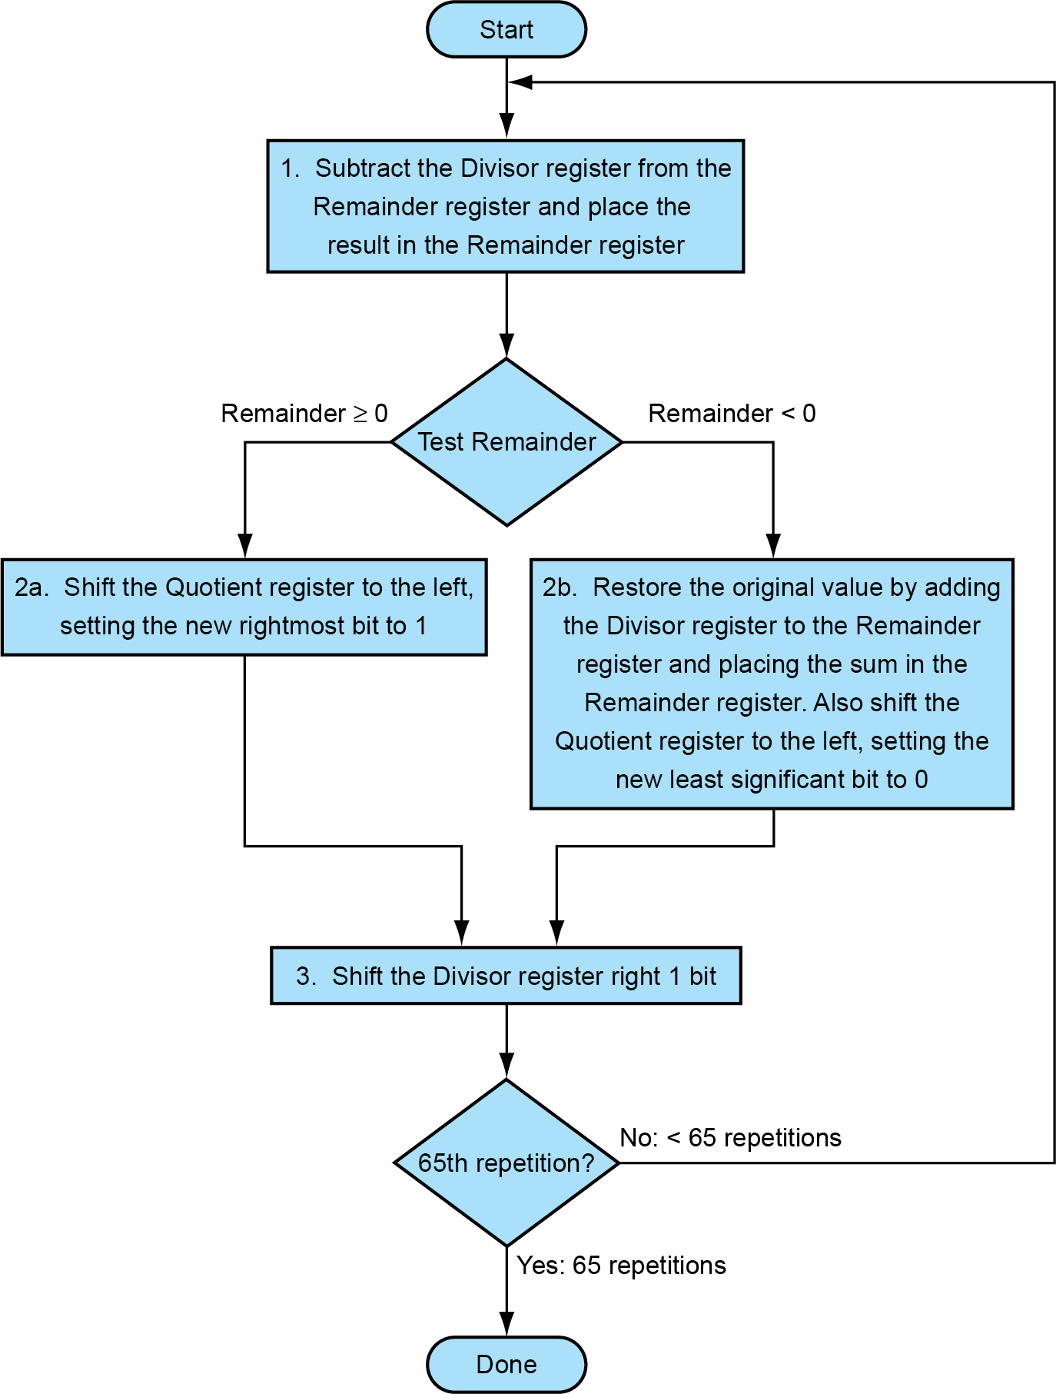
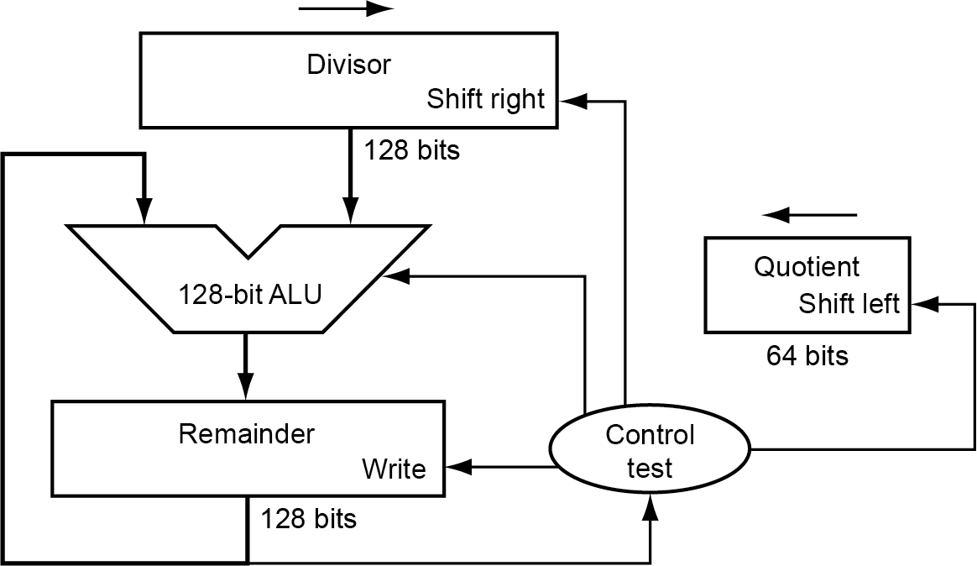
At first, the 64-bit divisor is in the left half of the divisor register, the 128-bit dividend is in remainder register.
Initially divisor in left half
Initially dividend

Slide 43
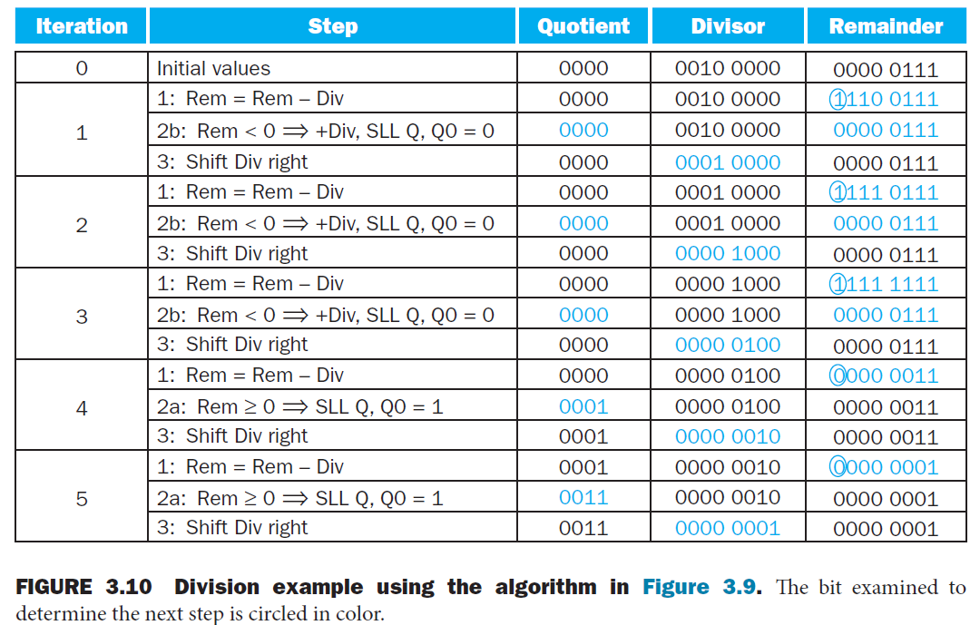
Example 7/2 for Division V1
>

Slide 44
Division
1001 ---- Quotient
Divisor 1000|1001010 ---- Dividend
-1000
0010
-0000
0101
-0000
1010
-1000
10 ---- Remainder
44
44
Notes:
44

Slide 45
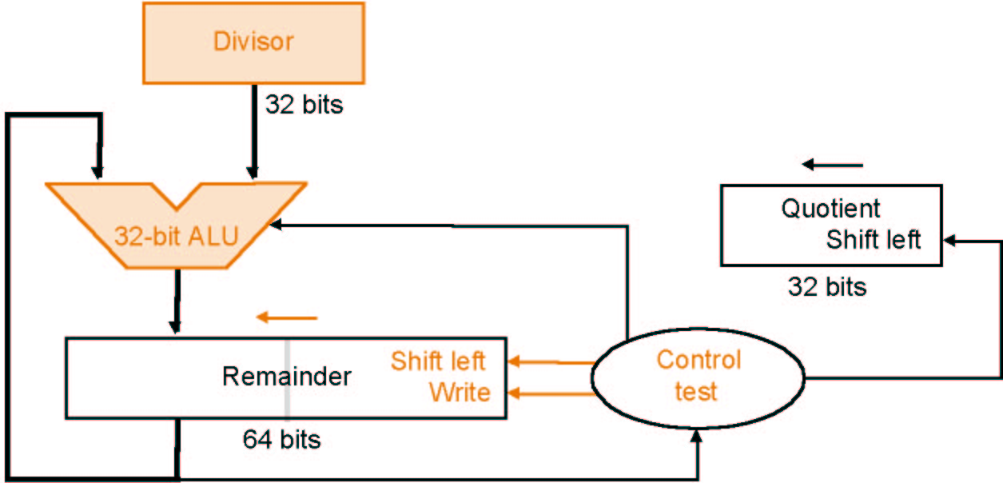
Division V2 (书上无V2,直接跳到V3）
Reduction of Divisor and ALU width by half
Shifting of the remainder
65 次迭代(先做溢出检查：第1次迭代时，若remainder的左64位大于等于divisor则溢出，结束运算；若未溢出，接着做第2-65次迭代)
64-bit
64-bit ALU
64-bit
dividend
128-bit

Slide 46
Division V2 (书上无V2,直接跳到V3）
Reduction of Divisor and ALU width by half
Shifting of the remainder
65 次迭代(先做溢出检查：第1次迭代时，若remainder的左64位大于等于divisor则溢出，结束运算；若未溢出，接着做第2-65次迭代)
64-bit
65-bit
It is 129 bit including 1-bit CF
ALU
64-bit
CF
dividend
128-bit

Slide 47
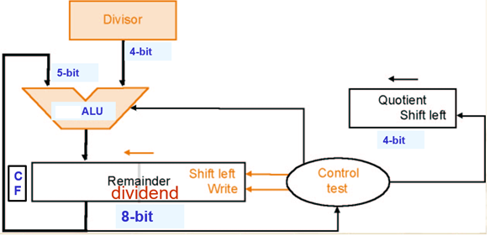
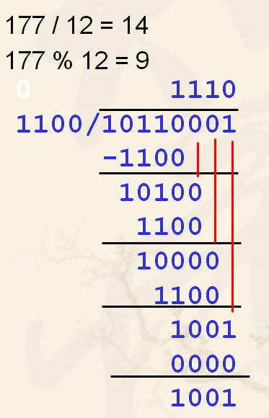
Division V2
根据右边的例子， Division V2 需要做一些修正才正确：
4-bit ALU has 1-bit extra CF (Carry Flag）and 5-bit minuend.
5-bit minuend（被减数）includes CF and upper 4-bit of remainder register.
Remainder register plus CF has 9 bits.

Slide 48
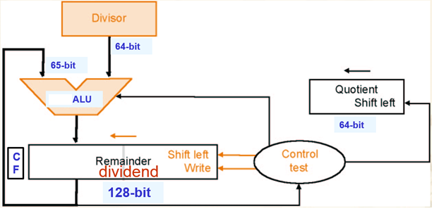
It is 129 bit including 1-bit CF
Division V2
根据右边的例子， Division V2 需要做一些修正才正确：
64-bit ALU has 1-bit extra CF (Carry Flag）and 65-bit minuend.
65-bit minuend（被减数）includes CF and upper 64-bit of remainder register.
Remainder register plus CF has 129 bits.

Slide 49
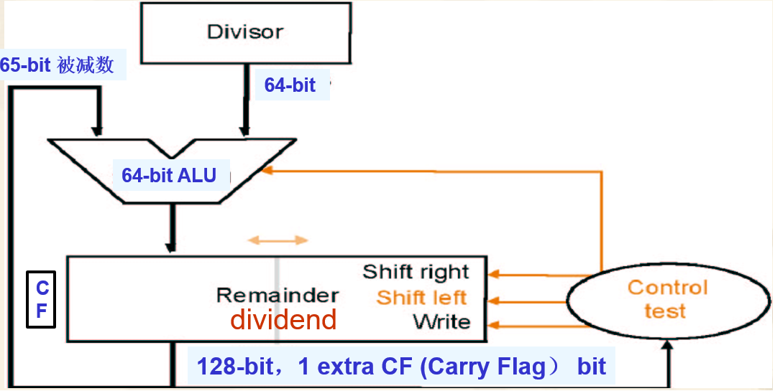
Division V3
64-bit ALU has extra CF, 65-bit minuend.
Quotient register is omitted, it utilize lower 64 bit of remainder register.
Remainder register plus CF is 129-bit.
It is 129 bit including 1-bit CF

Slide 50
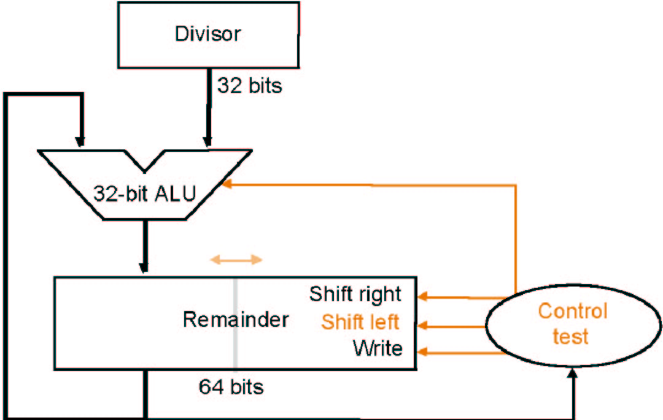
Division V3
64-bit ALU has extra CF, 65-bit minuend.
Quotient register is omitted, it utilize lower 64 bit of remainder register.
Remainder register plus CF is 129-bit.
65-bit 被减数
64-bit
It is 129 bit including 1-bit CF
64-bit ALU
dividend
129-bit

Slide 51
Signed division
Basic approach:
Store the signs of the operands
Convert signed numbers to unsigned numbers
(most significant bit (MSB) = 0)
Perform division
If sign bits of operands are equal
sign bit of quotient <= 0 else
sign bit of quotient <= 1
Remainder sign of signed division is discussed in next page.

Slide 52
Remainder sign of Signed division
We should always keep the same signs for Dividend and Remainder!
(+ 7) ÷( + 2) = + 3 Remainder = +1
7 = 3 × 2 + (+1) = 6 + 1
(- 7 ) ÷(+ 2) = - 3 Remainder = -1
-7 = -3 × 2 + (-1) = - 6 - 1
(+ 7 ) ÷( - 2) = - 3 Remainder = +1
(- 7 ) ÷(+2) = -4 Remainder = 1, wrong!

Slide 53
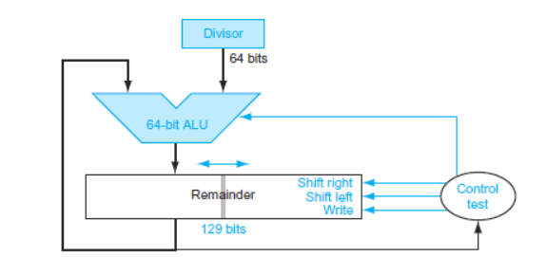
Optimized Divider
书上无, 不讲
One cycle per partial-remainder subtraction
Looks a lot like a multiplier!
Same hardware can be used for both

Slide 54
Faster Division
书上无细节,快进
Can’t use parallel hardware as in multiplier
Subtraction is conditional on sign of remainder
Faster dividers (e.g. SRT devision) generate multiple quotient bits (e.g. 4 bits) per step
Still require multiple steps

Slide 55
RISC-V Division
Four instructions: dividend is 64-bit, not 128-bit.
div, rem: signed divide, remainder
divu, remu: unsigned divide, remainder
Overflow and division-by-zero don’t produce errors
RISC-V divide instructions ignore overflow, so software must determine whether the quotient is too large.
software must check the divisor to discover division by 0 and overflow.

Slide 56
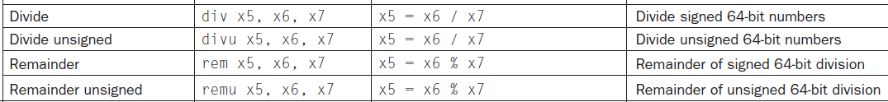
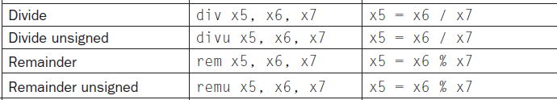
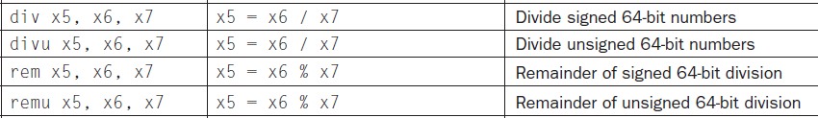
================ 放大如下 =================

Slide 57
3.6 Floating point numbers
Reasoning
Larger number range than integer range
Numbers like e (2.71828) and π(3.14159265....)
Representation
sign
significand（有效数字）：is also called mantissa(尾数), 13.54 is the mantissa ( or significand) of 13.54*10^{7,}
For floating number 1.2345, 1.2345 is significand, 0.2345 is the fraction(小数) part of the number
exponent
More bits for significand: more accuracy
More bits for exponent: increases the range

Slide 58
Floating point numbers
Form
Arbitrary 363.4 • 10³⁴
Normalised 3.634 • 10³⁶
Binary notation
Normalised 1.xxxxxx • 2^{yyyyy}
Standardised format IEEE 754
Single precision 8 bit exp, 23 bit fraction
Double precision 11 bit exp, 52 bit fraction
Both formats are supported by MIPS
31 | 30 …… 23 | 22 …… 0
S | exponent | fraction
1 bit | 8 bits | 23 bits
Single precision
31 | 30 …… 20 | 19 …… 0
S | exponent | fraction
1bit | 11 bits | 20 bits
31 fraction (continued) 0
Double precision
32 bits

Slide 59
IEEE 754 standard
Leading '1' bit of significand is implicit
->saves one bit
Exponent is biased:
00...000 smallest exponent
11...111 biggest exponent
Bias 127 for single precision
Bias 1023 for double precision
Summary:
(-1)^{sign} • (1 + fraction) • 2^{exponent - bias}

Slide 60
For single precision:
-127 <= e <= 128
0 <= e+127 <= 255
0 <= E <= 255
Here E is Exponent below
normal number
special number

Slide 61
IEEE 754 standard
A number divided by zero yields “infinity”
Special numbers: NaN, +∞ , -∞
NaN: Not a number
For single precision X:
0 <= e+127 <= 255 ==> -127 <= e <= 128
e=-127: if fraction is 0, then X=0, otherwise X is normal number.
If -126<= e <= 127, then X is normal number.
If e = 128, then X is NaN, +∞ , -∞.
Mechanisms for handling exceptions
When overflow or underflow happens

Slide 62
IEEE 754 standard
0.4375×2=0.8750
0.8750× 2=1.7500
0.7500×2=1.5000
0.5000×2=1.0000
0.4375=0.0111
0.4375
× 2
0.8750
× 2
1.7500
0.7500
× 2
1.5000
0.5000
× 2
1.0000
0.4375×2=0.8750=0.111B
--> 0.4375=0.0111B
0.8750× 2=1.7500=1.11B
--> 0.8750=0.111B
0.7500×2=1.5000=1.1B
--> 0.7500=0.11B
0.5000×2=1.0000
→ 0.5000=0.1B

Slide 63
Example
Show the binary representation of -0.75 in IEEE single precision format
Decimal representation: -0.75 = - 3/4 = - 3/2²
Binary representation: - 0.11 = - 1.1 • 2⁻¹
Floating point
(-1)^{sign} • (1 + fraction) • 2^{exponent - bias}
(-1)^{sign} =-1,so Sign = 1
1+ fraction = 1.1,so fraction =0.1
Exponent -127 =-1,so Exponent=(-1 + 127) = 126
31 | 30 …… 23 | 22 …… 0
1 | 0111 1110 | 100 0000 0000 0000 0000 0000
1 bit | 8 bits | 23 bits
Single precision
31 | 30 …… 20 | 19 …… 0
1 | 011 1111 1110 | 1000 0000 0000 0000 0000
1bit | 11 bits | 20 bits
0000 0000 0000 0000 0000 0000 0000 0000
Double precision

Slide 64
Limitations
Overflow:
The number is too big to be represented
Underflow:
The number is too small to be represented, i.e. the magnitude (absolute value) of negative exponent is too large.

Slide 65
Floating point addition
Alignment
Addition of significands
Normalisation of the result
Rounding
Example in decimal
What is 9.999 • 10¹ + 1.610 • 10⁻¹ ?

Slide 66
Example for Decimal
Aligning the two numbers
9.999 •10¹
0.01610 •10¹ → 0.016 •10¹ Truncation
Addition
9.999 • 10¹
+ 0.016 • 10¹
10.015 • 10¹
Normalisation
1.0015 • 10²
Rounding
1.002 • 10²

Slide 67
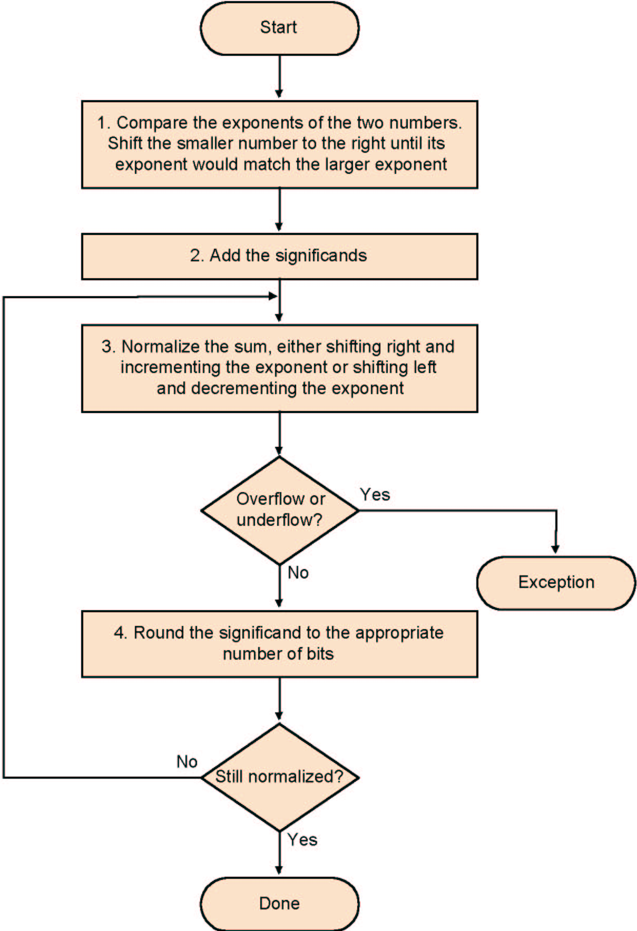
Algorithm
Shift Significands
Add Significands
Normalise the sum
Over/underflow
Rounding
Normalisation

Slide 68
Example y=0.5+(-0.4375) in binary
0.5₁₀ = 1.000₂×2⁻¹
-0.4375₂=-1.110₂×2⁻²
Step1:The fraction with lesser exponent is shifted right until matches
-1.110₂×2⁻² → -0.111₂×2⁻¹
Step2: Add the significands
1.000₂×2⁻¹
+) - 0.111₂×2⁻¹
0.001₂×2⁻¹
Step3: Normalize the sum and checking for overflow or underflow
0.001₂×2⁻¹ → 0.010₂×2⁻² → 0.100₂×2⁻³ → 1.000₂×2⁻⁴
Step4: Round the sum
1.000₂×2⁻⁴ = 0.0625₁₀

Slide 69
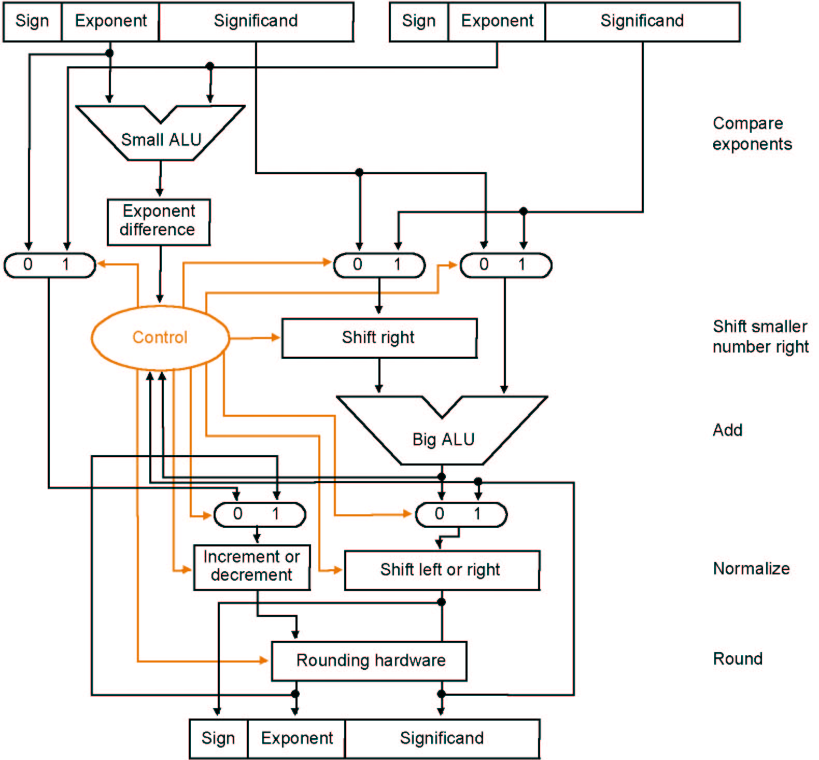
Algorithm
ADDITION
Step1：若Exponent difference是3,指数较小的加数的尾数将在1拍内右移3位
larger exponent
指数较大的加数的尾数
指数较小的加数的尾数
Step2：一拍内尾数相加，并送入shift left or right reg.
Step3：一拍内左或右移n位以便规格化，结果送入Rounding hardware reg. (n由Big ALU的结果确定)
Step4：一拍内Rounding hardware reg. 的尾数内容进行四舍五入，并保存。若变成非规格化数，则插入step5

Slide 70
Step5：一拍内尾数内容右移一位再四舍五入，指数加1, 并保存结果。
上述step1-5的每一步与前面的浮点数加法框图的每一步一致。

Slide 71
Multiplication
Composition of number from different parts → separate handling
(s1 • 2^{e1}) • (s2 • 2^{e2}) = (s1 • s2) • 2^{e1+ e2}
Example
1 10000010 000 0000 0000 0000 0000 0000 = -1 × 2³
0 10000011 000 0000 0000 0000 0000 0000 = 1 × 2⁴
Both significands are 1 → product = 1 →Sign=1
Add the exponents, bias = 127
10000010
+10000011
100000101
Correction: 100000101-01111111=10000110=134=127+3+4
The result: 1 10000110 000 0000 0000 0000 0000 0000 = -1 × 2⁷

Slide 72

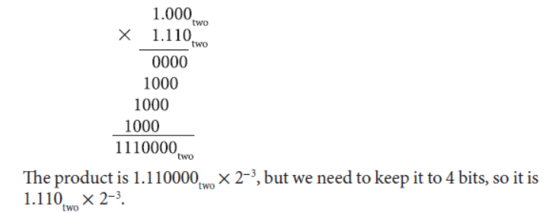

Multiplying 1.000_{two} × 2⁻¹ by −1.110_{two} × 2⁻²
Step 1. Adding the exponents :
Step 2. Multiplying the significands:
Step 3. Check the product: normalized? Yes.
then check the exponent: since 127 ≥ −3 ≥ −126, no overflow or underflow.
Step 4. Rounding the product makes no change:
不讲

Slide 73
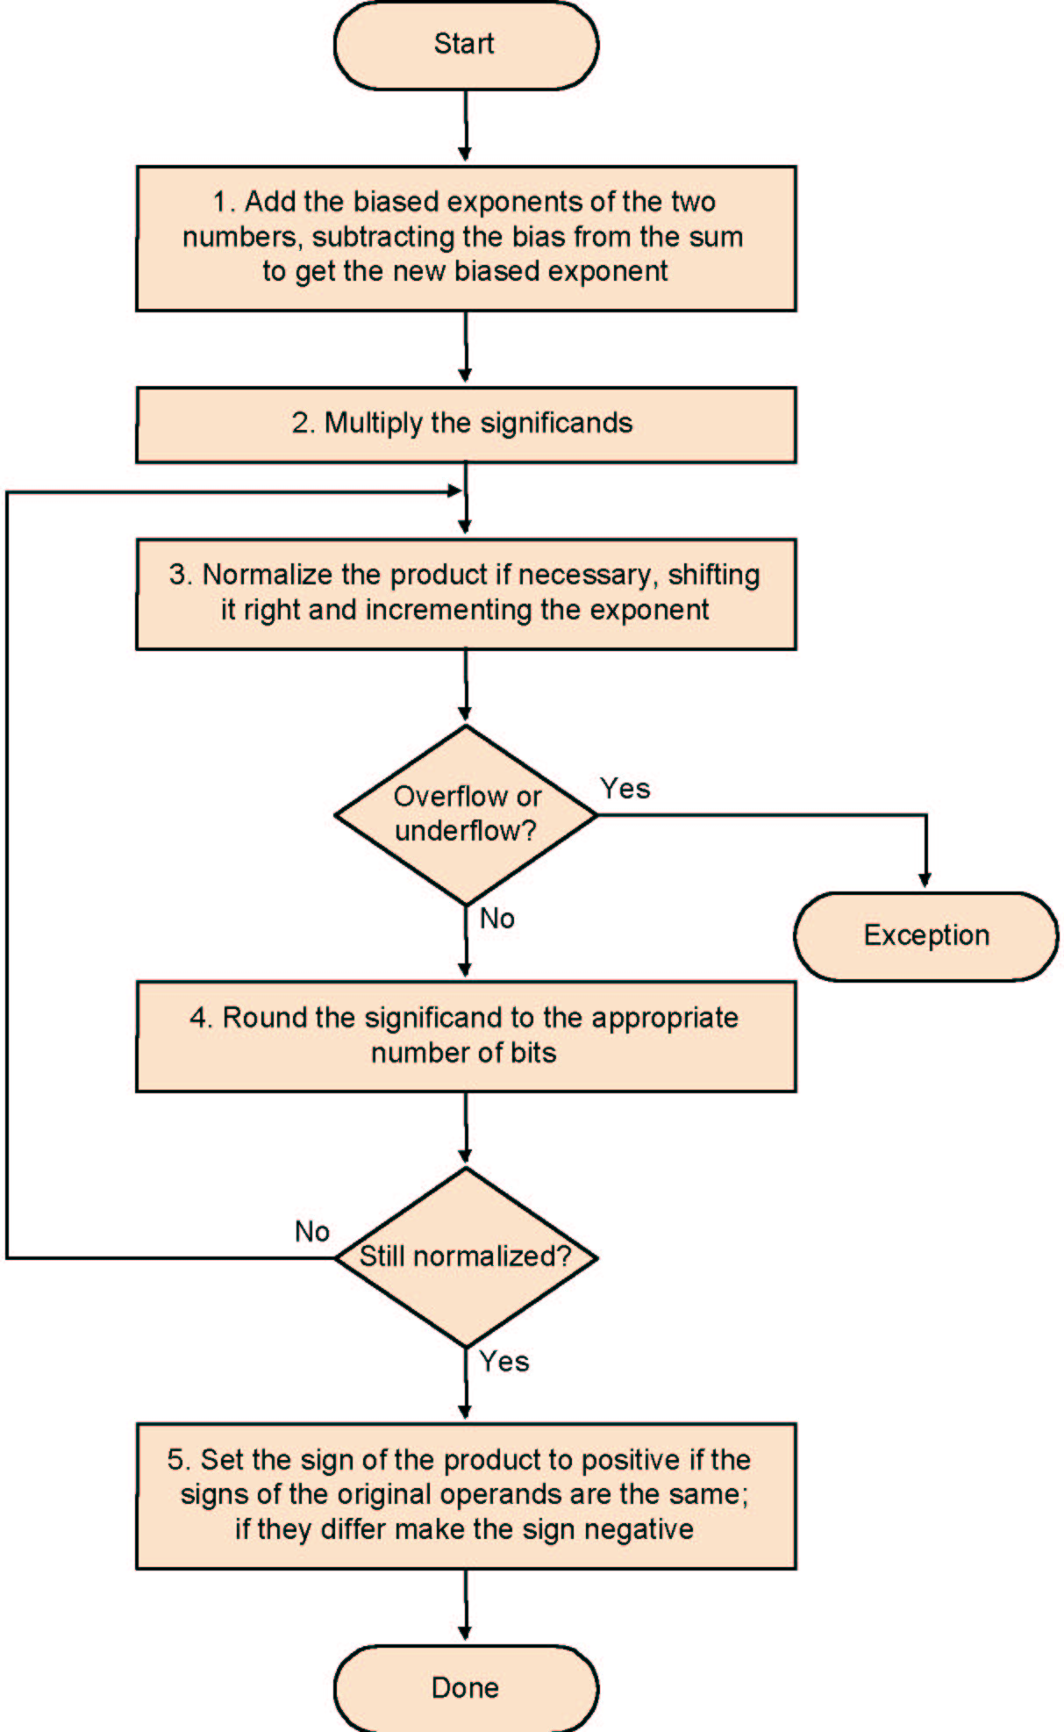
Multiplication
Add exponents
Multiply the significands
Normalise
Over- underflow
Rounding
Sign

Slide 74
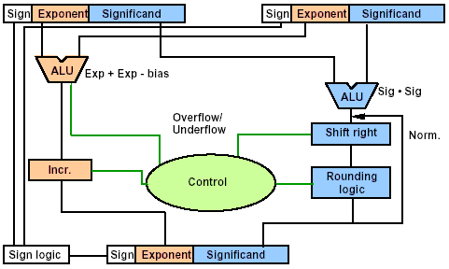
Data Flow
补充内容
Normalized ?

Slide 75
FP Multiplication
Similar steps: 1.110*10¹⁰ × 9.200*10⁻⁵
Compute exponent (careful!)
exponent=10+(-5)=5; 如果指数是移码表示，则求和时要减去偏移值
Multiply significands (set the binary point correctly)
1.110 × 9.200 → 10.212000
Normalize
10.212000 * 10⁵→ 1.0212 * 10⁶
Round (potentially re-normalize)
1.0212 * 10⁶ → 1.021 * 10⁶
Assign sign
+1.021 * 10⁶
75

Slide 76
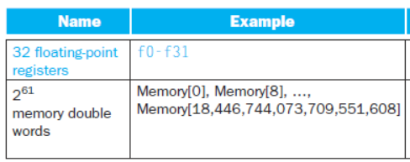
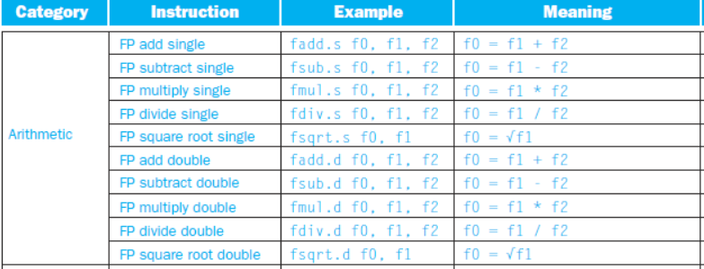
RISC-V floating-point operands
An f-register can hold:
8 bytes
a single-precision floating-point number
or a double-precision floating-point number
76

Slide 77
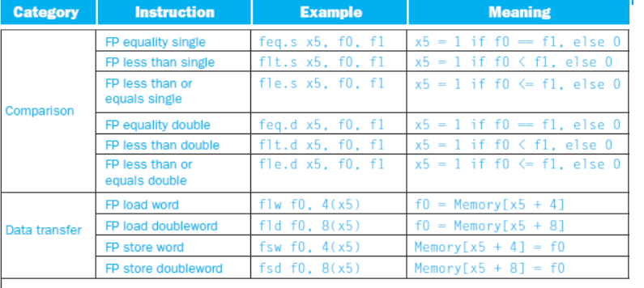
FIGURE 3.17 RISC-V floating-point architecture revealed
77

Slide 78
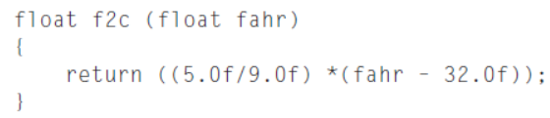
Compiling a Floating-Point C Program
into RISC-V Assembly Code
Assume that the floating-point argument fahr is passed in f10 and the result
should also go in f10.
f2c: flw f0, const5(x3) // f0 = 5.0f
flw f1, const9(x3) // f1 = 9.0f
fdiv.s f0, f0, f1 // f0 = 5.0f / 9.0f
flw f1, const32(x3) // f1 = 32.0f
fsub.s f10, f10, f1 // f10 = fahr – 32.0f
fmul.s f10, f0, f10 // f10 = (5.0f / 9.0f)*(fahr – 32.0f)
jalr x0, 0(x1) // return
78

Slide 79
IEEE 754 standard
Rounding: four rounding modes
Round to 0
Round to +∞
Round to -∞
Round to next even number (default) ，best!
传统的四舍五入用于纳税，对纳税人不公平：23.50→24 (+0.5), 24.50→25 (+0.5), 25.50→26 (+0.5), 26.50→27 (+0.5),
用本方法，对纳税人公平：23.50→24 (+0.5), 24.50→24 (-0.5), 25.50→26 (+0.5), 26.50→26 (-0.5), ……
用本方法，对于小数不是0.50的数，也是四舍五入：23.01--23.49（共49个数）都变成23, 23.51—23.99 （共49个数）都变成24.
用本方法，最公平合理，因而也最准确

Slide 80
Round modes
y | round down (towards −∞) | round up (towards +∞) | round towards zero | round to nearest even
+23.67 | +23 | +24 | +23 | +24
+23.50 | +23 | +24 | +23 | +24
+23.35 | +23 | +24 | +23 | +23
+23.00 | +23 | +23 | +23 | +23
0 | 0 | 0 | 0 | 0
−23.00 | −23 | −23 | −23 | −23
−23.35 | −24 | −23 | −23 | −23
−23.50 | −24 | −23 | −23 | −24
−23.67 | −24 | −23 | −23 | −24

Slide 81
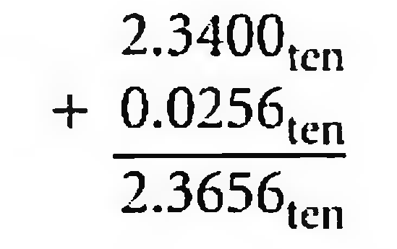
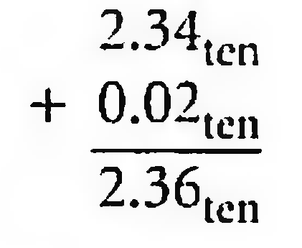
Accurate Arithmetic
IEEE 754 always keeps two extra bits on the right during intermediate(中间步骤的) additions, called guard and round
Rounding with Guard Digits
Add 2.56_{ten} x 10⁰ to 2.34_{ten} x 10²
three significant decimal digits
3个10进制数的有效数
During the addition, the guard digit holds 5 and the round digit holds 6.
Sum=2.37_{ten} x 10². More accurate!
Rounding without Guard Digits and Round Digits，only dropping 56 of 0.0256
Sum=2.36_{ten} x 10², not accurate!

Slide 82
sticky bit
Sticky bit is used for rounding in addition with guard and round digit.
It is set whenever there are nonzero bits to the right of the round bit.
E.g. 2.345013×10², with 3 significant decimal digits (2.34) and another 2 digit (Guard Digit 5 and Round Digit 0)
there are 13 to the right of the round digit 0, so Sticky bit=1
allows the computer to see the difference between 0.50 ... 00_{ten} and 0.50 ... 0l_{ten} when rounding.
examples in the floating point format with guard, round and sticky bits
Notes:
Guard, rounding, sticky bit

Slide 83
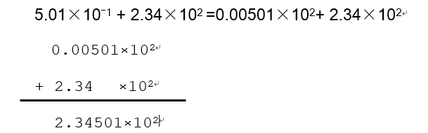
sticky bit
Sum of floating numbers with three significant decimal digits (2.34) and another 2 digit (Guard Digit 5 and Round Digit 0) is displayed in above figure.
The sticky bit=1, since there are nonzero bits to the right of 2.3450. Without the sticky bit to remember some 1s were shifted off, the sum is equal to 2.345000…00 and round to the nearest even of 2.34. incorrect!
With the sticky bit to remember that the sum is larger than 2.345000…00, we round instead to 2.35. correct!
Notes:
Guard, rounding, sticky bit

Slide 84
Examples for guard, round, and sticky bit
g r s
1.11000000000000000000100 0 0 0 becomes number in next line
1.11000000000000000000100 (mantissa used, exact representation)
1.11000000000000000000000 1 1 0 becomes number in next line
1.11000000000000000000001
1.11000000000000000000000 0 1 0 becomes number in next line
1.11000000000000000000000
1.11000000000000000000000 1 1 1 becomes number in next line
1.11000000000000000000001
1.11000000000000000000000 0 0 1 becomes number in next line
1.11000000000000000000000
1.11000000000000000000000 1 0 0 (the “halfway” case) 1.11000000000000000000000 （LSB=0）
1.11000000000000000000001 1 0 0 (the “halfway” case) 1.11000000000000000000010（LSB=1）
注意：关于保留位(Guard bit)、近似位(Round bit)和粘滞位(Sticky bit)，为了便于理解，前面用了多个10进制例子加以说明，但计算机实际不用十进制，只用2进制！ Guard, Round, Sticky都只是bit，不是十进制的digit（数位）。

Slide 85
Concluding Remarks
Bits have no inherent meaning
Interpretation depends on the instructions applied
Computer representations of numbers
Finite range and precision
Need to account for(考虑到) this in programs

