Slide 1
Chapter 5 Large and Fast: Exploiting Memory Hierarchy

Slide 2
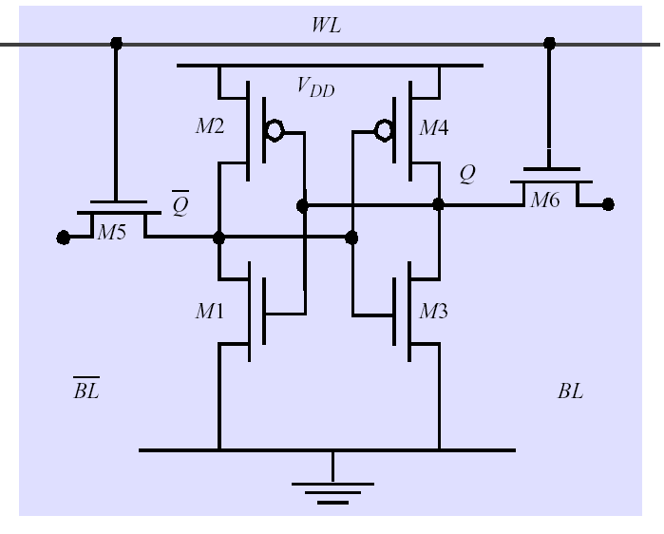
5.1 Introduction
附录也无此内容
SRAM:
value is stored on a pair of inverting gates
very fast but takes up more space than DRAM
(4 to 6 transistors)

Slide 3
Memories: Review
DRAM:
value is stored as a charge on capacitor (must be refreshed)
very small but slower than SRAM (factor（倍数） of 5 to 10)
Write
set wordline HIGH and Charge bitline HIGH or LOW
Read
Bit line is precharged to a voltage halfway between HIGH and LOW, and then the word line is set HIGH(晶体管基集为高时，
集电极与发射极导通).
Depending on the charge in the capacitor, the precharged bitline is pulled slightly higher or lower.
Sense Amplifier Detects change
RISCV教材附录 第A-63页有介绍
Word Line
C
. . .
Bit Line
Sense Amp

Slide 4
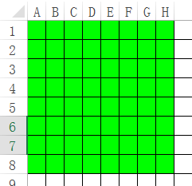
DRAM logical organization (256 Mbit) 1位数据读出
14bit col. Addr. Reg.
Column mutiplexer
Data in
14
CAS（列选通）
16384 bit col. data Reg.
D
RAS（行选通）
Sense
Amps & I/O
Data out
Q
Memory
Array
14
(16,384×16,384)
A0…A1
3
14bit row addr Reg
Bit Line
Row Decoder
…
Storage
Cell
Word Line
RAS: Row Access Strobe, CAS: Column Access Strobe

Slide 5
DRAM logical organization (256 Mbit) 1位数据写入
14bit col. Addr. Reg.
Column decoder
Data in
14
CAS（列选通）
16384 根3态门的控制线
D
RAS（行选通）
Data out
16384个3态门
Q
Memory
Array
14
(16,384×16,384)
A0…A1
3
Row Decoder
Bit Line
14bit row addr Reg
…
Storage
Cell
control
Word Line
output
上图未画出：有一个列解码器（14输入），列解码器有16384根输出线，每个输出线用于16384个三态门的控制线，这16384个三态门的输入连在一起，作为bit line的1位输入数据，这16384个三态门的输出作为memory array的列输入（其中1根为高或低，其余为高阻态）。
input

Slide 6
Locality---- two important concepts
1. temporal locality (locality in time):
If an item is referenced, it will tend to be referenced again soon.
2. spatial locality (locality in space):
If an item is referenced, items whose addresses are close by will tend to be referenced soon.
As we know, these principles actually exists in most programs.
Why does code have locality?
Our initial focus: two levels (upper, lower)
block: minimum unit of data (block) for transfers

Slide 7
Solutions
Block (aka line, 见RISCV书P368): unit of copying between memory and cache
May be multiple words
Build a memory hierarchy
S
p
e
e
d
C
P
U
S
i
z
e
C
o
s
t
(
$
/
b
i
t
)
processor
upper
F
a
s
t
e
s
t
M
e
m
o
r
y
S
m
a
l
l
e
s
t
H
i
g
h
e
s
t
Data are transferred
M
e
m
o
r
y
S
l
o
w
e
s
t
M
e
m
o
r
y
B
i
g
g
e
s
t
L
o
w
e
s
t

Slide 8
Some important concepts
Hit: The CPU accesses the upper level，data requested is in the upper level，succeeds.
Miss: The CPU accesses the upper level， data requested is not in the upper level，fails.
Hit time:
The time to access the upper level of the memory hierarchy, which includes the time needed to determine whether the access is a hit or a miss.
miss penalty:
The time to replace a block in the upper level with the corresponding block from the lower level
发生缺失时，访问1次内存的时间=hit_time + miss_penalty

Slide 9
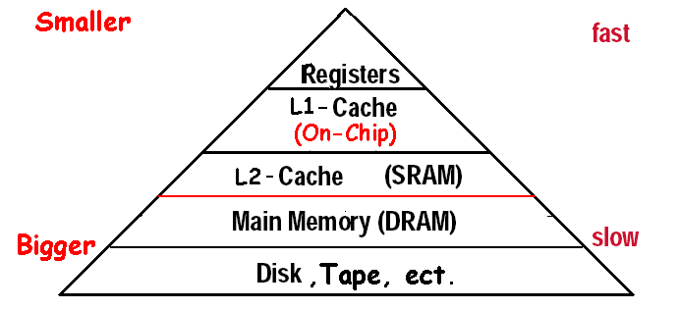
Exploiting Memory Hierarchy
Hierarchies bases on memories of different speeds and size
more close to CPU the level is, faster the one is.
more close to CPU the level is, smaller the one is.
more close to CPU the level is, more expensive
size
Levels in the memory hierarchy
Increasing distance from the CPU
Size of the memory at each level

Slide 10
Disk is normally the bottom of the hierarchy
Some systems use tape or file server in LAN as the next level below disk.
Design goal:
the processor has an access time of level 1 of the hierarchy
the processor has a memory as large as level n.
Exploited Memory Hierarchy
Cache: SRAM and DRAM (main memory)
The solution focuses on speed
Virtual Memory: DRAM and DISK
The solution focuses on size

Slide 11
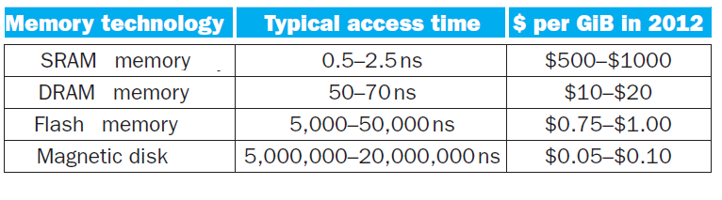
5.2 Memory Technology
Static RAM (SRAM)
0.5ns – 2.5ns, $2000 – $5000 per GB
Dynamic RAM (DRAM)
50ns – 70ns, $20 – $75 per GB
Magnetic disk
5ms – 20ms, $0.20 – $2 per GB
1 second=10^3 millisecond=10^6 us(micro second)
=10^9 ns(nanosecond)
Ideal memory Hierarchy
Access time of SRAM
Capacity and cost/GB of disk
§5.2 Memory Technologies

Slide 12
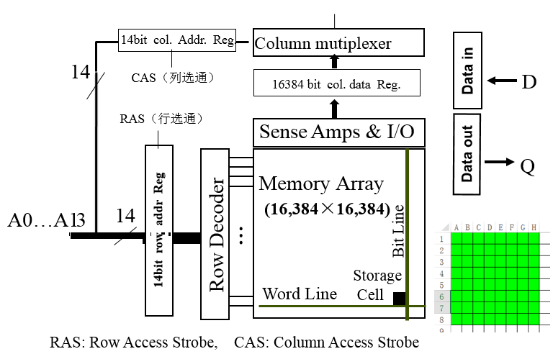
DRAM Technology
Data stored as a charge in a capacitor
Single transistor used to access the charge, The charge can be kept for several milliseconds.
Must periodically be refreshed
This consumes 1% to 2% of the active cycles of the DRAM
Performed on a DRAM “row”: refreshing an entire row (which shares a word line) with a read cycle followed immediately by a write cycle.

Slide 13
刷新与行地址有关。刷新时一行行进行的，必须在刷新周期内，由专用的刷新电路来完成对基本单元电路的逐行刷新，才能保证DRAM内的信息不丢失。通常有三种方式刷新：集中刷新、分散刷新和异步刷新。
DRAM 制造商的一些资料中显示，内存至少要每64ms刷新一次，这也就意味着内存有1％的时间要用来刷新。
内存的刷新关键 在于当对内存单元进行读取操作时保持内存的内容不变，所以DRAM单元每次读取操作之后都要进行刷新：执行一次回写操作，因为读取操作也会破坏内存中的电 荷，也就是说对于内存中存储的数据是具有破坏性的。

Slide 14
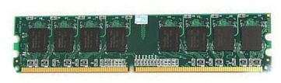
下图1条DRAM内存条有8片chip（市场上也有9片或4片的）。
例子：1个chip内有4个bank，每个bank内有8个array（8个array决定了位宽是8bit），一个特定地址的数据只在其中1个bank中，1个bank的容量是64K*8bit（256 row * 256 column * 8bit），则这个chip有256k*8bit，位宽8bit。
Chip的位宽由array数量决定，无关bank数量，增加chip内的bank数只会增加容量，不增加位宽。
输入地址时，地址译码电路会选择其中的一个bank
读数据的bank内地址是0xA1B4，clk1输入row-addr=0xA1,每个array读出1个row的256位存到row buffer（256 bits latches），8个array同时读出同1个row的256*8位存到row buffer， 接着clk2输入col-addr=0xB4, 会读出row buffer 内column-addr是0xB4处的8bit（对应bank内地址0xA1B4 ），row-addr不变 ，clk3和clk4输入col-addr=0xB5,0xB6, 依次读出0xA1B5处的8bit， 0xA1B6处的8bit。
When the row is in the buffer, it can be transferred by successive column addresses at whatever the width of the DRAM is (typically 4, 8, or 16 bits in DDR3). ➔ 在上例中，When the row is in the buffer, it can be transferred by successive column addresses at 8bit.
ftp: \课-计算机组成\电子书及补充读物\DRAM \DRAM的结构原理剖析-CSDN博客-210525.docx 很有用

Slide 15
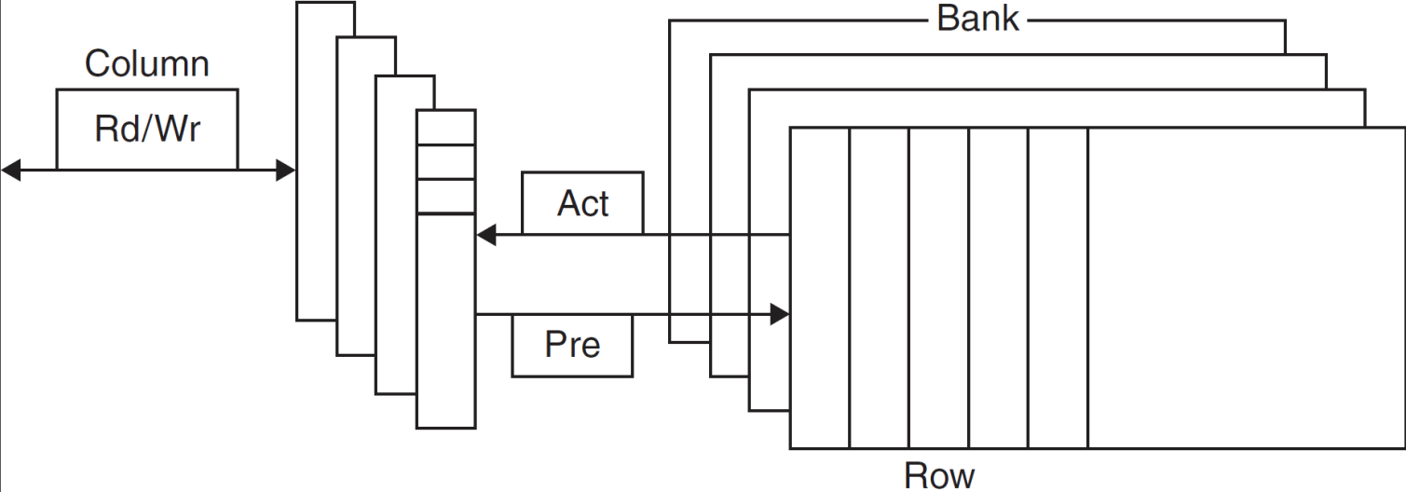
Internal organization of a DRAM
Modern DRAMs are organized in banks, typically four for DDR3.
Sending a PRE (precharge) command opens or closes a bank.
Memory addr: [bank-addr ] [row-addr] [column-addr],
E.g. : 24-bit address [2-bit] [11-bit] [11-bit]
Each bank consists of a series of rows. 这里的row不同于上个PPT页的array。
A row address is sent with an Act (activate), which causes the row to transfer to a buffer.
When the row is in the buffer, it can be transferred by successive column addresses at whatever the width of the DRAM is (typically 4, 8, or 16 bits in DDR3) or by specifying a block transfer and the starting address.
FIGURE 5.4 Internal organization of a DRAM.

Slide 16
Advanced DRAM Organization
Bits in a DRAM are organized as a rectangular array
DRAM accesses an entire row
Burst mode: supply successive words from a row with reduced latency
Double data rate (DDR) DRAM
Transfer on rising and falling clock edges
Example of Burst mode

Slide 17
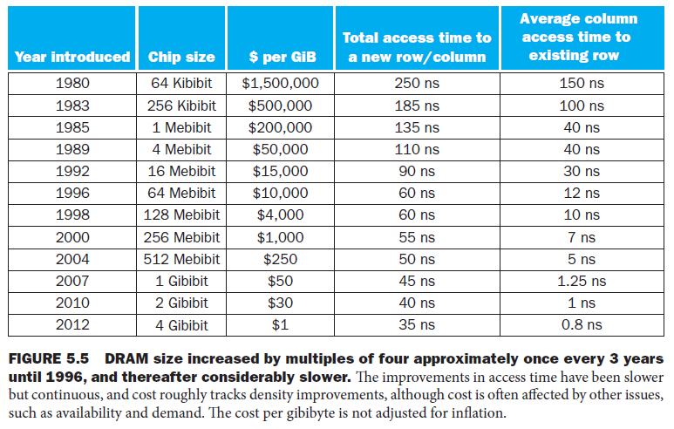
DRAM Generations
Year | Capacity | $/GB
1980 | 64Kbit | $1500000
1983 | 256Kbit | $500000
1985 | 1Mbit | $200000
1989 | 4Mbit | $50000
1992 | 16Mbit | $15000
1996 | 64Mbit | $10000
1998 | 128Mbit | $4000
2000 | 256Mbit | $1000
2004 | 512Mbit | $250
2007 | 1Gbit | $50

Slide 18
DRAM Performance Factors
Row buffer
Allows several words to be read and refreshed in parallel
Synchronous DRAM (SDRAM)
DRAMs added clocks
Allows for consecutive accesses in bursts without needing to send each address
Improves bandwidth
DRAM banking（不讲）
Allows simultaneous access to multiple DRAMs
Improves bandwidth

Slide 19
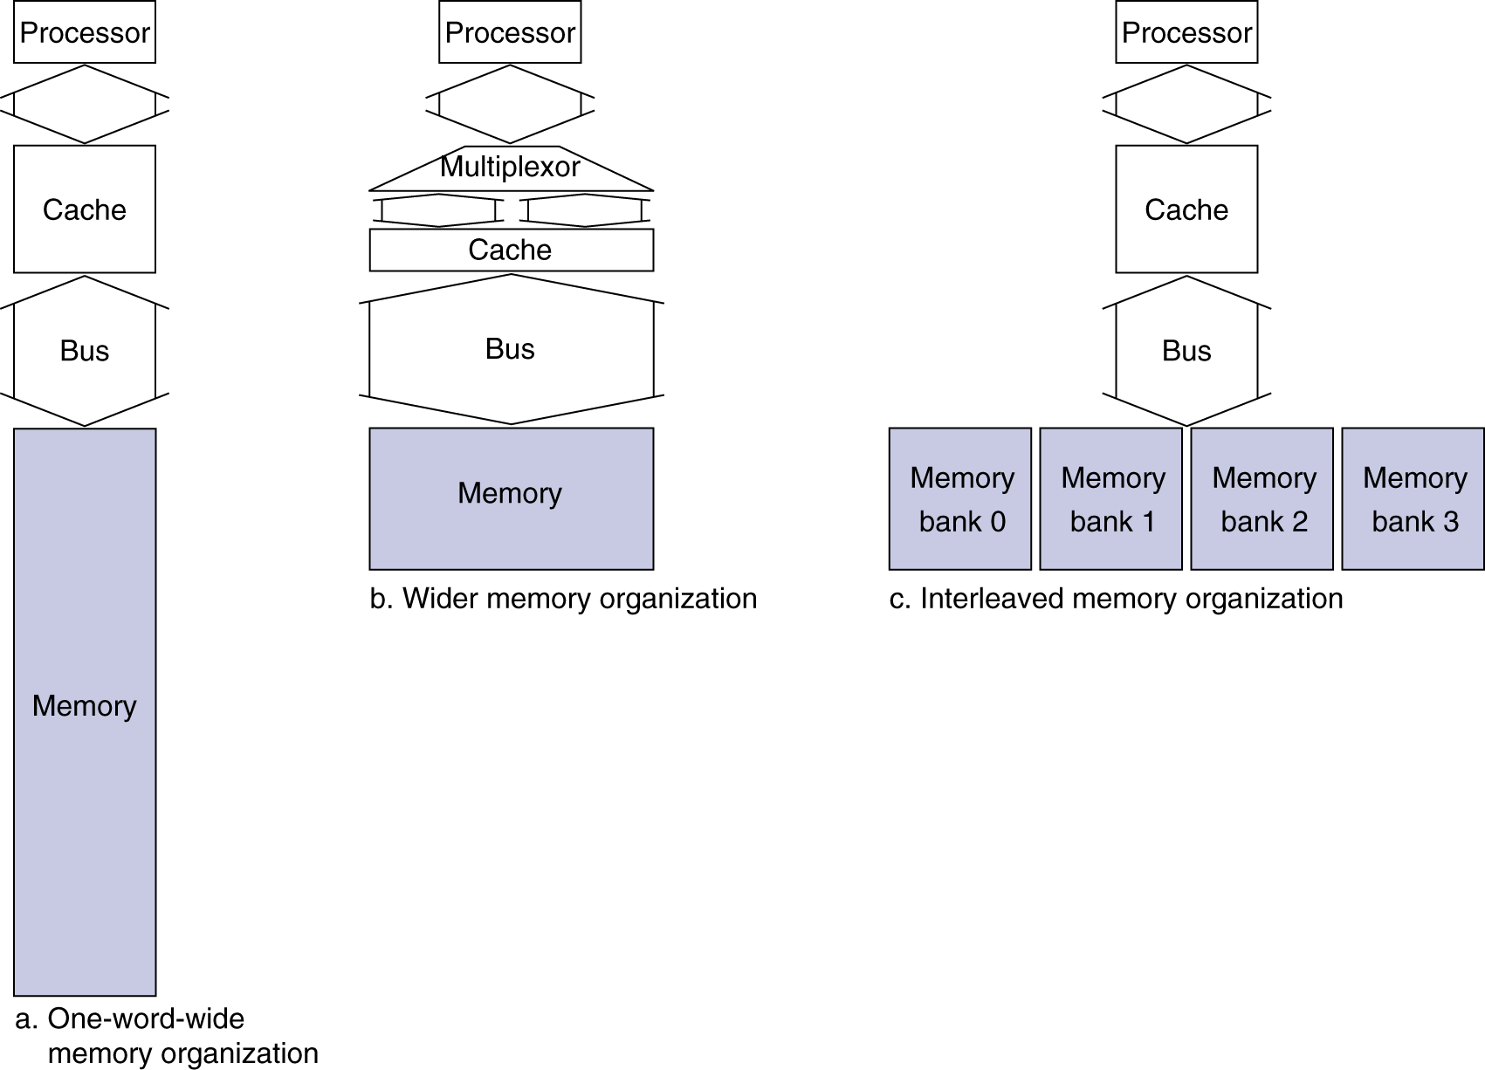
Increasing Memory Bandwidth
书上无，不讲
4-word wide memory
Miss penalty = 1 + 15 + 1 = 17 bus cycles
Bandwidth = 16 bytes / 17 cycles = 0.94 B/cycle
4-bank interleaved memory
Miss penalty = 1 + 15 + 4×1 = 20 bus cycles
Bandwidth = 16 bytes / 20 cycles = 0.8 B/cycle

Slide 20

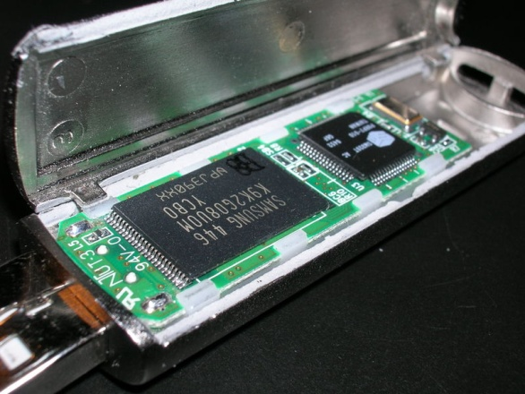
Flash Storage
Nonvolatile semiconductor storage
100× – 1000× faster than disk
Smaller, lower power, more robust
But more $/GB (between disk and DRAM)

Slide 21
Flash Types
NOR flash: bit cell like a NOR gate
NAND flash: bit cell like a NAND gate
Flash bits wears out after 1000’s of writes
Wear levelling(磨损均衡化): remap data to less used blocks

Slide 22

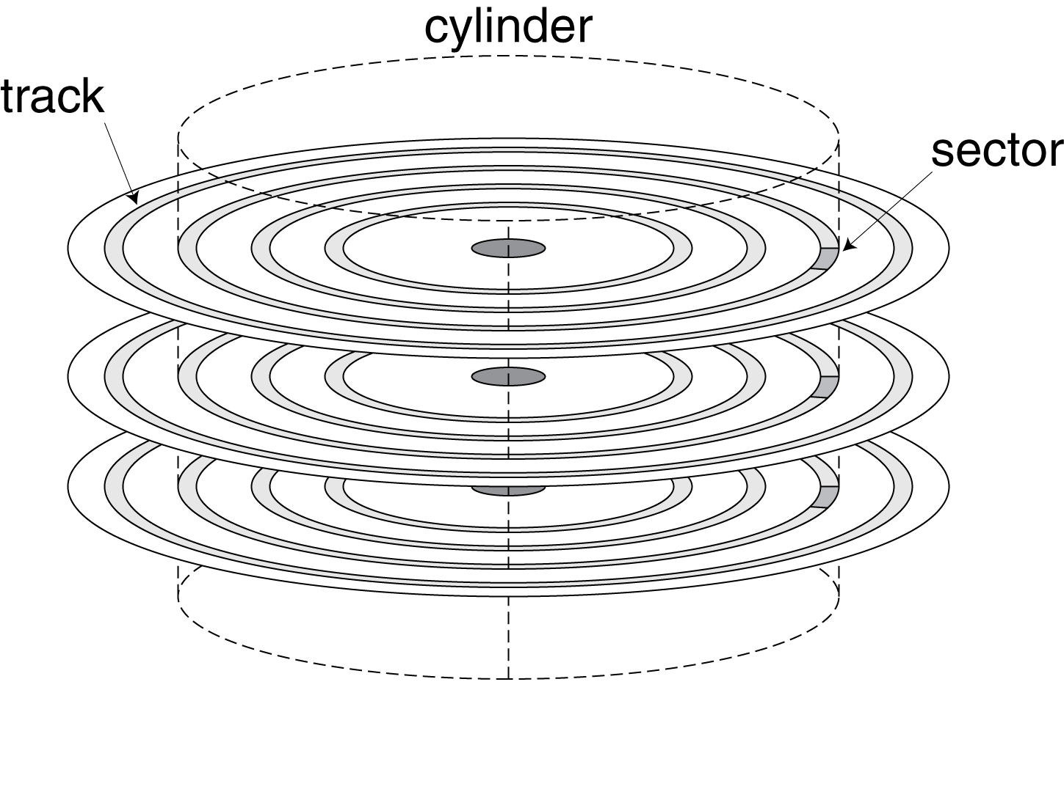
Disk Storage
Nonvolatile, rotating magnetic storage

Slide 23
Disk Sectors and Access
Each sector records
Sector ID
Data (512/1024/2048/4096 bytes, 4096 bytes proposed)
Error correcting code (ECC) or Error checking code
Synchronization fields and gaps
Access to a sector involves
Queuing delay if other accesses are pending
Seek: move the heads
Rotational latency
Data transfer
Controller overhead

Slide 24
Disk Access Example
书上无，不讲
Given
512B sector, 15,000 rpm(round per minute), 4ms average seek time, 100MB/s transfer rate, 0.2ms controller overhead, idle disk(no queuing delay )
Average read time
4ms seek time
+ ½ / (15,000/60) = 2ms rotational latency + 512 / 100MB/s = 0.005ms transfer time + 0.2ms controller delay = 6.2ms
If actual average seek time is 1ms
Average read time = 3.2ms

Slide 25
Disk Performance Issues
Manufacturers quote （报告） average seek time
Based on all possible seeks
Locality and OS scheduling lead to smaller actual average seek times
Disk drives include caches
Prefetch sectors in anticipation of access
Avoid seek and rotational delay

Slide 26
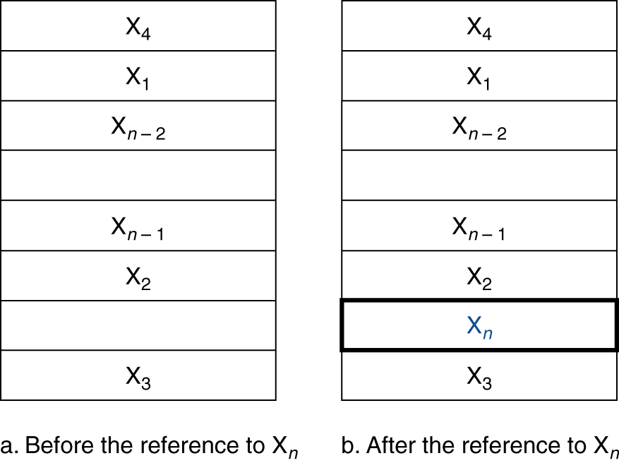
5.3 Cache Memory
P80有三种cache的介绍
Cache
Also known as “Cache Memory”, initially all entries are empty.
The level of the memory hierarchy closest to the CPU
Given accesses X₁, …, X_{n–1}, X_{n}
§5.3 The Basics of Caches
Two issues:
How do we know if a data item is in the cache?
If it is, how do we find it?
Figure 5.7 The cache: word Xn is not initially in the cache.

Slide 27
Direct Mapped Cache
Where can a block be placed in the upper level (cache)?
index
8 Block of cache
5 bit memory block address
Algorithm: Index is the cache block address, it is
(memory block address) modulo (the number of blocks in the cache)
The cache has 2^{n} blocks, index is equal to the lowest n bits of memory block address. Here n=3.

Slide 28
The basics of Cache
For each item of data at the memory, there is exactly one location in the cache where it might be.
e.g., lots of items at the lower level(memory) share locations in the upper level(cache)

Slide 29
5.3.1 Accessing a Cache
Tags and Valid Bits
How do we know which particular memory block is stored in a cache location?
Store memory block address as well as the data
Actually, only need the high-order bits (tag)
memory block address = { tag, index}
e.g. memory block address =10011,tag=10,index=011
Index | V | Tag | Data
000 | N
001 | N
010 | N
011 | N
100 | N
101 | N
110 | N
111 | N
a. The initial state of the cache after power-on
What if there is no data in a location?
V (Valid bit): 1 = present, 0 = not present
Initially all of V are 0

Slide 30
Accessing a cache---how do we find it?
32-bit or 64-bit memory address
Index=(memory block address) modulo (the number of blocks in the cache)
e.g. 011 = 10011 % 1000 （binary） , or 3=19 % 8
TAG
Index
Byte offset
Block address MOD Numbers of Cache Block
V:valid bit
Index | V | Tag | Data
000 | N
001 | N
010 | N
011 | N
100 | N
101 | N
110 | N
111 | N
a. The initial state of the cache after power-on
FIGURE 5.9

Slide 31
Access sequence: figure b,c,d,e, f,g,h,i
Access sequence of Mem Block address (red address indicates hit)：
10110,11010,10110,11010, 10000,00011,10000,10010
Index | V | Tag | Data
000 | N
001 | N
010 | N
011 | N
100 | N
101 | N
110 | Y | (10)₂ | Memory(10110)
111 | N
b. After handling a miss of address(10110)
Index | V | Tag | Data
000 | N
001 | N
010 | Y | (11)₂ | Memory(11010)
011 | N
100 | N
101 | N
110 | Y | (10)₂ | Memory(10110)
111 | N
c. After handling a miss of address(11010)
Index | V | Tag | Data
000 | N
001 | N
010 | Y | (11)₂ | Memory(11010)
011 | N
100 | N
101 | N
110 | Y | (10)₂ | Memory(10110)
111 | N
d. After handling a hit of address(10110)
Index | V | Tag | Data
000 | N
001 | N
010 | Y | (11)₂ | Memory(11010)
011 | N
100 | N
101 | N
110 | Y | (10)₂ | Memory(10110)
111 | N
e. After handling a hit of address(11010)
FIGURE 5.9

Slide 32
Access sequence
10110,11010,10110,11010, 10000,00011,10000,10010
Index | V | Tag | Data
000 | Y | (10)₂ | Memory(10000)
001 | N
010 | Y | (11)₂ | Memory(11010)
011 | N
100 | N
101 | N
110 | Y | (10)₂ | Memory(10110)
111 | N
f. After handling a miss of address(10000)
Index | V | Tag | Data
000 | Y | (10)₂ | Memory(10000)
001 | N
010 | Y | (11)₂ | Memory(11010)
011 | Y | (00)₂ | Memory(00011)
100 | N
101 | N
110 | Y | (10)₂ | Memory(10110)
111 | N
g. After handling a miss of address(00011)
Index | V | Tag | Data
000 | Y | (10)₂ | Memory(10000)
001 | N
010 | Y | (11)₂ | Memory(11010)
011 | Y | (00)₂ | Memory(00011)
100 | N
101 | N
110 | Y | (10)₂ | Memory(10110)
111 | N
h. After handling a hit of address(10000)
Index | V | Tag | Data
000 | Y | (10)₂ | Memory(10000)
001 | N
010 | Y | (11)→ (10)₂ | Memory(10010)
011 | Y | (00)₂ | Memory(00011)
100 | N
101 | N
110 | Y | (10)₂ | Memory(10110)
111 | N
i. After handling a miss of address(10010)
FIGURE 5.9

Slide 33
Direct Mapped Cache construction
Answer for two issues:
How do we know if a data item is in the cache?
If it is, how do we find it?
1 block includes only 1 word (4 byte) here
What kind of locality are we taking advantage of?
32-bit memory address
2
temporal

Slide 34
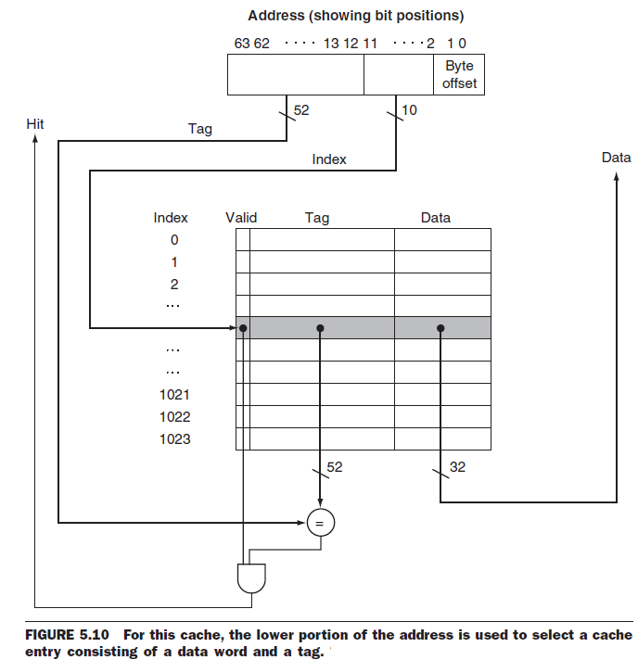
Direct Mapped Cache construction
Answer for two issues:
How do we know if a data item is in the cache?
If it is, how do we find it?
1 block includes only 1 word (4 byte)
64-bit memory address

Slide 35
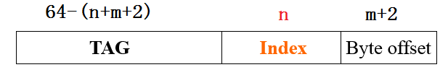
How many total number of bits needed for a cache in direct-mapped cache?
64-bit address, n bits index, The block size is 2^{m} words (2^{m+2} bytes)
The cache size is 2^{n} blocks
The data size in a block: 2^{m} words, 2^{m+2} bytes, 2^{m+5} bits
Address structure: m bits are used for the word within the block, and 2 bits are used for the byte part of the address
The size of the tag field is 64 − (n + m + 2).
The total bits in a direct-mapped cache is
2^{n} ×(block size + tag size + valid field size)
= 2^{n} ×[2^{m+5} + 64 − (n + m + 2) + 1] = 2^{n} ×[2^{m+5} + 63 − n − m)]
64-bits address:

Slide 36
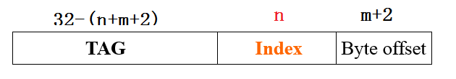
How many total number of bits needed for a cache in direct-mapped cache?
32位版本，不讲
32-bit address, n bits index, The block size is 2^{m} words (2^{m+2} bytes)
The cache size is 2^{n} blocks
The data size in a block: 2^{m} words, 2^{m+2} bytes, 2^{m+5} bits
m bits are used for the word within the block, and two bits are used for the byte part of the address
The size of the tag field is 32 − (n + m + 2).
The total bits in a direct-mapped cache is
2^{n} ×(block size + tag size + valid field size)
= 2^{n} ×[2^{m+5} + 32 − (n + m + 2) + 1] = 2^{n} ×[2^{m+5} + 31 − n − m)]
32-bits address:

Slide 37

Bits in Cache
Example
How many total bits are required for a direct-mapped cache (16KB of data and 4-word blocks)? assuming a 64-bit address.
Answer
One block=4 words = 16 bytes
Number of blocks = 16K ÷ 16 = 2¹⁰ blocks, index bits n=10
The data size in a block: 2² words, m=2
The size of the tag field: 64 − (n + m + 2) = 50 bits
Data bits of 1 block =4×32=128 bits
The total bits in cache is
2^{n} ×(block size + tag size + valid field size)
= 1024×[128 + 50+ 1] = 179 Kbits
The total bytes =179/8 KiB = 22.4 KiB =1.4*16 KiB
It is about 1.4 times of the data

Slide 38
Bits in Cache
Example
How many total bits are required for a direct-mapped cache (16KB of data and 4-word blocks)? assuming a 64-bit address.
Answer
One block=4 words = 16 bytes
Number of blocks = 16K ÷ 16 = 2¹⁰ blocks, index bits n=10
The data size in a block: 2² words, m=2
The size of the tag field: 64 − (n + m + 2) = 50 bits
Data bits of 1 block =4×32=128 bits
The total bits in cache is
Total data size + 2^{n} ×(tag size + valid field size)
= 16K*8 + 1024×[50+ 1] = 128K+51K = 179 Kbits
本PPT页的方法与上页有区别（但篮框内基本相同），是更好的方法

Slide 39
Mapping an Address to Multiword Cache Block
Example
Consider a cache with 64 blocks and a block size of 16 bytes.
What cache block number does byte address 1200 map to?
Answer： Cache block number =
(memory Block address) modulo (Number of cache blocks)
Where the memory Block address is
So cache block number =75 modulo 64 =11,
cache block number is also known as cache block address .
The start and end byte address of the block where address 1200 is located in:
Byte address
1200
=
= 75
Bytes per block
16
Byte address
×Byte per block -----
Byte address
+( Byte per block-1)
Bytes per block
Bytes per block
×Byte per block
Here:
1200 ----- 1215
63
10
9
4
3
0
Tag
Index
Offset
54 bits
6 bits
4 bits

Slide 40
Block Size Considerations
Larger blocks with many bytes should reduce miss rate
Due to spatial locality
But in a fixed-sized cache
Larger block size ⇒ fewer block number
More competition（很多内存块争着要进入cache） ⇒ a block will be moved out from cache before many of its words are accessed
Larger blocks, larger miss penalty
Fetch more bytes from Memory when miss occurs.
Can override(消除) benefit of reduced miss rate
Early restart and critical-word-first can help
early restart: resume execution as soon as the requested word of the block （e.g. the 2# word in 8-word block） is returned, no wait for entire block (i.e. no wait for 3#--8# words) to be loaded.
critical-word-first: Organize the memory, the requested word is transferred first. The remainder is then transferred, starting from the next word after the requested one and wrapping around to the beginning of the block.

Slide 41
Larger blocks exploit spatial locality
Taking advantage of spatial locality to lower miss rates with many word in the block:
direct-mapped cache
FIGURE A-1

Slide 42
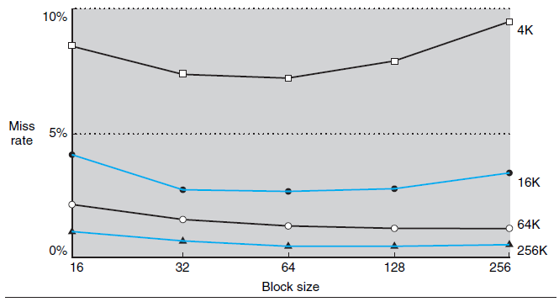
The miss rate goes up if block size is too large relative to the cache size.
Each line represents a cache of different size： 4K, 16K, 64K, 256K bytes.
following figure data are based on SPEC92. SPEC92是在SPEC89的10个基准程序基础上再增加了4个测试整数运算性能的程序和8个测试浮点数性能的程序,分别称之为SPECint92(共8个程序)和SPECfP92(共14个程序)
Figure 5.11 Miss rate versus block size. 4 caches: 4K, 16K, 64K, 256K bytes

Slide 43
5.3.2 Handling Cache Misses
Handling Cache reads hit and read Miss
Read hits: this is what we want !
Read misses, two kinds of misses:
instruction cache miss
data cache miss
a cache miss creates a instruction pipeline stall
we stall the entire processor, essentially freezing the contents of the temporary and programmer-visible registers
meanwhile we wait for memory.
in contrast to an exception or interrupt: saving the state of all registers.
assume in-order processors ( not out-of-order processors) stalls on cache misses in this section.

Slide 44
Steps of instruction cache read miss operation
for instruction cache miss, we stall the CPU, fetch block from memory, deliver to cache, restart CPU read.
Step-1 Send the original PC value [(current PC)-4] to the memory address.
Reason of (current PC)-4 : at the end of 1# cycle (IF stage) in pipeline, PC <-- PC+4, after the begin of 2# cycle (ID stage), we fetch memory block, but [current PC] is ([original PC]+4)
Step-2 Instruct main memory to read a block and wait, this takes multiple clock cycles ( e,g, 100 cycles).
Step-3 Write the cache entry: put the data from memory into the data portion of the entry, write the upper bits of the address (from the ALU) into the tag field, and set valid bit to 1.
Step-4. Restart the instruction execution at the first step, which will refetch the instruction again, this time finding it in the cache.
Above approach can be extended to handle data misses
But some differences exists.

Slide 45
5.3.3 Handling Writes
2 kinds of caches
write-through cache: when cache writes hit, cache system write the data into cache and memory
The latest data is in memory. But makes writes take longer
e.g., if base CPI = 1, 10% of instructions are stores, write to memory takes 100 cycles，no write buffer
Effective CPI =( N+N*10%*100)/N = 1 + 0.1×100 = 11
write-back cache: when cache writes hit, cache system only writes data into cache, don't write into memory.
The latest data is in cache
Memory data may be obsolete, when a cache block is removed from cache, it should be written back to memory.

Slide 46
Write stall ---When the CPU must wait for writes to complete during write through
Write buffers
A small cache that can hold a few values waiting to go to main memory.
补充：each buffer entry contains data and its memory address.
To avoid stalling on writes, many CPUs use a write buffer.
A write buffer includes one or several entries
Each entry contains data (1 byte or 1 word or 1 double-word) and its memory address(依据：书P434 Figure 5.32)
After putting data into write buffer, CPU continues subsequent cycle or instruction immediately
Only stalls on write if write buffer is already full
This buffer helps when writes are clustered.
It does not entirely eliminate stalls since it is possible for the buffer to be full if the write burst is larger than the buffer.

Slide 47
Write buffers
CPU
in out
Write Buffer
write
buffer
DRAM
(or lower mem)

Slide 48
Write hits: Difference Strategy for write-back and write-through cache
Write-back cache (Causing Inconsistent)
Write the data into only the data cache, Fast
Write back cache block to memory when the block is replaced.
A write-back scheme is more complex to implement than write-through.
write-back Improves performance, especially when processors can generate writes as fast as (or faster than) the writes can be handled by main memory;
Write-through cache ( Ensuring Consistent)
Write operation always update the memory
It is slower because of writing memory, solution: using write buffer

Slide 49
本页内容在英文教材PDF文件的P386 “Elaboration”
Options of write misses in write-through caches
Write allocate（写分配）
Allocate a cache block（在direct mapped cache中，不需要分配，可选的cache entry是唯一的，但在其它2种cache中，有多个cache entry可选，需要分配一个） , load memory data into cache, then write data in cache
No write allocate (aka Write around)
The data is only written to main memory, not written into the cache. Don’t fetch a memory block to cache.
Reason： programs often write a whole block before reading it (e.g., initialization). 这时把一个block从内存搬到cache是白费力气，因为block内的所有字都是只写不读（至少在初始化后的一段较长时间内不读取）。
None of Write-allocate and No-write-allocate exist in write-back caches
aka: also known as

Slide 50
aka: also known as
3 steps for Write misses :
Only for write-back cache: if the cache block is dirty, write it back to memory. Write-through cache无本步骤.
dirty: cache block has been modified after load from memory
First read the entire block into cache from memory
the word (or double words) that SW/SD instruction writes need not be moved into cache because it will be updated immediately.
Then write a word (for SW instr.) or double word (for SD instr.) into:
Only cache (for write-back cache)
Only memory (for write-through cache with no write allocate )
both cache and memory (for write-through cache with write allocate ).

Slide 51
Write-through scheme VS write-back scheme
When data is written into the cache (executing a SW(Store Word) or SD instruction), is the data also written to main memory?
write-through cache
yes
Can always discard cached data, the latest data is in memory
Cache control bit: only a valid bit
memory always have latest data
advantage: Read misses don't result in writing memory, memory hierarchy is consistent and it is simple to implement.
write-back cache
no
Can’t just discard cached data, we have to write it back to memory
Cache control bits: valid and dirty bits
Less access to memory, since data often overwritten multiple times
advantage : Writings occur at speed of cache, writing main memory happens less frequently when multiple writing occur to the same block.

Slide 52
Cache总结（SW指令）
以cache写hit时采用write back(方案A)和write through（方案B）为中心，分别有2种cache系统：
系统A： cache写hit时采用write back(方案A)
系统B： cache写hit时采用write through（方案B）
SW（store word）指令执行时的操作
系统A：cache写hit时，采用write back只写cache （化1个cycle）;
cache写miss时，依次完成（1）如果cache dirty先把cache的1个block写回内存（可使用write buffer加快速度，估计化1个cycle），如果cache不dirty则不写回内存（不花时间）。（2）把内存的1个block读入cache（可能化100 cycle）；（3） 写1个字到cache（化1个cycle），不写内存;

Slide 53
Cache总结（SW指令）
SW（store word）指令执行时的操作，SD指令与此类似
系统B-方案B1： write through with “Write allocate”.
Cache写hit时，既写cache又写内存，写内存时使用write buffer加快速度;
Cache写miss时，（1）把内存的1个block读入cache （可能化100 cycle） ，原cache内容直接丢弃；（2）同时写1个字到cache （化1个cycle）和内存（最快时化1个cycle） ，写内存时使用write buffer加快速度（但连续多条SW指令可能引起Write Stall--写停顿，下同）;
系统B-方案B2： write through with “No write allocate” (Write around)
Cache写hit时，与B1相同: 既写cache又写内存，写内存时使用write buffer加快速度;
cache写miss时，采用“No write allocate”，不读内存的1个block到cache中 ，不写cache只写内存(写1个字到内存)，写内存时使用write buffer加快速度，最快时化1个cycle ;

Slide 54
内容重复，不讲
5.3.3 Elaboration(详述): write misses in write- through caches
aka: also known as
Consider a write miss in a write-through cache.
Options of write misses in write-through caches
Write allocate（写分配）
Allocate a cache block（在direct mapped cache中，不需要分配，可选的cache entry是唯一的，但在其它2种cache中，有多个cache entry可选，需要分配一个） , load 1 memory block into cache, then write 1 word or double word in cache
No write allocate (aka Write around)
The data is only written to main memory, not written into the cache. Don’t fetch a memory block to cache.

Slide 55
5.3.3 Elaboration(详述): write operation of write-through cache
Suppose write-through cache (with write-allocate?) is used.
Step 1 in write-through cache: we write the data into the cache while reading the tag;
If the tag matches, i.e. write hits ,write is finished in one cycle
correct block has been updated, the processor can continue normally.
Lkj补充：write operation: write a word or double words into memory, i.e. execute a SW or SD instruction .
if the tag mismatches, then a miss occurs.
the overwriting of the block in the cache is not catastrophic.
Since memory has the correct value.
Step 2: usually a memory block will be copied into cache with 10-100 cycle.
Step 3: write a word or double words into memory (or both memory and cache).

Slide 56
5.3.3 Elaboration: write miss operation of write-back cache
Suppose write-back cache is used.
A write-back scheme is more complex to implement than write-through
When write miss occurs
Step1:write the dirty block back to memory with 10-100 cycle
If write-back buffer is used, this 10-100 cycle will decrease to minimum of 1 cycle.
If dirty-bit is 0, step1 can be omitted.
Step 2: a memory block will be copied into cache with 10-100 cycle.
Step 3: write a word or double words in cache.
Overwriting cache block prior to hit tests is not allowed
This would destroy the cache block (which is not backed up in memory)
Although this is allowed for a write-through cache

Slide 57
5.3.3 Elaboration: write hit operation of write-back cache
When cache write hits, Method 1 : memory-stores may be finished in 2 cycles
a cycle to check for a hit
followed by a cycle to actually perform the write
When cache write hits, Method 2 : memory-stores may be finished using 1 normal cache cycle plus 1 unused cache cycle
因为pipeline操作，本方法实际只消耗1个（不是2个）周期
A store buffer must be used to hold data
The processor lookups cache, and places the data into store buffer in 1 normal cache cycle.
This take only one normal cache cycle based on pipeline.
Now cache is hit, the new data in store buffer are written into cache on the next unused cache cycle.
Here the new data is word for SW(Store Word), or double word for SD (Store Double-word), .

Slide 58
5.3.3 Elaboration: write-back caches also uses write buffers
Many write-back caches also include write buffers (here also called write-back buffer )
to reduce the miss penalty
when a miss occurs and a modified block is replaces.
the modified block is moved to a write-back buffer while the requested block is read from memory.
The cache block in write-back buffer is later written back to memory.

Slide 59
5.3.3 Elaboration: write-back caches also uses write buffers
Many write-back caches also include write buffers (here also called write-back buffer )
to reduce the miss penalty
when a miss occurs and a modified block is replaces.
the modified block is moved to a write-back buffer while the requested block is read from memory.
The cache block in write-back buffer is later written back to memory.
本页与上页内容全同，仅用于格式刷的黑字体模板来源

Slide 60
5.3.4 An Example Cache: The Intrinsity FastMATH Processor
Embedded MIPS processor
12-stage pipeline
Instruction and data access on each cycle simultaneously
Split cache: separate I-cache (Instruction cache) and D-cache (Data cache)
Each 16KB: 256 blocks × 16 words/block,8-bit index, 18-bit tag, 18=32-8-6
The processor can request both an instruction word and a data word on every clock.
D-cache: write-through or write-back
In practice, to eliminate the multiplexor, caches use a separate large RAM for the data and a smaller RAM for the tags
SPEC2000 miss rates
I-cache: 0.4%,D-cache: 11.4%, Weighted average: 3.2%

Slide 61
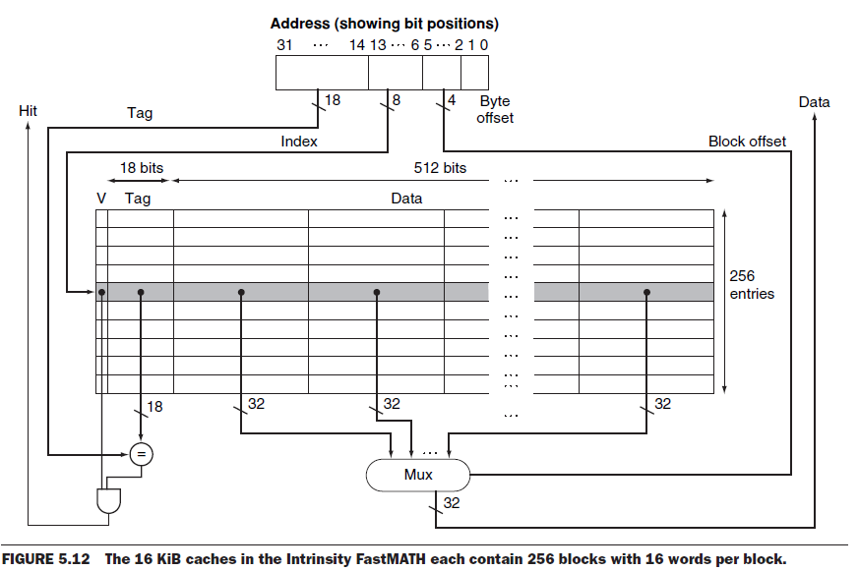
Example: Intrinsity FastMATH
16 words per block here

Slide 62
5.4 Measuring and Improving Cache Performance
We use CPU time to measure cache performance.
CPU time= (CPU execution clock cycles + Memory-stall clock cycles) ×Clock cycle time
Memory-stall clock cycles =Read-stall cycles + Write-stall cycles
For Read-stall:
Read-stall cycles = ×Read miss rate ×Read miss penalty
For a write-through plus write buffer scheme:
Write-stall cycles= ×Write miss rate ×Write miss penalty
+ Write buffer stalls
If the “write buffer stalls” are small, we can safely ignore them .
Reads
Program
Writes
Program

Slide 63
Combine the reads and writes
In most write-through cache organizations, the read and write miss penalties are the same（假定用前面讲的B1方案，不用B2方案）
the time to fetch the block from memory.
If we neglect the write buffer stalls, we get the following equation:
Memory-stall clock cycles ＝
× Miss rate × Miss penalty
We can also write this as:
Memory-stall clock cycles ＝
The above Instructions is the number of memory access instructions.
Memory accesses
Program
Instructions
Misses
×
Instructions
×Miss penalty
Program

Slide 64
Calculating cache performance
Assume:
Instruction cache miss rate 2%
data cache miss rate 4%
CPI without any memory stalls 2
miss penalty 100 cycles
The Load & stores are 36% of instructions
Question: How faster a processor would run with a perfect cache?
Answer: (下面的单位都是cycles)
Suppose total instruction count is I.
Instruction miss cycles = I×2%×100 =2.00I
Data miss cycles = I×36%×4%×100 =1.44I
Total memory-stall cycles= 2.00I+ 1.44I =3.44 I
CPI with stall = (total cycles for perfect cache + total memory-stalls) / I
= (2*I + 3.44 *I )/ I = 5.44
Total memory-stall cycles / Total cycles = 3.44 I/5.44I= 63%

Slide 65
How faster a processor for ideal
CPU time with stalls
I×CPI_{stall}×Clock cycle
=
CPU time with perfect cache
I×CPI_{perfect}×Clock cycle
=
CPI_{stall}
=
5.44
=2.72
CPI_{perfect}
2
What happens if the processor is made faster?
Assume CPI reduces from 2 to 1
Total cycles = total cycles for perfect cache + total memory-stalls
=1*I+3.44*I = 4.44I
CPU time with stalls
I * CPI_{stall}
=
4.44
=4.44
=
CPU time with perfect cache
I * CPI_{perfect}
1
Total memory-stall cycles / Total cycles = 3.44 I/4.44I= 77%
Total memory-stall cycles / Total cycles
from
3.44
3.44
=63% to
=77%
5.44
4.44

Slide 66
Calculating cache performance with Increased Clock Rate
本页内容书上无，不讲
Suppose we increase the performance of the computer in the previous example：doubling CPU clock rate ，while memory access time does not change.
Question : How much faster will the computer be with the faster clock to slow clock?
Answer
Total miss cycles per instruction = (2%×200) + 36%×(4%×200)=6.88
CPI with cache misses = 2 + 6.88 =8.88
Performance with fast clock
=
Execution time with slow clock
Performance with slow clock
Execution time with fast clock
=
I×CPI_{slow clock}×Clock cycle
=
5.44
=1.23
I×CPI_{fast clock}×Clock cycle/2
8.88×1/2
I: Instruction Count
This, the computer with the faster clock is about 1.2 times faster rather than 2 time faster.

Slide 67
Average Access Time Per Instruction
Hit time is also important for performance
Increasing the cache size will cause a bigger cache access time.
AMAT(Average Memory Access Time): the average time Per Instruction to access memory considering hit time, miss penalty, and miss rate.
N Instructions
Total time of memory access: N * hit-time + N * Miss-rate * Miss-penalty
AMAT = (N * hit-time + N * Miss-rate * Miss-penalty) / N
= hit-time + Miss-rate * Miss-penalty
= Time for a hit + Miss rate × Miss penalty
Example: CPU with 1ns clock, hit time = 1 cycle(5-stage pipeline 在数据和指令访问都hit时每条指令的内存访问平均花一个cycle), miss penalty = 20 cycles, miss rate = 5%
AMAT = 1 + 0.05 × 20 = 2ns
2 cycles per instruction

Slide 68
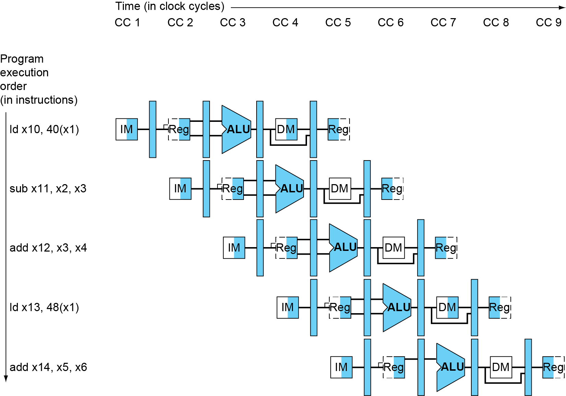
Multi-Cycle Pipeline Diagram
Form showing resource usage

Slide 69
Average Access Time Per Access
本书不用 AMAT per access
Hit time is also important for performance
Increasing the cache size will cause a bigger cache access time.
AMAT(Average Memory Access Time): the average time Per access to access memory considering hit time, miss penalty, and miss rate.
N memory access
Total time of memory access: N * hit-time + N * Miss-rate * Miss-penalty
AMAT = (N * hit-time + N * Miss-rate * Miss-penalty) / N
= hit-time + Miss-rate * Miss-penalty
= Time for a hit + Miss rate × Miss penalty
Example: CPU with 1ns clock, hit time = 1 cycle, miss penalty = 20 cycles, I-cache miss rate = 5%
AMAT = 1 + 0.05 × 20 = 2ns, 这里AMAT指指令内存的每次平均访问时间
2 cycles per instruction

Slide 70
说明：本页PPT从另一角度计算 Average Memory Access time per access，最终结果（红色的公式） 与上页PPT相同
不讲，本书不用 AMAT per access
Average Memory Access time = (total-hit-time + total-miss-time) / I
=[I * hit rate * Cache time + I * miss rate *(Cache time + Miss_penalty) ] / I
= 99% * 5 + (100%-99%) * 45 =5.5ns
150605标注：这里 I=number of total memory access, Miss penalty=40ns，
hit rate=99%, miss rate =1%
发生缺失的单条指令花时间= Cache time +Miss_penalty=5+40=45ns
Average Memory Access time
= [ I * hit rate * Cache time + I * miss rate *(Cache time + Miss_penalty) ] / I
= [ I * (hit rate + miss rate )* Cache time + I * miss rate * Miss_penalty) ] / I
= [ I * Cache time + I * miss rate * Miss_penalty) ] / I
= Cache time + miss rate * Miss_penalty
Note: (hit rate + miss rate ) =100%

Slide 71
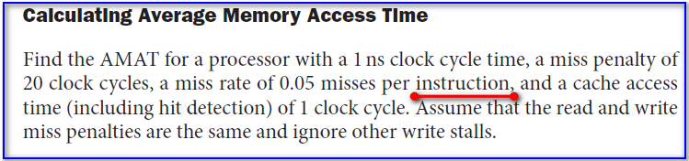
Risc-V 第5版 P394上面的这段文字，红线画出的instruction 是否应写成 access 才正确？
Answer: 不用改

Slide 72
Performance Summary
Decreasing base CPI
Greater proportion of time spent on memory stalls
Increasing clock rate
Memory stalls spend more CPU cycles
Can’t neglect cache behavior when evaluating system performance

Slide 73
The disadvantage of a direct-mapped cache
C
a
c
h
e
0
1
0
1
0
1
0
1
0
0
1
1
0
0
1
1
0
0
0
0
1
1
1
1
0
0
0
0
1
0
0
1
0
1
0
1
0
0
1
0
1
1
0
1
1
0
0
0
1
1
0
1
0
1
1
1
0
0
1
1
1
1
0
1
M
e
m
o
r
y
If the CPU requires the following memory units sequentially: word 0,word 8 and word 0. Word 0 and word 8 both are mapped to cache block 0, so the third access will be a miss.
Suppose each block contains 1 word.
But obviously, if one memory block can be placed in any cache block , the miss can be avoided. So, there is possibility that the miss rate can be improved.

Slide 74
Direct mapped
Block can only go in one place in the cache
Memory-block-address MOD Number-of-blocks-in-cache
Fully associative ：Block can go anywhere in cache.
Set associative
Block can go in one of a set in the cache.
A set is a group of blocks in the cache.
Memory-Block-address MOD Number-of-sets-in-the-cache
If each set has n blocks, the cache is said to be n-way set associative.
Note that direct mapped is the same as 1-way set associative, and fully associative is m-way set-associative (for a cache with m blocks).

Slide 75
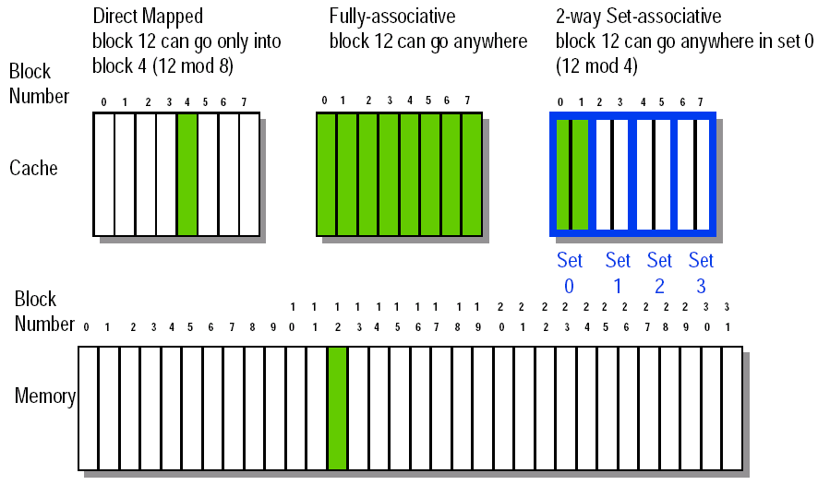
Figure 8-32 Block Placement

Slide 76
Q2: Block Identification
不讲
Every row of cache has an address tag that stores the main memory address of the data stored in the block.
When checking the cache, the processor will compare the requested memory address to the cache tag -- if the two are equal, then there is a cache hit and the data is present in the cache
Often, each cache block also has a valid bit that tells if the contents of the cache block are valid

Slide 77
The basics of a set-associative cache Decreasing miss ratio with associativity
A set-associative cache is divided into some sets. A set contains several blocks.
A memory block is mapped to a set in the cache through a mapping algorithm.
The memory block can be placed in any block in the corresponding set.
The mapping algorithm is:
Set number (Index) =
(Memory block number) modulo (Number of sets in the cache)
If a set has only one block, this set-associative cache is actually a direct-mapped cache.
If a set-associative cache has only one set, this set-associative cache is called a fully-associative cache.

Slide 78
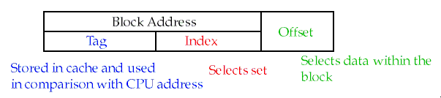
The Format of the Physical Memory Address
The Index field selects
The set, in case of a set-associative cache
The block, in case of a direct-mapped cache
Has as many bits as log₂(#sets) for set-associative caches, or log₂(#blocks) for direct-mapped caches
The Byte Offset field selects
The byte within the block
Has as many bits as log₂(size of block), here the size of block is total bytes in a block.
The Tag is used to find the matching block within the cache
Has as many bits as Address_size – Index_size – Byte_Offset_Size

Slide 79
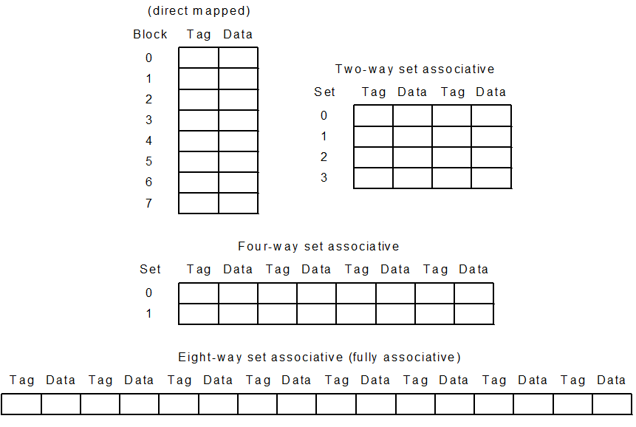
An eight-block cache configured as variety-way

Slide 80
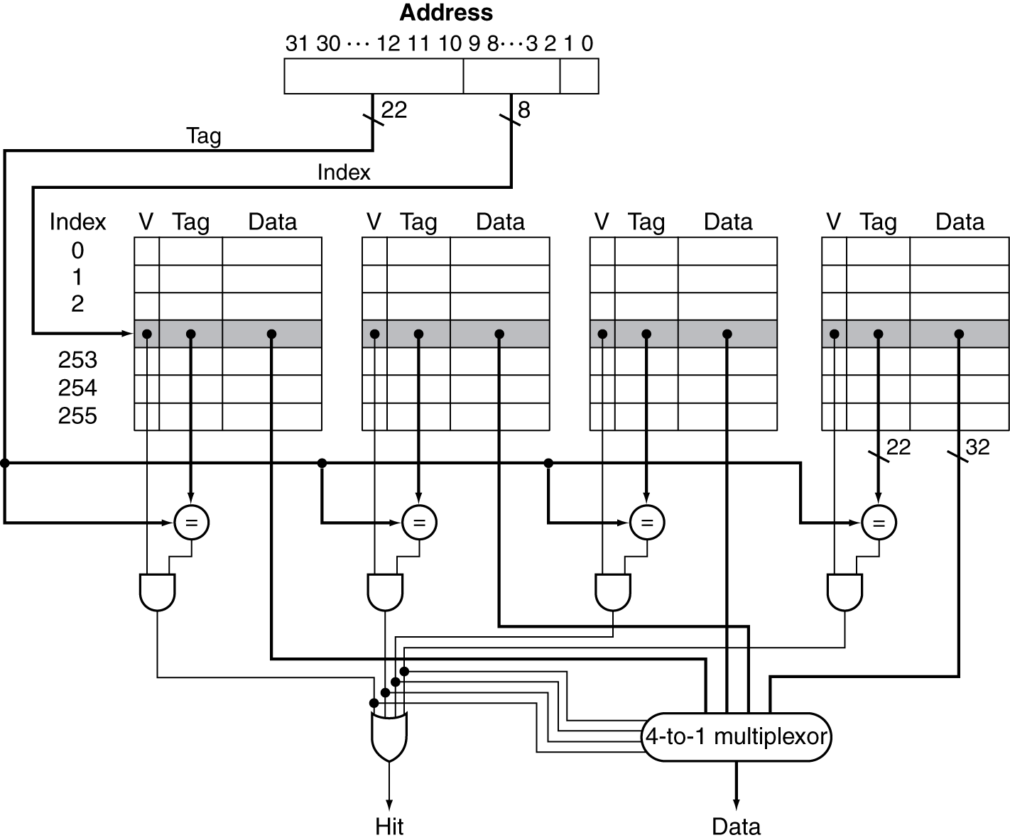
Set Associative Cache Organization
Total 256 sets

Slide 81
Miss rate versus set-associativity
Assume: there are three small caches, each consisting of four one-word blocks.
One cache is direct-mapped,
the second is two-way set associative
and the third is fully associative.
Question: Given the following sequence of block addresses: 0,8,0,6,8, find the number of misses for each cache organization.
Answer: for direct-mapped 5 misses
Memory block | Hit or miss | Contents after each reference
 |  | Set 0 | Set 1 | Set 2 | Set 3
 |  | Block 0 | Block 1 | Block 2 | Block 3
0 | Miss | M[0]
8 | Miss | M[8]
0 | Miss | M[0]
6 | Miss | M[0] |  | M[6]
8 | Miss | M[8] |  | M[6]

Slide 82
Second, for the two-way set associative cache. 4 misses
Memory block | Hit or miss | Contents after each reference
 |  | Set 0 |  | Set 1
 |  | Block 0 | Block 1 | Block 2 | Block 3
0 | Miss | M[0]
8 | Miss | M[0] | M[8]
0 | Hit | M[0] | M[8]
6 | Miss | M[0] | M[6]
8 | Miss | M[8] | M[6]
Finally, for the fully associative cache. 3 misses
Memory block | Hit or miss | Contents after each reference
 |  | Only one set
 |  | Block 0 | Block 1 | Block 2 | Block 3
0 | Miss | M[0]
8 | Miss | M[0] | M[8]
0 | Hit | M[0] | M[8]
6 | Miss | M[0] | M[8] | M[6]
8 | Hit | M[0] | M[8] | M[6]

Slide 83
How much of a reduction in the miss rate is achieved by associativity?
Associativity | Data miss rate
1 | 10.3%
2 | 8.6%
4 | 8.3%
8 | 8.1%
The data cache miss rates for organization like the Intrinsity FastMATH processor for SPEC2000 benchmarks with associativity varying from one-way to eight-way .
Data cache organization is 64KB data cache and 16-word block

Slide 84

Size of tags versus set associativity
Assume
Cache size is 4K Block
Block size is 4 words
Physical address is 32bits
Question
Find the total number of set and total number of tag bits for variety associativity
Answer
Offset size (Byte) = 16= 2⁴ 4 bits for byte-offset Number of memory block = 2³²÷2⁴=2²⁸ 28 bits for memory Block # Number of cache block = 2¹² 12 bits for cache Block #
For direct-mapped
Bits of index = 12 bits
bits of Tag = (28-12) ×4K=16×4K=64 Kbits
4 bits
32-bits address:

Slide 85
For two-way associative
Number of cache set = 2¹² ÷ 2= 2¹¹
Bits of index =11 bits
Bits of Tag = (28-11) ×4K=17×4K=68 Kbits
For four-way associative
Number of cache set = 2¹² ÷ 4= 2¹⁰
Bits of index =10 bits
Bits of Tag = (28-10) ×4K=18×4K=72 Kbits
For full associative
Number of cache set = 1
Bits of index = 0 bits
Bits of Tag = (28-0) ×4K=112 Kbits
 | Direct | 2-way | 4-way | Fully
Index(bit) | 12 | 11 | 10 | 0
Tag(bit) | 16 | 17 | 18 | 28

Slide 86
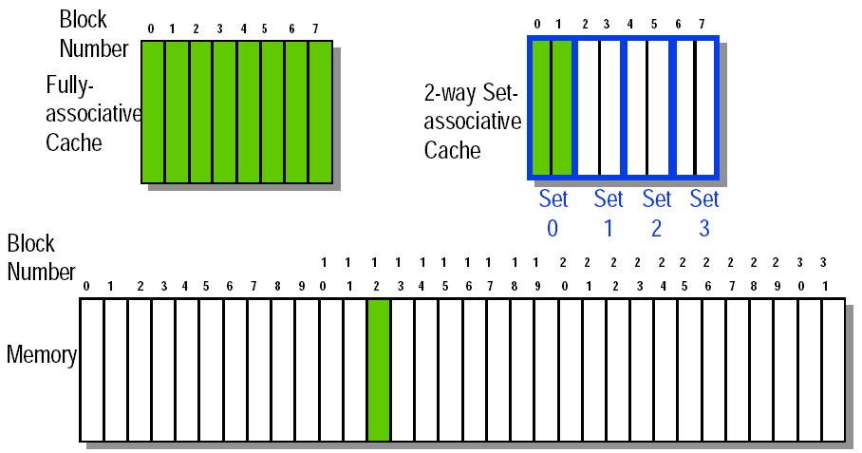
Choosing which block to replace
In a direct-mapped cache, there is only one block that can be replaced
In set-associative and fully-associative caches, there are N blocks (where N is the degree of associativity

Slide 87
Strategy of block Replacement
Several different replacement policies can be used
Random replacement - randomly pick any block
Easy to implement in hardware, just requires a random number generator
Spreads allocation uniformly(均衡地) across cache
May evict a block that is about to be accessed
Least-recently used (LRU) - pick the block in the set which was least recently accessed
Assumed more recently accessed blocks more likely to be referenced again
This requires extra bits in the cache to keep track of accesses.
First in,first out(FIFO)-Choose a block from the set which was first came into the cache

Slide 88
5.4.3 Choosing which block to replace
In an associative cache, we must decide which block to replace when a miss happens and the corresponding set is full.
The most commonly used scheme is least recently used (LRU), which we used in the previous example. In an LRU scheme, the block replaced is the one that has been unused for the longest time.
For a two-way set associative cache, the LRU can be implemented easily. We could keep a single bit in each set. We set the bit whenever a specific block in the set is referenced, and reset the bit whenever another block is referenced.
As associativity increases, implementing LRU gets harder.

Slide 89
5.4.4 Decreasing miss penalty with multilevel caches
不讲
本页及后4页PPT来自MIPS教材，非本书内容
Add a second level cache:
often primary cache is on the same chip as the processor
use SRAMs to add another cache above primary memory (DRAM)
miss penalty goes down if data is in 2nd level cache
Example:
Part1: With just primary cache, CPI of 1.0 on a 5GHz machine with a 2% miss rate, 100ns DRAM access
Miss penalty to main memory is
The CPI with one level of caching
Total CPI = 1.0 + Memory-stall cycles per instruction
=( 1.0 *I+ 2%*I × 500 ) / I = 1.0 + 2% × 500 = 11.0
Part2: Adding 2nd level cache with 5ns access time, decreases miss rate to 0.5%（That is，for n instructions( not n memory accesses)，total 0.5%*n access to DRAM， total 2%*n access to the 2nd level cache ）
Suppose: no double miss (both instruction cache and data cache miss ) occurs during each one-instruction execution.(书上没说，但这条很重要)
100ns
= 500 clock cycles
0.2
5ns
= 25 clock cycles=Miss penalty of 2nd level cache
0.2

Slide 90
不讲
The CPI with Two level of cache with 0.5% miss rate for main memory
Total CPI = 1.0 + Primary stalls per instruction + Secondary stalls per instruction
= 1 + 2% ×25 + 0.5% × 500
= 1.0 + 0. 5 +2.5 = 4.0
The processor with secondary cache is faster, the faster factor(倍数) is
Using multilevel caches:
try and optimize the hit time on the 1st level cache
try and optimize the miss rate on the 2nd level cache
11.0
=2.8
4.0

Slide 91
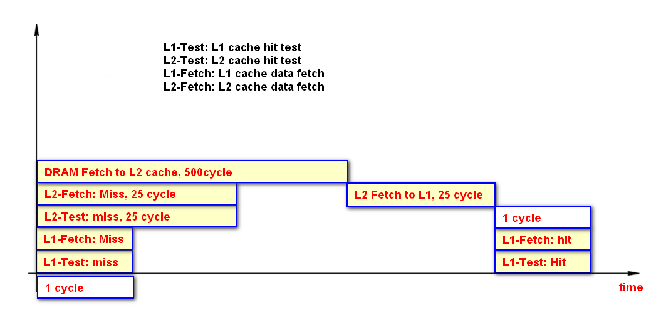
不讲
Fig. Total time of an instruction reading memory with both miss of L1 and L2 cache: 526 cycles
while L1 cache hit test is operating, we process L1 cache data fetching simultaneously, these 2 operations begin at the same time and cost same time.
L2 cache operates so.

Slide 92
Decreasing miss penalty with multilevel caches
不讲
Total N instructions (e.g. N=10000, 4000 memory access instructions, 6000 other instructions such as ADD、SUB、AND、BEQ、J……, total memory access number: 14000(not N) )
N*98% instructions without any miss penalty, time A=N*98%*H1 cycle
N*2% instructions with miss of first level cache, time: B+C= N*2%*(H1+H2) + N*0.5% *M2
N*1.5% access with hit of 2nd level cache, time B=N*1.5% *(H1+H2)
N*0.5% access with miss of 2nd level cache, Time C= N*0.5% *(H1+H2+M2)
3 kinds of access time
H1: 1 cycle, access none of 2nd level cache and DRAM
H2: 25 cycles to access 2nd level cache
M2: 500 cycles, miss penalty to access 2nd level cache (i.e. time to access DRAM)
Total time of N instructions: A+B+C
= N*98%*H1 + N*2%*(H1+H2) + N*0.5% *M2
= N*H1 + N*2%*H2 + N*0.5% *M2 = N*(1+2%*25+0.5%*500) = 4*N
average CPI=4N/N=4
often primary cache is on the same chip as the processor
use SRAMs to add another cache above primary memory (DRAM)
miss penalty goes down if data is in 2nd level cache
Example:
CPI of 1.0 on a 5GHz machine with a 2% miss rate, 100ns DRAM access
Adding 2nd level cache with 5ns access time decreases miss rate to 0.5%（That is，for n memory access instructions ，total 0.5%*n access to RAM， total 2%*n access to the 2nd level cache ）
Miss penalty to main memory is
Miss penalty to 2nd level cache is

Slide 93
Decreasing miss penalty with multilevel caches
不讲
Total N instructions (e.g. N=10000, 4000 memory access instructions, 6000 other instructions such as ADD、SUB、AND、BEQ、J……, total memory access number: 14000(not N) )
N*98% accesses without any miss penalty, time A=N*98%*H1 cycle
N*2% accesses with miss of first level cache, time: B+C= N*2%*(H1+H2) + N*0.5% *M2
N*1.5% instructions with hit of 2nd level cache, time B=N*1.5% *(H1+H2)
N*0.5% instructions with miss of 2nd level cache, Time C= N*0.5% *(H1+H2+M2)
3 kinds of access time
H1: 1 cycle, hit time to access first level cache
H2: 25 cycles, hit time to access 2nd level cache
M2: 500 cycles, miss penalty to access 2nd level cache (time to access DRAM)
Total time of N instructions: A+B+C
= N*98%*H1 + N*2%*(H1+H2) + N*0.5% *M2
= N*H1 + N*2%*H2 + N*0.5% *M2 = N*(1+2%*25+0.5%*500) = 4*N
average CPI=4N/N=4
often primary cache is on the same chip as the processor
use SRAMs to add another cache above primary memory (DRAM)
miss penalty goes down if data is in 2nd level cache
Example:
CPI of 1.0 on a 5GHz machine with a 2% miss rate, 100ns DRAM access
Adding 2nd level cache with 5ns access time decreases miss rate to 0.5%（That is，for n memory access instructions ，total 0.5%*n access to RAM， total 2%*n access to the 2nd level cache ）
Miss penalty to main memory is
Miss penalty to 2nd level cache is
本页是一种错误的解题思路，要引起注意

Slide 94
5.4.4 Decreasing miss penalty with multilevel caches
同RISC-V教材
Add a second level cache:
often primary cache is on the same chip as the processor
use SRAMs to add another cache above primary memory (DRAM)
miss penalty goes down if data is in 2nd level cache
Example:
Part1: With just primary cache, CPI of 1.0 on a 4GHz machine with a 2% miss rate, 100ns DRAM access
Miss penalty to main memory is
The CPI with one level of caching
Total CPI = 1.0 + Memory-stall cycles per instruction
=( 1.0 *I+ 2%*I × 400 ) / I = 1.0 + 2% × 400 = 9
I: total instruction number
Part2: Adding L-2 cache with 5ns access time, decreases miss rate to 0.5%（That is，for n instructions( not n memory accesses)，total 0.5%*n access to DRAM， total 2%*n access to the 2nd level cache ）
Suppose: no double miss (both instruction cache and data cache miss ) occurs during each one-instruction execution.(书上没说,补充)
100ns
= 400 clock cycles
0.25
5ns
= 20 clock cycles=Miss penalty of 2nd level cache
0.25

Slide 95
Note: miss rate is the miss rate per instruction, not the miss rate per access.
The CPI with Two level of cache with 0.5% miss rate for main memory
Total CPI = 1.0 + Primary stalls per instruction + Secondary stalls per instruction
= 1 + 2% ×20 + 0.5% × 400
= 1.0 + 0. 4 +2 = 3.4
The processor with secondary cache is faster, performance ratio is
Using multilevel caches:
try and optimize the hit time on the 1st level cache
try and optimize the miss rate on the 2nd level cache
9.0
=2.6
3.4

Slide 96
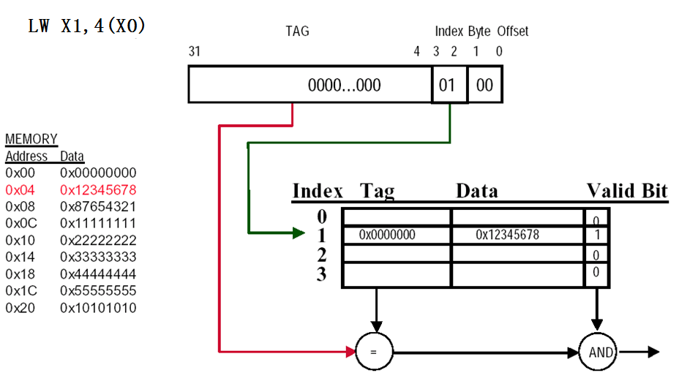
Direct-mapped Cache Example (1-word Blocks)
总结和回顾
不讲

Slide 97
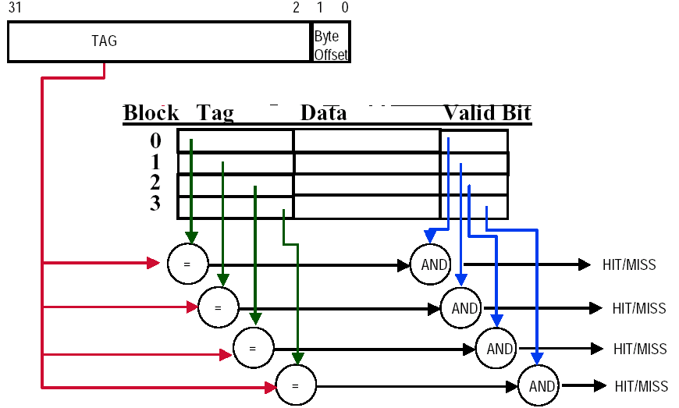
Fully-Associative Cache example (1-word Blocks)
总结和回顾
不讲
Assume cache has 4 blocks

Slide 98
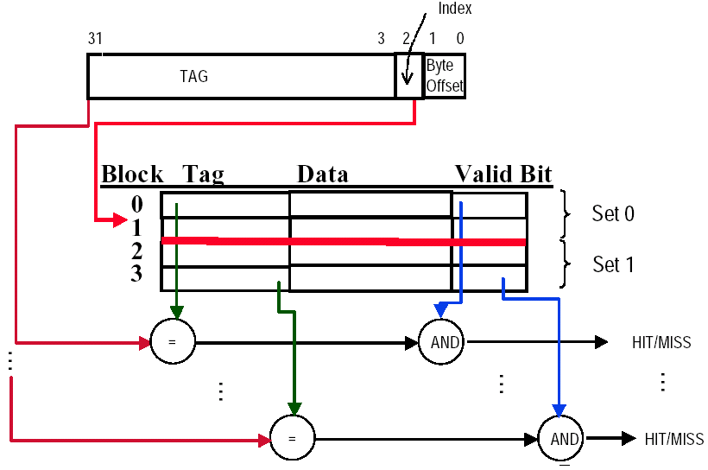
2-Way Set-Associative Cache
总结和回顾
不讲
Assume cache has 4 blocks and each block is 1 word
2 blocks per set, hence 2 sets per cache

Slide 99
Deep concept in Cache
总结和回顾
不讲
Four Questions for Memory Hierarchy Designers
Caching is a general concept used in processors, operating systems, file systems, and applications.
There are Four Questions for Memory Hierarchy Designers
Q1: Where can a block be placed in the upper level?
(Block placement)
Fully Associative, Set Associative, Direct Mapped
Q2: How is a block found if it is in the upper level? (Block identification)
Use Tag
Q3: Which block should be replaced on a miss? (Block replacement)
Random, LRU,FIFO
Q4: What happens on a write? (Write strategy)
Write Back or [Write Through (with Write Buffer)]

Slide 100
5.4.5 Decreasing Software Optimization via Blocking 因课时限制，本小节上课不讲，自学 5.5 Dependable Memory Hierarchy 在下一章【Chapter 8 Storage, Networks and Other Peripherals】（来源于第三版教材）讲 5.6 Virtual Machines 因课时限制，本小节上课不讲，自学

Slide 101
5.7 Virtual Memory
§5.7 Virtual Memory
Use main memory as a “cache” for secondary (disk) storage
Managed jointly by CPU hardware and the operating system (OS)
Programs share main memory
Each gets a private virtual address space holding its frequently used code and data
Protected from other programs
CPU and OS translate virtual addresses to physical addresses
VM （Virtual Memory）“block” is called a page
如果虚拟地址的长度（位数）足够长，磁盘划出的用于虚拟内存的磁盘空间大小（字节数）为B，物理内存大小（字节数）为A，则用户可用的虚拟内存大小为A+B

Slide 102
5.7 Virtual Memory
Main memory can act as a cache for the secondary storage (disk)
Advantages:
illusion of having more physical memory
program relocation
protection
Virtual addr.
Physical addr.

Slide 103
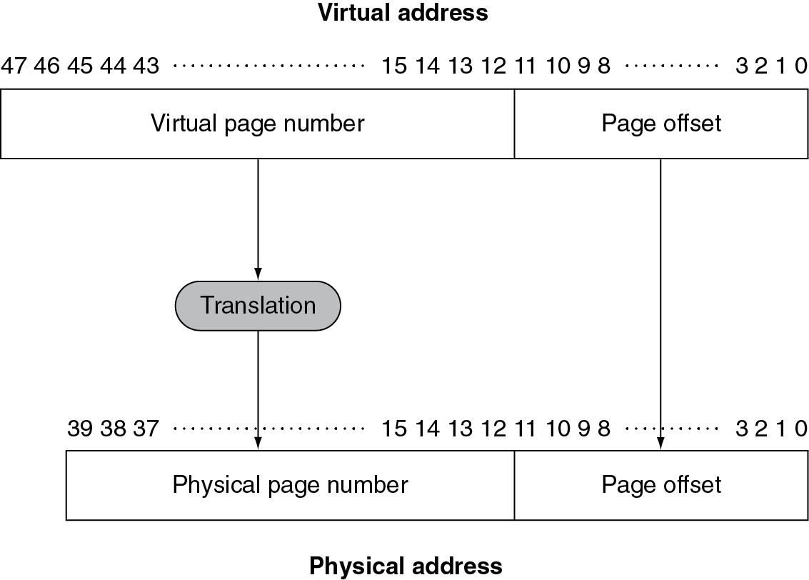
Pages: virtual memory blocks
Page faults: the data is not in memory, retrieve it from disk
huge miss penalty, thus pages should be fairly large (e.g., 4KB)
reducing page faults is important (LRU is worth the price)
can handle the faults in software instead of hardware
using write-through is too expensive so we use write back

Slide 104
Page Fault Penalty
On page fault, the page must be fetched from disk
Takes millions of clock cycles
Handled by OS exception processing program
Try to minimize page fault rate
Fully associative placement
Smart replacement algorithms

Slide 105
Page Tables
Stores placement information
Array of page table entries, indexed by virtual page number
Page table register in CPU points to page table start address in physical memory
If page is present in memory
PTE (Page Table Entry) stores the physical page number
Plus other status bits (referenced, dirty, …)
Reference bit (aka use bit) in PTE is set to 1 on each access to corresponding page, periodically cleared to 0 by OS
Dirty bit in PTE is initialized to 0, set to 1 when any byte of the page is written
Valid bit
0: the page is present in disk, and a page fault occurs.
1: the page is present in main memory
Plus other page protection bits (writable, non-kernel process readable, …)
If page is not present in memory
PTE can refer to location in swap space on disk

Slide 106
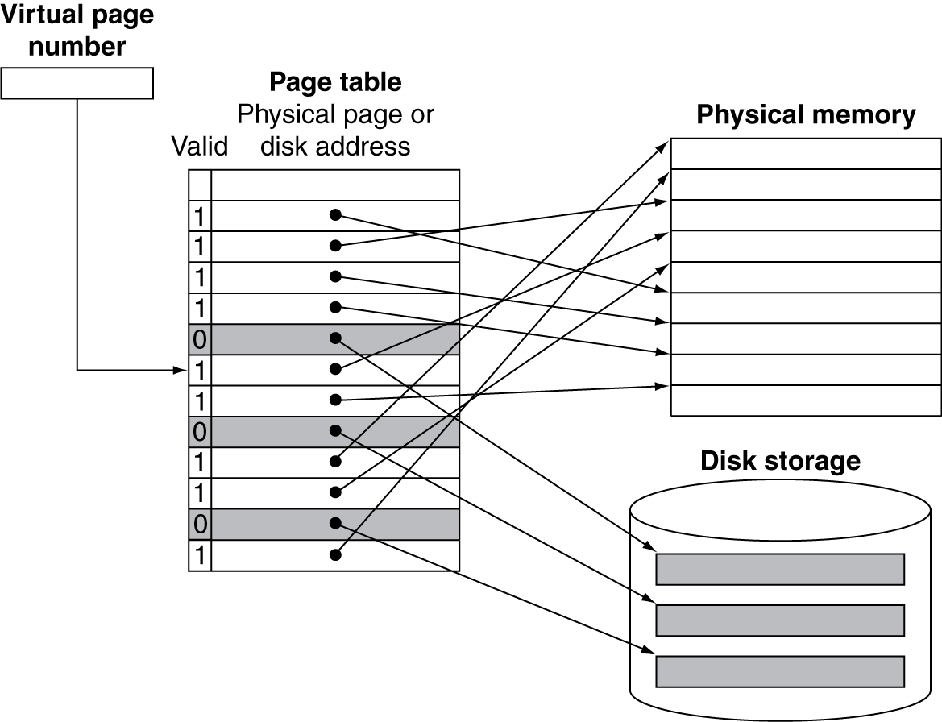
Mapping Pages to Storage
valid bit
0: the page is present in disk, and a page fault occurs.
1: the page is present in main memory

Slide 107
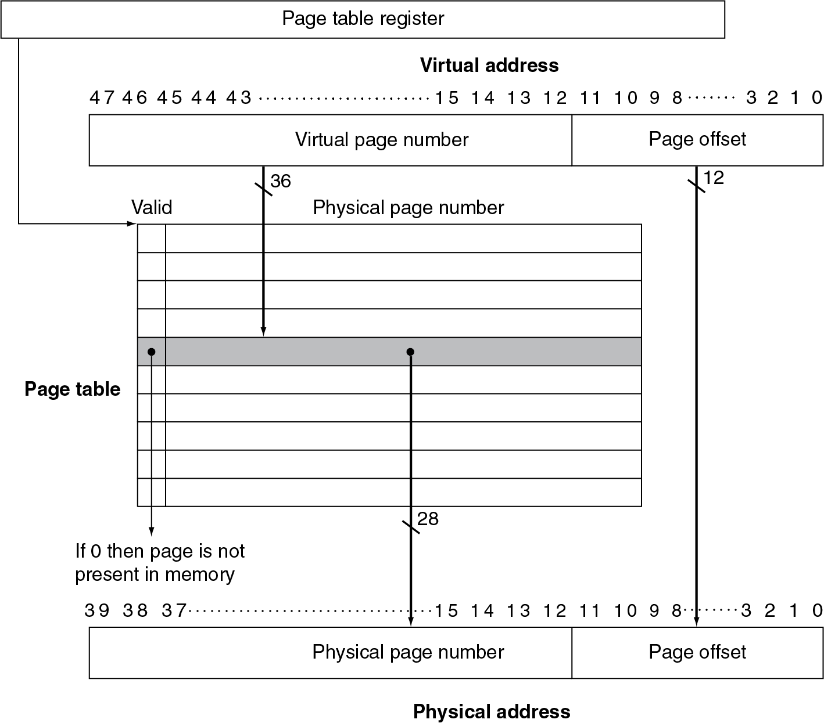
5.7.1 Placing a page and finding it again ----Page Tables
Virtual memory systems use fully associative mapping method

Slide 108
5.7.2 Page faults
When the OS creates a process, it usually creates the space on disk for all the pages of a process.
When a page fault occurs, the OS will be given control through exception mechanism.
The OS will find the page in the disk by the page table.
Next, the OS will bring the requested page into main memory. If all the pages in main memory are in use, the OS will use LRU strategy to choose a page to replace
It is possible that part of the page table is moved into data cache (依据：书P435第8行）
Virtual page

Slide 109
Replacement and Writes
To reduce page fault rate, prefer least-recently used (LRU) replacement
Reference bit (aka use bit) in PTE is set to 1 on access to page
Reference bit is periodically cleared to 0 by OS
A page with reference bit = 0 has not been used recently
Disk writes take millions of cycles
Write through is impractical
Use write-back
Dirty bit in PTE is set to 1 when page is written
5.7.4 What about writes?

Slide 110
5.7.5 Making Address Translation Fast----TLB
Lookaside:后备，旁视
Fast Translation Using a TLB
TLB (Translation-Lookaside Buffer)：A cache for address translations, more accurate to call it a translation cache, 中文常称为【快表】
Address translation requires extra memory references
One to access the page table in memory
Then the actual memory access
But access to page tables has good locality
So use a fast cache of PTEs within the CPU
Called Translation Look-aside Buffer (TLB), it make translation faster.
Typical: 16–512 entries, 0.5–1 cycle for hit, 10–100 cycles for miss, 0.01%–1% miss rate, 4–8 bytes each TLB entry
cache block size: size of 1-2 TLB entry
TLB Misses could be handled by hardware or software

Slide 111
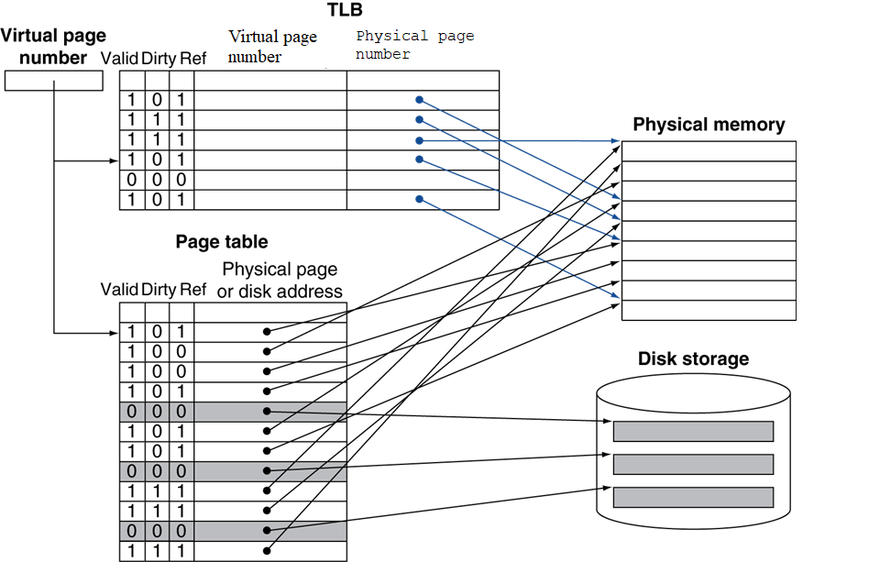
5.7.5 Making Address Translation Fast----TLB
Virtual page number in TLB acts as tag in cache
TLB一般都是fully-associative cache，极少数采用set-associative cache

Slide 112
TLB Misses (virtual page number Not found in TLB)
When TLB Misses, 2 cases
If page is in memory
Load the PTE from memory and retry
Could be handled in hardware
Or in software
Raise a special exception
If page is not in memory (page fault)
page fault exception happens, OS handles fetching the page and updating the page table
Then restart the faulting instruction (e.g. LD,SD,LW,SW…)

Slide 113
TLB Miss Handler
TLB miss indicates
Page present in memory, but PTE not in TLB
Or page not present in memory
TLB Miss Handler in Intrinsity FastMATH do:
Hardware saves the virtual page number of the reference into a special register
Generates an exception which handles the miss in software.
Exception handler (software) do:
Use virtual page number to find entry in page table
If the PTE have a valid physical address: Copies PTE (page table entry) in memory to TLB, restarts the instruction, get physical address in TLB.
If the PTE does not have a valid physical address, page fault will occur

Slide 114
Page Fault Exception Handler
本页PPT书上好像没有
Use faulting virtual address to find PTE
Locate page on disk
Choose page to replace
If dirty, write to disk first
Read page into memory and update page table
Copy updated PTE into TLB (补充）
Re-execute faulting instruction (e.g. LW, LD, SD……)

Slide 115
5.7.6 The Intrinsity FastMATH TLB An real example: the Intrinsity FastMATH
both virtual page number and physical page number are 20 bits
The TLB contains 16 entries, mixed with instruction PTE and data PTE
Each TLB entry is 64 bits wide
a 20-bit tag (i.e. virtual page number)
a 20-bit physical page number
a valid bit, a dirty bit…...
Its cache is direct mapped cache
Like most MIPS systems, it uses software to handle TLB misses. A TLB miss exception takes about 13 clock cycles, assuming
the exception code is in instruction cache
the page table entry (PTE) is in data cache.

Slide 116
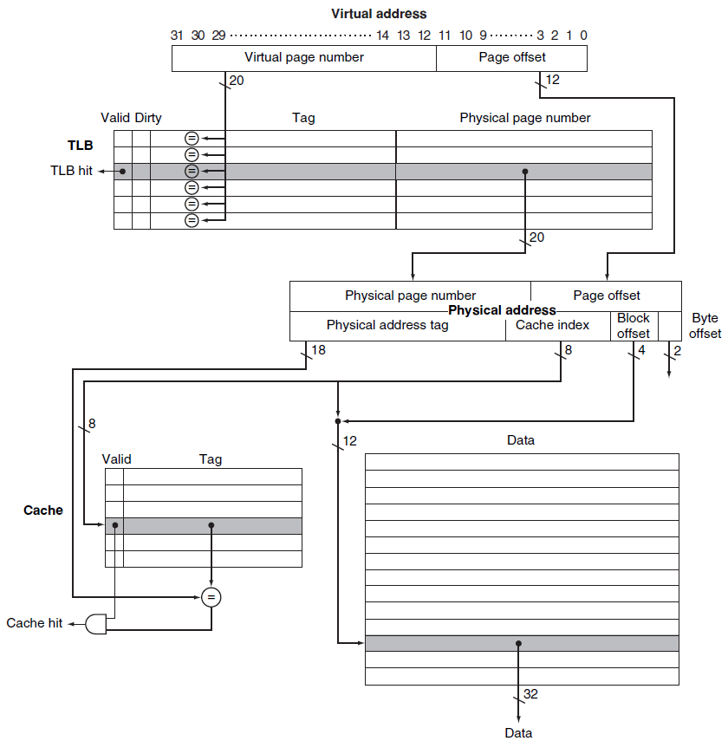
Used in Intrinsity FastMATH Memory Hierarchy

Slide 117
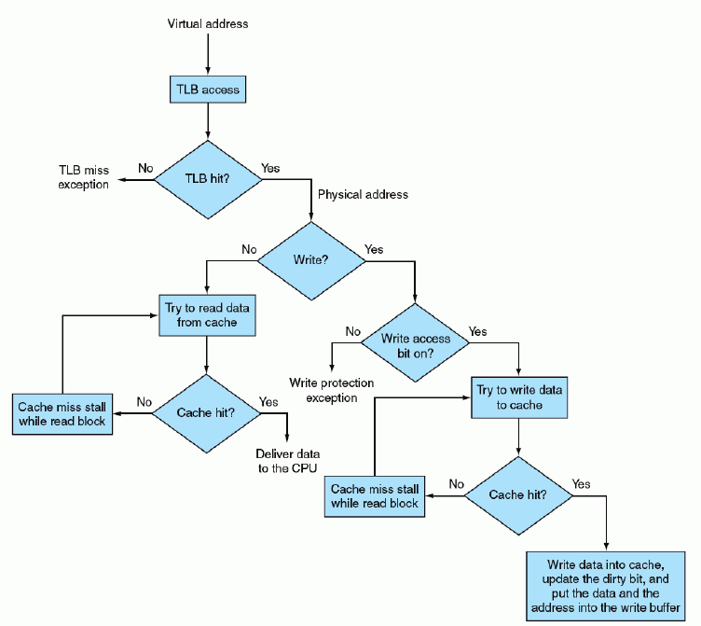
TLBs and caches scheme in Intrinsity FastMATH CPU adopting write-through with write allocate for cache
全图
FIGURE 5.32 Processing a read or a write-through in the Intrinsity FastMATH TLB and cache

Slide 118
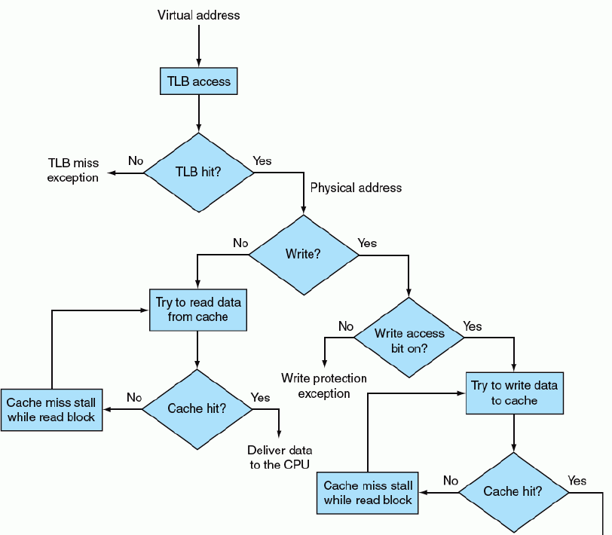
TLBs and caches
放大后的局部图

Slide 119
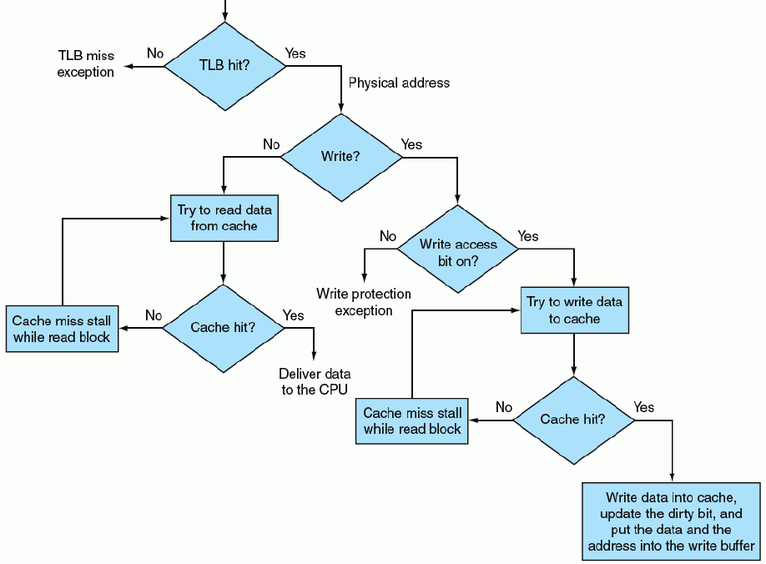
TLBs and caches
放大后的局部图

Slide 120
5.7.7 Integrating Virtual Memory, TLBs, and Caches
Our virtual memory and cache systems work together as a hierarchy:
data cannot be in the cache unless it is present in main memory.
When OS migrate every page from main memory to secondary memory（disk）
It flushes all contents of this page from cache.
It modifies the page table entry and clears TLB entry of this page to indicate the page migrated to disk.

Slide 121
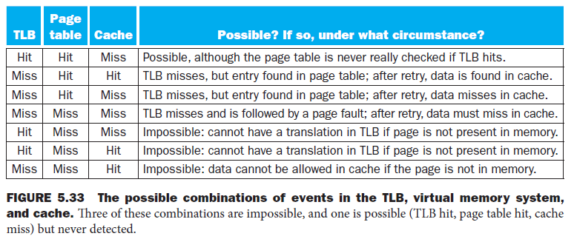
Possible combinations of Event
Three different types of misses: TLB miss, page Fault, cache miss
Page table Miss: =[page fault], page is in disk;
Page table Hit: page is in memory

Slide 122
5.7.8 Implementing Protection with Virtual Memory
The most important function of virtual memory
to allow sharing of a memory area by multiple processes
providing memory protection among these processes, (including OS process)
to implement protection in the virtual memory, the hardware must provide 3 functions:
Support at least two modes
user process mode
supervisor process mode
operating system process = supervisor process = kernel process = executive process.
Provide information of the process state: user/supervisor mode bit, the page table pointer, the TLB.
a user process can read but not write these information.
OS uses special instructions (only available in supervisor mode) to write these information

Slide 123
the processor can go from user mode to supervisor mode, and vice versa.
The first direction is finished by a system call exception (instruction ECALL in RISC-V)
It transfers control to a dedicated location in supervisor code space.
Like other exception, PC is saved in the SEPC (supervisor exception program counter), and the processor enters supervisor mode.
To return to user mode from the exception, use the supervisor exception return (instruction SRET)
补充知识（非本书内容，[操作系统]课）
每一个进程都拥有一个自己的页表，每一个进程的PCB（Process Control Block,进程控制块）中有指针指向本进程的页表。
当进程切换时，比如现在是进程1运行，TLB中放的是进程1的相关数据的地址，突然切换到进程2，TLB中原有的数据不是进程2相关的，此时TLB刷新数据有两种办法:
全部刷新：很简单，但花销大，很多不必刷新的数据也刷新，增加了花销
部分刷新：根据标志位，刷新需要刷新的数据，不需要刷新的被保留。

Slide 124
5.7.8 Implementing Protection with Virtual Memory
storing the page tables in OS address space, the OS can change the page tables
a user process can not change page tables
process A can not change any page table mapping.
process A can not map its virtual page to physical page of process B
protecting data of process B from reading or writing by process A;
To allow another process P1 to read a page owned by process P2,
P2 asks OS to create a page table entry mapping virtual page of P1 to P2’s physical page that P2 wants to share.
The OS use the write protection bit to prevent P1 from writing the data.

Slide 125
Modern Systems
Very complicated memory systems:

