Slide 1
GTSRB Traffic Sign Recognition
An end to end TensorFlow pipeline
IEEE project presentation
Akshit Mehta
Notes:
Opening: This project classifies a cropped traffic-sign image into one of 43 known GTSRB classes. The presentation follows the complete path from verified data to model prediction. Emphasize that this is image classification, not object detection or a safety-certified driving system.

Slide 2
01 / CONTEXT
Problem and objective
Input
Model
Output
One cropped traffic-sign image
Neural network learns visual patterns
Class ID and confidence
The goal is a reproducible classification pipeline with honest evaluation and interpretable evidence.
Notes:
Explain classification as choosing one label. The input is already cropped, so the system does not answer where a sign is in a road scene. The model predicts one of 43 labels and a probability-like confidence score.

Slide 3
02 / DATA
Dataset and integrity
39,209
12,630
43
training images
official test images
classes, IDs 0–42
The downloader verifies the published MD5 checksum before extraction and checks that every class is present.
Notes:
The archive comes from Zenodo. Explain why checksums matter: a download can be incomplete or corrupted while still looking like a file. The MD5 fingerprint provides a reproducible integrity check. The test set stays separate until final evaluation.

Slide 4
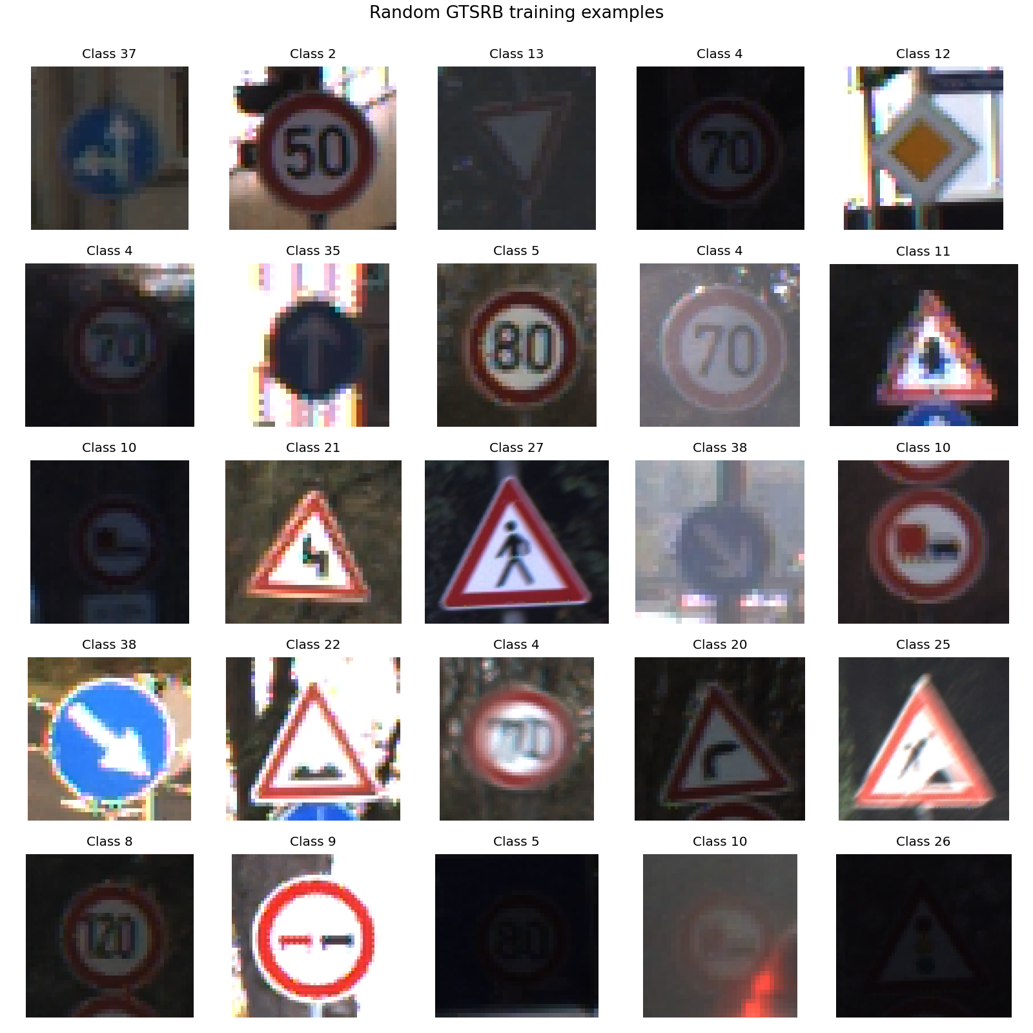
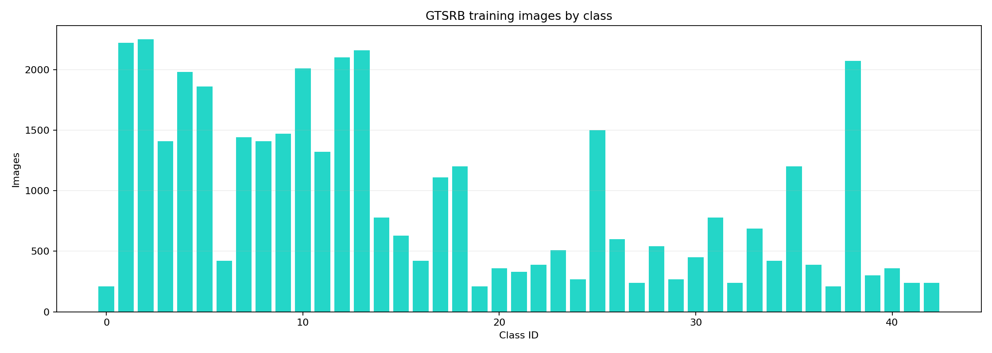
03 / UNDERSTANDING THE DATA
Exploratory data analysis
The class counts are uneven, and the images vary in lighting, size, blur, and viewpoint.
Notes:
Read the left graph as examples per class. Some classes have a few hundred images and others have more than two thousand, which is class imbalance. The sample grid shows the visual variation. This is why we report macro F1 as well as accuracy.

Slide 5
04 / DATA PIPELINE
Preparation and leakage control
Resize
64×64 or 96×96
Normalize
pixel values to 0–1
Augment
rotation, translation, zoom, brightness, contrast
Split
group related sequences before validation
Validation examples guide training decisions. The official test set remains untouched until the end.
Notes:
Explain that pixels have different original sizes, so the model needs a fixed tensor shape. Normalization makes optimization numerically stable. Augmentation creates realistic variations while keeping the same label. Grouping related frames reduces near-duplicate leakage between training and validation.

Slide 6
05 / ARCHITECTURES
Two model choices
Custom CNN
MobileNetV2
Learns edges, colors, shapes, and symbols from this dataset. Compact and easy to explain.
Lightweight transfer-learning network. Reuses general visual features and adapts the final layer to 43 classes.
Baseline versus reusable visual knowledge
Notes:
A convolutional neural network applies small filters over an image. The custom CNN is the baseline because it is transparent. MobileNetV2 is efficient and can start with ImageNet features. A fair comparison needs matched training budgets.

Slide 7
06 / EXPERIMENT DESIGN
Training and evaluation
Training
Metrics
Batches → predictions → loss → weight updates
Accuracy: overall correctness
Macro F1: equal weight per class
Confusion matrix: which classes are mixed up
Callbacks
Early stopping, learning-rate reduction, best checkpoint
Notes:
One epoch means one pass through the training data. Loss is the error signal used for weight updates. Early stopping and checkpoints prevent keeping a worse later model. Accuracy is useful but can hide poor rare-class performance, so macro F1 and confusion matrices are important.

Slide 8
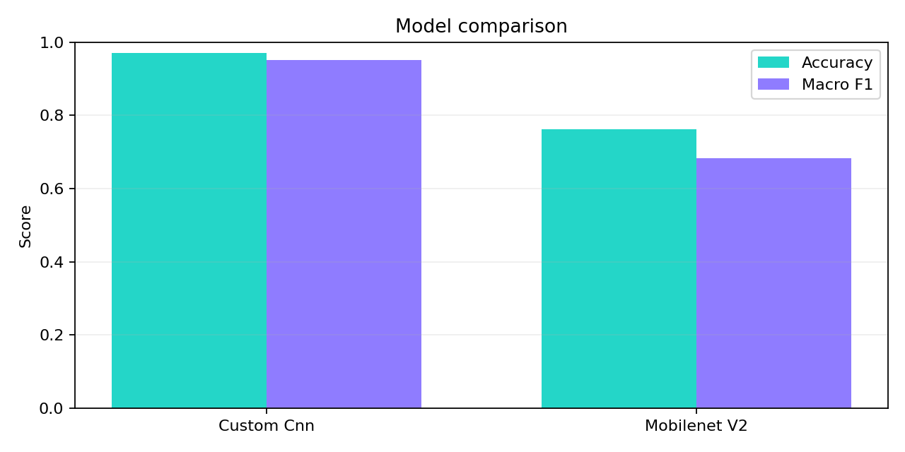
07 / OFFICIAL TEST SET
Measured results
Custom CNN
56.90% accuracy
56.19% macro F1
MobileNetV2
62.86% accuracy
55.74% macro F1
Notes:
These are full-dataset matched five-epoch runs on the Apple M1 Metal GPU. MobileNetV2 leads on overall accuracy, while the custom CNN is slightly ahead on macro F1. This is a reproducible baseline, not a maximum-performance benchmark.

Slide 9
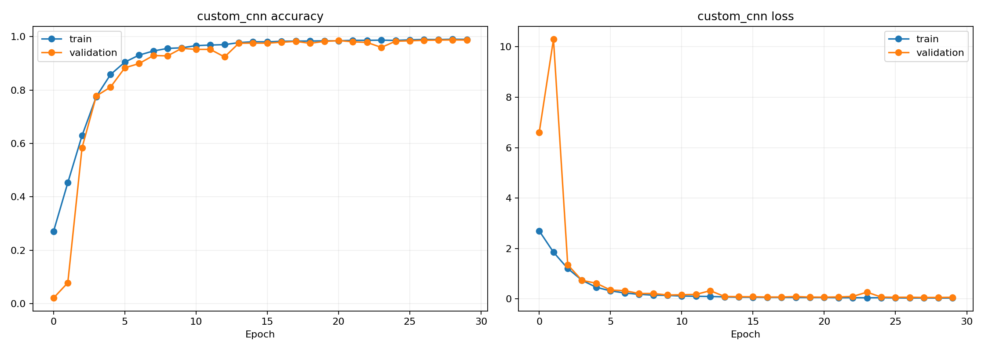
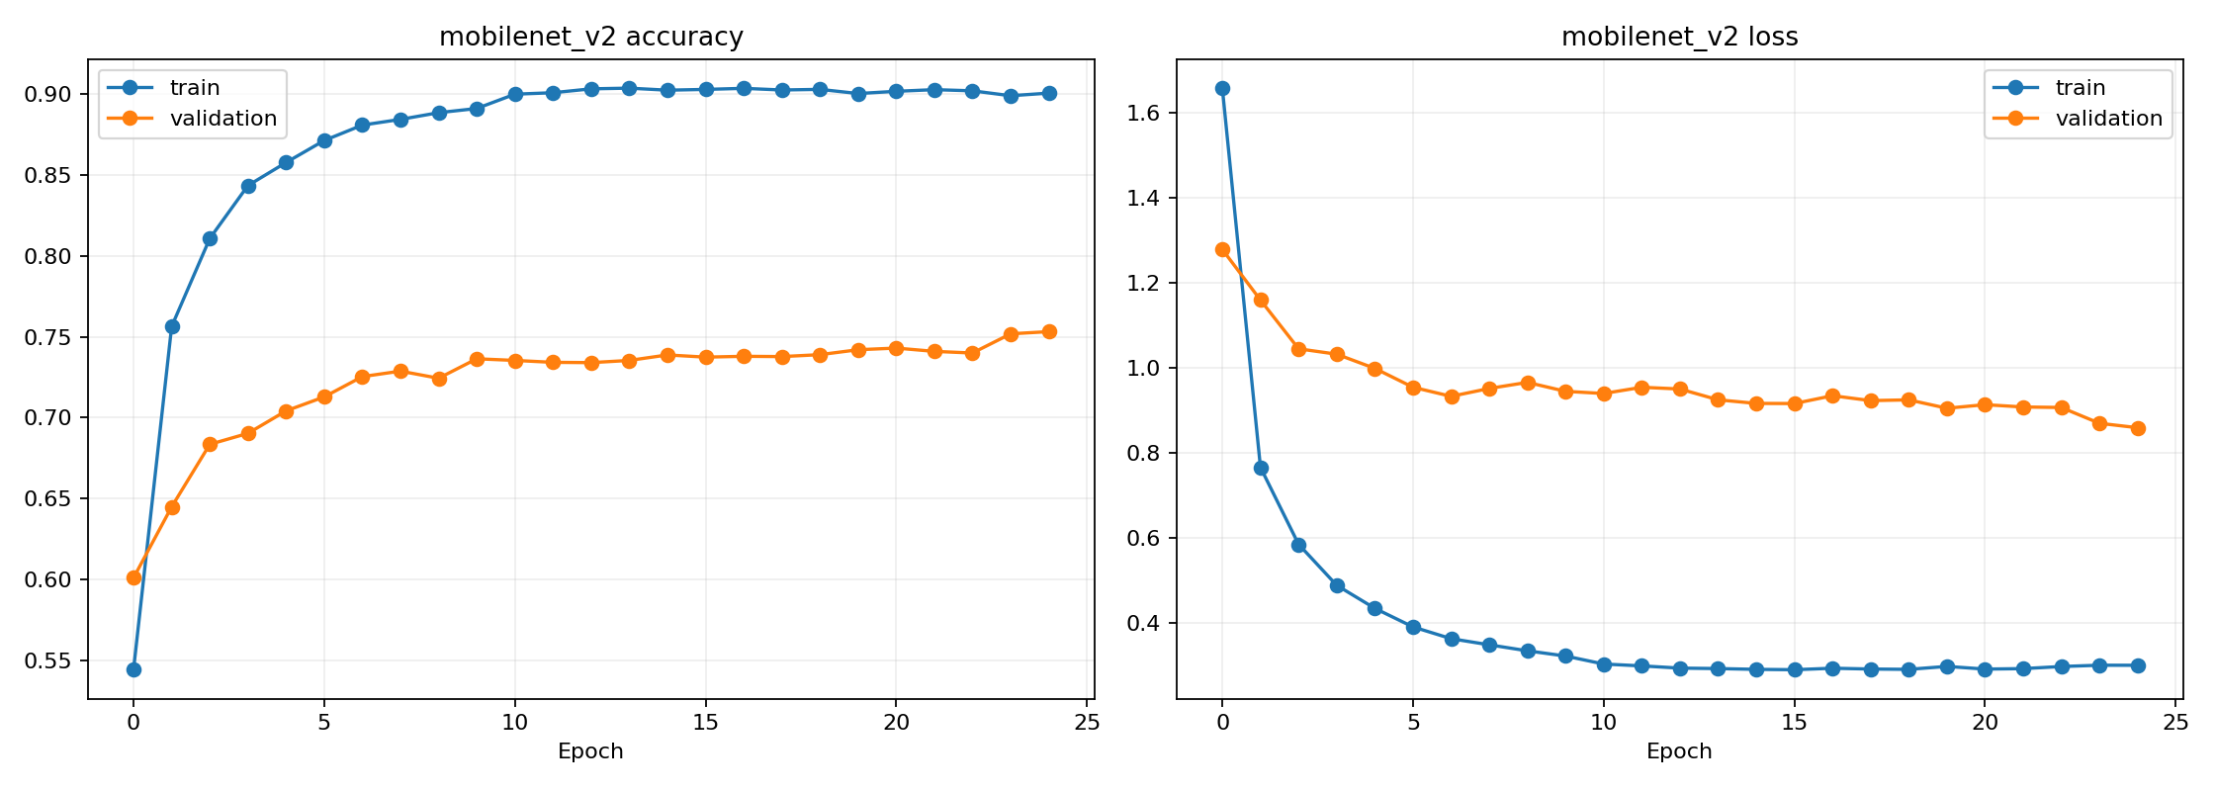
08 / INTERPRETATION
Learning curves and error analysis
Learning curves show progress over epochs. Confusion matrices reveal specific class pairs that need improvement.
Notes:
A single MobileNetV2 epoch is now visible because the plot uses explicit epoch markers. If training accuracy rises while validation falls, that suggests overfitting. For deeper error analysis, the project now saves top confusion pairs and a top-confusions plot.

Slide 10

09 / USABILITY
Explainable prediction and live demo
Grad-CAM
Highlights image regions that contributed to the predicted class. It helps us ask whether the model is looking at the sign instead of background noise.
Local demo: upload an image or use the webcam. The browser sends the frame to a local Keras server and receives class, top-k scores, and the heatmap.
Notes:
Grad-CAM is an explanation aid, not proof that the model reasons like a person. The heatmap is useful for debugging shortcuts. The demo server keeps model files local and intentionally does not place them in Git or the static hosted site.

Slide 11
10 / CONCLUSION
Limitations and next steps
Current boundary
Next experiment
Cropped-image classification only
Not safety-certified
Matched five-epoch M1 Metal GPU baseline
Run matched multi-epoch training with --require-gpu on a host that exposes the M1 Metal device
Add class balancing and compare learning rates
Extend to YOLO-style detection for full scenes
Viva point: a trustworthy result includes the data boundary, split strategy, metrics, errors, and limitations.
Notes:
Close by stating the boundary clearly. The current environment loads TensorFlow Metal but reports no supported GPU, so the full-data results were CPU runs. The code is GPU-ready: --require-gpu prevents an accidental CPU fallback. Mention class imbalance, cropped inputs, and the path toward detection.

