Slide 1


ISMS Security Awareness & Compliance Training
Briskon Technologies Pvt. Ltd.

Slide 2

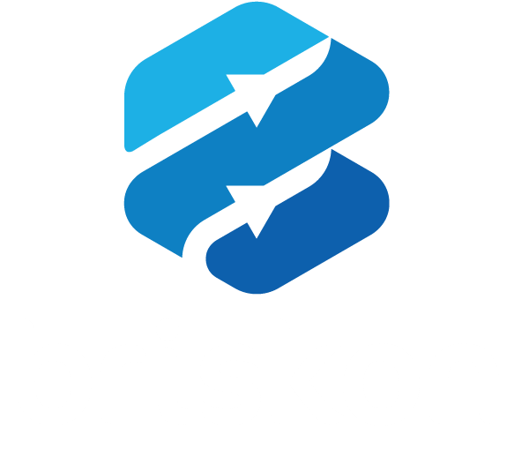
ISMS Security Awareness & Compliance Training
2026 Edition
Protecting Our Information Assets Under ISO/IEC 27001:2022
Organization: Briskon Technologies Pvt. Ltd.
Target Audience: All Personnel, Contractors, and Third-Party Users
Document ID: ISMS-TRN-001 | Version: v1.0
Presenter / Authority: Bharath G (IT Admin)
Auditor Note: Satisfies Clause 7.5 (Documented Information) versioning rules.
ISMS-TRN-001 | v1.0 | Internal Use

Slide 3
The Human Element in Cyber Security
80%+ of Data Breaches involve human error, weak credentials, or phishing.
Security is a shared operational responsibility, not just an IT department function.
Our Goal: Foster a strong security culture to protect client data, corporate assets, and business reputation.
ISO 27001 compliance supports business continuity and customer trust.
ISMS-TRN-001 | v1.0 | Internal Use

Slide 4
ISO/IEC 27001:2022 & The CIA Triad
Information Security Management System (ISMS): Our structured framework for managing data security risks.
Confidentiality — Information is accessible only to authorized personnel.
Integrity — Safeguarding the accuracy and completeness of data.
Availability — Ensuring authorized users have timely access to critical systems.
ISO Requirement: Every employee must understand and align with our Information Security Policy.
ISMS-TRN-001 | v1.0 | Internal Use

Slide 5
ISO/IEC 27001:2022 & The CIA Triad
Confidentiality — Protect Information from Unauthorized Access
What it means: Information is accessible only to authorized individuals, systems, and processes.
Why it matters: Prevents unauthorized disclosure of customer, employee, financial, and business information.
Your responsibilities:
  Use strong passwords and MFA.
  Share information only with authorized recipients.
  Follow data classification and handling requirements.
  Never upload confidential information to unapproved applications or AI tools.
Examples of threats: Phishing, unauthorized access, accidental disclosure, stolen devices.
Remember:“Only the right people should see it.”
ISMS-TRN-001 | v1.0 | Internal Use

Slide 6
ISO/IEC 27001:2022 & The CIA Triad
Integrity — Keep Information Accurate and Trustworthy
What it means: Information remains accurate, complete, consistent, and protected from unauthorized modification.
Why it matters: Incorrect or manipulated information can lead to financial loss, operational failures, and poor business decisions.
Your responsibilities:
Verify information before making critical changes.
Follow change-management and approval processes.
Protect systems and files from unauthorized modification.
Report suspicious changes or data discrepancies immediately.
Examples of threats: Malware, unauthorized edits, compromised accounts, incorrect data entry.
Remember: “Information must remain accurate and trustworthy.”
ISMS-TRN-001 | v1.0 | Internal Use

Slide 7
ISO/IEC 27001:2022 & The CIA Triad
Availability — Ensure Information Is Accessible When Needed
What it means: Authorized users can access systems and information when required for business operations.
Why it matters: System outages can disrupt customers, employees, revenue, and critical business processes.
Your responsibilities:
Report outages and system failures promptly.
Follow business continuity and disaster recovery procedures.
Protect devices and accounts from compromise.
Participate in backup, recovery, and continuity exercises when required.
Examples of threats: Ransomware, hardware failures, network outages, power disruption, denial-of-service attacks.
Remember: “The right information must be available at the right time.”
ISMS-TRN-001 | v1.0 | Internal Use

Slide 8
Individual Accountability Under Clause 7.3
Comply with all established security policies and SOPs.
Protect credentials, devices, and client information.
Report potential security threats or incidents immediately.
Policy violations can expose the organization to legal liabilities, data loss, and client breach penalties.
Disciplinary actions up to contract termination may apply, as defined in HR policies (Annex A 6.4).
ISMS-TRN-001 | v1.0 | Internal Use

Slide 9
Protecting Digital Identities
Principle of Least Privilege: Access is granted only to systems required for your job role.
Password rules: Use 12–16+ character passphrases or approved password managers.
Never reuse work passwords across personal accounts.
Zero Password Sharing: Never share credentials with colleagues, managers, or IT staff.
MFA is mandatory on Google Workspace, GitHub, and internal portals. Always verify authenticator prompts.
ISMS-TRN-001 | v1.0 | Internal Use

Slide 10
Securing Laptops & Workstations
Lock screens every time you step away: Win + L / Cmd + Ctrl + Q.
Clean Desk & Clear Screen: Do not expose physical documents, credentials, or post-it notes.
Clear whiteboards and desk surfaces at the end of the workday.
Use company-issued devices only for authorized business tasks.
Never connect to unencrypted public Wi-Fi without an active corporate VPN.
Ensure full-disk encryption (BitLocker) is enabled.
ISMS-TRN-001 | v1.0 | Internal Use

Slide 11
Email, SMS, and Chat Security
Common attack vectors: Phishing (Email), Smishing (SMS), and Impersonation (Slack/Teams).
Red flags: domain misspellings, urgency and pressure, suspicious links, unexpected attachments.
Watch for requests involving wire transfers, gift cards, password resets, or sensitive data.
Treat unexpected .exe, .zip, or macro-enabled files with caution.
Golden Rule: Verify unusual requests through an independent secondary channel.
ISMS-TRN-001 | v1.0 | Internal Use

Slide 12
Defending Against Targeted Executive Fraud
What is BEC? Attackers impersonate executives, vendors, or clients to manipulate financial transactions or data.
Example: “Change vendor bank account details on this pending invoice.”
Example: “Send over the employee salary spreadsheet urgently.”
Mandatory: Dual authorization for bank account updates or payments.
Use verbal confirmation via verified phone numbers for sensitive requests.
ISMS-TRN-001 | v1.0 | Internal Use

Slide 13
Classifying & Protecting Information
PUBLIC — Approved for marketing or external release.
INTERNAL — Operational documents, internal newsletters, team guidelines.
CONFIDENTIAL / RESTRICTED — Customer PII, source code, financial records, API keys, passwords.
Never upload confidential company code or client data to unapproved public AI tools.
Store and share files only through approved cloud drives (Google Drive / OneDrive / SharePoint).
Do not store customer data on local desktop drives or personal cloud drives.
ISMS-TRN-001 | v1.0 | Internal Use

Slide 14
DevSecOps & Operational Security
Technical, Product & Operations Staff
Secure Coding: Follow OWASP Top 10 guidance; never hardcode secrets or tokens in repositories.
Peer Code Reviews: Secondary approval is required before merging into main branches.
Pipeline Security: SAST/DAST security scans must pass before production releases.
Change Approvals: Production deployments require documented Jira tickets and rollback plans.
ISMS-TRN-001 | v1.0 | Internal Use

Slide 15
Managing ICT Supplier Risks
Our security extends to SaaS tools, cloud vendors, external contractors, and libraries.
All new software, SaaS platforms, or vendor tools require CISO / Security risk assessment before purchase.
NDAs and DPAs are required before granting data access, where applicable.
Keep open-source software libraries updated to address supply-chain vulnerabilities.
ISMS-TRN-001 | v1.0 | Internal Use

Slide 16
Operational Resilience & Backups
Automated daily backups are maintained for core databases, code repositories, and file systems.
RTO (Recovery Time Objective): Target maximum allowable downtime.
RPO (Recovery Point Objective): Target maximum acceptable data loss window.
During disruptions: follow emergency notification channels and report outages immediately.
Use designated backup communication tools during failover drills.
ISMS-TRN-001 | v1.0 | Internal Use

Slide 17
How to Report Security Incidents
What counts: lost/stolen company device; misdirected sensitive email; suspicious link or credential entry; malware pop-ups or unexpected system behavior.
Contact: itadmin@briskon.com
Slack/Teams: #security-incidents
NO-BLAME CULTURE: Immediate reporting reduces impact and enables swift containment.
ISMS-TRN-001 | v1.0 | Internal Use

Slide 18
Your Daily Security Checklist
Set strong passwords and use MFA everywhere.
Lock your workstation whenever you leave your desk.
Be cautious with external links, attachments, and urgent requests.
Store confidential documents in official, encrypted cloud storage.
Report lost devices, phishing attempts, or anomalies immediately.
ISMS-TRN-001 | v1.0 | Internal Use

Slide 19


Thank You
ISMS-TRN-001 | v1.0 | Internal Use

