Slide 1

The Python community at BGS
> Who we are and what we do

Slide 2
Who we are?
Users of the Python programming language
Scientists/software developers/tinkerers
Experienced developers → complete beginners

Slide 3
Why Python?
Easy to read – easy to collaborate
Huge international user community
Multiple extensions (packages)
Geo-friendly (think ArcGIS, QGIS…)
Growing usage
A good “first language”
Notes:
https://medium.com/@mindfiresolutions.usa/advantages-and-disadvantages-of-python-programming-language-fd0b394f2121

Slide 4
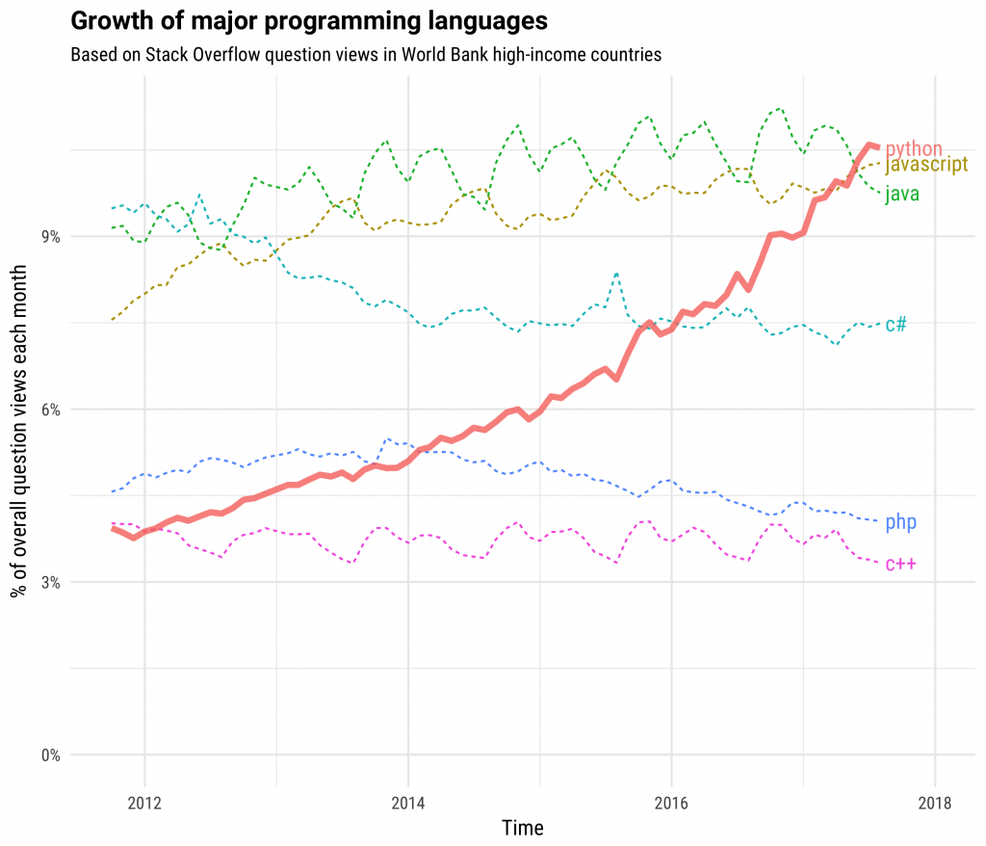
Notes:
Source: https://stackoverflow.blog/2017/09/06/incredible-growth-python/

Slide 5
What do we do?
Bring people together ☺
Provide a space for beginners to get started
Work through problems together
Expose people to new techniques
Meet every few weeks
Very flexible in what we discuss

Slide 6
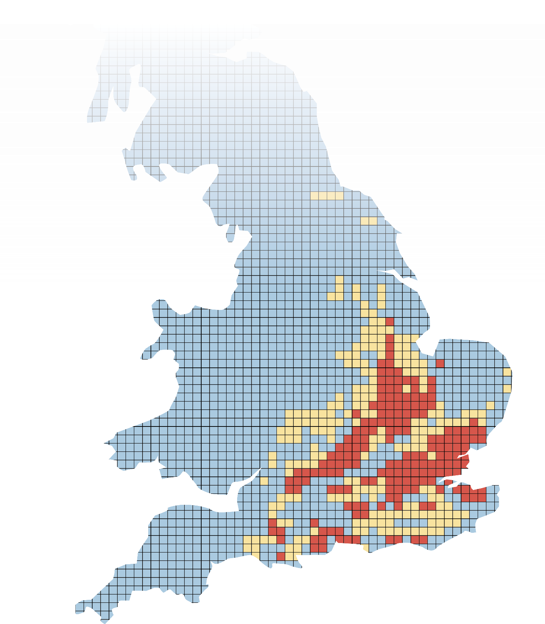
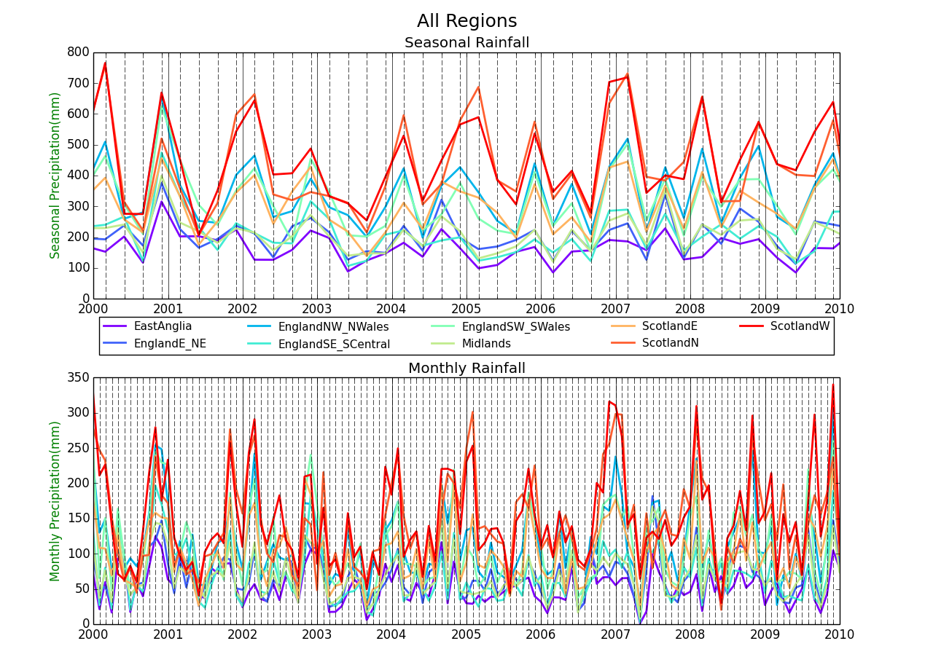
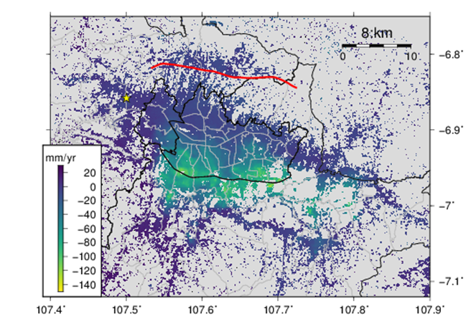
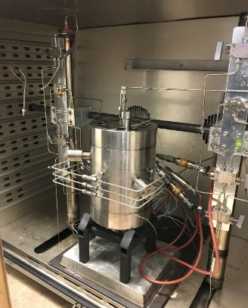
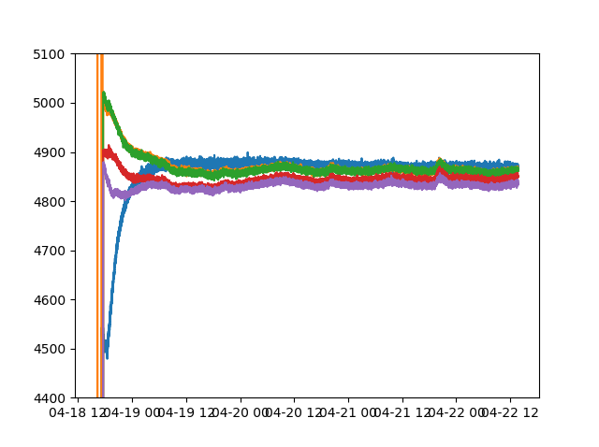
Analysing climate records
Python applications at BGS
Hazard product
development
Laboratory data analysis
Remote sensing

