Slide 1
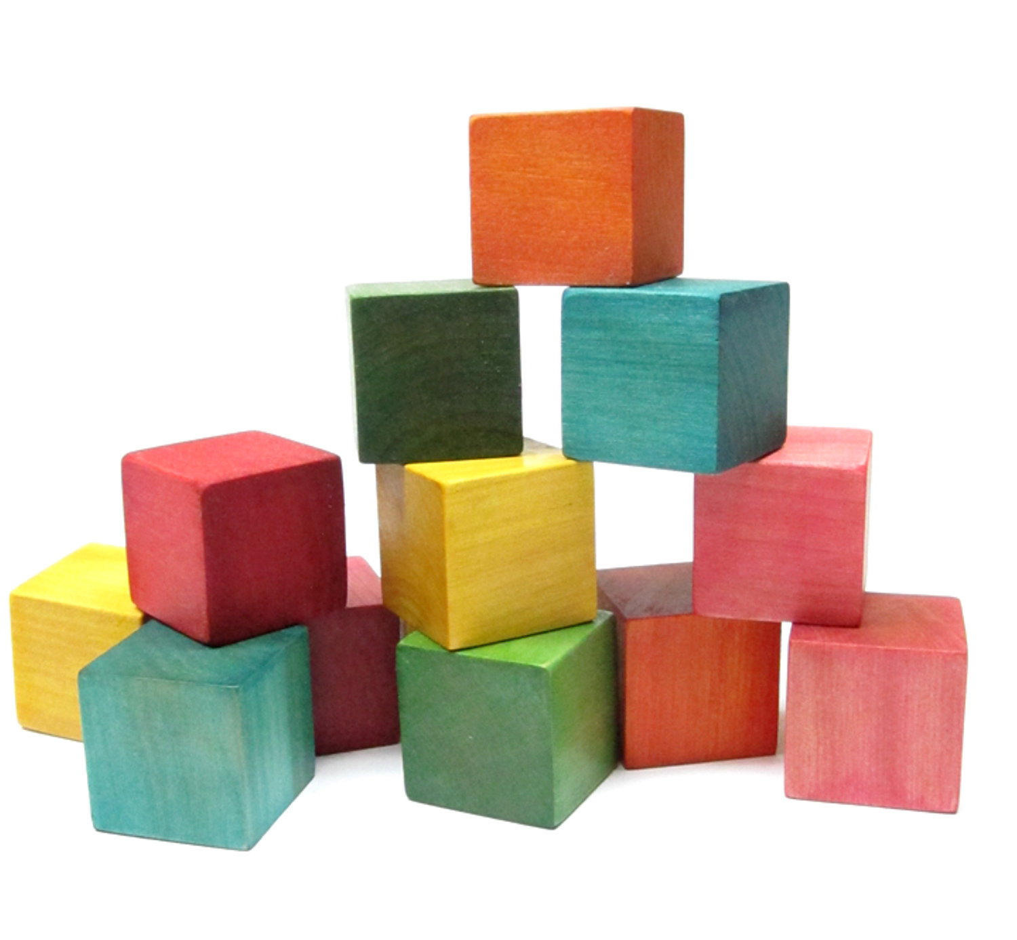
Streamlining development for analysis, research and product development
http://clipart-library.com/clipart/zTX5yRByc.htm

Slide 2
Why is this important?
Research
Analysis
Product development
Team working
Reproducibility
Transparency
Legacy
Accessibility
Time travel for when you screw up
Collaboration

Slide 3

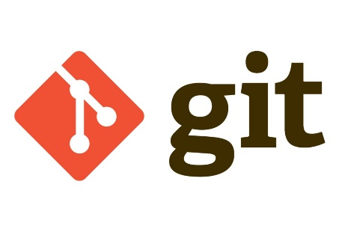



What are we talking about?
Foundations are from software develpment
Version control – keep track of what you’ve got and what version it is
Lots of options – Git, Subversion, BitBucket etc.

Slide 4
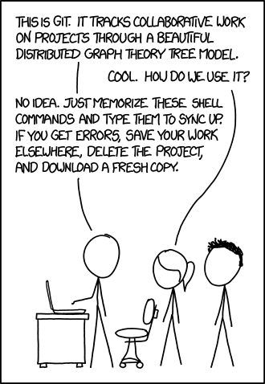
Don’t drown in it
Git is the underlying software
Github is the facebook of Git
Gitlab is the more beefed up version of Github – generally less open
Git commands all the same
Accept the learning curve –
do a course

Slide 5
Keeping it simple
Don’t have to worry about branching, forking, merging
Keep it basic – get your code there and learn as you go
Start every project with a dedicated folder that is your “git repo”
Every folder should have a README

Slide 6
Example: ERCG dataset
https://kwvmxgit.ad.nerc.ac.uk/chrwil/ercg-emergency-service-datasets

Slide 7
Example: Toprock
https://kwvmxgit.ad.nerc.ac.uk/chrwil/toprock

Slide 8
Next steps
Software carpentry git course:
https://swcarpentry.github.io/git-novice/
Git basics
https://git-scm.com/book/en/v1/Getting-Started-Git-Basics
Also a BGS course – if interested, get signed up through training@bgs.ac.uk
Ask around too – loads of people here at BGS are using it already

