Slide 1

BMI Calculator App
RNS INSTITUTE OF TECHNOLOGY
BENGALURU - 98
DEPARTMENT OF INFORMATION SCIENCE & ENGINEERING
Presentation on Internship
Britisha Binod Prasad
USN: 1RN18IS034
ENMAZ Engineering Services Pvt. Ltd.
Internal Guide
Mrs. Shreedevi Suresh
Asst. Prof, Dept of ISE, RNSIT
External Guide
Mr. Akshay D R
Co-founder, ENMAZ Bangalore

Slide 2
AGENDA
Abstract
About the Company
Introduction
Literature Survey
Requirements
System Design
Detailed Design
Implementation
Testing
Conclusion and Future Enhancements
References
Q & A

Slide 3
ABSTRACT
BMI is a measurement of a person's leanness or corpulence based on their height and weight, and is intended to quantify tissue mass.
It is widely used as a general indicator of whether a person has a healthy body weight for their height.
With this BMI Calculator, Body Mass Index (BMI) can be calculated and evaluated based on the relevant information on body weight, height and gender.

Slide 4
About the Company
Enmaz has a simple yet robust solution that helps any Industry / Factory digitize their work floor in no time. The products offered will help in remote monitoring, controlling and also analyzing any machine parameter or process
Reliable Hardware : Time tested, high quality, designed, developed and manufactured in India. 18 months of replacement warranty.
Innovative Software : Easy to use, highly scalable and cloud-based IoT platform. Dynamic dashboard, Reports, Remote control, Email & SMS alerts.

Slide 5
INTRODUCTION
Body mass index (BMI) is a measure of body fat based on height and weight that applies to adult men and women.
With this BMI Calculator, Body Mass Index (BMI) can be calculated and evaluated based on the relevant information on body weight, height and gender.
Overweight and obesity are risk factors for diseases such as hypertension, heart disease and diabetes, hence it’s very important to find healthy weight by keeping the BMI in check.

Slide 6
LITERATURE SURVEY
Weight management is an effective strategy for controlling chronic disease and maintaining physical health and research on this topic has risen dramatically over the past four decades.
The present systematic literature review aimed to identify existing evidence on the efficacy of mobile health technology in facilitating weight management behaviors, such as healthy food consumption and physical activity.
The potential of BMI calculator apps in facilitating weight loss/gain lies in their ability to increase treatment adherence through strategies such as self-monitoring. This help will help to monitor the body mass index for maintaining healthy weight.

Slide 7
Requirements
The Hardware requirements are very minimal and the program can be run on most of the machines.
Processor : Pentium 4 Processor
Processor Speed : 2.4 GHz
RAM : 2 GB
Storage Space : 40 GB
The software requirements are very minimal and the program can be run on the machines with these requirements satisfied:
Editor : Visual Studio Code
Operating System : Windows/Mac OS
IDE : VS Code
Backend Tool : JSON

Slide 8
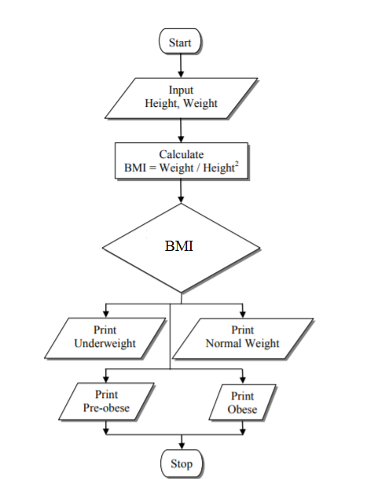
System Design
Flow Chart :

Slide 9
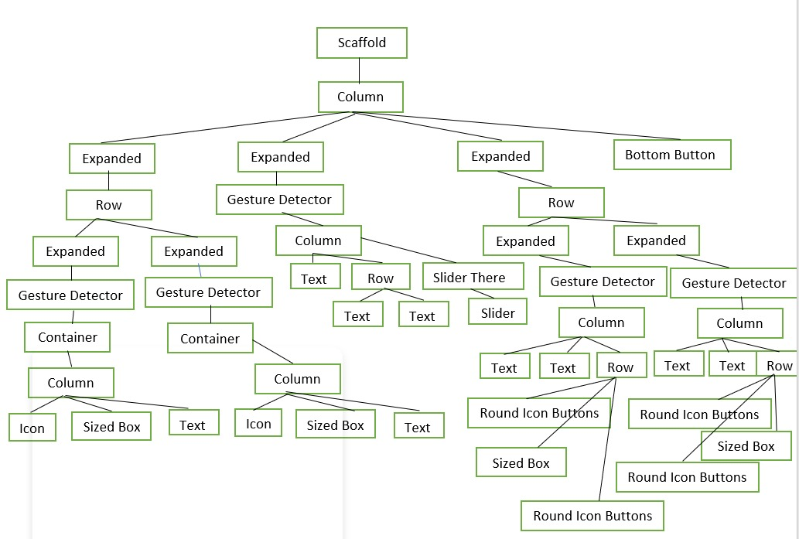
Detailed Design
Input Page Widget Tree

Slide 10
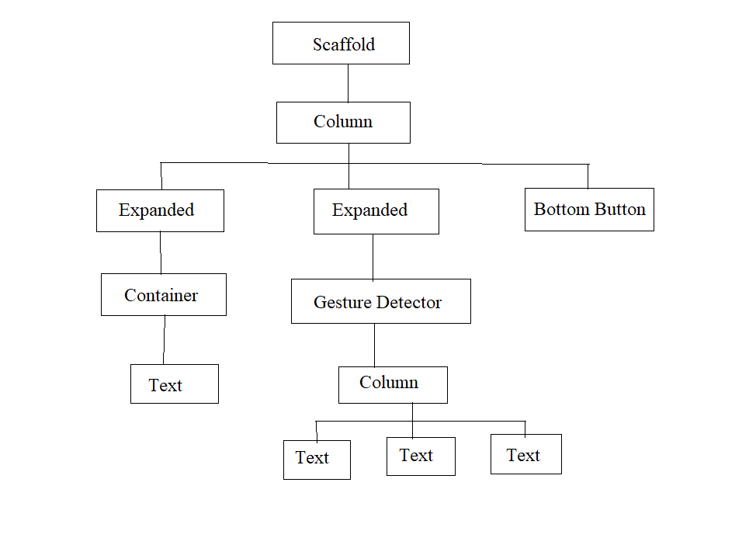
Detailed Design Contd.
Results Page Widget Tree

Slide 11
Implementation / Coding
Main.dart
import 'package:bmi_calculator/screens/input_page.dart';
void main() => runApp(BMICalculator());
class BMICalculator extends StatelessWidget {
@override
Widget build(BuildContext context) {
return MaterialApp(
theme: ThemeData.dark().copyWith(
primaryColor: Color(0xFF0A0E21),
scaffoldBackgroundColor: Color(0xFF0A0E21),
),
home: InputPage(),
);
}
}

Slide 12
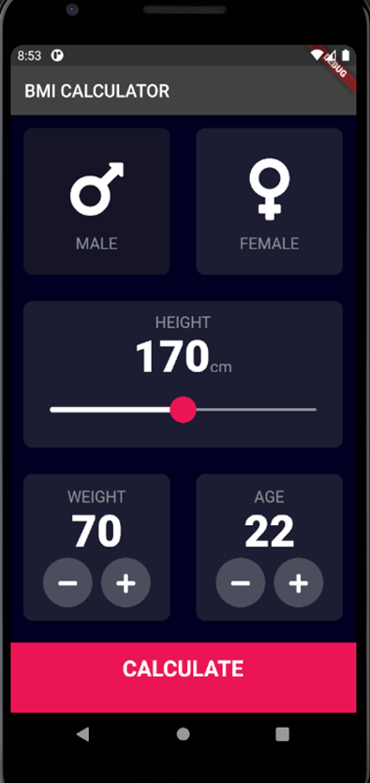
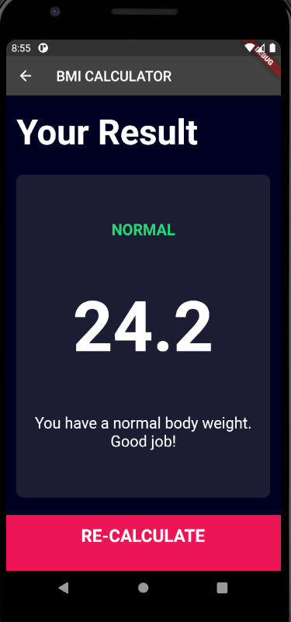
Design

Slide 13
CONCLUSIONS
An application that calculates body mass index on different categories including underweight, normal weight, pre-obese and obese is needed by the health-conscious community.
Being overweight or underweight can have significant health effects.
While BMI is an imperfect measure of healthy body weight, it is a useful indicator of whether any additional testing or action is required.
Although BMI is a widely used and useful indicator of healthy body weight, it does have its limitations. BMI is only an estimate that cannot take body composition into account.

Slide 14
Future Enhancements
The ideal weight after the BMI index calculation can be shown. So that the user knows how many kgs need to be gained or lost to be ideal weight.
A meal planning feature can be added to help people get an idea of what they should eat to gain/lose weight to get to their ideal weight.
A chart can be added to keep a track of changes in BMI over the months.
A login feature can be added for the app to be used by multiple users and save their progress under their own accounts.

Slide 15
REFERENCES
1. https://rubygarage.org
2. www.hackernoon.com
3. www.ncbi.nlm.nih.gov
4. www.ispo.com
www.github.com
https://www.researchgate.net/publication/311480903_The_Design_and_Development_of_BMI_Calc_Android_Application
http://www.ijirset.com/upload/2017/october/158_BMC%20CALCULATOR_IEEE.pdf

Slide 16
Question and Answer

Slide 17
THANK YOU

