Slide 1



Multi-Tier accent classification for improved transcribing
Damiano Nicastro & Frankie Inguanez
Institute of Information & Communication Technology
MCAST, Paola, Malta
10th IEEE International Conference
On Consumer Technology

Slide 2
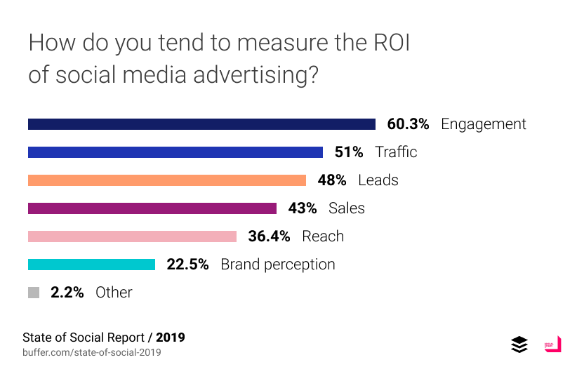
Problem Definition
Motivation: Public opinion can shape sentiment towards brand
Sources: user feedback; public opinion on products or services;
Concerns: illegal use of merchandising and competitive research
Problem: big data problem (volume, velocity, variety, validity)
Notes:
Nowadays, the online business reputation, is an essential aspect of the company branding given the competition in today’s market.
And, there are various reasons why a company would monitor the reference made of it brand.
Such reasons include
the gathering of user feedback
public opinions on products or services
illegal use of merchandising
and, competitive research
However, due to the surge of video sharing media platforms, such as “YouTube”
It has become nearly impossible to keep track of the mentioning of the brand given the big data problem.

Slide 3
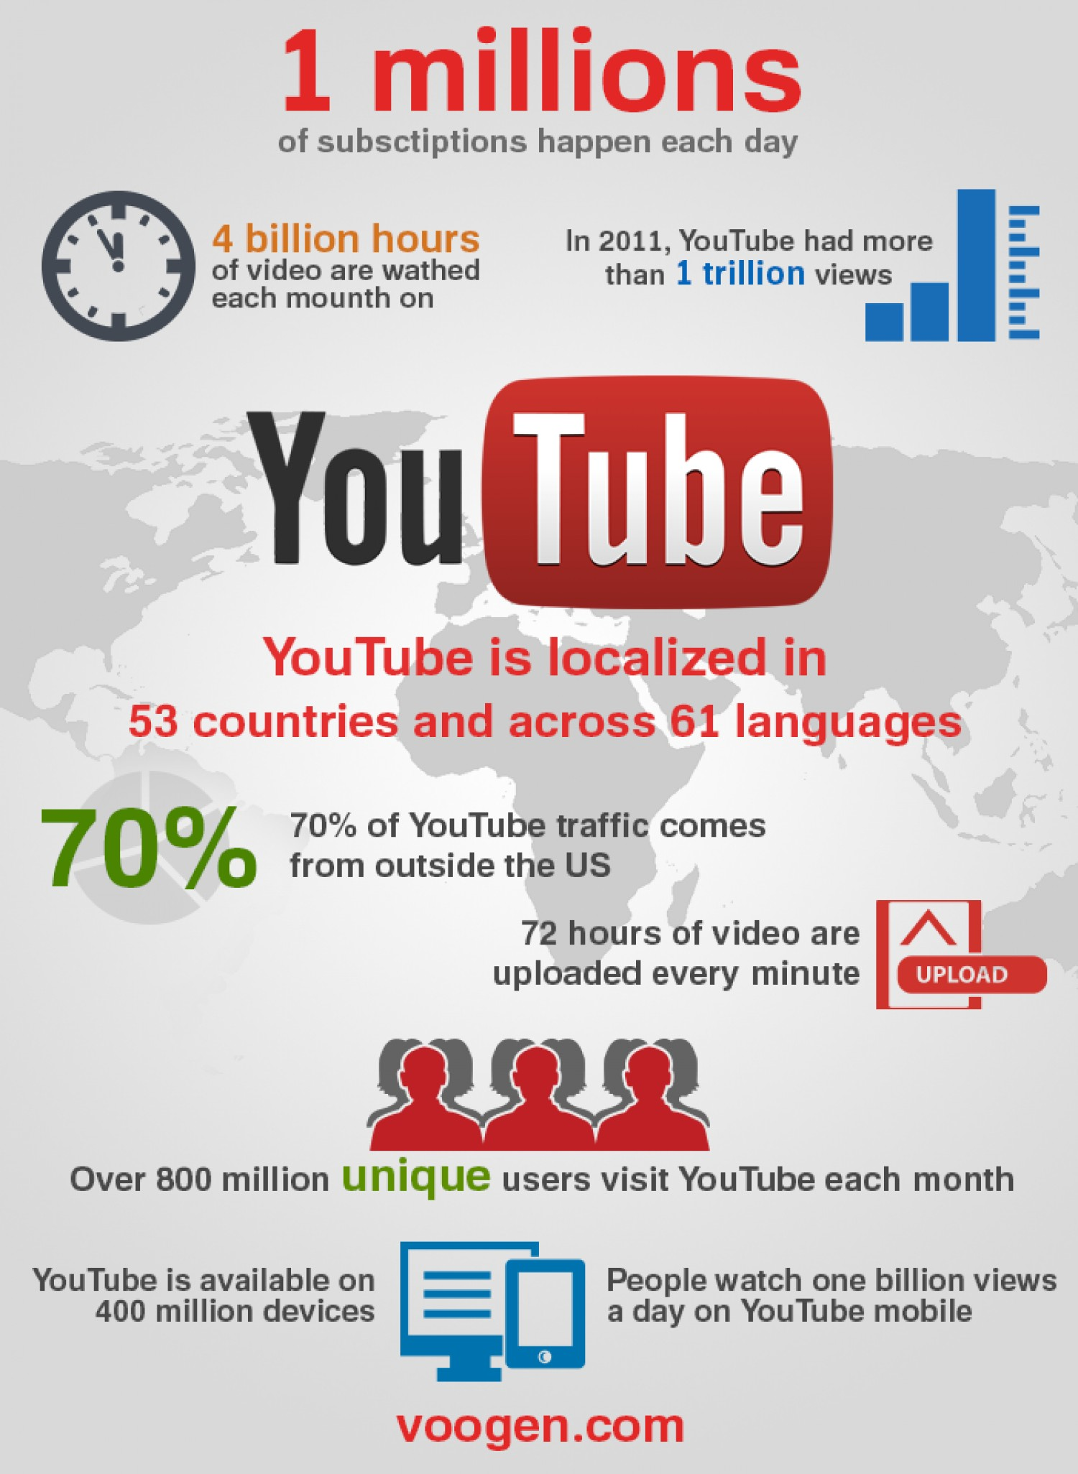
Problem Definition
As of 2015, 80 million to 3 billion videos hosted on such platform (Vonderau, 2016).
62% of businesses use “YouTube” to share their brand.
90% of consumers say that such media platform helps them discover new brands State of Social 2019 (2019).
The challenge is detect such mentioning of the brand before the content goes “viral”.
Accents play a crucial part in transcribing using ASR engines (Damiano and Inguanez, 2019).
https://visual.ly/community/Infographics/social-media/how-get-lots-youtube-views-fast
Notes:
Our primary focus are videos hosted on “YouTube”.
A study presented by Vonderau, shows that as of 2015 there where nearly 3 billion videos hosted on such platform.
Another survey carried out by state of social says that 62% of the business use “YouTube” to share their brand marketing.
While 90% of the consumes ay that “YouTube” helped them discover new brands.
Therefore, the challenge here, is to detect the mentioning of the brand before the content goes “viral” and gathers
Following our previous research on brand monitoring, it has become clear that accents do indeed affect the transcription process using speech recognition engines.
Thus, an automated and scalable solution is needed to monitor brand identifies
Most of the ASR engines are trained for American English and do not perform well on heavy accents. Therefore, the aim of this research intends to focus on the recognition and catering of accents within the English spoken language.

Slide 4
Hypothesis & Questions
It is possible to automate the detection and recognition of heavy accents in order to enhance the transcribing of spoken language
What factors need to be considered in datasets for proper training of models for detection and recognition of accents?
What are the determining factors of varying degrees of accents?
How can an accent recognition model be integrated in ASR for enhancement of speech transcribing?
Notes:
Therefore, this research intends to focus on the recognition and catering of accents within the English spoken language and we hypothesise that…
To address the hypothesis, we ask these 3 research questions to identify the determining factors of accents and how ASR can be enhanced with our research

Slide 5
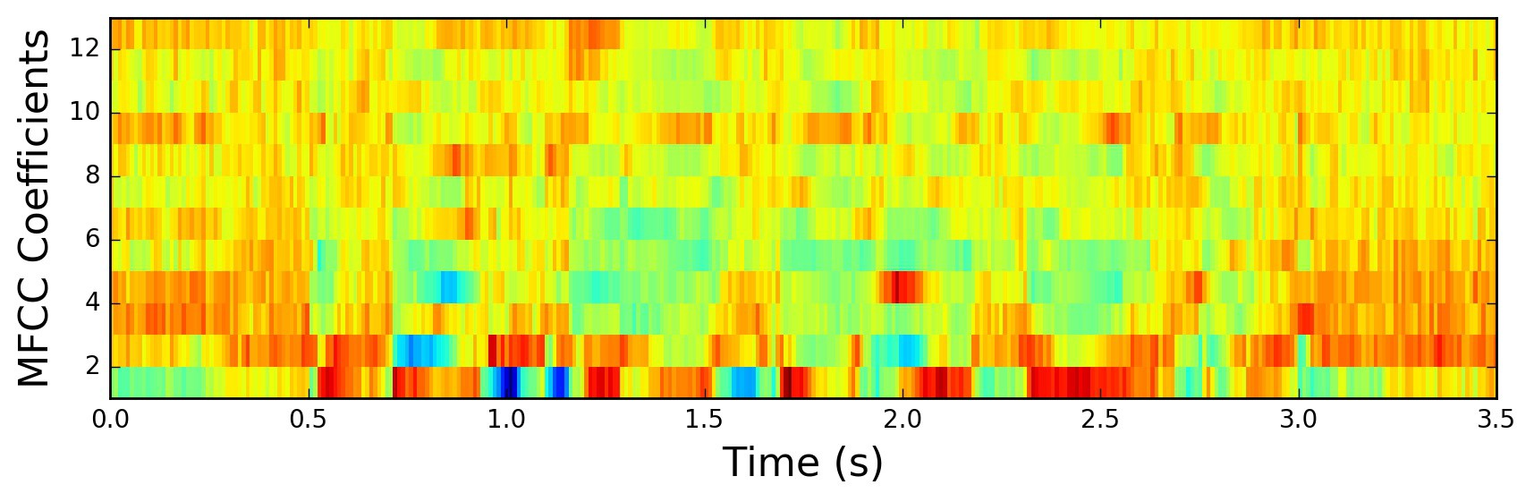
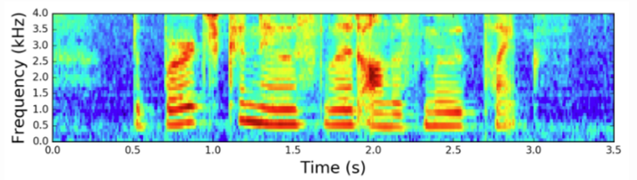
Literature: Feature Extraction
MFCC
MFCCs are widely used in the area of speech processing due to its robustness (Mammone et al., 1996, Reynolds, 1994, Hasan et al., 2004).
Represents the short-term power spectrum of sound and is more persistent with the characteristics of the ear’s auditory system
Spectrogram
Provides a visual display of the temporal and spectral characteristics
Widely used as a tool for understanding the acoustic properties and speech analysis (Zue and Lamel, 1986).
Notes:
The first steps in nearly every speech recognition and accent recognition system is the feature extraction.
There are various types of feature extraction techniques
But the most common are Mel-Frequency cepstral coefficients and Spectrogram.
Basically, with such technique’s important information from an audio sample are extracted and computed into an 2 dimensional array, or a 2 dimensional image for classification.
Then, features are fed into some sort of classifier/model for classification

Slide 6
Literature: Classifiers/Models
PHONOTACTIC SYSTEMS
DEEP NEURAL NETWORKS
ACOUSTIC SYSTEMS
Phone Recognition Language Modelling (PRLM)
Parallel Phone Recognition Language Modelling (PPRLM)
Gaussian Mixture Model – Universal Background Model (GMM-UBM)
Gaussian Mixture Model – Support Vector Machine (GMM-SVM)
I-Vector
Hidden Markov Model (HMM)
Convolutional Neural Network (CNN)
Recurrent Neural Network (RNN)
Notes:
During research it was noticed that there was a timeline of techniques used in this area
Starting from the phonotactic systems
Mainly based on phoneme recognition with language modelling
Acoustic systems - a combination of model and classifiers
Then, due to the advancements in processing power deep neural networks have emerged
The most frequent being CNN and RNN.

Slide 7
Literature : AID Results
System | ACC
GMM-UBM | 61.13%
GMM-SVM | 76.11%
GMM-uni-gram | 72.28%
GMM-bi-gram | 57.83%
Acoustic-fused | 77.32%
Phonotactics | 82.14%
Acoustic-Phonotactic-fused | 89.6%
ACCDIST-Cor.dist. | 93.17%
ACCDIST-SVM | 95.18%
Human | 58.24%
System | ACC
DNN + RNN (Jiao, et al., 2016) | 51.92%
CNN-VFNet (Ahmed, et al., 2019) | 70.33%
CNN (Sheng & Edmund, 2017) | 88%
CNN (Zhong, et al., 2018) | MFCC – 90% Spec – 86% Rhythm – 87% Feature M – 94%
CNN (Grigoriadis, 2019) | 96.72%
Accuracy rates by different AID systems, adapted from Hanani et al. (2013)
Notes:
Here, we can find best accuracy rates by different accent identification systems
The table found on the left side, shows different acoustic and phonotactic results which can be comparable since training was performed on the same dataset
On the other hand, the table on the right show different accuracy rates using deep neural network approaches
However, these can’t be compared since different dataset and accent combination were used.

Slide 8
Literature : Datasets
Dataset | Speakers | Utterances | Accents | Citations | Type
ABI | 280 | 855 | 14 | 28 | N
TIMIT | 630 | 6,300 | 8 | 1,918 | N
Common Voice | 50,590 | 644,120 | 16 | N/A | N & NN
WSJCAM0 | 140 | 4,400 | 4 | 346 | N
Speech Accent Archive | 2,140 | 2,140 | >100 | 132 | N & NN
Arctic CMU | 18 | 1,150 | 4 | 458 | N & NN
VoxCeleb2 | 6,000 | 1,128,246 | 6 | 168 | N & NN
Data-set comparison. Accent types: Native (N); Non-Native (NN)
Notes:
So, once we discovered which feature extraction techniques are widely used, and explored different accent identification technique
Next step was to compare and discuss the available datasets that were used or can be used for this research area.
Therefore, we plotted a table with a total of 7 datasets and compared the various features of each.

Slide 9
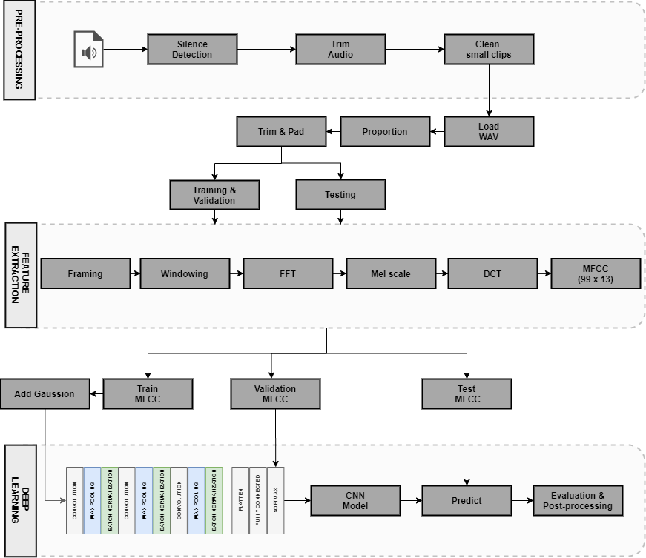
Methodology
Datasets
Common Voice
WildCat Corpus
Custom “YouTube”
Pre-processing
Silence Detection
Split/Trim/Clean
Data Augmentation (Gaussian Noise)
Feature Extraction
Mel-Frequency Cepstral Coefficients
Classifier
Convolutional Neural Network
Evaluation
Confusion Matrix and respective metrics
Notes:
So, the proposed system is mainly composed on this pipeline split in 3 phases.
In the pre-processing stage, all the audio files were converted to WAV and sampled at 16,000 Khz mono.
Then we used silence detection to segment the audio chucks.
Split the audio files into a maximum of one second window and in an automated process, clips shorter than 0.5 seconds were cleaned from the dataset.
To train the models, first the audio files are loaded, proportioned according to the label with the least values, trimmed again by adding random silence so to ensure that all audio files had uniform length and split for training, validation and testing.
At this stage, the WAV file is just a vector representing the sound wave amplitude. Therefore, we apply Mel-frequency coefficients to every audio file.
Now that we have a two-dimensional image representing a second of the human vocal range, thus shifting from sound processing to image classification, the training set is duplicated and random gaussian noise is added to have a different variation of vocal frequency per speaker.
Finally, the data is fed into a 3 layered convolutional neural network and evaluated using confusion matrix and other respective metrics

Slide 10
Methodology
Stage 1: Calibration dataset
Calibrating the proposed system on WildCat Corpus
Three accents (Korean, English, Chinese)
Compare our results with Sheng & Edmund
Stage 2:
Novel dataset
Trained and evaluated the system on the “validated” and “train, val, test” files provided in the Common Voice dataset
“Validated” – 14 accents
“Train, val, test” – 12 accents
Stage 3:
Real-world dataset
Proposed a hierarchical model trained on both validated and train, val, test files (Jiao et al. (2016)
Tested on real-world unseen data from “YouTube”.
Notes:
Our system was evaluated on three different stages
Stage 1
In stage one, we calibrated our system on the Wildcat corpus, and used the same accent labels as sheng and Edmund, so to compare our results with theirs
Stage 2
Using the proposed model and pipeline in stage 1, we evaluated a novel dataset the common voice which according to the literature presented, it received little attention to accent recognition
This dataset has two files, the validated and train, test and val.
The difference is that the validated can contain the same speaker in both splits, while the other files are already split, and the same speaker cannot be in both train or test. Furthermore, the train, dev and test files are much smaller in volume.
Stage 3
Finally, following the recommendation f Jiao et al, we wanted to test our system on reel unseen data and proposed a hierarchal model trained on both validated and train, val, test, and tested on a custom YouTube dataset containing 22 videos

Slide 11
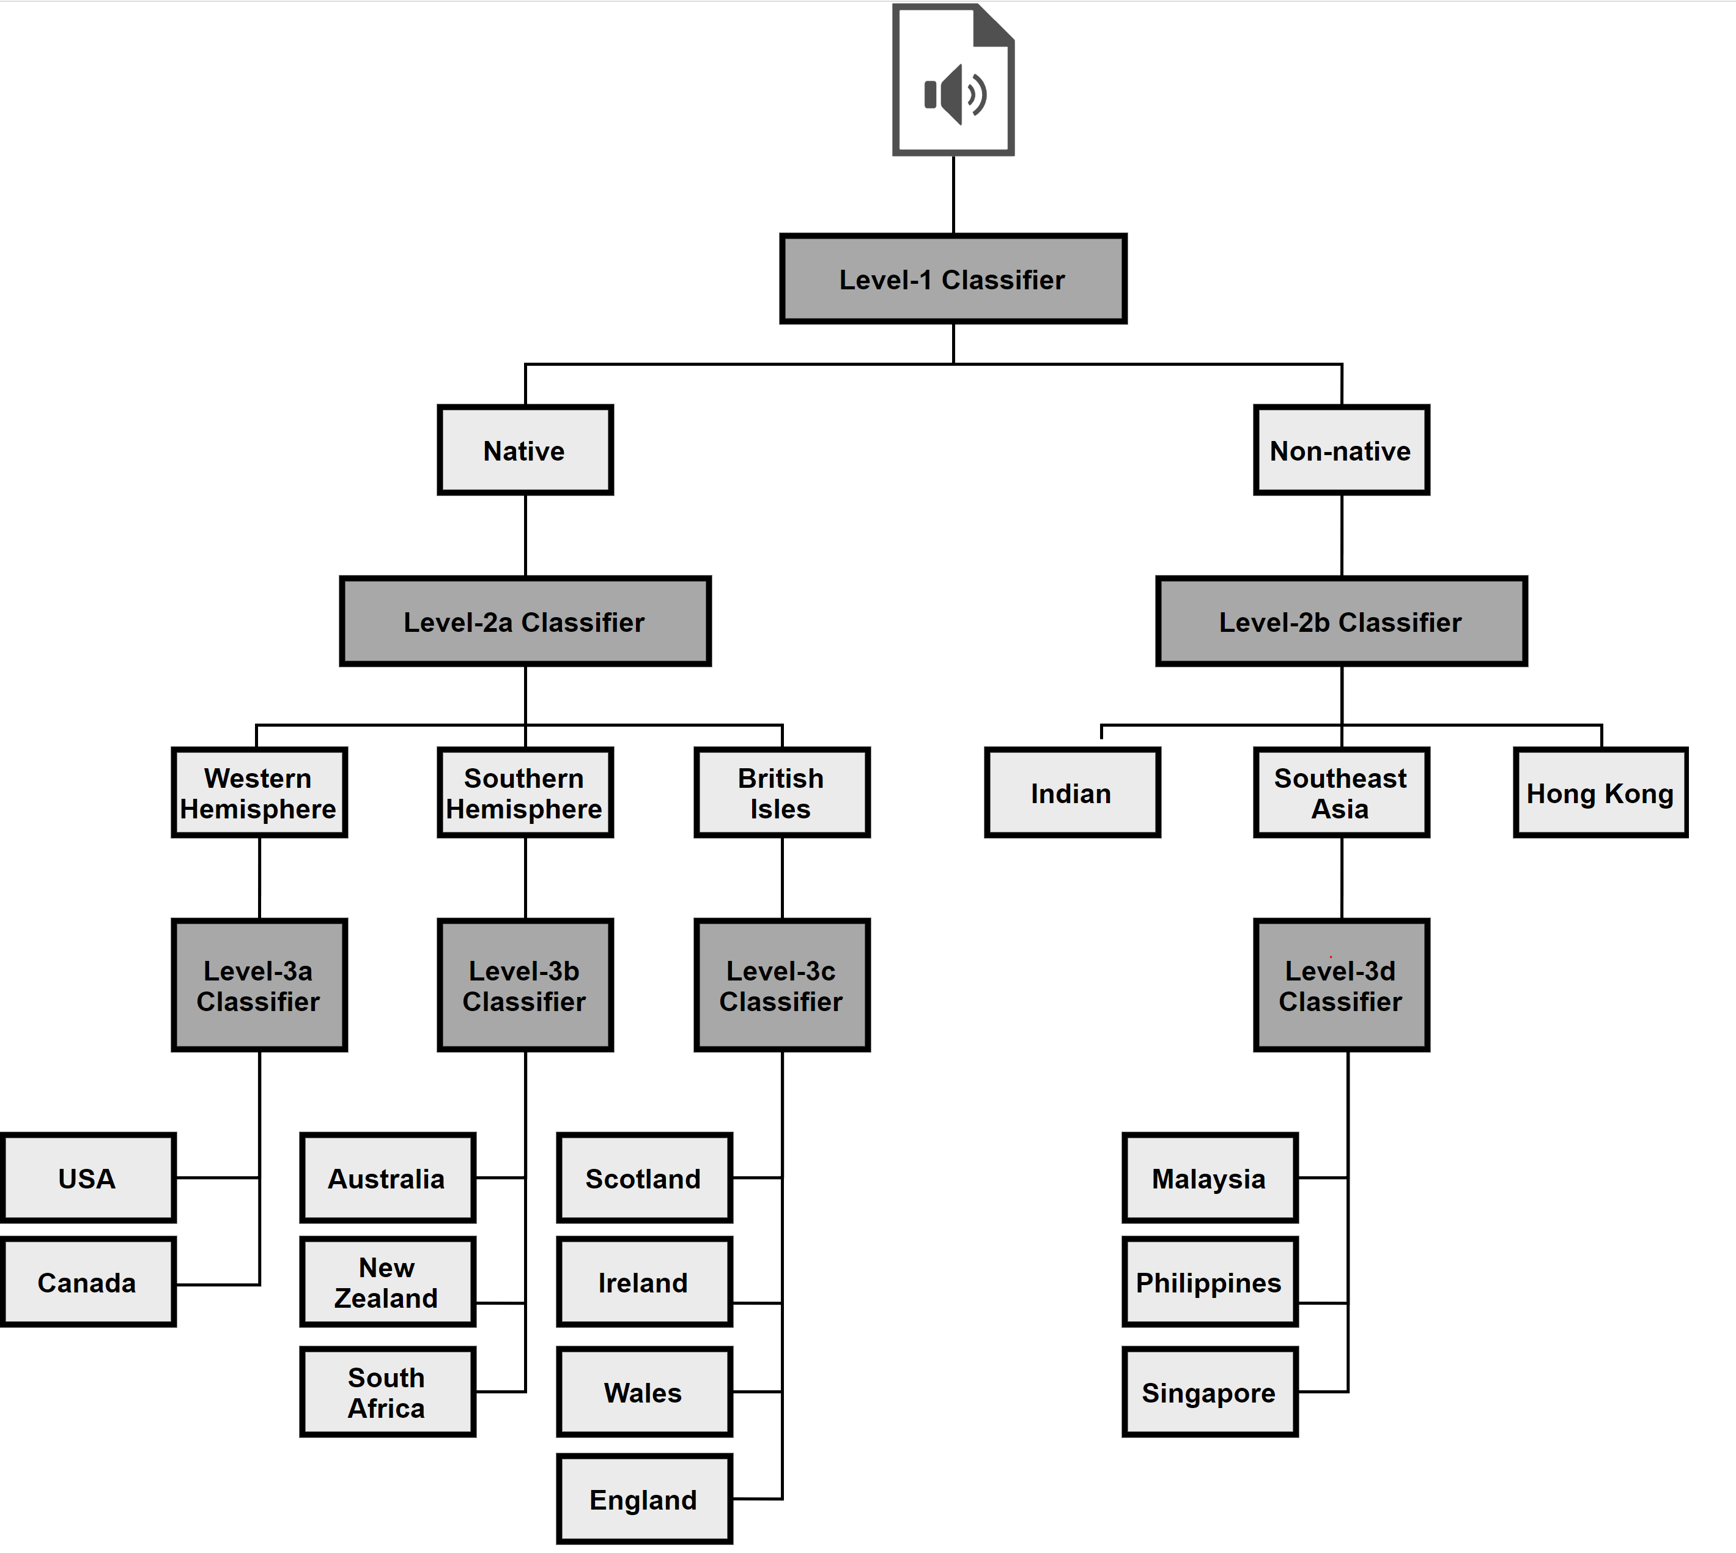
Methodology
Datasets
Pre-processing
Feature Extraction
Classifier
Convolutional Neural Network
Evaluation
Notes:
This diagram shows our proposed ensemble of classifiers with 3 different levels
Firstly, at level-1 starting with a native or non-native classification
In level-2 classifiers the accents are split based on the location of the continents/hemispheres
Finally, arriving at level-3, the classifiers have to predict which is the target accent label

Slide 12
Results : Stage 1
The importance of further data-pre-processing, data cleaning and data augmentation
Misclassified audio files
Crosstalk
Non-audible sounds
Background noise
Managed to achieves the same outcomes as Sheng & Edmund
# | Labels | Accuracy
1 | ENGLISH, CHINESE, KOREAN | 71%
2 | ENGLISH, CHINESE, KOREAN | 84%
3 | ENGLISH, CHINESE, KOREAN | 88%
Notes:
Following the results in stage 1, we noticed the accuracy per test had increased.
Test one and two shows the importance of pre-processing on the dataset where there is a noticeable increase of 13% accuracy
The final test illustrates clearly the importance of further cleaning of the dataset, modifications to the CNN and data augmentation
Upon manual inspection of the misclassified audio files we noticed the following issues
Crosstalk
Non-audible sound
Background noise
Finally, we were pleased with the results and because we achieved the same accuracy as sheng and Edmund.
Therefore, we proceeded with the second stage of testing

Slide 13
Results : Stage 2
“Validated”
“Train, val, test”
# | Labels | Accuracy
14 | AF, AU, CA, EN, HK, IN, IE, MY, NZ, PH, SC, SG, US, WA | 69%
13 | AF, AU, CA, EN, HK, IN, IE, NZ, PH, SC, SG, US, WA | 72%
12 | AF, AU, CA, EN, HK, IN, IE, NZ, PH, SC, US, WA | 70%
11 | AF, AU, CA, EN, HK, IN, IE, NZ, PH, SC, US | 73%
10 | AF, AU, CA, EN, IN, IE, NZ, PH, SC, US | 74%
9 | AF, AU, CA, EN, IN, IE, NZ, SC, US | 67%
8 | AF, AU, CA, EN, IN, NZ, SC, US | 65%
7 | AF, AU, CA, EN, IN, NZ, US | 69%
6 | AU, CA, EN, IN, NZ, US | 68%
5 | AU, CA, EN, IN, US | 68%
4 | AU, EN, IN, US | 71%
3 | EN, IN, US | 77%
2 | EN, US | 82%
# | Labels | Accuracy
12 | AF, AU, CA, EN, IN, IE, MY, NZ, PH, SC, SG, US | 7%
11 | AF, AU, CA, EN, IN, IE, NZ, PH, SC, SG, US | 13%
10 | AF, AU, CA, EN, IN, NZ, PH, SC, SG, US | 13%
9 | AF, AU, CA, EN, IN, NZ, PH, SC, US | 13%
8 | AF, AU, CA, EN, IN, NZ, SC, US | 20%
7 | AF, AU, CA, EN, IN, NZ, US | 20%
6 | AU, CA, EN, IN, NZ, US | 19%
5 | AU, CA, EN, IN, US | 29%
4 | AU, EN, IN, US | 32%
3 | EN, IN, US | 43%
2 | IN, US | 63%
Notes:
In stage 2 we noticed that there is a noticeable discrepancy in accuracy between the files provided
However, at this point we do not if the high accuracy achieved, is determined by having the same speaker voice in both training and testing Or due to repeated sentences by different speakers
In contrast, the tests carried on the train, val, test shows the impact of not having the same speaker in either the training or testing set, were the accuracy is very low in comparison.
As a result, we believe that this can be attributed to having a large number of different sentences spoken by the same speaker in each file.
Upon manual inspection of the misclassified audio files we noticed the following factors
Annotation Errors
Low-quality Equipment
Gender Discrepancy
Inaudible Clips
Age gap discrepancy
So, at this point, on the benchmark dataset, we know that the validated is more capable at detecting the accent nature. But, since our target is that of detecting the brand identity from YouTube videos, we proceeded with stage 3 of testing, on reel unseen data.

Slide 14
Results : Stage 3
“Validated”
“Train, val, test”
# | Actual |  |  | Predicted
 | Level-1 | Level-2 | Level-3 | Level-1 | Level-2 | Level-3
1 | N | WH | Us | N | WH | Us
2 | N | WH | Us | N | WH | Us
3 | N | WH | Us | N | BI
4 | N | WH | Us | N | WH | Us
5 | N | WH | Us | N | WH | Canada
6 | N | BI | England | N | BI | Scotland
7 | N | BI | England | N | BI | England
8 | N | BI | England | N | BI | Ireland
9 | N | BI | England | N | BI | Scotland
10 | NN | Indian | N/a | N
11 | NN | Indian | N/a | N
12 | NN | Indian | N/a | N
13 | NN | Indian | N/a | N
14 | N | WH | Canada | N | WH | Canada
15 | N | WH | Canada | N | WH | Canada
16 | N | WH | Canada | N | WH | Us
17 | N | WH | Canada | N | WH | Us
18 | N | WH | Canada | N | WH | Us
19 | N | WH | Canada | N | WH | Us
20 | N | BI | Ireland | N | WH
21 | N | BI | Scotland | N | BI | Scotland
22 | N | SH | Australian | N | WH
Total |  |  |  | 82% | 83% | 47%
# | Actual |  |  | Predicted
 | Level-1 | Level-2 | Level-3 | Level-1 | Level-2 | Level-3
1 | N | WH | Us | N | WH | Us
2 | N | WH | Us | N | WH | Us
3 | N | WH | Us | N | WH | Us
4 | N | WH | Us | N | WH | Us
5 | N | WH | Us | N | WH | Canada
6 | N | BI | England | N | BI | England
7 | N | BI | England | N | BI | England
8 | N | BI | England | N | BI | England
9 | N | BI | England | N | BI | England
10 | NN | Indian | N/a | N
11 | NN | Indian | N/a | NN | Indian | N/a
12 | NN | Indian | N/a | N
13 | NN | Indian | N/a | NN | Indian | N/a
14 | N | WH | Canada | N | BI
15 | N | WH | Canada | N | WH | Us
16 | N | WH | Canada | N | WH | Us
17 | N | WH | Canada | N | WH | Us
18 | N | WH | Canada | N | WH | Us
19 | N | WH | Canada | N | WH | Us
20 | N | BI | Ireland | N | BI | England
21 | N | BI | Scotland | NN
22 | N | SH | Australian | N | WH
Total |  |  |  | 86% | 89% | 59%
Notes:
The are the results of the proposed ensemble classifiers performed “YouTube” dataset
The target accents/categories are found under the actual column, while the predicted column shows the classified accent/categories by our models.
And finally the total accuracy per level.

Slide 15
Results : Stage 3
“Validated”
# | Actual |  |  | Predicted
 | Level-1 | Level-2 | Level-3 | Level-1 | Level-2 | Level-3
1 | N | WH | Us | N | WH | Us
2 | N | WH | Us | N | WH | Us
3 | N | WH | Us | N | BI
4 | N | WH | Us | N | WH | Us
5 | N | WH | Us | N | WH | Canada
6 | N | BI | England | N | BI | Scotland
7 | N | BI | England | N | BI | England
8 | N | BI | England | N | BI | Ireland
9 | N | BI | England | N | BI | Scotland
10 | NN | Indian | N/a | N
11 | NN | Indian | N/a | N
12 | NN | Indian | N/a | N
13 | NN | Indian | N/a | N
14 | N | WH | Canada | N | WH | Canada
15 | N | WH | Canada | N | WH | Canada
16 | N | WH | Canada | N | WH | Us
17 | N | WH | Canada | N | WH | Us
18 | N | WH | Canada | N | WH | Us
19 | N | WH | Canada | N | WH | Us
20 | N | BI | Ireland | N | WH
21 | N | BI | Scotland | N | BI | Scotland
22 | N | SH | Australian | N | WH
Total |  |  |  | 82% | 83% | 47%
Notes:
Here are the validated results, with or ensemble classifier.
Just to illustrate again the hierarchy of the models

Slide 16
Results : Stage 3
“Train, val, test”
# | Actual |  |  | Predicted
 | Level-1 | Level-2 | Level-3 | Level-1 | Level-2 | Level-3
1 | N | WH | Us | N | WH | Us
2 | N | WH | Us | N | WH | Us
3 | N | WH | Us | N | WH | Us
4 | N | WH | Us | N | WH | Us
5 | N | WH | Us | N | WH | Canada
6 | N | BI | England | N | BI | England
7 | N | BI | England | N | BI | England
8 | N | BI | England | N | BI | England
9 | N | BI | England | N | BI | England
10 | NN | Indian | N/a | N
11 | NN | Indian | N/a | NN | Indian | N/a
12 | NN | Indian | N/a | N
13 | NN | Indian | N/a | NN | Indian | N/a
14 | N | WH | Canada | N | BI
15 | N | WH | Canada | N | WH | Us
16 | N | WH | Canada | N | WH | Us
17 | N | WH | Canada | N | WH | Us
18 | N | WH | Canada | N | WH | Us
19 | N | WH | Canada | N | WH | Us
20 | N | BI | Ireland | N | BI | England
21 | N | BI | Scotland | NN
22 | N | SH | Australian | N | WH
Total |  |  |  | 86% | 89% | 59%
Notes:
And here are the results of “Train, val, test”

Slide 17
Results : Stage 3
Results on the “YouTube” dataset performed on the ensemble classifiers, we managed to arrive at more concrete conclusions
Discrepancy in the accuracy achieved between the files provided on the benchmark dataset.
On real unseen data, the ensemble classifiers trained on “train, val, test” performed slightly better although trained with much lesser data.
Therefore, these tests emphasise the importance of testing the accuracy of the models on real unseen data rather than relying only on the benchmark dataset as pointed out in (Bock & Shamir, 2015).
Model | Validated | Train, Val & Test
Level-1 | 78% | 63%
Level-2a | 62% | 36%
Level-2b | 75% | 48%
Level-3a | 71% | 53%
Level-3b | 75% | 38%
Level-3c | 59% | 25%
Level-3d | 74% | 36%
Model | Level 1 | Level 2 | Level 3
Validated | 82% | 83% | 47%
Train, Val & Test | 86% | 89% | 59%
Notes:
Following the “YouTube” results we managed to arrive at a more concrete conclusion.
Again, we noticed a discrepancy between the two files on the benchmark dataset, as seen on the top table were the validated file has much higher accuracy.
However, as shown in the bottom table, on unseen data the discrepancy between the files is now nearly equal, actually the model trained on the train/val/test can predict slightly better on unseen data.

Slide 18
Conclusions
We are proposing a viable pre-processing and data augmentation pipeline to enhance datasets in this area, which have proven to be very important.
Factors: Cross-talk; non-audible sounds; background noises; annotation errors; low-quality equipment; gender discrepancy; inaudible clips; and age gap discrepancy are all factors that need to be considered in datasets for proper detection and recognition of accents.
The models having much lesser data and lower accuracy trained with the same speaker in either the training or testing set can predict slightly better on unseen data. Therefore, we emphasize not to rely only on the accuracy of the benchmark dataset, but to test the implementation on real unseen data.
Notes:
So the following are our important conclusions
First, we are proposing a viable pre-processing and data augmentation pipeline to enhance datasets
We identified a number of factors that affect the accuracy of this research, thus we recommend other researchers to focus on detecting such factors
And finally, we support the recommendation to test on unseen data as pointed in a research carried out by (Bock & Shamir, 2015).

Slide 19
Conclusions
We can conclude that our accent recognition system, using a classifier ensemble, can detect the recognition of accents, subject to certain limitations
Despite having proposed a hierarchical classifier as denoted in Jiao et al. (2016), the system achieves high accuracy on groups of languages.
However, when making more fined-grained decisions on geographically close accents, the system makes more mistakes as pointed out by the same author
Such system can be used as a pre-processing add-on/plugin to the ASR engines before transcription.
Notes:
To conclude, our proposed ensemble of classifiers, achieved the aim of this research in line with Jiao et all, with potential for improvement on fined-grained decisions on geographically close accents.
And, we can confidently answer our research question that yes, such as system improves ASR engines.

Slide 20
Future Recommendations
We are proposing the following recommendations for future work
K-Fold cross-validation to address the issue of overfitting in train/test/val dataset.
Applying Principal Component Analysis (PCA)
Applying the use of transfer learning optimisation
Integration of other deep learning techniques such as RNN’s and LSTM’s
Better dataset (different speakers, even spread of accents)
Notes:
* And these are our few points that we recommend to future researchers.

Slide 21
References
Vonderau, P. (2016), ‘The video bubble: Multichannel networks and the transformation of youtube’, Convergence 22(4), 361–375.
Damiano, N. and Inguanez, F. (2019), Brand usage detection via audio streams, in ‘2019 IEEE 9th International Conference on Consumer Electronics (ICCEBerlin)’, IEEE, pp. 180–183.
Mammone, R. J., Zhang, X. and Ramachandran, R. P. (1996), ‘Robust speaker recognition: A feature-based approach’, IEEE signal processing magazine 13(5), 58.
Reynolds, D. A. (1994), ‘Experimental evaluation of features for robust speaker identification’, IEEE Transactions on Speech and Audio Processing 2(4), 639– 643.
Hasan, M. R., Jamil, M., Rahman, M. et al. (2004), ‘Speaker identification using mel frequency cepstral coefficients’, variations 1(4).
Zue, V. and Lamel, L. (1986), An expert spectrogram reader: A knowledge-based approach to speech recognition, in ‘ICASSP’86. IEEE International Conference on Acoustics, Speech, and Signal Processing’, Vol. 11, IEEE, pp. 1197–1200.
Hanani, A., Russell, M. J. and Carey, M. J. (2013), ‘Human and computer recognition of regional accents and ethnic groups from british english speech’, Computer Speech & Language 27(1), 59–74.

Slide 22
References
Jiao, Y., Tu, M., Berisha, V. and Liss, J. M. (2016), Accent identification by combining deep neural networks and recurrent neural networks trained on long and short term features., in ‘Interspeech’, pp. 2388–2392.
Ahmed, A., Tangri, P., Panda, A., Ramani, D. and Karmakar, S. (2019), ‘Vfnet: A convolutional architecture for accent classification’, arXiv preprint arXiv:1910.06697 .
Sheng, L. M. A. and Edmund, M. W. X. (2017), ‘Deep learning approach to accent classification’.
Zhong, J., Zhang, P. and Li, X. (2018), ‘Adaptive recognition of different accents conversations based on convolutional neural network’, Multimedia Tools and Applications pp. 1–19.
Grigoriadis, S. (2019), ‘Convolutional neural networks for accent classification’.
Bock, B. and Shamir, L. (2015), Assessing the efficacy of benchmarks for automatic speech accent recognition, in ‘Proceedings of the 8th International Conference on Mobile Multimedia Communications’, pp. 133–136.

Slide 23
Thank you Damiano Nicastro, Frankie Inguanez

