Slide 1
EXOSIMS Pre-lim Testing for IPAC web-interface
Rahul Patel

Slide 2
This “presentation” shows the initial results of running EXOSIMS (end 2 end).
I show here the procedures to run the code and the implementation to extract necessary simulation data to merge with a web-interface.
I present a few plots out of the initial run and steps that can be taken to move this forward on the IPAC side.

Slide 3
Set up
Input Json file is variation of KnownRV planet template ('template_rpateltest_KnownRV.json’)
Added:
"Nplanets":1e8 → sets up number of MC runs "logfile":"rpatel_log.txt” → saves log to listed file. "missionLife":6, → lifetime of mission (years)
Current run doesn’t deviate from defaults.

Slide 4
Running the simulation
Run begins by starting with the standard bare bones command as listed in ICD:
>> sim = msim.MissionSim(scriptfile)
100 MC iterations
>> CPU times: user 2h 50min 57s, sys: 20min 39s, total: 3h 11min 36s
>> Wall time: 15h 22min 14s

Slide 5
Running the simulation
Once completeness calculations are done for a particular PlanetPopulation module, the results are saved and same MC need not be run again.
KnownRVPlanets.py in this case
Questions: Can a different save file be created for the same PlanetPopulation module but different initial conditions?

Slide 6
Simulation initialization outline
By creating the “sim” object in the previous 2 slides, series of modules are instantiated to set up the survey. The flow of it all is shown in the next slide:

Slide 7
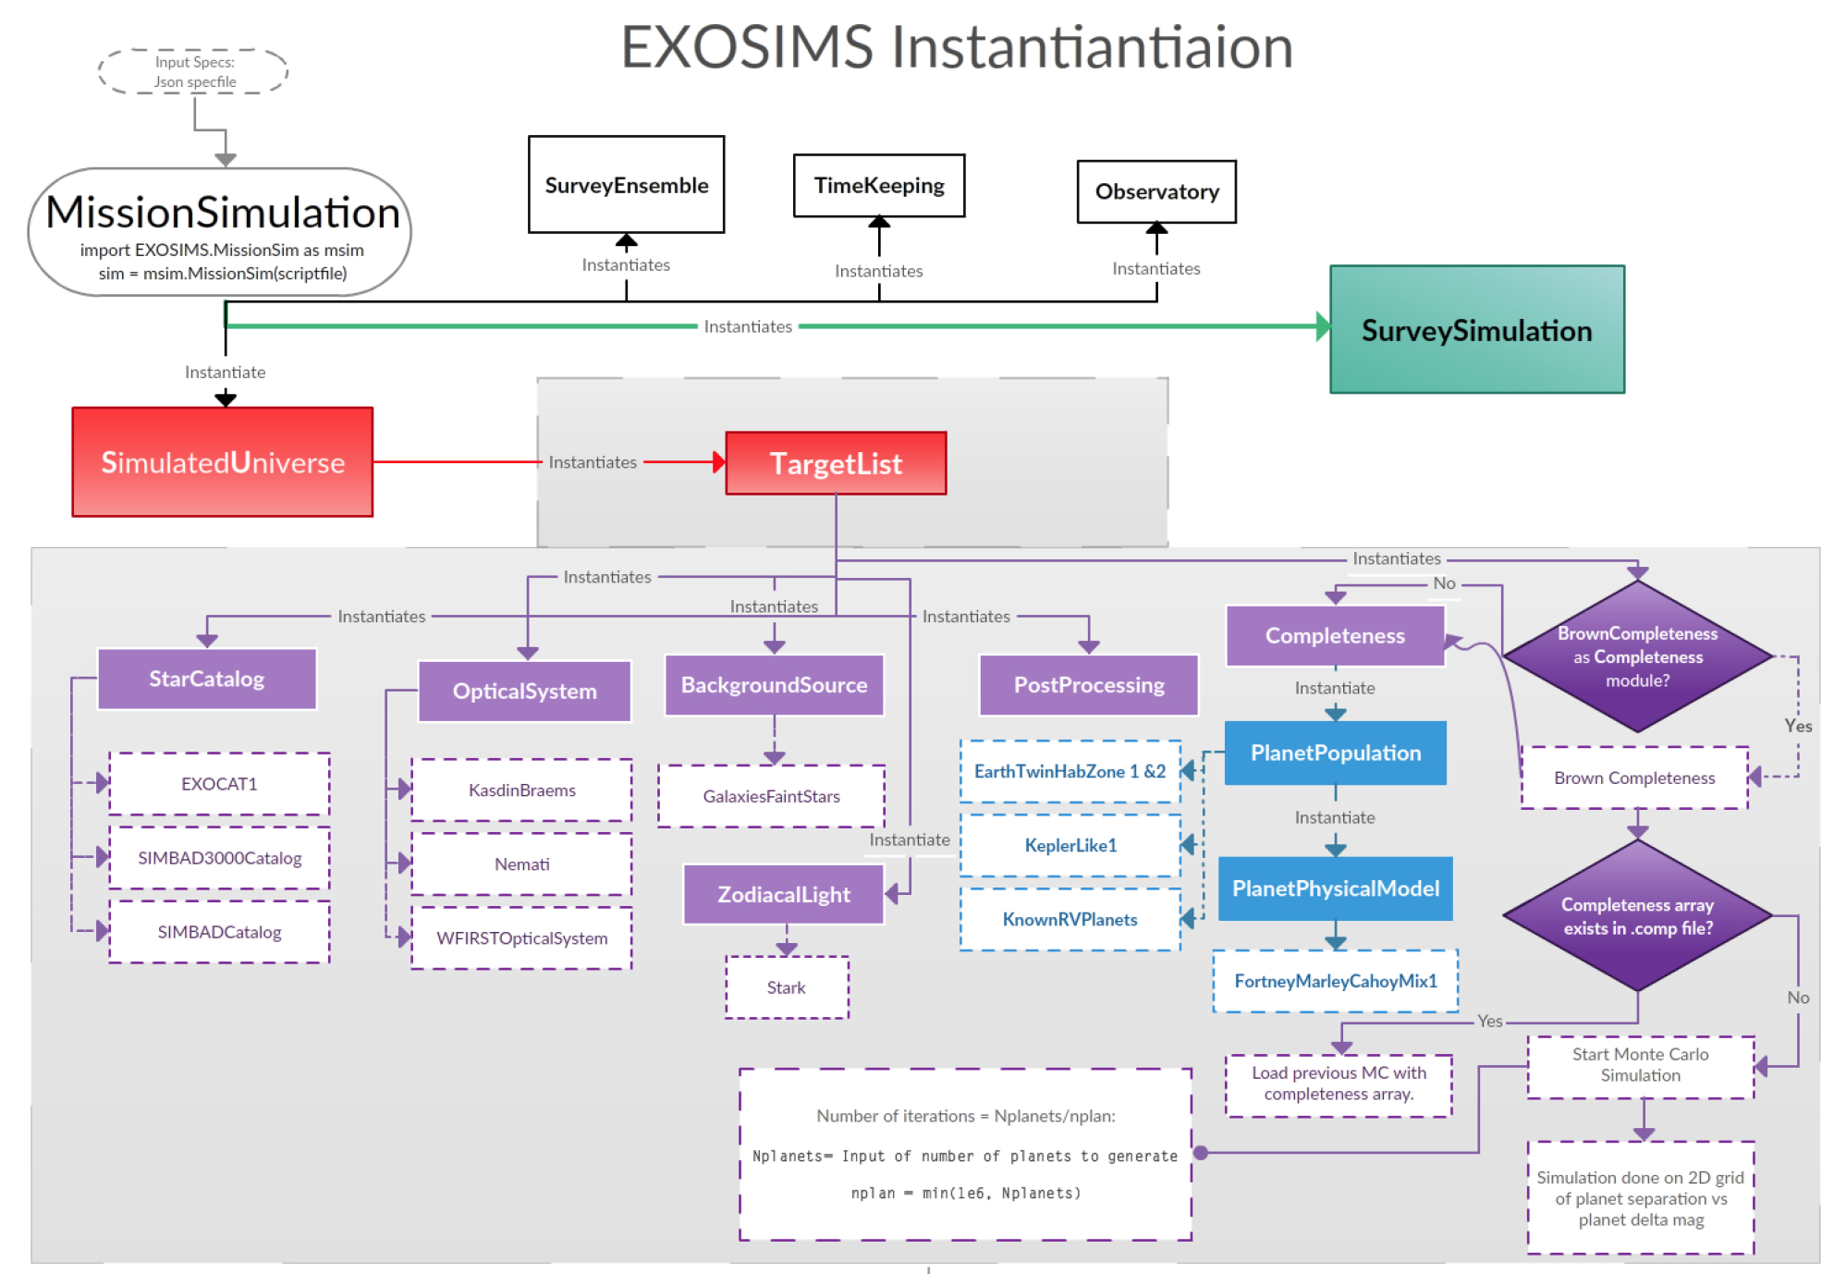
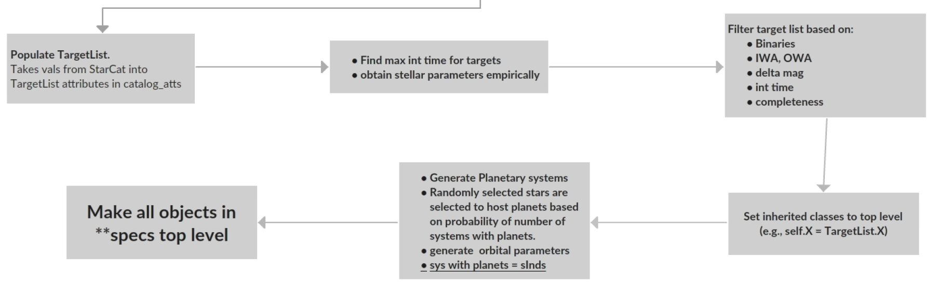

Slide 8
Survey Simulation Run
The next step was to run the survey simulation, seen as the green box in the last flow chart.
This command
>> sim.SurveySimulation.run_sim()
Runs the mission simulation and selects targets to observe and looks for detections.
Flow chart on next slide:

Slide 9
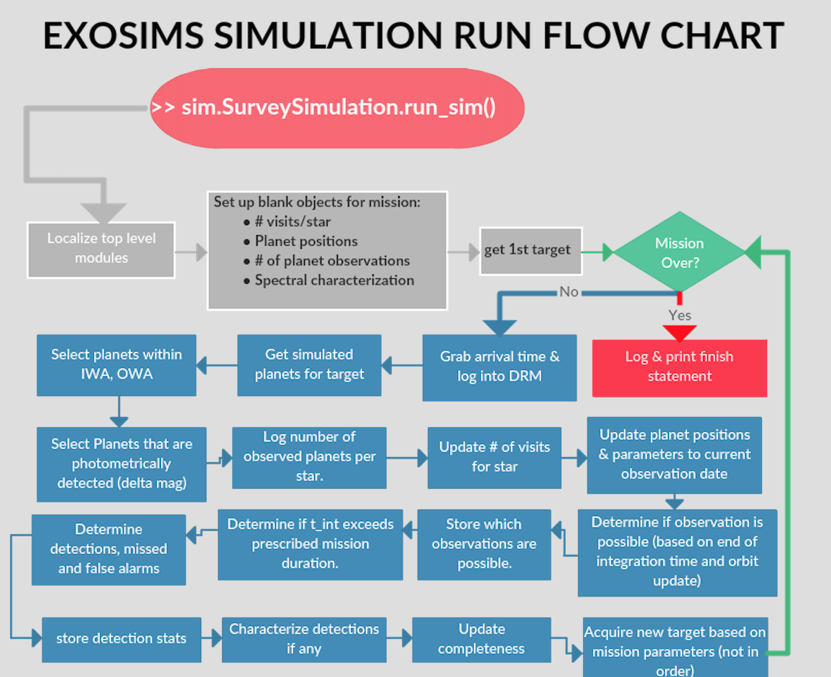
Survey Simulation Run

Slide 10
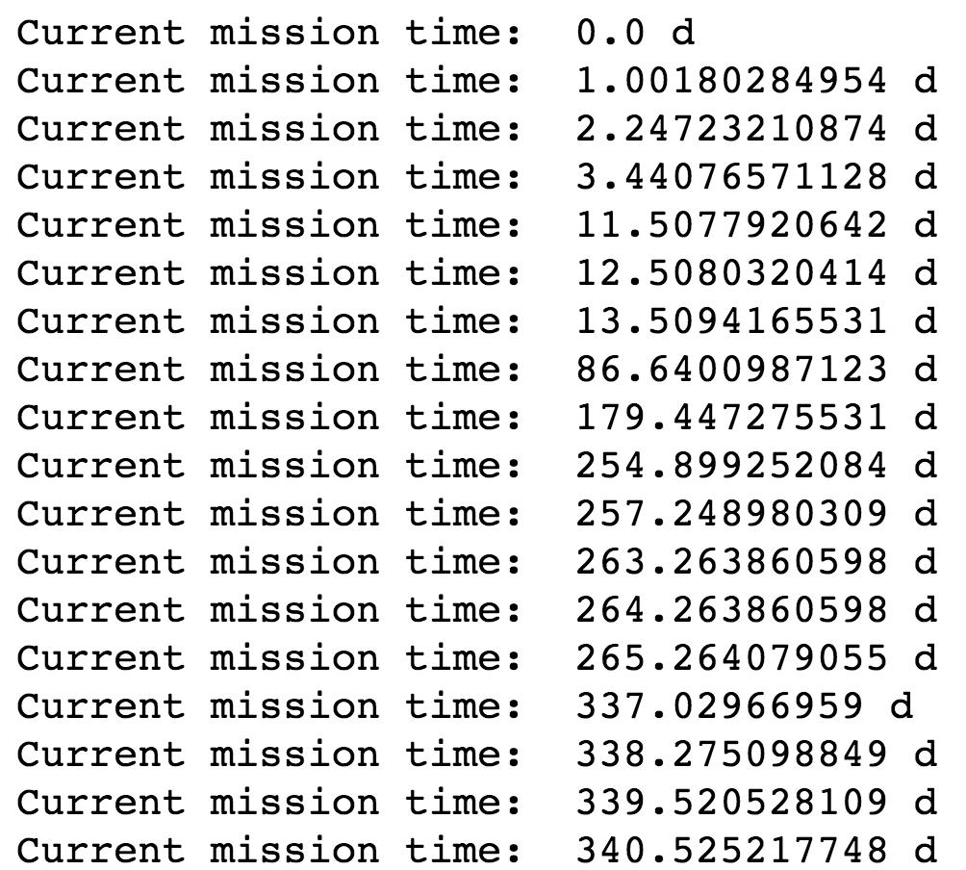
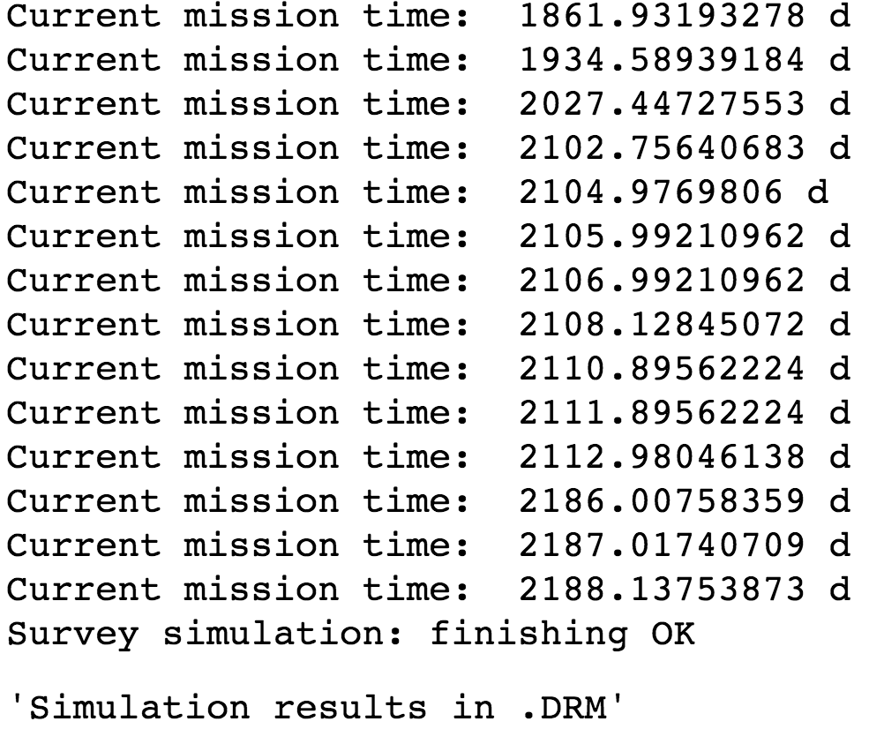
Survey Simulation Run
The run will keep track of time and list the point a new target is selected. For this run, the mission lasted 6 years.
…

Slide 11
Output objects
The simulation doesn’t automatically spit out graphs and results to the user. However, it saves a log of the run and all results are stored as python objects (arrays, dictionaries, etc.).
One can access these objects from the instantiated top level modules, as shown in the next few slides.

Slide 12
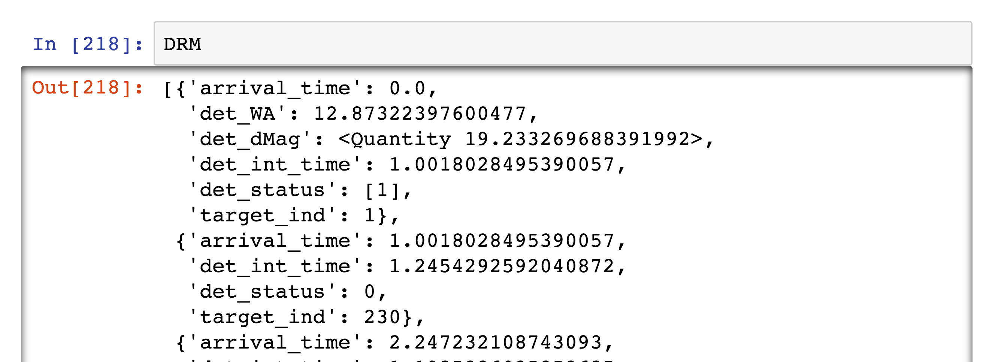
Output objects
The DRM array (DRM = sim.SurveySimulation.DRM) of dictionaries. Each array entry in DRM lists the detection results for each star observed during the survey.
Angular distance of detection?
1st star visited
Delta mag (contrast) of detection
Detection integration time (days).
Detection status:
0 = null detection
1 = detection
-2 = false alarm
-1 = missed detection
Array index of star used in target list (TargetList.Name)
***This particular simulation only produced one detection***

Slide 13
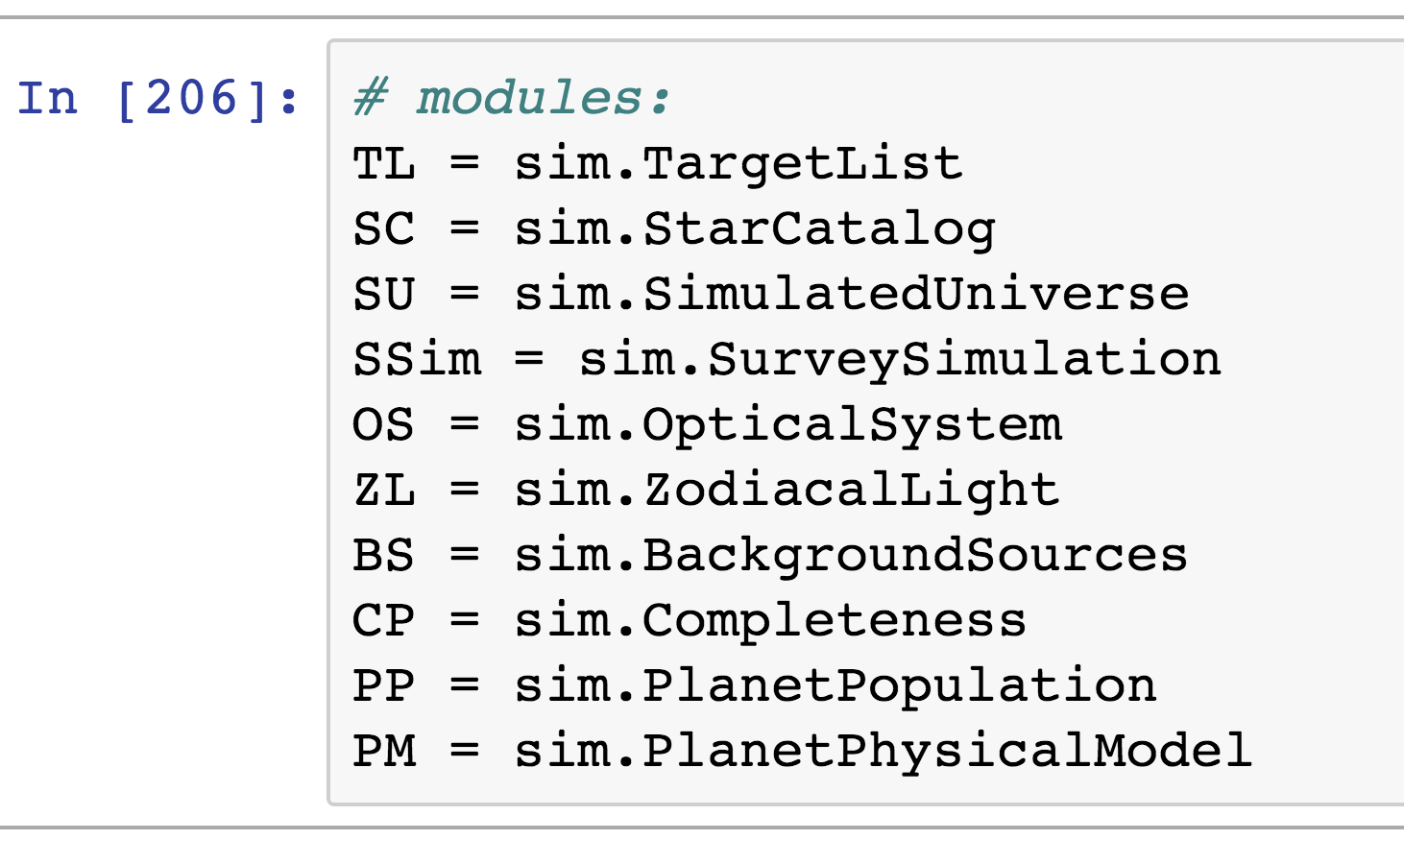
Output objects
Module Objects
The simulation python variables are listed under the top-level modules and can be accessed as follows:

Slide 14
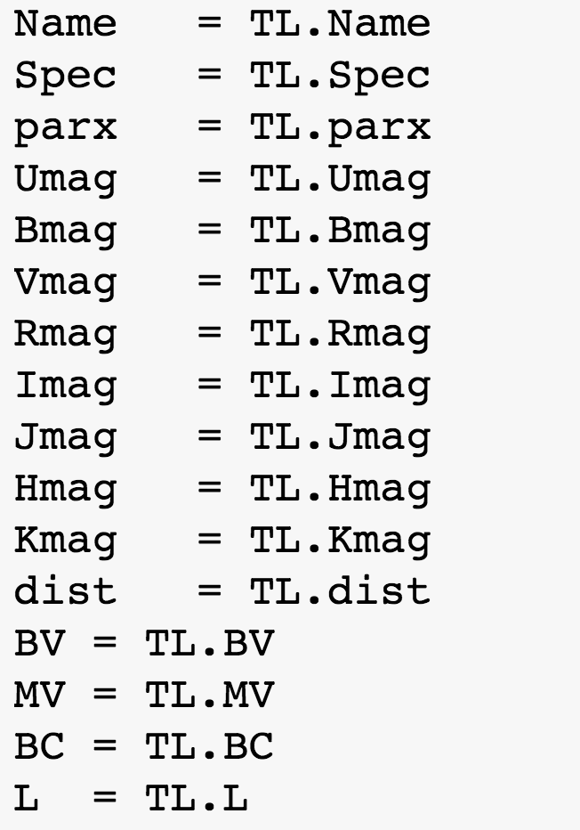
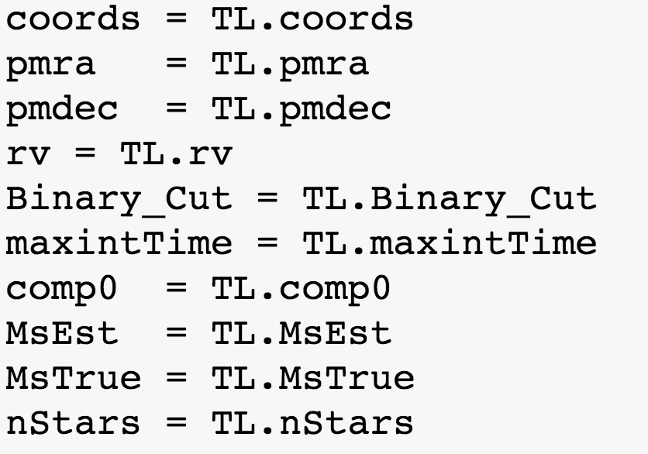
Output objects
Stellar Objects

Slide 15
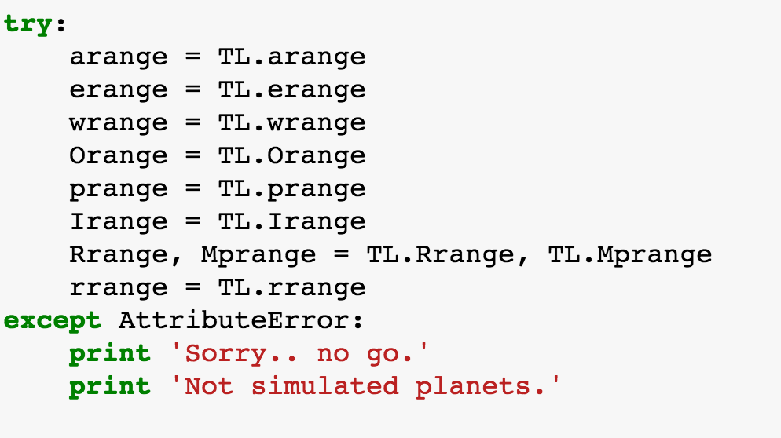
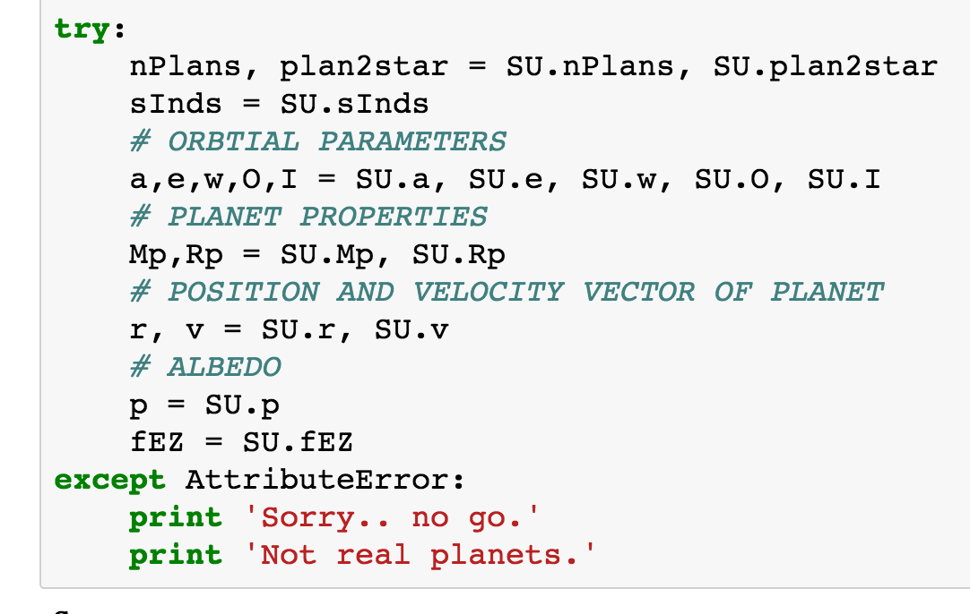
Output objects
Planet Objects
Simulated data
Since this run used RV Planet targets, the data is empirically derived for each planet
Empirically derived data

Slide 16
Preliminary Survey Plots

Slide 17
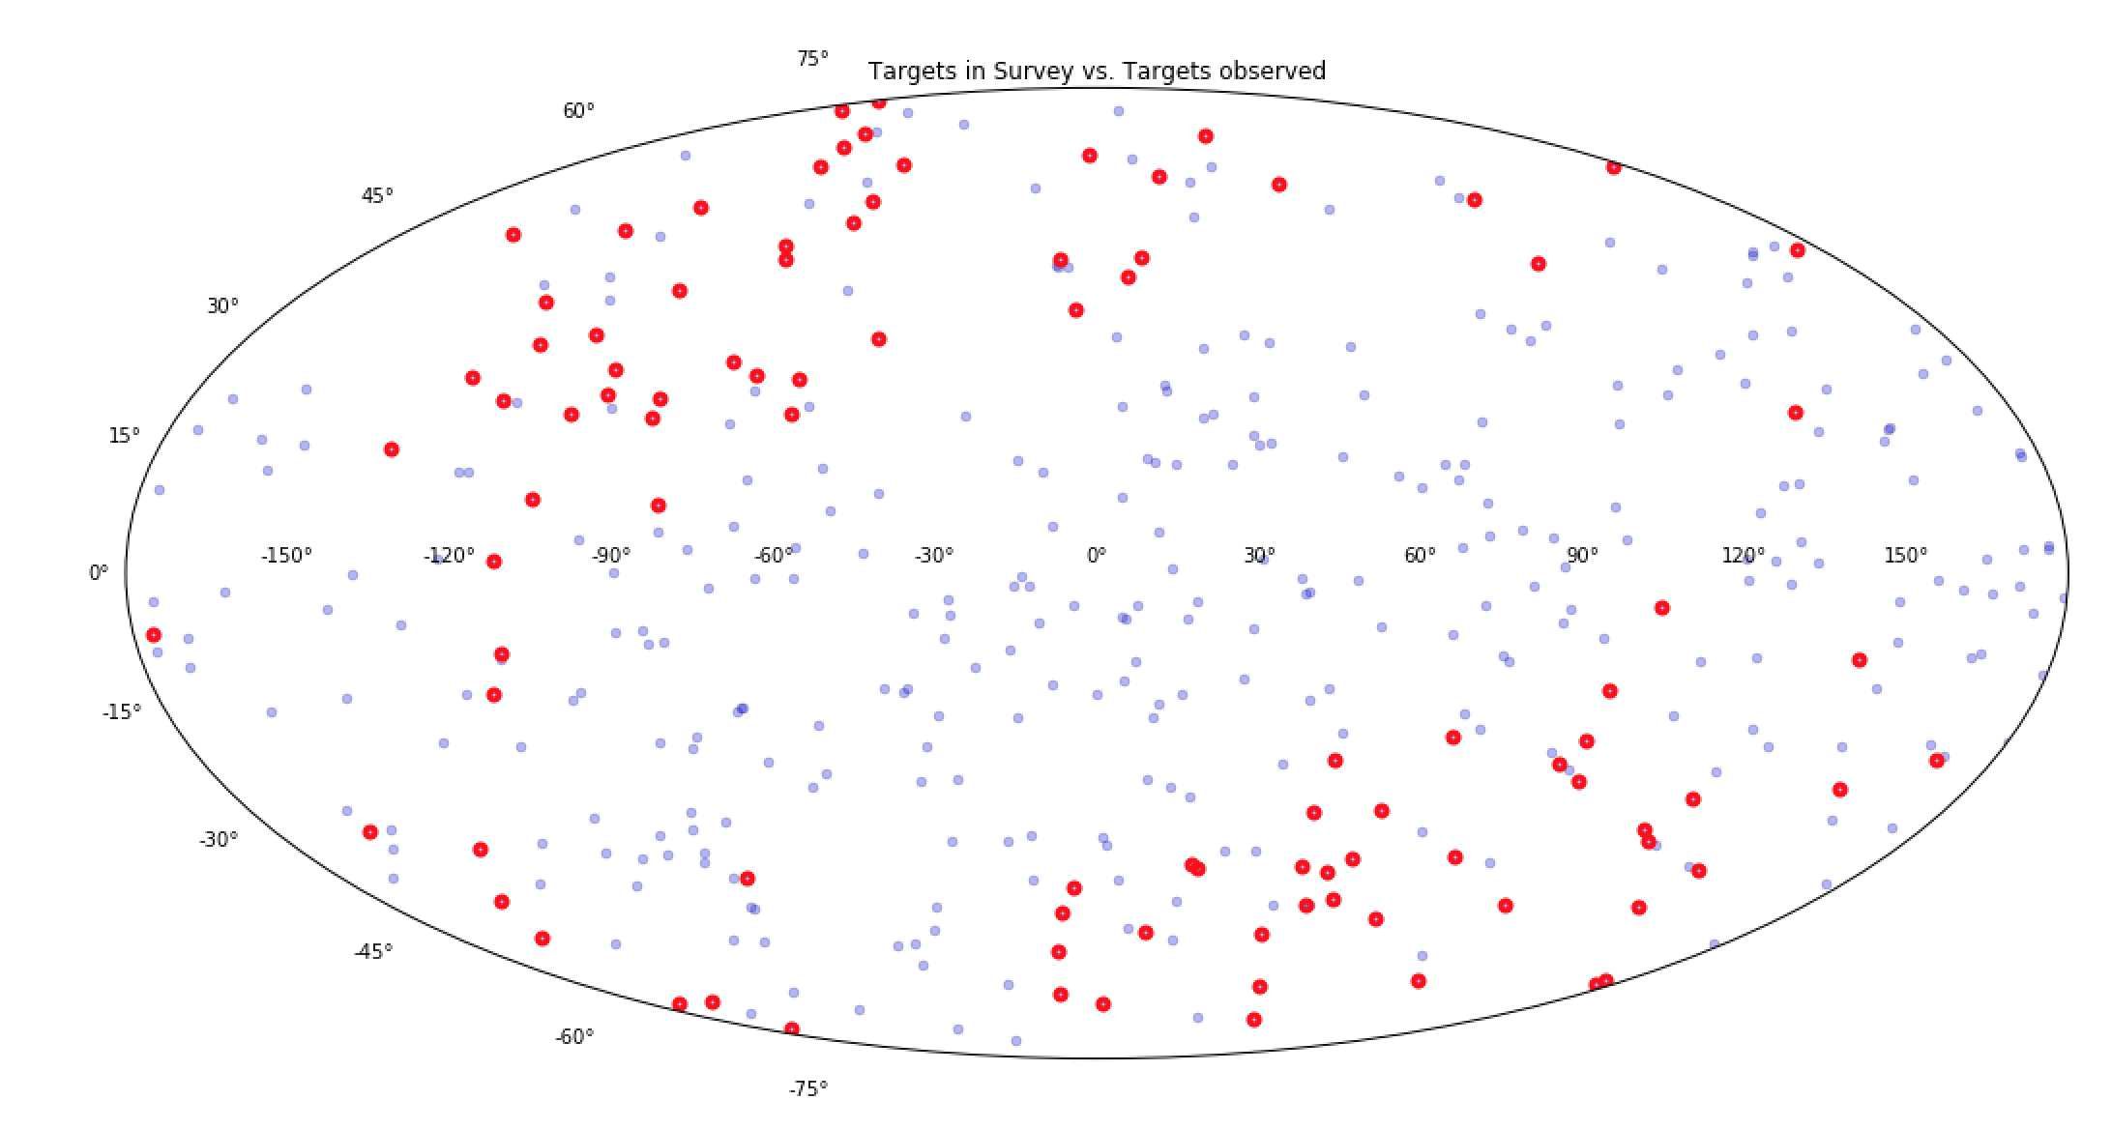
Sky Chart
All targets uploaded to survey (blue dots) and targets that were visited (red) by the “spacecraft”

Slide 18
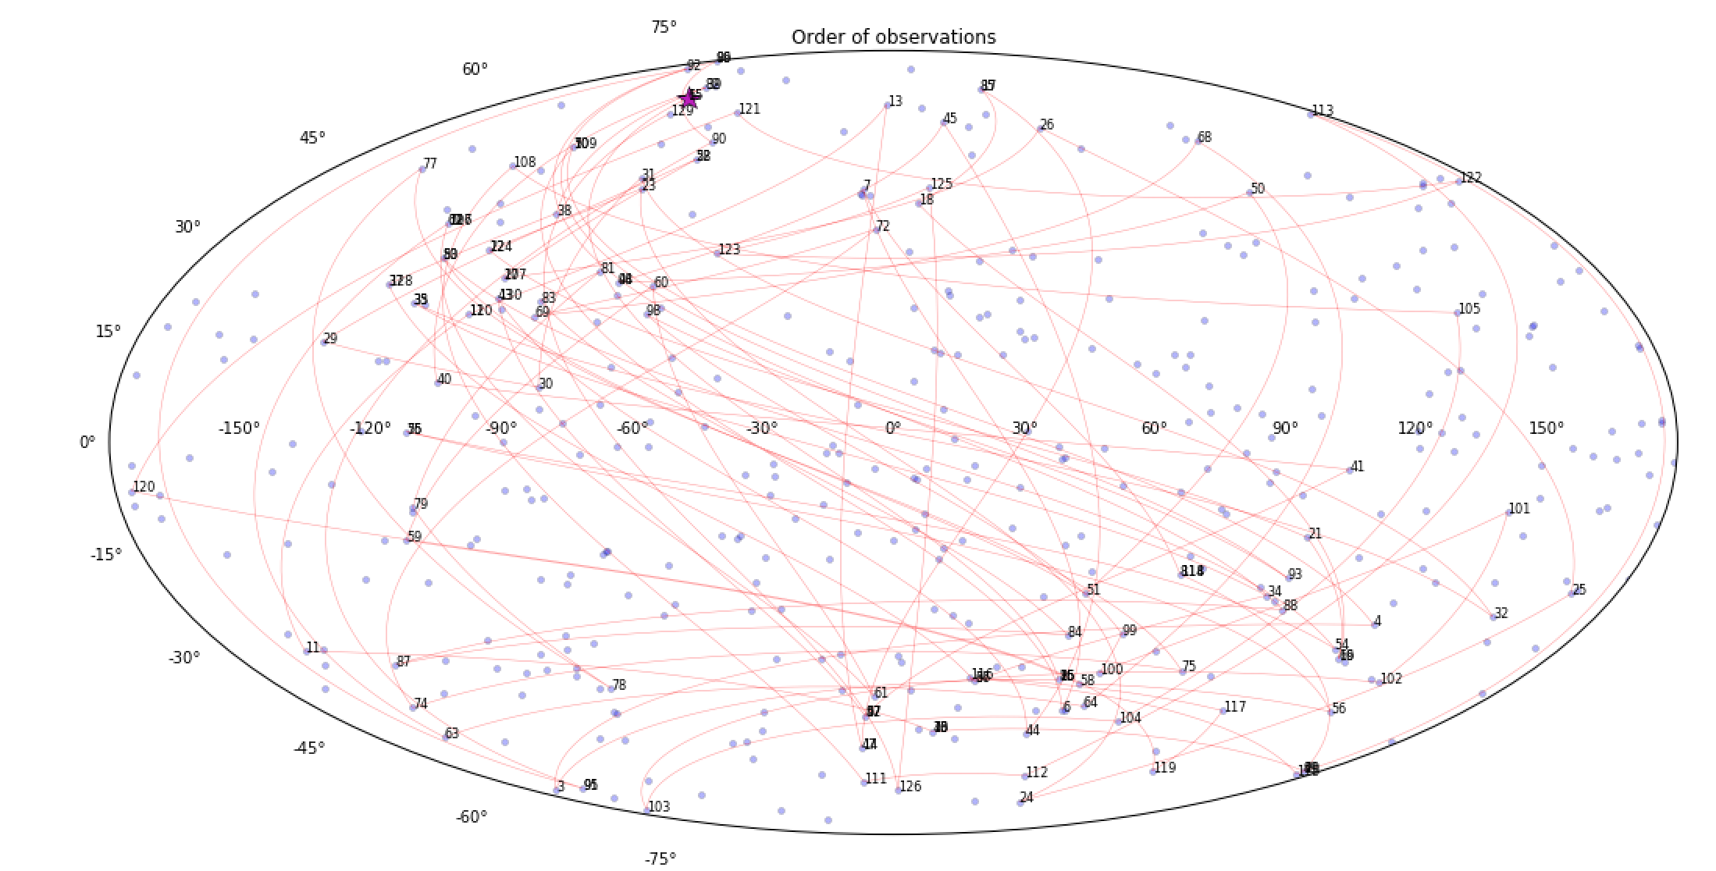
Target Order
This sky projection shows the order of observations across the sky.

Slide 19
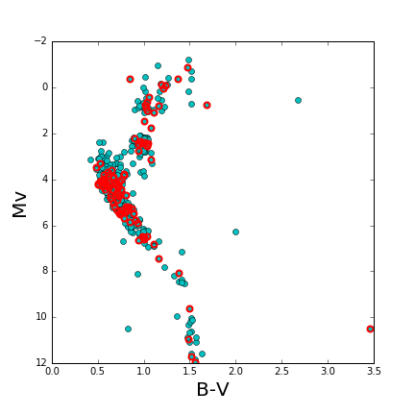
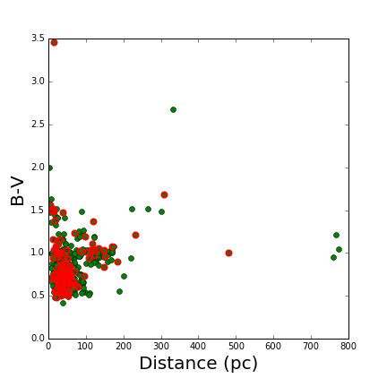
Target Description

Slide 20
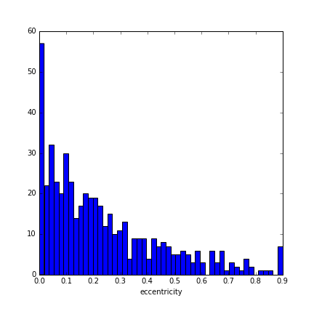
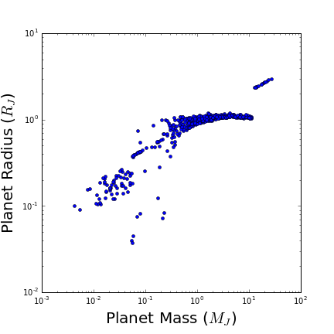
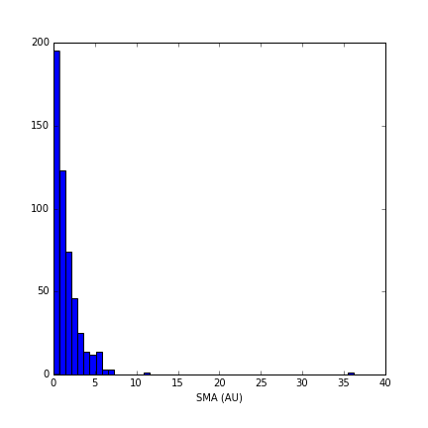
Planet Distributions

Slide 21
Next move…
Run this for simulated planet data
E.g., Keplerlike Planets, Habitable zone planets
More importantly, produce input/output distribution plots seen in Dmitry’s paper
Towards developing IPAC U.I.
Wrapper for output variables
Show plots on website of what I presented.
Maybe have a drop down menu of all variables to plot in empty plot window… ?
Any suggestions/comments on inaccuracies in this presentation are more than welcome.

