Slide 1
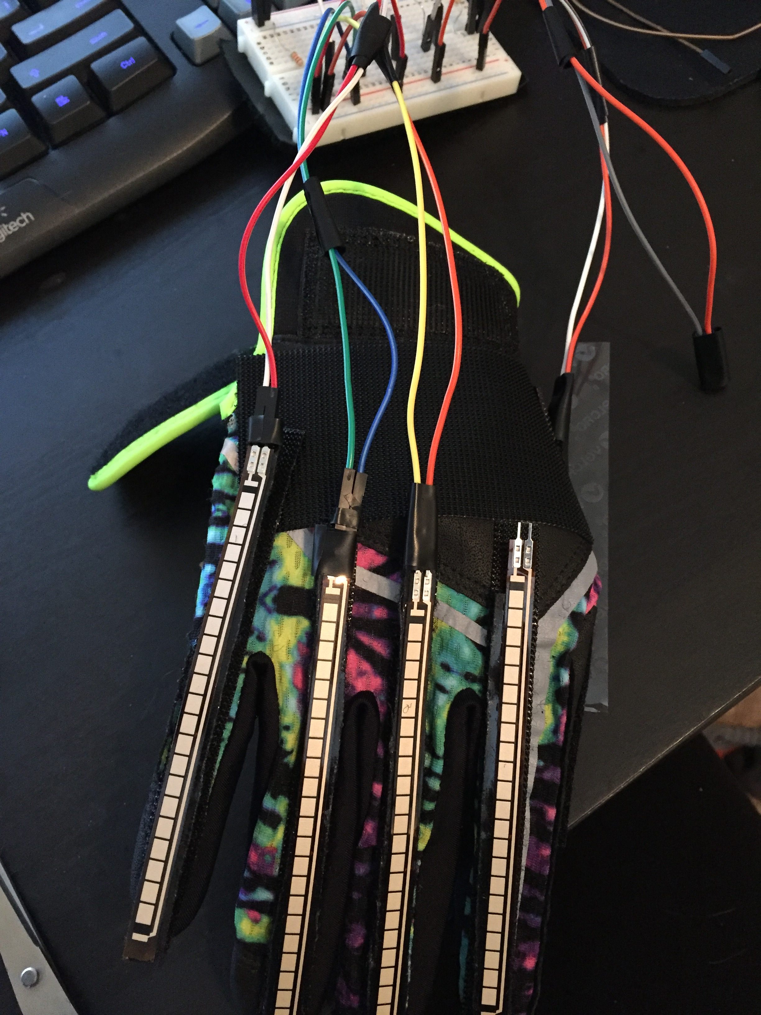
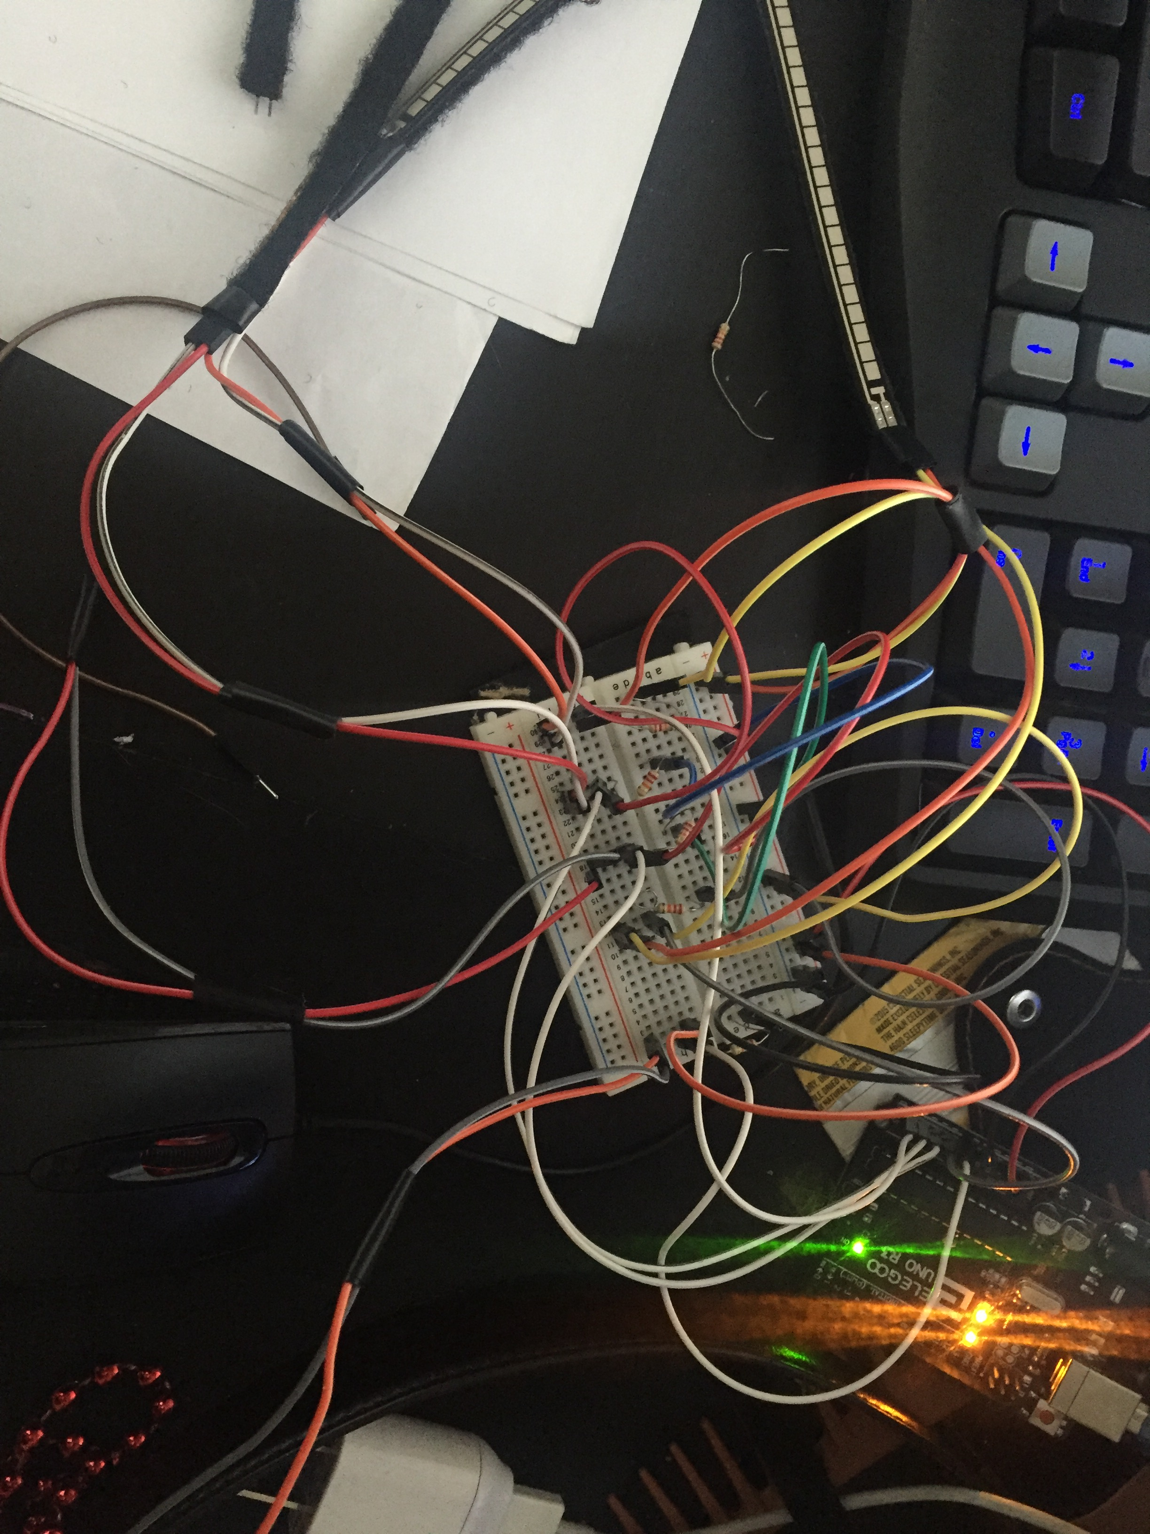
Ebisu: An Innovative User-Input Solution
Brittany Barnes and Yusef Ghouth
University of San Diego
Conclusion
This is where our final thoughts/conclusions will go for the final project
Also incorporate a couple finished prototype photos
Abstract
Ebisu is a Machine Learning Algorithm that aims to recognize and categorize wearable device data, such as accelerometer data, into gestures. These gestures open up a new avenue in user-machine interaction, allowing customers to have a form-fitting experience with their technology. Ebisu will detect and categorize multi-dimensional data into both pre-learned gestures and new ones, giving it the ability to learn user-specific commands and interaction. To pair along with the Ebisu software, we are also designing a physical wearable prototype that will transmit data to a host device for processing.
Machine Learning Algorithim
Physical Prototype
Ebisu’s Machine Learning algorithm is a Multiclass Perceptron: A neural Network designed to observe datasets and classify them as one of many pre-learned classes. The twist is Ebisu’s algorithm can also recognize new patterns and categorize them on the go, making it a much more versatile tool
Input
Class A
Class B
New Class
Class C
Results
Hardware
Here is where some text about the final project will go relating to the Hardware
Software
Here is where some text relating to the software will go. Here is where some text relating to the software will go.
Here is where some text relating to the software will go.
Here is where some text relating to the software will go.
Here is where some text relating to the software will go.
Here is where some text relating to the software will go.
Here is where some text relating to the software will go.
Here is where some text relating to the software will go.
Here is where some text relating to the software will go.
Here is where some text relating to the software will go.
Here is where some text relating to the software will go.
Here is where some text relating to the software will go.
Here is where some text relating to the software will go.
Here is where some text relating to the software will go.
Here is where some text relating to the software will go.
Here is where some text relating to the software will go.
Methods
Hardware
5 4.5’ Flex Sensors
1 InvenSense MPU-6050 Accelerometer
1 Breadboard
Jumper Wires
Softball Glove
Velcro
Arduino Uno
Software
Multilayer Perceptron
Function
References
https://github.com/VRomanov89/EEEnthusiast/blob/master/MPU-6050%20Implementation/MPU6050_Implementation/MPU6050_Implementation.ino
https://learn.sparkfun.com/tutorials/flex-sensor-hookup-guide
https://people.ece.cornell.edu/land/courses/ece4760/FinalProjects/f2015/akl52_amb493_jc957/akl52_amb493_jc957.old/akl52_amb493_jc957/
4.https://www.youtube.com/watch?v=M9lZ5Qy5S2s

