Slide 1
FANATICS AND LUNATICS ETL-PROJECT
Benjamin Hawkins, Brittany Oleniacz,
David Seger, Andrew Walker

Slide 2
Extract
Primary data sources:
Los Angeles Crime & Arrest Data (Kaggle)
UFO Sightings, from the National UFO Reporting Center or NUFORC (Kaggle)
Format: CSV files (738 MB and 28 MB)
Datasets picked for a broad set of data with date/time stamps and location information--possible data query use/joins
Location of the "crime" dataset determined based on the state with the most UFO sightings (California)

Slide 3
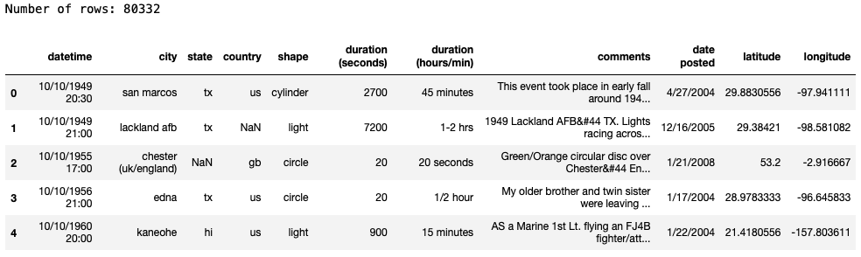
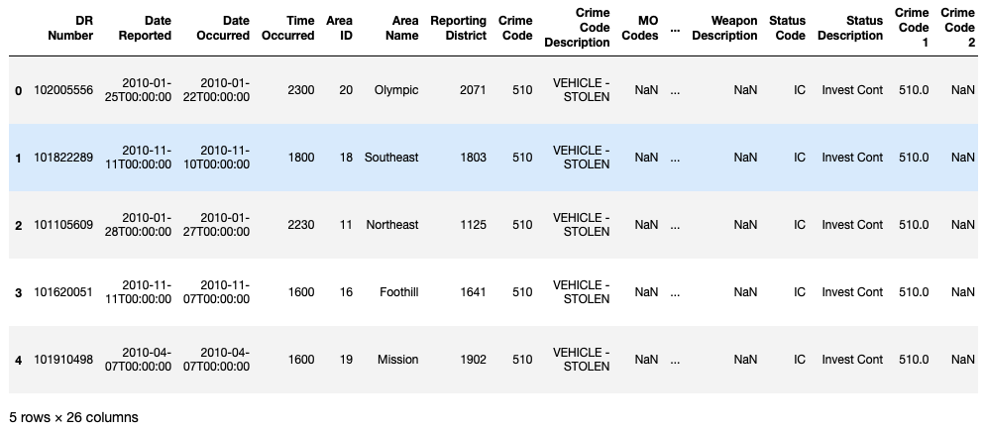

Slide 4
Transform
Types of transformation needed: cleaning and filtering
Reduced the number of columns to remove:
excess/redundant data
specific coding (lack of documentation for our own use)
weird data types
Dropped rows with missing data or NaNs
Filtered results down to California
Converted the date-time columns to date-only datetime objects
Restricted datasets from date of earliest crime data available to lastest UFO sighting data available

Slide 5
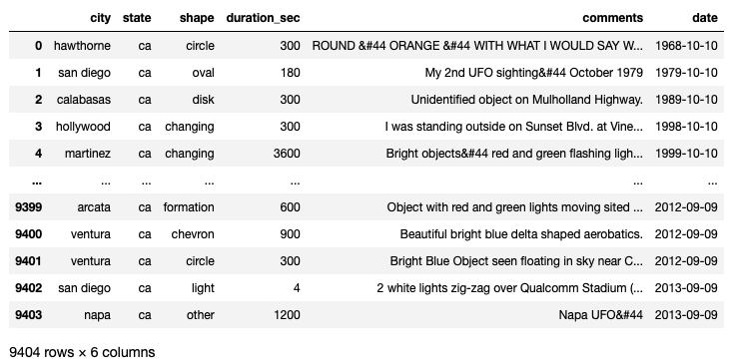

Slide 6
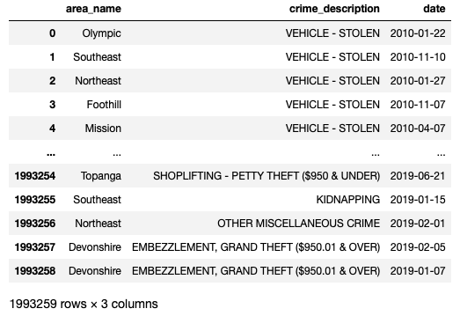

Slide 7
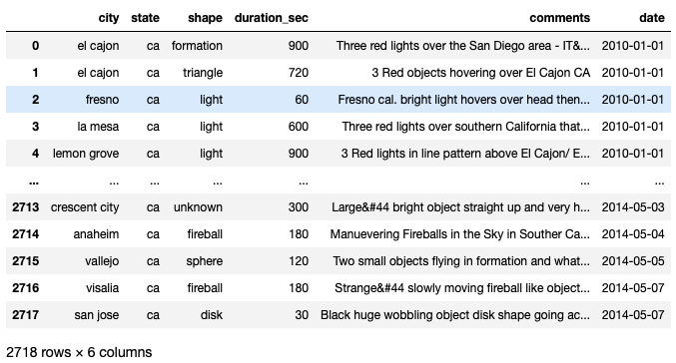
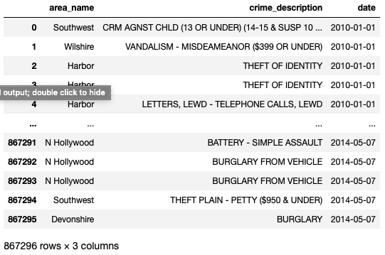

Slide 8
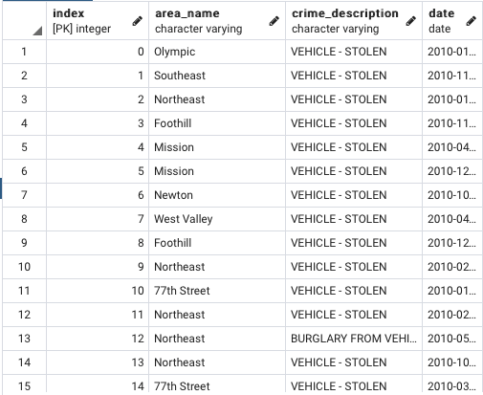
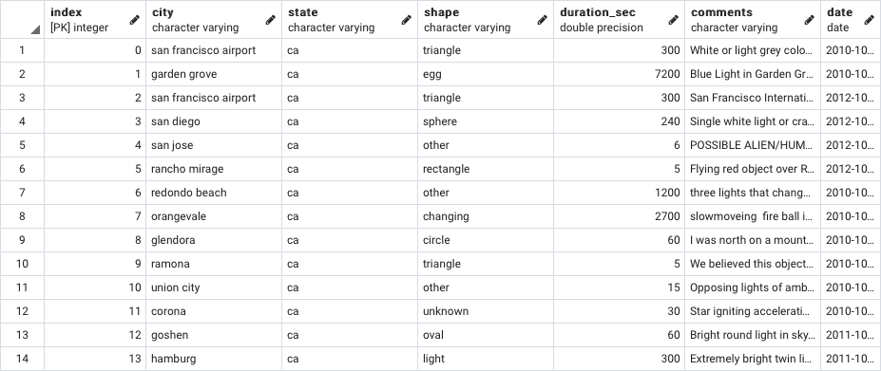
Load
The final database used: PostgreSQL
Two tables created, UFO and Crime, with table schema queries
PGAdmin was used for ease of coding/familiarity through Jupyter Notebook
Also picked for practical application (can easily demonstrate joins between tables on particular dates/periods of time)

