Slide 1
SMART FARMING

Slide 2
Relevance
Incorrect usage of fertilizers.
To understand about varying climate in our location.
Manual water pumping in farm.

Slide 3
Description
Smart Farming system helps farmers to monitor water content and atmospheric temperature.
Based on the water content level, water will be automatically pumped to the farm.
PH sensor is used to sense the PH level of the soil, using this PH value appropriate fertilizers will be suggesting the to the farmer.
A particle sensor is used to detect the amount of pollutants in atmosphere.

Slide 4
Objective
To deal with sudden climatic changes in farming.
To increase the productivity.
To reduce the uncontrolled usage of fertilizers.
Safety measures can be implemented based on the particle sensor value.

Slide 5
Existing system
Proposed system
Using the PH value appropriate fertilizers will be suggested to the farmers.
IOT sensor will sense the water level and pump water automatically.
Detect the amount of atmospheric particles.
Soil testing and suggestion of fertilizers is done by the agriculture office (krishibhavan).
Man power is required

Slide 6
Modules Identified
Module-1
Hardware connection.
Module-2
Data collection.
Module-3
Storage and retreival of data.
Module-4
Prediction of fertilizers.

Slide 7
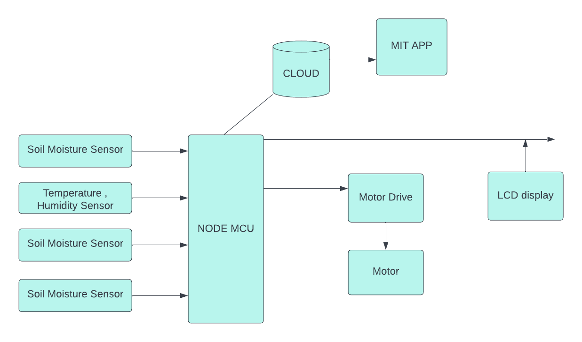
Hardware connection

Slide 8
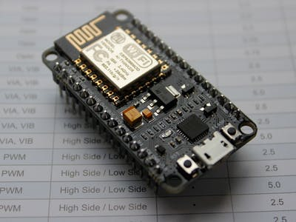
NODE MCU
NodeMCU is an open-source firmware for which open-source prototyping board designs are available.
Eg: Amica,Doit,Lolin
The name “NodeMCU” combines “Node” and “MCU”.
The firmware uses the Lua scripting language.
It provides easy and very stable connection to the internet.

Slide 9
Data collection
Collecting data from IOT sensors.
Soil moisture sensor
PH sensor
Temperature ,Humidity sensor
Particle sensor

Slide 10
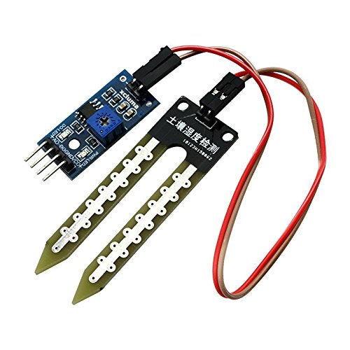
Soil moisture sensor

Slide 11
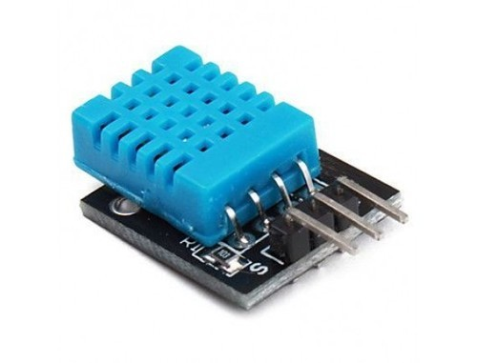
Temperature, Humidity sensor

Slide 12
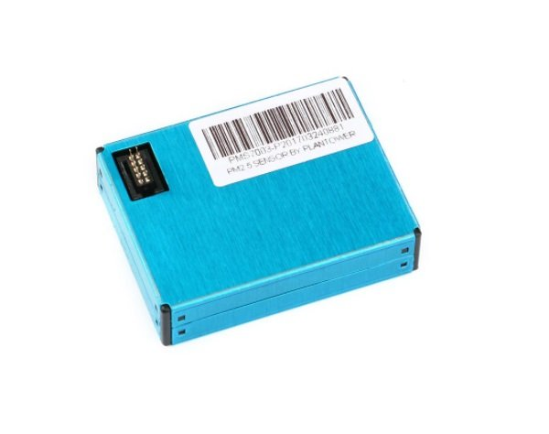
Particle sensor

Slide 13
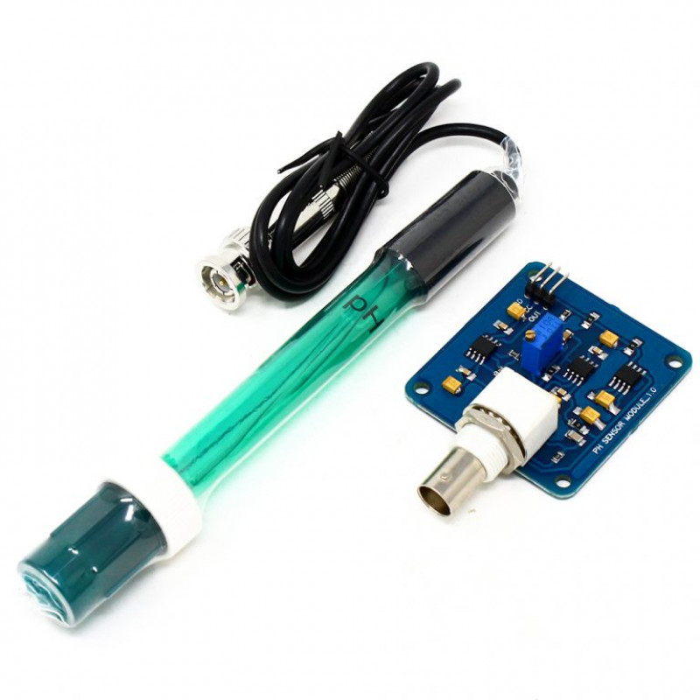
PH sensor

Slide 14
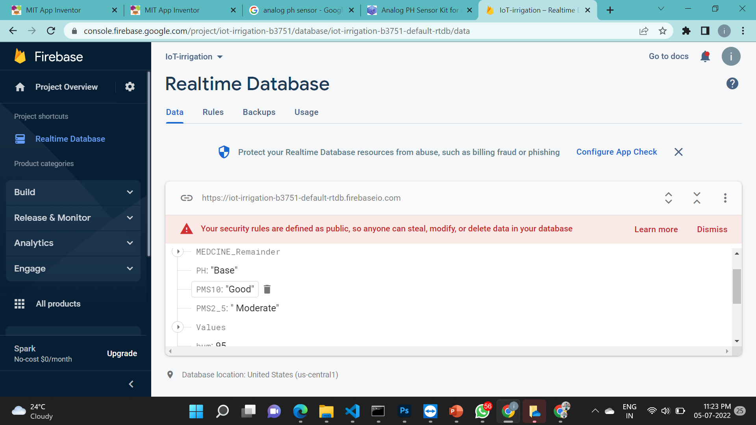
Module-3(storage and retrieve of data)
Using cloud as database.
Firebase free cloud is used.
Retrieving data from firebase and display on application.

Slide 15
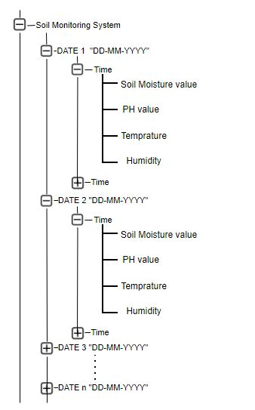

Slide 16
Module-4(prediction of fertilizers)
Dataset
Mainly four values are used to suggest the fertilizers
Dataset contain four inputs
PH value
Water content
Temperature
Humidity
And one fertilizer based on the inputs

Slide 17
Fertilizers for paddy only taken
Limestone,
Urea,
20 X20,
18 X 18,
Urea,
NPK
Amonium Nitrate
Sulphur
Fatamphos
Pulverised Limestone

Slide 18
Algorithm
Check 2 algorithm
KNN
Nave base
KNN have 82 accuracy
Here using Nave base Algorithm.
Which have 99 accuracy

Slide 19
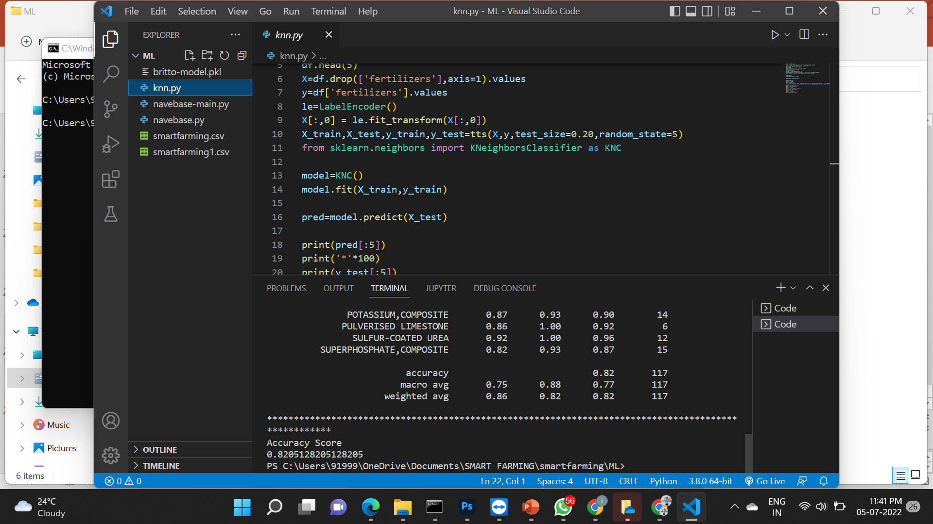
KNN

Slide 20
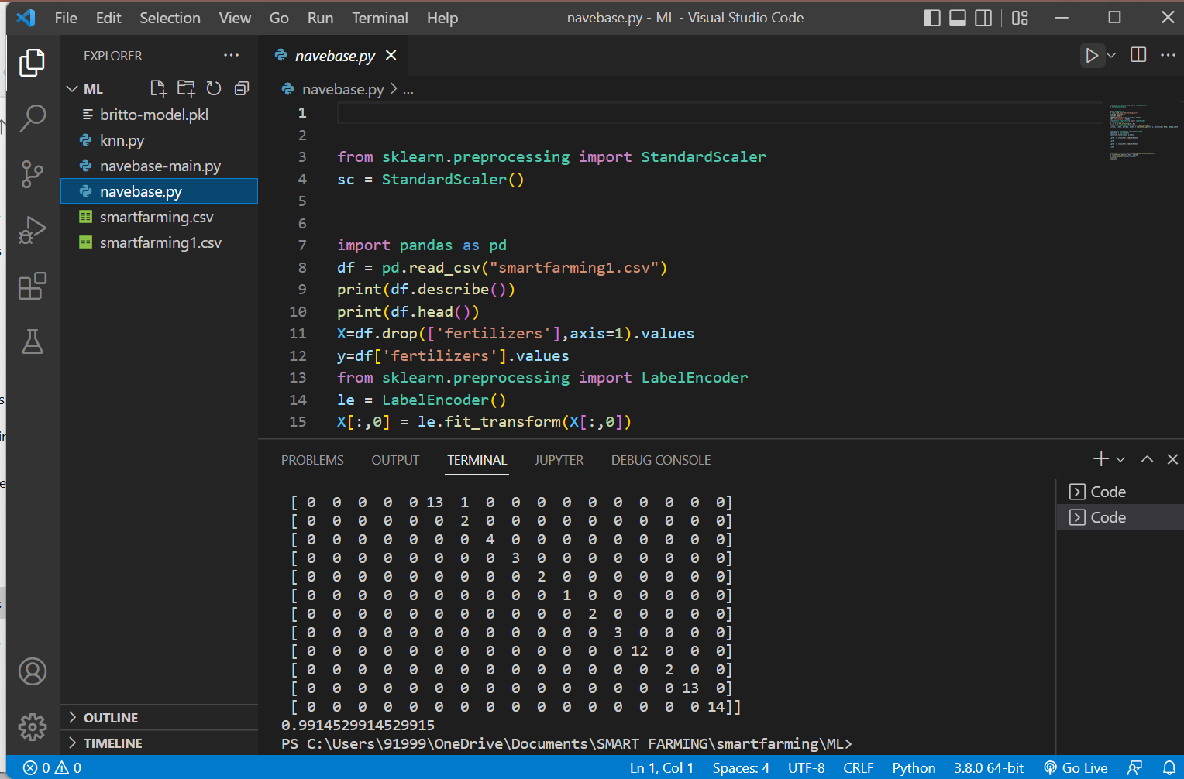
Nave base

Slide 21
Input/ Output and Code Description
Code for connecting to wifi.
Code for accessing sensor data to program
Code for storing data to firebase.
Code for model training.

Slide 22
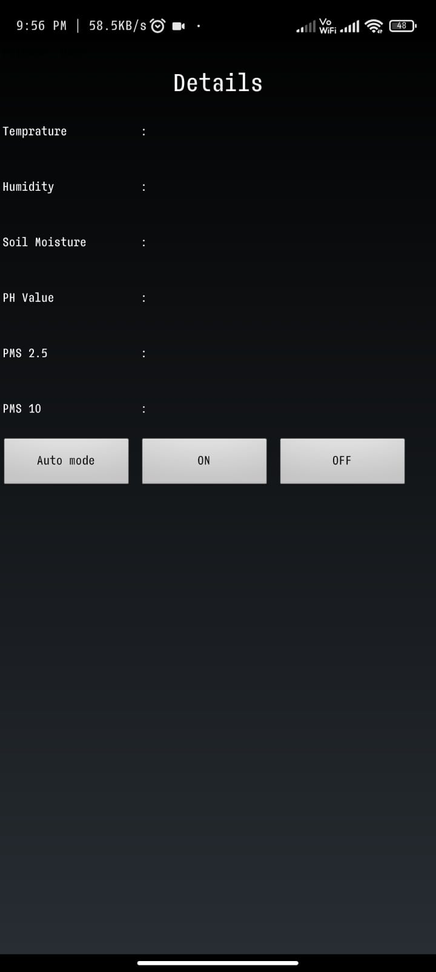
Sample Screenshots

Slide 23


Slide 24
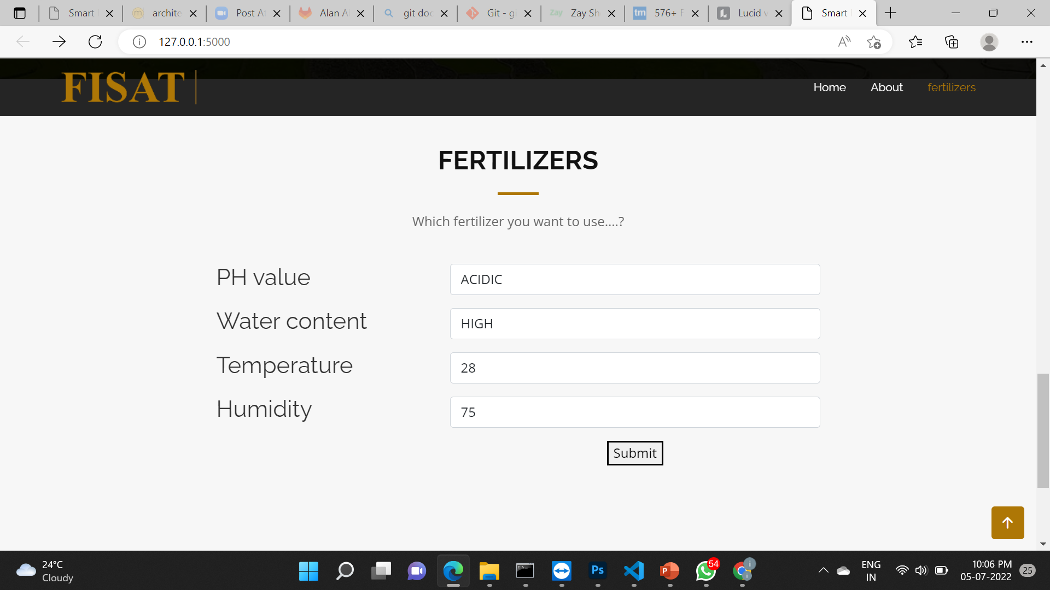

Slide 25
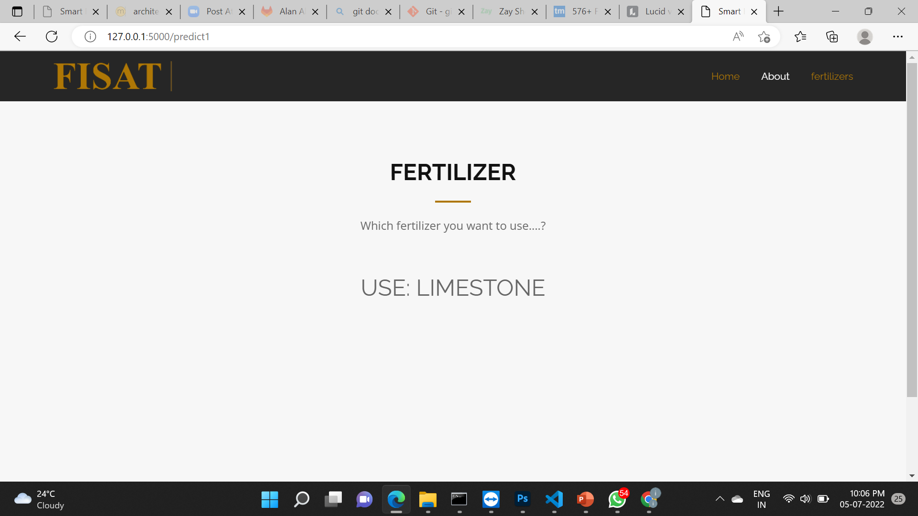
Fertilizer Prediction

Slide 26
Future scope
We can implement sensors for detecting nitrogen and potassium to predict more fertilizers.
Instead of inputting data directly to the website, data can be retrieved from the cloud for predicting the fertilizer.

Slide 27
Thank you

