Slide 1



Image Processing
Ellen Siro - Marcus Walbridge

Slide 2


Requirements
Power-Law
Negative
Log
Arithmetic Operations:
Addition
Subtraction
Multiplication
Division

Slide 3
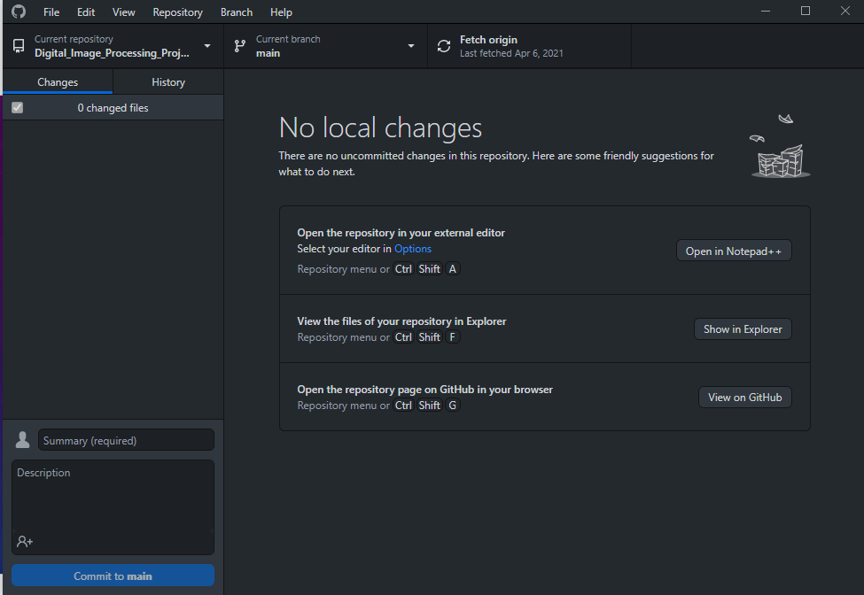
Tools
GitHub
IntelliJ
Swing
Blue J (Documentation Tool)
Discord/Zoom
Violet UML

Slide 4
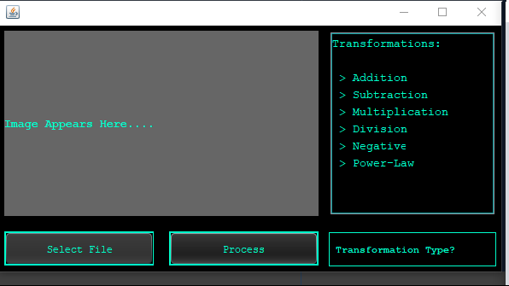
Steps
Select File
Enter Transformation
Answer Prompts (If Applicable)
Select Process
View Result

Slide 5
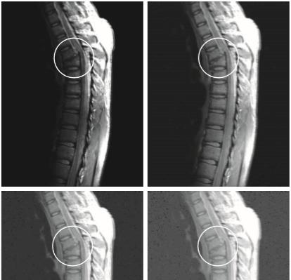
Power-Law
Enhance Image for new displays or devices
Utilizes both Gamma and C values
Can be referred to as Gamma Correction
Lower Gamma Values = Brighter Image

Slide 6
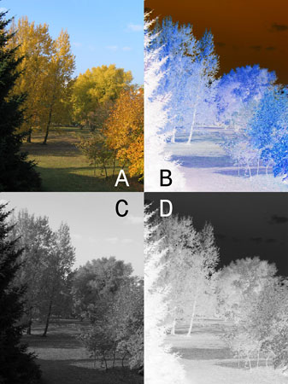
Negative
Image Inversion
Provides ability to see details from darkest areas on Photo
Subtract intensity of each pixel with max of each pixel

Slide 7
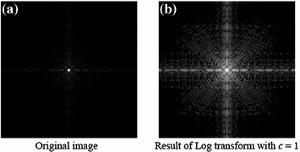
Log
Replace Pixels with Log Value
C log( r+1)
Dark Pixels Expand
High Pixel Values Compress

Slide 8
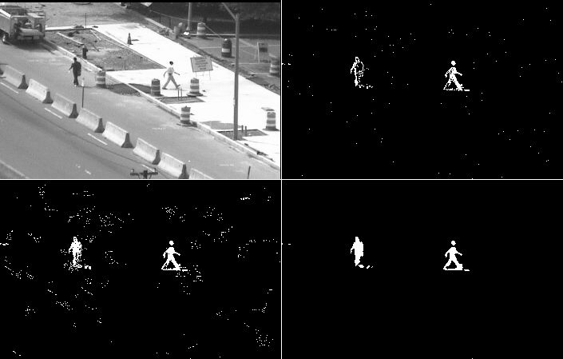
Arithmetic
Addition / Subtraction
Multiplication / Division
For example, Subtraction is viable for identifying differences in Images

