Slide 1
CS 470 – artificial intelligence
Lesson #12

Slide 2
Clustering: K-Means Algorithm
K-Means is one of the most common algorithms that is used for clustering
The number of clusters, K, is chosen beforehand
The middle of each cluster is called a centroid
K-Means initially places the centroids randomly
K-Means++ uses the input data for initial placement
Ideally, centroids are initially placed far apart
Look at: kmeans.py
Input: data_clustering.txt (350 pairs of data values)
Choose k=5 clusters, number of iterations = 10
What if k=4? k=3? k=2? k=6? k=10?
What is the ideal number of clusters (k)?

Slide 3
Clustering: Estimating the Number of Clusters
Mean Shift is a powerful algorithm using in unsupervised learning
It is a non-parametric algorithm since it doesn’t make any assumptions about the underlying distributions
The feature space is considered as a probability density function
Clusters correspond to local maxima of the distribution
If there are K clusters, there are K peaks in the data
Each data point has a window around it that iteratively moves closer towards the peak of the nearest cluster
The centroids (or means) continually shift towards the cluster peaks. Eventually, the algorithm converges
Goal is to find number of clusters and their centers
Look at: mean_shift.py
Increasing the quantile parameter will increase the bandwidth which lowers the number of clusters (and vice versa)
Can you create or modify a data file to produce different K?

Slide 4
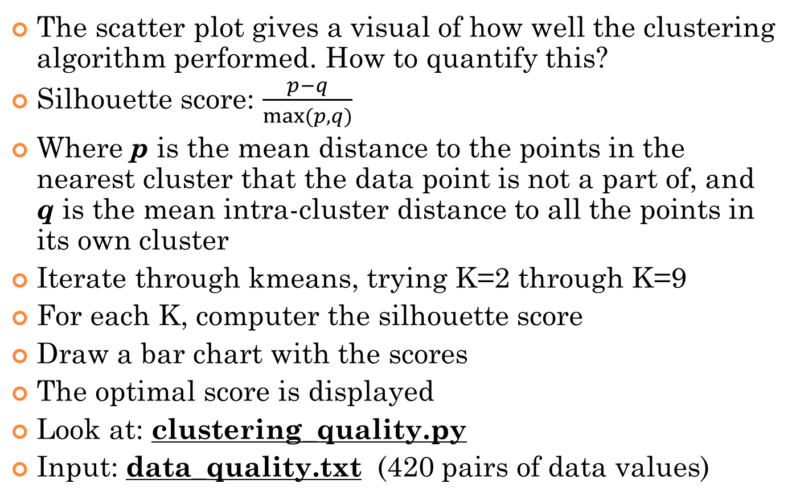
Estimate Quality of Clustering
The scatter plot gives a visual of how well the clustering algorithm performed. How to quantify this?
Silhouette score: $\frac{p−q}{max⁡(p,q)}$
Where p is the mean distance to the points in the nearest cluster that the data point is not a part of, and q is the mean intra-cluster distance to all the points in its own cluster
Iterate through kmeans, trying K=2 through K=9
For each K, computer the silhouette score
Draw a bar chart with the scores
The optimal score is displayed
Look at: clustering_quality.py
Input: data_quality.txt (420 pairs of data values)

Slide 5
Gaussian Mixture Models
Gaussian Mixture Model (GMM) – unsupervised machine learning technique used to classify and cluster data
Mixture model – a type of probability density model where data is governed by several component distributions
If the distribution is Gaussian, it is a GMM
Useful for providing greater precision and flexibility in modeling a diverse data distribution
Look at: gmm_classifier.py
Input: iris dataset (contains 50 samples of 3 different flowers)
The three colored ellipses represent different distributions

Slide 6
Segmenting the Market Based on Shopping Patterns
Look at: market_segmentation.py
Input: sales.csv (contains sales for 440 stores)
Each row contains store ID, along with sales for t-shirts, tank tops, halter tops, turtlenecks, tube tops, and sweaters
Goal is to create clusters of stores that have similar sale patterns
Mean Shift is used to determine the number of clusters
Since there are 6 input variables, a scatter plot becomes troublesome
3-value pairs are used to create "x" and "y" centers in order to plot the data

