Slide 1
CS 470 – artificial intelligence
Lesson #17

Slide 2
Artificial Neural Network
Artificial Neural Network (ANN) is synonymous with Neural Network (NN)
A neural network is a collection of connected neurons
Each connection, like the synapses in a biological brain, can transmit a signal to other neurons
A neuron that receives a signal, then processes it, and can signal neurons connected to it
The "signal" at a connection is a real number, and the output of each neuron is computed by some non-linear function of the sum of its inputs
The connections are called edges
Neurons and edges typically have weights that adjust as learning proceeds
The weight increases or decreases the strength of the signal at a connection

Slide 3
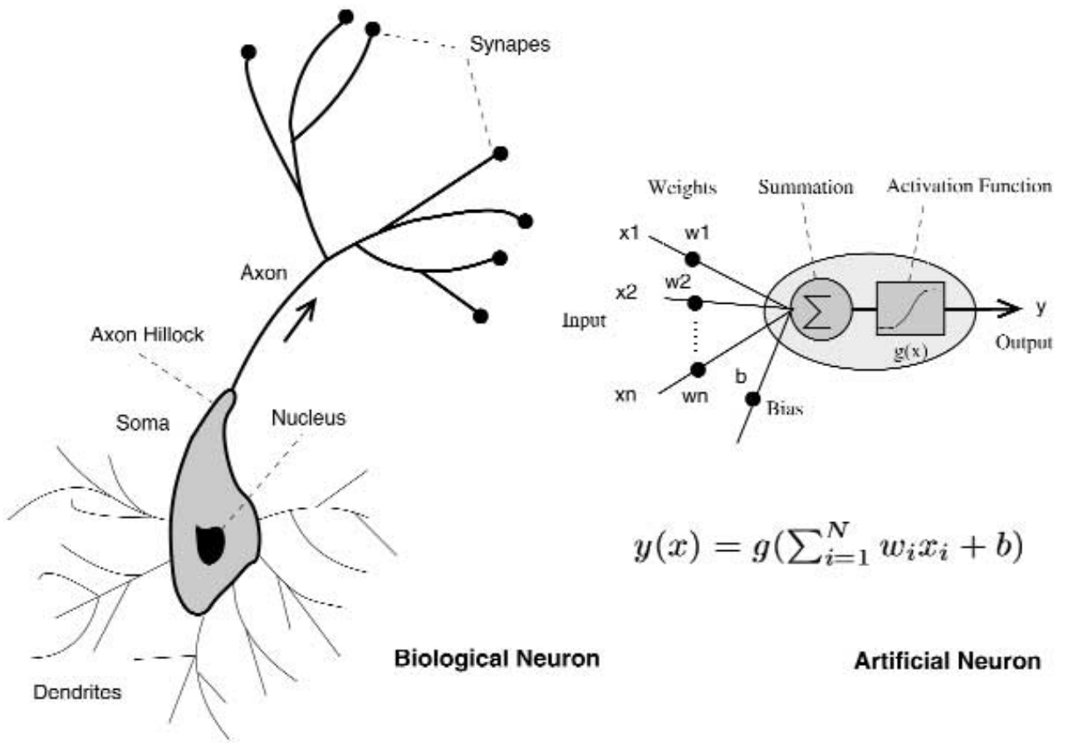
Artificial Neural Network

Slide 4
Artificial Neural Network
Warren McCulloch and Walter Pitts opened the subject by creating a computational model for neural networks in 1943
In the late 1940s, D. O. Hebb created a learning hypothesis based on the mechanism of neural plasticity that became known as Hebbian learning
In 1954, Farley and Wesley A. Clark first used computational machines, then called "calculators", to simulate a Hebbian network
Rosenblatt (1958) created the perceptron
The first functional networks with many layers were published by Ivakhnenko and Lapa in 1965
The basics of continuous backpropagation were derived in the context of control theory by Kelley in 1960 and by Bryson in 1961 using principles of dynamic programming

Slide 5
Neural Network: Perceptron Classifier
The neurolab Python module is a library for that contains base neural networks, train algorithms and flexible framework to create and explore other neural network types
Input file: data_perceptron.txt
0.38 0.19 0
0.17 0.31 0
0.29 0.54 0
0.89 0.55 1
0.78 0.36 1
Look at: perception_classifier.py
Figure 1 -> create a scatter plot

Slide 6
Neural Network: Perceptron Classifier
Neural networks can use supervised or unsupervised learning
They can be used for tasks such as classification, regression, and segmentation (identifying parts of an image)
All inputs (visual, textual, time-series) must be converted to numerical format for neural network
Many neural networks consist of many layers
The input layer will consist of N neurons
In a classification problem with M distinct classes, the output layer will consist of M neurons
All layers in between input and output are called hidden layers
A deep neural network has many layers

Slide 7
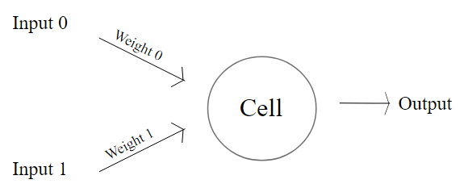
Neural Network: Perceptron Classifier
A simple Perceptron will add the weights of the activated inputs plus a constant (called the bias)
If the summation is greater than a threshold, then the output is activated (the neuron fires)

Slide 8
Neural Network: Perceptron Classifier
Okay, let's get back to the code....
The data points are 2-dimensional
Therefore, create a single-layer (newp) Perceptron with 2 input neurons
Train the Perceptron with the training data
Input array (data)
Output array (labels)
Number of epochs (epochs=100)
The print period (show=20)
Learning rate (lr=0.03)
See Figure 2
Print error_progress...try fewer epochs...change show=1

Slide 9
Neural Network: Perceptron Classifier
The learning rate is a tuning parameter in an optimization algorithm that determines the step size at each iteration while moving toward a minimum of a loss function
Since it influences to what extent newly acquired information overrides old information, it metaphorically represents the speed at which a machine learning model "learns"
In setting a learning rate, there is a trade-off between the rate of convergence and overshooting

Slide 10
Single -Layer Neural Network
A Perceptron is a simple building block of an ANN
The human brain has approximately 85 billion neurons
Let's look at a neural network with a single layer
Input file: data_simple_nn.txt
1.0 4.0 0 0
1.1 3.9 0 0
1.2 4.1 0 0
0.9 3.7 0 0
7.0 4.0 0 1
7.2 4.1 0 1
6.9 3.9 0 1
7.1 4.2 0 1
4.0 1.0 1 0
4.1 0.9 1 0
4.2 1.1 1 0
3.9 0.8 1 0
4.0 7.0 1 1
4.2 7.2 1 1
3.9 7.1 1 1
4.1 6.8 1 1

Slide 11
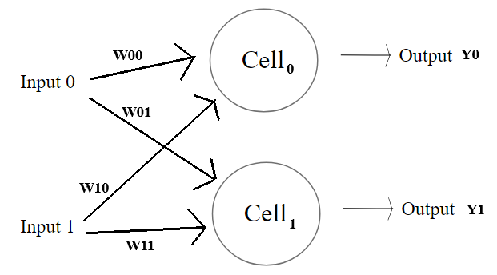
Single -Layer Neural Network
There are two labels for each data point since there are 4 distinct classes (00, 01, 10, 11)
Look at: simple_neural_network.py
Figure 1 -> create a scatter plot
Define a single-layer perceptron with 2 outputs
Train the neural network using the 16 data points
See Figure 2: Plot the training progress
Examine error progress over each epoch

Slide 12
Single -Layer Neural Network
Testing the trained neural network with 3 data points
data_test = [[0.4, 4.3], [4.4, 0.6], [4.7, 8.1]]
Look back at data file to make your own predictions
Run sim to simulate a neural network
Examine the training error after 100 epochs
The fact that we cannot get the error closer to zero with data that should be easy to classify shows us the limitation of this current single-layer approach

Slide 13
Multi -Layer Neural Network
Look at: multilayer_neural_network.py
Multiple layers allows solving more complex problems
Use ANN for regression (instead of classification)
Generate 130 points, x in [-15..15] based on y = 3x² + 5
Normalize the y values
Figure 1 -> scatter plot the 130 normalized points
Use x as the data
Use y as the labels
Define a multilayer ANN with 2 hidden layers:
First hidden layer consists of 10 neurons
Second hidden layer consists of 6 neurons
Output layer consists of 1 neuron
nn = nl.net.newff([[min_val, max_val]], [10, 6, 1])

Slide 14
Multi -Layer Neural Network
Train neural network with gradient descent:
Input: data and labels arrays
Epochs: 2000
Show: every 100 epochs
Goal: 0.01
error_progress = nn.train(data, labels, epochs=2000, show=100, goal=0.01)
Simulate the neural network using the training data
Figure 2 -> Plot the training error progress
Figure 3 -> Plot the actual data vs. predicted data

Slide 15
Neural Networks – More Details….
WATCH THIS VIDEO:
But what is a neural network? (19 min.)
https://www.youtube.com/watch?v=aircAruvnKk

