Slide 1
Welcome to the first JAM in Brno!

Slide 2
Agenda
Brno JAM introduction, future and how to get involved
Informal speeches and presentations
  Multibranch project
  Pipeline (formerly known as Workflow)
  What is new in Jenkins 2.0
Discussion/Networking
Wrap up around 3 pm

Slide 3
Brno JAM introduction
1 - 2 a year
Informal
User contributed content
Both novice and seasoned users
Jenkins oriented

Slide 4
Getting involved
Submit a talk, presentation or a workshop!
Help with JAM organization
  Find a place to meet
  Topic suggestions
  Invite a speaker
Come! Ask questions! Bring a friend!

Slide 5
Multi-branch project plugin
The old way
  Git plugin
  Multiple jobs
Why both sucks?
The proper way
Demo

Slide 6
Pipeline (ex Workflow)
  Jenkins as code
  Demo
  Extended features
    Power of the code
    Flexible node assignments
    User input integrated into pipeline
    Checkpoints
    Stages
  Does not support all plugins out of the box

Slide 7
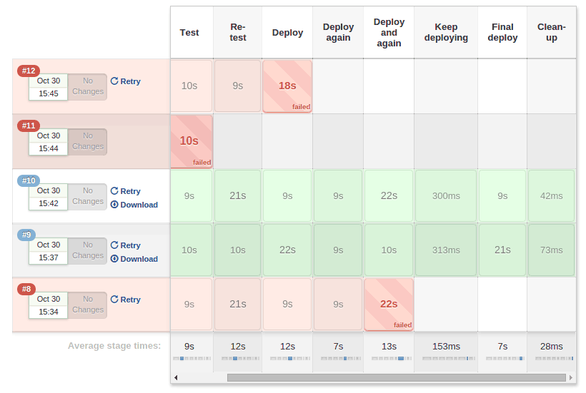
Pipeline stage view
Developed by CloudBees Inc.
Not yet opensourced
JENKINS-31154

Slide 8
Jenkins 2.0
Why do we need that?
What is being done?
  Out-of-the-box experience
  CD is the new king
  Pipeline as code
  Website

Slide 9
Discussion/Networking

