Slide 1
END USER COMPUTING. BICT 1101
Lecture 2: Word Processing (Contd..)

Slide 2
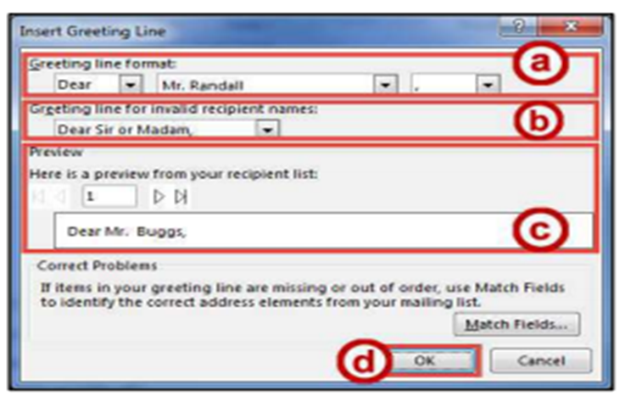
MAIL MERGE (GREETING LINE)
Figure 35 Inert Greeting Line

Slide 3
MAIL MERGE
Click More items.
Fields - Insert specific fields into your letter, one field at a time.
Insert - Insert the selected field.
Click the Close button.
In the Mail Merge pane, click Next: Preview your letters.
In the Mail Merge pane under Preview your letters, you can preview all letters before completing your mail merge.
Click Next: Complete the merge.

Slide 4
MAIL MERGE
In the Mail Merge pane under Merge, click Print.
In the Merge to Printer dialog box, select your option to Print Records.
Click the OK button.
The Print window will open. Adjust your settings for your printer and print your documents.

Slide 5
GRAPHICS
The use of graphics will improve your documents and allow you to provide the readers with more information in the form of a visual aid.
Some of the graphics features in Word include: Inserting Pictures, Inserting Shapes, Inserting Shapes, SmartArt, Chart.

Slide 6
INSERTING SHAPES
The following steps explains how to insert different predefined shapes into your Word document:
Click the Insert tab.
In the Illustrations group, click on the Shapes button.
A drop-down window will appear with a library of shapes to choose. Click on a shape to select it.
Your cursor will change to a crosshair and you will be ready to insert your selected shape.
To draw your selected shape within your document, hold the left mouse button and drag the cursor to draw your shape.
Release the left mouse button when you are finished drawing your shape. The shape will be added to your document.

Slide 7
INSERTING SHAPES
Modifying Shapes with Drawing Tools
You can modify shapes in a number of ways. Below are some of the ways that shapes can be changed:
Re-sizing a Shape
Re-sizing a shape is similar to re-sizing a graphic (picture or clip art).
Re-Shaping
After clicking on a shape, the shaping handles will appear (along with the sizing handles) as yellow squares. A two-dimensional shape can be altered by clicking and dragging the yellow squares to alter a certain aspect of the shape.

Slide 8
INSERTING SHAPES
Accessing the Drawing Tools – Format Tab
Shapes will have their own set of editing tools accessible by a context sensitive tab on the Ribbon. To access this tab, click on a shape in your document and the Drawing Tools – Format tab will appear in the Ribbon.
Adding Styles to your Shapes
Shapes have preset styles under the Drawing Tools – Format tab that you can use to alter the color, border, and any special effects to the shape. Steps to apply a style to a shape:
In the Shape Styles group, click on a Style of your choice.
Click the drop-down arrow to access additional styles.

Slide 9
INSERTING SHAPES
To access additional formatting options, click the dialog launcher in the lower-right corner of the Shape Styles grouping.
The Format Shape options will appear to the right of your document.
Applying Color to Your Shape: Steps to add/change the color of a shape:
In the Shape Styles group, click the drop-down arrow for Shape Fill.
Select a color to apply it to your shape.
Changing the Shape Outline: Steps to change the Shape Outline:
In the Shape Styles group, click the drop-down arrow for Shape Outline.
A drop-down menu will appear. From here you can alter the color, thickness (weight) of the outline, and add dashes.

Slide 10
INSERTING SHAPES
Switching Shapes: Steps to switch shapes in a document:
In the Insert Shapes group, click the Edit Shape icon. A drop-down menu will appear.
Click Change Shape. A list of shapes will appear.
Select a shape from the options available to switch it with your selected shape.
Add Text to a Shape: To add text to your shape, simply click on your shape to select it and begin typing. Your text will automatically fill into the shape. Adjust your shape as needed to make additional space for your text. Text can be formatted like regular text in the document.

Slide 11
INSERTING SMARTART
Inserting SmartArt: SmartArt graphics provide a visual representation of information or ideas. Steps to insert SmartArt graphics into your Word document:
Click the Insert tab.
In the Illustrations group, click on the SmartArt button.
The Choose a SmartArt Graphic window will open. Select a SmartArt graphic from the list.
Click the OK button.
The selected SmartArt graphic will be inserted into your Word document.

Slide 12
INSERTING SMARTART
Editing SmartArt Graphics: Once inserted into your Word document, your SmartArt can be edited and customized by accessing the SmartArt Tools tab. Steps on how to access the Design and Format tabs:
Click on the image of your SmartArt graphic. The SmartArt Tools contextual tab will appear at the top of the screen.
To alter aspects of the SmartArt design, click the Design tab. (The SmartArt Tools: Design tab contains tools that will allow you to alter the layout of the selected design, change colors, and select from preset styles).
To format aspects of the SmartArt graphic, click the Format tab. (The SmartArt Tools: Format tab contains tools that will allow you to change the shape of your SmartArt, add preset styles to the shape and words, and choose individual aspects of the SmartArt graphic to modify (e.g. changing the shape fill or outline)).

Slide 13
INSERTING CHARTS
Inserting Charts: Adding charts to your word document can help readers visualize a relationship among sets of data. Steps on how to add Charts to your word document.
Click the Insert tab.
In the Illustrations group, click on the Chart button.
The Insert Chart window will appear. Click on the chart you wish to use.
Click the OK button.
The selected chart will be inserted into your document.
Note: Hover your mouse over the picture of a graph for an enlarged preview of the chart.

Slide 14
INSERTING CHARTS
Editing your Chart
Once inserted into your Word document, your Chart can be edited and customized by accessing the Chart Tools tab. Steps to access the Design and Format tabs:
Click on your chart. The Chart Tools contextual tab will appear at the top of the screen.
To alter aspects of the Chart’s design, click the Design tab. (The Chart Tools – Design tab contains tools that will allow you to alter the layout of the selected chart, change colors, select and edit your data, and select from preset styles).

Slide 15
INSERTING CHARTS
To format aspects of the SmartArt graphic, click the Format tab. (The Chart Tools – Format tab contains tools that will allow you to add preset styles to the shape and words, arrange and position your chart within your document, and format specific areas of your chart (e.g. axis, chart title, values, legend, etc.)

Slide 16
INSERTING VIDEO
Inserting Video into your Document
This is a new feature in Word. When inserted into your document, the video will show a still image of the video.
When clicked, the video will open in a separate window and will play.
When printing out your document, the video will look like a picture.
Note: To use this feature, you will need an internet connection. Videos will not play if the computer accessing the document is not connected to the internet.
Steps to add video to your document:
Click the Insert tab.
In the Media group, click on the Online Video button.

Slide 17
INSERTING VIDEO
The Insert Video window will appear. A list of search options are presented.
In one of the search boxes, type a word or phrase that describes the desired video you wish to search for.
Press Enter.
A list of your search results will appear.
To preview the video, mouse over the image and click the magnifying glass.
Click the desired video you wish to add and click the Insert button.
The video will be added to your document. It will show a still image from the video that will display in the document as a picture (this is the image that will also appear if you print the document).
To play the video, click the play button on top of the still image.

Slide 18
INSERT WATERMARK
A Watermark is a faded background image that displays behind the text in a document.
It can be used to
indicate a document’s state e.g. Confidential, Draft, etc.
Add a Company logo
Add some art
Word offers you options to insert built-in Watermark or a Customized Watermark.

Slide 19
INSERT A WATERMARK
Inserting Built-in Watermark
Open the Design Tab
On the Page Background Group, click the Watermark button.
On the drop down menu, click on any of the built-in watermarks to insert into your document.
The watermark will be placed behind the text in your document.

Slide 20
INSERT A WATERMARK
Inserting Custom Watermark
You can also create custom watermarks from text or images.
Select the Custom Watermark from the Watermark drop down menu
In the Printed Watermark window that opens, select the Text Watermark option.
Type the text you want to use into the Text box and then configure the options for language, font, size, color and orientation the way you want them.
Click OK
Your Custom Watermark will be placed behind your text in your document.

