Slide 1
DATA

Slide 2

1. Introduction:
Big Data and Data Science hype and getting past the hype
Why now? – Datafication
The current landscape of perspectives
Skill sets needed
Overview

Slide 3
1. Introduction to Data Science & Big Data
What is Data Science?
The Hype vs Reality, Rise of Big Data, “Why Now?” – Datafication
Overview

Slide 4
The Hype vs The Reality
Hype | Reality
Data science is magic | It’s hard work, lots of trial-and-error
AI is smarter than humans | AI finds patterns, not meaning
Instant results | Takes time, clean data, and interpretation
Always accurate | Often uncertain, needs human oversight

Slide 5
The Hype vs The Reality
Media Portrayal & Misconceptions (The Hype)
The media often shows data science as magical.
It shows like you just feed data into an algorithm and get instant answers.
Buzzwords like AI, Big Data, and Machine Learning get thrown around like they solve everything.
Movies and articles make it look like one brilliant data scientist can predict the future or create a super-intelligent machine.

Slide 6
The Hype vs The Reality
Misconceptions:
Data science is just about coding (not true! Much time is about cleaning data, understanding context, and interpreting results).
AI = consciousness (nope! It is pattern recognition, not self-awareness).
Data science always leads to clear, perfect answers (Not quite! It often, gives probabilities, not certainties).

Slide 7
The Hype vs The Reality
Reality: Real-World Impact vs Marketing Buzz
Reality check: Data science is powerful but has limits.
It involves a lot of data cleaning, testing, and human judgment.
Many data projects fail or don't provide the promised ROI (return on investment).
But when done right, it can seriously improve decision-making, personalisation, and efficiency.

Slide 8
The Hype vs The Reality
Case Studies:
Facebook
Hype: AI predicts everything you’ll like. Reality: Uses algorithms to rank posts and ads, but struggles with misinformation, bias, and user trust.
Netflix
Hype: Netflix knows exactly what you want to watch. Reality: Recommendations are based on patterns, but they’re not perfect.
Its a mix of data + A/B testing + human curation.

Slide 9
The Hype vs The Reality
Amazon
Hype: Super smart AI that knows your next purchase before you do. Reality: Strong at using purchase history and browsing behaviour, but it still shows weird suggestions.
Much of its success comes from logistics and customer data, not just “AI.”

Slide 10
The Rise of Big Data – What’s Going On?
Big Data refers to the massive explosion of data in the world so much that traditional tools can’t handle it anymore.
It’s not just about having more data, but also about new types and faster flow of data.

Slide 11
Data
At its core, data is a collection of information that can be analysed to generate insights and support decision-making.
In Data Science, one of the primary goals is to structure data, transforming raw, unorganized information into a format that is interpretable and suitable for analysis.

Slide 12
Evolution of Data: Structured vs Unstructured
Structured data = neatly organized (like in spreadsheets or databases). Examples: names, dates, sales numbers.
Unstructured data = messy or free-form. Examples: photos, tweets, emails, videos, sensor data.
Now, most of the data is unstructured, and that is what makes Big Data challenging and exciting.
The reason an expert has to handle it; Data scientists.

Slide 13
How Do We Structure Data?
To make data usable for analysis, it needs to be organized using tools such as:
Arrays (in programming)
Tables (in databases)

Slide 14
The 5 Vs of Big Data
Volume – Huge amounts of data (think in terabytes to petabytes [1000TB]) or brontobytes.
Velocity – Data comes in fast (real-time tweets, stock trades, sensors).
Variety – Different types of data (text, images, audio, logs, etc.).
Veracity – This deals with the quality and trustworthiness of the data? (Is it clean, accurate, unbiased?)
Value – The usefulness and insights derived from the data. (Can we turn data into insights or profits?)

Slide 15
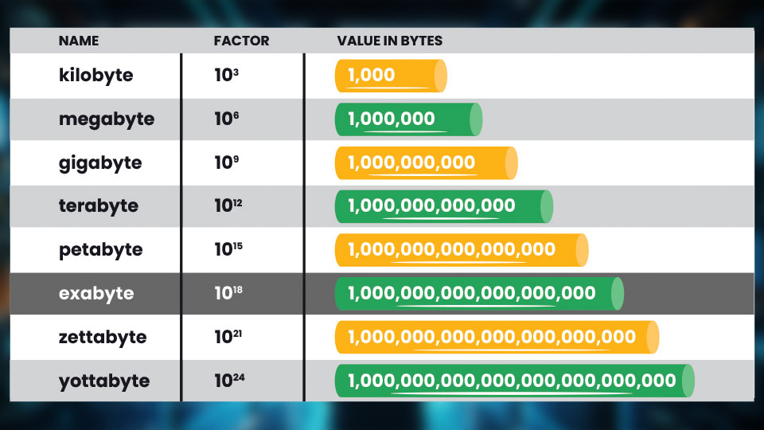
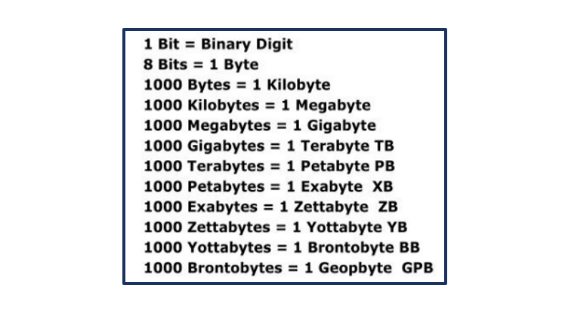
Data volume

Slide 16
Historical Context
From Databases to Distributed Systems
Old days: Data lived in structured databases on single machines.
Now: Data is too big, so we use distributed systems like Hadoop and Spark, spreading data across many servers to handle it.

Slide 17
Then | Now
Small, structured data | Massive, mixed-format data
Stored on local servers | Stored in the cloud
Analyzed manually | Analysed with AI/ML
Used mainly by businesses | Used by everyone: apps, governments, healthcare, etc.

Slide 18
Datafication
Why Now❓
We’re in a time where almost everything is turning into data.
Datafication means turning things that were never considered data before into data so we can analyse, track, and use them.
It’s not just about storing info anymore.
It’s about transforming everyday actions, behaviours, and processes into data.
Companies use this data to improve services, predict behaviour, or personalise experiences.
Governments use it for urban planning or public health. Scientists use it for research and discovery.

Slide 19
Real-world Thing | Datafied Version
Going for a run | Steps, heart rate, GPS route (via fitness app)
Watching a show | Viewing time, pause points, skips (on Netflix)
Social interaction | Likes, shares, comments (on social media)
Driving | Speed, location, braking (from car sensors)

Slide 20
What's Driving the Boom?
1. Sensors, Smartphones & Social Media
Billions of devices constantly generate data e.g. GPS, cameras, apps, wearables.
Every sentiment (like, view, comment, photo = data point.
2. Cloud Computing & Scalable Storage
Cloud platforms (like AWS, Azure, GCP) make it easy and cheap to store and process huge data sets, no need for your own servers.

Slide 21
3. Open Data Initiatives
Governments, organizations, and researchers are making tons of data publicly available for innovation, transparency, and research.
4. Machine Learning & AI as Enablers
These tools learn from big data to make predictions, automate decisions, and uncover patterns humans can’t see.

Slide 22
So, what is data science?

Slide 23
What is Data Science?
Data Science is about using data (numbers, text, images, videos, sounds, etc.) to find patterns, make predictions, and help make decisions.
It combines, statistics.
Data Science is an interdisciplinary field that combines math, statistics, computer science and domain knowledge.
It involves data analysis, and machine learning to interpret complex data and extract actionable insights.

Slide 24
Data science helps organizations make smarter decisions, solve complex problems, and understand human behaviour. With data growing rapidly, the demand for skilled professionals is rising.
Python and R are key languages in data science, with Python favoured for its:
Ease of Use: Simple, beginner-friendly syntax
Powerful Libraries: Tools like Pandas and NumPy for analysis and machine learning
Strong Community: Active support and abundant learning resources

Slide 25
Data Science
At its core, Data Science involves:
Data Collection
Data Analysis
Data-Driven Decision-Making
It enables organisations to identify patterns within data and make informed predictions about future outcomes.

Slide 26
Skill Sets of a Data Scientist
Type | Technical Skills | Statistical Foundations | Soft Skills | Roles in the Field
Examples | - Programming (Python, R) - Data wrangling - Machine learning - Visualization tools (Tableau, matplotlib) | - Hypothesis testing - Regression - Probability | - Communication - Problem-solving - Business acumen | - Data Analyst - Data Engineer - Data Scientist - ML Engineer
Self-assessment: Which skills do you currently have? Which do you want to develop?
Group discussion or reflection: “What kind of data scientist do you want to be?

Slide 27
Why is Data Science Important?
By leveraging Data Science, companies can:
Make smarter decisions (e.g., choose the most effective business strategy)
Conduct predictive analysis (e.g., forecast future trends or outcomes)
Uncover hidden patterns (e.g., identify anomalies or opportunities within datasets)

Slide 28
Applications of Data Science
Data Science is widely applied across various industries, including:
Banking . Consulting
Healthcare . Manufacturing
E-commerce . Logistics
Politics

Slide 29
Examples of use cases:
Optimising delivery routes and schedules
Predicting transportation delays
Designing targeted marketing campaigns
Forecasting company revenue
Evaluating the impact of health programs
Predicting election outcomes

Slide 30
How Data Scientists Work
A Data Scientist bridges technical knowledge with business understanding to drive data-informed decisions.
Key areas of expertise include:
Machine Learning
Statistics
Mathematics
Programming (Python, R)
Databases and Data Engineering

Slide 31
Typical Workflow of a Data Scientist
Define the Problem Understand the business context and formulate relevant questions.
Data Collection Gather data from databases, APIs, web logs, or customer feedback.
Data Preparation
Extract and transform data into a usable format
Clean and normalise data
Handle missing or inconsistent values

Slide 32
Typical Workflow of a Data Scientist
Data Analysis & Modelling
Identify patterns and correlations
Develop predictive models using machine learning techniques
Interpret & Communicate Results
Visualize insights clearly and effectively
Translate data findings into actionable business recommendations

Slide 33
2: The Data Science Landscape & Process Perspectives in Data Science, Components of the Data Science Process
Overview

Slide 34
Perspectives in Data Science,
Business = Use data to create value
Academia = Use data to learn and model
Engineering = Build the tools and systems to handle data

Slide 35
Perspectives in Data Science & Components of the Data Science Process
Perspectives in Data Science
Industry Viewpoints:
Business: Value creation through insights
Goal: Use data to make money or improve performance. Focus: "How can we use data to make better decisions, save costs, or grow?"
Example: A company uses customer data to recommend products and increase sales.

Slide 36
Perspectives in Data Science
Academia: Statistical modelling and discovery
Goal: Understand patterns and build theories using data. Focus: "How can we model the world using statistics and math?"
Example: A professor uses data to study how diseases spread.
This study results can be implemented inn the implementation

Slide 37
Perspectives in Data Science
Engineering View (Tech/IT): Building scalable data systems
Goal: Build systems that can handle huge amounts of data.
Focus: "How can we store, process, and move big data efficiently?"
Example: An engineer designs a data pipeline that handles millions of transactions per day.

Slide 38
Perspectives in Data Science & Components of the Data Science Process
Stakeholders:
Data Engineers, Analysts, Domain Experts, Product Managers, Decision Makers
Data Science Across Domains:
Healthcare, Finance, E-commerce, Social Media, Sports, Education

Slide 39
Components of the Data Science Process
1. Problem Formulation:
Turning vague questions into clear, testable hypotheses
2. Data Collection:
Sources: APIs, databases, web scraping, public datasets
3. Data Cleaning & Preparation:
Handling missing values, outliers, inconsistent data
4. Exploratory Data Analysis (EDA):
Summary statistics, visualizations, initial insights

Slide 40
Components of the Data Science Process
5. Modelling:
Choosing algorithms based on the problem type (classification, regression, clustering)
6. Evaluation:
Metrics (accuracy, precision, recall, RMSE, etc.)
7. Deployment & Communication:
Sharing results with stakeholders, dashboards, APIs
8. Iteration & Feedback Loops:
Continuous improvement, data drift awareness

Slide 41
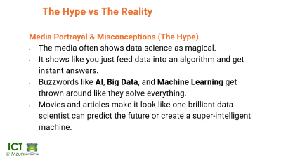
Seminar
Assignment: What Does Data Science Mean to Me?
Title: “Data Science: My Lens, My World”
Be creative! This is not a textbook definition exercise. It's a personal exploration of what data science means to you, based on what perceive and what excites you.
Suggestions:
Describe how you see data science transforming the world or your world.
Draw metaphors: Is data science a compass? A detective? A wizard?
Reflect on a moment you realized the power of data.
Imagine yourself as a future data scientist — what kind of problems would you want to solve?
Include personal inspirations: a project, a tech innovation, or a mentor figure
Deliverable: Tell your story in a unique way
Use visuals, animation (sketches, diagrams, infographics)
Engage in Higher-Level Thinking – Focus on critical thinking, debate, analysis, and be ready to be pointed at to present for your group at a random slot

