Slide 1
LESSON 2 Statistical Inference Populations and samples Statistical Modelling and Probability Introduction to modelling, fitting data to models Evaluating Model Performance Matters Distributions – Normal, Binomial, Poisson Simulating distributions and plot

Slide 2

2.2 Statistical Modelling and Probability
Overview

Slide 3
Human vs ML models
Humans and machine learning models differ significantly in how they learn and process information.
Humans learn through multimodal experiences, integrating knowledge from various senses and contexts.
Machine learning models primarily focus on data-driven learning, often limited to processing a single type of data.

Slide 4
Human Learning and Machine Learning models
Aspect | Human Learning | Machine Learning Models
Modality | Multimodal: Learns through vision, hearing, touch, smell, etc. | Unimodal or Multimodal: Can handle single or multiple data types (e.g., text, image).
Context Sensitivity | Contextual: Influenced by environment, social interaction, and experience. | Data-Driven: Learns from large datasets; context is encoded through data representation.
Complexity | Complex: Involves knowledge, skills, attitudes, and transfer of learning. | Predictive and Analytical: Focused on pattern recognition, analysis, and prediction.
Emotional Factors | Emotional and Intuitive: Emotions and subconscious processes impact learning. | Typically, Algorithm-Based: Guided by mathematical rules and training processes. Operates through formal algorithms without emotional input.
Learning Mechanism | Experience-based, adaptive, and intuitive. | Governed by mathematical models and training algorithms.

Slide 5
What is a Model?
Whether physical or mathematical, models help us understand, explain, and predict the world using data.
In Data Science a model is a program or system that learns from data to make predictions or decisions.
Physical models: These are small-scale, tangible representations of something real.
Example: A map of Malawi or a 3D model of a building.

Slide 6
What is a Model?
A model is a simplified version of something in the real world that helps us understand, explain, or predict how things work.
A map is a model of a place. It shows important features like roads and rivers but leaves out small details.
A toy airplane is a model of a real airplane.
It helps us see what a plane looks like without needing the real one.
In science or math, a model could be an equation that shows how something behaves like how fast something falls.

Slide 7
Why Use Models?
To predict future outcomes (e.g., crop harvest based on early rains)
To understand relationships (e.g., how education affects employment)
To test ideas (e.g., will giving mosquito nets reduce malaria cases?)

Slide 8
Model Components
Variables: These are what you measure.
The Things that can change. E.g. Inputs (rainfall), outputs (crop yield)
Parameters: Numbers you estimate to make the model work e.g. The slope of a line showing how much crop yield increases with more rainfall.
Example: In the equation Yield = 2 × Rainfall + 5, the number 2 is a parameter showing that for every unit increase in rainfall, crop yield increases by 2 units, 5 is the intercept that shows the yield when rainfall is zero.
Notes:
5 is the intercept it shows the yield when rainfall is zero.

Slide 9
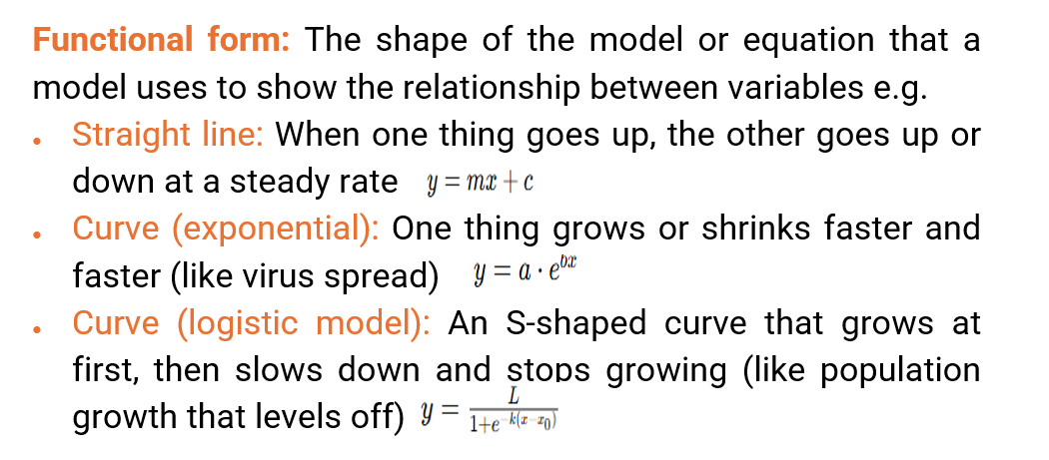
Model Components

Slide 10
Data and Modelling
Models are made or built using real-world information (data) to understand or predict something.
Example: Collect maize yield data from Mzuzu, fit a model with rainfall.
Example:
You collect maize yield data from Mzuzu.
You also record how much rainfall there was.
Then, you build a model to see how rainfall affects maize yield.

Slide 11
Fitting Models to Data
Like drawing the best line through data points.
Fitting is about adjusting the model so it matches the data as closely as possible.
Example: Imagine you have dots on a graph (your data), and you try to draw the best line that goes through or near them. That line is your fitted model.
Fitting = finding the best match between your model and the real-world data.

Slide 12
What is “Best Fit”?
The best-fitting model has small differences between real and predicted values.
Best fit means the model's predictions are very close to the actual data.
The difference between what really happened and what the model predicts is called a residual.
A good model has small residuals — meaning it predicts well. Best fit = smallest differences between real data and model predictions.

Slide 13
Model Complexity: Striking the Right Balance
When building models, it’s important to find the right balance between simplicity and complexity.
Two common problems that arise are overfitting and underfitting.
The Goal is Generalisation
A good model:
Captures the underlying pattern (signal),
Ignores the random noise,
Performs well on both training and new data.

Slide 14
Generalization
Generalisation describes how well a model performs on new, unseen data which is exactly what underfitting, proper fitting, and overfitting relate to.
It sits at the core of the trade-off:
Underfitting → Poor generalisation due to oversimplified model
Good fit → Optimal generalisation
Overfitting → Poor generalisation due to overly complex model

Slide 15
Overfitting: Too Complex
The model is too complex and captures not just the real pattern (signal) in the data but also the random fluctuations (noise).
It fits the training data too perfectly, including the outliers or random variations.
Consequence: Poor performance on new or unseen data as it doesn’t generalise well.
Example: Fitting a 5th-degree polynomial curve to just 3 data points. It may look perfect, but it's misleading.
Overfitting = Model learns the noise.

Slide 16
Underfitting: Too Simple
The model is too simple to capture the underlying structure or patterns in the data.
It misses important trends and relationships.
Consequence: The model performs poorly even on training data, let alone new data.
Example: Using a straight line to fit data that clearly follows a curved trend.
Underfitting = Model misses the signal.

Slide 17
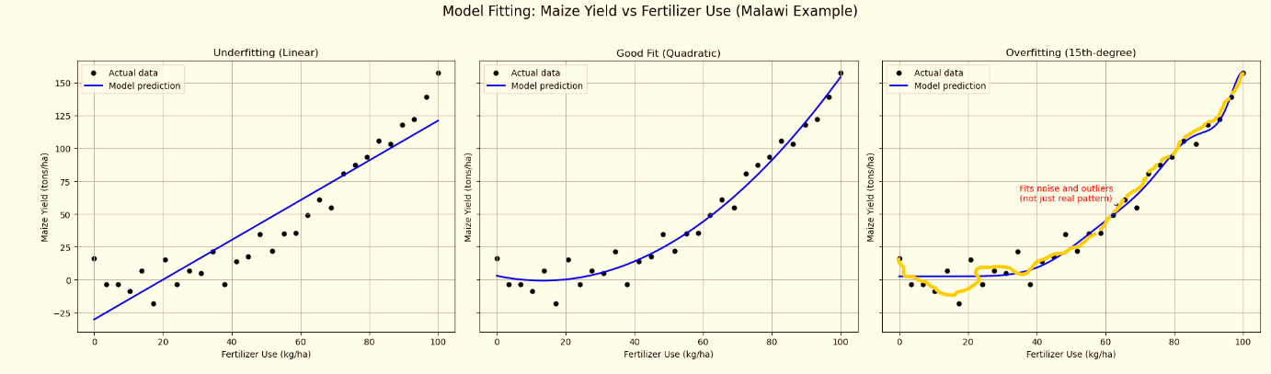
Model generalisation spectrum

Slide 18
Examples of Models- Linear model
Why Use a Linear Model?
Easy to interpret
Works well when the relationship is simple and direct
Shows clear trends in data

Slide 19
Example – Linear Fit
Data: Fertilizer use (input) vs. maize yield (output)
You plot the data points on a graph and then you draw a line that goes as close as possible to most of the points. This is the best-fitting line as it best represents the trend.
A linear fit means drawing a straight line through data points to show a trend.
As fertilizer use increases, maize yield usually increases — the line shows that general trend. Linear fit = straight line that best shows the pattern in the data.

Slide 20
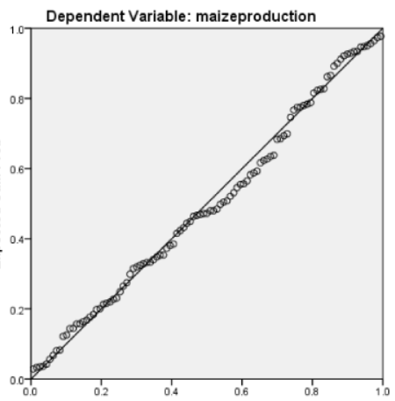
A simple linear regression
Maize yield ( kt)
Fertiliser ( kt)

Slide 21
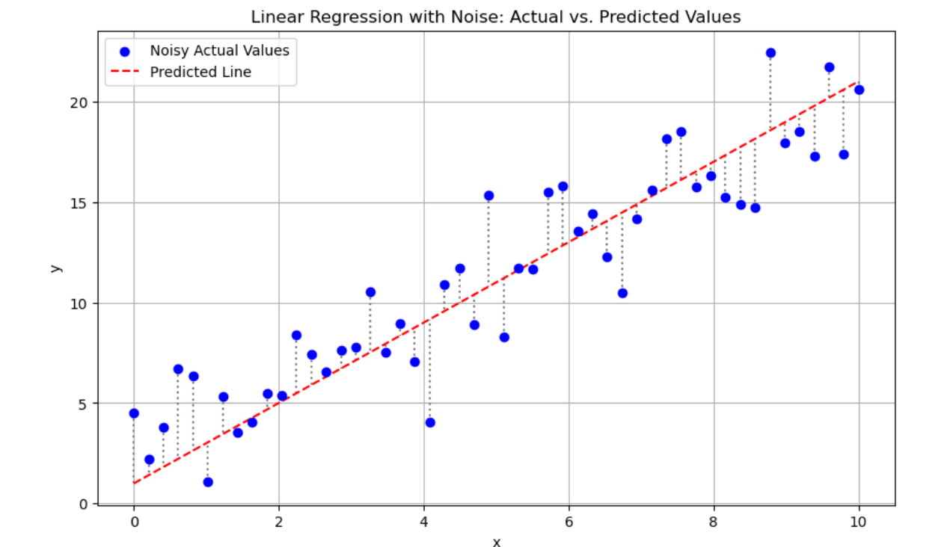
Linear regression

Slide 22
Nonlinear Models
In many real-world situations, relationships between variables aren't perfectly straight.
That’s where nonlinear models come in.
Unlike linear models, which use a straight line, nonlinear models use a curved line to better represent data patterns that change at varying rates.

Slide 23
Why Use Nonlinear Models?
Real-life patterns are rarely linear: Data often changes more rapidly or more slowly at different points.
More accurate fits: Curved models can more precisely match complex trends that a straight line cannot capture.
Better predictions: When the relationship isn't linear, forcing a straight line can lead to poor predictions. A curve fits better.

Slide 24
Fitting Nonlinear Models: How It’s Done
Select the type of curve that might fit the data (e.g., exponential, quadratic, logistic).
Use software tools like Excel, R, or Python to compute the best-fitting curve.
Evaluate the model to ensure it accurately represents the data.
Key Point: Fitting a nonlinear model means using statistical software to find the curve that best matches data patterns that don’t follow a straight line.

Slide 25
Fitting Nonlinear Models
Example:
As education level increases, birth rate decreases, but not in a straight line.
At first, the drop is big, then it slows down, so the line curves. Nonlinear model = a curve that better fits data when the relationship isn’t straight

Slide 26
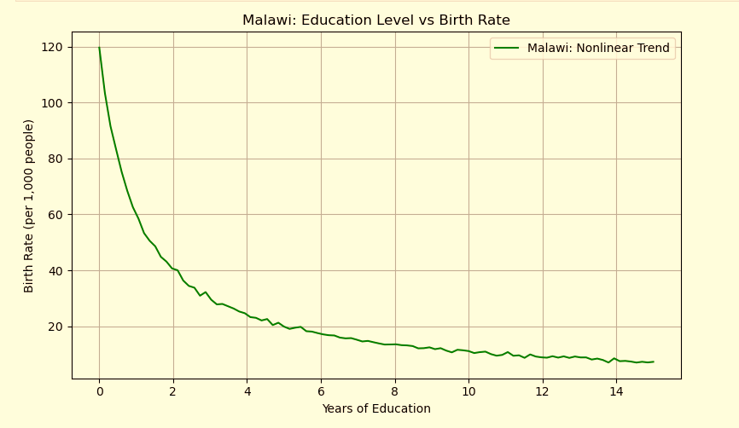
Nonlinear Models

Slide 27
Nonlinear Models
Why the Decline in Birth Rate Slows at Higher Education Levels?
Most of the big impact happens early
When people go from no education to basic education, there’s a huge lifestyle shift:
Better health knowledge
Family planning awareness
Higher chance of employment, especially for women This rapidly reduces birth rates.

Slide 28
Nonlinear Models
After a certain point, changes are smaller
Going from secondary to university still lowers birth rates, but the effect is less dramatic.
These groups already have:
Access to contraception
Career goals that delay childbirth
Fewer social or economic pressures to have many children So, the decline slows down it’s still falling, just more gradually.

Slide 29
Nonlinear Models
Cultural and economic factors level off
In some cases, education rises, but cultural values or access to healthcare remain unchanged.
In other words, people with high education may still choose to have children later but not necessarily fewer.
Statistical flattening
As birth rates approach low levels, there's simply less room to drop further.
You can't go below zero kids, so the curve naturally flattens.

Slide 30
Examples of Models- Multiple Linear Regression
Multiple Linear Regression: A method to predict a number (output) using two or more input features.
Like simple linear regression but with multiple features instead of just one.
Example Features
Size of the house
Number of bedrooms
Distance to the city centre
Use case: Predict house prices by considering all these factors together.

Slide 31
Examples of Models- Multiple Linear Regression
Multiple Linear Regression is a way to predict a number (output) using two or more inputs (features).
It's like regular linear regression (where you predict something using one feature), but here you use more than one feature.
It extends simple linear regression (which uses one feature) to handle multiple variables.
In multiple linear regression, you use more features, like:
Size of the house (in square meters)
Number of bedrooms
Distance to city centre (in km)

Slide 32
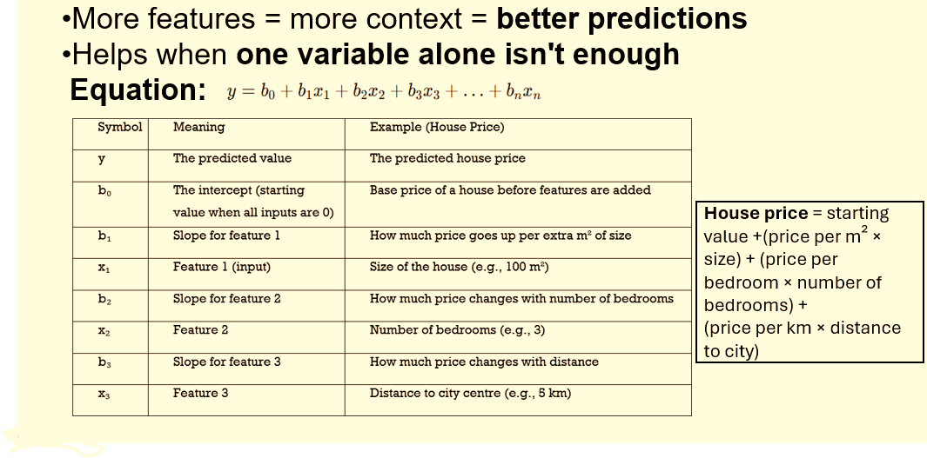
Examples of Models- Multiple Linear Regression

Slide 33
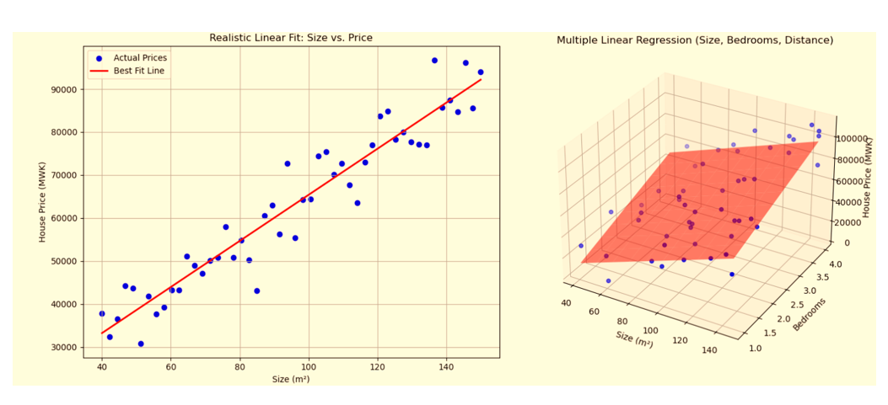
Model examples: Simple vs multiple

Slide 34
Model examples: Simple vs multiple
Dots - Real data points (actual prices)
Surface/line - Predicted prices by the model
If dots are close to the surface, the model is accurate.
If dots are far from the surface, the model made an error (residual is large).

Slide 35
Model examples: Simple vs multiple
Each blue dot represents an actual house in the dataset.
Each one has:
A certain size (in m²)
A number of bedrooms
A measured price (in Malawian Kwacha)
The Red surface
This is the predicted house price according to the multiple linear regression model.
It’s like the model’s “best guess” of what the price should be based on size, bedrooms, and average distance.
The surface helps you visually compare actual dots (real prices) with the model’s predictions.

Slide 36
Examples of Models- Logistic model
A logistic model shows growth that starts slow, speeds up, and then slows down again as it reaches a limit (saturation).
Shape overview: It forms an S-shaped curve (also called a sigmoid curve).
S-Shaped Curve (Logistic or Sigmoid Growth)
Shape: Slow start → rapid increase → levels off (saturation)
Think of it like: An S-shaped curve fast growth at first, then it levels off.
S-shaped models, also known as logistic models, show a more gradual increase initially, followed by a slowdown and levelling off

Slide 37
Model examples: Logistic model
Model Type: Logistic Model
Often used in:
Logistic Regression (for classification problems)
Logistic Growth Models (in biology, economics, etc.)

Slide 38
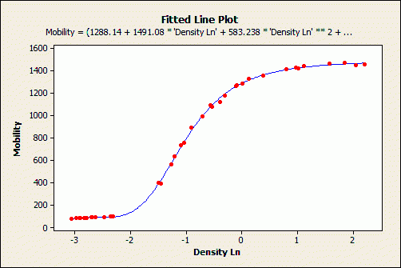
Model examples:S-shaped curve

Slide 39
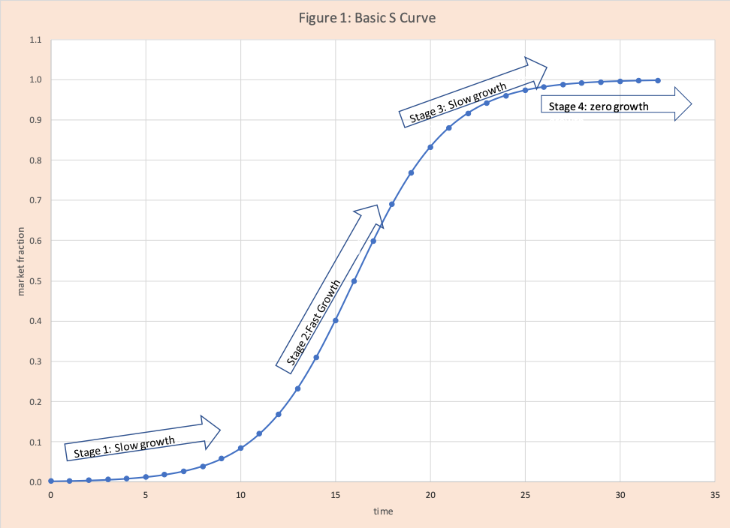
Model examples

Slide 40
Model examples: Logistic model
The logistic growth model like mobile internet adoption over time is a regression problem, not classification.
You're predicting a continuous value (like adoption percentage over time).
It's just shaped like an S-curve, but it’s still numeric prediction, not labels

Slide 41
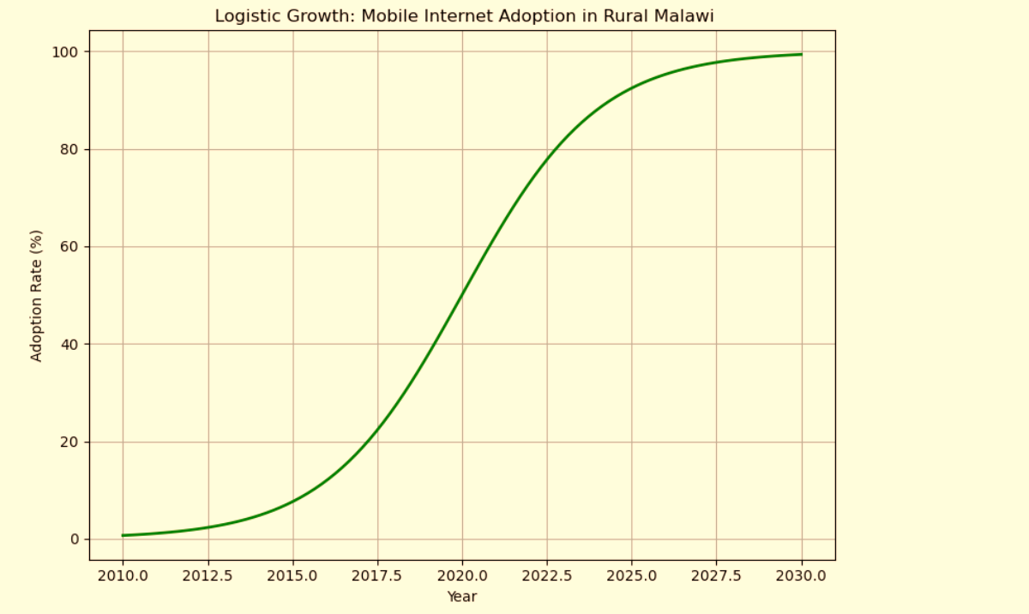
Model examples: The logistic growth model

Slide 42
Model examples: Logistic model
But when is it a classification problem?
When you use a logistic model for classification, it’s typically Logistic Regression but goal is to:
Predict categories, e.g.: Will a student drop out? → Yes/No
Is this SMS spam? → Spam/Not spam
Will the maize crop fail? → Fail/Not fail.
Model Type | Use Case | Output Type | Is it Classification?
Logistic Growth Model | e.g. Internet adoption over time | Continuous % | ❌ No
Logistic Regression | e.g. Predict dropout (Yes/No) | Class Label | ✅ Yes

Slide 43
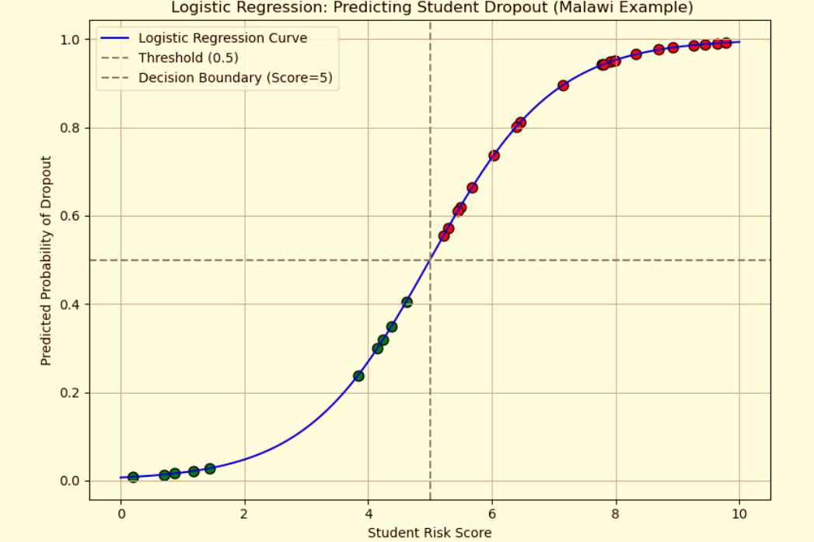
Model examples :Logistic model

Slide 44
Model examples :Logistic model
Red dots: Predicted to drop out (Class = 1)
Green dots: Predicted to stay (Class = 0)
Curve: Logistic regression output
Dashed line at 0.5: Classification threshold

Slide 45
Examples of Models- Logistic model
Use When:
There is a carrying capacity or upper limit
Growth slows as it approaches a maximum
Real-World Examples:
Technology adoption
Disease spread with herd immunity
Example: How a disease like cholera spreads and slows over time
This means: The disease spreads quickly at first but then slows down as more people recover or get treated.
Battery charging over time

Slide 46
Model examples: J-Shaped Curve (Exponential Growth)
J-Shaped Curve : shows a pattern where change starts small, then becomes faster and faster either increasing or decreasing rapidly.
Exponential Model
Exponential Growth: 📈 Exponential Growth Model
Exponential Decay: 📉 Exponential Decay Model

Slide 47
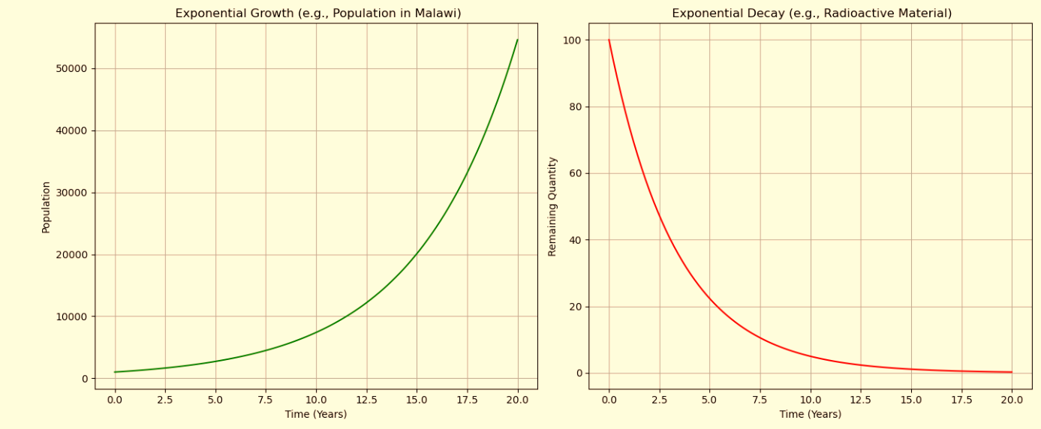
Model examples: Exponential Growth/Decay

Slide 48
Model examples: Exponential model
Use When:
Growth or decay is not constant
Change speeds up over time
Data doesn’t fit a straight line or S-curve
Growth or decay accelerates

Slide 49
Model examples :Exponential model
Real-World Examples:
Population growth in fast-growing districts in Malawi over the years
Spread of infectious diseases (e.g., cholera or COVID-19 cases)
Radioactive decay (science lab experiments)
Mobile money users doubling rapidly in rural areas
Think of it like: A snowball rolling down a hill – it starts small but grows quickly.

Slide 50
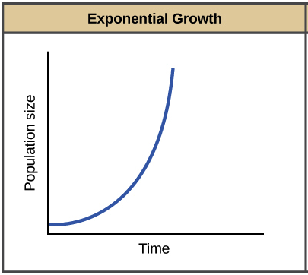
Model examples: Exponential model

Slide 51
Model examples
The main difference between exponential growth and S-shaped (logistic) growth lies in how they account for resource limitations.
Exponential growth models, often represented by a J-shaped curve, assume unlimited resources and lead to rapid, accelerating growth.
S-shaped growth, on the other hand, incorporates resource constraints and a carrying capacity, resulting in a slower, then accelerating, growth that eventually plateaus.

Slide 52
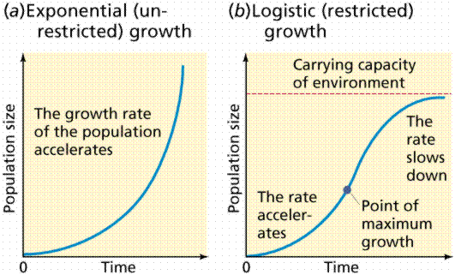
Model examples

Slide 53

Model examples: U-Shaped or Inverted U (Quadratic or Polynomial)
Shape: Data curves once (either up or down)
Model Type: Polynomial Model (usually degree 2)
Equation:
Examples
Quadratic Regression
Polynomial Regression (degree >1)
Use When:
Data has a turning point (minimum or maximum)
Real-World Examples:
Projectile motion
Cost vs. quantity (economies of scale)

Slide 54
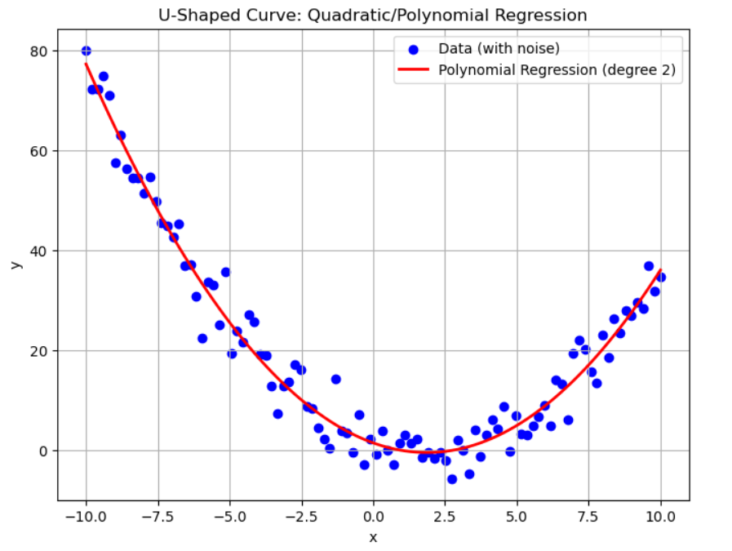
Model examples: U-Shaped or Inverted U (Quadratic or Polynomial)

Slide 55
Step Function Modelling or Piecewise Modelling
Plateau or Step Trend
This modelling approach is used when data shows sudden changes followed by periods of stability, forming a plateau or step-like trend.
The model doesn't assume a smooth, continuous relationship but instead defines distinct intervals (pieces) where the behaviour remains relatively constant, and then abruptly shifts at known points.

Slide 56
Step Function Modelling or Piecewise Modelling
Shape: Sudden changes jumps or drops, then flat regions, then a step pattern stabilisation
Model Type:
Step Function: Assigns constant values within intervals. Piecewise Function: Uses different functions or constants for different intervals.
Equation: Depends on piecewise definition

Slide 57
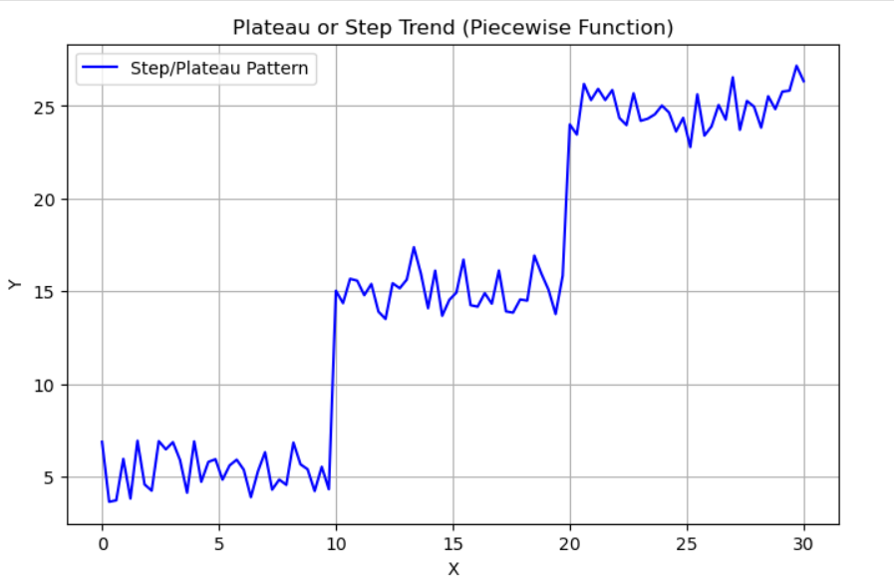
Step Function Modelling or Piecewise Modelling

Slide 58
Step Function Modelling or Piecewise Modelling
Examples:
Decision Trees: Split data at thresholds, leading to discrete steps in prediction.
Stepwise Regression: Adds/removes variables in steps.
Use When: There are known breakpoints in the data — e.g., policy changes, regime shifts, or technical thresholds
Common Use Cases:
Sales data after a product launch
Website traffic before and after a campaign
Economic data following regulation changes

Slide 59
2.3 Evaluating Model Performance Matters

Slide 60
Why Evaluating Model Performance Matters
Building a predictive model is only half the job the other half is evaluating how well the model performs. Without proper evaluation, you can’t tell whether a model is making accurate predictions, overfitting the data, or missing key patterns.

Slide 61
Why Evaluating Model Performance Matters
To ensure a model is reliable, accurate, and generalizes well to new data, data scientists use a variety of tools and techniques.
These help in:
Assessing how well the model fits the data
Measuring prediction errors
Diagnosing performance issues
Improving the model for better outcomes

Slide 62
Evaluating Model Fit
Choosing the Right Model
Start simple Begin with a simple model like a linear model (a straight line).
Example: You want to predict maize yield based on rainfall. Use background knowledge – rainfall doesn’t grow crops instantly, so maybe not linear
When building a model to predict something (like crop yield, prices, or rainfall), it's important to check if the model fits the data well. This is called evaluating model fit. Why? It’s easy to understand and often works well enough.

Slide 63
Evaluating Model Fit
Choosing the Right Model
Increase complexity only if needed
Make it more complex only when necessary. If the simple model doesn’t work well (big errors or strange results), then try a more complex one (e.g., stepwise, polynomial, decision tree).
Example: If you see that after a certain amount of rain, the maize yield doesn’t increase (it plateaus or even drops), a straight line isn’t the best choice maybe a step function or curve fits better.

Slide 64
Evaluating Model Fit
Choosing the Right Model
Use Local Knowledge
.Use local knowledge to guide model choice.
Don’t just trust the model use what you know from real life.
Example: Rain doesn't grow crops instantly.
Too much rain can damage crops.
Fertilizer use or planting time also affects yield.
So, your model should reflect that:
Maybe delay the impact of rain by a few weeks.
Don’t assume yield always increases with rain.

Slide 65
Tools to Evaluate and Improve Model Performance
Error Metrics
Classification Metrics
Diagnostic Plots
Cross-Validation
Model Comparison Tools
Feature Analysis & Model Tuning
Model Validation Techniques

Slide 66
Error Metrics
Used primarily in regression tasks to quantify the size of prediction errors.
Mean Absolute Error (MAE)-Tells how far off your predictions are, on average.
E.g On average, your model is off by 0.5 tons/ha in maize yield.
Mean Squared Error (MSE)- Gives more weight to large errors.
Useful when big mistakes are especially bad (e.g., drought prediction).

Slide 67
Error Metrics
Root Mean Squared Error (RMSE)-Similar to MAE, but also penalizes big errors more strongly. Easier to interpret because it's in the same units as the data.
Mean Absolute Percentage Error (MAPE)-Tells how big your errors are in percent terms. e.g Your predictions are off by 10% on average.
R² (Coefficient of Determination)-Ranges from 0 to 1 (or 0% to 100%). E.g. R² = 0.85 → the model explains 85% of the variation in crop yield.

Slide 68
Error and Residuals
A residual shows how far off the model’s prediction is from the real value.
Residual = Actual data – Model prediction
Formula:
Residual = Actual value – Model prediction
Example: Model says yield is 3 tons/ha of maize, actual is 2.8 → residual = -0.2
Residuals tell us how well the model fits the data — smaller residuals = better fit.

Slide 69
Least Squares Method
Least Squares Method: Is a method to find the best fit by minimizing the sum of squared residuals.
Makes large errors count more, so they’re avoided.
It finds the best-fitting model by making the residuals (errors) as small as possible.

Slide 70
How Least Squares Method works
It squares each residual (so negatives don’t cancel positives).
Then adds them up.
The model that gives the smallest total is the best fit.
Why square them?
Big errors become even bigger when squared, so the method tries to avoid them.
In short: Least Squares = Find the model that makes total squared errors as small as possible.

Slide 71
How Least Squares Method works
When you calculate residuals (actual − predicted), some will be positive and some negative:
Positive = the model underestimated the real value.
Negative = the model overestimated the real value.
If you just add them up, the positives and negatives can cancel each other out, making the total look smaller than the actual errors.
Example:
Residuals: +2, −2
Total: +2 + (−2) = 0 → Looks like no error, but there is!
To fix this, we square each residual, so:
(−2)² = 4
(+2)² = 4
Now, both count as 4 – no cancelling out.
In short: Squaring makes all errors positive, so the total reflects the true size of the mistakes.

Slide 72
Evaluating Model Fit
How to check if a model is good
R² Score (R-squared):
Tells how well the model explains the data.
Closer to 1 = better fit.
Closer to 0 = model doesn’t explain much.

Slide 73
Evaluating Model Fit
Residual Plots:
Show the errors (residuals) for each prediction.
If the errors look random, the model is likely good.
If you see patterns, the model might be missing something.
Use R² for a number score and residual plots to visually check if your model fits well.

Slide 74
Classification Metrics
For models that predict categories (e.g., spam vs. not spam, diseased vs. healthy):
Accuracy
Precision, Recall, F1 Score
Confusion Matrix
ROC Curve and AUC
Log Loss

Slide 75
Diagnostic Plots
Visual tools for spotting model weaknesses or violations of assumptions:
Residual Plots
Q-Q Plots
Leverage vs. Residual Plots
Learning Curves
Prediction Error Plots

Slide 76
Cross-validation
Split data into training/testing
Used to test how well the model generalizes to new data:
K-Fold Cross-Validation
Leave-One-Out Cross-Validation (LOOCV)
Stratified K-Fold (for classification tasks)
Example: Use 2020–2022 rainfall/yield data to build model, test on 2023

Slide 77
Model Comparison Tools
Help decide between multiple models:
Grid Search / Random Search
AIC / BIC (for statistical models)
Adjusted R²
Bayesian Optimization

Slide 78
Feature Analysis & Model Tuning
Used to refine models and understand which inputs matter most:
Feature Importance
Permutation Importance
Partial Dependence Plots (PDP)
SHAP / LIME (explainable AI)
Regularization – Lasso, Ridge, Elastic Net

Slide 79
Model Validation Techniques
Ensures model reliability and resistance to overfitting:
Train/Test Split
Bootstrap Resampling
Out-of-Sample Testing

Slide 80
Key Takeaways
Models explain or predict real-world situations
Fitting = adjusting model to data
Use math tools + judgment to choose models

