Slide 1
LESSON 2 Statistical Inference Populations and samples Statistical Modelling and Probability Introduction to modelling, fitting data to models Evaluating Model Performance Matters Distributions – Normal, Binomial, Poisson Simulating distributions and plot

Slide 2
2.4 Distributions – Normal, Binomial, Poisson Simulating distributions and plot

Slide 3
Distributions
A distribution is a way to shows how values are spread out or how often each value happen. It helps us understand patterns in data. e.g.. (crop yield values, test scores, or daily rainfall)
It helps us understand or answer questions like :
What values are common
What values are rare
How the data behaves
Is the data centred or spread out?
Some are discrete (whole numbers), others continuous

Slide 4
Understanding Probability Distributions
Probability distributions are fundamental in statistics for describing how values of a random variable are likely to occur.
Understanding these components helps in interpreting data patterns and making predictions based on observed or expected outcomes.

Slide 5
Understanding Probability Distributions:
Key Concepts and Tools
Below are ten key concepts that form the foundation of working with probability distributions.
Mean (Average), Variance and Standard Deviation, Shape of the Distribution, Type of Data, probability function (Probability Mass Function (PMF), Probability Density Function (PDF)), Real-Life Example, Cumulative Distribution Function (CDF), Parameters (Inputs), kurtosis, Range of Values.

Slide 6
Things Associated with Distributions
These components work together to define, interpret, and apply probability distributions in statistical analysis, helping you make data-driven decisions in a wide range of fields.
Mean (μ)
Median
Mode
Variance
Skewness
Kurtosis
Probability Density Functions PDF
Cumulative Distribution Function (CDF)

Slide 7
Unimodal or Bimodal
When we talk about a distribution, we're usually describing how data is spread out like in a graph or a histogram.
A distribution can be unimodal (one peak) or bimodal (two peaks).
A unimodal distribution means the data has one main peak like a single hill.
This means most of the values are grouped around one central point.

Slide 8
Unimodal example
Maize prices in Lilongwe markets during one season. Most traders sell maize at about the same price for example, around K300 per kg. So, the graph of maize prices would have one clear peak around K300.

Slide 9
Bimodal distribution
A bimodal distribution means the data has two peaks — like a graph with two hills.
This suggests there are two common values or groups in the data, possibly from two different sources or patterns.

Slide 10
Bimodal example:
Final exam scores from two secondary schools combined.
One school is in a rural area with fewer resources, and average score is around 40%.
Another school is in a city with better teachers, and average score is around 75%. When you combine the scores, the graph will show two peaks: -One near 40%, -Another near 75%. That’s a bimodal distribution two groups with different performance levels.

Slide 11
Things Associated with Distributions
Mean (μ) – The Average-Tells where the centre of the data is.
The central value of a distribution, especially important in symmetric distributions like the normal distribution.
It gives a general idea of where the data "centre." E.g. If many students score around 60%, the mean might be 60.
Median-The middle value when data is ordered. Half the data is below it, half is above.

Slide 12
Things Associated with Distributions
Mode-The value that appears most often.
Variance and Standard Deviation (σ)-Show how spread out the data is.
These measures indicate how spread out the values are around the mean.
A low standard deviation means data points are close to the average; a high one means they are more spread out.
Low standard deviation = values are close to the mean
High standard deviation = values are more spread out.

Slide 13
Things Associated with Distributions
Skewness (Shape of the Distribution)
Distributions can take on different forms; symmetric, skewed, bell-shaped, or flat. Each indicating different data characteristics.
For example, a normal distribution is symmetric and bell-shaped, while a Poisson distribution is typically skewed.
Tells if the distribution is symmetrical or leaning to one side
Right-skewed: Tail on the right (e.g. income)
Left-skewed: Tail on the left

Slide 14
Things Associated with Distributions
Type of Data: Distributions differ based on the nature of the data:
Discrete: Whole number outcomes (e.g. binomial, Poisson).
Continuous: Any value within a range (e.g. normal distribution).

Slide 15
Things Associated with Distributions
Probability Functions
-PDF (Probability Density Function) – For continuous data (e.g. normal)
-PMF (Probability Mass Function) – For discrete data (e.g. binomial)
Probability Density Function (PDF): For continuous distributions, the PDF shows how likely values are within a certain interval.
Unlike PMFs, PDFs don’t give the probability of exact values but rather ranges.

Slide 16
Things Associated with Distributions
Probability Density Function (PDF):
A Probability Density Function (PDF) is used for continuous data. It shows how likely values are within a range, not at exact points.
The area under the curve between two values gives the probability of the variable falling in that range.
The total area under the curve is 1 (100%).

Slide 17
Things Associated with Distributions
Probability Density Function (PDF):
Suppose MSCE Mathematics scores for students in Malawi are normally distributed with:
Mean = 50%
Standard Deviation = 10%
We can use a PDF to see how likely students are to score between, say, 40% and 60%

Slide 18
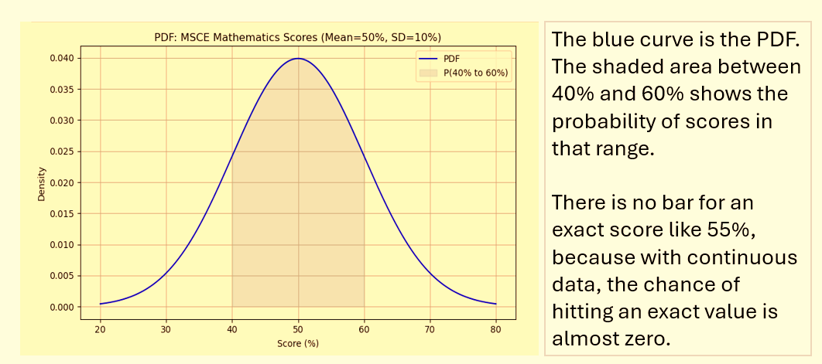
Things Associated with Distributions

Slide 19
Things Associated with Distributions
Probability Mass Function (PMF): Used for discrete distributions, it gives the probability of each specific outcome.
For example, the PMF of a binomial distribution shows the chance of getting exactly 3 successes in 10 trials.

Slide 20
Things Associated with Distributions
PMF example
Suppose a farmer in Malawi plants 5 maize seeds, and each seed has a 70% chance of germinating.
We want to find out: What is the probability of getting seed 0, 1, 2, 3, 4, or all 5 seeds germinating?
This is a binomial distribution, perfect for using PMF.

Slide 21
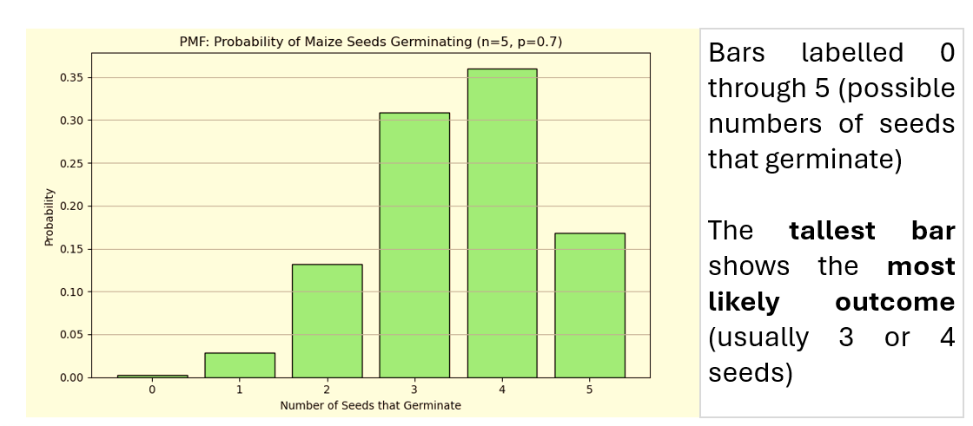
Things Associated with Distributions-PMF example

Slide 22
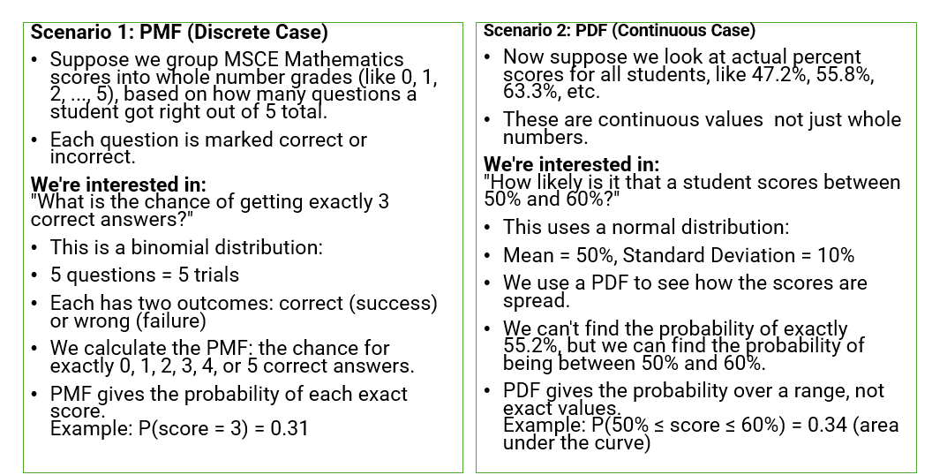
PMF VS PDF

Slide 23
Things Associated with Distributions
Real-Life Example: Applying a distribution to real-world scenarios helps build intuition like modelling the number of defective products in a batch or the time between bus arrivals.
Cumulative Distribution Function (CDF): This function gives the probability that a value is less than or equal to a specific number.
It's useful for understanding thresholds, such as “What’s the probability of scoring below 70%?”

Slide 24
Things Associated with Distributions
Cumulative Distribution Function (CDF)
Shows the total probability up to a certain value
Helps find the chance that something is less than or equal to a value.
Imagine a student in Mzuzu is checking MSCE results. They want to know the chance of scoring 60% or less in Mathematics. If the CDF says:
CDF(60%)=0.75, it means there’s a 75% chance that a student scores 60% or less.
CDF adds up the chances from the lowest score up to the value you choose (in this case, 60%).

Slide 25
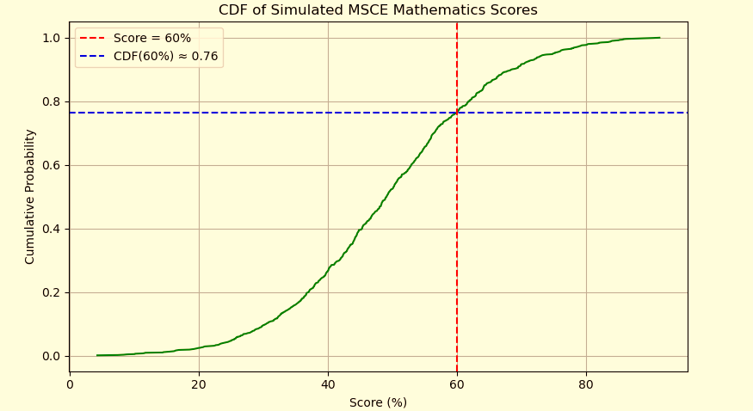
Cumulative Distribution Function (CDF)

Slide 26
Things Associated with Distributions
Kurtosis-Tells how peaked or flat the distribution is
High kurtosis = sharp peak
Low kurtosis = flat top

Slide 27
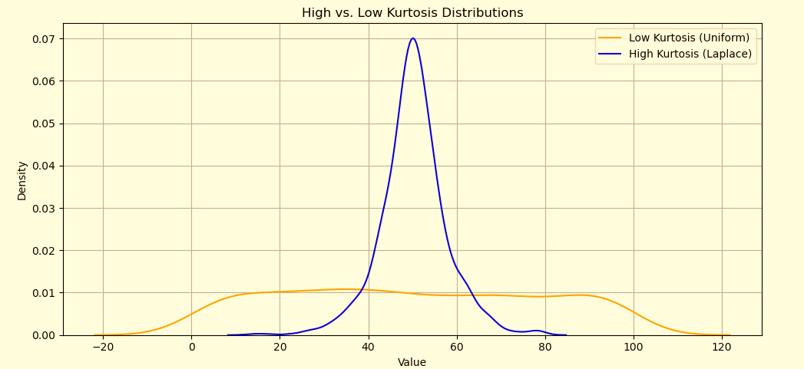
Things Associated with Distributions-Kurtosis

Slide 28
Common Types of Distributions
Normal Distribution (Bell Curve)
Binomial Distribution
Poisson Distribution

Slide 29
Things Associated with Distributions
Parameters (Inputs) Each distribution has specific parameters that define its behaviour:
Normal: Mean (μ), Standard Deviation (σ)
Binomial: Number of trials (n), Probability of success (p)
Poisson: Rate (λ)

Slide 30
Things Associated with Distributions
Parameters
Each distribution has special inputs (parameters) that control its shape:
Distribution | Parameters
Normal | Mean (μ), Standard Deviation (σ)
Binomial | Trials (n), Success Chance (p)
Poisson | Rate (λ)
Exponential | Rate (λ)

Slide 31
Things Associated with Distributions
Range of Values: Different distributions cover different value ranges:
Different probability distributions cover different types of values based on the nature of the data:

Slide 32
Things Associated with Distributions
Normal Distribution:
Has an infinite range from −∞ to +∞
Used for continuous data like heights, weights, or test scores, where values cluster around a mean
Poisson Distribution:
Starts at 0 and goes up to infinity
Used to model counts of events over time or space, given a known average rate
Binomial Distribution:
Values range from 0 to n (a fixed number of trials)
Used to count successes in a set number of attempts.

Slide 33
Normal Distribution (Bell Curve)
Shape: Smooth, Symmetrical (looks like a hill or bell-shaped curve
Meaning: Most values are near the centre, or middle (average), and fewer are far away
Fewer values at the ends (extremes)
Key Point: The curve is symmetric, same on both sides

Slide 34
Normal Distribution (Bell Curve)
Real-Life Examples and application
Adult heights of people in a village,
Exam/ test scores
Maize yields from similar farms
Daily temperatures in Mzuzu
Blood pressure readings at clinics

Slide 35
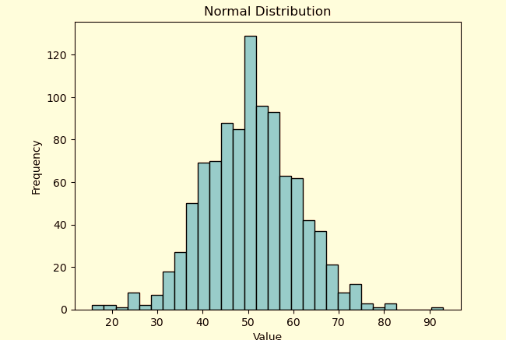
Normal Distribution

Slide 36
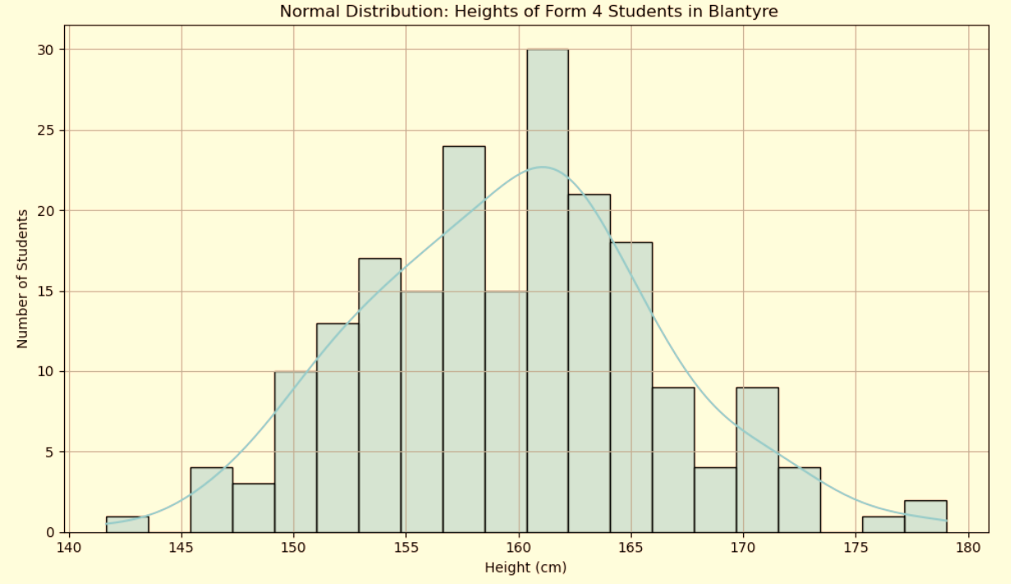
Normal Distribution
Bell-shaped, symmetric
Example: Heights of Form 4 students in Blantyre schools
A bell-shaped curve (symmetric around the mean)Most students’ heights cluster around 160 cm Fewer students are much shorter or much taller

Slide 37
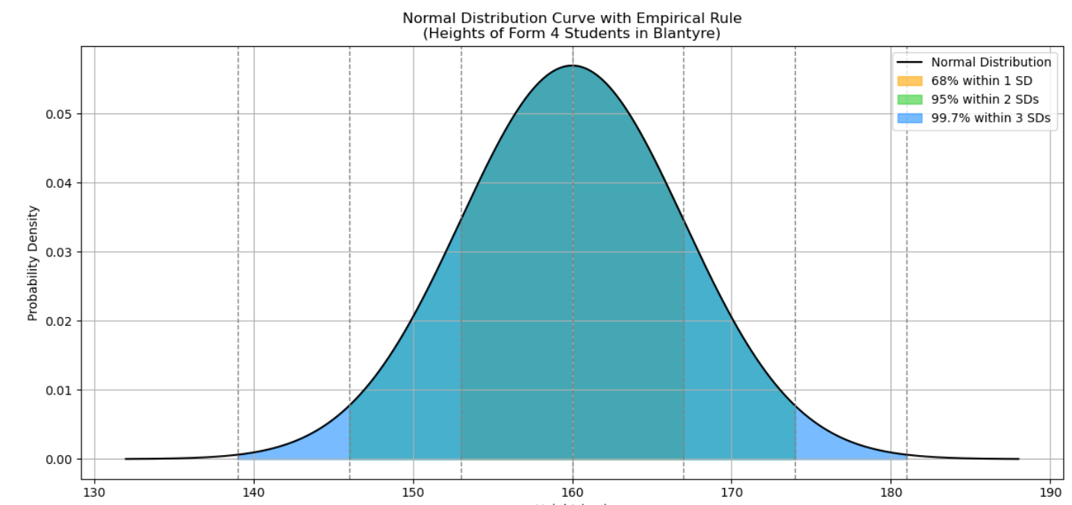
Properties of Normal Distribution
Mean = median = mode
Empirical Rule: 68% within 1 SD, 95% within 2 SDs
Draw curve showing this

Slide 38
Binomial distribution
The binomial distribution means something that has two possible outcomes, and it is used when:
There are only two possible outcomes (like success/failure, yes/no, pass/fail),
You repeat the same experiment several times,
And you want to know the number of successes.

Slide 39
Binomial Distribution
In statistics, the binomial distribution is used when:
You repeat the same experiment several times
Each time has only two outcomes
The chance of success stays the same each time
Key Point: It tells us the chance of getting a certain number of successes
Counts how many times something happens in fixed number of tries
Used for: Repeated yes/no events (success/failure)

Slide 40
Examples
Rain prediction:
Each day, it either rains or doesn't rain (two outcomes).
You want to know: How many days out of 30 will rain?
Chickens hatching:
Each egg either hatches or doesn't hatch.
If a farmer has 20 eggs, how many are likely to hatch?
Pass/fail in exams:
A student either passes or fails.
If 10 students take an exam, how many are likely to pass?

Slide 41
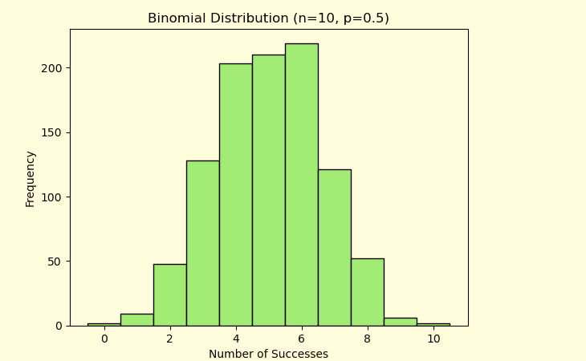
Binomial Distribution

Slide 42
Binomial Distribution
Key Features:
Used when there are two outcomes (like yes/no, success/fail)
Based on fixed number of trials
Each trial is independent
Key terms:
n = number of trials (e.g., 10 chickens)
p = probability of success (e.g., 0.7 survive)

Slide 43
Examples: Binomial Distribution
Passing or Failing an Exam.
A student takes 5 subjects in MSCE. Each subject can either be a pass or fail.
Binomial: Success = pass, Failure = fail
Maize Seeds Germinating
A farmer plants 10 maize seeds. Each seed will either germinate or not.
Binomial: Success = germinates, Failure = does not
Mobile Money Transactions
A person tries to send Airtel Money 6 times in a day. Each transaction can either go through or fail.
Binomial: Success = goes through, Failure = fails

Slide 44
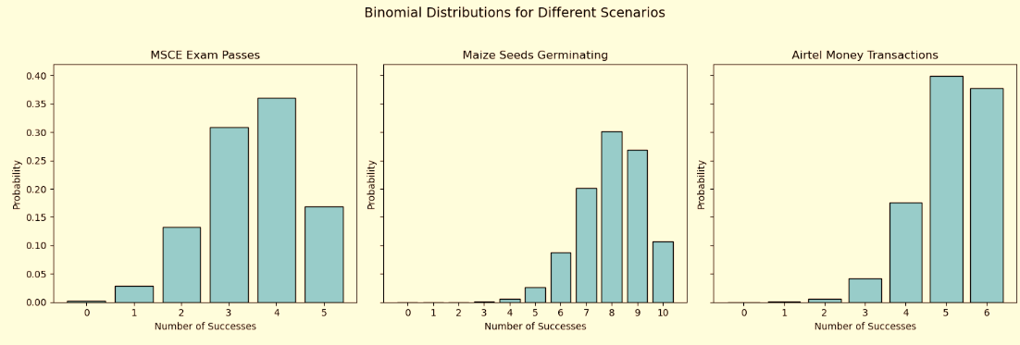
Examples: Binomial Distribution

Slide 45
Examples: Binomial Distribution
Customers Buying at a Market
Out of 20 people who pass by a stall at Limbe market, each will either buy something or not.
Binomial: Success = buys, Failure = doesn’t buy
Rain Forecast Accuracy
Out of 7 days, the weather forecast says it will rain.
Each day it will either actually rain or not.
Binomial: Success = it rains, Failure = it doesn't

Slide 46
Examples: Binomial Distribution Binomial Distribution
Flipping/Tossing a coin 10 times (head or tail), counting how many heads
Farmers trying a new fertilizer: success = higher yield, fail = no improvement
Chickens vaccinated or not, and whether they survive

Slide 47
Examples: Binomial Distribution Binomial Distribution
Scenario:
Example: In Luwinga village 10 people take HIV test; how many people test positive?
Assume the chance of one person testing positive is 20% (p = 0.2).
What's the probability that exactly 3 people test positive?
This kind of problem is modelled using the binomial distribution.

Slide 48
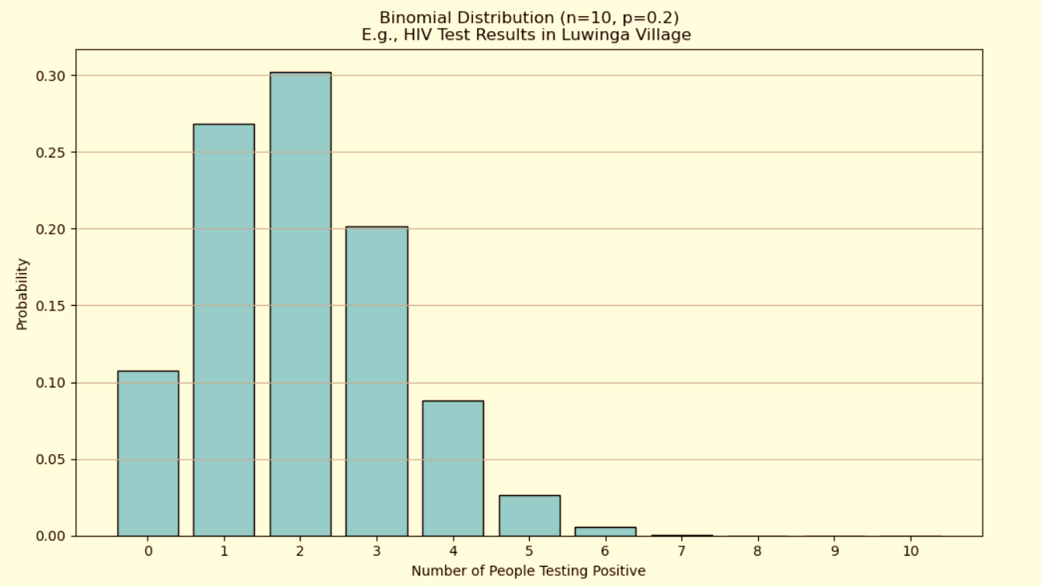
Binomial Distribution
Parameters: n = number of trials, p = probability
Skewed if p is near 0 or 1
Simple graph (bars) to show probabilities.

Slide 49
The Poisson Distribution
The probability of observing exactly 'k' events in a given time interval, given a known average rate of 'λ' events per interval.
What is the probability of receiving exactly 8 customers in the next hour?
What is the probability of receiving more than 12 customers in the next hour?

Slide 50
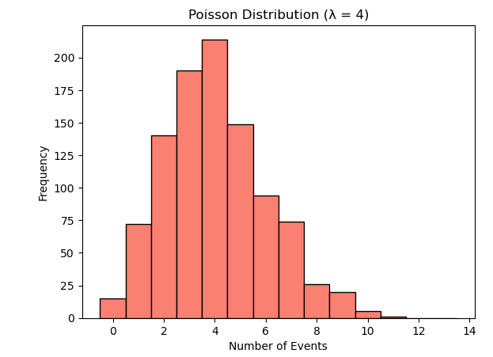
Poisson

Slide 51
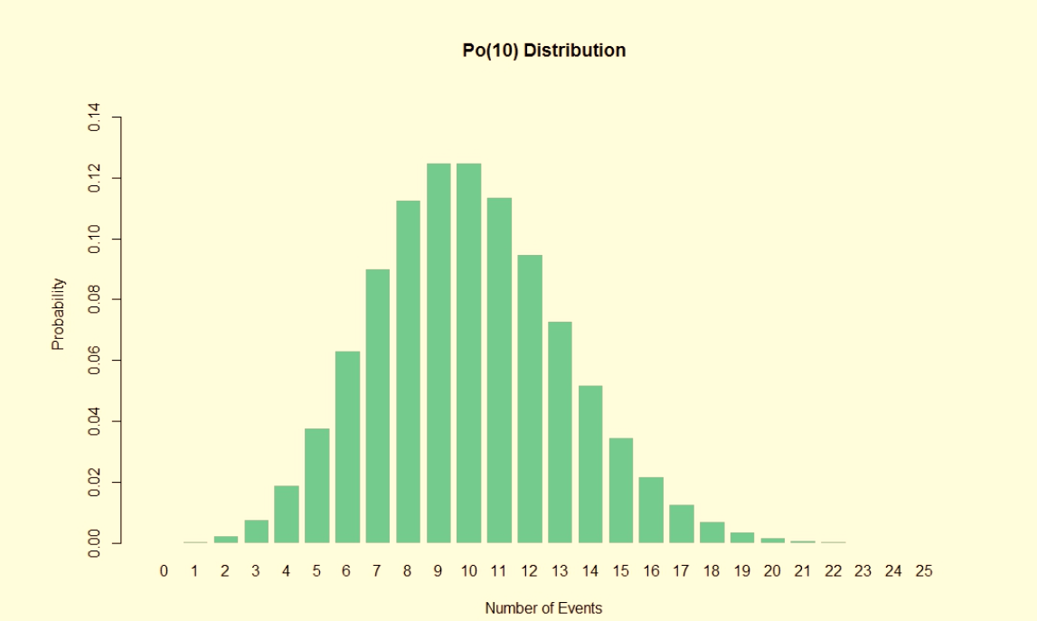
The Poisson Distribution

Slide 52
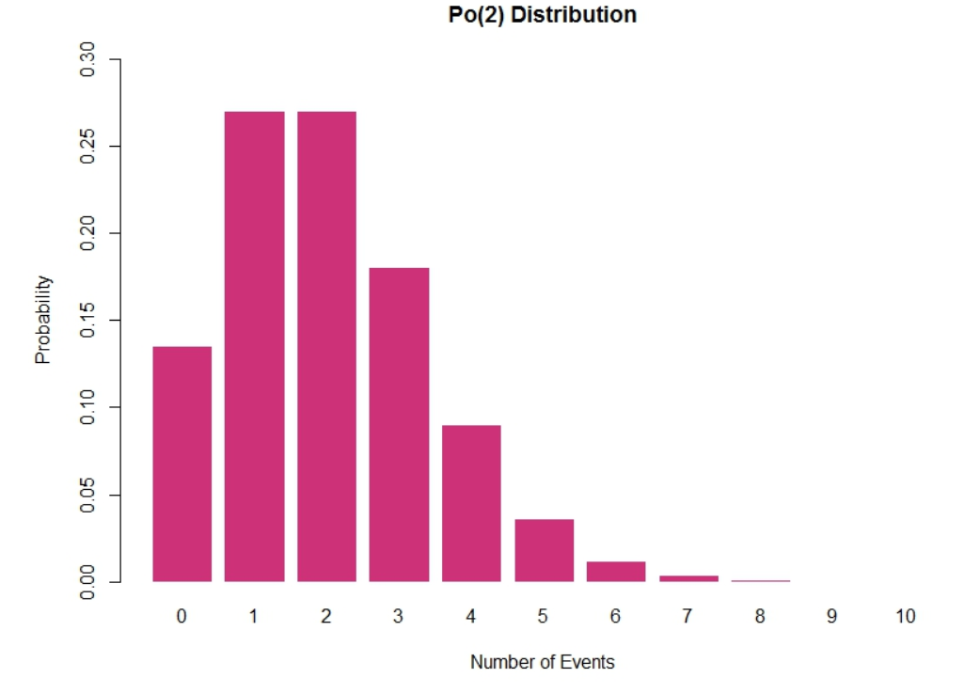
The Poisson Distribution

Slide 53
The Poisson Distribution
Counts events in a time/space unit. Good for rare events like power cuts at State house per week
Example: Number of patients visiting a clinic in Chitipa per hour
Key Features:
Events are counted (not measured)You know the average rate (λ, lambda) of occurrence
Time or space is fixed (e.g., per hour, per square km)

Slide 54
The Poisson Distribution
Example Scenario: A rural clinic in Chitipa sees about 4 patients per hour.
What's the probability that exactly 6 patients come in a given hour?
You can use a Poisson distribution with λ = 4 to answer this.
Only one parameter: λ = average rate

Slide 55
The Scenario:
Imagine a bank that, on average, receives 10 customers per hour.
This scenario fits the Poisson distribution because the number of customers arriving is a count of independent events (each customer's arrival is independent of others) occurring within a fixed interval of time (the hour).
The average rate of customer arrival is known (10 per hour).

Slide 56
Poisson Distribution
Used for: Counting rare events in a fixed time or space
Example: Number of emails you get in an hour, number of accidents at a crossing in a day
Key Point: Events happen randomly but at a known average rate

Slide 57
When to Use Each Distribution
Distribution | When to Use | Example
Normal | Continuous, symmetric data | Exam scores in Mzuzu city
Binomial | Count of successes | Girls passing MSCE
Poisson | Events per time/space | Hospital births per day

Slide 58
Practice Problems

Slide 59
Assessment 2-Work in groups

