Slide 1
NATIONAL INCOME
MEASUREMENT

Slide 2
NATIONAL INCOME ACCOUNTING
In the 1930s it was impossible for macroeconomics to exist in the form we know it today because many aggregate concepts had not yet been formulated, or were lacking rigour.

Slide 3
NATIONAL INCOME ACCOUNTING
In the mid-1930s, two Keynesians, Simon Kuznets and Richard Stone, began to develop this terminology.

Slide 4
NATIONAL INCOME ACCOUNTING
They developed national income accounting – a set of rules and definitions for measuring economic activity in the aggregate economy – that is, in the economy as a whole.

Slide 5
MEASURING TOTAL ECONOMIC OUTPUT OF GOODS AND SERVICES
Gross Domestic Product (GDP) is the total market value of all final goods and services produced in an economy in a one-year period.
It is the single most-used economic measure.

Slide 6
MEASURING TOTAL ECONOMIC OUTPUT OF GOODS AND SERVICES
Gross National Product (GNP) is the aggregate final output of citizens and businesses of an economy in one year.

Slide 7
MEASURING TOTAL ECONOMIC OUTPUT OF GOODS AND SERVICES
GDP measures the economic activity that occurs within a country.
GNP measures the economic activity of the citizens and businesses of a country.

Slide 8
MEASURING TOTAL ECONOMIC OUTPUT OF GOODS AND SERVICES
Net foreign factor income is added to GDP to create the GNP.
  Net foreign factor income is the income from foreign domestic factor sources minus foreign factor incomes earned domestically.
  In other words, we must add the foreign income of our citizens and subtract the income of residents who are not citizens.

Slide 9
CALCULATING GDP
Calculating GDP requires adding together million of goods and services.
All goods and services produced by an economy must be weighted, that is, each good and service must be multiplied by its price.

Slide 10
CALCULATING GDP
Once quantities of a particular good or service are multiplied by its price, we arrive at a value measure of the good or service.
Finally, all the value measures are added to calculate that year’s GDP.
GDP is a flow measure (an amount per year).

Slide 11
GDP IS A FLOW CONCEPT
GDP is a measure of final output per year – it is a flow concept, not a stock (an amount at a particular moment in time).

Slide 12
GDP IS A FLOW CONCEPT
The store of wealth, in contrast, is a stock concept.
The stock equivalent to national income accounts is the national balance sheet – a balance sheet of an economy’s stock of assets and liabilities.

Slide 13
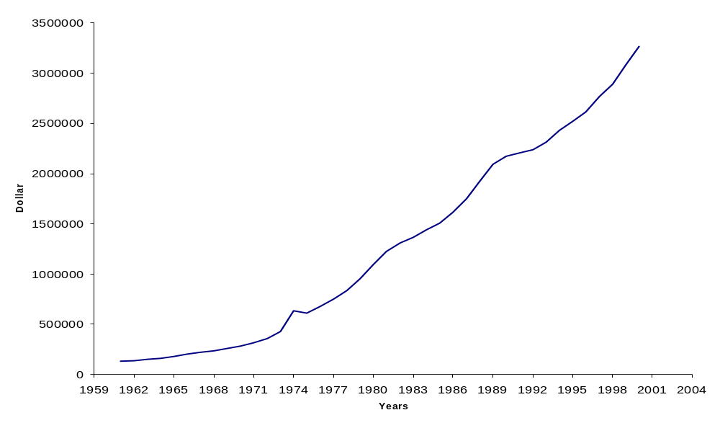
CANADIAN FINANCIAL FLOWS, FIG. 7-1, P 165

Slide 14
GDP MEASURES FINAL OUTPUT
GDP does not measure total transactions in the economy.
It counts final output but not intermediate goods.

Slide 15
GDP MEASURES FINAL OUTPUT
Final output – goods and services purchased for final use.
Intermediate products are used as inputs in the production of some other product.

Slide 16
GDP MEASURES FINAL OUTPUT
Counting the sale of final goods and intermediate products would result in double and triple counting.
If we did not eliminate intermediate goods, a change in organization—say, a merger—would look like a change in output.

Slide 17
TWO WAYS OF ELIMINATING INTERMEDIATE GOODS
There are two ways of eliminating intermediate goods.
The first is to calculate only final sales.

Slide 18
TWO WAYS OF ELIMINATING INTERMEDIATE GOODS
A second way is to follow the value added approach.
  Value added is the increase in value that a firm contributes to a product or service.
  It is calculated by subtracting intermediate goods from the value of its sales.

Slide 19
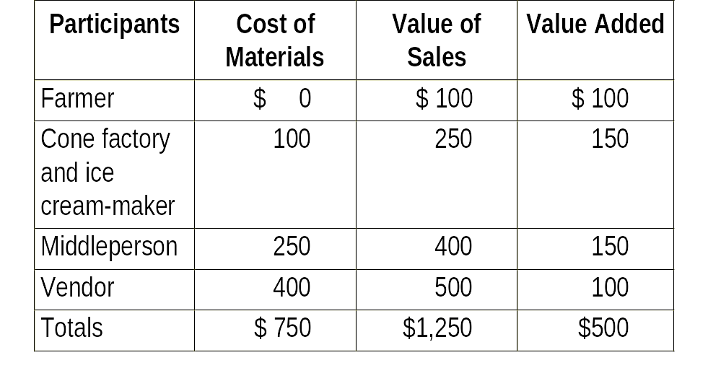
VALUE ADDED APPROACH ELIMINATES DOUBLE COUNTING,TABLE 7-1, P 166

Slide 20
CALCULATING GDP: SOME EXAMPLES
Selling your car to a neighbor does not add to GDP.
Selling your car to a used car dealer who sells your car to someone else for a higher price, does add to GDP.
The value added is the dealer's services.

Slide 21
CALCULATING GDP: SOME EXAMPLES
Selling a stock or bond does not add to GDP.
The stock broker's commission for the sales does add to GDP.

Slide 22
CALCULATING GDP: SOME EXAMPLES
Pension payments, welfare payments, employment insurance benefits, and other government transfer payments are not included in GDP.
The work of unpaid house spouses does not appear in GDP calculations.

Slide 23
TWO METHODS OF CALCULATING GDP
There are two methods of calculating GDP: the expenditure approach and the income approach.
This is because of the national income accounting identity.

Slide 24
THE NATIONAL INCOME ACCOUNTING IDENTITY
The equality of output and income is an accounting identity in the national income accounts.
The identity can be seen in the circular flow of income in an economy.

Slide 25
THE CIRCULAR FLOW, FIG. 7-2, P 169
Wages, rents, interest, profits
Factor services
Goods
Household
Firms (production)
Government
Government Spending
Taxes
Savings
Financial markets
Investment
Imports
Personal consumption
Exports
Other countries

Slide 26
THE EXPENDITURE APPROACH
The expenditure approach is shown on the bottom half of the circular flow.
Specifically, GDP is equal to the sum of the four categories of expenditures.
GDP = C + I + G + (X - IM)

Slide 27
CONSUMPTION
When individuals receive income, they can spend it on domestic goods, save it it, pay taxes, or buy foreign goods.

Slide 28
CONSUMPTION
Consumption is the largest and most important of the flows.
It is also the most obvious way in which income received is returned to firms.

Slide 29
INVESTMENT
The portion of income that individuals save leaves the spending stream and goes into financial markets.
Business spending on equipment, structures, and inventories is counted as part of gross private investment, together with household spending on new owner-occupied housing.

Slide 30
INVESTMENT
Sooner or later, plant and equipment wears out.
This wearing-out process is called depreciation – the decrease in an asset's value.

Slide 31
INVESTMENT
Economists differentiate between total or gross private domestic investment and the new investment that is above and beyond replacement investment.
Net private investment – gross private investment less depreciation.

Slide 32
GOVERNMENT EXPENDITURES
When individuals pay taxes, those taxes are either spent by government on goods and services or are returned to individuals in the form of transfer payments.

Slide 33
GOVERNMENT EXPENDITURES
Government payments for goods and services or investment in equipment and structures are referred to as government expenditures.

Slide 34
GOVERNMENT EXPENDITURES
There is a connection between the government and the financial markets.
If the government runs a deficit, it must borrow from financial markets to make up the difference.

Slide 35
NET EXPORTS
Spending on foreign goods escapes the system and does not add to domestic production, thus spending on imports are subtracted from total expenditures.

Slide 36
NET EXPORTS
Exports to foreign nations are added to total expenditures.
These flows are usually combined into net exports (exports minus imports).

Slide 37
GDP AND NDP
Net domestic product (NDP) is the sum of consumption expenditures, government expenditures, net foreign expenditures, and investment less depreciation.

Slide 38
GDP AND NDP
Net domestic product is GDP adjusted for depreciation:
GDP = C + I + G + (X - IM)
NDP = C + I + G + (X - IM) - Depreciation

Slide 39
GDP AND NDP
NDP is actually preferable to GDP as an expression of a nation's domestic output.

Slide 40
GDP AND NDP
Since it is so hard to measure depreciation in the real world, economists use capital consumption allowance rather than depreciation.

Slide 41
EXPENDITURE BREAKDOWN OF GDP FOR SELECTED COUNTRIES, TABLE 7-2, P 171
 | Nominal GDP (billions US$) | Personal consumption (%of GDP) | Gross private investment (% of GDP) | Government expenditures (% of GDP) | Exports (% of GDP) | Imports (-% of GDP)
Country
Canada | 750 | 58 | 18 | 19 | 42 | -37
U.S. | 10,198 | 69 | 16 | 18 | 10 | -13
Brazil | 760 | 64 | 21 | 16 | 10 | -11
Germany | 2,081 | 58 | 21 | 19 | 27 | -25
Japan | 4,395 | 60 | 29 | 10 | 11 | -10
Pakistan | 60 | 78 | 15 | 11 | 15 | -19
Tunisia | 21 | 63 | 28 | 12 | 42 | -45
Tanzania | 9 | 72 | 18 | 13 | 20 | -23

Slide 42
THE FACTOR INCOMES APPROACH
The income approach is shown on the top half of the circular flow.
Firms make payments to households for supplying their services as factors of production.

Slide 43
THE FACTOR INCOMES APPROACH
National income is the total income earned by citizens and businesses of a country.
It consists of employee compensation, rent, interest, and profits.
When we add indirect taxes (less subsidies) and depreciation to nations income, we have GDP.

Slide 44
THE FACTOR INCOMES APPROACH
Wages, salaries and supplementary labour income that firms pay to workers constitute the largest component of GDP.
Corporate profits before taxes are also included in income.

Slide 45
THE FACTOR INCOMES APPROACH
Interest and investment income measures the difference between interest payments that households receive on loans they have made, and interest payments that they make on borrowed funds.

Slide 46
THE FACTOR INCOMES APPROACH
Further included in incomes are those incomes earned by owner-operators. Rental income is included in this category.
Gains and losses from holding inventories have to be removed form calculation, as well as indirect taxes and subsidies, and depreciation.

Slide 47
EQUALITY OF INCOME AND EXPENDITURE
Income and expenditures must be equal because of the rules of double-entry bookkeeping.
Profit is the balancing item.

Slide 48
EQUALITY OF INCOME AND EXPENDITURE
The national income accounting identity allows GDP to be calculated either by adding up all values of final output or by adding up the values of all earnings or income.

Slide 49
QUALIFICATIONS TO THE INCOME ACCOUNTING IDENTITY
To go from GDP to national income:
  Add net foreign factor income.
    National income is all income earned by citizens of a nation and is equal to GNP.
    To move from "domestic" to "national" we add net foreign factor income.
  Subtract depreciation from GDP.
  Subtract indirect business taxes less subsidies from GDP.

Slide 50
EQUALITY OF EXPENDITURE AND INCOME, FIG. 7-3, P 174
Net foreign factor income
Depreciation
Net exports
Indirect taxes-subsidies
Government expenditures
Inventory adjustment
Farm income
Investment
Interest and investment income
GNP
GDP
Profits before taxes
National Income
Consumption
Wages and salaries
(1)
Expenditures
=
(2)
Output
=
(3)
Income

Slide 51
OTHER INCOME TERMS
Other income terms are personal income and disposable personal income.
Personal income measures all income actually received by individuals.

Slide 52
OTHER NATIONAL INCOME TERMS
Personal income (PI) is national income plus net transfer payments from government minus amounts attributed but not received.
PI = NI + transfer payments from government - corporate retained earnings - corporate income taxes – employment taxes (CPP, EI)

Slide 53
OTHER NATIONAL INCOME TERMS
Disposable personal income is personal income minus personal income taxes and payroll taxes.
Disposable personal income is what people have readily available to spend.
DPI = PI - personal taxes

Slide 54
USING GDP FIGURES
GDP figures are used to make comparisons among countries and to measure economic welfare over time.

Slide 55
COMPARING GDP AMONG COUNTRIES
GDP gives a measure of economic size and power.
Per capita GDP is another measure often used to compare various nations' income.

Slide 56
COMPARING GDP AMONG COUNTRIES
Because of differences in nonmarket activities, per capita GDP can be a poor measure of the living standards in various nations.

Slide 57
COMPARING GDP AMONG COUNTRIES
To get around the problems of per capita GDP, economists use purchasing power parity (PPP), which adjusts for different relative prices among nations before making comparisons.

Slide 58
ECONOMIC WELFARE OVER TIME
Just because GDP rose does not mean welfare rose—it could be that only prices rose.
Comparing output over time is best done with real output which is nominal output adjusted for inflation.

Slide 59
REAL AND NOMINAL GDP
Nominal GDP is GDP calculated at existing prices.
Real GDP is nominal GDP adjusted for inflation.

Slide 60
REAL AND NOMINAL GDP
Real GDP is important to society because it measures what is really produced.

Slide 61

REAL AND NOMINAL GDP
Real GDP is calculated by dividing nominal GDP by the GDP deflator.

Slide 62
SOME LIMITATIONS OF NATIONAL INCOME ACCOUNTING
Although Canadian national income accounting statistics are among the most accurate in the world, they still have some serious limitations.

Slide 63
GDP MEASURES MARKET ACTIVITY, NOT WELFARE
GDP does not measure happiness, nor does it measure economic welfare.
Welfare is a complicated idea, very difficult to measure.

Slide 64
MEASUREMENT ERRORS
GDP figures do not measure all market economic activity.

Slide 65
MEASUREMENT ERRORS
GDP figures do not measure:
  Illegal drug sales.
  Under-the-counter sales of goods to avoid income and sales taxes.
  Work performed and paid for in cash.
  Unreported sales.
  Prostitution, loan sharking, extortion, and other illegal activities.

Slide 66
MEASUREMENT ERRORS
Estimates of the size of the underground economy range from1.5 to 20 percent of GDP in Canada.

Slide 67
MEASUREMENT ERRORS
A second type of measurement error occurs in adjusting GDP for inflation.
  If the price and the quality of a product go up together, has the price really gone up?
  Is it possible to measure the value of quality increases?

Slide 68
MISINTERPRETATION OF SUBCATEGORIES
The subcategories of GDP can be misinterpreted.
For example, the line between investment and consumption is often fuzzy.

Slide 69
MISINTERPRETATION OF SUBCATEGORIES
Some social scientists have developed alternatives to GDP such as the Genuine Progress Indicator (GPI).
The GPI tries to measure pollution, education, health concerns, as well as GDP.

Slide 70
CONCLUSION
National income accounting should be used with sophistication.
It is a powerful economic tool that informs average citizens about the direction of the economy.

