Slide 1

Introduction to C
Chapter 02
Introduction to Programming with C - Khwimah Mkamanga

Slide 2
Learning Objectives
In this chapter you will learn about:
Characteristics of C
Compilers and Interpreters
Lexical Conventions

Slide 3
Characteristics of C
C is a high-level language that was developed in the 1970s by Dennis Ritchie at Bell Labs
It is a general-purpose language that can be used for a wide variety of programming tasks
C is a structured language that uses control structures to control the flow of a program
It is a compiled language, which means that the source code is translated into machine code before it is executed
C is a powerful language that allows for low-level system programming and high-level application programming

Slide 4
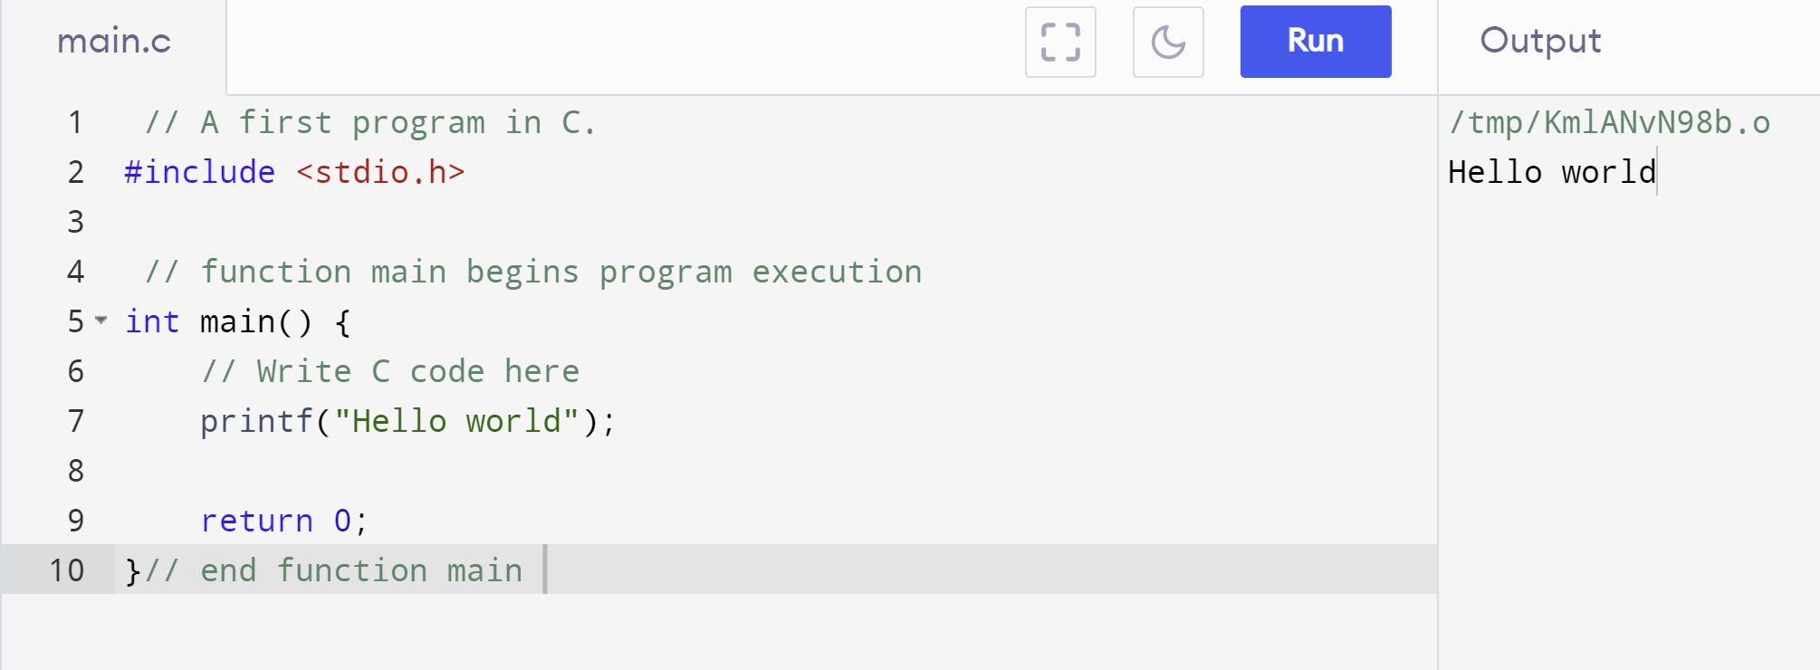
Characteristics of C (continued)
A simple C program

Slide 5
Characteristics of C (continued)
The #include <stdio.h> line at the top of the program is a preprocessor directive that tells the compiler to include the standard input/output library in the program.
The int main() { ... } section is the main function of the program, and it is where the program begins execution. The printf("Hello, World!\n"); line uses the printf function to print the string "Hello, World!" to the console. The \n at the end of the string is a newline character, which adds a line break after the text.
The return 0; line exits the program with a return value of 0, which indicates that the program ran successfully.

Slide 6
Characteristics of C – Use cases (continued)
C is a versatile programming language used in a wide range of applications:
Operating systems, device drivers, and compilers
Embedded systems, networking, and gaming
C's low-level nature and direct access to system resources make it ideal for developing high-performance, low-level applications.
C's continued popularity and widespread use in a variety of industries make it a valuable skill for programmers to learn.

Slide 7
Compilers and Interpreters
A compiler is a program that translates source code into machine code
The compiler goes through several stages to produce the machine code, including lexical analysis, syntax analysis, semantic analysis, code generation, and optimization
Once the machine code is produced, it can be executed directly by the computer
An interpreter is a program that executes source code directly, without translating it into machine code first
The interpreter goes through the same stages as a compiler, but it executes the code as it is being translated
Interpreted languages are often slower than compiled languages, but they are easier to debug and modify

Slide 8
Lexical conventions
Lexical conventions refer to the rules that govern the structure of the source code
C uses a set of reserved words and symbols that have specific meanings in the language
Some examples of reserved words in C include int, float, char, if, else, while, and for
C also uses symbols like +, -, *, /, =, and ; to perform operations and control the flow of a program
The syntax of C is strict, and any errors in the structure of the code will result in a compilation error

Slide 9
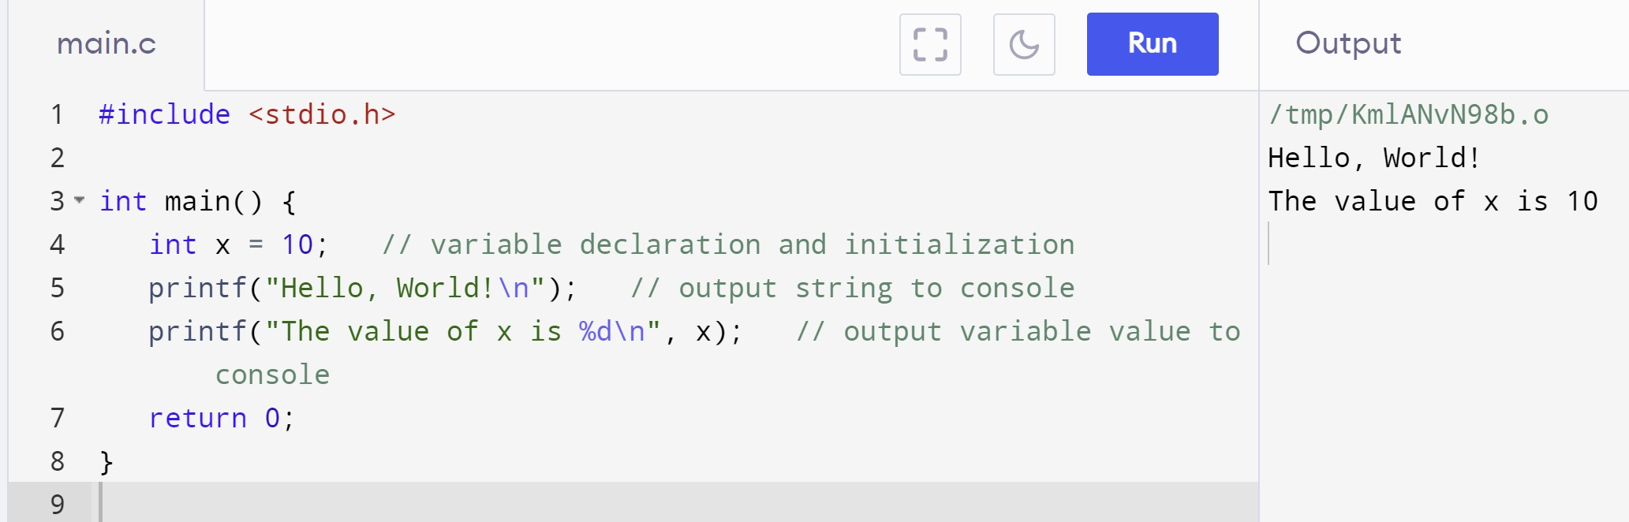
Lexical conventions – Code Example (continued)
This code snippet demonstrates some of the lexical conventions of C programming language, including keywords, identifiers, operators, delimiters, literals, and comments.
The code example is a simple "Hello, World!" program that declares and initializes a variable, outputs a string to the console, and outputs the variable value to the console.
By studying the lexical conventions of C, programmers can gain a better understanding of how the language works and how to write correct and efficient code.

Slide 10
Lexical conventions – Code Example (continued)
This code snippet demonstrates the following lexical conventions of C:
Keywords: int, return
Identifiers: main, x
Operators: =, +, -, *, /, %
Delimiters: ;, {}, ()
Literals: 10, "Hello, World!\n"
Comments: // variable declaration and initialization, // output string to console, // output variable value to console

Slide 11
Summary
In this chapter, we covered the characteristics of C, including its structure, versatility, and power
We also discussed the differences between compilers and interpreters, and how they translate source code into machine code
Finally, we looked at the lexical conventions of C, including reserved words and symbols, and the strict syntax rules that govern the structure of the code

