Slide 1
Facial Recognition with Accelerated Convolutional Neural Networks using CUDA
Chase Brown

Slide 2
Agenda
Basic understandings of a Convolutional Neural Network
Why Convolutional Neural Networks take so long to train
Where can parallel code be used in a CNN
Speedups with CUDA
Other Factors that play into runtime speeds for a CNN

Slide 3
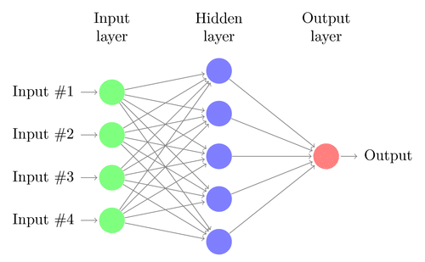
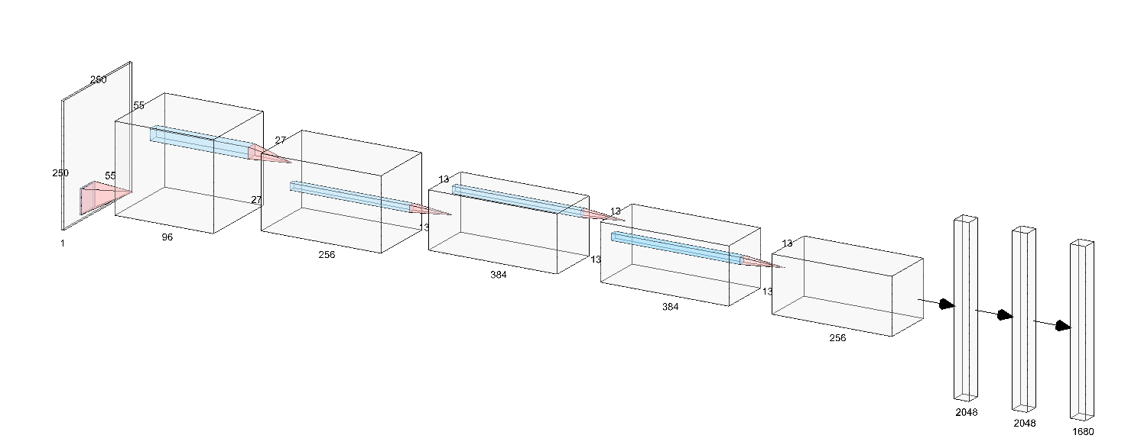
Convolutional Neural Network
Much like a simple neural network a convolutional neural network includes an input layer, hidden layers, and an output layer.
CNN input consist of an input height, width, and depth making them very useful when dealing with images.
Primarily used for visual recognition problems and signal processing. Problems that require spatial information to be kept.

Slide 4
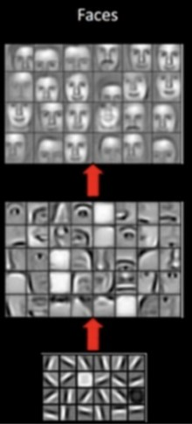
Feature Extraction
Primary goal of a convolutional neural network is to create filters that can extract features from the model input
Ex. Detection of a face is achieved by filters detecting features that are common in a human face such as an eye, nose, lips, an ears, etc.

Slide 5
CNN Basics : Layers
Convolutional Layer
Primary layer in a CNN
Use of filters/kernels to extract features from the original input or previous layer in the network
Pooling Layer
Average Pooling or Max Pooling are the most common used pooling layers
Method of downsampling to help reduce computations in a network.
Newer models have moved away from downsampling and instead use dilated convolutions
Fully Connected Layer
Flattened layer connected to the previous layers neurons.

Slide 6
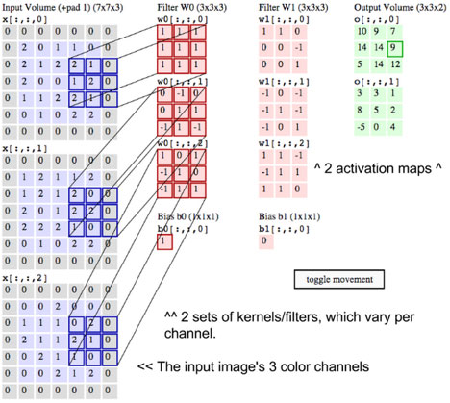
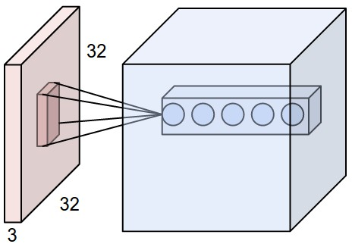
Convolution Layer
Filters/Kernels
H x W window randomly initialized using gaussian or normal distribution
Stride
Distance kernel will move after each iteration
Depth
The depth of an activation volume
Ex. Image with RGB channels has a depth of 3 when input into a CNN
Padding
Control the size of the output of a layer.

Slide 7
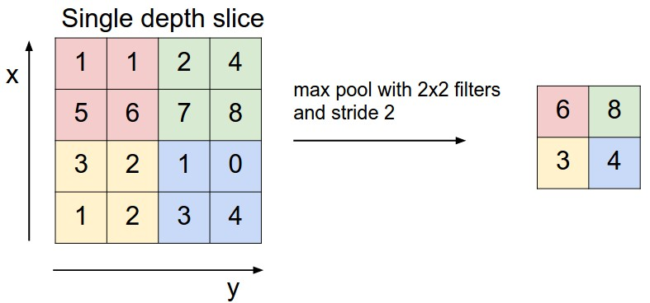
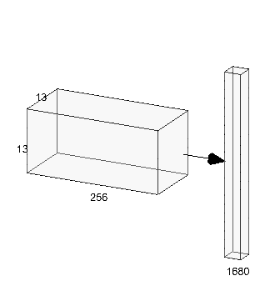
Pooling Layer and Fully Connected
Pooling is placed between convolution layers
Method used to reduce the spatial size of a layer and reduce the number of parameters in effect reducing the number of computations a network will perform in a convolution layer.
Recently has been falling out of favor for dilated convolutions. (non-contiguous convolution layers)
Fully Connected layer is a simple 1xn dimension layer that is connected to every activation neuron of the previous layer

Slide 8
Why do Convolutional Networks take so long to train?
Amount of parameters in a convolutional neural network
Example: Alexnet (2012)
First layer of size (227x227x3) ‘W =227’
Kernels = 96 with receptive field F = 11
Stride = 4
Padding = 0
We can calculate the number of output neurons from the layer with (W-F+2P)/S+1
(227-11)/4+1 = 55
Output layer = (55x55x96) = 290,400 neurons
Each neuron has (11x11x3) + 1 Bias weights giving 290,400 * 364 = 105,705,600 trainable parameters in just the first convolutional layer.

Slide 9
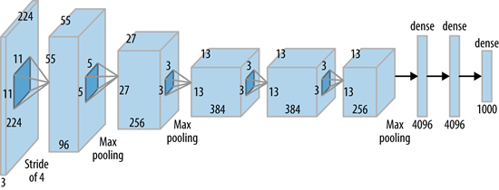
Why do Convolutional Networks take so long to train?
Possible to reduce the number of parameters
Assuming that a feature at one location is important then it must be at another position reducing the number of trainable parameters by creating depth slices. 96 slices of (55x55). Known as parameter sharing. 96 Unique weights for each slice. 96 * 11* 11 * 3 + 96 Biases = 34,944
This reduces the number of trainable parameters from 105,705,60 to 34,944
Alexnet Architecture:
Over 62 Million trainable variables to be updated

Slide 10
Why do Convolutional Networks take so long to train?
Convolutional Neural Networks take many iterations of forward and back propagation in order to train the weights to achieve high performance.
After a forward pass through the given networks architecture the trained data is tested for performance.
The model then does a back propagation through the network updating the trainable parameters in the network and performing gradient descent on the Convolutional and Fully Connected layers to make them consistent with the labels of the training set.
Then, the network makes another forward pass repeating this process until reaching a desired accuracy or number of training iterations.

Slide 11
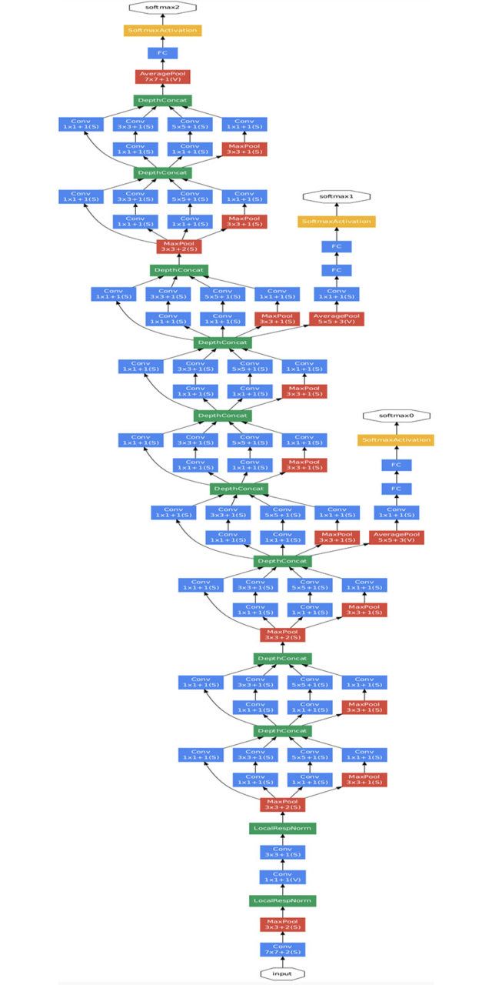
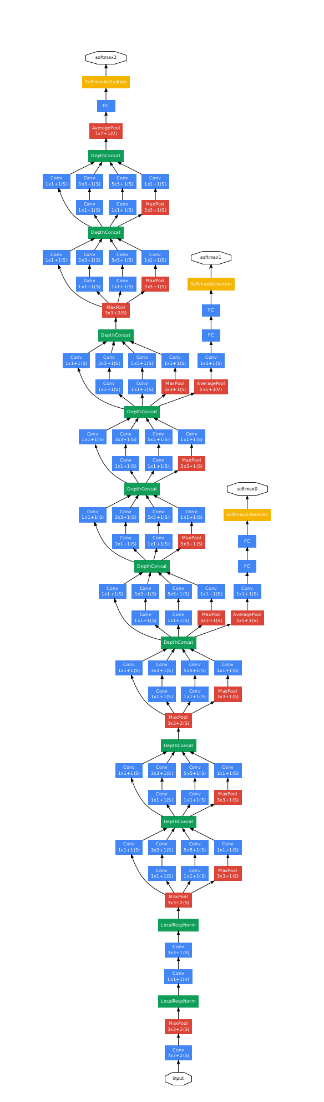
The need for GPU Processing
Large Scale CNN’s
The need for GPU computing and distributed systems for training large scale systems being used in applications such as self driving cars is continuing to increase.
The models are becoming more complex and require the use of GPU processing to reduce training times from days/weeks to hours/days.

Slide 12
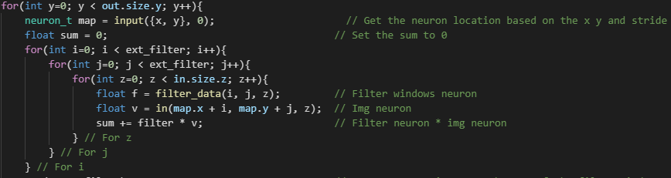
C++ code
C++ code for a CNN has nested for loops everywhere dealing with filter windows calculating the position of a neuron and summing the values.

Slide 13
Where can Parallel Code be used?
Forward Propagation
Convolutional Layer
Pooled Layer
Fully Connected Layer
Softmax/log Likelihood by Reduction
Activations
Computing Delta
Backpropagation
Convolutional Layer
Pooled Layer
Fully Connected Layer
Updating Weights
Gradients

Slide 14
CUDA Programming
Much of a convolutional neural network deals with performing the same task repeatedly using filters in a layers visual field that moves along at a given pace (Stride) calculating the next layers neuron using weights from the filters and the neurons in that filters visual field.
This is great because it allows for a task (Single instruction) to be executed over multiple threads. ‘SIMT’.
Obvious use case is using parallel code on convolutional, pooled, and fully connected layers.

Slide 15
Filter Windows with CUDA
Using CUDA splitting this process up into 32 slices for 32 cases at a time we can use blocks of 1024 threads. The task of this block is to compute the activations for 1024 neurons in the current layer’s visual field.
This also allows us to utilize fast shared memory during this process to reduce the number of slow loads on the GPU from global memory.
Loading the filter weights and prior-layer neurons for 32 cases into shared memory from global will reduce the number of slow loads from global memory by a factor of 32.
The two previous steps each take 2048 loads from global memory. The summation is executed 32 times for 64K loads. If the filters and prior-layer neurons are not loaded into shared memory we would be loading 64k slow loads.

Slide 16
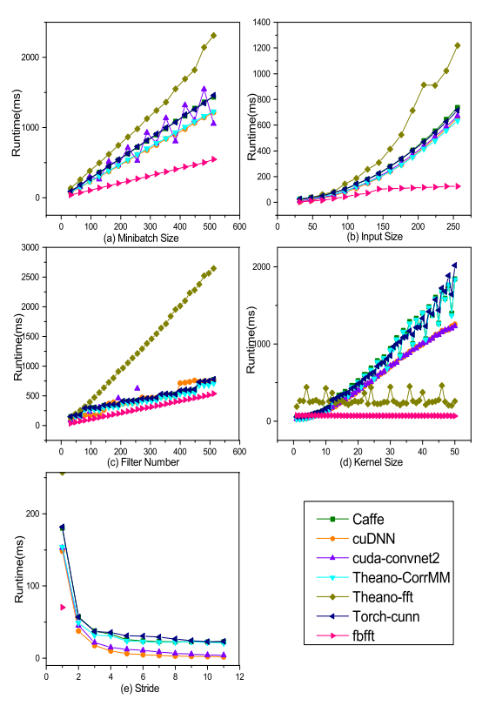
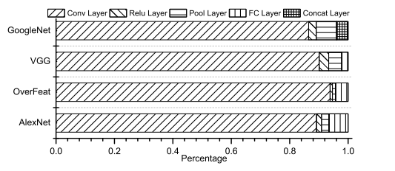
Runtime Factors for a CNN
Runtime Breakdown

Slide 17
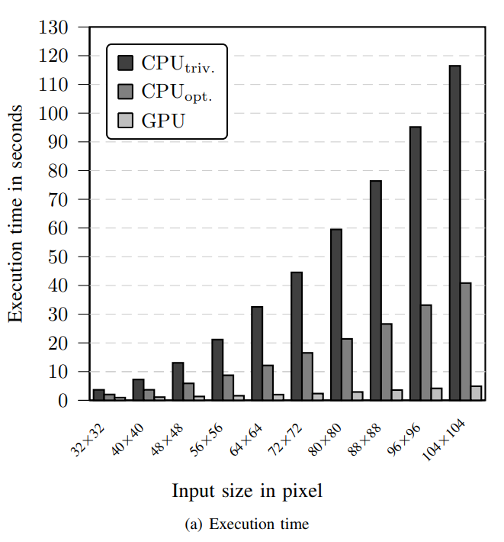
CNN Training Time
Performed in single precision on an Intel Core i7 860 with a GeForce GTX 275 (OLD 2009)
1000 Iterations (Forward and Back Propagation)
Performance and Scalability of GPU-based Convolutional Neural Networks

Slide 18
Convolutional Networks and CUDA
Issues to watch for when CUDA programming a CNN
Previously seen the amount of trainable parameters becomes very large quickly causing memory issues.
Windows Display Driver Model, WDDM timeouts. Breaking input data up into batches not only helps reduce the chance of memory issues but CUDA can run into problems such as WDDM timeouts with windows systems.

Slide 19
References
Krizhevsky, A., Sutskever, I., & Hinton, G. E. (n.d.). ImageNet Classification with Deep Convolutional Neural Networks. Retrieved from http://code.google.com/p/cuda-convnet/
(Krizhevsky, Sutskever, & Hinton, n.d.)
Vis-cs.umass.edu. (2019). LFW Face Database : Main. [online] Available at: http://vis-www.cs.umass.edu/lfw/index.html [Accessed 17 Oct. 2019].
Karpathy, A. Convolutional Neural Networks for Visual Recognition http://cs231n.github.io/convolutional-networks/
Strigl, D., Et al, Performance and Scalability of GPU-based Convolutional Neural Networks.
Masters, T., Deep Belief Nets in C++ and CUDA, Volume III: Convolutional Nets.
Li, Xiaqing, Et al, Performance Analysis of GPU-Based Convolutional Neural Networks. https://www2.seas.gwu.edu/~howie/publications/GPU-CNN-ICPP16.pdf

Slide 20
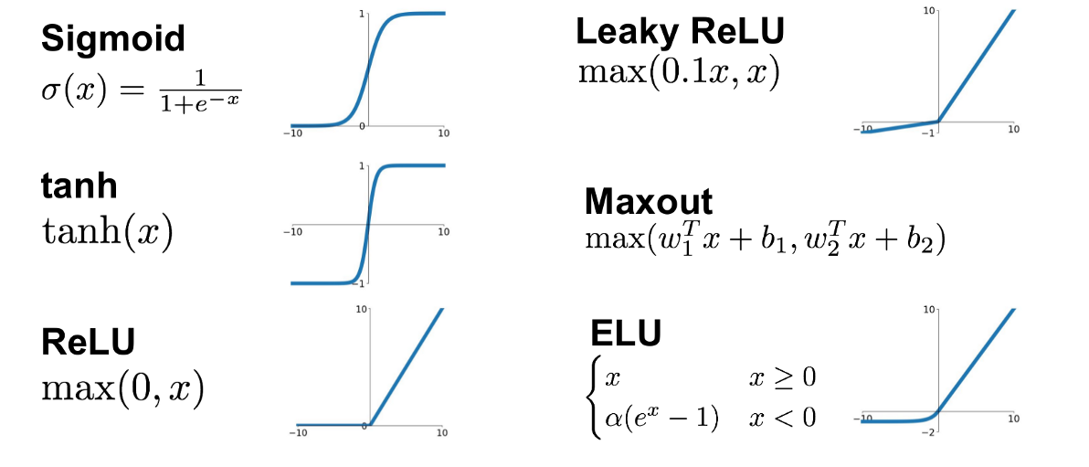
Activation Functions
Sigmoid
tanh
ReLu
Leaky ReLu
eLu
Maxout
Activation functions are used for non-linearity in a neural network. Adding layers or depth to linear network does not increase its approximation power.

