Slide 1
CSE 280 Discrete Mathematics
Week 03 Day 1
W. Clements
Sets 3.1 – 3.4

Slide 2
Review

Slide 3
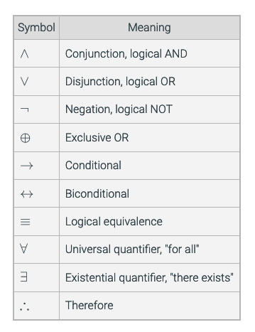
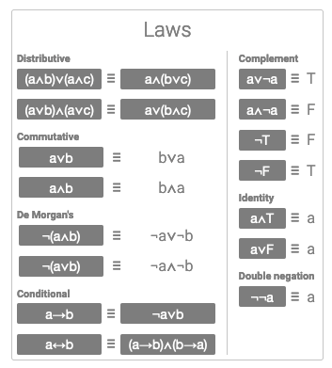

Review
Vocabulary Notation
Prepositions p, q, x, y
Predicates P(x), P(q, p)
Quantifiers $∀x ∃x$
Proofs
Truth Tables
Venn Diagrams
Laws

Slide 4
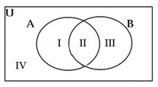
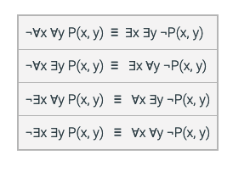





De Morgan's Laws
Negate the following:
For quantifiers
$$¬∀x P\left(x\right)≡∃x¬P(x)$$
$$¬∃x P\left(x\right)≡∀x¬P(x)$$
$$¬\left(p∨q\right)≡$$
$$¬p∧¬q$$
$$¬\left(p∧q\right)≡$$
$$¬p∨¬q$$

Slide 5
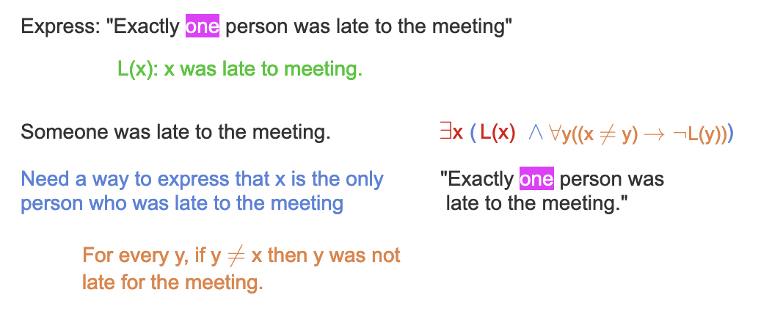
Uniqueness
M(x, y): x is married to y. A(x): x is an adult.
∀x (A(x) → ∃y M(x, y))
∀x ∃y(A(x) → M(x, y))
∀x ∃y(A(x) → M(x, y)) is not logically equivalent to
∃y ∀x(A(x) → M(x, y)).

Slide 6
Application
Games: Othello, Clue
Testing
Data Mining
Statistics
SW Maintenance – grep code
Software requirements
Software testing

Slide 7
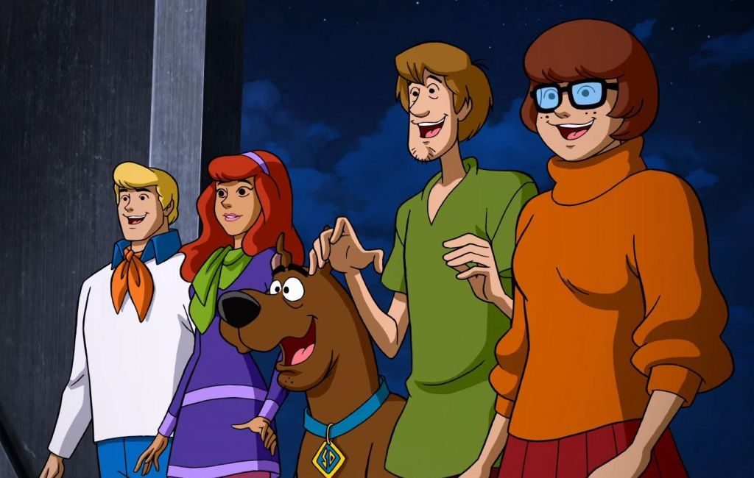
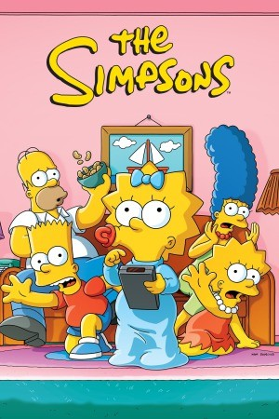
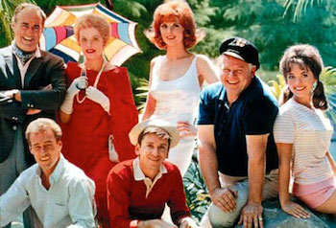

Introduction to Sets
Sets are like Prepositions
They are multiple true, false
p = preposition elements
Fred is in ScoobyDo
Scrappy is in ScoobyDo
P(x) = predicate in a set
U(x) x is the uncle of Dipper
R(x) y is related to x
Sets are groups of values
SD = { Fred, Daphne, Velma, Shaggy}
GI = { Gilligan, Skipper, Howells, Professor, Ginger, Mary Ann }
GF = { Grunkle Stan, Mabel, Dipper, Wendy}
S = { Homer, Marge, Bart, Lisa, Maggie}
We could use a set of prepositions
TV Shows = { SD, GI, G, S }

Slide 8

Set Membership
SD = { Fred, Daphne, Velma, Shaggy}
GI = { Gilligan, Skipper, Howells, Professor, Ginger, Mary Ann }
G = {Grunkle Stan, Mabel, Dipper, Wendy}
S = { Homer, Marge, Bart, Lisa, Maggie}
Set Membership
x ∈ X x is a membership of set X
a ∈ A a is a membership of set A
Typically, lower-case represents a value or subset of the upper-case Set
a ∉ A a is not membership of set A
$∅$ empty set
|A| cardinality (count, size)

Slide 9
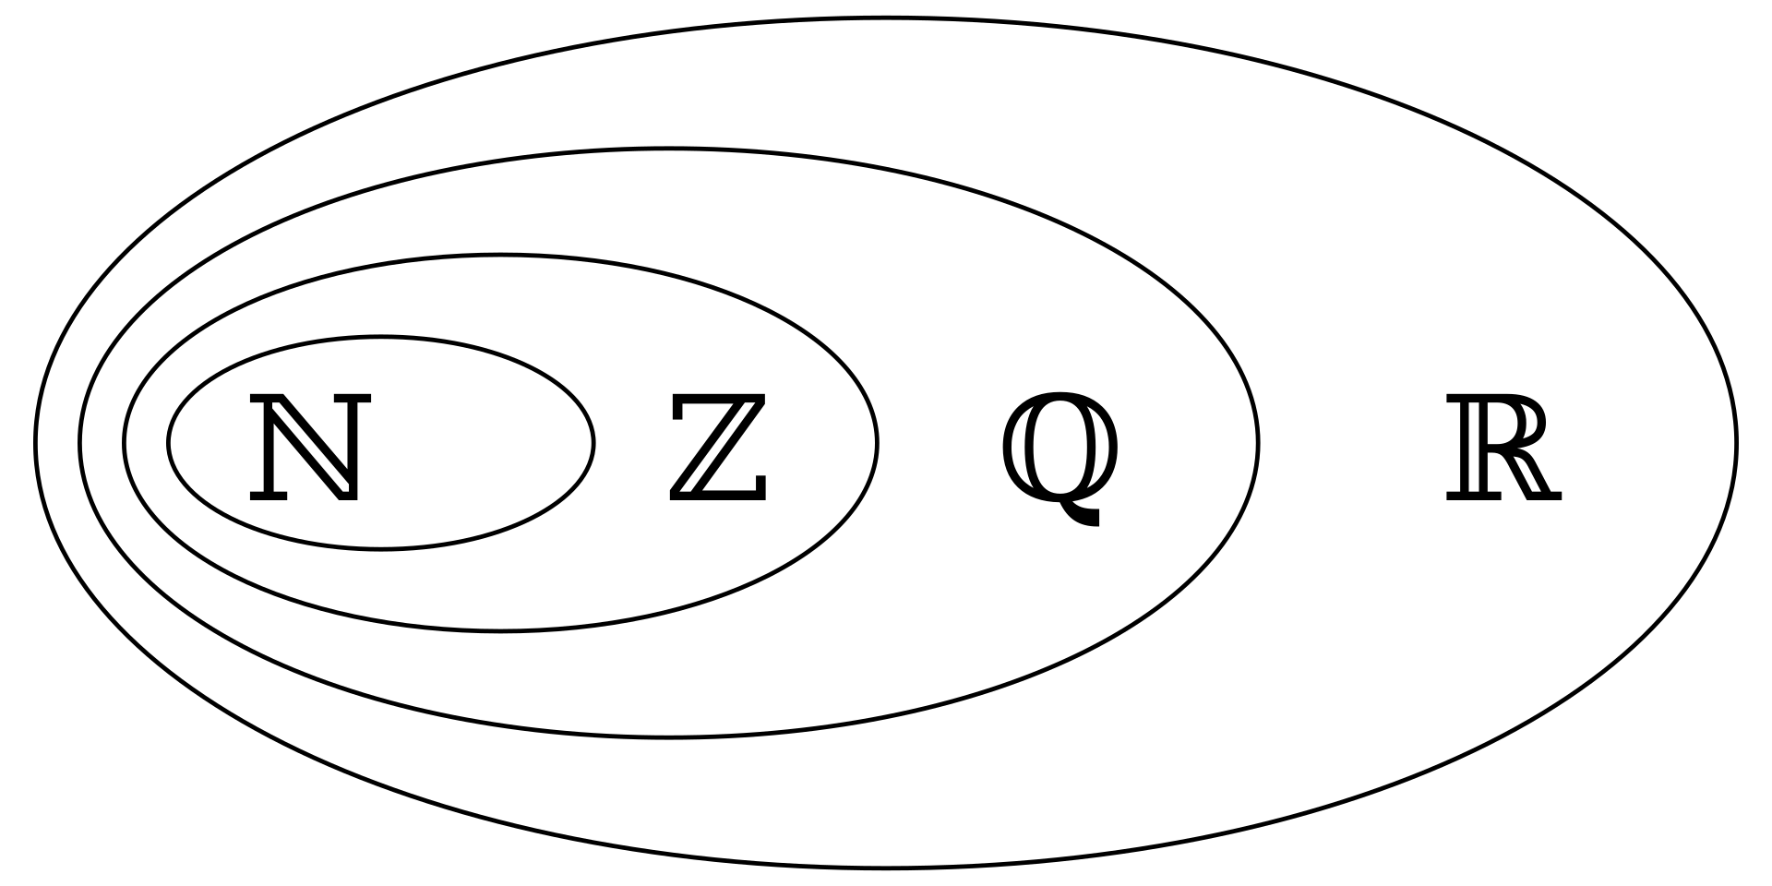
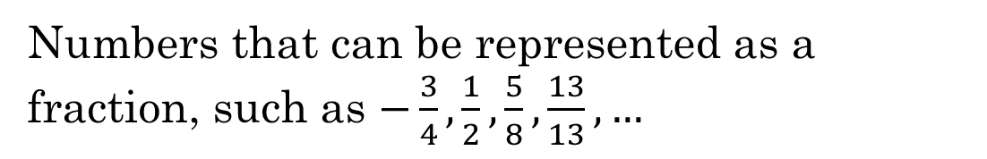





Some special sets
$$ℕ$$
Natural Numbers
$\left\{1,2,3,4,…\right\}$ (although some people include $0$)
$$ℤ$$
Integers
$\{…, −2, −1, 0, 1,2,…\}$
$$ℚ$$
Rational numbers
Numbers that can be represented as a fraction, such as $−\frac{3}{4},\frac{1}{2},\frac{5}{8},\frac{13}{13}, …$
$$ℝ$$
Real numbers
All numbers that can be represented on a continuous number line
What are some other nested sets?

Slide 10
Sets of Sets
The power set of a set A, denoted P(A), is the set of all subsets of A.
For example, if A = { 1, 2, 3 }, then
P(A) = { ∅, { 1 }, { 2 }, { 3 }, { 1, 2 }, { 1, 3 }, { 2, 3 }, { 1, 2, 3 } }

Slide 11
Theorem 3.2.1: Cardinality of a power set.
Let A be a finite set of cardinality n. Then the cardinality of the power set of A is 2^{n}, or |P(A)|=2^{n}.
There are $2^{n}$ rows in a truth table with $n$ variables

Slide 12
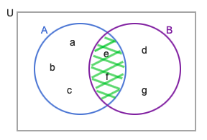

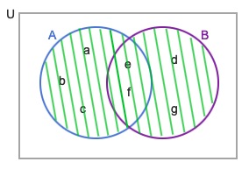

3.3 Union and intersection
The intersection of A and B, denoted A ∩ B and read "A intersect B", is the set of all elements that are elements of both A and B.
The union of two sets, A and B, denoted A ∪ B and read "A union B", is the set of all elements that are elements of A or B.

Slide 13
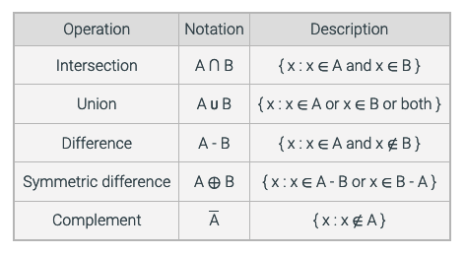
The complement of a set A, denoted A, is the set of all elements in U that are not elements of A.

Slide 14

Sets
Universe
Universe
Union: $A∪B$ A or B or both
Intersection: $A∩B$ A and B
Difference: $A − B$ A minus B
Complement: $\overline{B}$ Not B
A
A
A
B
B
B

Slide 15

Sets
Universe
Universe
Union: $A∪B$ A or B or both
Intersection: $A∩B$ A and B
Difference: $A − B$ A minus B
Complement: $\overline{B}$ Not B
A
A
A
B
B
B

Slide 16
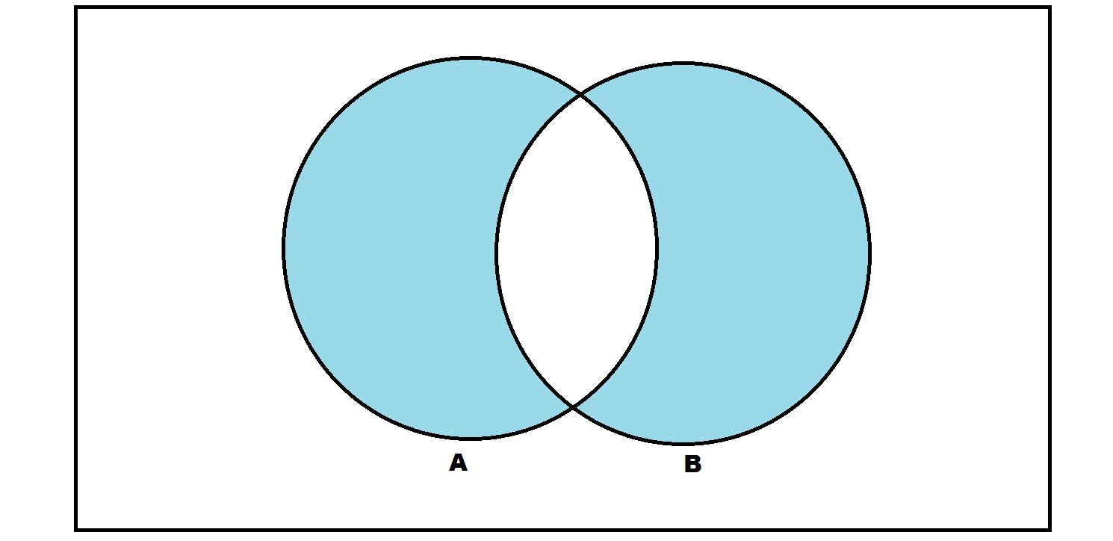

Sets
Universe
Universe
Union: $A∪B$ A or B or both
Intersection: $A∩B$ A and B
Difference: $A − B$ A minus B
Symmetric Difference
Complement: $\overline{B}$ Not B
A
A
A
B
B
B

Slide 17

Sets
Universe
Universe
Union: $A∪B$ A or B or both
Intersection: $A∩B$ A and B
Difference: $A − B$ A minus B
Complement: $\overline{B}$ Not B
A
A
A
B
B
B

Slide 18
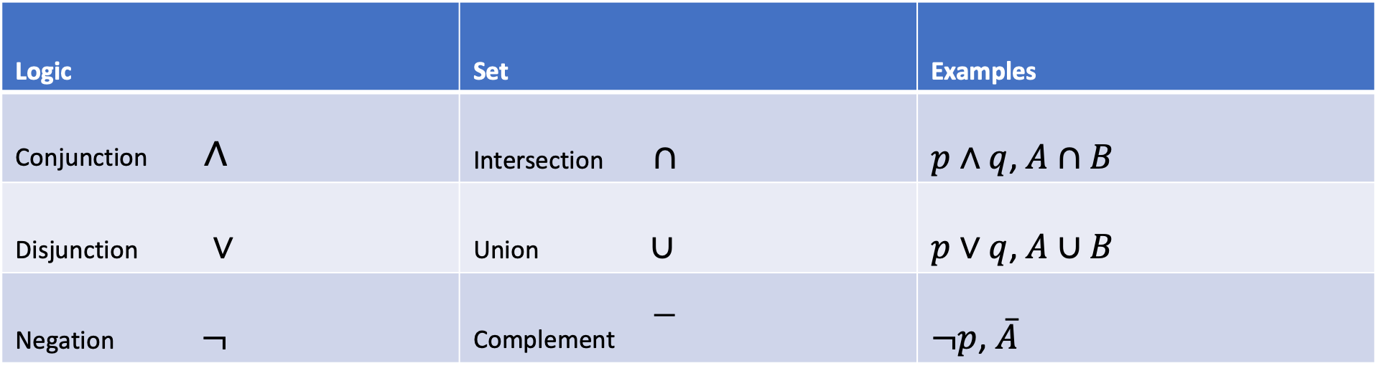
Logical & Set Operators Compared
Logic | Set | Examples
Conjunction $∧$ | Intersection $∩$ | $p∧q$, $A∩B$
Disjunction $∨$ | Union $∪$ | $p∨q$, $A∪B$
Negation $¬$ | Complement | $¬p$, $\overline{A}$

Slide 19
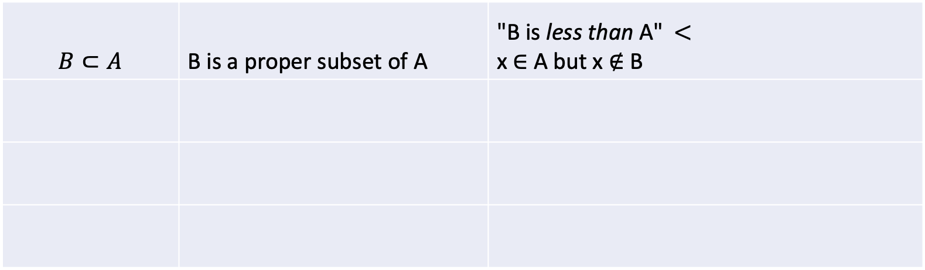
Subsets and Supersets
$$B⊂A$$ | B is a proper subset of A | "B is less than A" $<$ x ∈ A but x ∉ B

Slide 20
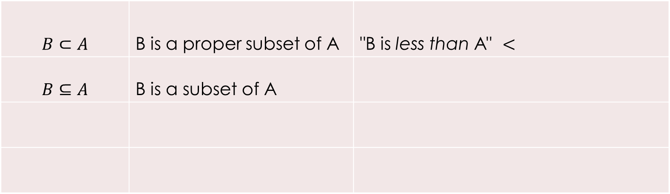
Subsets and Supersets
$$B⊂A$$ | B is a proper subset of A | "B is less than A" $<$
$$B⊆A$$ | B is a subset of A

Slide 21
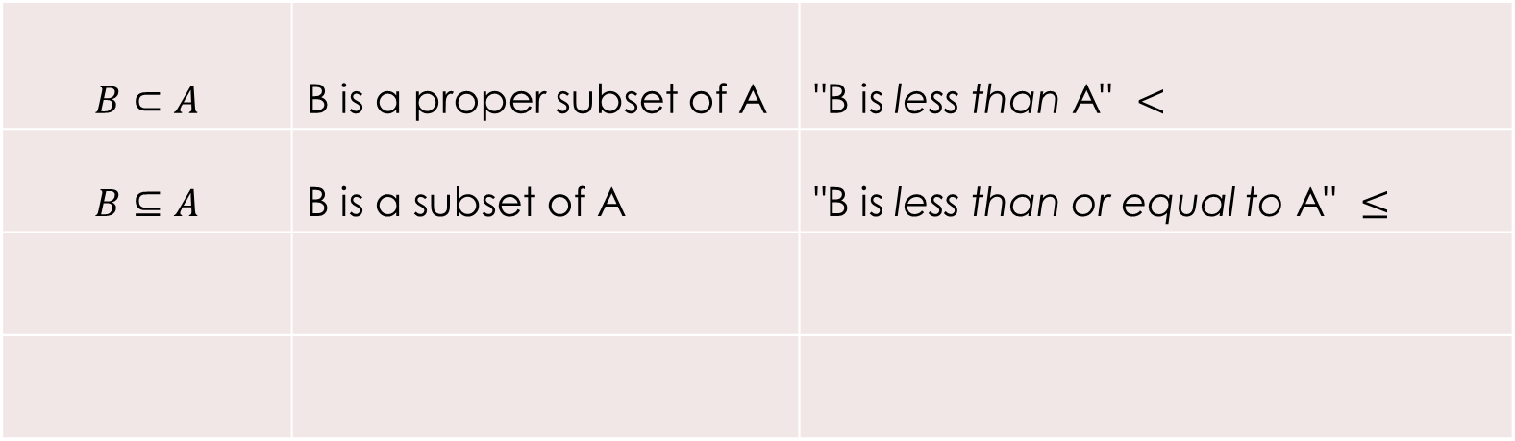
Subsets and Supersets
$$B⊂A$$ | B is a proper subset of A | "B is less than A" $<$
$$B⊆A$$ | B is a subset of A | "B is less than or equal to A" $≤$

Slide 22
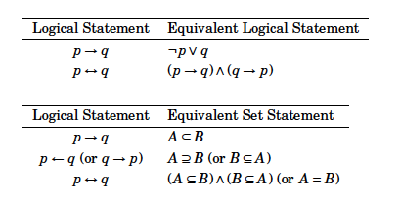
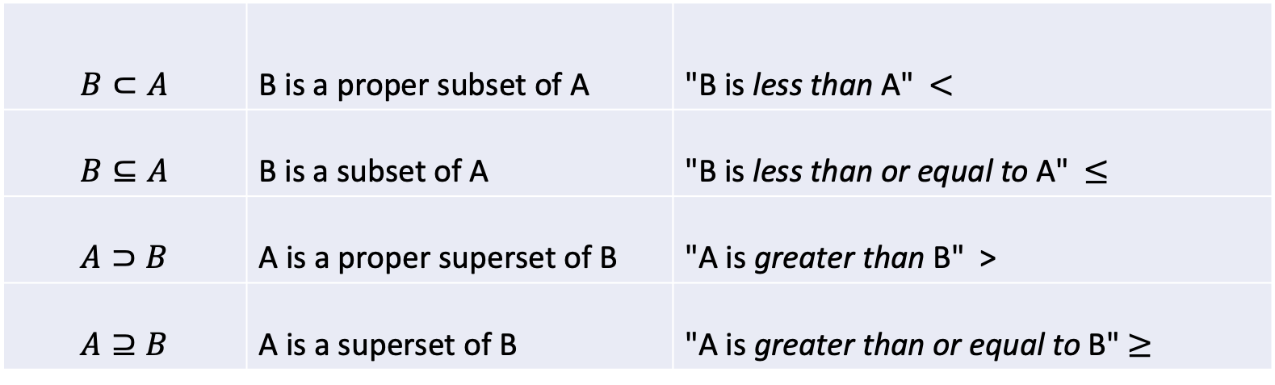
Subsets and Supersets
$$B⊂A$$ | B is a proper subset of A | "B is less than A" $<$
$$B⊆A$$ | B is a subset of A | "B is less than or equal to A" $≤$
$$A⊃B$$ | A is a proper superset of B | "A is greater than B" >
$$A⊇B$$ | A is a superset of B | "A is greater than or equal to B" $≥$

Slide 23
A is a subset of B, denoted as A ⊆ B
∅ ⊆ A ⊆ U
A = B if and only if A ⊆ B and B ⊆ A
If A ⊆ B and there is an element of B that is not an element of A (i.e., A ≠ B),
A is a proper subset of B, denoted as A ⊂ B

Slide 24
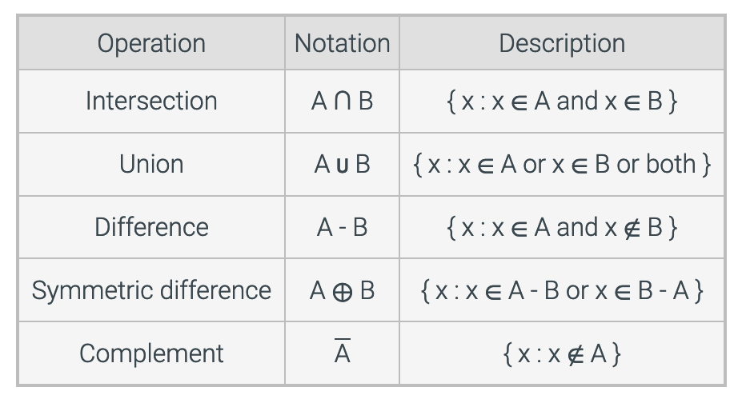
Summary

Slide 25

Powerset
The set of all subsets of a set
$A=\{a, b, c\}$
What is the powerset of $A$, which is denoted as $P(A)$?
$\left\{∅, \left\{a\right\}, \left\{b\right\}, \left\{c\right\}, \left\{a, b\right\}, \left\{b,c\right\}, \left\{a,c\right\}, \left\{a,b,c\right\}\right\}$
What is the cardinality of $A$?
$2^{3}=8$ Why?

Slide 26
Some python examples
Let A = {apple, banana, cherry, date}
A = {'apple', 'banana', 'cherry', 'date'}
A={x:2<x<10} A={x for x in range(3,10)

Slide 27
Work as a team on additional exercises:
3.1.4
3.3.1
3.4.3

Slide 28
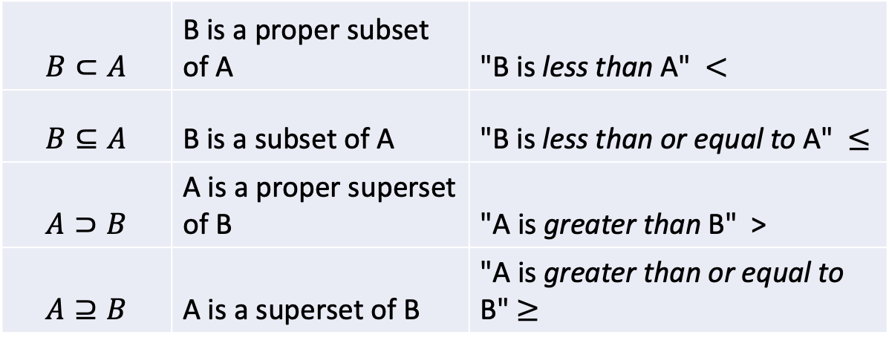
3.1.4
Define sets A, B and C as follows:
A = {2, 4, 6, 8}
B = {x ∈ Z: x is even and 0 < x < 10}
C = {x ∈ Z: x is even and 0 < x ≤ 10}
Indicate whether each statement about the sets A, B and C is true or false.
(a) A ⊆ B
(b) A ⊂ B
(c) A ⊆ C
(d) A ⊂ C
(e) C ⊆ B
(f) A = C
(g) A = B
$$B⊂A$$ | B is a proper subset of A | "B is less than A" $<$
$$B⊆A$$ | B is a subset of A | "B is less than or equal to A" $≤$
$$A⊃B$$ | A is a proper superset of B | "A is greater than B" >
$$A⊇B$$ | A is a superset of B | "A is greater than or equal to B" $≥$

Slide 29
Define sets A, B and C as follows:
A = {2, 4, 6, 8}
B = {x ∈ Z: x is even and 0 < x < 10}
C = {x ∈ Z: x is even and 0 < x ≤ 10}
Indicate whether each statement about the sets A, B and C is true or false.
(a) A ⊆ B True. Every element of A is also an element of B.
(b) A ⊂ B False. A = B. There is no element of B that is not also an element of A.
(c) A ⊆ C True. Every element of A is also an element of C.
(d) A ⊂ C True. Every element of A is also an element of C. Also 10 ∈ C and 10 ∉ A.
(e) C ⊆ B False. 10 ∈ C and 10 ∉ B.
(f) A = C False. 10 ∈ C and 10 ∉ A.
(g) A = B True. B = {2, 4, 6, 8}.

Slide 30
3.3.1
Define the sets A, B, C, and D as follows:
A = {-3, 0, 1, 4, 17}
B = {-12, -5, 1, 4, 6}
C = {x ∈ Z: x is odd}
D = {x ∈ Z: x is positive}
For each of the following set expressions, if the corresponding set is finite, express the set using roster notation. Otherwise, indicate that the set is infinite.
(a) A ∪ B
(b) A ∩ B
(c) A ∩ C
(d) A ∪ (B ∩ C)
(e) A ∩ B ∩ C
(f) A ∪ C
(g) (A ∪ B) ∩ C
(h) A ∪ (C ∩ D)

Slide 31
3.3.1
Define the sets A, B, C, and D as follows:
A = {-3, 0, 1, 4, 17}
B = {-12, -5, 1, 4, 6}
C = {x ∈ Z: x is odd}
D = {x ∈ Z: x is positive}
For each of the following set expressions, if the corresponding set is finite, express the set using roster notation. Otherwise, indicate that the set is infinite.
(a) A ∪ B {-12, -5, -3, 0, 1, 4, 6, 17}
(b) A ∩ B {1, 4}
(c) A ∩ C {-3, 1, 17}
(d) A ∪ (B ∩ C) {-5, -3, 0, 1, 4, 17}
(e) A ∩ B ∩ C {1}
(f) A ∪ C Infinite
(g) (A ∪ B) ∩ C {-5, -3, 1, 17}
(h) A ∪ (C ∩ D) Infinite

Slide 32
3.4.3
Define the following sets.
A = {x ∈ Z: x is a multiple of 3}
B = {3, 5, 7, 9}
C = {2, 3, 4, 5}
Indicate whether each statement is true or false.
(a) |B| = |C|
(b) |A ∩ B| = |A ∩ C|
(c) A ∩ C ⊆ A ∩ B
(d) C - B ⊆ A
(e) B ∪ C = {3, 5}
(f) 2 ∈ A ∪ C
(g) {2, 3} ∈ C
(h) {3} ∈ P(C)
(i) A ∩ B ∩ C = ∅
(j) ∅ ∈ A
$$B⊂A$$ | B is a proper subset of A | "B is less than A" $<$
$$B⊆A$$ | B is a subset of A | "B is less than or equal to A" $≤$
$$A⊃B$$ | A is a proper superset of B | "A is greater than B" >
$$A⊇B$$ | A is a superset of B | "A is greater than or equal to B" $≥$

Slide 33
3.4.3
Define the following sets.
A = {x ∈ Z: x is a multiple of 3}
B = {3, 5, 7, 9}
C = {2, 3, 4, 5}
Indicate whether each statement is true or false.
(a) |B| = |C| True
(b) |A ∩ B| = |A ∩ C| False
(c) A ∩ C ⊆ A ∩ B True
(d) C - B ⊆ A True
(e) B ∪ C = {3, 5} False
(f) 2 ∈ A ∪ C True
(g) {2, 3} ∈ C False
(h) {3} ∈ P(C) True
(i) A ∩ B ∩ C = ∅ False
(j) ∅ ∈ A False

Slide 34
Work as a team.
3.1.1
3.1.2
3.1.4*
3.2.1
3.2.2
3.3.1*
3.4.3*
3.4.4

