Slide 1
CSE 280 Discrete Mathematics
Day 2: Propositions & Logic
W. Clements

Slide 2
What is Discrete Mathematics?
"the branch of mathematics dealing with objects that can assume only distinct, separated values" – Wolfram Mathworld
In contrast with continuous mathematics, which deals with things that vary smoothly / continuous numbers (e.g., calculus)
https://mathworld.wolfram.com/DiscreteMathematics.html

Slide 3
Think integers vs real numbers
1,2,3,4,5,...
vs
3.14159265359...

Slide 4
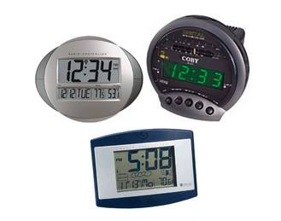
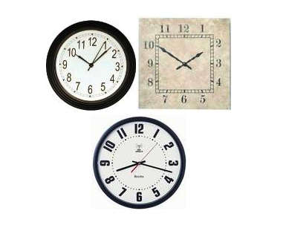
Think digital vs analog
Think about clocks.
Clock on the wall vs a digital watch
Clocks

Slide 5
Think cycles
What has a cycle...
...with period 12 (or 24)?
...with period 10?
...with period 7?
...with period 2?

Slide 6
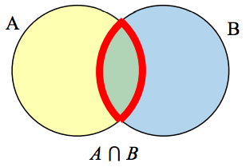
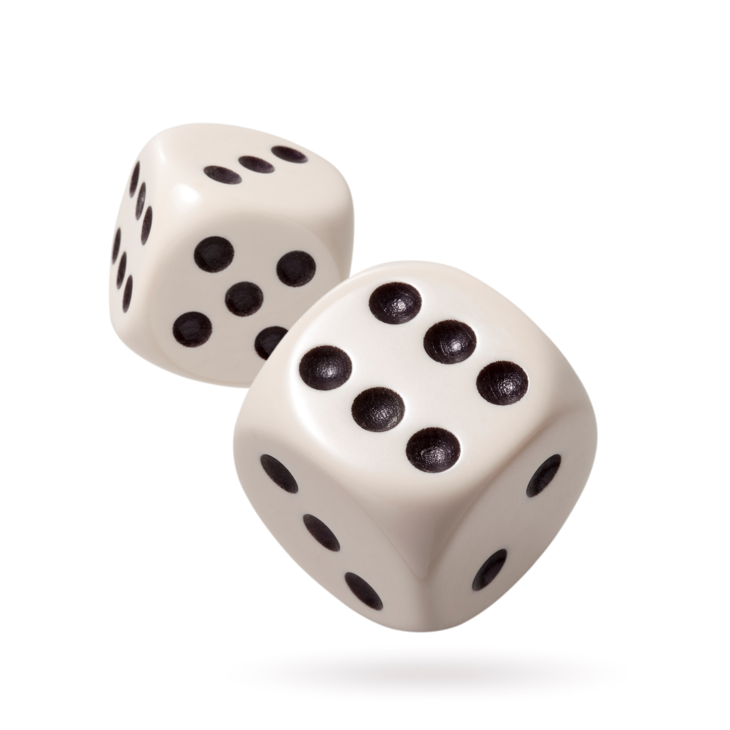
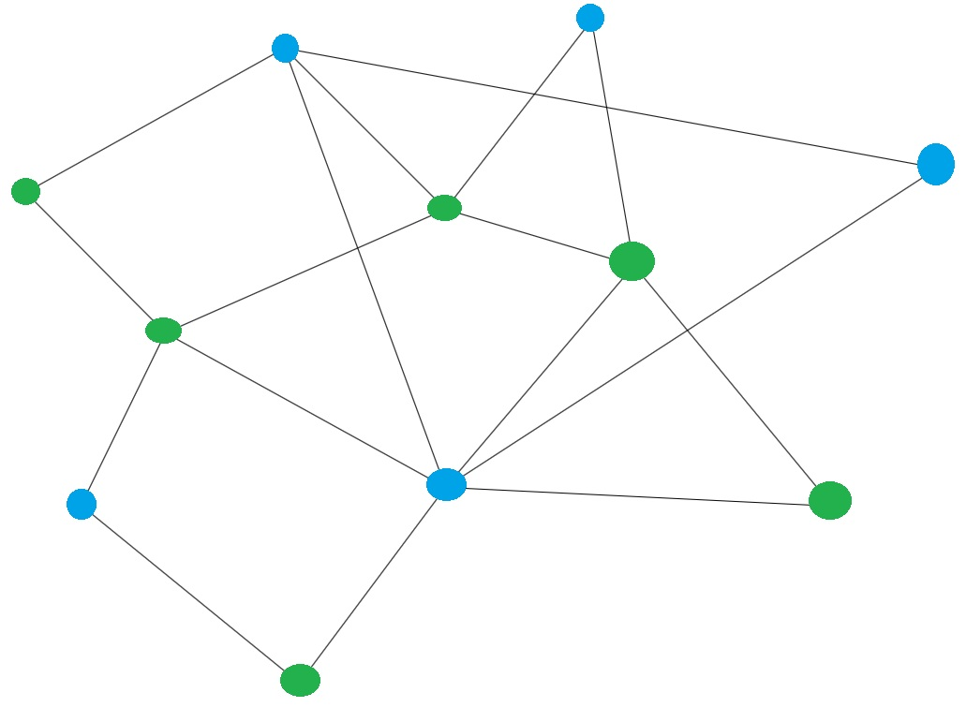



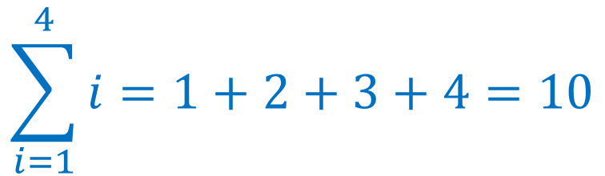




Topics
$$p∧q$$
$$p∨q$$
$$∀x P(x)$$
$$∃x P(x)$$
Propositions and Logic
Predicates and Quantifiers
Sets
Functions
Relations
Number Theory (Integers, prime numbers)
Combinatorics
Sequences and Summations
Probability
Graphs
Trees
$$F(x)=x^{2},x∈ℝ$$
$$R=\left\{\left(a,b\right) \right| a+b=6\}$$
2,3,5,7,11,13,17,19...
$$\sum_{i=1}^{4}{i}=1+2+3+4=10$$
$$\left({11 \atop 3}\right)$$

Slide 7

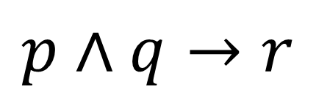


Propositions & Logic
$$p∧q→r$$
$$¬p∨¬q$$
$$¬\left(p∧r\right)∨(q∧s)$$
$$\left(\left(p∨q\right)∧\left(¬p∨r\right)\right)→(q∨r)$$

Slide 8
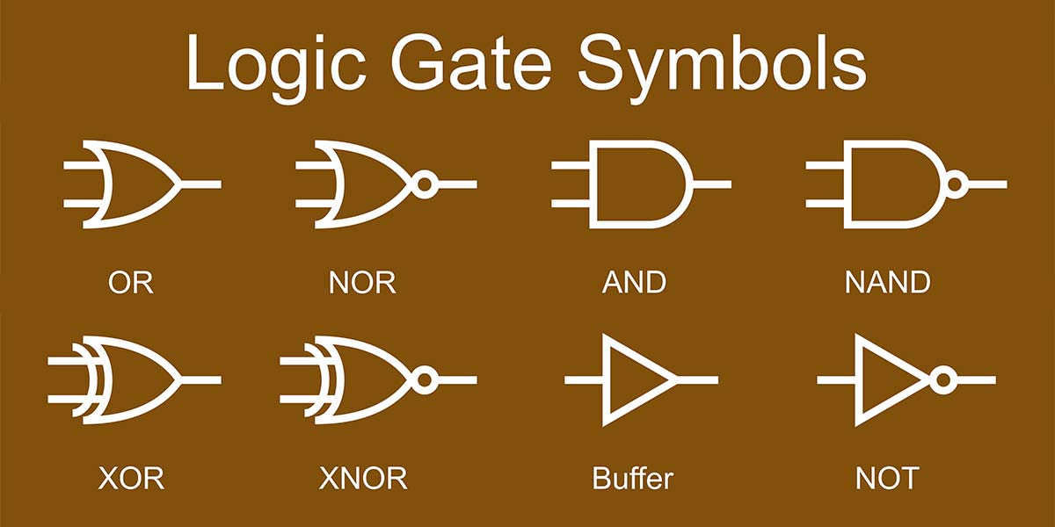
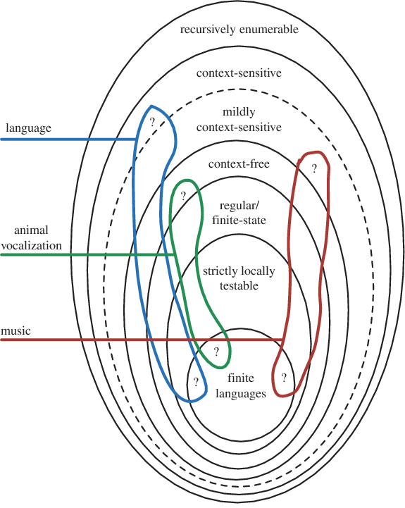
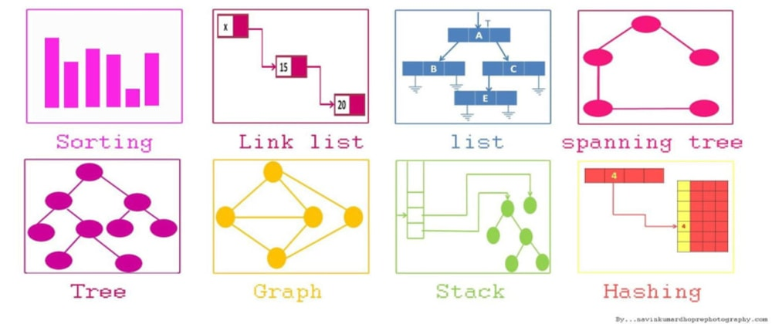
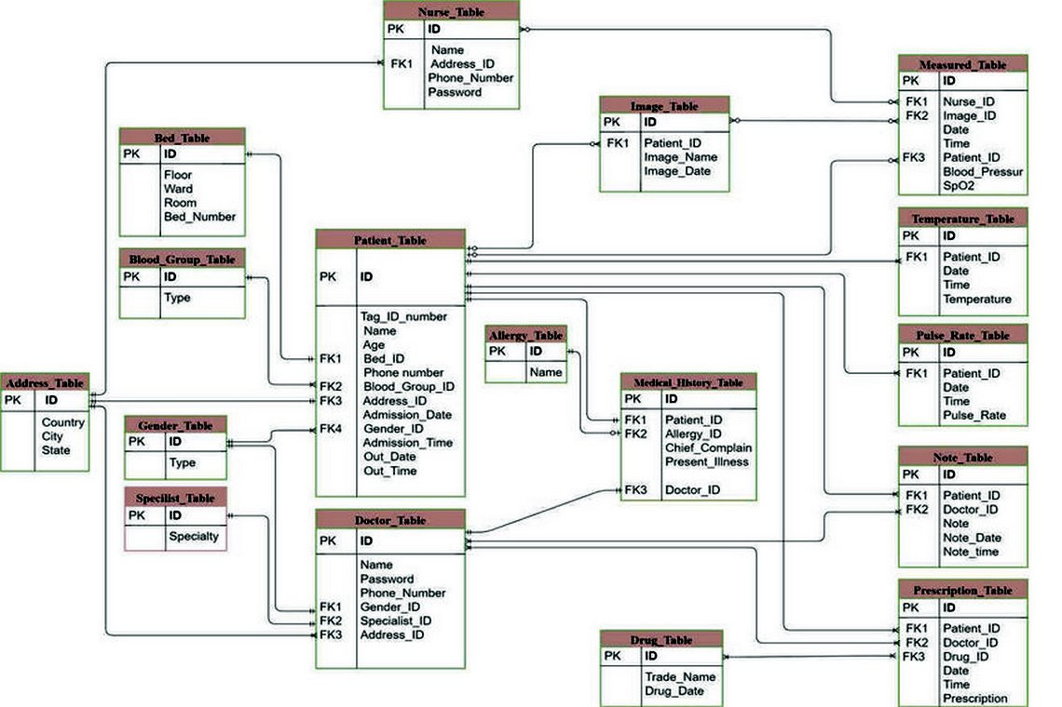
Why do I need this?
Rules of Logic are everywhere:
Mathematical reasoning
Computer circuits (Logic gates)
Formal Languages (computer languages)
Data Structures
Algorithm Design
Compiler Design
Relational Database Theory
Computability Theory
…
All built on a foundation of formal logic

Slide 9
Why do I need this?
Why is it important to think logically?
Logic sharpens your thinking, allowing it to “cut” more powerfully.
Why know logic (formal or informal)?
Logic gives you a means to mechanize reasoning.
Mechanizing reasoning means programming a computer to do it.
Sound Thinkers (ILO)
We frame and solve problems using creative and critical thinking.

Slide 10
Propositions
A proposition is...
A declarative sentence.
In other words, a sentence that is either True or False
The sky is blue
Today is Tuesday
We are in a discrete math class

Slide 11
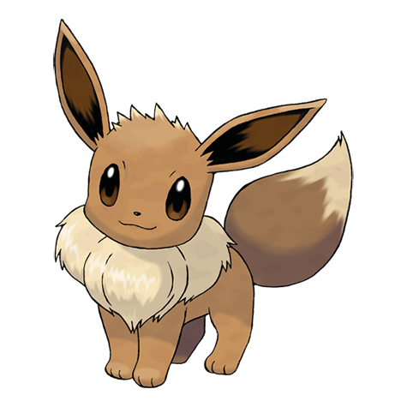
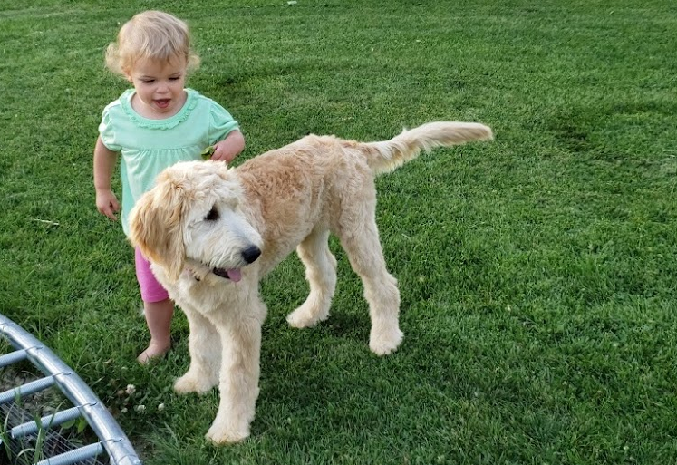

Propositions
We represent propositions using a variable, such as $p$, $q$, $r$, $s$
Examples:
$p=$The sky is blue
$q=$It is raining
$r=$My dog's name is Eevee

Slide 12
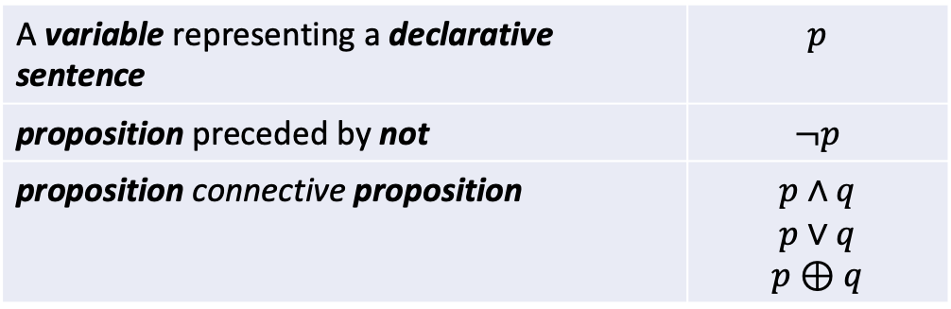

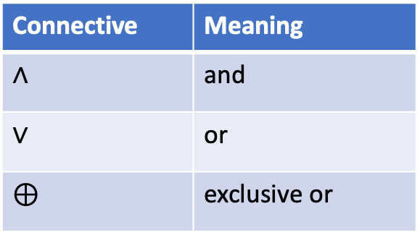
Propositions
We can build compound propositions by following these rules:
A proposition is...
$p=$We are in a discrete math class
$q=$It is Wednesday
$p∧q$ = We are in a discrete math class and it is Wednesday.
Connective | Meaning
$∧$ | and
$∨$ | or
$⊕$ | exclusive or
A variable representing a declarative sentence | $$p$$
proposition preceded by not | $$¬p$$
proposition connective proposition | $$p∧q$$ $$p∨q$$ $$p⊕q$$
Mult |  |  |  | Xor
+ (positive) | X | + (positive) | = +(positive) | False
- (negative) | X | + (positive) | = - (negative) | True
+ (positive) | X | - (negative) | = - (negative) | True
- (negative) | X | - (negative) | = + (positive) | False

Slide 13

Translating to/from English
$p=$ It is raining
$q=$It is sunny
$r=$We will go outside
Translate the following into English:
$$p∨q$$
$$\left(p∧¬r\right)∨\left(q∧r\right)$$
$p∧q∧r$
It is raining or it is sunny.
It is raining and we will not go outside, or it is sunny and we will go outside.
It is raining and it is sunny and we will go outside.

Slide 14
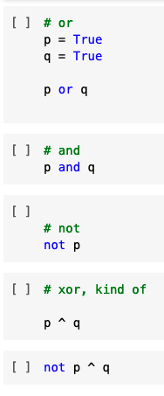
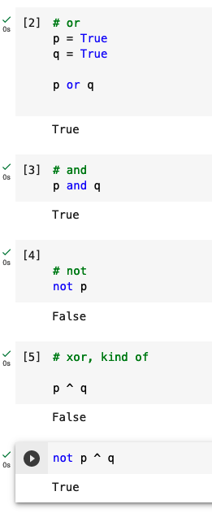
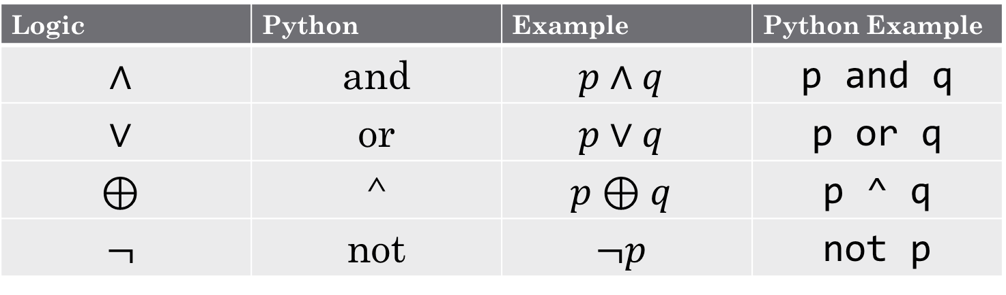
Logic symbols in Python
Logic | Python | Example | Python Example
$$∧$$ | and | $$p∧q$$ | p and q
$$∨$$ | or | $$p∨q$$ | p or q
$$⊕$$ | ^ | $$p⊕q$$ | p ^ q
$$¬$$ | not | $$¬p$$ | not p
Exclusive XOR
Examples

Slide 15
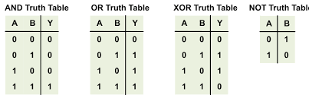
Truth Tables
Mult |  |  |  | Xor
+ (positive) | X | + (positive) | = +(positive) | False
- (negative) | X | + (positive) | = - (negative) | True
+ (positive) | X | - (negative) | = - (negative) | True
- (negative) | X | - (negative) | = + (positive) | False

Slide 16
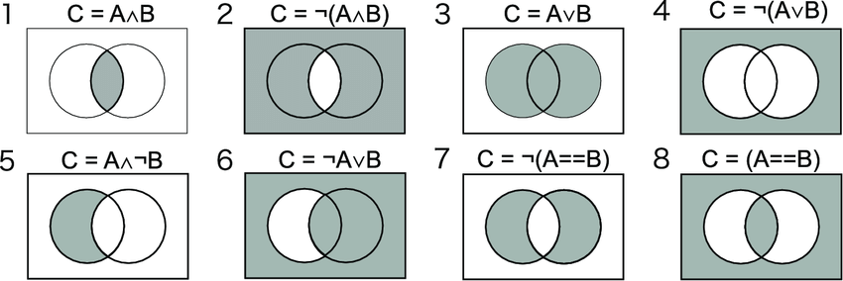

Slide 17
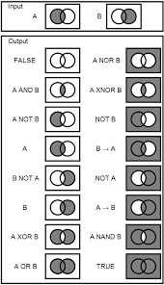


Slide 18
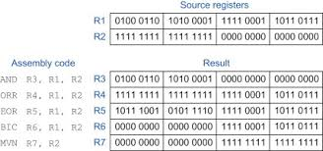
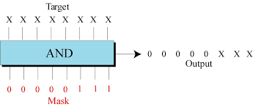
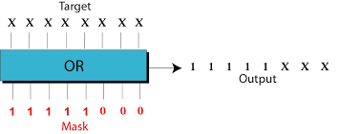
Bit Masking and Turning on Flags i.e.; Networking and Flags
Checking for flag
Adding a flag

Slide 19
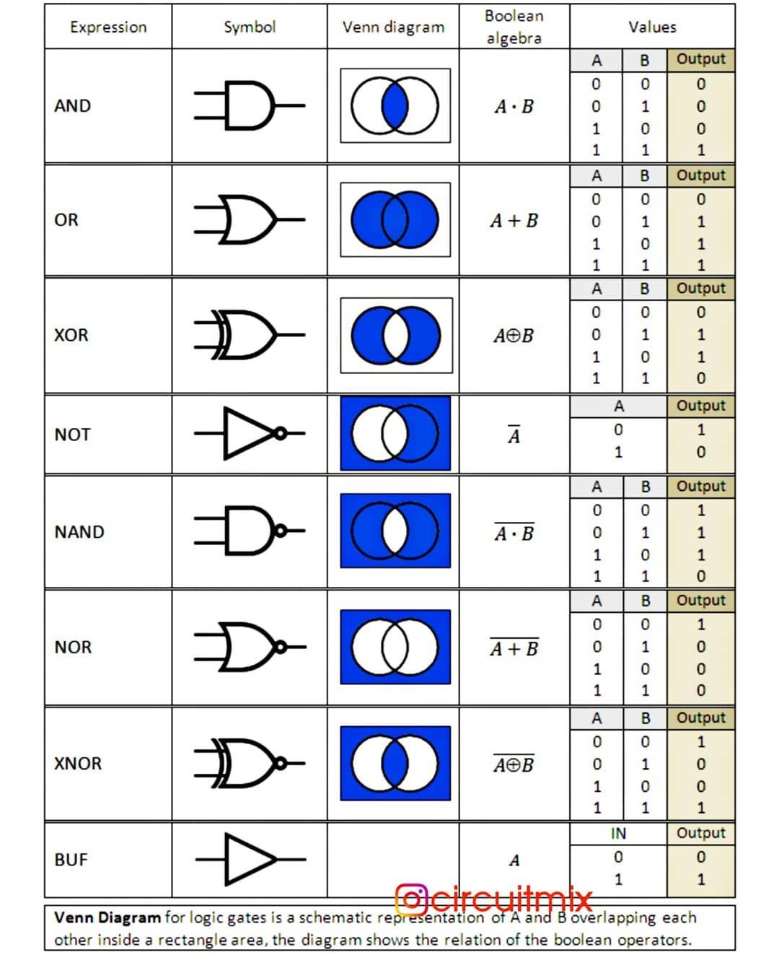
Venn Diagrams

Slide 20
Group Activity
With a group of 2-4 people, work through the following Additional exercises at the bottom of reading 1.1
1.1.3
1.1.4
1.1.5

Slide 21
Homework 1
Share or as a group work through 1.1 and 1.3
Challenge 1.5

Slide 22
For Next Class Period…
Complete 01 Reading & Activity: 1.2 & 1.3 Compound Propositions & Conditions
Save off Homework 1

