Slide 1

CSE 280 Discrete Mathematics
Day 3: Compound Propositions & Conditions
W. Clements

Slide 2
Team setup

Slide 3
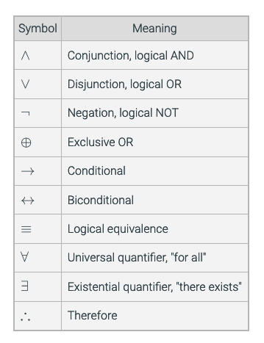
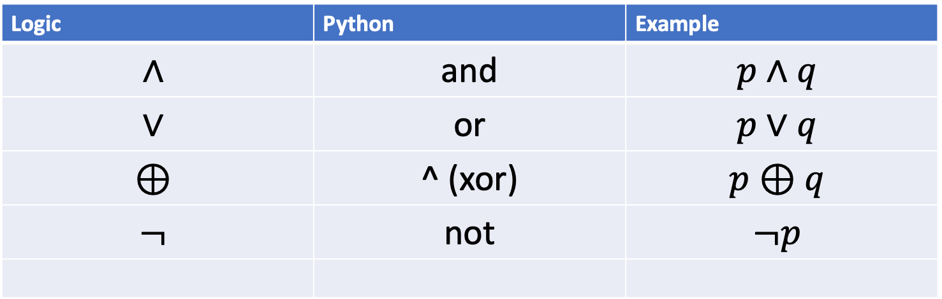
Review some symbols
Logic | Python | Example
$$∧$$ | and | $$p∧q$$
$$∨$$ | or | $$p∨q$$
$$⊕$$ | ^ (xor) | $$p⊕q$$
$$¬$$ | not | $$¬p$$

Slide 4
Homework 1
Talk about 1.4 and 1.5
print(f'p q p and q p or q not p or q p and not q')
p_values = [True, False]
q_values = [True, False]
for p in p_values:
for q in q_values:
# Note: !s forces printing "True" instead of "1" and "False" instead of "0" when
# using string formatting to align the output
# p q p and q p or q not p or q p and not q'
print(f'{p!s:<8} {q!s:<8} {p and q!s:<10} {p or q!s:<10} {not p or q!s:<13} {p and not q!s:<13} {p ^ q!s}')

Slide 5
Practical Uses of Logical Operators
Search Engines
Conditionals in programming
Can you think of any others?

Slide 6
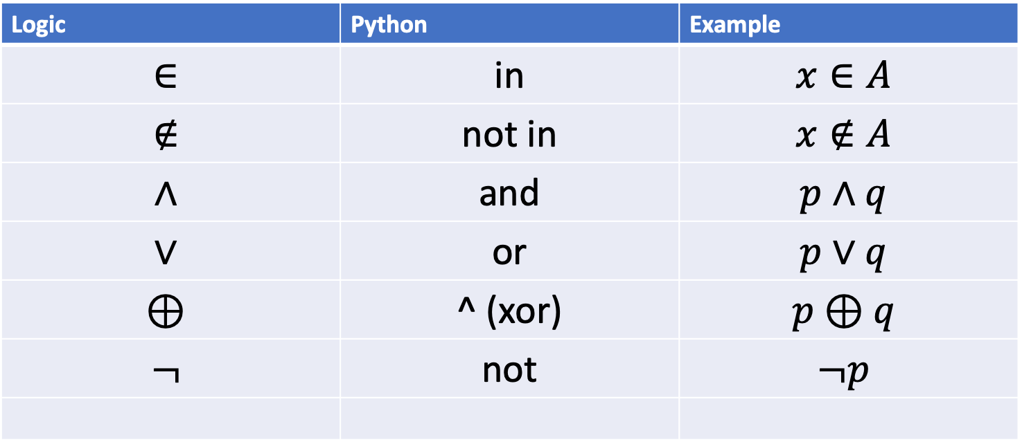
Review some symbols
Logic | Python | Example
$$∈$$ | in | $$x∈A$$
$$∉$$ | not in | $$x∉A$$
$$∧$$ | and | $$p∧q$$
$$∨$$ | or | $$p∨q$$
$$⊕$$ | ^ (xor) | $$p⊕q$$
$$¬$$ | not | $$¬p$$

Slide 7
Review Terms
And If both are true, then true, else false
Or If both are false, then false, else true
Not
Xor ++/-- --> Same their False, else true

Slide 8
Rules on Compound Propositions
There are four of them:”
1. A proposition is a variable, that is, a single element from the set {p, q, r, s, t,...};
2. alternatively, a proposition is a proposition preceded by a not;
3. alternatively, a proposition is a proposition followed by a connective followed by a proposition.
4. A connective is a single element from the set {and, or, xor}.

Slide 9


Truth Tables (cardinality)
How many rows will be in the truth table for the following propositions?
$p∧q$
$p∨q∧r$
$\left(p∧¬q\right)∨(r∧q)$
$p∧q∧r∧s$
4 rows
There are $2^{n}$ rows in a truth table with $n$ variables
8 rows
8 rows
16 rows!

Slide 10
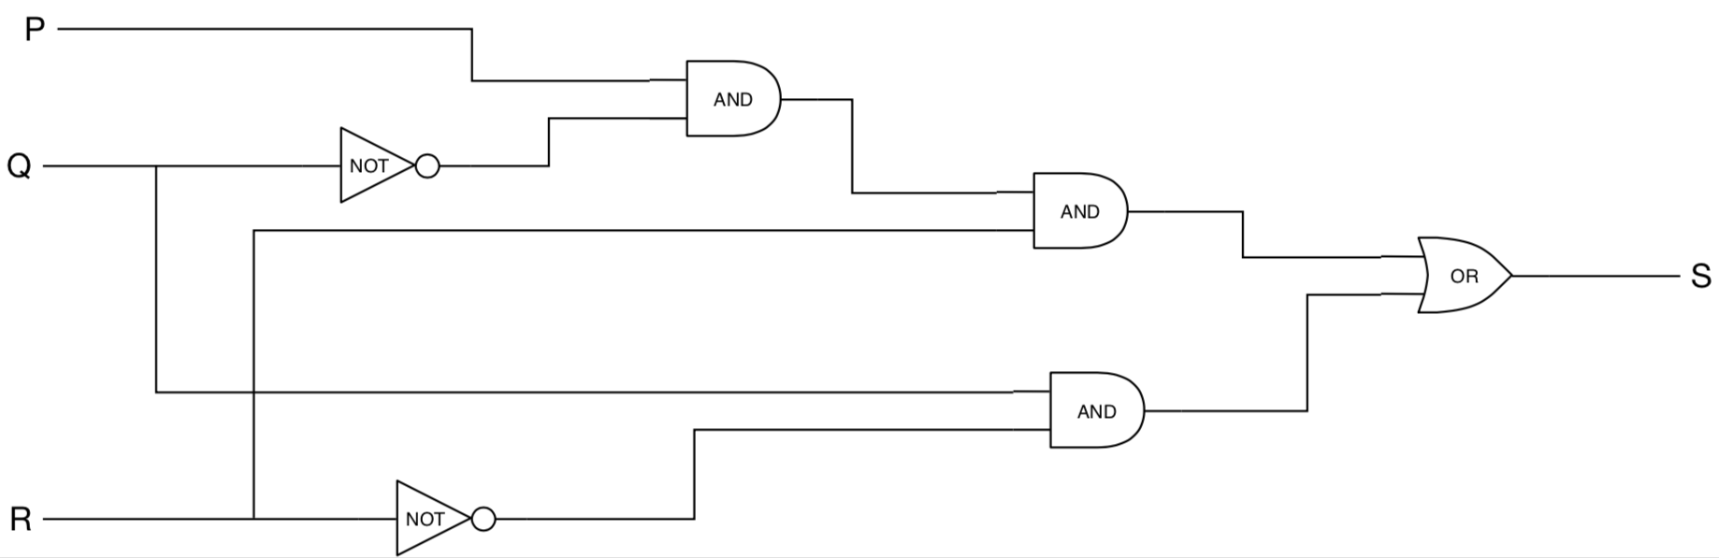
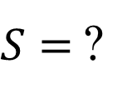
Convert to Boolean
$S=$?
$$S=(P∧¬Q∧R)∨(Q∧¬R)$$

Slide 11

Conditional
q
p
In p → q, the proposition p is called the hypothesis, and the proposition q is called the conclusion.
The truth table for p → q is given below
$p:$You are in this class
$q:$You are a BYU-I student
P | Q | P->q
T | T | T
T | F | F
F | T | T
F | F | T
if p, then q
if p, q
p only if q
p implies q
p is sufficient for q
q if p
q whenever p
q is necessary for p
You being in this class is
sufficient for me to conclude that
you are a BYU-I student.

Slide 12
The converse, contrapositive, and inverse
Proposition | p → q | If it is raining today, the game will be cancelled
Converse | q → p | If the game is cancelled, it is raining today.
Contrapositive | !q →!p | If the game is not cancelled, then it is not raining today.
Inverse | !p →!q | If it is not raining today, the game will not be cancelled.

Slide 13


Conditionals: $p→q$
$p=$It is sunny
q = We will go outside
Conditional: $p→q$
Converse: $q→p$
Inverse: $¬p→¬q$
Contrapositive: $¬q→¬p$
If it is sunny, then we'll go outside.
If we go outside, then it is sunny.
If it is not sunny, then we will not go outside.
If we do not go outside, then it is not sunny.

Slide 14

Conditionals: $p→q$
$p=$You pass the exam
q = You get an A in the class
Conditional: $p→q$
Converse: $q→p$
Inverse: $¬p→¬q$
Contrapositive: $¬q→¬p$
If you pass the exam, then you get an A in the class.
If you get an A in the class, then you passed the exam.
If you didn't pass the exam, then you won't get an A in the class.
If you don't get an A in the class, then you didn't pass the exam.

Slide 15

Biconditional
If p and q are propositions, the proposition "p if and only if q" is expressed with the biconditional
operation and is denoted p ↔ q.
p if and only if q
p iff q
p is necessary and sufficient for q
if p then q and if q then p
if p then q and conversely
P | Q | P<->q
T | T | T
T | F | F
F | T | F
F | F | T
$p$: You get an A in the class
$q$: You pass the final exam
You will get an A in the class
if and only if
you pass the final exam.

Slide 16

Class exercises
s → q
(r ↔ s) ∧ q
q → $¬$r
(q ∧ s) → p
(p ↔ r) ∧ ($¬$r ∧ $¬$s)
q → $¬$(r ∨ q)

Slide 17
Review
p q ? T T F T F T F T F F F F | p q ? T T F T F T F T T F F F | p q ? T T T T F F F T F F F T

Slide 18
Let's Practice
With 2-3 people to a group, do the following Additional Exercises from the textbook:
1.2.1 a,b,c
1.2.3 a-f
1.2.4 d
1.2.7
1.3.2 a-b
1.3.4 a, c
1.3.7 a, b, d
1.3.8

Slide 19
Exercise 1.7
If 2 + 2 = 4, then pigs can fly.
If 2 + 7 = 5, then Elvis is alive.
If pigs can fly, then dogs can't fly.
If dogs have four legs, then ostriches have two legs.
2 + 1 = 3 if and only if 1 + 2 = 3.
1 + 2 = 3 if and only if 3 + 1 = 6.
1 + 3 = 2 if and only if the earth is flat.
1 < 2 if and only if 2 < 3.

Slide 20
