Slide 1
CSE 280 Discrete Mathematics
Week 02 Day 1
W. Clements
Logical Equivalence & De Morgan's Laws 1.4 & 1.5

Slide 2
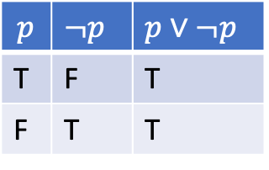
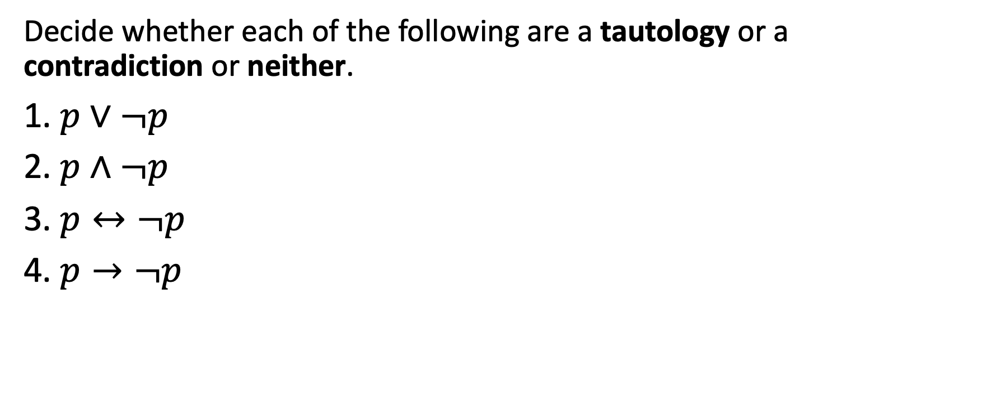
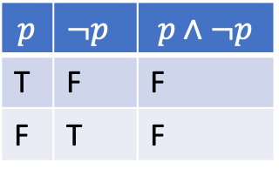
Check your understanding
$$p$$ | $¬p$ | $p∨¬p$
T | F | T
F | T | T
Decide whether each of the following are a tautology or a contradiction or neither.
1. $p∨¬p$
2. $p∧¬p$
3. $p↔¬p$
4. $p→¬p$
$$p$$ | $¬p$ | $$p∧¬p$$
T | F | F
F | T | F
Tautology. It is always true no matter the value of $p$.
Contradiction. It is always false no matter the value of $p$.
This sentence is false
Contradiction. It is always false no matter the value of $p$.
The following sentence is true.
The previous sentence is false.
Neither. It is sometimes true and sometimes false depending on the value of $p$.

Slide 3
Logically Equivalent
Two compound propositions are said to be logically equivalent if they have the same truth value regardless of the truth values of their individual propositions.
If s and r are two compound propositions, the notation s ≡ r is used to indicate that r and s are logically equivalent.
p and ¬¬p
Propositions s and r are logically equivalent if and only if the proposition s ↔ r is a tautology.

Slide 4
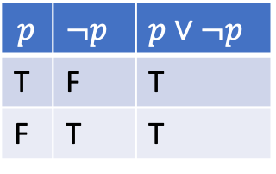
Is this true?
Propositions s and r are logically equivalent if and only if the proposition s ↔ r is a tautology.
$$p$$ | $¬p$ | $p∨¬p$
T | F | T
F | T | T
Tautology. It is always true no matter the value of $p$.
Note that s ≡ r if and only if r ≡ s.

Slide 5
Wait what is “if and only if”, again
Recall
In p → q, the proposition p is called the hypothesis, and the proposition q is called the conclusion
If p and q are propositions, the proposition "p if and only if q" is expressed with the biconditional operation and is denoted
p ↔ q.

Slide 6

De Morgan's Laws
De Morgan’s laws for logic state:
The negation of a conjunction is the disjunction of negations; likewise, the negation of a disjunction is the conjunction of negations.
$$¬\left(p∧q\right)≡¬p∨¬q$$
$$¬\left(p∨q\right)≡¬p∧¬q$$

Slide 7
De Morgan's Laws
De Morgan’s laws for logic state:
The negation of a conjunction is the disjunction of negations; likewise, the negation of a disjunction is the conjunction of negations.
$$¬\left(p∧q\right)≡¬p∨¬q$$
$$¬\left(p∨q\right)≡¬p∧¬q$$

Slide 8
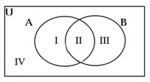
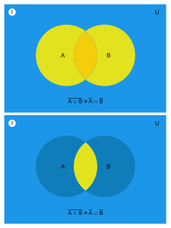

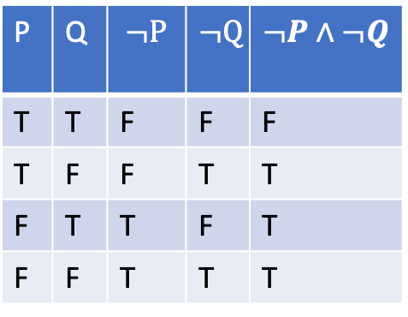
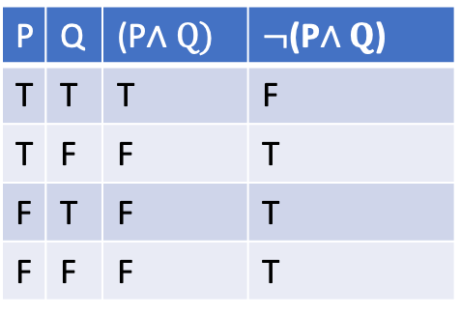
De Morgan's Laws
De Morgan’s laws for logic state:
The negation of a conjunction is the disjunction of negations; likewise, the negation of a disjunction is the conjunction of negations.
$$¬\left(p∧q\right)≡¬p∨¬q$$
$$¬\left(p∨q\right)≡¬p∧¬q$$
P | Q | (P$∧Q)$ | $¬$(P$∧Q$)
T | T | T | F
T | F | F | T
F | T | F | T
F | F | F | T
P | Q | $$¬P$$ | $$¬Q$$ | $$¬P∧¬Q$$
T | T | F | F | F
T | F | F | T | T
F | T | T | F | T
F | F | T | T | T

Slide 9
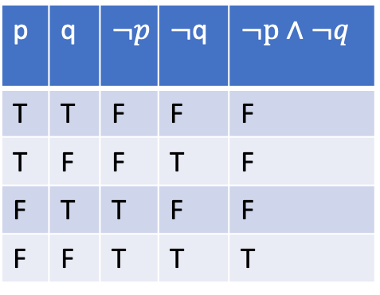

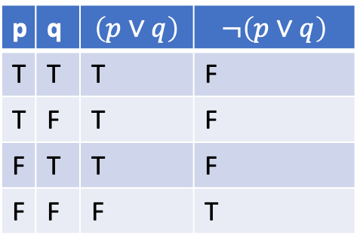
De Morgan's Laws
De Morgan’s laws for logic state:
The negation of a conjunction is the disjunction of negations; likewise, the negation of a disjunction is the conjunction of negations.
$$¬\left(p∧q\right)≡¬p∨¬q$$
$$¬\left(p∨q\right)≡¬p∧¬q$$
p | q | $$\left(p∨q\right)$$ | $$¬\left(p∨q\right)$$
T | T | T | F
T | F | T | F
F | T | T | F
F | F | F | T
p | q | $$¬p$$ | $¬$q | $¬p$ $∧¬q$
T | T | F | F | F
T | F | F | T | F
F | T | T | F | F
F | F | T | T | T

Slide 10
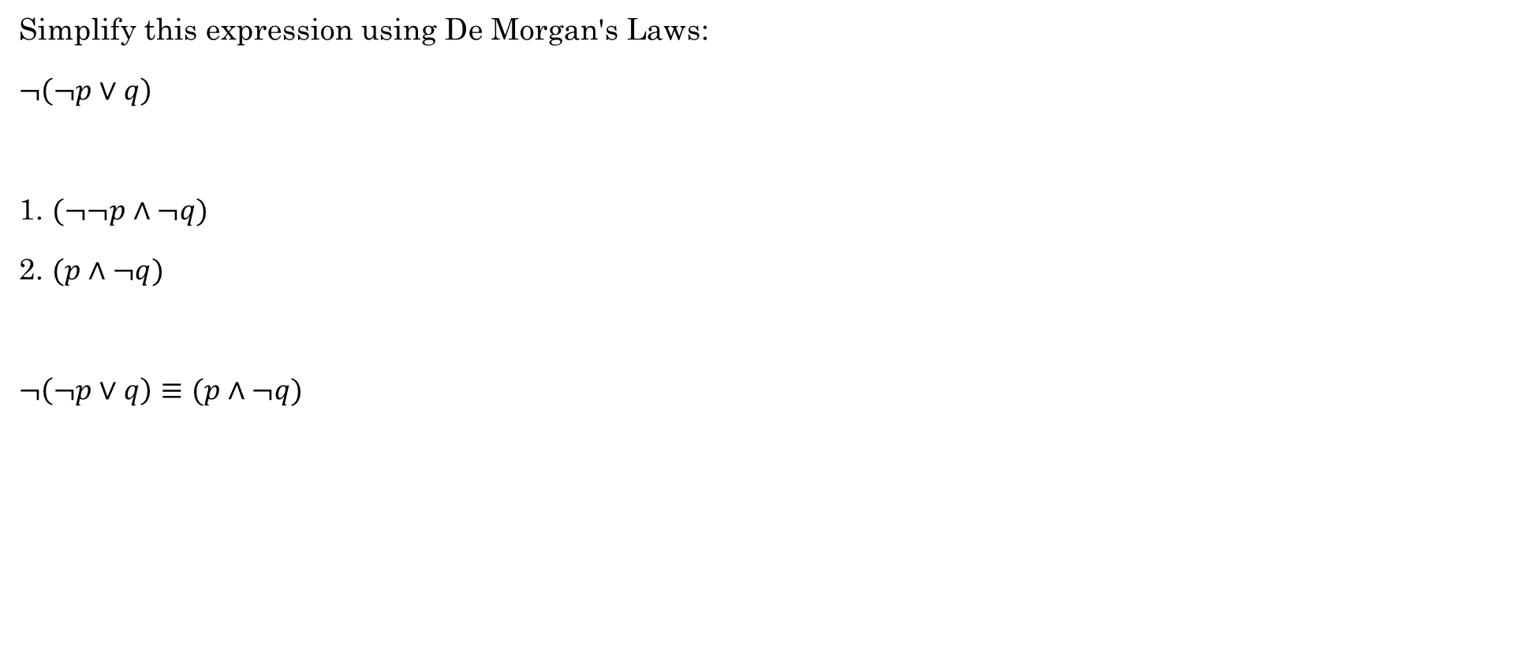
Example
Simplify this expression using De Morgan's Laws:
$¬\left(¬p∨q\right)$
1. $(¬¬p∧¬q)$
2. $(p∧¬q)$
$¬\left(¬p∨q\right)≡(p∧¬q)$

Slide 11
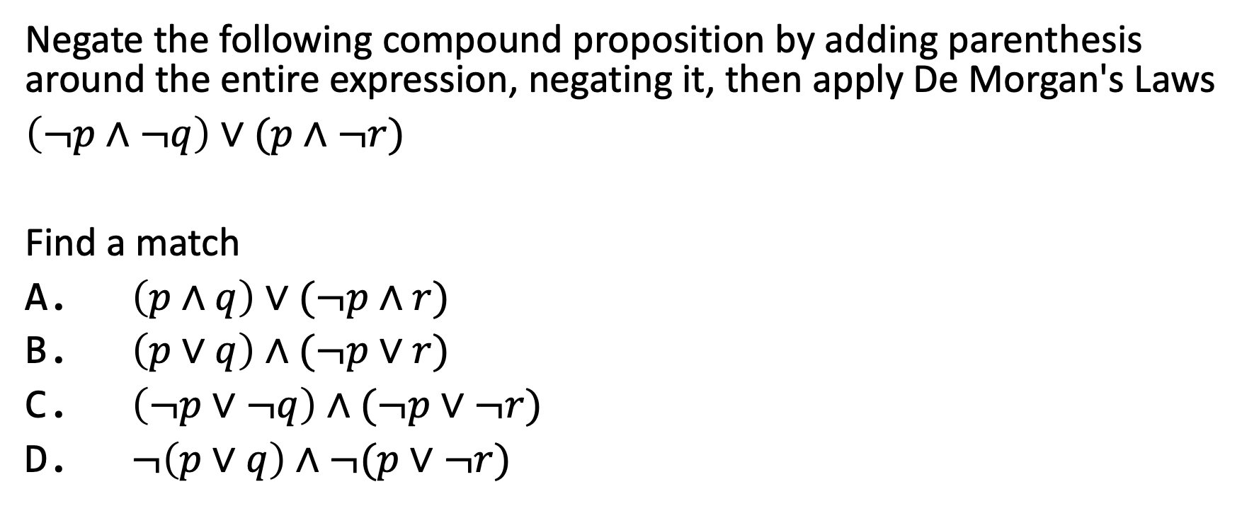
You try it
Negate the following compound proposition by adding parenthesis around the entire expression, negating it, then apply De Morgan's Laws
$\left(¬p∧¬q\right)∨(p∧¬r)$
Find a match
A. $\left(p∧q\right)∨(¬p∧r)$
B. $\left(p∨q\right)∧(¬p∨r)$
C. $\left(¬p∨¬q\right)∧(¬p∨¬r)$
D. $¬\left(p∨q\right)∧¬(p∨¬r)$

Slide 12


Translate from English to Logic
You cannot ride a roller coaster if you are under 4 feet tall unless you are older than 16 years old.
$r=$You can ride a roller coaster
$s=$You are under 4 feet tall
$t=$You are older than 16
Hint: $p→q$ can be pronounced as $q if p$
$$(s∧¬t)→¬r$$
Notes:
If you are under 4 feet tall and not older than 16, then you cannot ride the roller coaster.
-r, if s ^ -t
(s ^ -t) -> -r
Another way, start with the contrapositive: If you can ride the roller coaster, then you must be over 4 feet or older than 16.
r -> (-s v t)

Slide 13

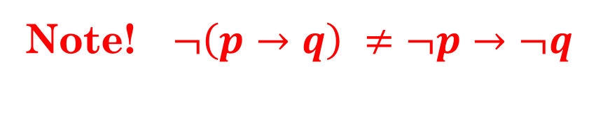
Let's Practice
Construct a Truth Table to verify the following equivalencies.
$p→q≡¬q→¬p$ (Conditional & its contrapositive)
$p→q≡¬p∨q$ (Conditional & a disjunction)
$¬p→¬q≡q→p$ (Inverse & Converse)
$¬\left(p→q\right)≡(p∧¬q)$ (Negation of a Conditional)
Note! $¬\left(p→q\right) ≠¬p→¬q$
Notes:
Each group choose a different one to do, then they show each other their truth tables.

Slide 14
Laws of Propositional Logic
Idempotence: the property of certain operations in mathematics and computer science whereby they can be applied multiple times without changing the result beyond the initial application 1*1 = 1
p ∨ p ≡ p p ∧ p ≡ p
Association & Commutative law: We can apply the association law to the multiplication or addition of the three numbers in discrete mathematics. i.e. 2+3+4 = 4+2+3, 2*3*4 = 4*3*2
( p ∨ q ) ∨ r ≡ p ∨ ( q ∨ r ) ( p ∧ q ) ∧ r ≡ p ∧ ( q ∧ r )
Distributive:
a(b + c) = ab + ac; multiplication accures both additive operators.
p ∨ ( q ∧ r ) ≡ ( p ∨ q ) ∧ ( p ∨ r ) p ∧ ( q ∨ r ) ≡ ( p ∧ q ) ∨ ( p ∧ r )

Slide 15
Identity laws: if we combine a statement and a True value with the symbol ∨(or), then it will generate the True value. If we combine a statement and a False value with the symbol ∧(and), then it will generate the statement itself.
p ∨ F ≡ p p ∧ T ≡ p
Domination laws: opposite
p ∧ F ≡ F p ∨ T ≡ T
Double negation law:
¬¬p ≡ p

Slide 16
Complement laws:The union of a set A and its complement A' gives the universal set U of which, A and A' are a subset
p ∨ ¬p ≡ T -> ¬F ≡ T p ∧ ¬p ≡ F -> ¬T ≡ F
Remember: Idempotence p ∨ p ≡ p p ∧ p ≡ p
De Morgan's laws:
¬( p ∨ q ) ≡ ¬p ∧ ¬q ¬( p ∧ q ) ≡ ¬p ∨ ¬q
Absorption laws:
Can we prove this with De Morgan? p ∨ (p ∧ q) ≡ p p ∧ (p ∨ q) ≡ p
Conditional identities:
p → q ≡ ¬p ∨ q p ↔ q ≡ ( p → q ) ∧ ( q → p )
These are interesting, how far can be break down iff ↔?

Slide 17
Laws of Propositional Logic
Table 1.5.1: Laws of propositional logic.
Idempotent laws: | p ∨ p ≡ p | p ∧ p ≡ p
Associative laws: | ( p ∨ q ) ∨ r ≡ p ∨ ( q ∨ r ) | ( p ∧ q ) ∧ r ≡ p ∧ ( q ∧ r )
Commutative laws: | p ∨ q ≡ q ∨ p | p ∧ q ≡ q ∧ p
Distributive laws: | p ∨ ( q ∧ r ) ≡ ( p ∨ q ) ∧ ( p ∨ r ) | p ∧ ( q ∨ r ) ≡ ( p ∧ q ) ∨ ( p ∧ r )
Identity laws: | p ∨ F ≡ p | p ∧ T ≡ p
Domination laws: | p ∧ F ≡ F | p ∨ T ≡ T
Double negation law: | ¬¬p ≡ p
Complement laws: | p ∧ ¬p ≡ F ¬T ≡ F | p ∨ ¬p ≡ T ¬F ≡ T
De Morgan's laws: | ¬( p ∨ q ) ≡ ¬p ∧ ¬q | ¬( p ∧ q ) ≡ ¬p ∨ ¬q
Absorption laws: | p ∨ (p ∧ q) ≡ p | p ∧ (p ∨ q) ≡ p
Conditional identities: | p → q ≡ ¬p ∨ q | p ↔ q ≡ ( p → q ) ∧ ( q → p )
Irani, Sandy. Discrete Mathematics. Zyante Inc, 2020

Slide 18
Let's do Challenge 1.5 as a class.

Slide 19
Let's Practice
With your group, do the following additional exercises:
1.4.1 (pick any two)
(a) (p ∨ q) ∨ (q → p)
(b) (p → q) ↔ (p ∧ ¬ q)
(c) (p → q) ↔ p
(d) (p → q) ∨ p
(e) (¬ p ∨ q) ↔ (p ∧ ¬ q)
(f) (¬ p ∨ q) ↔ (¬ p ∧ q)
1.4.4 (pick any two)
(a) ¬ (p ∨ ¬ q) and ¬ p ∧ q
(b) ¬ (p ∨ ¬ q) and ¬ p ∧ Å q
(c) p ∧ (p → q) and p → q
(d) p ∧ (p → q) and p ∧ q
1.4.6
Translate each English sentence into a logical expression using the propositional variables defined below. Then negate the entire logical expression using parentheses and the negationoperation. Apply De Morgan's law to the resulting expression and translate the them logical expression back into English.
p: the applicant has written permission from his parents
e: the applicant is at least 18 years old
s: the applicant is at least 16 years old
(a) The applicant has written permission from his parents and is at least 16 years old.
(b) The applicant has written permission from his parents or is at least 18 years old.

Slide 20
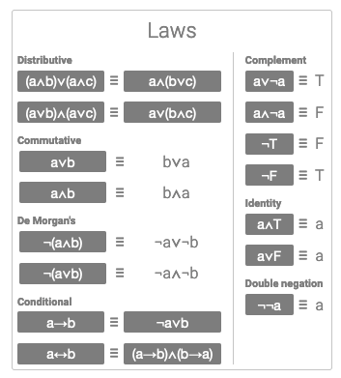
Challenge 1.5.2
Simplify (¬s∧q)∨¬(s∨q) to ¬s
and 1.5.3
Simplify ¬(s∧(q∨¬s)) to ¬s∨¬q

Slide 21
Group Activity: Logic Puzzles
https://colab.research.google.com/github/byui-cse/cse280-course-notebooks/blob/main/notebooks/solve-some-logic-puzzles.ipynb

