Slide 1
CSE 280 Discrete Mathematics
Week 02 Day 3
W. Clements
Predicates & Qualifiers 1.8-1.10

Slide 3
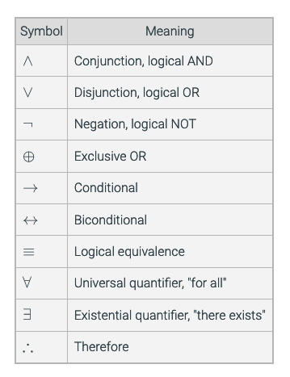
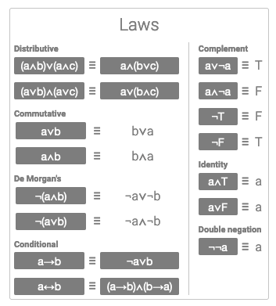

Slide 4





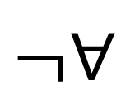
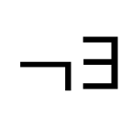

Review Quantifier Symbols
Name it
What does it mean in English?
$∀$
Universal quantifier
For every, Every, All, For all
$∃$
Existential quantifier
There is at least one, some, for some, at least one, there is
$¬∀$
Universal quantifier,
negated
Not every, not all
$¬∃$
Existential quantifier,
negated
There is not one, there are none, there are not any, none
LaTeX for $∀$ is \forall
LaTeX for $∃$ is \exists

Slide 5
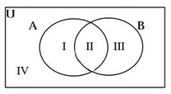





De Morgan's Laws
Negate the following:
For quantifiers
$$¬∀x P\left(x\right)≡∃x¬P(x)$$
$$¬∃x P\left(x\right)≡∀x¬P(x)$$
$$¬\left(p∨q\right)≡$$
$$¬p∧¬q$$
$$¬\left(p∧q\right)≡$$
$$¬p∨¬q$$

Slide 6
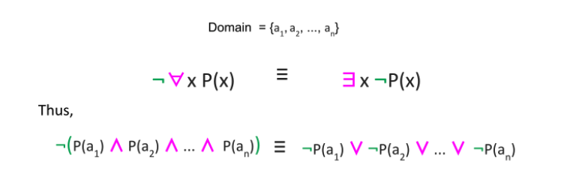
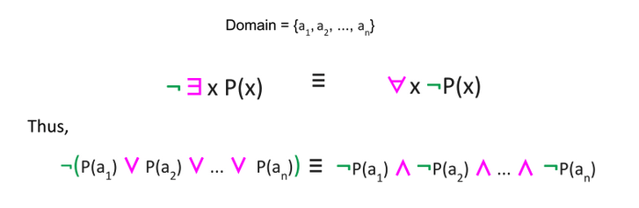

Slide 7

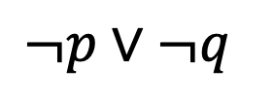


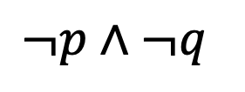

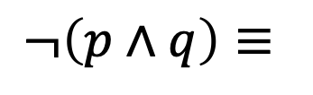



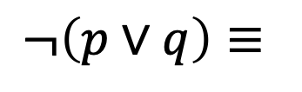



De Morgan's Laws - Examples
$$¬\left(p∨q\right)≡$$
$$¬p∧¬q$$
$$¬\left(p∧q\right)≡$$
$$¬p∨¬q$$
Simplify the following using De Morgan's Laws:
$¬∃x P(x)$
$∀x ¬P(x)$
$¬∃x \left(P\left(x\right)∧Q\left(x\right)\right)$
$∀x \left(¬P\left(x\right)∨¬Q\left(x\right)\right)$
$$¬∀x P\left(x\right)≡∃x¬P(x)$$
$¬∀x \left(P\left(x\right)∧Q\left(x\right)\right)$
$∃x \left(¬P\left(x\right)∨¬Q\left(x\right)\right)$
$$¬∃x P\left(x\right)≡∀x¬P(x)$$
$$¬∀x∃y P(x,y)$$
$$∃x∀y ¬P(x,y)$$
$¬∃x∀y \left(P\left(x,y\right)∧Q\left(x\right)\right)$
$∀x∃y \left(¬P\left(x,y\right)∨¬Q\left(x\right)\right)$

Slide 8
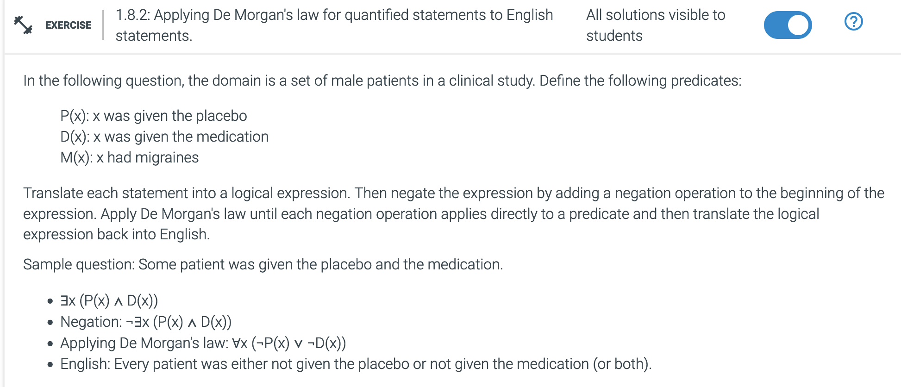
In Class Exercise
1.8.2
(a) Every patient was given the medication.
(b) Every patient was given the medication or the placebo or both.
(c) There is a patient who took the medication and had migraines.
(d) Every patient who took the placebo had migraines. (Hint: you will need to apply the conditional identity, p → q ≡ ¬p ∨ q.)
(e) There is a patient who had migraines and was given the placebo.

Slide 9

Other Laws
Idempotent laws:
Associative laws:
Commutative laws:
Distributive laws:
Identity laws:
Domination laws:
Double negation law:
Complement laws:
De Morgan's laws:
Absorption laws:
Conditional identities:
? $¬∃x P(x)$

Slide 10
Nested Predicates

Slide 11

Nested Predicates
$∀x∀yP\left(x,y\right)$
$∀x∃yP\left(x,y\right)$
$∃x∀yP\left(x,y\right)$
$∃x∃yP\left(x,y\right)$
What is x and y?
Prepositions or Sets of values
Can be defined as a predicate statement?
Or as a truth table

Slide 12
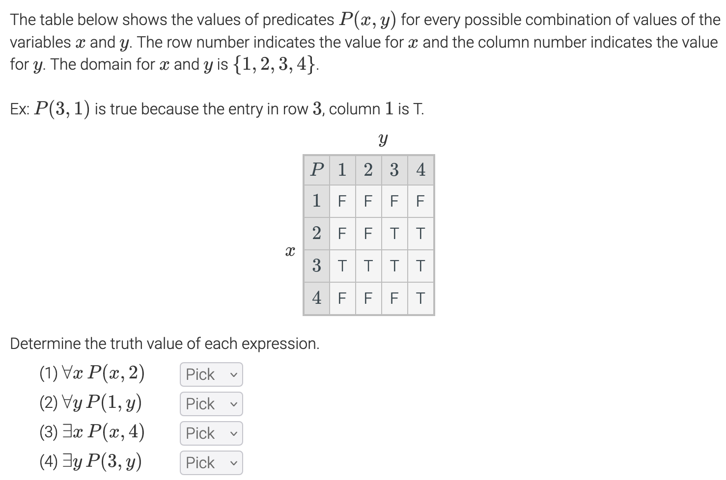
Nested Predicates – Truth tables

Slide 13
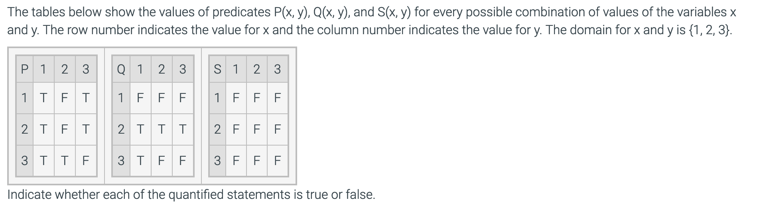
In Class Exercise
1.8.2
(a) ∃x ∀y P(x, y)
(b) ∃x ∀y Q(x, y)
(c) ∃y ∀x P(x, y)
(d) ∃x ∃y S(x, y)
(e) ∀x ∃y Q(x, y)
(f) ∀x ∃y P(x, y)
(g) ∀x ∀y P(x, y)
(h) ∃x ∃y Q(x, y)
(i) ∀x ∀y ¬S(x, y)

Slide 14
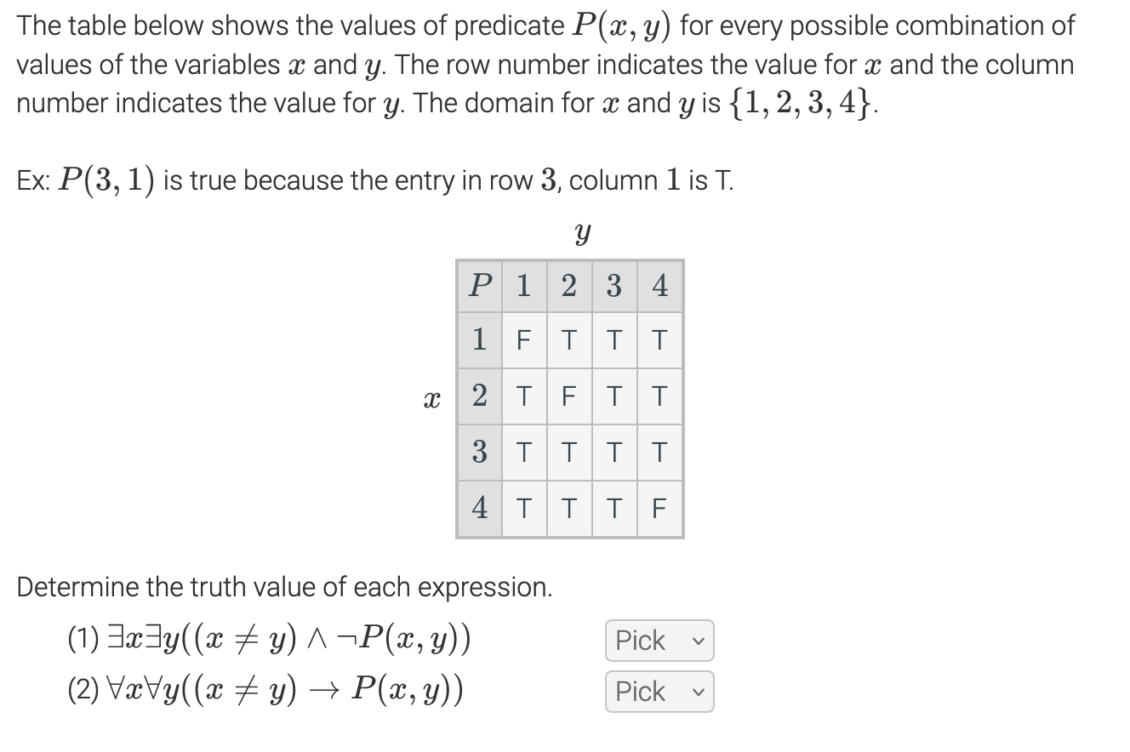
In Class Exercise
Challenge 1.9.1

Slide 15
DeMorgan’s Law - Nested

Slide 16
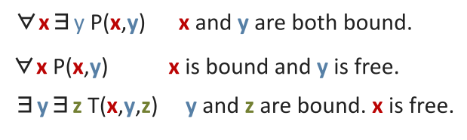
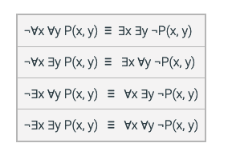
DeMorgan’s Law - Nested

Slide 17
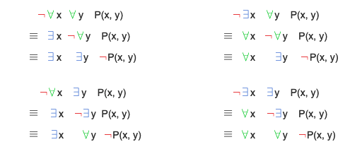

Prove from Single to Nested
$$¬∀x P\left(x\right)≡∃x¬P(x)$$
$$¬∃x P\left(x\right)≡∀x¬P(x)$$

Slide 18
Combining what we know

Slide 19
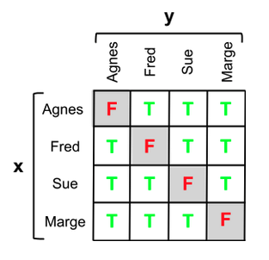
Using logic to express "everyone else"
Lets look at the M(x, y) = “x sent an email to y”
∀x ∀y M(x, y)
M(Fred, Fred) and M(Marge, Marge) = False
How do we get to be true?
∀x ∀y ((x ≠ y) → M(x, y))
Problems:
"Everyone sent an email to someone else”
∀x ∃y M(x, y)
∀x ∃y ((x ≠ y) ∧ M(x, y)) where x=Sue
∀x ∃y ((x ≠ y) ∧ M(x, y)) T/F?

Slide 20
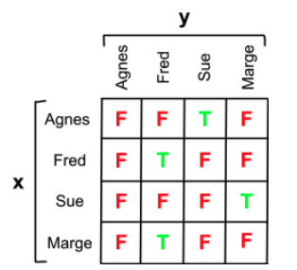
Using logic to express "everyone else"
Lets look at the M(x, y) = “x sent an email to y”
∀x ∀y M(x, y)
M(Fred, Fred) and M(Marge, Marge) = False
How do we get to be true?
∀x ∀y ((x ≠ y) → M(x, y))
Problems:
"Everyone sent an email to someone else”
∀x ∃y M(x, y)
∀x ∃y ((x ≠ y) ∧ M(x, y)) where x=Sue
∀x ∃y ((x ≠ y) ∧ M(x, y)) T/F?
What if we change the Predication definition

Slide 21
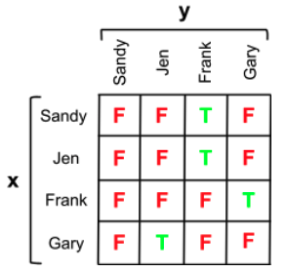
Using logic to express "everyone else"
Lets look at the M(x, y) = “x sent an email to y”
∀x ∀y M(x, y)
M(Fred, Fred) and M(Marge, Marge) = False
How do we get to be true?
∀x ∀y ((x ≠ y) → M(x, y))
Problems:
"Everyone sent an email to someone else”
∀x ∃y M(x, y)
∀x ∃y ((x ≠ y) ∧ M(x, y)) where x=Sue
∀x ∃y ((x ≠ y) ∧ M(x, y)) T/F?
How about now at the next game

Slide 22
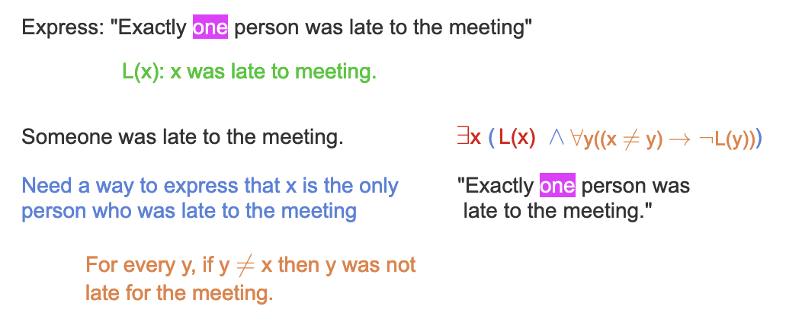
Uniqueness
M(x, y): x is married to y. A(x): x is an adult.
∀x (A(x) → ∃y M(x, y))
∀x ∃y(A(x) → M(x, y))
∀x ∃y(A(x) → M(x, y)) is not logically equivalent to
∃y ∀x(A(x) → M(x, y)).

Slide 23
Work as a team
Additional Exercises:
1.9.3 (a-e)
1.9.4
1.9.5
1.10.1
1.10.7 *

Slide 24
See you Monday…

Slide 25
Stop - Backup

Slide 26
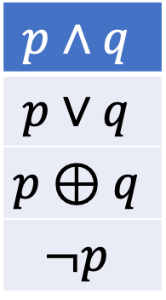

Let’s look at
110 and 111
Discrete Math
$$p∧q$$
$$p∨q$$
$$p⊕q$$
$$¬p$$
Variable
Conditions
Branches
Loops
Functions
Map, Filter, Reduce
s → q
p ↔ q
$P\left(x\right)$
$∀x P\left(x\right)$
$∃x P\left(x\right)$

Slide 27
seq = [0, 1, 2, 3, 5, 8, 13]
result = list(filter(lambda x: x%2 != 0, seq))
len(list(filter(lambda name: 'e' in name, names))) > 0

