Slide 1
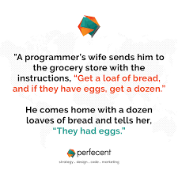
CSE 280 Discrete Mathematics
Week 03 Day 1
W. Clements
Mon: Functions 4.1 – 4.4
Wed: Logs & Exponents 4.5 – 4.6
Friday: Functional Programming (map, filter, reduce)

Slide 2
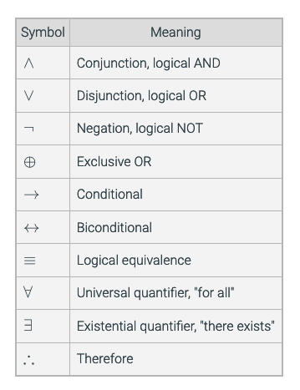
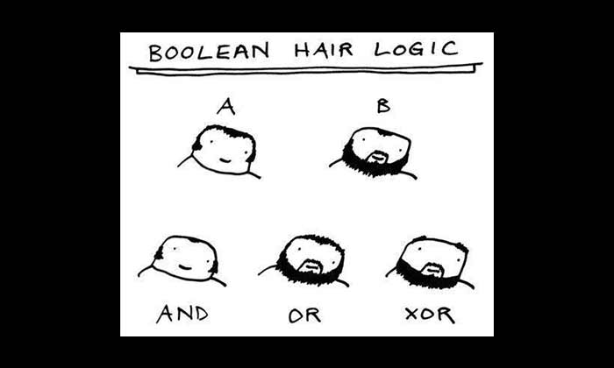
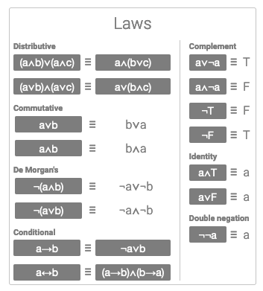
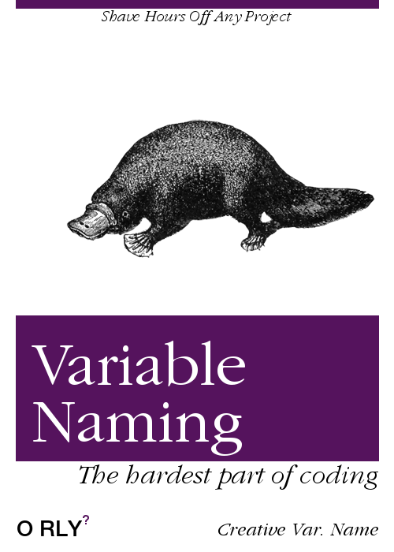
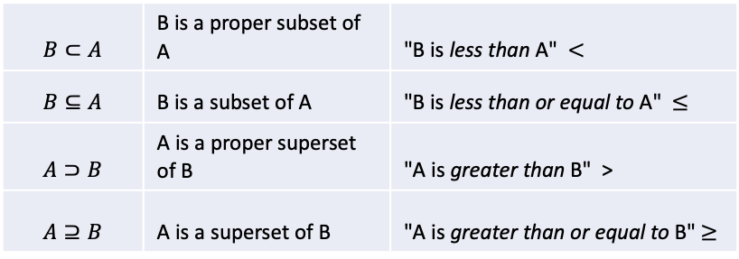
Review
Prepositions
Predicates
Quantifiers
Sets
Cartesian Product
$$B⊂A$$ | B is a proper subset of A | "B is less than A" $<$
$$B⊆A$$ | B is a subset of A | "B is less than or equal to A" $≤$
$$A⊃B$$ | A is a proper superset of B | "A is greater than B" >
$$A⊇B$$ | A is a superset of B | "A is greater than or equal to B" $≥$

Slide 3
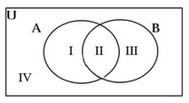
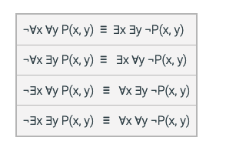





De Morgan's Laws
Negate the following:
For quantifiers
$$¬∀x P\left(x\right)≡∃x¬P(x)$$
$$¬∃x P\left(x\right)≡∀x¬P(x)$$
$$¬\left(p∨q\right)≡$$
$$¬p∧¬q$$
$$¬\left(p∧q\right)≡$$
$$¬p∨¬q$$

Slide 4
Homework Review
Review Homework 04 from last week with a partner.
Look at 3.5, 3.6

Slide 5
3.5
Set Notation 𝑆={𝑥∈ℤ:𝑥=2𝑛 𝚊𝚗𝚍 0≤𝑛≤19}
Python
S = {2*n for n in range(20)}
print(S)
Using Python list (or set) comprehensions, create the following sets. Assume the domain is ℤ.
When printing the result, use sorted to convert the sets to a sorted list to make it easier to verify your result.
The first 100 multiples of 3.
The perfect squares from 1 to 100. (An integer 𝑥 is a perfect square if there is an integer 𝑦 such that 𝑥=𝑦2 )
All integers whose absolute value is less than 5.
The odd integers between -10 and 10.
The integers between 0 and 100 that end in the digit 3 or 7.

Slide 6
3.5
The first 100 multiples of 3.
print('1.', sorted({3*n for n in range(101)}))
The perfect squares from 1 to 100. (An integer 𝑥 is a perfect square if there is an integer 𝑦 such that 𝑥=𝑦2 )
print('2.', sorted({x**2 for x in range(1, 11)}))
All integers whose absolute value is less than 5.
print('3.', sorted({x for x in range(-4, 5)}))
The odd integers between -10 and 10.
print('4.', sorted({x for x in range(-10, 11) if x%2}))
The integers between 0 and 100 that end in the digit 3 or 7.
print('5.', sorted({x for x in range(101) if x%10 == 3 or x%10 == 7}))

Slide 7
3.6
Use Python set comprehensions to generate and display all the members of the following sets:
{1𝑛:𝑛∈{2,4,8,16}}
{𝑛2:𝑛∈{−2,−1,0,1,2}}
{𝑛∈ℤ+:𝑛 is a factor of 24}
{𝛼∈the English alphabet:𝛼 precedes F}

Slide 8
3.6
Use Python set comprehensions to generate and display all the members of the following sets:
{1𝑛:𝑛∈{2,4,8,16}}
{𝑛2:𝑛∈{−2,−1,0,1,2}}
{𝑛∈ℤ+:𝑛 is a factor of 24}
{𝛼∈the English alphabet:𝛼 precedes F}
print('1.', {1/n for n in [2,4,8,16]})
print('2.', {n**2 for n in range(-2,3)})
print('3.', {n for n in range(1, 24) if not 24 % n})
print('4.', {a for a in 'ABCDEFGHIJKLMNOPQRSTUVWXYZ' if a < 'F'})

Slide 9
3.7
Let A and B be two sets of words:
A = {'verve', 'vim', 'vigor'}
B = {'butter', 'vinegar', 'pepper', 'vigor'}
For each of the following set operations, give its resulting members as a set of strings. Use Python.
The set of words that are in A ∪ B; call this set C.
The set of words that are in A ∩ B; call this set D.
The subset of set C of words that start with 'v'.
The subset of set C of words that end with 'r'.
The subset of set C of words that start with 'v' and end with 'r'.
The subset of set D of words that have five letters.
The subset of set D of words that have six letters.
A = {'verve', 'vim', 'vigor'}
print('A =', A)
B = {'butter', 'vinegar', 'pepper', 'vigor'}
print('B =', B)
C = A.union(B)
print('1. C =', C)
D = A.intersection(B)
print('2. D =', D)
start_with_v = {word for word in C if word[0] == 'v'}
print('3. start_with_v =', start_with_v)
end_with_r = {word for word in C if word[-1:] == 'r'}
print('4. end_with_r =', end_with_r)
start_with_v_and_end_with_r = start_with_v.intersection(end_with_r)
print('5. start_with_v_and_end_with_r =', start_with_v_and_end_with_r)
subset_of_D_of_words_with_five_letters = {word for word in D if len(word) == 5}
print('6. subset_of_D_of_words_with_five_letters =', subset_of_D_of_words_with_five_letters)
subset_of_D_of_words_with_six_letters = {word for word in D if len(word) == 6}
print('7. subset_of_D_of_words_with_six_letters =', subset_of_D_of_words_with_six_letters)

Slide 10
3.7
Let A and B be two sets of words:
A = {'verve', 'vim', 'vigor'}
B = {'butter', 'vinegar', 'pepper', 'vigor'}
For each of the following set operations, give its resulting members as a set of strings. Use Python.
The set of words that are in A ∪ B; call this set C.
The set of words that are in A ∩ B; call this set D.
The subset of set C of words that start with 'v'.
The subset of set C of words that end with 'r'.
The subset of set C of words that start with 'v' and end with 'r'.
The subset of set D of words that have five letters.
The subset of set D of words that have six letters.

Slide 11




Quick Review: Cartesian Product
Given these sets:
$A=\{a\}$ $B=\{b, c\}$ $C=\{a, b, d\}$
Write the elements of the following:
1. $A×(B∪C)$
2. $Ρ(A×B)$
$$\left(B∪C\right)=\left\{a,b,c,d\right\}$$
$A×\left(B∪C\right)=\left\{a\right\}×\left\{a,b,c,d\right\}=\{aa, ab, ac, ad\}$
$A×B=\left\{ab, ac\right\}$
$Ρ(A×B)=\left\{∅, \left\{ab\right\}, \left\{ac\right\}, \left\{ab, ac\right\}\right\}$

Slide 12
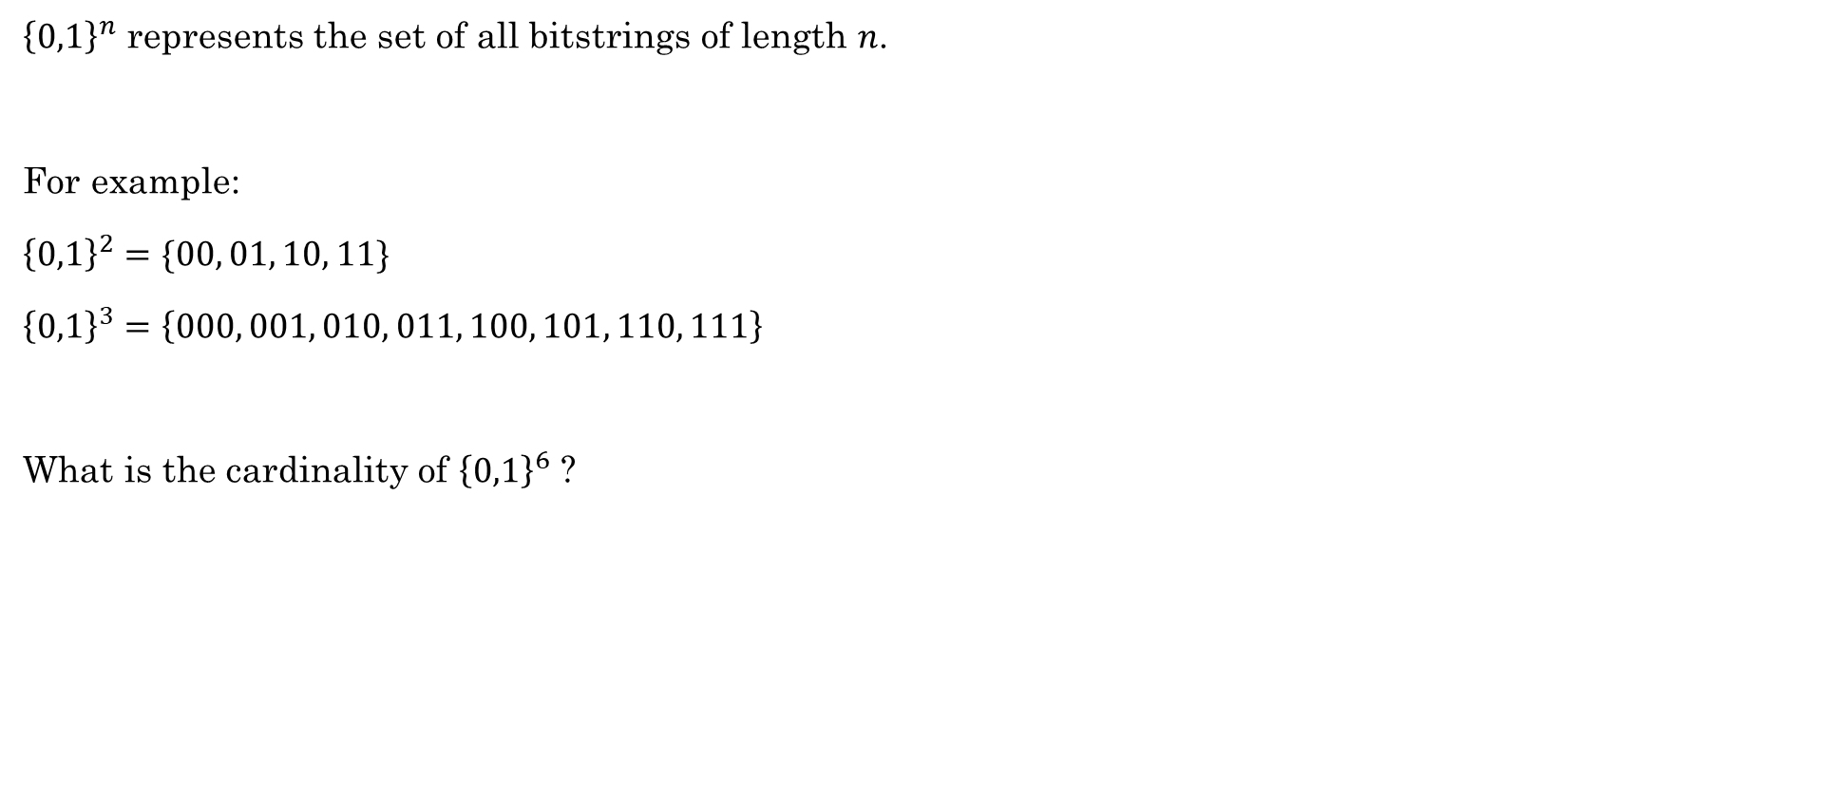
Quick Review: Bit strings
${\left\{0,1\right\}}^{n}$ represents the set of all bitstrings of length $n$.
For example:
${\left\{0,1\right\}}^{2}=\{00, 01, 10, 11\}$
${\left\{0,1\right\}}^{3}=\left\{000, 001, 010, 011, 100, 101, 110, 111\right\}$
What is the cardinality of ${\left\{0,1\right\}}^{6}$ ?

Slide 13
What is a function?

Slide 14
Problem Statement
Expected Output
Instruction Givens
Processing needed
Input
Process
Output

Slide 15
What is a function?
Simplest form: An object that takes objects and gives other objects
Arity: Taking objects (parameters, arguments)
Unary
Binary
Ternary
Poly-nary

Slide 16
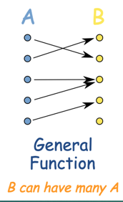
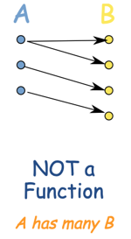
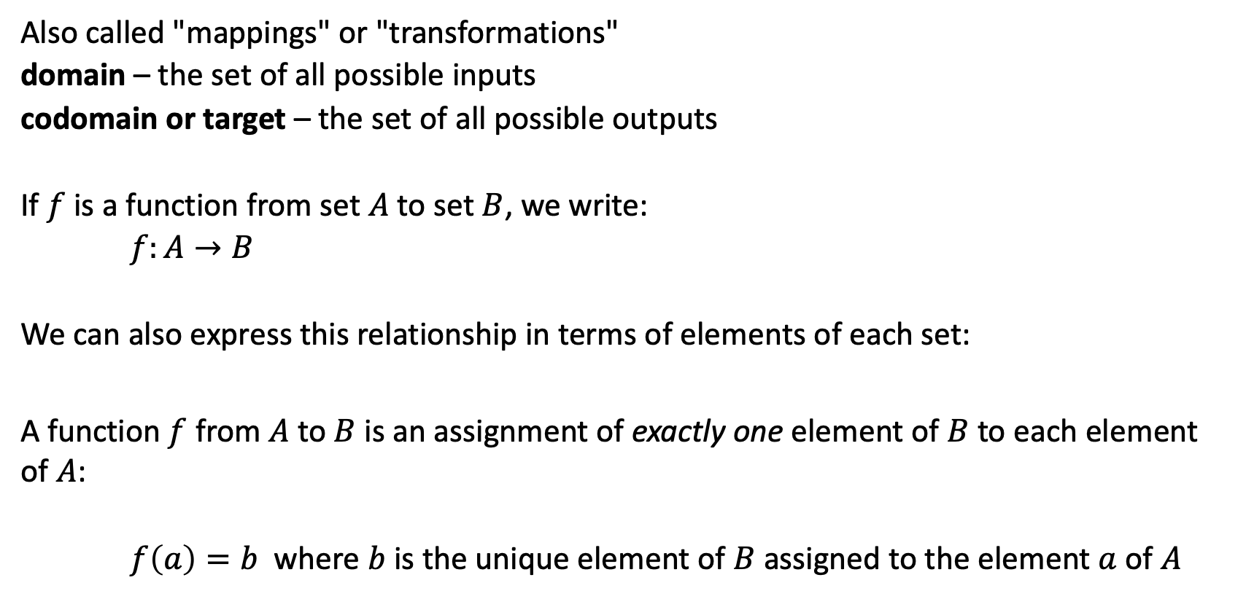
Functions
Also called "mappings" or "transformations"
domain – the set of all possible inputs
codomain or target – the set of all possible outputs
If $f$ is a function from set $A$ to set $B$, we write:
$f:A→B$
We can also express this relationship in terms of elements of each set:
A function $f$ from $A$ to $B$ is an assignment of exactly one element of $B$ to each element of $A$:
$f\left(a\right)=b$ where $b$ is the unique element of $B$ assigned to the element $a$ of $A$
Rosen, Kenneth. Discrete Mathematics and Its Applications, 7th Edition. McGraw-Hill, 2012

Slide 17


Problem Statement
Expected Output
Instruction Givens
Processing needed
Input
Process
Output
main
getInteger
getFloat
getString
getFromFile
Processing
Update
Output-only
Filter
Map
Reduce
Data Structures
Print()
Display()
Gui

Slide 18
What is a function?
Simplest form: An object that takes objects and gives other objects
Arity: Taking objects (parameters, arguments)
Unary
Binary
Also know as preimage, or plan, or dream
Order Matters
Prefix, Postfix, Infix
Infix: Normal Math
2 plus 2
Prefix:
Add 2 to 2
Postfix:
2 & 2 added together

Slide 19
Review: Order of operations
() | Parentheses
++ -- | Increment, decrement
! | Not
* / % | Multiply, divide, modulo
+ - | Addition, subtraction
> >= < <= | Greater than, less than, etc.
== != | Equality
&& | And
|| | Or
= += *= | Assignment
Math
Unary
Logic
Math
Relative
Binary
Absolute
Logic
AND
OR
Unary before binary
Math before logic
Relative before absolute
AND before OR
Savitch, W. A. (2008). Absolute C++ (3rd Edition). p. 50

Slide 20

What is a function?
Simplest form: An object that takes objects and gives other objects
Arity: Taking objects (parameters, arguments)
Unary
Binary
Also know as preimage, or plan, or dream
Order Matters
Prefix, Postfix, Infix
Infix: Normal Math
2 plus 2
Prefix:
Add 2 to 2
Postfix:
2 & 2 added together
Output
Codomain vs Range
Range $∈$ Codomain
Those members of the codomain that are actually used
Addition range
Multiplication range
Floor Ceiling
Power range
Also known as image

Slide 21
Describing Functions
one-to-one
onto
both one-to-one
and onto

Slide 22



Classify these functions
Are the following functions one-to-one (injective), onto (surjective), neither, or both (bijective)?
a) $f:ℤ→ℤ. f\left(x\right)=x+1$
One-to-one and onto, which is a bijection
b) $f:ℤ→ℤ. f\left(x\right)=3x$
One-to-one but not onto
c) $f:ℝ→ℝ. f\left(x\right)=3x$
One-to-one and onto, which is a bijection
d) $f:{\left\{0,1\right\}}^{3}→{\left\{0,1\right\}}^{3}.$ The output is obtained by reversing the input. For example, $f\left(011\right)=110$
One-to-one and onto, which is a bijection
e) $f:{\left\{0,1\right\}}^{3}→{\left\{0,1\right\}}^{2}.$ The output is obtained by dropping the first bit. For example, $f\left(011\right)=11$
Onto but not one-to-one

