Slide 2
CSE 280 Discrete Mathematics
Week 03 Day 2
W. Clements
Mon: Functions 4.1 – 4.4
Wed: Logs & Exponents 4.5 – 4.6
Friday: Functional Programming (map, filter, reduce)

Slide 3
Loops
What are the different kinds of Code Loops?
When & Where do we use loops?
Why do we use loops?
How do we use loops?
Uses?
What are the advantages?
What are the disadvantages?

Slide 4
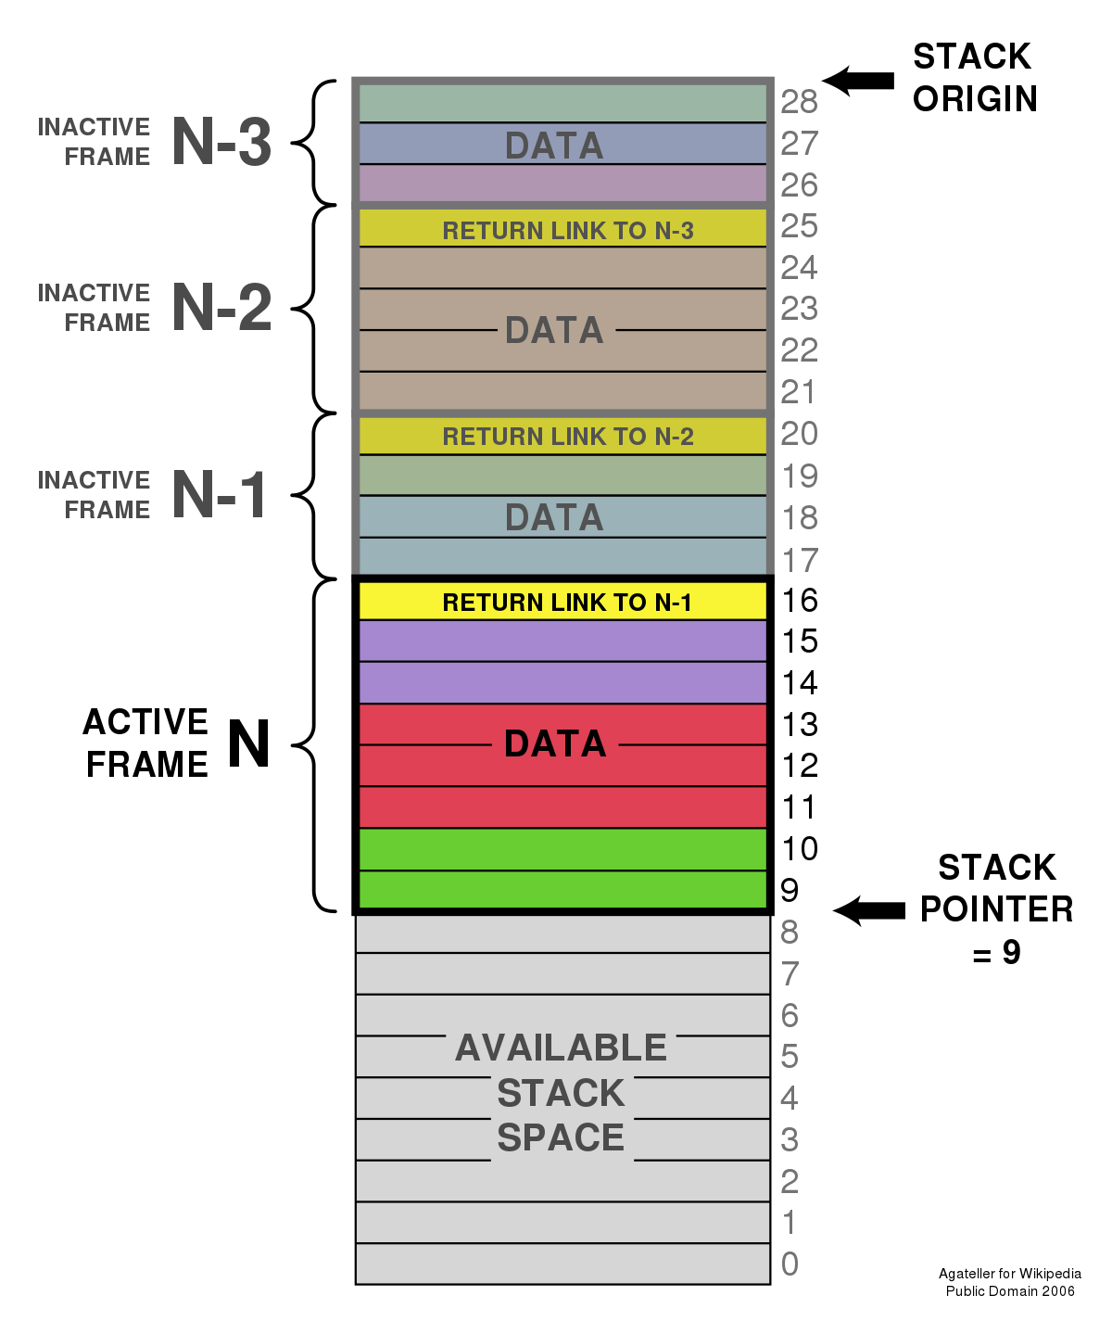
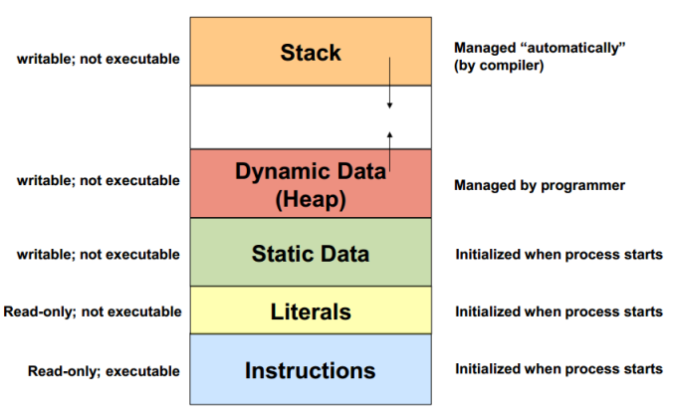
Functional Programming
Functional programming is a programming paradigm that emphasizes the use of functions to solve problems.
Unlike imperative programming:
sequences of instructions that modify program state,
functional programming involves defining functions that take inputs and produce outputs, without modifying any external state.
Stateless, immutable, threadable
Collections: sets, lists, dictionaries
Adv: Multi-core and GPUs
Higher-Order Functions: filter, map, reduce

Slide 5
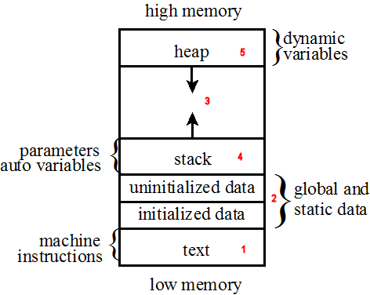
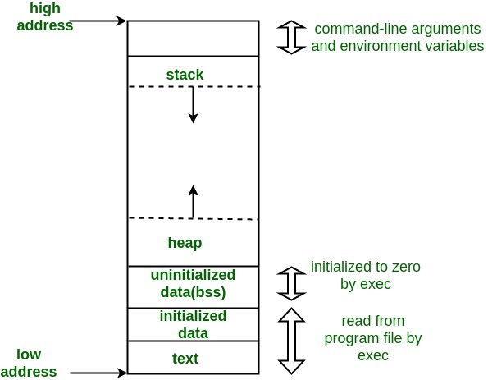
Which makes more sense?
We do neither now?

Slide 6
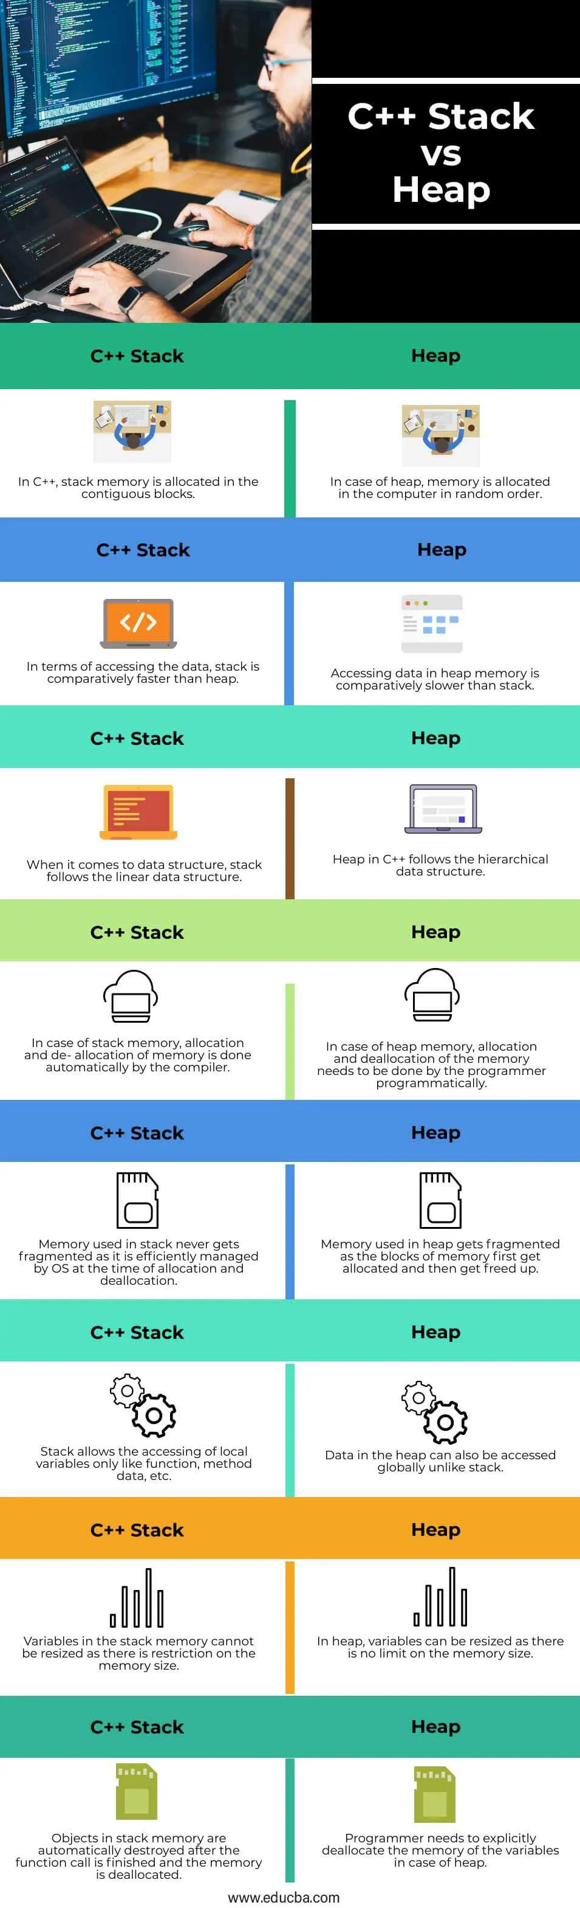
Lamba function
Anonymous, nameless function
Syntax: lamda [parameters]: expression
i.e lambda a, b: a+b
i.e. addr = lambda a,b: a+b print (addr(2,4)) #6
Notice: implicate return statement

Slide 7
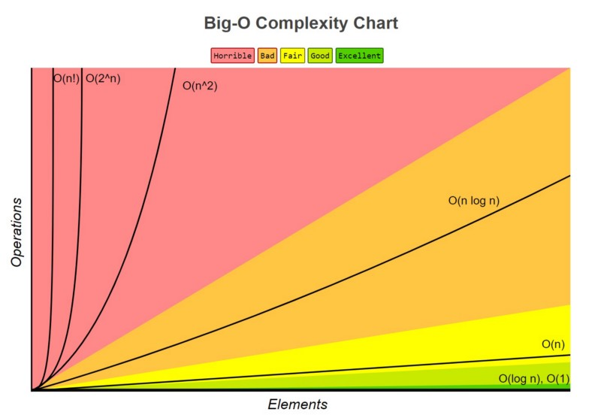
Getting ride of loops
Types of loops
Iterative: Definite: for, while, foreach, do…while
Indefinite: while, do…while
Recursive
What is the danger of loops in coding?
Complexity – BigO ( f(x) )
Abstracting loops away…
Implementation: hardware(multi-core, GPUs), software (threading)

Slide 8
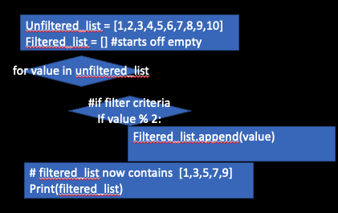
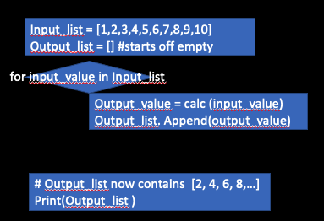
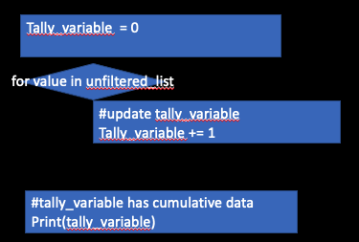
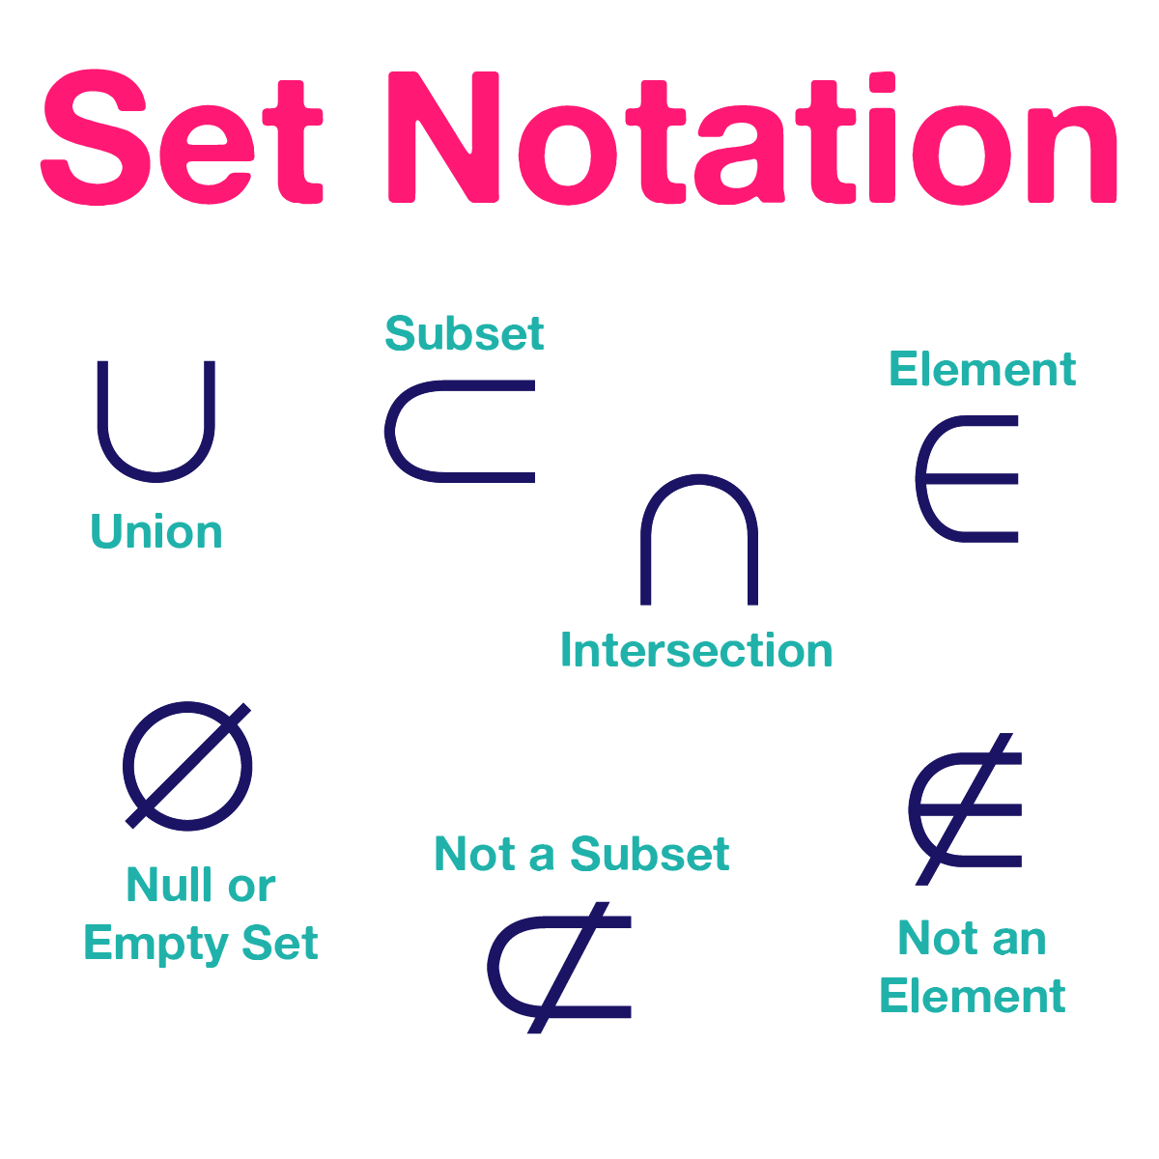
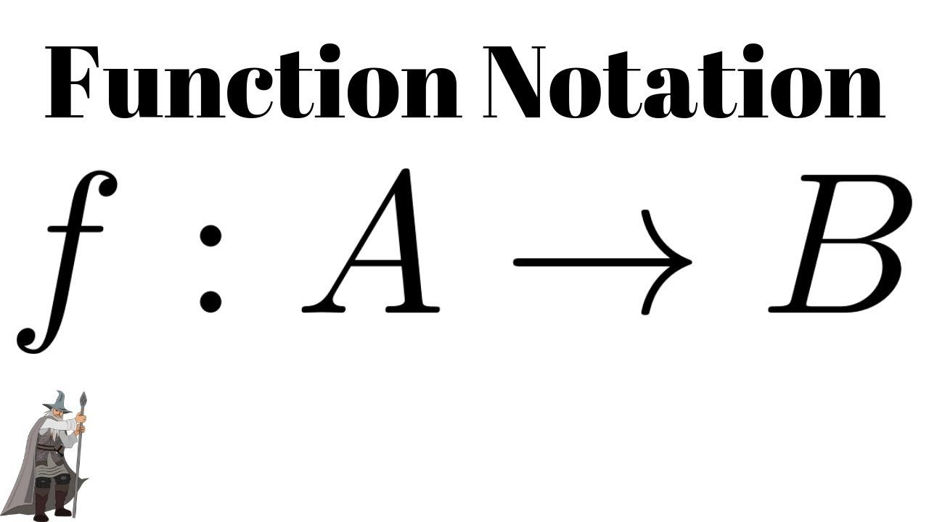
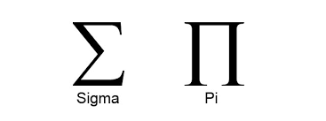

Slide 10
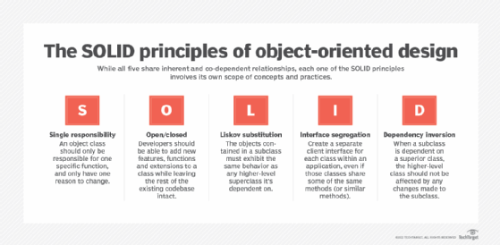

Slide 11
Filter
filter(predicate, iterable)
nums = [1,2,3,4,5] # this list is an iterable
# Find everything greater than 2
result = list(filter(lambda x: x > 2, nums))
# The predicate here is a lambda function that returns True if x > 2
print(result)

Slide 12
Map
map(function, iterable, *iterables)
nums = [1,2,3,4,5]
# Double each number in the list
result = [*map(lambda x: 2 * x, nums)]

Slide 13


Reduce
functools.reduce(function, iterable[, initializer])
nums = [1,2,3,4,5]
# Using a loop
result = 0
for x in nums: result += x
print(result)
Progressions:
Summation, Product, Integrals
Recursion
Partitions

Slide 14
Power of Lambda
Use of the stack not memory
Function Parameter - Function Pointer, Func-ter
What do you think OO Inheritance is? Abstract function
Multi-CPU and GPU processing
Image taking a nested loop, i.e. 2D or 3D graphics, and spreading it across more memory and more CPU.
Pick 2: Space, Time, Complexity
Trading in speed(time) and space vs complexity

