Slide 2
CSE 280 Discrete Mathmatics
W. Clements
Week 05
Day 1: Relations 6.1-6.3
Day 2: More relations 6.4- 6.6
Day 3: Equivalent Relations & DB 6.9-6.10, Activity
Take Home Quiz : 50 questions, no time limit

Slide 3


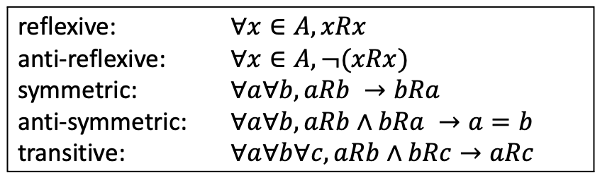
Set: In python, you have ints, floats, strings.
Relationship of numbers
Operations/Functions Relations?:
Sets int{1,2,…} $∈$ float{1.0, 1.1}; strings?
Conversion i.e. int->float, float->int, string->?
Arithmetic i.e. +, *,
Relation $\left(a,b\right)∈R$ ; $a R b →$ $R ⊆A×B$
Ints
Floats
Strings
reflexive: $∀x∈A, xRx$
anti-reflexive: $∀x∈A, ¬(xRx)$
symmetric: $∀a∀b, aRb →bRa$
anti-symmetric: $∀a∀b, aRb∧bRa →a=b$
transitive: $∀a∀b∀c, aRb∧bRc→aRc$

Slide 4


Review
Relation $\left(a,b\right)∈R$ ; $a R b →$ $R ⊆A×B$
Properties of Relations
Representation of Relations
Roster Notation {}
Set Notation 𝑥 ∈ 𝑆 : 𝑃(𝑥)
Table
Graph
reflexive: $∀x∈A, xRx$
anti-reflexive: $∀x∈A, ¬(xRx)$
symmetric: $∀a∀b, aRb →bRa$
anti-symmetric: $∀a∀b, aRb∧bRa →a=b$
transitive: $∀a∀b∀c, aRb∧bRc→aRc$

Slide 5
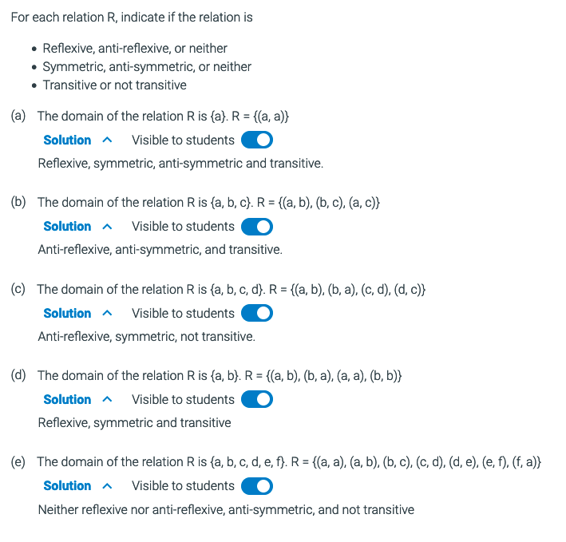
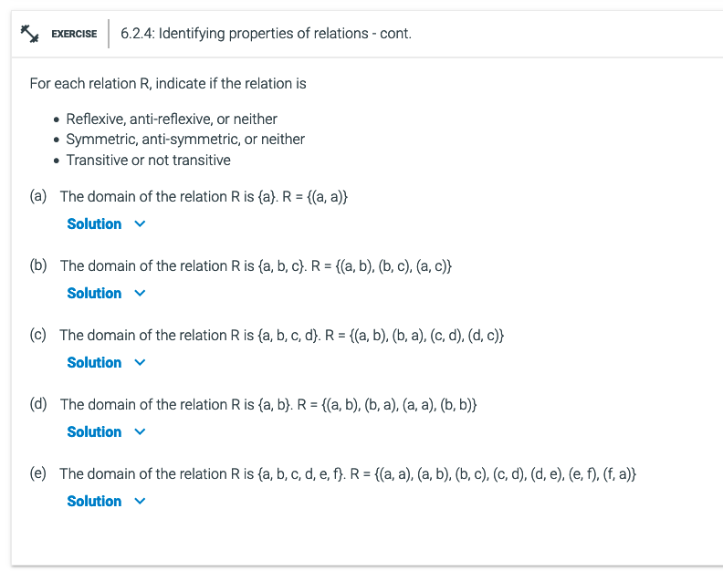
Review
Additional Exercises
6.2.4

Slide 6
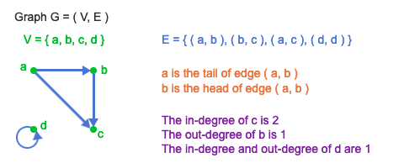
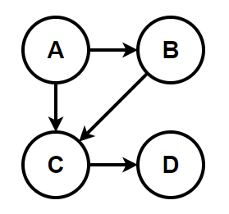
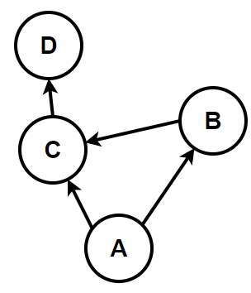
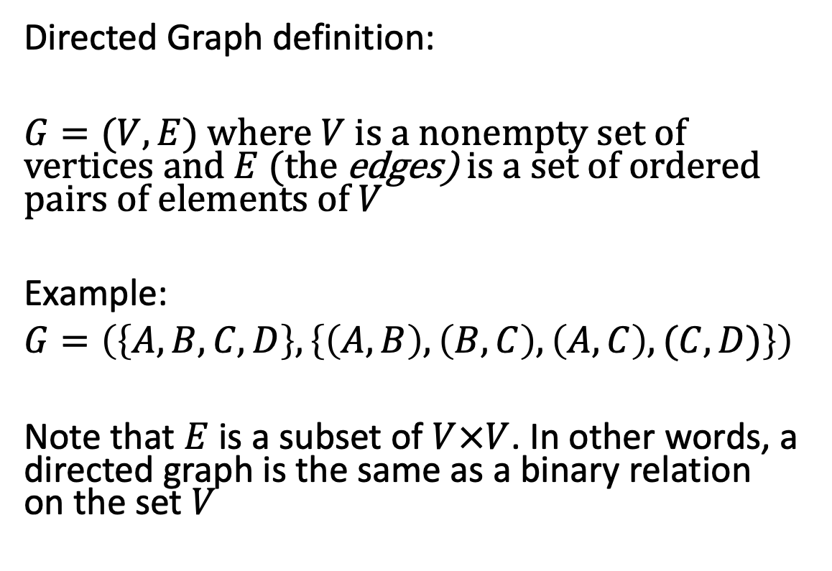
Directed Graphs
Directed Graph definition:
$G=(V,E)$ where $V$ is a nonempty set of vertices and $E$ (the edges) is a set of ordered pairs of elements of $V$
Example:
$G=\left(\left\{A, B, C, D\right\}, \left\{\left(A,B\right), \left(B,C\right), \left(A,C\right), (C,D)\right\}\right)$
Note that $E$ is a subset of $V×V$. In other words, a directed graph is the same as a binary relation on the set $V$
It can be helpful to draw it, but this is not necessary to be considered a graph
Sets
Product subset of Cartisian
These both represent the same graph
The in-degree of a vertex is the number of edges pointing into it.
The out-degree of a vertex is the number of edges pointing out of it.
in-degree(u) = |{ v | (v, u) ∈ E }|
out-degree(u) = |{ v | (u, v) ∈ E }|

Slide 7
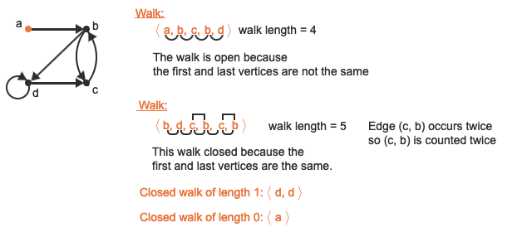
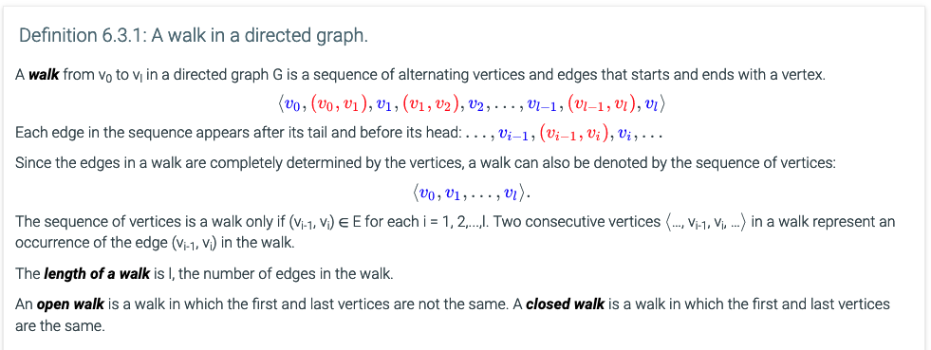
Walks in directed graphs

Slide 8
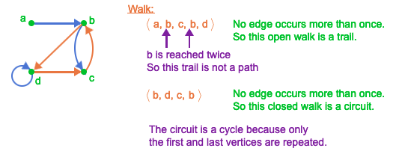
Trails, circuits, paths, and cycles
A trail is a walk in which no edge occurs more than once.
A path is a walk in which no vertex occurs more than once.
A circuit is a closed trail.
A cycle is a circuit of length at least 1 in which no vertex occurs more than once, except the first and last vertices which are the same.

Slide 9
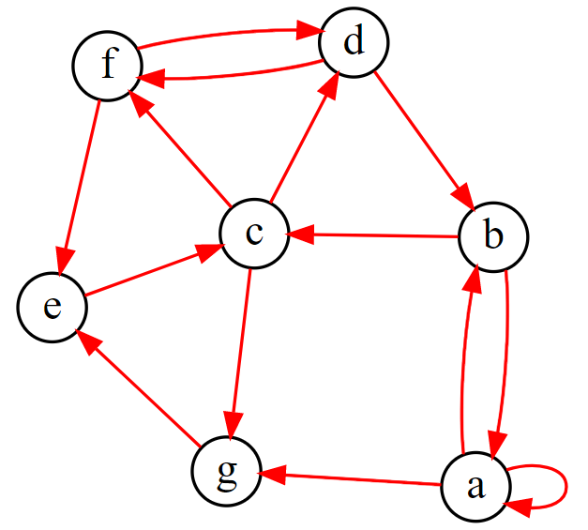
Directed Graphs
With a partner, discuss the following terms using this graph.
What is the in-degree of vertex a? What is the out-degree of vertex c?
What is the head of edge (b,c)?
What is the tail of edge (e,c)?
Which vertex has a self-loop?
Find a trail. (no edge occurs more than once)
Find a path. (no vertex occurs more than once)
Find a circuit. (no edge occurs more than once)
Find a cycle. (no edge or vertex occurs more than once)
Notes:
g = '''
digraph {
layout=neato;
label="Sample Graph";
labeljust=l;
labelloc=t;
edge [arrowsize=0.75; color=red]; # specifies the arrowhead size
node [shape=circle; fixedsize=true; width=0.30]; # specifies the node size/shape
a->b;a->g;a->a;
b->c; b->a;
c->d; c->f; c->g;
d->b;
e->c;
g->e;
f->e;
f->d; d->f;
}
'''

Slide 10

How do directed graphs show the properties of binary relations?
Reflexive
Anti-reflexive
Symmetric
Anti-symmetric
Transitive
Equivalence relation
reflexive: $∀x∈A, xRx$
anti-reflexive: $∀x∈A, ¬(xRx)$
symmetric: $∀a∀b aRb →bRa$
anti-symmetric: $∀a∀b aRb∧bRa →a=b$
transitive: $∀a∀b∀c aRb∧bRc→aRc$

Slide 11
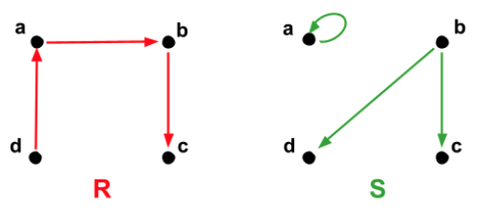
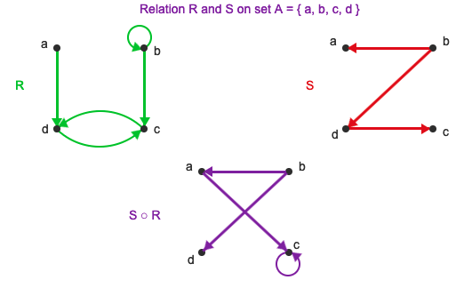
Composition of relations
The composition of relations R and S on set A is another relation on A,
denoted S ο R.
The pair (a, c) ∈ S ο R if and only if there is a b ∈ A such that (a, b) ∈ R and (b, c) ∈ S.
R
(a,d)
(b,b)
(b,c)
(c,d)
(d,c)
S
(b,a)
(b,d)
(d,c)
S o R
R S
(a,d) -> (d,c) = (a,c)
(b,b) -> (b,a) = (b,a)
(b,b) -> (b,d) = (b,d)
(c,d) -> (d, c) = (c,c)
(d,c) -> x

Slide 12
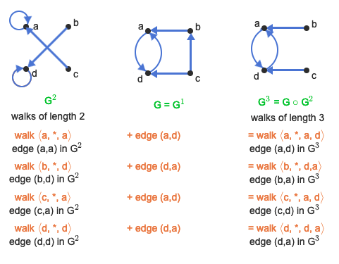
Graph powers and the transitive closure
Theorem 6.5.1: The Graph Power Theorem.
Let G be a directed graph. Let u and v be any two vertices in G. There is an edge from u to v in G^{k} if and only if there is a walk of length k from u to v in G.
G
(a,d)
(b,a)
(c,b)
(c,d)
(d,a)
G
(a,d)
(b,a)
(c,b)
(c,d)
(d,a)
GoG= G^2
(a,a)
(b,d)
(c, a)
(c, a)
(d, d)
GoGoG= G^3
(a,d)
(b,a)
(c,d)
(c,d)
(d,a)

Slide 13
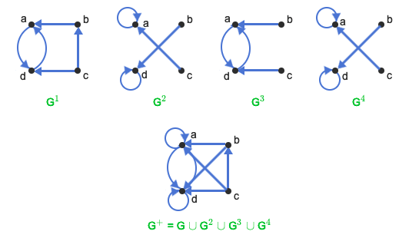
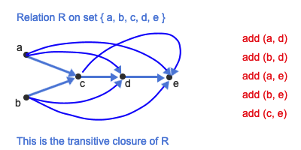
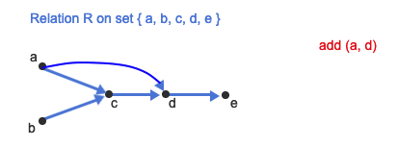
The transitive closure (All of GoG)
The union of G^{k} for all k ≥ 1 (denoted G⁺) represents reachability by walks of any positive length in G. In taking the union of graphs, there is only one copy of the vertex set and the union is taken over the edge sets of the respective graphs.
G⁺ = G¹ ∪ G² ∪ G³ ∪ G⁴ ....
If G is a directed graph, then G⁺ is called the transitive closure of G.
Let R be a relation on a finite domain with n elements. Then
R⁺ = R¹ ∪ R² ∪ R³ ∪....∪ R^{n}
The relation R⁺ is called the transitive closure of R
From previous RoR

Slide 14
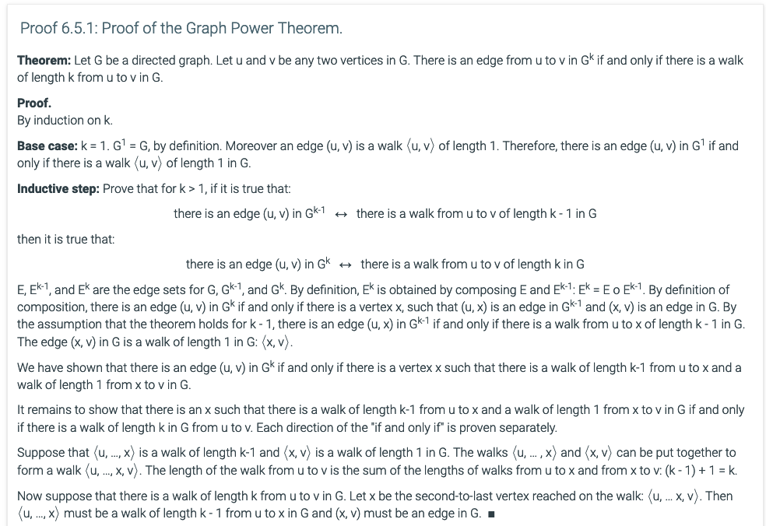
Graph Power Theorem (Summary)
The theorem states that for any k ≥ 1:
there is an edge (u, v) in G^{k} ↔ there is a walk from u to v of length k in G.
G¹ G² G³ G⁴
a
b
d
c

Slide 15
6.6 Matrix multiplication and graph powers

Slide 16
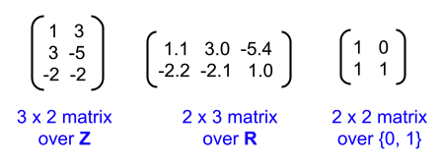
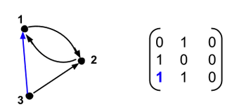
Dot Product
An n × m matrix over a set S is an array of elements from S with n rows and m columns.
Each element in a matrix is called an entry.
The entry in row i and column j of matrix A is denoted by A_{i,j}.
A matrix is called a square matrix if the number of rows is equal to the number of columns.

Slide 17

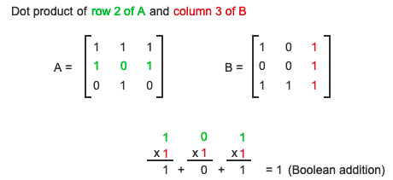
Dot Product
A Boolean matrix is a matrix whose entries are from the set {0, 1}.
If A and B are n × n matrices, the dot product of row i of A and column j of B is the sum of the product of each entry in row i from A with the corresponding entry in column j from B:

Slide 18
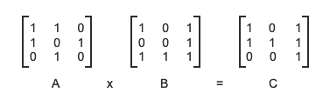
matrix product
If A and B are n × n matrices over the integers, then the matrix product of A and B, denoted AB or A·B, is another n × n matrix such that (AB)_{i,j} is the result of taking the dot product of row i of matrix A and column j of matrix B
A B C
(1, A) (1, B), (1, C)
1
2
3

Slide 19
1
2
3
4
1
2
(1,1)
(1,2)
(2,1)
(2,3)
(3,2)
(1,1)
(1,3)
(2,3)
(3,1)
(3,2)
(1,1)
(1,3)
(2,1)
(2,2)
(2,3)
(3,3)
3
4
1
2
3
4

Slide 20

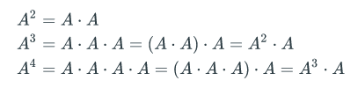
power of a matrix
Matrix multiplication is associative, meaning that if A, B, and C are all n × n matrices, then A(BC) = (AB)C. However, matrix multiplication is not commutative because there are matrices A and B for which AB ≠ BA. The k^{th} power of a matrix A is the product of k copies of A:

Slide 21
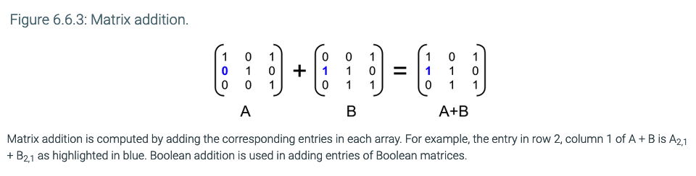
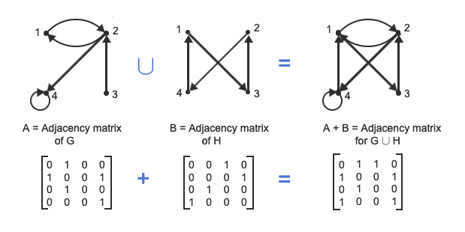
matrix sum

Slide 22
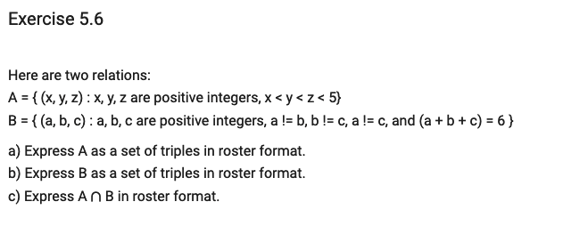
a) {(1,2,3), (1,2,4), (1,3,4), (2,3,4)}
b) {(1,2,3), (1,3,2), (2,1,3), (2,3,1), (3,1,2), (3,2,1)}
c) {(1,2,3)}

