Slide 1
CSE 280 Discrete Mathematics
Week 01 Day 1
W. Clements

Slide 2
Classroom arrangement

Slide 3
What’s It All About?
This course is about mathematics for computer science.
It introduces the mathematical topics needed to provide a solid theoretical foundation for your career and continued learning in computer science.
We will cover the following topics:
Sets
Logic
Functions and Relations
Combinatorics and Probability
Number Theory
Trees and Graphs

Slide 4
Outcomes
The outcomes for this course list the knowledge and skills you can expect to achieve if you complete the activities and assignments provided each week. If you will diligently apply yourself to learning the course material, by the end of the course you will:
Master the basic terminology and operations of sets and logic, functions and relations, combinatorics and probability, number theory, and trees and graphs.
Demonstrate logical reasoning as you solve problems.
Interpret the meaning of mathematical statements in the context of applications in computer science.
Think like a mathematician by making good connections.
Learn basic functional programming through using, reading, and writing Python code.

Slide 5
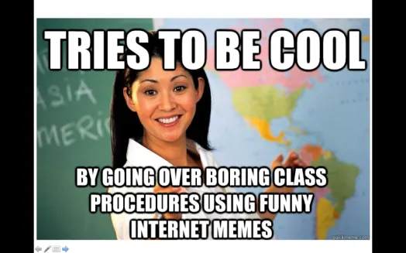
A little about me… Myth: Don’t talk to strangers
20+ Years experience
Masters: Univ of CO @ Denver; Bachlors; BYU-Provo; Associates: Ricks College
Worked for Northrop Grumman (TRW) for 13 years, Raytheon for 5 years
Been teaching for 8 years: Online, Hybrid, and Campus for Community Colleges of Colorado, BYU-Online, and BYU-Idaho
I love computing, I have since I saw my first for-loop fill the screen with my name.
I have moved over 20x, CA, UT, ID, MO, OK, TX, CO
Hobbies: Board Games, Family outings

Slide 6
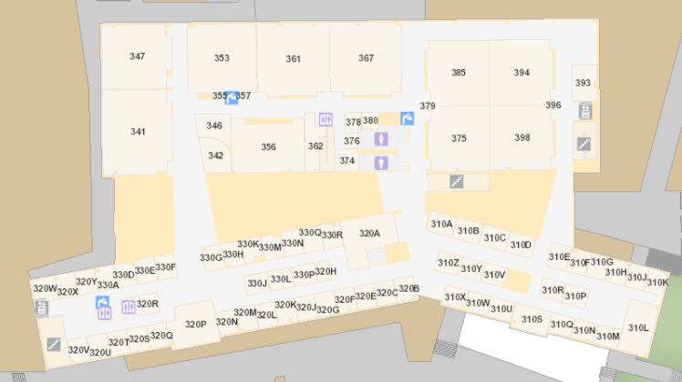
Bro Clements
William Clements
Email: ClementsW@byui.edu
Google Phone: (208) 557-4333
Office Phone: 208-496-7617
Office Rm: 320 T (Mark Twain with a T – Samuel Clemens)

Slide 7
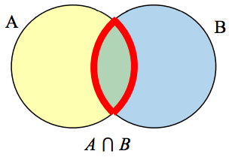

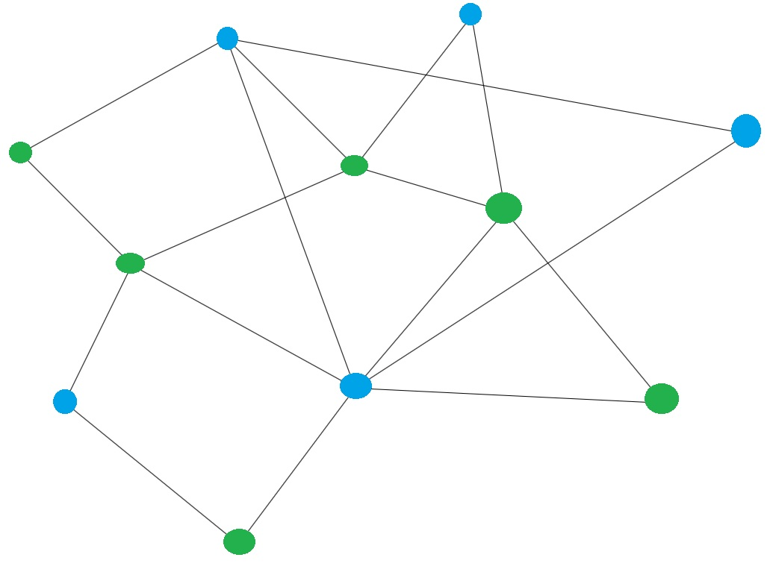




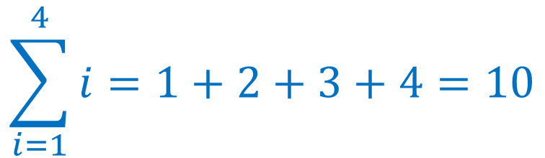




Topics – We will be learning Greek
$$p∧q$$
$$p∨q$$
$$∀x P(x)$$
$$∃x P(x)$$
Propositions and Logic
Predicates and Quantifiers
Sets
Functions
Relations
Number Theory (Integers, prime numbers)
Combinatorics
Sequences and Summations
Probability
Graphs
Trees
$$F(x)=x^{2},x∈ℝ$$
$$R=\left\{\left(a,b\right) \right| a+b=6\}$$
2,3,5,7,11,13,17,19...
$$\sum_{i=1}^{4}{i}=1+2+3+4=10$$
$$\left({11 \atop 3}\right)$$

Slide 8
Syllabus / Course Layout
Questions?
Schedule (reading, homework)
Reading / Activities – ZyBooks
Homework – Google Colab, grading, how to submit
Groups – 2-4, 3 is ideal
Grading
Resubmission policy

Slide 9
Grading
Weekly Reading and Activities 25%
Weekly Homework 30%
Participation & Attendance 15%
Take Home Exams (1,2,3) 30%
Letter grades will be awarded as follows:
Percentage Range |  | Letter Grade
93% | 100.00% | A
90% | 92.99% | A−
87% | 89.99% | B+
83% | 86.99% | B
80% | 82.99% | B−
77% | 79.99% | C+
73% | 76.99% | C
70% | 72.99% | C−
67% | 69.99% | D+
63% | 66.99% | D
60% | 62.99% | D−
0% | 59.99% | F

Slide 10
Weekly Reading and Activities
Task:
Complete the assigned reading,
participation activities (PAs), and
challenge activities (CAs) prior to class.
Submit the assignment in Zbook.

Slide 11
About Your Textbook: Discrete Mathematics
The primary textbook for this course is an interactive digital textbook provided through zyBooks. Purchase is available through the bookstore or directly through the book website. The cost is $58.
To access the textbook:
Purchase an access code through the bookstore or be prepared to purchase the book directly using a credit card.
Click on zyBooks Table of Contents.
You will be prompted to create a student account in zyBooks. Make sure to use your BYU-Idaho email address.
Subscribe using the access code you received from the bookstore or pay for the book directly.
Although not required, you are allowed to use the "Print to PDF" feature to save chapters from the textbook to a PDF for future use.

Slide 12
Grading
Weekly Reading and Activities 25%
Weekly Homework 30%
Participation & Attendance 15%
Take Home Exams (1,2,3) 30%
Letter grades will be awarded as follows:
Percentage Range |  | Letter Grade
93% | 100.00% | A
90% | 92.99% | A−
87% | 89.99% | B+
83% | 86.99% | B
80% | 82.99% | B−
77% | 79.99% | C+
73% | 76.99% | C
70% | 72.99% | C−
67% | 69.99% | D+
63% | 66.99% | D
60% | 62.99% | D−
0% | 59.99% | F

Slide 13
Homework 30%

Slide 14
Saving Homework to Google Drive
Instructions: Complete the exercises below.
Make a copy of this Colab Notebook using File -> Save a copy in Drive.
Should see “Copy of cse280-homework-##.ipynb”, and you can edit the 1st
Rename the file 2023FallCSE280HW##, then save it
Answer the exercise questions below. Type your answers to each question by double-clicking on Your Answer and typing your response.
Note that you can use any combination of plain text, Markdown, or LaTeX. As a last resort, you can simply take a picture of your handwritten work and upload it to an answer cell below.
To submit your work, turn in the URL for your Colab notebook by clicking "Share" then "Copy Link".

Slide 15
Google Colab Demo
Saving your work
Should see “Copy of cse280-homework-##.ipynb”, and you can edit the 1st
Rename the file 2023FallCSE280HW##, then save it
# Markdown / LaTeX
Python

Slide 16
Grading
Weekly Reading and Activities 25%
Weekly Homework 30%
Participation & Attendance 15%
Take Home Exams (1,2,3) 30%
Letter grades will be awarded as follows:
Percentage Range |  | Letter Grade
93% | 100.00% | A
90% | 92.99% | A−
87% | 89.99% | B+
83% | 86.99% | B
80% | 82.99% | B−
77% | 79.99% | C+
73% | 76.99% | C
70% | 72.99% | C−
67% | 69.99% | D+
63% | 66.99% | D
60% | 62.99% | D−
0% | 59.99% | F

Slide 17
Participation 15%
Participation Report - Weekly

Slide 18
Grading
Weekly Reading and Activities 25%
Weekly Homework 30%
Participation & Attendance 15%
Take Home Exams (1,2,3) 30%
Letter grades will be awarded as follows:
Percentage Range |  | Letter Grade
93% | 100.00% | A
90% | 92.99% | A−
87% | 89.99% | B+
83% | 86.99% | B
80% | 82.99% | B−
77% | 79.99% | C+
73% | 76.99% | C
70% | 72.99% | C−
67% | 69.99% | D+
63% | 66.99% | D
60% | 62.99% | D−
0% | 59.99% | F

Slide 19
Take Home Exams (1,2,3) 30%
There are three Take Home Exams.
They are open book.
There are 50 questions
One attempt.

Slide 20
Late Work
Course Policy
My Policy
Late work will be graded with a 1% penalty applied for each day that has passed since the due date, up to a week late.
Quiz don’t apply – you must take them during the given time.
You must work through the course sequentially.
All reports are due at the end of the semester.

Slide 21
Academic Honesty
School and Course Policy
My Policy – Properly source your work
Students are expected to follow the university's policies for academic honesty.
Students may work with your classmates but all submitted work for projects and assignments must be original. Share ideas; do not share code! Assistance from a classmate should be on par with the help students would expect from a lab assistant.
If you work closely with another student, helping teach and learn from each other, make sure you each still write your own code, but in this case, your solutions may end up being very similar. This is completely fine, but please make sure to put a comment in your code stating that you wrote your own program, but worked closely with that person, and that is why it is similar.
Students are encouraged to use the Internet as a resource, but recognize that they should not copy and paste someone else's work as your own. Cite all sources and follow copyright laws. When in doubt, give credit and be upfront.
Do not look for or share solutions on "note sharing" internet sites.
The penalty for copying or plagiarism of assignments might be one or more of the following: a score of zero (0) on an assignment, being asked to withdraw from the class, a failing grade in the class, or disciplinary action by the University.
DO YOUR OWN WORK!!!
IF you use the internet to looks stuff up, cite your research.
Copying from one or two sources without citation is plagiarism
Using three or more sources is called research. Cite your sources.
USING CourseHero will get you nowhere but zero.
USING WIKIPEDIA is ok, but look up the resources in the citations.
All assignments will have:
Name, Date, and Description

Slide 22
Dress and Grooming
Grievance Policy
Students are expected to follow the university's Dress and Grooming Standards
No Hats –someone look up hat etiquette
Honesty, Integrity, Ownership
Head, Shoulders, Knees, and Toes
Review the Academic Student Grievance Policy.
1st – come to talk to me, if did something stupid, educate me.

Slide 23
Student Support
Sexual Harassment
Support is available in many ways including via other class members and discussion in Slack. In addition, help is available through the university's academic support center.
BYU-Idaho is committed to promoting and maintaining a safe and respectful environment for the campus community. Sexual misconduct is against the law, contrary to the teachings of The Church of Jesus Christ of Latter-day Saints and the Honor Code and inconsistent with the life and teachings of Jesus Christ, which we hope are embodied on our campus. The university prohibits sexual misconduct perpetrated by or against university students, university employees, participants in university programs, or visitors to its campus, whether the behavior occurs on or off campus.
Click here for more information.

Slide 24
Students with Disabilities
Brigham Young University-Idaho is committed to providing a working and learning atmosphere that accommodates qualified persons with disabilities.
If you have a disability and require accommodations, please contact the Disability Services Office (208) 496-9210.
Reasonable academic accommodations are reviewed for all students who have qualified documented disabilities.
Services are coordinated with the students and instructor by the Disability Services Office.
I am flexible, Do the Work - get the grade.

Slide 25
Introductions
Get to know each other:
Talk to at least 2 people near you. Find out:
Name
Where from
Major
One thing they over break
One interesting thing about them

Slide 26
For Next Class Period…
Complete 01 Reading & Activity: 1.1 Propositions & Logic
Save off Homework 1

