Slide 1
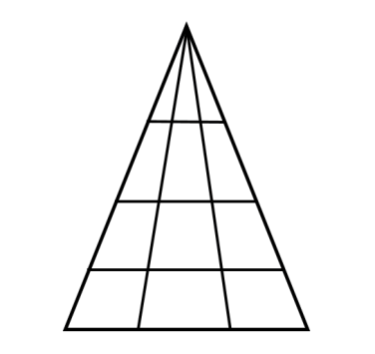
CSE 280 Discrete Mathematics
How many triangles do you see?
W. Clements
Week 3 Day 2
Set Identities, Cartesian Product, Partitions 3.5 – 3.7

Slide 2
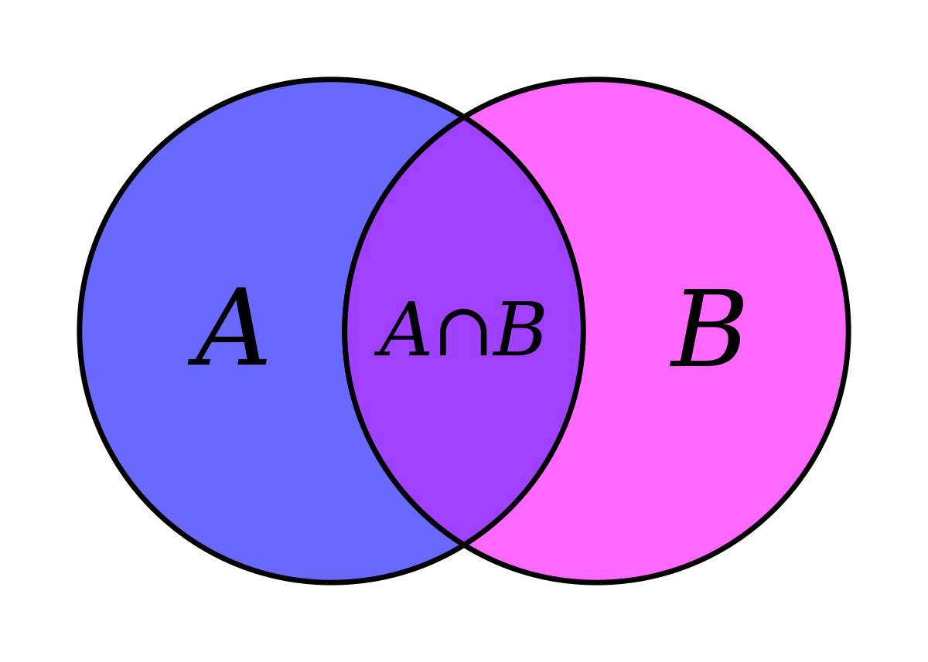
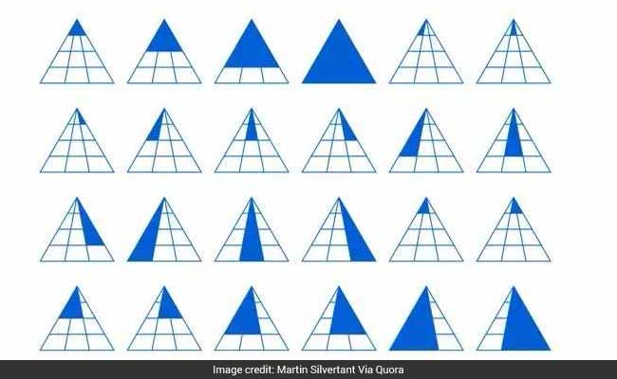
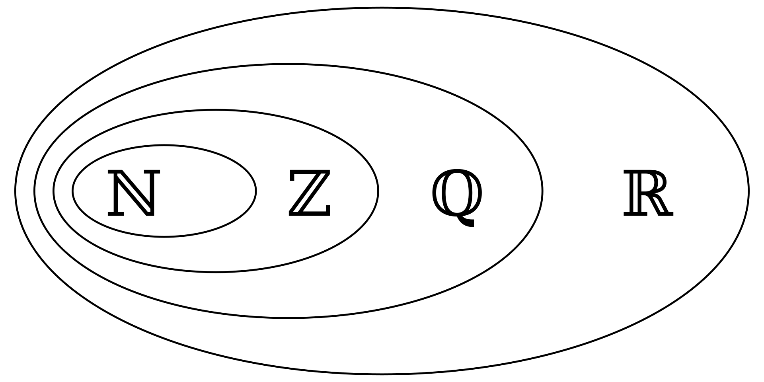
What if I could prove there is more than that?
How many bridges are there on I-20 between
Idaho Falls and the last exit in Rexburg?

Slide 3
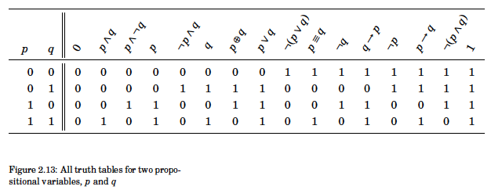
Review

Slide 4
Vocabulary
Predicate
Preposition
Quantifier
Cardinality
Sets
Cartesian Product

Slide 5
What is a set in Object Oriented Programming?
x are Prepositions
X is a set of Prepositions
A Class has a member variable
A Delivered Class is a Parent Class

Slide 6
Universal Set
All elements are in Universal Set
x ∈ ∅ ↔ F
x ∈ U ↔ T

Slide 7
Laws of Propositional Logic
Table 1.5.1: Laws of propositional logic.
Idempotent laws: | p ∨ p ≡ p | p ∧ p ≡ p
Associative laws: | ( p ∨ q ) ∨ r ≡ p ∨ ( q ∨ r ) | ( p ∧ q ) ∧ r ≡ p ∧ ( q ∧ r )
Commutative laws: | p ∨ q ≡ q ∨ p | p ∧ q ≡ q ∧ p
Distributive laws: | p ∨ ( q ∧ r ) ≡ ( p ∨ q ) ∧ ( p ∨ r ) | p ∧ ( q ∨ r ) ≡ ( p ∧ q ) ∨ ( p ∧ r )
Identity laws: | p ∨ F ≡ p | p ∧ T ≡ p
Domination laws: | p ∧ F ≡ F | p ∨ T ≡ T
Double negation law: | ¬¬p ≡ p
Complement laws: | p ∧ ¬p ≡ F ¬T ≡ F | p ∨ ¬p ≡ T ¬F ≡ T
De Morgan's laws: | ¬( p ∨ q ) ≡ ¬p ∧ ¬q | ¬( p ∧ q ) ≡ ¬p ∨ ¬q
Absorption laws: | p ∨ (p ∧ q) ≡ p | p ∧ (p ∨ q) ≡ p
Conditional identities: | p → q ≡ ¬p ∨ q | p ↔ q ≡ ( p → q ) ∧ ( q → p )
Irani, Sandy. Discrete Mathematics. Zyante Inc, 2020

Slide 8
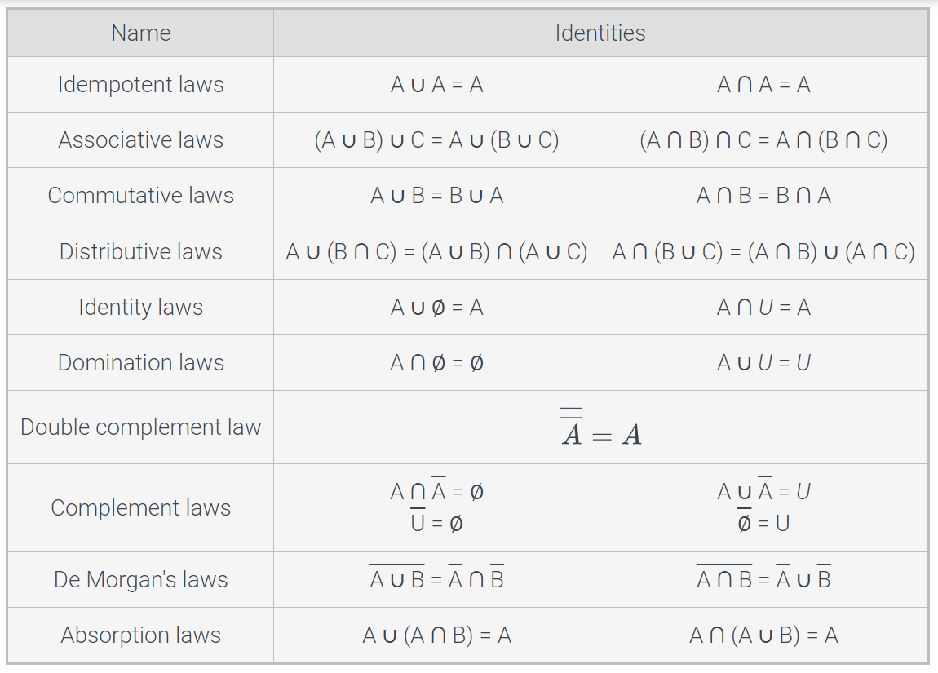
Set identities and Laws

Slide 9

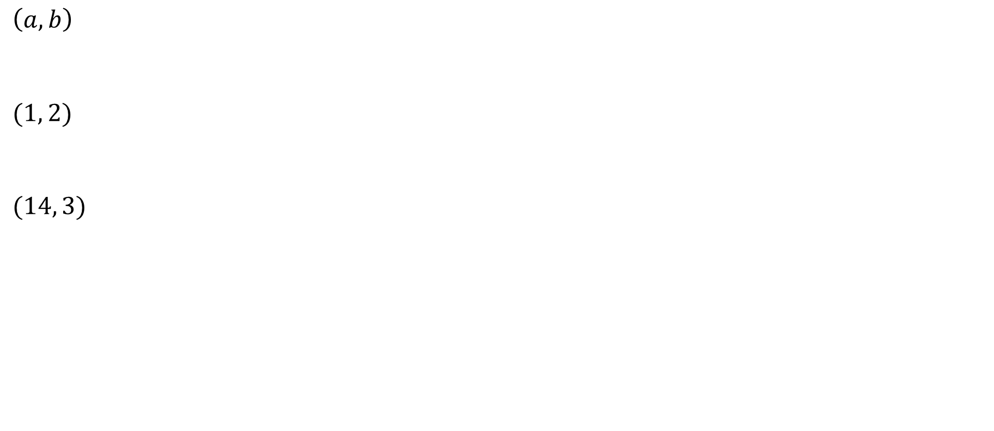


Ordered pairs
$$≠(b, a)$$
$\left(a, b\right)$
$(1, 2)$
$(14, 3)$
$$≠(2, 1)$$
$$≠(3, 14)$$

Slide 10

Cartesian Product
Example:
$A=\{1, 2\}$
$B=\{a, b, c\}$
What is $A×B$?
What is $B×A$?
Note: $A×B ≠B×A$
$$A×B=\left\{\left(a,b\right) \right| a∈A∧b∈B\}$$
$A×B=\{\left(1,a\right), \left(1,b\right), \left(1,c\right), \left(2,a\right), \left(2,b\right), \left(2,c\right)\}$
$$B×A=\{\left(a,1\right),\left(a,2\right),\left(b,1\right),\left(b,2\right),\left(c,1\right),\left(c,2\right)\}$$

Slide 11

Find the Cartesian Product of A with itself where A = {0, 1}:
$A×A= ?$
{(0,0), (0,1), (1,0), (1,1)}
In Python:
A = [0,1]
[(x,y) for x in A for y in A]
Can you generate ${\left\{0,1\right\}}^{5}$ and list them all?
Example

Slide 12
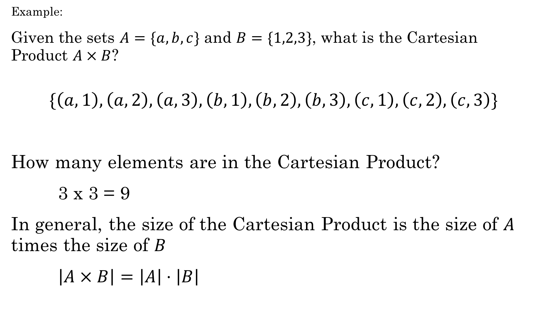
Example:
Given the sets $A=\{a,b,c\}$ and $B=\{1,2,3\}$, what is the Cartesian Product $A×B$?
$$\{\left(a,1\right),\left(a,2\right),\left(a,3\right),\left(b,1\right), \left(b,2\right),\left(b,3\right), \left(c,1\right),\left(c,2\right),\left(c,3\right)\}$$
How many elements are in the Cartesian Product?
3 x 3 = 9
In general, the size of the Cartesian Product is the size of $A$ times the size of $B$
$\left|A×B\right|=\left|A\right|⋅\left|B\right|$

Slide 13

You own an ice cream shop. If you offer 15 different flavors of ice cream, how many types of 3-scoop cones might you be able to claim in your advertising if you use the Cartesian product to build the set of possibilities?
Write Python code! Can you list all the possibilities easily?
Answer: 3375
Example

Slide 15
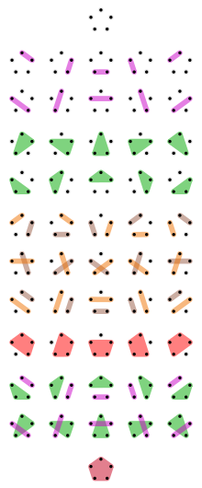
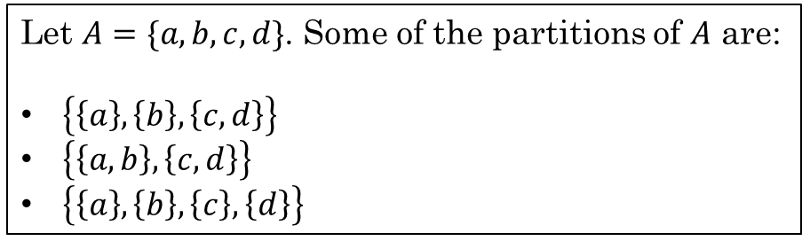

Partitions
A partition of a set is $A$ is a set of one or more nonempty subsets of $A:A_{1},A_{2}, A_{3},…$, such that every element of $A$ is in exactly one set.
In symbolic terms,
1. $A_{1}∪A_{2}∪A_{3}∪⋯=A$
2. $If i≠j then A_{i}∩A_{j}=∅$
Example:
Let $A=\{a,b,c,d\}$. Some of the partitions of $A$ are:
$\left\{\left\{a\right\}, \left\{b\right\}, \left\{c,d\right\}\right\}$
$\left\{\left\{a,b\right\}, \left\{c,d\right\}\right\}$
$\left\{\left\{a\right\}, \left\{b\right\}, \left\{c\right\}, \left\{d\right\}\right\}$
There are 15 different partitions of a set with four elements. For more, look up the Bell numbers.
https://discretemath.org/ads/s-partitions-and-law-of-addition.html

Slide 16
Group Time
Do Additional Exercises with a group:
3.1.4
3.3.1
3.4.3
3.6.6*
3.6.7*
3.7.1
3.7.2

