Slide 2
CSE 280 Discrete Mathematics
W. Clements
Week 05
Day 1: Relations 6.1-6.3
Day 2: More relations 6.4- 6.6
Day 3: Equivalent Relations & DB 6.9-6.10, Activity

Slide 3

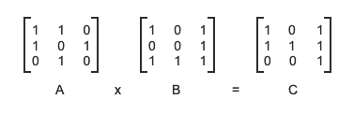
Dot Product or Multiplication or Ands Use of transitive property
(dot)And +or
1
2
1
2
3
4
3
4
(1,1)
(1,2)
(2,1)
(2,3)
(3,2)
(1,1)
(1,3)
(2,3)
(3,1)
(3,2)
(1,1)
(1,3)
(2,1)
(2,2)
(2,3)
(3,3)
1
2
Reflexive
Symmetric
Transitive
3
4

Slide 4
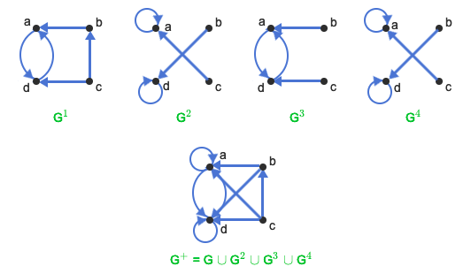
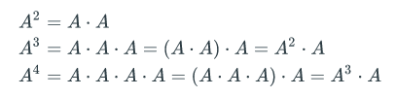

G¹ G² G³ G⁴
a
b
d
c

Slide 5
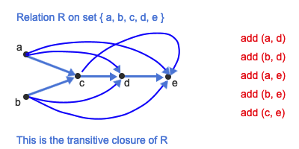
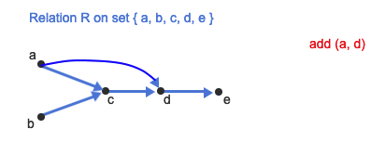
6.9 Equivalence relations
A relation R is an equivalence relation if R is reflexive, symmetric, and transitive. If a relation R is an equivalence relation, the notation a~b is used to express aRb. a~b is read "a is equivalent to b".
(a,c,d) ~ (a,d)

Slide 6
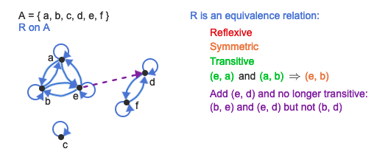

Equivalence Relation
A binary relation that is
Reflexive
Symmetric
Transitive
the same ______ as
The same parent as
The same name as
The same birthday as
C variables – the same first 31 characters
$a\sim b$ means "$a$ is equivalent to $b$"
All equivalent variable names in C:
number_of_named_tropical_storms
number_of_named_tropical_storms_atlantic
number_of_named_tropical_storms_pacific
number_of_named_tropical_storms_2020
number_of_named_tropical_storms_2021

Slide 7
Key Point: Whenever you have a relation where something has the same ______ as something else, you have an equivalence relation:
• x has the same age as y
• the same birthday as
• the same name as
• the same parent as
• the same major as
• the same first three bits as
• the same first 31 characters as
• the same ... as

Slide 8

Equivalence Classes
If $A$ is the domain of an equivalence relation $R$ and $a∈A$ then ${\left[a\right]}_{R}$ is the set of all $x∈A$ such that $a\sim x$.
${\left[a\right]}_{R}=\left\{x | \left(a,x\right)∈R\right\}$
${\left[a\right]}_{R}=\left\{x | a\sim x\right\}$
If there is an equivalence relation $R$ on set $A$, the set of all elements $x$ related to an element $a∈A$ is the equivalence class.
Example: $R$ = set of all people $(x,y)$ where $x$ has the same last name as $y$
Reflexive: $xRx$ for every person $x$. All people have the same last name as themself.
Symmetric: $yRx$ whenever $xRy$ for all $(x,y)$. If you have the same last name as Bob, then Bob has the same last name as you.
Transitive: $\left(xRy∧yRz\right)→xRz$. If person 1 has the same last name as person 2 and person 2 has the same last name as person 3, then person 1 has the same last name as person 3.
[Smith] = The set of all people with the last name of "Smith".
[x] = The set of all people with the last name of $x$.
Rosen, Kenneth. Discrete Mathematics and Its Applications, 7th Edition. McGraw-Hill, 2012

Slide 9

Example:
Let $A$ be the set of all students in the class.
Let $R$ be the equivalence relation on $A$ represented by all pairs $(x,y)$ where $x$ and $y$ are at the same table.
List out the pairs $\left(x,y\right)$ for all students in the class.
{(bob, sam), (sam, bob), (bob, sue), (sue, bob), (sue, sam), (sam, sue), (bob, bob), (sam, sam), (sue, sue), (bill, jeff), (jeff, bill), (jeff, jeff), (bill, bill), ...}
What is [bob]?
[bob] = {bob, sam, sue}
This subset of $A$ consists of all students at the same table as bob. This is the set of all students equivalent to bob with respect to $R$. This subset is an equivalence class of the relation.

Slide 10

Example
Domain: All people
$R$ = $\left\{\left(x,y\right)\right| x and y have the same mother\}$
Is this an equivalence relation?
Reflexive?
Symmetric?
Transitive?
What is an equivalence class in this relation?
Each equivalence class is the set of people with the same mother. The equivalence classes form a partition on the set of all people.
Yes. You have the same mother as yourself.
Yes. If Bob has the same mother as Sue, then Sue has the same mother as Bob.
Yes. If Bob has the same mother as Sue and Sue has the same mother as
Bill, then Bob has the same mother as Bill.

Slide 11
Example
Domain: All people
$R$ = $\left\{\left(x,y\right)\right| x and y have a common parent\}$
Is this an equivalence relation?
Reflexive?
Symmetric?
Transitive?
It is not an equivalence relation.
Yes. You have the same parent as yourself.
Yes. If Bob has a common parent with Sue, then Sue has a common parent with Bob.
No. Bob and Sue can have the same mother. Sue and Bill can have the same father. That does not imply that Bob and Bill have the same father.

Slide 12







Example
Domain: $ℤ$
$R$ = $\left\{\left(x,y\right) \right| \left(x,y\right) have the same remainder when divided by 5\}$
Is this an equivalence relation?
Reflexive?
Symmetric?
Transitive?
Yes. $x$ has the same remainder as itself.
Yes. If $x$ as the same remainder as $y$, then $y$ has the same remainder as $x$.
Yes. If $x$ has the same remainder as $y$ and $y$ has the same remainder as $z$, then $x$ has the same remainder as $z$.
What are the equivalence classes for this relation?
${\left[0\right]}_{R}$:
$\{−10, −5, 0, 5, 10, 15, 20, …\}$
${\left[1\right]}_{R}$:
$\{−9, −4, 1, 6, 11, 16, 21,…\}$
${\left[2\right]}_{R}$:
$\{−8, −3, 2, 7, 12, 17, 22,…\}$
${\left[3\right]}_{R}$:
$\{−7, −2, 3, 8, 13, 18, 23,…\}$
Note that the equivalence classes for this relation form a partition of $ℤ$.
${\left[4\right]}_{R}$:
$\{−6, −1, 4, 9, 14, 19, 24,…\}$

Slide 13
Additional Exercises
6.9.1
6.9.2
6.10.1
6.10.2
6.10.4

Slide 14
6.9.1: Recognizing equivalence relations.
Determine whether each relation is an equivalence relation. Justify your answer. If the relation is an equivalence relation, then describe the partition defined by the equivalence classes.
The domain is a group of people. Person x is related to person y under relation P if x and y have a common parent (i.e., x and y have the same biological mother or the same biological father or both). You can assume that there is at least one pair in the group, x and y, such that xPy.
The domain is a group of people. Person x is related to person y under relation M if x and y have the same biological mother. You can assume that there is at least one pair in the group, x and y, such that xMy.

Slide 15
6.9.1: Recognizing equivalence relations.
Determine whether each relation is an equivalence relation. Justify your answer. If the relation is an equivalence relation, then describe the partition defined by the equivalence classes.
The domain is a group of people. Person x is related to person y under relation P if x and y have a common parent (i.e., x and y have the same biological mother or the same biological father or both). You can assume that there is at least one pair in the group, x and y, such that xPy.
Not necessarily an equivalence relation. The relation P is not necessarily transitive. It is possible for x and y to have the same mother and for y and z to have the same father, but x and z do not share a common parent.
The domain is a group of people. Person x is related to person y under relation M if x and y have the same biological mother. You can assume that there is at least one pair in the group, x and y, such that xMy.
Equivalence relation.
Reflexive. A person has the same mother as herself or himself.
Symmetric. If person x has the same mother as person y, then y has the same mother as x.
Transitive. If x has the same mother as y and y has the same mother as z, then x has the same mother as z.
Each equivalence class consists of all the children of one mother.

Slide 16
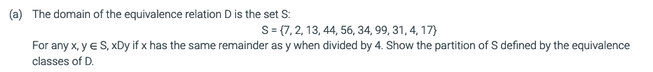
6.9.2: Equivalence classes for remainders of integer division.

Slide 17
6.9.2: Equivalence classes for remainders of integer division.
{44, 56, 4}, {13, 17}, {2, 34}, {7, 99, 31}

Slide 18
From Additional Exercises 6.9.2
Equivalence classes in Python

Slide 19
N-ary relations
A relation on sets A₁, A₂,...,A_{n} is a subset of A₁ x A₂ x ... x A_{n}. Each element of the relation is an n-tuple in which the i^{th} entry in the n-tuple is from A_{i}. A relation on n sets is called an n-ary relation.
For example, a relation could consist of all 4-tuples (w, x, y, z) ∈ R⁴ such that wx = yz.
Then (3, 12, 4, 9) would be in the relation because 3⋅12 = 4⋅9.
However (3, 8, 5, 6) would not be in the relation because 3⋅8 ≠ 5⋅6.

Slide 20
relational databases
A database is a large collection of data records that is searched and manipulated by a computer.
The relational database model stores data records as relations.
The type of data stored in each entry of the n-tuple is called an attribute. In the airline example, "flight number" is the first attribute.
A key is an attribute or set of attributes that uniquely identifies each n-tuple in the database.

Slide 21
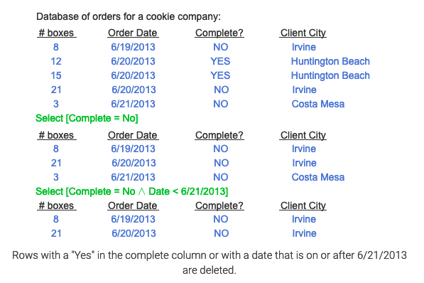
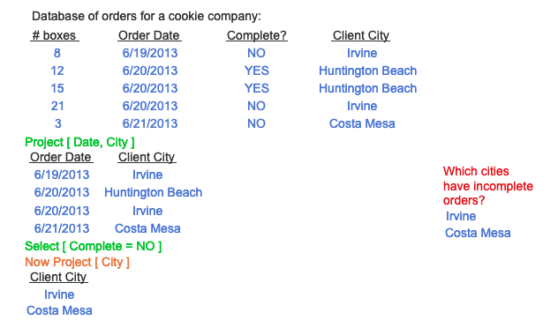
The selection operation
The selection operation chooses n-tuples from a relational database that satisfy particular conditions on their attributes.
The projection operation
The projection operation takes a subset of the attributes and deletes all the other attributes in each of the n-tuples.

Slide 22
Relational Databases
Selection
Projection
name | email | phone | job title | manager | hometown
Bob | bob@company.com | 867-5309 | Computer Scientist | Sue | Rexburg
Sue | sue@company.com | 555-5555 | Senior Computer Scientist | John | Idaho Falls
Carl | carl@company.com | 555-5432 | Engineer | Sue | Rexburg
Which part is the Selection, and which is the Projection?
In SQL (Structured Query Language):
SELECT name, phone, email FROM employees WHERE hometown="Rexburg";
Bob | 867-5309 | bob@company.com
Carl | 555-5432 | carl@company.com
In Python:
[(x[0], x[2], x[4]) for x in employees if x[5]=="Rexburg"]
Live Demo

Slide 23
Relational Databases
Class activity
https://tinyurl.com/cse280-relations

Slide 24
6.10.1
Airline | Flight Number | Gate | Destination | Departure Time
FlyRight | 323 | 33 | Honolulu | 08:25
JetGreen | 222 | 34 | Anchorage | 08:26
JetGreen | 122 | 34 | Anchorage | 08:28
JetGreen | 322 | 33 | Detroit | 08:32
JetGreen | 323 | 34 | Honolulu | 08:46
FlyRight | 199 | 22 | Denver | 09:24
JetGreen | 221 | 33 | Denver | 09:35
A key for this database is {Departure Time}?. Key: {? }
SELECT[Airline="JetGreen" ^ Destination="Denver"]?
How many elements are returned with the operation: Project[ Airline, Gate ]?
How many elements are returned with the operation: Project[ Airline, Destination ]?
How many elements are returned with the operation: Select[Airline="FlyRight"] followed by Project[ Gate ]?

Slide 25
6.10.1: n-ary relations: Numerical examples.
Express each relation as a set of n-tuples in roster format.
(a) R = { (a, b, c, d): a, b, c, d are positive integers and a + b + c + d = 6 }
R = { (1, 1, 1, 3), (1, 1, 3, 1), (1, 3, 1, 1), (3, 1, 1, 1), (2, 2, 1, 1), (2, 1, 2, 1), (2, 1, 1, 2), (1, 2, 2, 1), (1, 2, 1, 2), (1, 1, 2, 2) }
(b) S = { (a, b, c): a, b, c are positive integers and a < b < c < 5 }
S = { (1, 2, 3), (1, 2, 4), (1, 3, 4), (2, 3, 4) }

Slide 26
6.10.1: n-ary relations: Numerical examples.
Express each relation as a set of n-tuples in roster format.
(a) R = { (a, b, c, d): a, b, c, d are positive integers and a + b + c + d = 6 }
R = { (1, 1, 1, 3), (1, 1, 3, 1), (1, 3, 1, 1), (3, 1, 1, 1), (2, 2, 1, 1), (2, 1, 2, 1), (2, 1, 1, 2), (1, 2, 2, 1), (1, 2, 1, 2), (1, 1, 2, 2) }
(b) S = { (a, b, c): a, b, c are positive integers and a < b < c < 5 }
S = { (1, 2, 3), (1, 2, 4), (1, 3, 4), (2, 3, 4) }

Slide 27
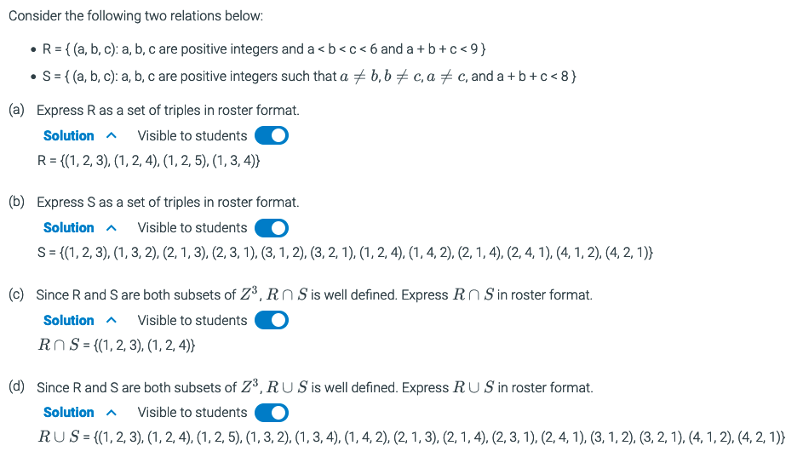
6.10.2: n-ary relations, cont.

Slide 28
6.10.2: n-ary relations, cont.
Consider the following two relations below:
R = { (a, b, c): a, b, c are positive integers and a < b < c < 6 and a + b + c < 9 }
S = { (a, b, c): a, b, c are positive integers such that a!= b, b!=c, a!=c and a + b + c < 8 }
(a) Express R as a set of triples in roster format.
R = {(1, 2, 3), (1, 2, 4), (1, 2, 5), (1, 3, 4)}
(b) Express S as a set of triples in roster format.
S = {(1, 2, 3), (1, 3, 2), (2, 1, 3), (2, 3, 1), (3, 1, 2), (3, 2, 1), (1, 2, 4), (1, 4, 2), (2, 1, 4), (2, 4, 1), (4, 1, 2), (4, 2, 1)}
(d) Since R and S are both subsets of , is well defined. Express in roster format.
S= {(1, 2, 3), (1, 2, 4), (1, 2, 5), (1, 3, 2), (1, 3, 4), (1, 4, 2), (2, 1, 3), (2, 1, 4), (2, 3, 1), (2, 4, 1), (3, 1, 2), (3, 2, 1), (4, 1, 2), (4, 2, 1)}

Slide 29
6.10.4: Select and Project operations on a relational database: University courses.
Course Number | Course Title | Instructor | Quarter
CS 111 | Digital Image Processing | Gupta | Spring
CS 112 | Computer Graphics | Gupta | Spring
CS 117 | Project in Computer Vision | Hawkins | Fall
CS 116 | Intro to Computer Vision | Hawkins | Winter
CS 122A | Intro to Database Management | Spencer | Spring
CS 122A | Intro to Database Management | Wang | Winter
CS 122C | Principles of Database Management | Spencer | Winter
The table below shows a small database whose records correspond to courses offered in a university.
(a) Give a key for this database.
{Course Number, Instructor}
(b) Show the results of the operation Select[Course Number = "CS 122A" ∨ Course Number = "CS 122C"]
(CS 122A, Intro to Data Management, Spencer, Spring)
(CS 122A, Intro to Data Management, Wang, Winter)
(CS 122C, Principles of Data Management, Spencer, Winter)
(c) Show the results of the operation Project[Instructor]
(Gupta), (Hawkins), (Spencer), (Wang)
(d) Show the results of the operation Select[Quarter = "Spring"] followed by Project[Course Number]. Express in English what question this combination of operations is asking.
(CS 111), (CS 112), (CS 122A). Which courses are offered in Spring?
(e) Which operations should be performed if you want to know in which quarters CS 122A is being offered?
Select[Course Number = "CS 122A"]
Project[Quarter]
(f) Which operations should be performed if you want to know which courses are being taught by Prof. Gupta? A course is identified by its course title.
Select[Instructor = "Gupta"]
Project[Course Title]

Slide 30
6.10.4: Select and Project operations on a relational database: University courses.
Course Number | Course Title | Instructor | Quarter
CS 111 | Digital Image Processing | Gupta | Spring
CS 112 | Computer Graphics | Gupta | Spring
CS 117 | Project in Computer Vision | Hawkins | Fall
CS 116 | Intro to Computer Vision | Hawkins | Winter
CS 122A | Intro to Database Management | Spencer | Spring
CS 122A | Intro to Database Management | Wang | Winter
CS 122C | Principles of Database Management | Spencer | Winter
The table below shows a small database whose records correspond to courses offered in a university.
(a) Give a key for this database.
{Course Number, Instructor}
(b) Show the results of the operation Select[Course Number = "CS 122A" ∨ Course Number = "CS 122C"]
(CS 122A, Intro to Data Management, Spencer, Spring)
(CS 122A, Intro to Data Management, Wang, Winter)
(CS 122C, Principles of Data Management, Spencer, Winter)
(c) Show the results of the operation Project[Instructor]
(Gupta), (Hawkins), (Spencer), (Wang)
(d) Show the results of the operation Select[Quarter = "Spring"] followed by Project[Course Number]. Express in English what question this combination of operations is asking.
(CS 111), (CS 112), (CS 122A). Which courses are offered in Spring?
(e) Which operations should be performed if you want to know in which quarters CS 122A is being offered?
Select[Course Number = "CS 122A"]
Project[Quarter]
(f) Which operations should be performed if you want to know which courses are being taught by Prof. Gupta? A course is identified by its course title.
Select[Instructor = "Gupta"]
Project[Course Title]

Slide 31
Extras

Slide 32

Congruences
$a≡_{m}b$ $a$ is congruent modulo $m$ to $b$
$a≡b(mod m)$ $a$ is congruent modulo $m$ to $b$
Both $a$ and $b$ have the same remainder when divided by $m$.
Example:
14 and 21 are congruent modulo 7
0, 5, 10, 15, 20 are all congruent modulo 5

Slide 33
Congruences
Another way to think about it:
$a mod m=b mod m$
0, 12, 24, 36, 48, … are all congruent mod 12
0, 7, 14, 21, 28, … are all congruent mod 7
1, 8, 15, 22, 29… are all congruent mod 7

Slide 34

Congruences
$a≡_{m}b$
$m | a−b$ $7 | 28−14$
$∃c\left(c∗m=a −b\right)$ $c ∗7=28 −14$, $c=2$
$∃k\left(a=k∗m+b\right)$ $28=k ∗7+14$, $k=2$
$\left(a −b\right) mod m=0$ $\left(28 −14\right) mod 7=0$
Python:
a % m == b % m
(a – b) % m == 0
Example

Slide 35
Equivalence Classes
${\left[a\right]}_{R}=\left\{s | \left(a,s\right)∈R\right\}$
Meaning: If we have an equivalence relation $R$ on set $A$, the set of all elements $s$ related to an element $a$ of $A$ is the equivalence class.
In other words, if we have $(a,b)$ as a pair in $R$, then the set of all $b$ for a given $a$ is the equivalence class of that $a$.
Rosen, Kenneth. Discrete Mathematics and Its Applications, 7th Edition. McGraw-Hill, 2012

Slide 36

Example:
Let $A$ be the set of all students in the class.
Let $R$ be the equivalence relation on $A$ represented by all pairs $(x,y)$ where $x$ and $y$ are at the same table.
List out the pairs $\left(x,y\right)$ for your table. $\{(bob,sam), (sam, bob), (bob, sue), (sue, bob),$
$$(sue, sam), (sam, sue), (bob, bob), (sam, sam), (sue, sue)\}$$
What is ${\left[bob\right]}_{R}$?
${\left[bob\right]}_{R}=\{bob, sam, sue\}$
This subset of $A$ consists of all students at the same table as bob. This is the set of all students equivalent to bob with respect to $R$. This subset is an equivalence class of the relation.

Slide 37

Example:
Let $R$ be the equivalence relation for congruence modulo 4 where the domain is $ℤ$.
What is ${\left[0\right]}_{R}$?
${\left[0\right]}_{4}=\{…, −8, −4, 0, 4, 8, 12, …\}$
What is ${\left[1\right]}_{R}$?
${\left[1\right]}_{4}=\{…, −7, −3, 1, 5, 9, …\}$
Rosen, Kenneth. Discrete Mathematics and Its Applications, 7th Edition. McGraw-Hill, 2012

Slide 38
Example:
Let $R$ be the equivalence relation on $A$ for congruence modulo 5 where the $A$is the set of integers defined by range(-20,21).
Use Python to generate the equivalence class ${\left[3\right]}_{R}$?
Example
Rosen, Kenneth. Discrete Mathematics and Its Applications, 7th Edition. McGraw-Hill, 2012

