Slide 2
Cryptography
The study of integers
9.6 Number representation
9.7 Fast exponentiation
9.8 Introduction to cryptography
9.9 The RSA cryptosystem

Slide 3

Review
Questions?
Division Theorem $n=dq+r$ ;$0≤r<d$
Using $n=dq+r$
Solve gcd(97, 11)
1. 97 = 11( ? ) + ?
2. 97 = 11 (8) + 9
1. 11 = 9 (?) + ?
2. 11 = 9 (1) + 2
1. 9 = 2(4) + 1
1. 2 = 1 (2) + 0
Euclidean GCD Algorithm
gcd (a, b)
Divide larger :
if a<b: n =a & d=b
else : n=b & d=a
1. Shift d and r to be new n and d.
2. Divide n by d to get a n and d
3. Repeat until the remainder is 0.
The last non-zero remainder is the GCD.

Slide 4


Review
Questions?
GCD Theorem
Let $x$ and $y$ be two positive integers where $x≠0$.
Then $\gcd\left(x,y\right)=gcd\left(x, y mod x\right);y>x$
$=gcd\left(x mod y, x\right);x>y$
Division Theorem $n=dq+r$ ;$0≤r<d$
Euclidean GCD Algorithm
gcd (a, b) = n=dp + r => n=d,d=r
Extended Euclidean Algorithm
gcd(x, x mod y) = (s*x + t*y)
Multiplicative Inverse
$1=sx+tn$ ➔ sx -1 = -tn; sx is 1 more than multiple of n

Slide 5





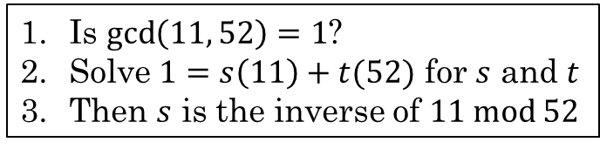

Review
Is $\gcd\left(11, 52\right)=1$?
Solve $1=s\left(11\right)+t(52)$ for $s$ and $t$
Then $s$ is the inverse of $11 mod 52$
Finally, use substitution to solve, start off with 1
$1=s(11)+t(52)$ for $s$ and $t$.
S is the MMI of 11 mod 52
$1=3−1\left(8−2\left(3\right)\right)$ substitute 2 $1=3−1\left(8\right)+2\left(3\right)$ simplify $1=3\left(3\right)−1\left(8\right)$ simplify
$1=3\left(11−1\left(8\right)\right)−1\left(8\right)$ substitute 3 $1=3\left(11\right)−3\left(8\right)−1\left(8\right)$ simplify $1=3\left(11\right)−4(8)$ simplify
$1=3\left(11\right)−4\left(52−4\left(11\right)\right)$ substitute 8 $1=3\left(11\right)−4\left(52\right)+16\left(11\right)$ simplify $1=19\left(11\right)−4(52)$ simplify
S=19
Let's review the Extended Euclidean Algorithm
Find the inverse of 11 mod 52
First, find $gcd⁡(11, 52)$:
$$52=11\left(4\right)+8 \\ 11=8\left(1\right)+3 \\ 8=3\left(2\right)+2 \\ 3=2(1)+1$$
$\gcd\left(11,52\right)=1$
Next, rearrange each equation, by remainder:
r = n - dq
$8=52−4(11)$ $3=11−1(8)$ $2= 8−2(3)$ $1= 3−1(2)$
$n=dq+r$
$$\gcd\left(x, y\right)=s∗x+t∗y$$
$$MMI: gcd\left(x, y\right)=s∗x+t∗y=1$$
The MMI of $11 mod 52$ is $19$.
MMI of 52 mod 11 is -4
$$sx−1=−tn$$

Slide 6
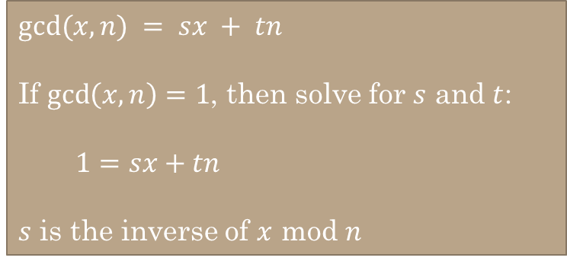

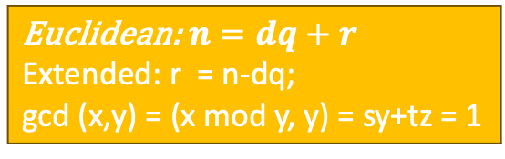

$gcd⁡(x,n) = sx + tn$
If $\gcd\left(x,n\right)=1$, then solve for $s$ and $t$:
$1=sx+tn$
$s$ is the inverse of $x$ mod $n$
Use the Extended Euclidean Algorithm to find the inverse of $x mod n$for each of the following:
x=35, n=48
11
1. Euclidean GCD Algorithm
2. d mod q = r
3. Extended Euclidean
4.MMI
$n=dq+r$ ;$0≤r<d$
Euclidean:$n=dq+r$
Extended: r = n-dq;
gcd (x,y) = (x mod y, y) = sy+tz = 1
r = n - dq
gcd(x, x mod y) = (s*x + t*y)
$1=sx+tn$ ➔ sx -1 = -tn; relative prime
x=25, n=84
37

Slide 7
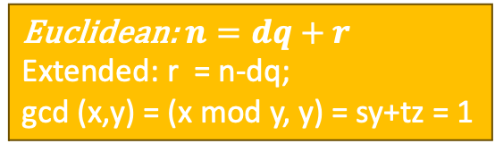
$gcd⁡(x,n) = sx + tn$
If $\gcd\left(x,n\right)=1$, then solve for $s$ and $t$:
$1=sx+tn$
$s$ is the inverse of $x$ mod $n$
Use the Extended Euclidean Algorithm to find the inverse of $x mod n$for each of the following:
x=35, n=48
11
(sy + tz) = n – dq = 1
Euclidean:$n=dq+r$
Extended: r = n-dq;
gcd (x,y) = (x mod y, y) = sy+tz = 1
x=25, n=84
37

Slide 8
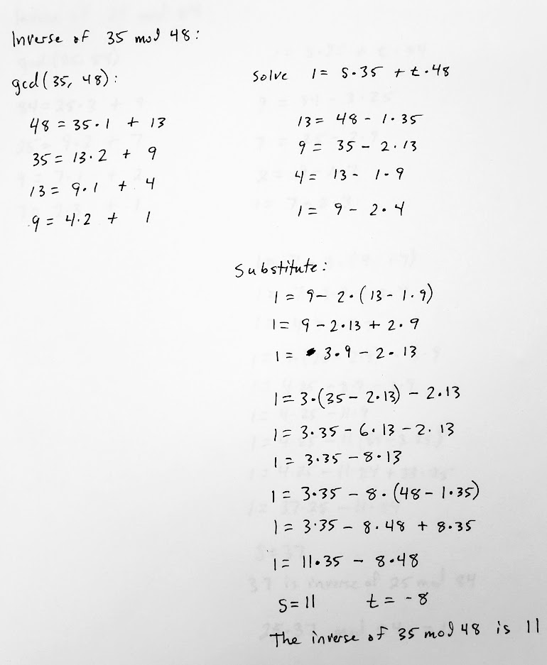
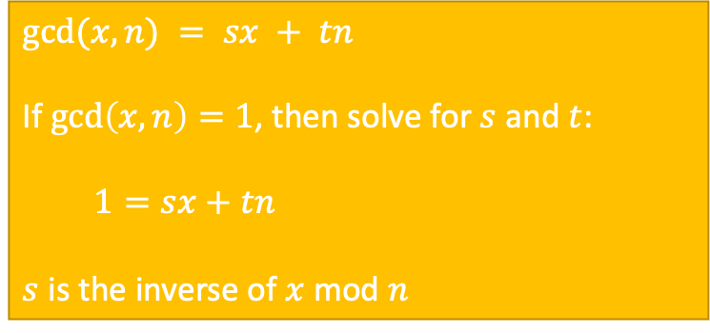
$gcd⁡(x,n) = sx + tn$
If $\gcd\left(x,n\right)=1$, then solve for $s$ and $t$:
$1=sx+tn$
$s$ is the inverse of $x$ mod $n$
Use the Extended Euclidean Algorithm to find the inverse of $x mod n$for each of the following:
x=35, n=48
11
(sy + tz) = n – dq = 1
Euclidean:$n=dq+r$
Extended: r = n-dq;
gcd (x,y) = (x mod y, y) = sy+tz = 1
x=25, n=84
37

Slide 9
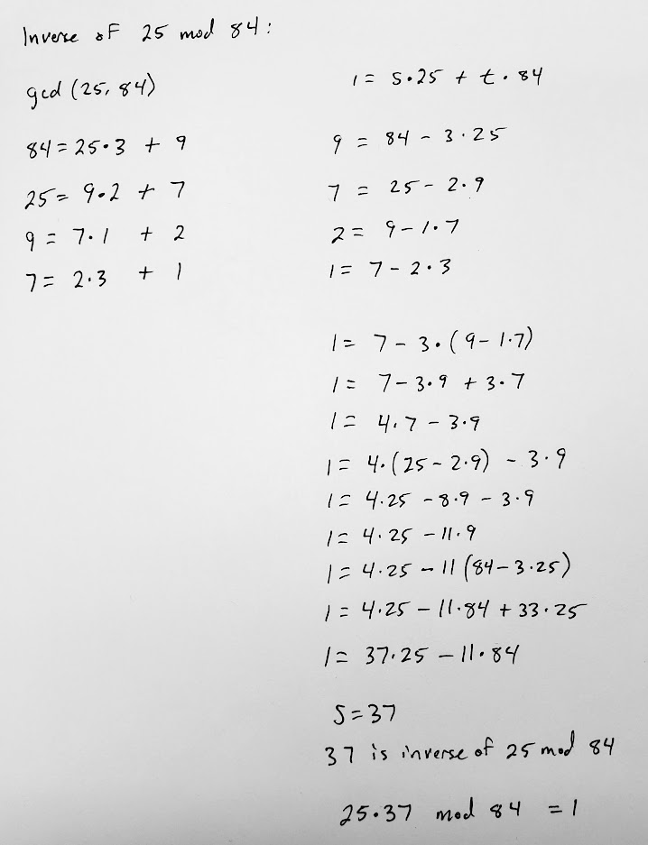
$gcd⁡(x,n) = sx + tn$
If $\gcd\left(x,n\right)=1$, then solve for $s$ and $t$:
$1=sx+tn$
$s$ is the inverse of $x$ mod $n$
Use the Extended Euclidean Algorithm to find the inverse of $x mod n$for each of the following:
x=35, n=48
11
(sy + tz) = n – dq = 1
Euclidean:$n=dq+r$
Extended: r = n-dq;
gcd (x,y) = (x mod y, y) = sy+tz = 1
x=25, n=84
37

Slide 10
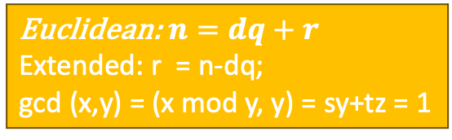




$1=s(11)+t(52)$ for $s$ and $t$.
S is the MMI of 11 mod 52
$$1=19\left(11\right)−4(52)$$
Then $\gcd\left(x,y\right)=gcd\left(x, y mod x\right);y>x$
$=gcd\left(x mod y, x\right);x>y$
$MMI: gcd\left(x, y\right)=sx+ty=1$
The MMI of $x mod y$ is s.
MMI of y mod x is t
x & y are relative primes (GCD/MMI = 1)
Let: m & c have same length
e = x, encryption value
d = y, decryption value
Then: m = s & c = t
Due to the relationship of relative primes and mods, for a give value, can get a relative value,
Encrypt m: c = m^{e} % n
Decrypt c: m = c^{d} % n
$[(x mod m)(y mod m)] mod m = [xy] mod m$
$$x^{2} mod m=\left(x∗x\right) mod m=\left(x mod m\right)∗\left(x mod m\right) mod m$$
Euclidean:$n=dq+r$
Extended: r = n-dq;
gcd (x,y) = (x mod y, y) = sy+tz = 1
$3⋅x≡_{7}1$

Slide 11
9.6 Number representation

Slide 12




Base-b
We can express any integer $n$ using any base-$b$ where $b > 1$
$n=a_{k}b^{k}+a_{k−1}b^{k−1}+…+a_{1}b^{1}+a_{0}b^{0}$
$$523=(5⋅{10}^{2})+(2⋅{10}^{1})+(3⋅{10}^{0})$$
${\left(a_{k}a_{k−1}…a_{1}a_{0}\right)}_{b}$
base $b$ expansion of $n$
$${523}_{10}$$
Binary: ${\left(10110100\right)}_{2}=({1∙2}^{7})+(0∙2^{6})+(1∙2^{5})+(1∙2^{4})+\left(0∙2^{3}\right)+(1∙2^{2})+(0∙21)+(0∙20)=180$
Octal: ${\left(264\right)}_{8}=(2⋅8^{2})+(6⋅8^{1})+4=180$
Hexadecimal: ${\left(B4\right)}_{16}=(B⋅{16}^{1})+4=(11⋅16+4)=176+4=180$

Slide 13






Convert base-b to n
$n=a_{k}b^{k}+a_{k−1}b^{k−1}+…+a_{1}b^{1}+a_{0}b^{0}$
Convert each of the following to base-10 (without using a calculator):
$${1101011}_{2}$$
$$=1⋅2^{6}+1⋅2^{5}+0⋅2^{4}+1⋅2^{3}+0⋅2^{2}+1⋅2^{1}+1⋅2^{0} \\ =64+32+8+2+1 \\ =107$$
$${1234}_{5}$$
$$=1⋅5^{3}+2⋅5^{2}+3⋅5^{1}+4⋅5^{0} \\ =125+50+15+4 \\ =194$$
$${1221}_{3}$$
$$=1⋅3^{3}+2⋅3^{2}+2⋅3^{1}+1⋅3^{0} \\ =27+18+6+1 \\ =52$$

Slide 14



Convert $n$ to $base_{b}$
Example:
${97}_{10}$ to base₃
$$97=3⋅\left(32\right)+\left(1\right)$$
$$32=3⋅\left(10\right)+\left(2\right)$$
$$10=3⋅\left( 3\right)+\left(1\right)$$
$$3 =3⋅\left( 1\right)+\left(0\right)$$
$$1 =3⋅\left( 0\right)+\left(1\right)$$
Divide $n$ by $b$ to get a quotient $q$and remainder $a_{0}$:
$n=bq_{0}+a_{0}$
The remainder is the rightmost "digit" in the base$_b$ expansion of $n$
Divide the quotient $q_{0}$ by $b$ to obtain a new quotient $q_{1}$ and remainder $a_{1}$.
$q_{0}=bq_{1}+a_{1}$
The remainder $a_{1}$ is the next rightmost "digit".
Continue the process until the quotient is $0$.
21
1
121
0121
10121
10121₃
Rosen, Kenneth. Discrete Mathematics and Its Applications, 7th Edition. McGraw-Hill, 2012

Slide 15
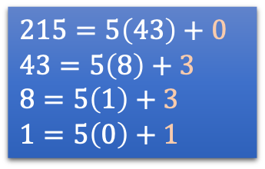



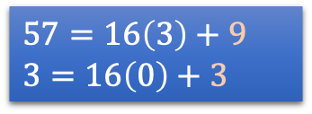

Try it!
$215=5\left(43\right)+0$
$43=5\left(8\right)+3$
$8=5\left(1\right)+3$
$1=5\left(0\right)+1$
Example:
${97}_{10}$ to base₃
$$97=3⋅\left(32\right)+\left(1\right)$$
$$32=3⋅\left(10\right)+\left(2\right)$$
$$10=3⋅\left(3\right)+\left(1\right)$$
$$3 =3⋅\left( 1\right)+\left(0\right)$$
$$1 =3⋅\left( 0\right)+\left(1\right)$$
$$10121$$
$$1330$$
Convert ${215}_{10}$ to base-5
Convert 57₁₀ to base-16
$57=16\left(3\right)+9$
$3=16\left(0\right)+3$
$$39$$

Slide 16
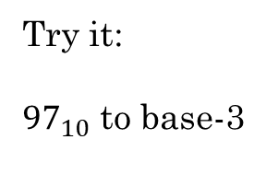
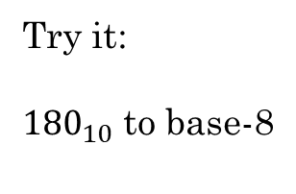
Try it:
${180}_{10}$ to base-8
Try it:
${97}_{10}$ to base-3
180₁₀->base₈
180 = 8(22) + 4
22 = 8(2) + 6
2 = 8(0) + 2
= 2648
97₁₀->base₃
97 = 3(32) +1
32 = 3(10) +2
10 = 3(3) + 1
3 = 3(1) + 0
1 = 3(0) + 1
= 10121₃

Slide 17
Additional Exercises:
9.6.1 (a-d)
9.6.2 (a-d)

Slide 18
9.6.1 (a-d)
Compute the decimal representation for each of the following numbers.
(a) (1100110)₂
(1100110)₂ = 2⁶ + 2⁵ + 2² + 2¹ = 64 + 32 + 4 + 2 = 102
(b) (346)₇
(346)₇ = 3·7² + 4·7¹ + 6·7⁰ = 3·49 + 4·7 + 6 = 181
(c) (1024)₈
(1024)₈ = 1·8³ + 2·8¹ + 4·8⁰ = 1·512 + 2·8 + 4 = 532
(d) (3B2)₁₆
(3B2)₁₆ = 3·(16)² + 11·(16)¹ + 2·(16)⁰ = 3·256 + 11·16 + 2 = 946

Slide 19
A number N is given below in decimal format. Compute the representation of N in the indicated base.
(a) N = 217, binary.
217 mod 2 = 1 217 div 2 = 108 108 mod 2 = 0 108 div 2 = 54 54 mod 2 = 0 54 div 2 = 27 27 mod 2 = 1 27 div 2 = 13 13 mod 2 = 1 13 div 2 = 6 6 mod 2 = 0 6 div 2 = 3 3 mod 2 = 1 3 div 2 = 1 1 mod 2 = 1 1 div 2 = 0 217 = (11011001)₂
(b) N = 99, hex.
99 mod 16 = 3 99 div 16 = 6 6 mod 16 = 6 6 div 16 = 0 99 = (63)₁₆
(c) N = 344, hex.
344 mod 16 = 8 344 div 16 = 21 21 mod 16 = 5 21 div 16 = 1 1 mod 16 = 1 1 div 16 = 0 344 = (158)₁₆
(d) N =136, base 7.
136 mod 7 = 3 136 div 7 = 19 19 mod 7 = 5 19 div 7 = 2 2 mod 7 = 2 2 div 7 = 0 136 = (253)₇

Slide 21

Fast Modular Exponentiation
In cryptography, it is important to find $b^{n} mod m$ quickly and efficiently, with $b$, $n$, and $m$ being large integers.
$b^{n}$ is a HUGE number, so it is not practical to compute it directly, then divide it by $m$ to find the remainder. ($n$ is typically 1024 or 2048 bits)
Instead, we use the fast modular exponentiation algorithm, which uses binary expansion of the exponent $n$
This makes computing $x$ where $x≡b^{n}(mod m)$ very fast and efficient.
However, reversing this process and finding $n$ if we know $x, b, and m$ is very difficult. This is the basis of some cryptographic algorithms.
i.e. b²⁰⁴⁸ / m
i.e. b²⁰⁴⁸ mod m
$n=a_{k}b^{k}+a_{k−1}b^{k−1}+…+a_{1}b^{1}+a_{0}b^{0}$
Rosen, Kenneth. Discrete Mathematics and Its Applications, 7th Edition. McGraw-Hill, 2012

Slide 22
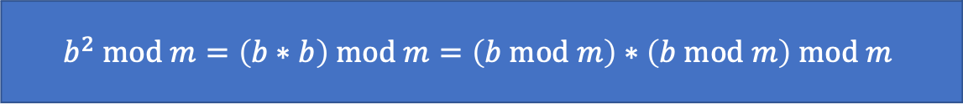

Modular exponentiation
We can quickly compute $b^{n} mod m$ if $n$ is a power of 2 because:
Compute $7^{256}\left(mod 13\right)$:
$7 mod 13=7$
$7^{2} mod 13=\left(7∗7\right) mod 13=49 mod 13=10$
$7^{4} mod 13=\left(7^{2}∗7^{2}\right) mod 13=\left(7^{2}mod 13 ∗7^{2}mod 13\right) mod 13=\left(10∗10\right) mod 13=9$
$7^{8} mod 13=\left(7^{4}∗7^{4}\right) mod 13=\left(9∗9\right) mod 13=81 mod 13=3$
$7^{16} mod 13=\left(7^{8}∗7^{8}\right) mod 13=\left(3∗3\right) mod 13=9 mod 13=9$
$7^{32} mod 13=\left(7^{16}∗7^{16}\right) mod 13=\left(9∗9\right) mod 13=3$
$7^{64} mod 13=\left(7^{32}∗7^{32}\right) mod 13=\left(3∗3\right) mod 13=9$
$7^{128} mod 13=\left(7^{64}∗7^{64}\right) mod 13=\left(9∗9\right) mod 13=3$
$7^{256} mod 13=\left(7^{128}∗7^{128}\right) mod 13=\left(3∗3\right) mod 13=9$
$$b^{2} mod m=\left(b∗b\right) mod m=\left(b mod m\right)∗\left(b mod m\right) mod m$$
https://www.khanacademy.org/computing/computer-science/cryptography/modarithmetic/a/fast-modular-exponentiation

Slide 23

If $n$ is not a power of 2, we convert it into multiples of powers of 2:
$$b^{n}=b^{{a_{k−1}∗2}^{k−1}+a_{k−2}∗2^{k−2}+ …+a_{1}2^{1}+a_{0}}=b^{{a_{k−1}∗2}^{k−1}}∗…∗b^{a_{1}∗2}∗b^{a_{0}}$$
Example:
$b^{117}$
$117={1 1 1 0 1 0 1}_{2}$
$117=64+32+16+4+1$
$b^{117}=b^{(64+32+16+4+1) }=b^{64}∗b^{32}∗b^{16}∗b^{4}∗b$
Now we can find something like $5^{117} mod 19$
Let walk through this…
64
32
16
4
1
Rosen, Kenneth. Discrete Mathematics and Its Applications, 7th Edition. McGraw-Hill, 2012
https://www.khanacademy.org/computing/computer-science/cryptography/modarithmetic/a/fast-modular-exponentiation

Slide 24
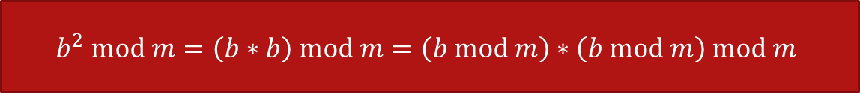

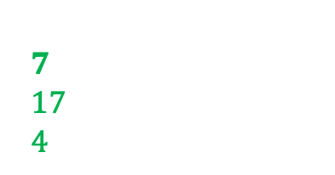
$$b^{2} mod m=\left(b∗b\right) mod m=\left(b mod m\right)∗\left(b mod m\right) mod m$$
$5^{117} mod 19$
$5^{117} mod 19=5^{64+32+16+4+1} mod 19=5^{64}∗5^{32}∗5^{16}∗5^{4}∗5^{1} mod 19$
$5^{1} mod 19=5$
$5^{2} mod 19=\left(5∗5\right) mod 19=25 mod 19=6$
$5^{4} mod 19=\left(5^{2}∗5^{2}\right) mod 19=\left(6∗6\right) mod 19=36 mod 19=17$
$5^{8} mod 19=\left(5^{4}∗5^{4}\right) mod 19=\left(17∗17\right) mod 19=289 mod 19=4$
$5^{16} mod 19=\left(5^{8}∗5^{8}\right) mod 19= \left(4∗4\right) mod 19=16 mod 19=16$
$5^{32} mod 19=\left(16 ∗16\right) mod 19=256 mod 19=9$
$5^{64} mod 19=\left(9 ∗9\right) mod 19=81 mod 19=5$
$5^{117} mod 19=\left(5∗9∗16∗17∗5\right) mod 19=61200 mod 19=1$
$5^{64}∗5^{32}∗5^{16}∗5^{4}∗5^{1}$
$$\left(5∗9\right) mod 19 =7 \\ \left(7∗16\right) mod 19=17 \\ \left(17∗17\right) mod 19=4 \\ \left(4∗5\right) mod 19=1$$
https://www.khanacademy.org/computing/computer-science/cryptography/modarithmetic/a/fast-modular-exponentiation

Slide 25
Practice
Compute the following using fast modular exponentiation:
5³⁵ mod 11
5⁶⁸ mod 7
53²⁷ mod 12
46³⁹ mod 11
Let’s take a look at 1st one

Slide 26
Practice
Compute the following using fast modular exponentiation:
5³⁵ mod 11
5⁶⁸ mod 7
53²⁷ mod 12
46³⁹ mod 11
5¹ mod 11 = 5 mod 11 = 5
5² mod 11 = 5* 5 mod 11 = 3
5⁴ mod 11= = 5²* 5² mod 11 = (5² mod 11 * 5² mod 11) mod 11 = 3 * 3 mod 11 = 9
5⁸ mod 11 = 5⁴ * 5⁴ mod 11 = (5⁴ mod 11 * 5⁴ mod 11 ) mod 11 = 9 * 9 mod 11 = 4
5¹⁶ mod 11 = 5⁸ * 5⁸ mod 11 = 4 * 4 mod 11 = 5
5³² mod 11 = 5¹⁶ * 5¹⁶ mod 11 = 5 * 5 mod 11 = 3
535 mode 11 = 5³² * 5² * 5¹ mod 11 = = 3 * 3 * 5 mod = 1

Slide 27
Practice
Compute the following using fast modular exponentiation:
5³⁵ mod 11
5⁶⁸ mod 7
53²⁷ mod 12
46³⁹ mod 11
5⁴ mod 7 = 2
5⁶⁴ mod 7 = 2

Slide 28
Practice
Compute the following using fast modular exponentiation:
5³⁵ mod 11
5⁶⁸ mod 7
53²⁷ mod 12
46³⁹ mod 11
53 mod 12 = 5
53² mod 12 = 1
53⁴ mod 12 = 1
53⁸ mod 12 = 1
53¹⁶ mod 12 = 1

Slide 29
Practice
Compute the following using fast modular exponentiation:
5³⁵ mod 11
5⁶⁸ mod 7
53²⁷ mod 12
46³⁹ mod 11
46 mod 11
46² mod 11 = 4
46⁴ mod 11 = 5
46⁸ mod 11 = 3
46¹⁶ mod 11 = 9
46³² mod 11 = 4

