Slide 2
CSE 280
FSM

Slide 3
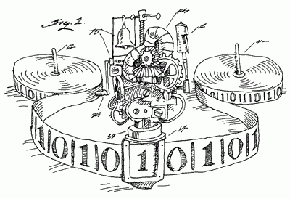
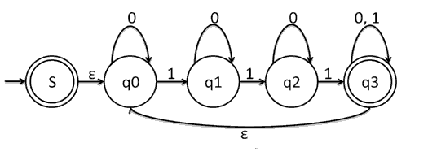
FSMs & Turing Machines

Slide 4
Modeling Computation
Modeling computation helps us to answer questions such as
Given a task, can it be done using a computer?
If so, how can the task be carried out?
We can study computation using different structures
Grammars
Finite State Machines
Turing Machines
In this class, we will touch briefly on Finite State Machines and Turing Machines
Rosen, Kenneth. Discrete Mathematics and Its Applications, 7th Edition. McGraw-Hill, 2012

Slide 5
Finite State Machines
Many types of machines, including computer components, can be modeled using finite state machines.
The basis for many types of programs:
spell checkers
grammar checkers
searching text
speech recognition
markup language transformation (HTML, Markdown, LaTeX, etc.)
network protocols
...
Rosen, Kenneth. Discrete Mathematics and Its Applications, 7th Edition. McGraw-Hill, 2012

Slide 6
Finite State Machines
Different types of FSMs can model different things.
We will look at two types of FSMs:
1. Produce output
2. Recognize a language / bitstring / sequence of inputs / property

Slide 7
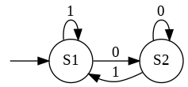
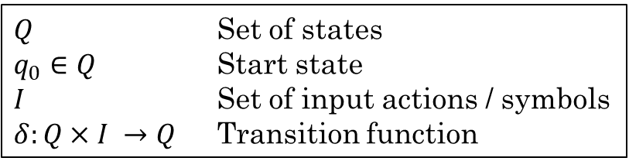
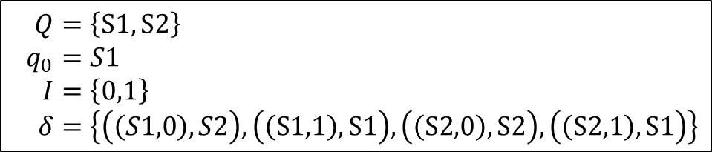
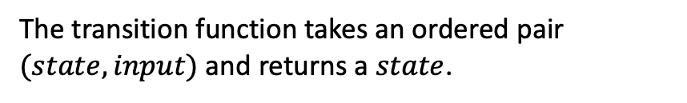
Finite State Machines
$Q$ Set of states
$q_{0}∈Q$ Start state
$I$ Set of input actions / symbols
$δ:Q×I →Q$ Transition function
All FSMs include:
Finite set of states
Starting state
Input alphabet or input actions
Transition function
The FSM is given a sequence of inputs. The transition function determines the next state based on the current state and the current input.
Example:
$$Q=\left\{S1, S2\right\} \\ q_{0}=S1 \\ I=\left\{0,1\right\} \\ δ=\left\{\left(\left(S1,0\right),S2\right), \left(\left(S1,1\right),S1\right), \left(\left(S2,0\right),S2\right), \left(\left(S2,1\right),S1\right)\right\}$$
We can also represent a transition function using a state diagram:
The transition function takes an ordered pair $(state, input)$and returns a $state$.
Rosen, Kenneth. Discrete Mathematics and Its Applications, 7th Edition. McGraw-Hill, 2012

Slide 8
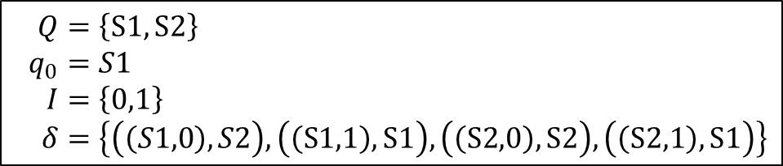
Finite State Machines
Example:
$$Q=\left\{S1, S2\right\} \\ q_{0}=S1 \\ I=\left\{0,1\right\} \\ δ=\left\{\left(\left(S1,0\right),S2\right), \left(\left(S1,1\right),S1\right), \left(\left(S2,0\right),S2\right), \left(\left(S2,1\right),S1\right)\right\}$$
Example Input: 1001101
Which is the last state given this input?
Rosen, Kenneth. Discrete Mathematics and Its Applications, 7th Edition. McGraw-Hill, 2012

Slide 9
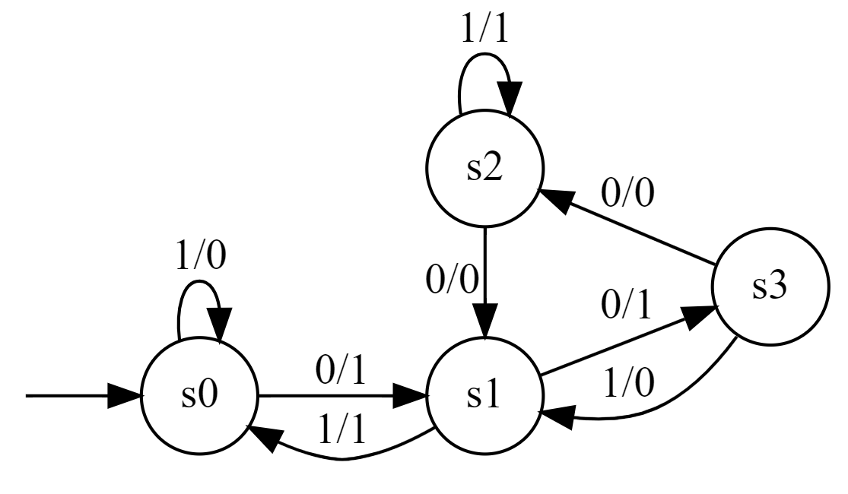
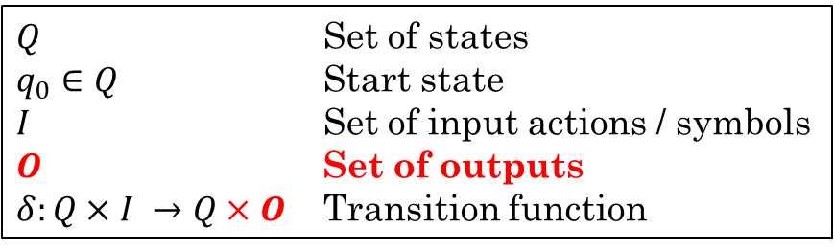

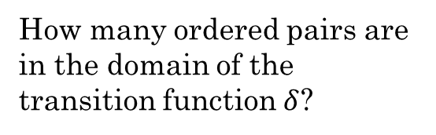

FSM with Output
Some FSMs produce output from an output alphabet or output set.
The output is determined based on the current state and the current input.
$Q$ Set of states
$q_{0}∈Q$ Start state
$I$ Set of input actions / symbols
$O$ Set of outputs
$δ:Q×I →Q×O$ Transition function
Example:
$$Q=\left\{s0, s1, s2, s3\right\} \\ q_{0}=s0 \\ I=\left\{0,1\right\} \\ O=\left\{0,1\right\} \\ δ=$$
How many ordered pairs are in the domain of the transition function $δ$?
$$\{ \\ \left(s0,0\right)→\left(s1,1\right), \\ \left(s0,1\right)→\left(s0,0\right), \\ \left(s1,0\right)→\left(s3,1\right), \\ \left(s1,1\right)→\left(s0,1\right), \\ \left(s2,0\right)→\left(s1,0\right), \\ \left(s2,1\right)→\left(s2,1\right), \\ \left(s3,0\right)→\left(s2,0\right), \\ \left(s3,1\right)→\left(s1,0\right) \\ \}$$
Draw this FSM
What would be the output on the input of 1010101?
0111111
Input of 1100101?
0011010

Slide 10
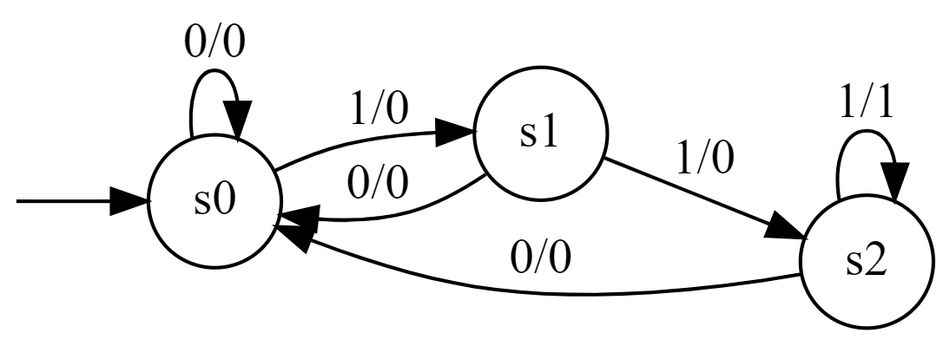
FSM with Output
Imagine a coding scheme in which the receiver of a message knows there has been a transmission error whenever three consecutive 1s appear. Let's build an FSM that will output a 1 whenever it detects three consecutive 1s and a 0 otherwise.
An FSM can only remember its current state. So how many states will we need to "remember" three bits?
Three
Let's draw it.
What would be the output on the input of 101101?
000000
On an input of 101110?
000010
Rosen, Kenneth. Discrete Mathematics and Its Applications, 7th Edition. McGraw-Hill, 2012

Slide 11
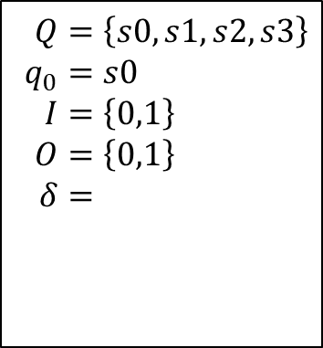
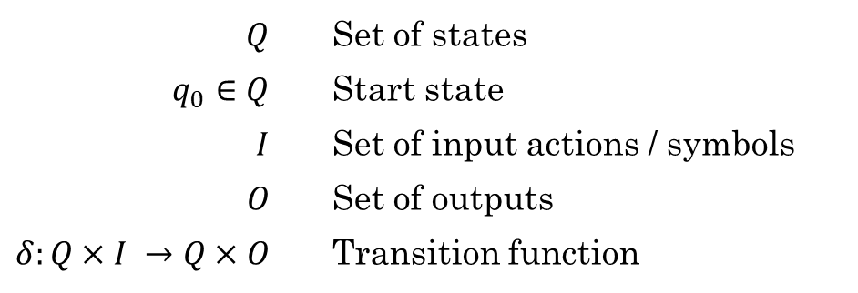
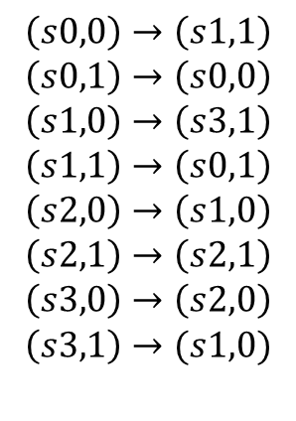
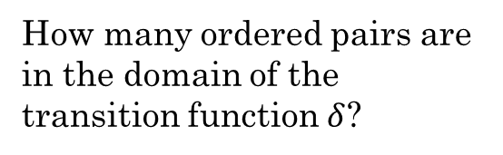
FSM with Output
Some FSMs produce output from an output alphabet or output set.
The output is determined based on the current state and the current input.
$Q$ Set of states
$q_{0}∈Q$ Start state
$I$ Set of input actions / symbols
$O$ Set of outputs
$δ:Q×I →Q×O$ Transition function
Example:
How many ordered pairs are in the domain of the transition function $δ$?
$$Q=\left\{s0, s1, s2, s3\right\} \\ q_{0}=s0 \\ I=\left\{0,1\right\} \\ O=\left\{0,1\right\} \\ δ=$$
$$Q$$ | Set of states
$$q_{0}∈Q$$ | Start state
$$I$$ | Set of input actions / symbols
$$O$$ | Set of outputs
$$δ:Q×I →Q×O$$ | Transition function
$$\left(s0,0\right)→\left(s1,1\right) \\ \left(s0,1\right)→\left(s0,0\right) \\ \left(s1,0\right)→\left(s3,1\right) \\ \left(s1,1\right)→\left(s0,1\right) \\ \left(s2,0\right)→\left(s1,0\right) \\ \left(s2,1\right)→\left(s2,1\right) \\ \left(s3,0\right)→\left(s2,0\right) \\ \left(s3,1\right)→(s1,0)$$

Slide 12
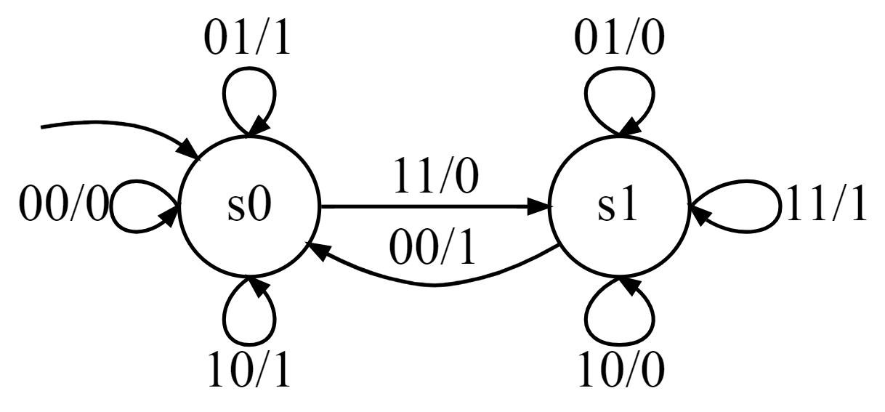


Example: Add two binary numbers
$$Q=\left\{s0, s1\right\} \\ q_{0}=s0 \\ I=\left\{00,01,10,11\right\} \\ O=\left\{0,1\right\} \\ δ=$$
$$\{ \\ \left(s0,00\right)→\left(s0,0\right), \\ \left(s0,01\right)→\left(s0,1\right), \\ \left(s0,10\right)→\left(s0,1\right), \\ \left(s0,11\right)→\left(s1,0\right), \\ \left(s1,00\right)→\left(s0,1\right), \\ \left(s1,01\right)→\left(s1,0\right), \\ \left(s1,10\right)→\left(s1,0\right), \\ \left(s1,11\right)→\left(s1,1\right) \\ \}$$
What is the result of adding these two numbers:
0110
0011
This FSM takes an input consisting of 2 bits at a time and outputs one bit. Now we can add two binary numbers.
1001
Rosen, Kenneth. Discrete Mathematics and Its Applications, 7th Edition. McGraw-Hill, 2012

Slide 13
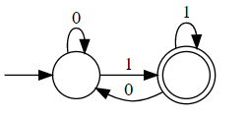
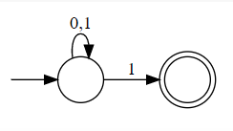
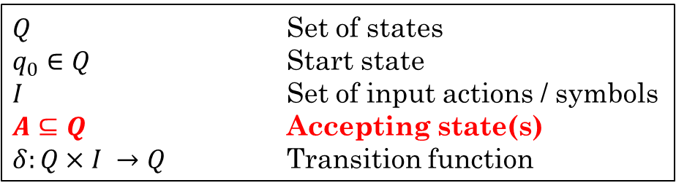
FSMs that Recognize Properties
Some FSMs recognize whether a sequence of inputs has a particular property.
Instead of producing an output, these FSMs have one or more accept states.
If an input string ends on an accept state, we say the input has the property recognized by the FSM, or that the input is a valid string in the language of the FSM.
Can be used to represent a regular language in a graphical way.
Example:
The language of all bitstrings that end with a 1:
"01", "11", "11111", "01010101", ...
Regular expression: (0|1)*1
$Q$ Set of states
$q_{0}∈Q$ Start state
$I$ Set of input actions / symbols
$A⊆Q$ Accepting state(s)
$δ:Q×I →Q$ Transition function
These types of FSMs are also known as Finite State Automata
colab notebook

Slide 14
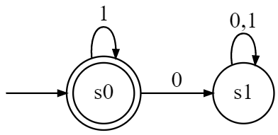
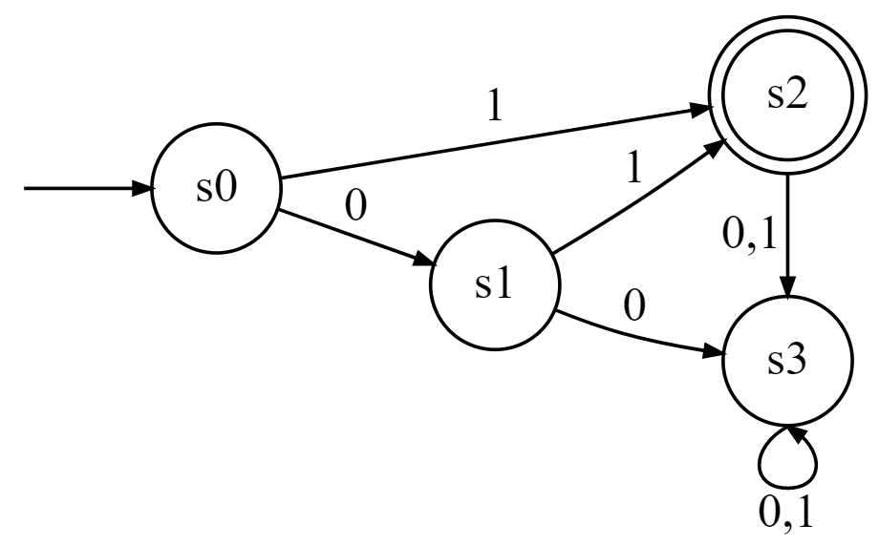

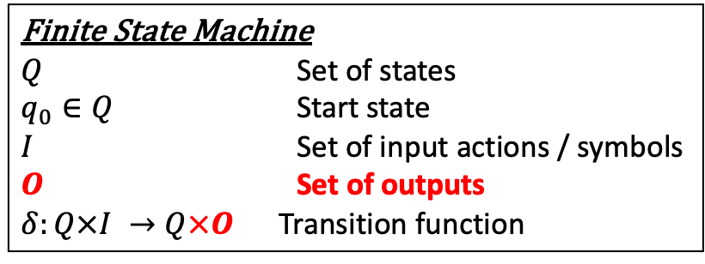
Finite State Automata
Finite State Machine
$Q$ Set of states
$q_{0}∈Q$ Start state
$I$ Set of input actions / symbols
$O$ Set of outputs
$δ:Q×I →Q×O$ Transition function
Do not produce output.
Have a set of final states (accepting states).
Accepting states are shown using a double circle.
Finite State Automata
$Q$ Set of states
$q_{0}∈Q$ Start state
$I$ Set of input actions / symbols
$A⊆Q$ Accepting state(s)
$δ:Q×I →Q$ Transition function
Describe the language recognized by these finite state automata.
All bitstrings that contain only 1s
The bitstrings {1, 01}

Slide 15
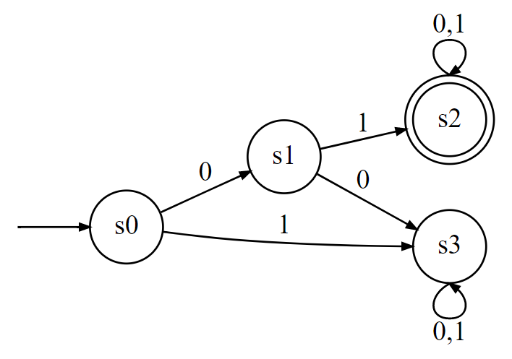
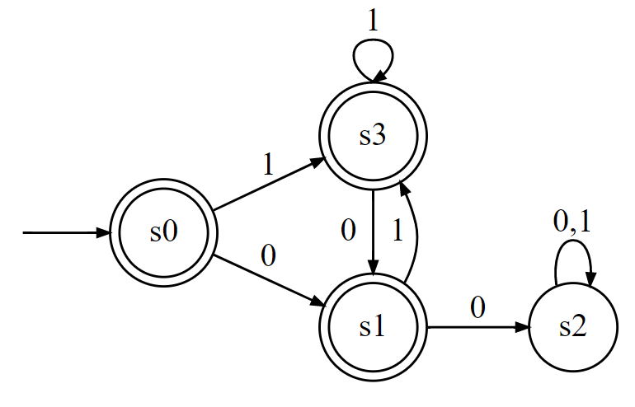
Finite State Automata
Draw these two finite state automata:
1. The set of bitstrings that begin with 01
2. The set of bitstrings that do not contain two consecutive 0s

Slide 16
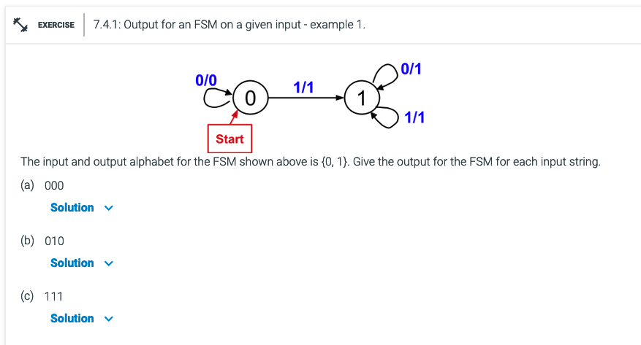
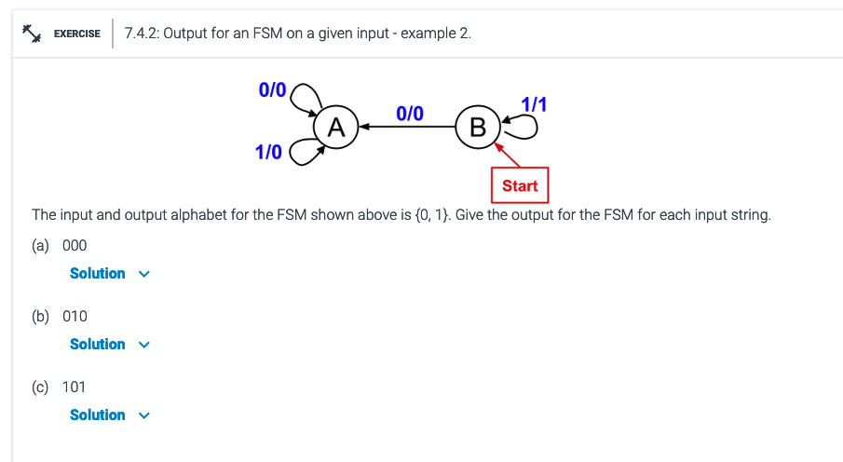
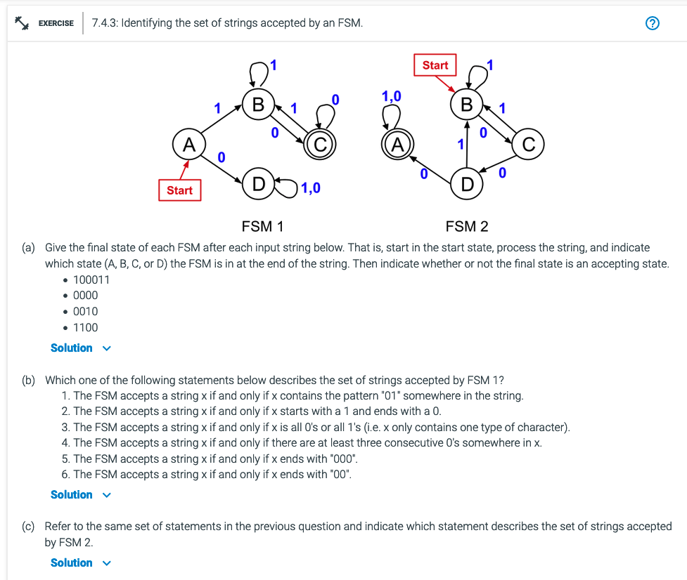
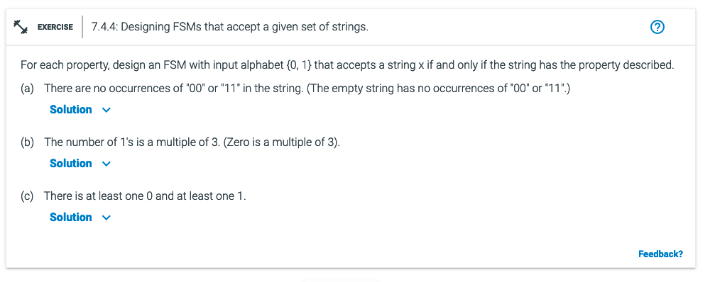
Additional Exercises:
7.4.1
7.4.3
7.4.4

Slide 17
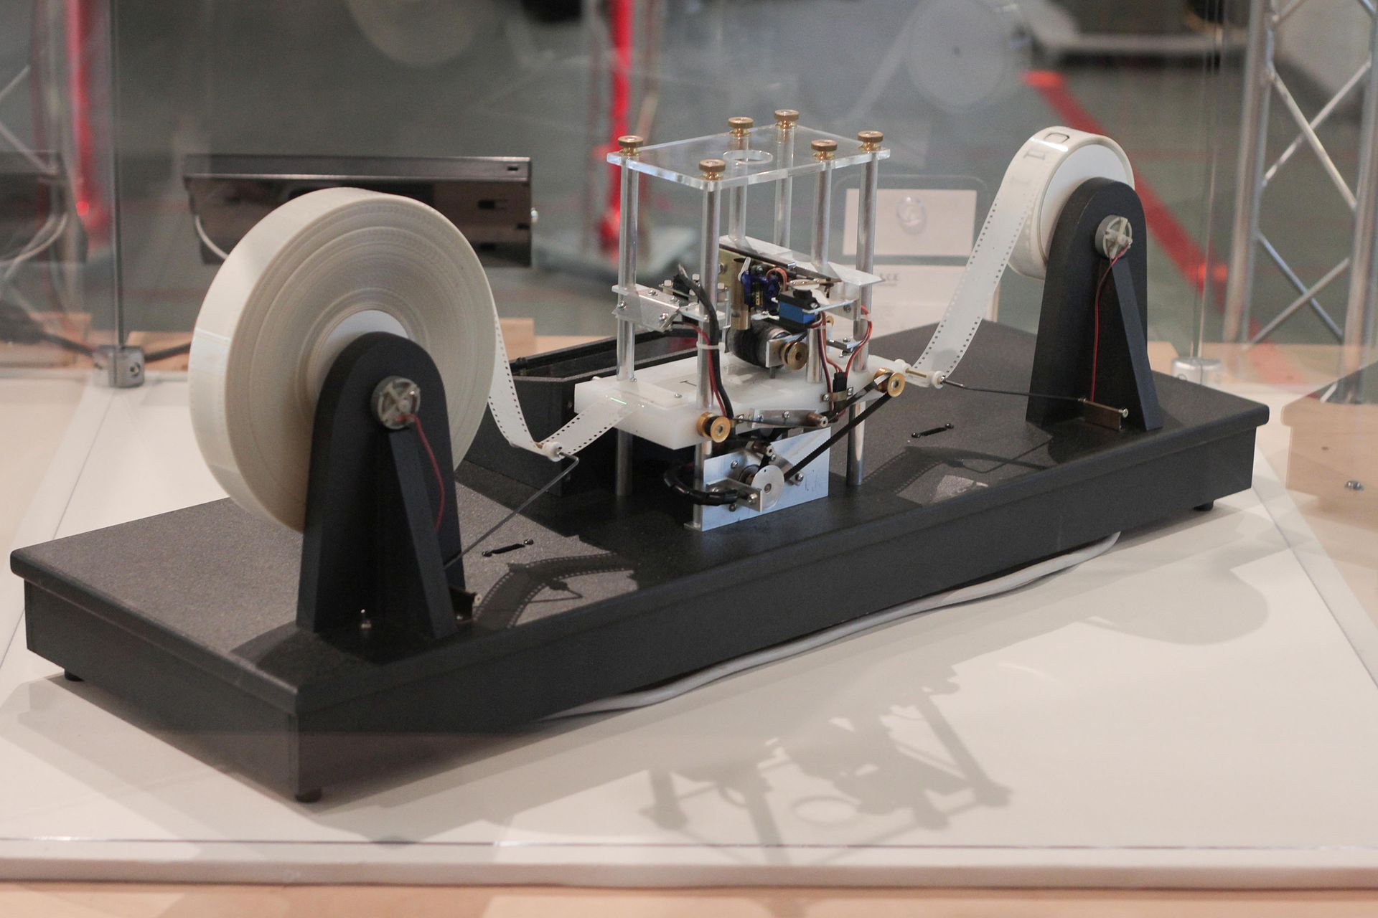
Turing Machines
A mathematical model of computation that describes an abstract machine.
Can perform any computation a real-world computer can do.
Turing proved there are some computations not possible for a computer to do. (The Halting Problem)
Turing Completeness describes the ability of a computer language to simulate a Turing machine. Most programming languages are Turing complete, ignoring the limitations of finite memory.
Infinite memory using a memory tape.
Finite set of symbols called the alphabet.
Read head.
State.
Finite table describing what to do for a given state and symbol.
Rocky Acosta, CC BY 3.0 via Wikimedia Commons

Slide 18
Turing Machines Explained – Computerphile
The Halting Problem: The Unsolvable Problem

Slide 19
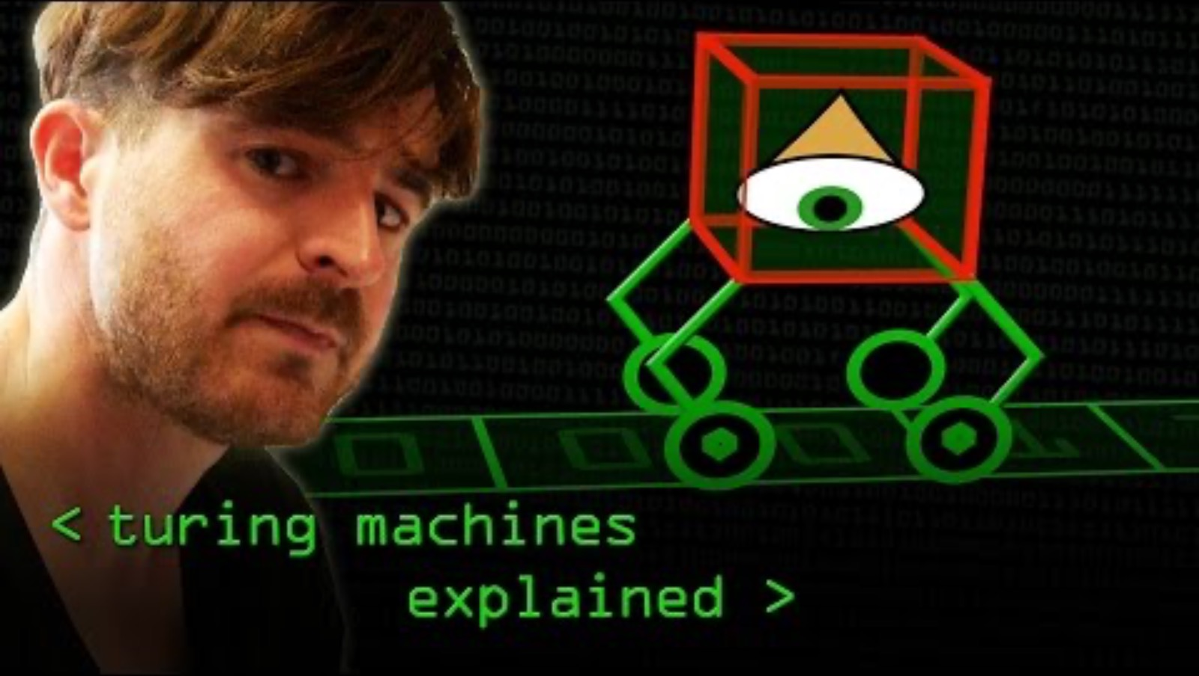
Turing Machines explained

Slide 20

The Halting Problem

Slide 21
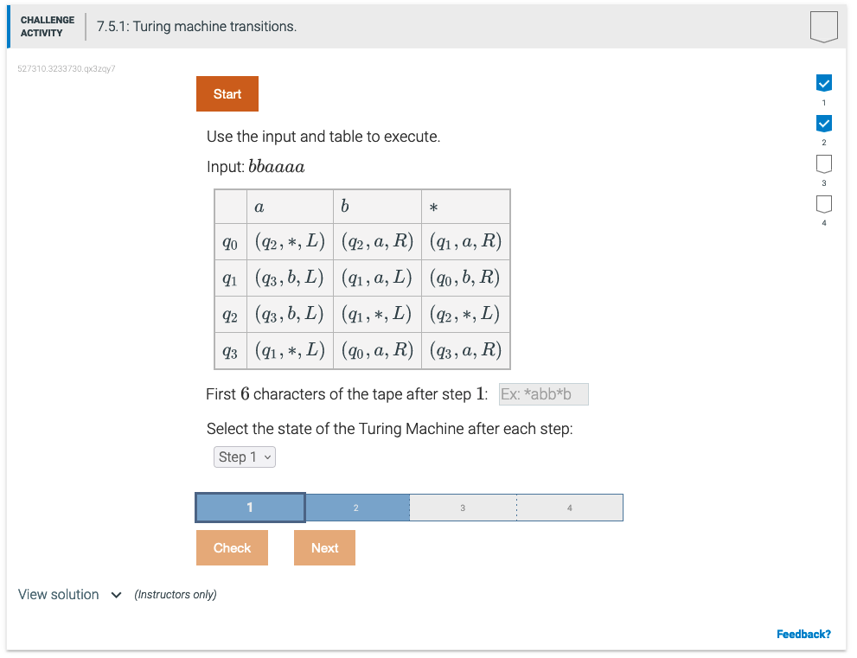
Additional Exercises
7.5.1
https://learn.zybooks.com/zybook/BYUICSE280Winter2024/chapter/7/section/5

