Slide 1
Which Comes next?
OTTFFS???
MTWTFS?
JFMAM?
MVEMJ???
=9
Which number comes next in the series?
312, 267, 222, 177, ?
90, 74, 66, 62, ?
=16
=?

Slide 2
Sequences & Summations
8.1-8.2
8.3
8.8, 8.10

Slide 3




Sequences
Ordered list of elements
Special function in which domain is a set of consecutive integers (e.g., 1, 2, 3, 4, ...)
Many different sequences used in discrete mathematics
Finite (a_{n}), Inifinate (a_{n+2}, …)
We study them and try to find a way to express them
Examples:
0, 1, 4, 9, 16, 25, 36, ... Explicit formula
0, 1, 8, 27, 64, 125, ...
1, 2, 4, 8, 16, 32, 64, ...
1, 1, 2, 6, 24, 120, 720, ...
0, 1, 1, 2, 3, 5, 8, 13, ...
$$a_{n}^{2}$$
$$a_{n}^{3}$$
$$2^{n}$$
$$a_{n}!$$
$$a_{n}=a_{n−1}+a_{n−2}, for n>1 and a_{0}=0, a_{1}=1$$

Slide 4

Sequences
Arithmetic progression:
$a, a+d, a+d+d, a+d+d+d, …$
$a,a+d, a+2d, a+3d, …,a+nd$
In general, each term is of the form:
$a+nd$
We can also write it in terms of the previous term:
$a_{n+1}=a_{n}+d$
Geometric progression:
$a, ar, ar^{2},ar^{3},…, ar^{n}$
$ar^{n}$
$a_{n+1}=a_{n} ∗ r$

Slide 5
Two special types of sequence
Arithmetic progression
1, 3, 5, 7, 9, ...
0, 7, 14, 21, ...
Geometric progression
1, 2, 4, 8, 16, 32, ...
1, 5, 25, 125, 625, ...

Slide 6

Arithmetic progression
A sequence of numbers separated by a fixed common difference.
Interval = 1: 1, 2, 3, 4, 5, ...
Interval = 2: 1, 3, 5, 7, 9, ...
Interval = 5: 1, 6, 11, 16, 21, ...
Interval = 5: 0, 5, 10, 15, 20, ...
How would you do this in Python?
range(start, stop, step)
Example
$a_{n}=a_{0}+n⋅d, for n≥0$

Slide 7

Geometric progression
A sequence of numbers separated a common ratio.
Multiple = 1: 1, 2, 3, 4, 5, ...
Multiple = 2: 3, 6, 12, 24, ...
Multiple = 2: 1, 2, 4, 8, 16, 32, ...
Multiple = 3: 1, 3, 9, 27, 81, ...
Multiple = 3: 4, 12, 36, 108, 324, ...
Multiple = 5: 0, 5, 25, 125, 625, ...
How would you do this in Python?
[a_0 * r**n for n in range(0, end)]
$a_{n}=a_{0}⋅r^{n} for n≥0$
Example

Slide 8
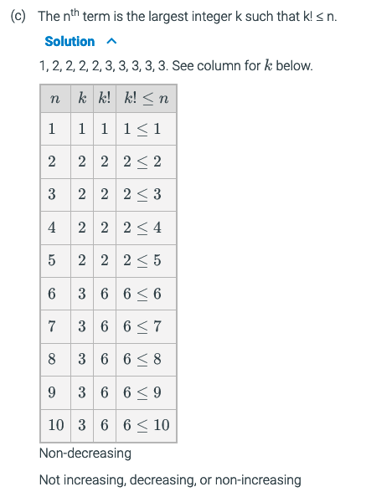
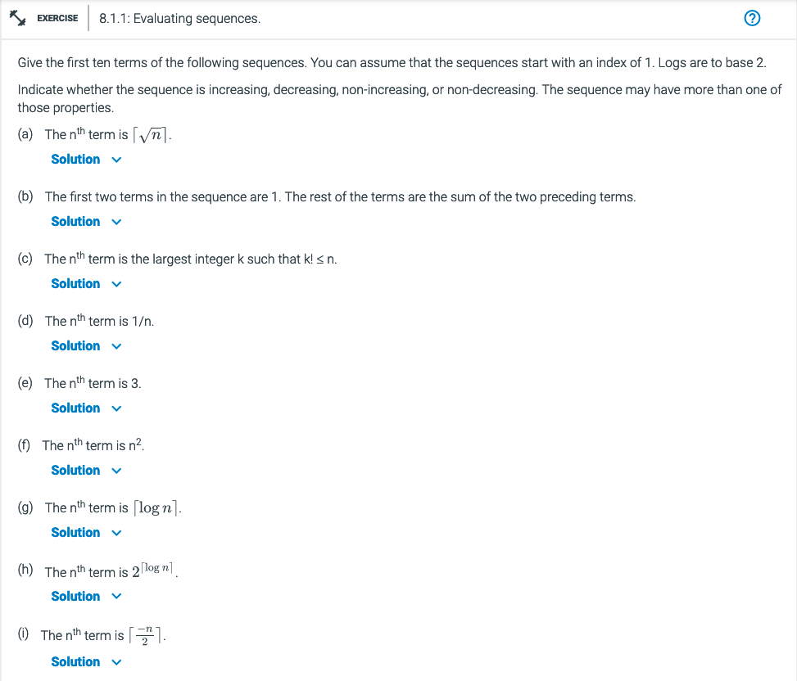
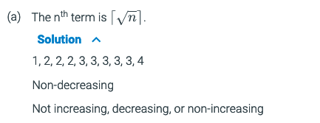
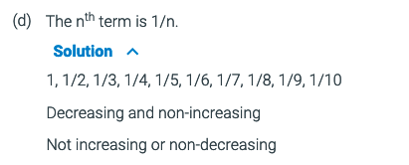
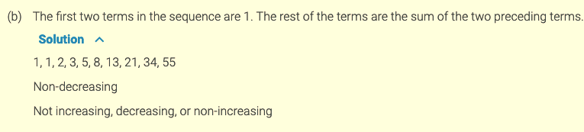
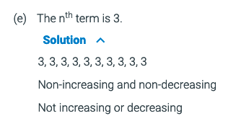
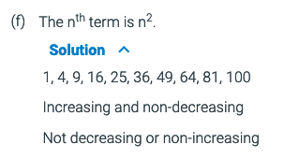
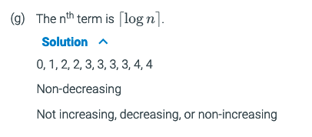
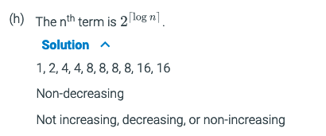
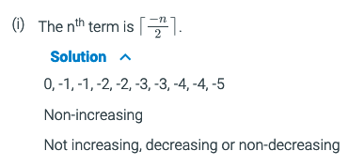
8.1.1
What is the seq?
Characteristics
Increasing (>)
Decreasing (<)
Non-Increasing (>=)
Non-descreasing (<=)

Slide 9
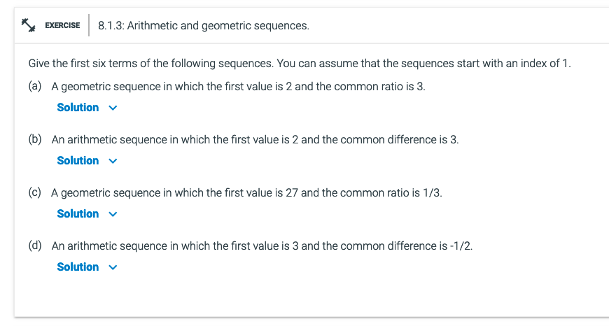
8.1.3
A) 2, 6, 18, 54, 162, 486
B) 2, 5, 8, 11, 14, 17
C) 27, 9, 3, 1, 1/3, 1/9
D) 3, 5/2, 2, 3/2, 1, 1/2

Slide 10
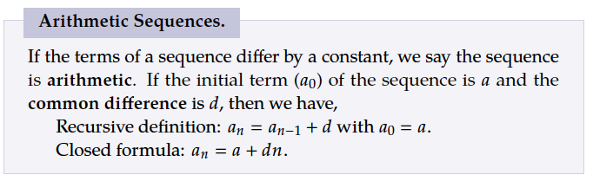

Recurrence Relations
Progression work both way, forwards and backwards.
Defines the next term in a sequence using earlier terms in the sequence.
Arithmetic sequence as a recurrence relation:
$a,a+d, a+2d, a+3d, …,a+nd$
Each term looks like: $a+nd$
To define a recurrence relation, we rewrite to define each term in terms of the previous terms
$a_{n}=a_{n−1}+d, for n≥1$
And we need to add a base case to define the very first term:
$a_{0}=a$

Slide 11
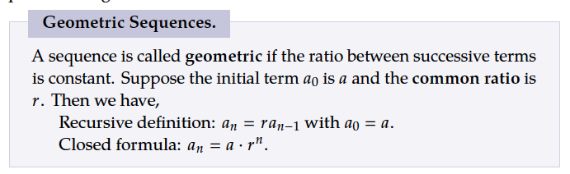

Recurrence Relations
Defines the next term in a sequence using earlier terms in the sequence.
Geometric sequence as a recurrence relation:
$a, ar, ar^{2},ar^{3},…, ar^{n}$
Each term looks like: $a⋅r$
To define a recurrence relation, we rewrite to define each term in terms of the previous terms
$a_{n}=a_{n−1}⋅r, for n≥1$
And we need to add a base case to define the very first term:
$a_{0}=a$

Slide 12
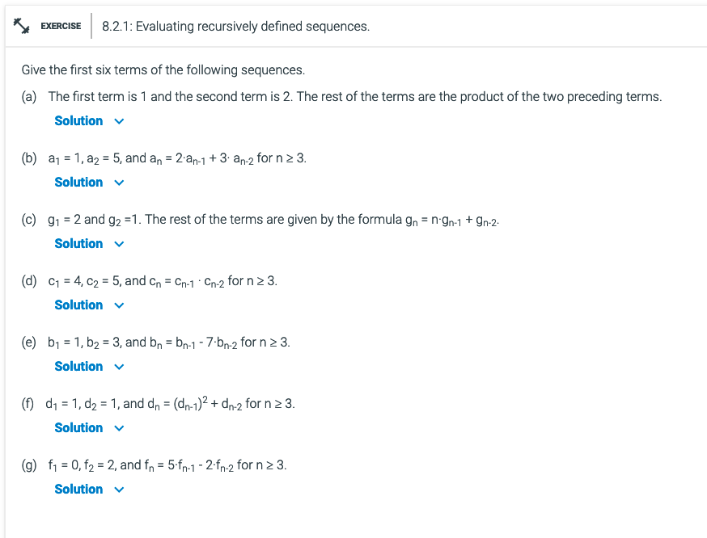
8.2.1
A) 1, 2, 2, 4, 8, 32
B) 1, 5, 13, 41, 121, 365
C) 2, 1, 5, 21, 110, 681
D) 4, 5, 20, 100, 2000, 200000
E) 1, 3, -4, -25, 3, 178
F) 1, 1, 2, 5, 27, 734
G) 0, 2, 10, 46, 210, 958

Slide 13
Day 2

Slide 14


Review - Sequences
Arithmetic progression
Geometric progression
Recurrence Relations
Sliding window
$a_{n}=a_{0}+n⋅d, for n≥0$
$a_{n}=a_{0}⋅r^{n} for n≥0$

Slide 15
Summations

Slide 16

Summations
$$\sum_{i=1}^{4}{i}=1+2+3+4=10$$
In Python:
sum(range(1,5))
reduce(add, range(1,5))
reduce(lambda a,b: a+b, range(1,5))
Examples

Slide 17

Summations
$$\sum_{i=1}^{4}{i^{2}}$$
sum([i**2 for i in range(1,5)])
or
reduce(add, map(lambda i: i**2, range(1,5)))

Slide 18

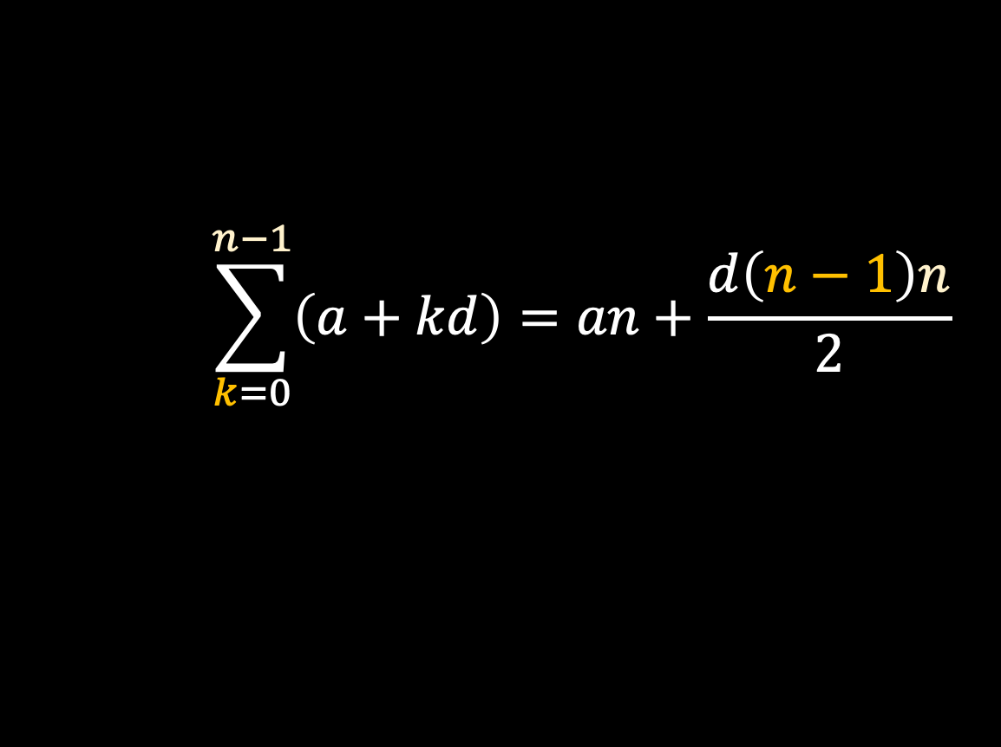
Summations – Closed Forms
Closed form arithmetic sequence:
$$\sum_{k=0}^{n−1}{\left(a+kd\right)=an+\frac{d\left(n−1\right)n}{2}}$$
Closed form geometric sequence:
$$\sum_{k=0}^{n−1}{\left(a⋅r^{k}\right)=\frac{a\left(r^{n}−1\right)}{r−1}}$$

Slide 19

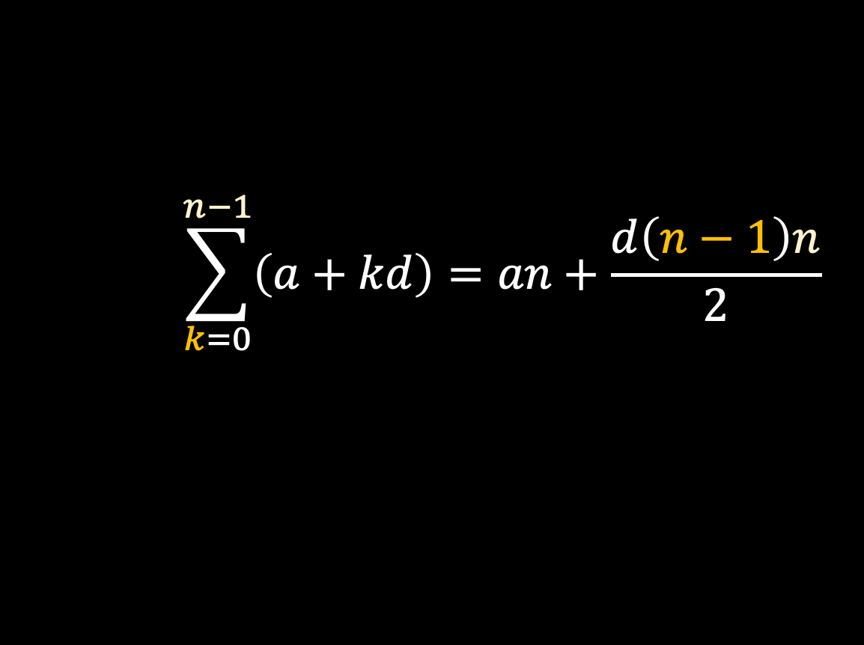

Product Sequence - Review
$$\sum_{k=0}^{n−1}{\left(a+kd\right)=an+\frac{d\left(n−1\right)n}{2}}$$
$$\sum_{i=1}^{4}{i}=1+2+3+4=10$$
$$\prod_{i=1}^{4}{i=1∗2 ∗3 ∗4=24 }$$
$$\sum_{k=0}^{n−1}{\left(a⋅r^{k}\right)=\frac{a\left(r^{n}−1\right)}{r−1}}$$
?

Slide 20
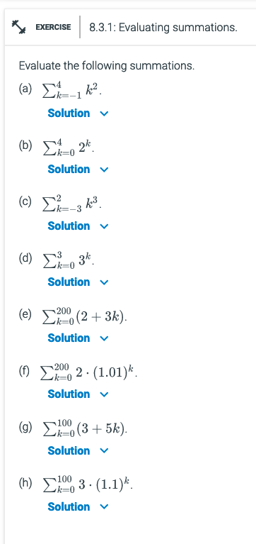


8.3.1
Evaluate the following summations.
A) (-1)² + 0² + 1² + 2² + 3² + 4² = 31
B) 2⁰ + 2¹ + 2² + 2³ + 2⁴ = 31
C) (-3)³ +(-2)³ +(-1)³ + 0³ + 1³ + 2³ = -27 - 8 - 1 + 0 + 1 + 8 = -27
D) 3⁰ + 3¹ + 3² + 3³ = 40
E)
F)
G)
H)

Slide 21
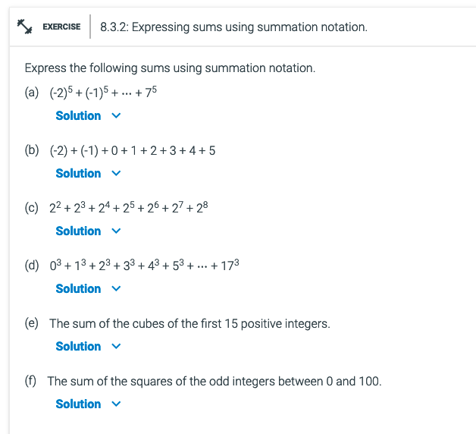
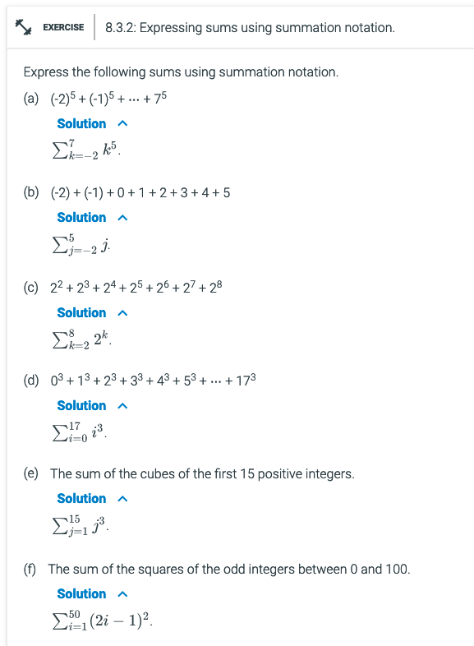

Slide 22
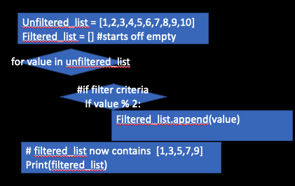
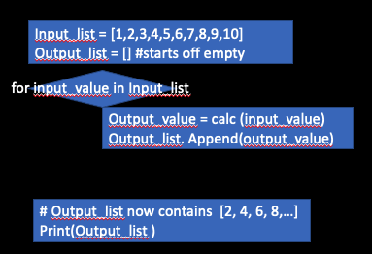
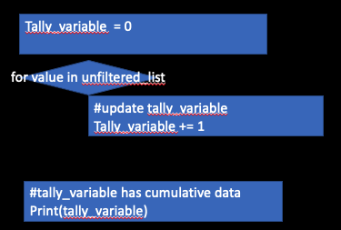
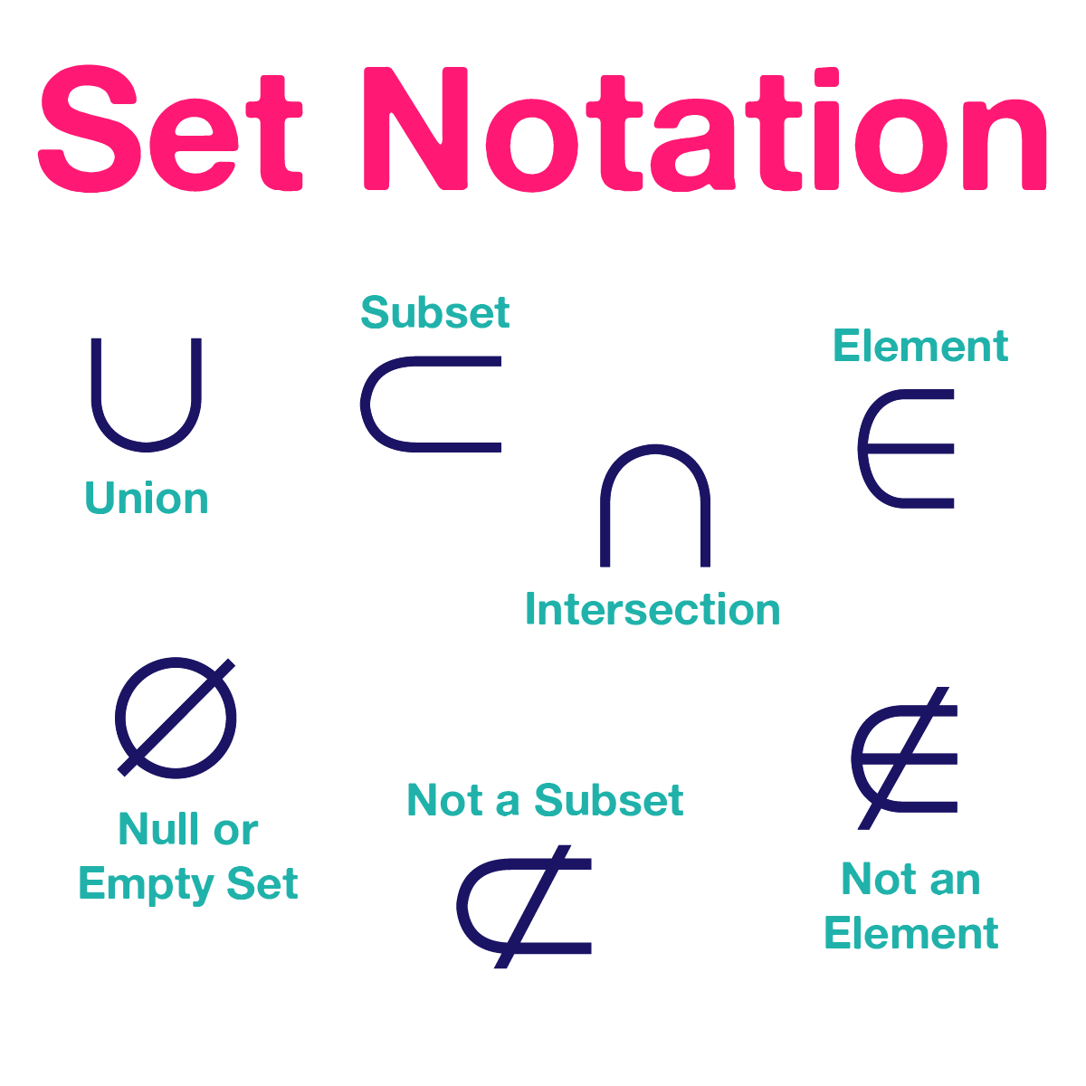
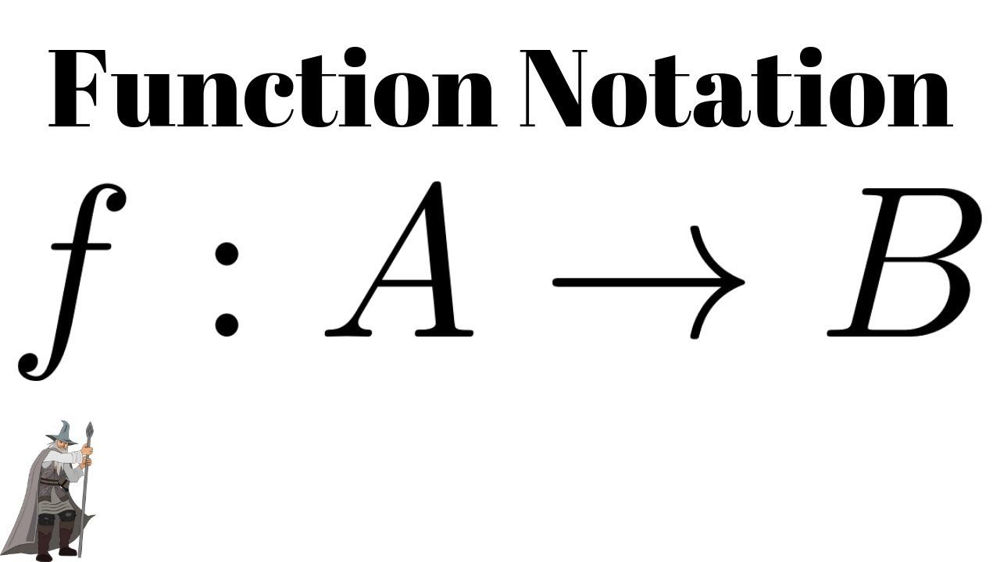


Slide 23
Additional Exercises:
8.1.1
8.1.3
8.2.1 (use python)
8.3.1 (use python)
8.3.2

Slide 24
Recursive
Day 3

Slide 25
Recursive definitions
There are for types of functions (Induction) Exit strategy
For, foreach 0…n n
While 0…? False; Boolean expression
Do…while 1…? 1+ False; Boolean expression
Recursive Functions that calls itself with a smaller subset
i.e. factoral function f(n) = n! = n*(n-1); n<= 0
Basis Must have a end point i.e. n<=0
Recursive rule i.e.: (n-1)

Slide 26
When to use recursion?
For, foreach 0…n n
While 0…? False; Boolean expression
Do…while 1…? 1+ False; Boolean expression
Recursion n…0 Backwards
Define using set notation or algorithmic
Immutable
Uses:
Trees - searches
Summations, Sequences
Elements of algorithm
Name
Contract
Input
Output
Procedures
Exit Criteria A₀
Function calls
Return
Alphabet: P = { }
Derived set: P’ ?
Base case: {ƛ, ?} ∈ P’
Recursive rules: if x ∈ P,’ then
??? ∈ P’

Slide 27
Defining a recursive Function
Two types of definition templates
Elements of algorithm
Name: Function (x)
Contract
Input
Output
Procedures
Exit Criteria A₀
Function calls
Return
Function (s)
Alphabet: P = { }
Derived set: P’ ?
Base case: {ƛ, ?} ∈ P’
Recursive rules: if x ∈ P,’ then
??? ∈ P’

Slide 28
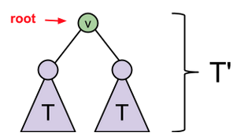

Recursion in …
Function (s)
Alphabet: P = { }
Derived set: P’ ?
Base case: {ƛ, ?} ∈ P’
Recursive rules: if x ∈ P,’ then
??? ∈ P’
Alphabet: P = { }
Derived set: B’(prime, subset), B⁺(1+), B*(0+), or results
Base case:
- starting point
empty* or initial values⁺
Recursive rule: The loop
B set of possible values (prime’, one or more+, zero or more*)
Use of a variable
x is the substring of larger elements members
append to alphabet or another variable
ƛ -> ƛ 0 -> {ƛ, 0 }
ƛ -> ƛ 1 -> { ƛ, 1 }

Slide 29
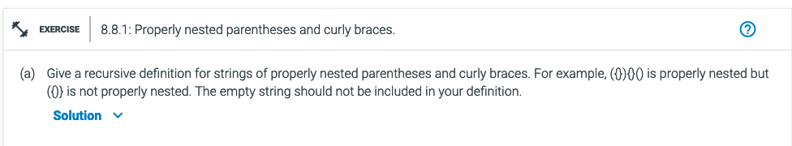
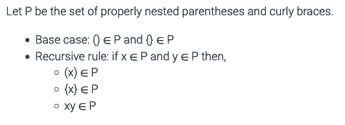
Function (s)
Alphabet: P = { }
Derived set: P’ ?
Base case: {ƛ, ?} ∈ P’
Recursive rules: if x ∈ P,’ then
??? ∈ P’
Alphabet Set: B
Derived set: B’(prime, subset), B⁺(1+), B*(0+), or results
Base case: empty* or initial values⁺
Recursive rules : if x ∈ B(derived set) (the following rules also apply)
Set rules using variable, x, set notation (∈), and Derived Set
i.e.
Alphabet: P = {‘}’,’{‘,’(‘,’)’}
Derived set: P’ are Nested
Base case: () ∈ P’ and {} ∈ P’
Recursive rules: if x ∈ P,’ then
(x) ∈ P’
{x} ∈ P’
Right and left use also another variable y ∈ P’
xy ∈ P’

Slide 30
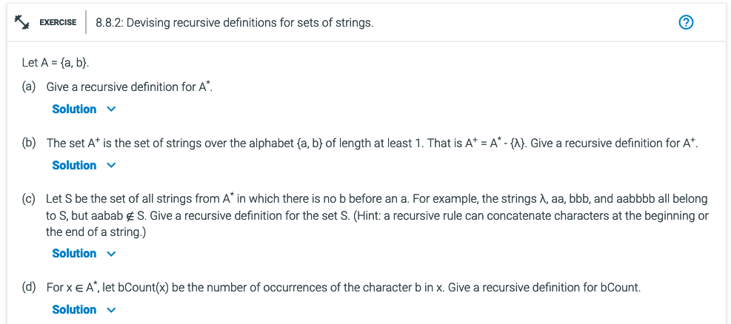
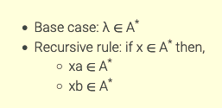
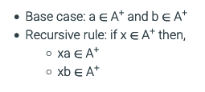
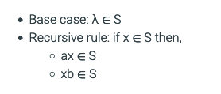
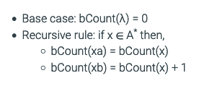
Function(s)
Alphabet: P = { }
Derived set: P’ ? B’(subset), B⁺(1+), B*(0+), or results
Base case: {ƛ, ?} ∈ P’
Recursive rules: if x ∈ P,’ then
Append (front or back) or call a function ∈ P’
Order matters with this one, difference between xa ∈A vs ax ∈A
Instead of a value (a), you can put a function results. i.e. Base case: bCount(ƛ) = 0

Slide 31
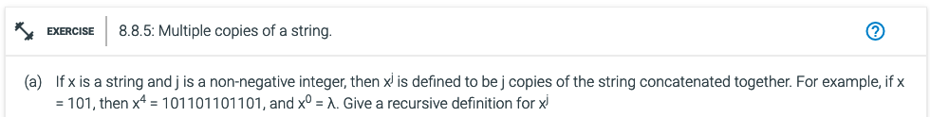
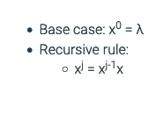
Fucntion(s)
Alphabet: P = { }
Derived set: P’ ?
Base case: {ƛ, ?} ∈ P’
Recursive rules: if x ∈ P,’ then
??? ∈ P’
X⁰ =
X¹ =
X² =
X³ =
X⁴ =
Function (x)
Base: ƛ ∈ P’
Recursive: if y ∈ P’, then
ƛx ∈ P’
xx ∈ P’
Function (x)
Base: ƛ ∈ P’
Recursive: if y ∈ P’, then
yx ∈ P’

Slide 32
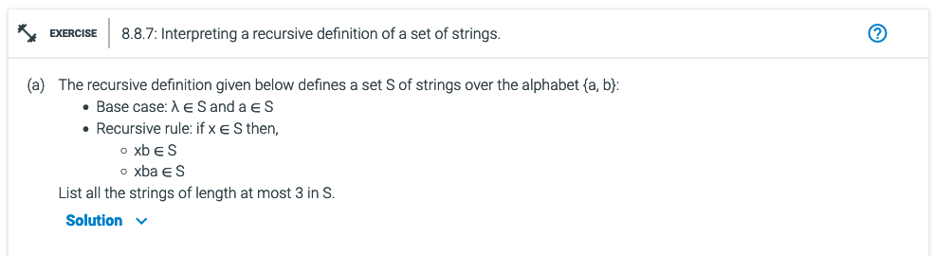
Function(s)
Alphabet: P = { }
Derived set: P’ ?
Base case: {ƛ, ?} ∈ P’
Recursive rules: if x ∈ P,’ then
??? ∈ P’
x
ƛ
a
b
ba
ab
aba
bb
bba
bab
baba
abb
abba
bbab
bbabba
bbb
bbab
babb
babab
abbb
abbab
bbabb
bbabbab
bbba
bbabba
babba
bababa
abbba
abbaba
bbabba
bbabbaba

Slide 33
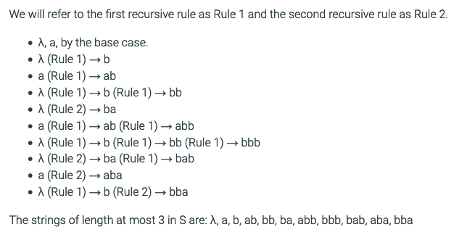
Function(s)
Alphabet: P = { }
Derived set: P’ ?
Base case: {ƛ, ?} ∈ P’
Recursive rules: if x ∈ P,’ then
??? ∈ P’
1
2
3
4
5
6
7
8
9
10
x
1
1
ƛ
a
2
5
3
9
b
ba
ab
aba
4
10
8
6
bb
bba
bab
baba
abb
abba
bbab
bbabba
7
bbb
bbab
babb
babab
abbb
abbab
bbabb
bbabbab
bbba
bbabba
babba
bababa
abbba
abbaba
bbabba
bbabbaba

Slide 34
Recursive algorithms
Function(s)
Alphabet: P = { }
Derived set: P’ ?
Base case: {ƛ, ?} ∈ P’
Recursive rules: if x ∈ P,’ then
??? ∈ P’
Elements of algorithm: Function (s)
Name
Contract
Input What is the input?
Output What is the output? i.e.?
Procedures
Exit Criteria A₀ What is your exit plan?
Function calls What is the process?
Return What are you returning?

Slide 35
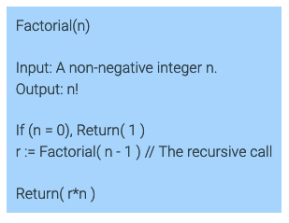
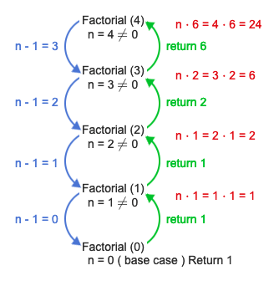
Recursive algorithms
f(n) = n! = n*(n-1); n<= 0
N:
N-1:
N-2:
…
1
0
Elements of algorithm: Function (s)
Name
Contract
Input What is the input?
Output What is the output? i.e.?
Procedures
Exit Criteria A₀ What is your exit plan?
Function calls What is the process?
Return What are you returning?

Slide 36
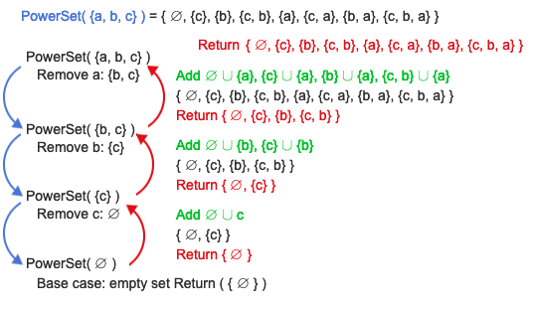
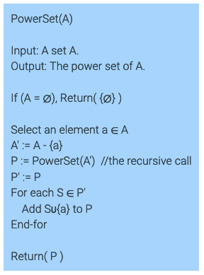
1
I: PowerSet ( {a, b, c} )
N: A’ = A-{a} = {b, c}
N-1: PowerSet( {b,c} )
A’ = A-{a} = {c}
N-2: (1) PowerSet( {c} )
A’ = A-{a} = {}
0 PowerSet (0)
45
68
9
45
68
9
45
68
1
2
3
4
5
6
7
8
9
45
9
3
Elements of algorithm: Function (s)
Name
Contract
Input What is the input?
Output What is the output? i.e.?
Procedures
Exit Criteria A₀ What is your exit plan?
Function calls What is the process?
Return What are you returning?
a and {0, c, b,{c,b}
b and {0, c}
0 and {c}

Slide 37
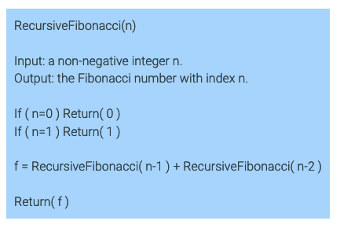
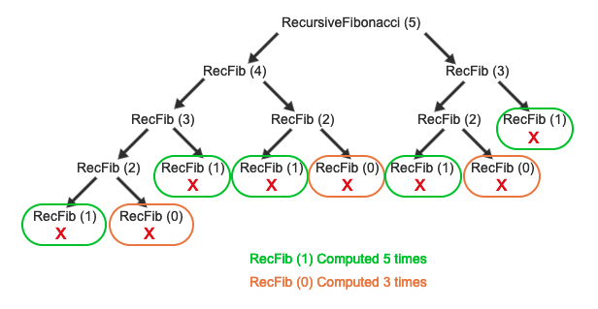
Elements of algorithm
Name
Contract
Input
Output
Procedures
Exit Criteria A₀
Function calls
Return
1, 1, 2, 3, 5, 8, …
RF(5) = RF(4) + RF(3)
RF(5) = RF(3) + RF(2) + RF(3)
RF(5) = RF(2) + RF(1) + RF(2) + RF(3)
RF(5) = RF(1) + RF(0) + RF(1) + RF(2) +RF(3)
RF(5) = 1 + RF(0) + RF(1) + RF(2) +RF(3)
RF(5) = 1 + 0 + RF(1) + RF(2) +RF(3)
RF(5) = 1 + 0 + 1 + RF(2) +RF(3)
RF(5) = 1 + 0 + 1 + RF(1) + RF(0) +RF(3)
RF(5) = 1 + 0 + 1 + 1 + RF(0) +RF(3)
RF(5) = 1 + 0 + 1 + 1 + 0 +RF(3)
RF(5) = 1 + 0 + 1 + 1 + 0 +RF(2) +RF(1)
RF(5) = 1 + 0 + 1 + 1 + 0 +RF(1) +RF(0) +RF(1)
RF(5) = 1 + 0 + 1 + 1 + 0 + 1 +RF(0) +RF(1)
RF(5) = 1 + 0 + 1 + 1 + 0 + 1 + 0 +RF(1)
RF(5) = 1 + 0 + 1 + 1 + 0 + 1 + 0 + 1
RF(5) = 1 + 0 + 1 + 1 + 0 + 1 + 1
RF(5) = 1 + 0 + 1 + 1 + 0 + 2
RF(5) = 1 + 0 + 1 + 1 + 2
RF(5) = 1 + 0 + 1 + 3
RF(5) = 1 + 0 +4
RF(5) = 1 + 4
RF(5) = 5
5 3 2 1 1

Slide 38
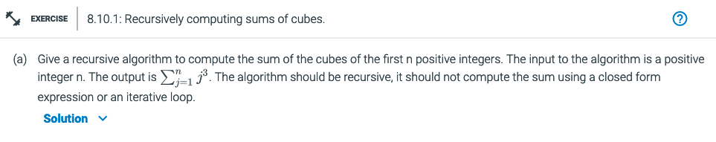
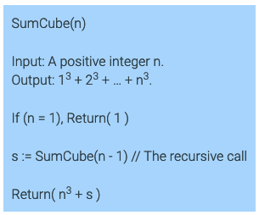
Elements of algorithm: Function(s)
Name
Contract
Input What is the intput?
Output What is the output? i.e.?
Procedures
Exit Criteria A₀ What is your exit plan?
Function calls What is the process?
Return What are you returning?

Slide 39
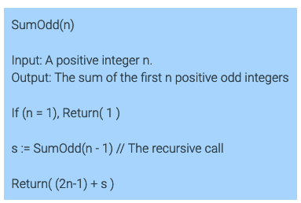
8.10.2: Recursively computing the sum of the first n positive odd integers.
n:
1: 1
2: (2[2]-1)+1
3, 1 = 4
2nd odd number: 3
3: (2[3]-1) + 4
5 , 4 = 9
3rd odd number: 5
Give a recursive algorithm which takes as input a positive integer n and returns the sum of the first n positive odd integers.
Elements of algorithm: Function(s)
Name
Contract
Input What is the intput?
Output What is the output? i.e.?
Procedures
Exit Criteria A₀ What is your exit plan?
Function calls What is the process?
Return What are you returning?
sum of the first n positive odd integers
Vs. Sum of odd numbers starting at n

Slide 40
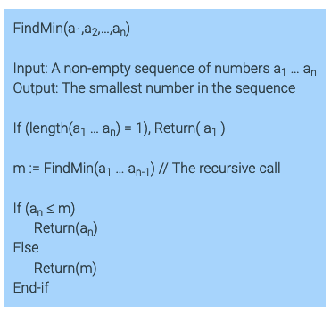
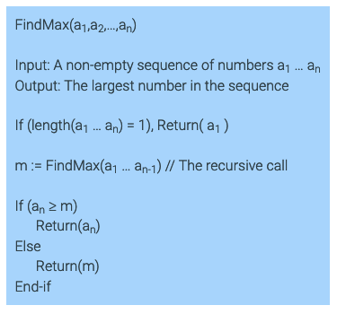
8.10.3: Recursively computing the maximum and minimum of a sequence.
The input to the maximum and minimum problems is a sequence of numbers, a₁ … a_{n}, where n, the length of the sequence, is a positive integer.
The function length(a₁ … a_{n}) returns n,
the length of the sequence. If n > 1,
you can also create a new sequence a₁ … a_{n-1}, which is the original sequence a₁ … a_{n},
with the last number a_{n} omitted.
Give a recursive algorithm which takes as input a sequence of numbers and returns the minimum (i.e., smallest) number in the sequence. Your algorithm should not use an iterative loop.
Give a recursive algorithm which takes as input a sequence of numbers and returns the maximum (i.e., largest) number in the sequence. Your algorithm should not use an iterative loop.
Elements of algorithm: Function(s)
Name
Contract
Input
Output
Procedures
Exit Criteria A₀
Function calls
Return

