Slide 2
Number Theory
The study of integers
9.1-9.2 Division Algorithm & Modular Arithmetic
9.3-9.4 Prime factorization & Factoring & Primality testing
9.5 Greatest Common Divisor & Euclid’s algorithm

Slide 3
How do you when a number is divisible by?
2
3
4
5
6
7
8
9
10
11
Even
+digits->3, 6 ,9
even
0, 5
Even & +digits->3, 6 ,9
?
even
+digits-> 9
0
palindrome

Slide 4
Important applications
Division and modular arithmetic
Generating pseudorandom numbers
Check digits
Encryption
Hashing
Assigning memory locations
Arithmetic with LARGE integers. (Too large to be represented easily in a computer)
Prime numbers
Modern cryptography
Rosen, Kenneth. Discrete Mathematics and Its Applications, 7th Edition. McGraw-Hill, 2012

Slide 5

Division
If $a$ and $b$ are integers and $a≠0$, we say that $a$ divides $b$ if there is an integer $c$ such that $b=ac$.
In other words,c = $\frac{b}{a}$ is an integer. There is no remainder.
$a | b$ means $a$(lower number) divides $b$ (larger number)
$3 | 12$ is true because $\frac{12}{3}=4$ with no remainder.
$3 | 13$ is not true because $\frac{13}{3}=4 remainder 1 or 4.33\overline{3}$.

Slide 6
True or False? Where | is integer division
3 | 12
3 | 13
13 | 52
14 | 58
1 | n
n | n
n | 0
0 | n
Example
Neff, Rick, and Gopalakrishnan, Ganesh. First Three Odds Double Halve Divide Reciprocate. CRC Press, 2021

Slide 7

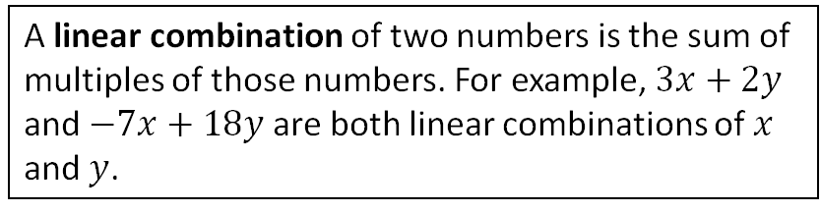

Linear Combinations
A linear combination of two numbers is the sum of multiples of those numbers. For example, $3x+2y$ and $−7x+18y$ are both linear combinations of $x$ and $y$.
If a number $x$ divides two different numbers, $y$ and $z$, then $x$ divides any linear combination of $y$ and $z$.
Let $x$, $y$, and $z$ be integers. If $x|y$ and $x|z$, then $x|(sy + tz)$for any integers $s$ and $t$.
Using quantifiers:
Let $x$, $y$, $z$, $s$, and $t$ be integers. $∀s∀t \left(\left(x\left|y∧x\right|z\right)→\left(x \right|\left(sy+tz\right)\right)$
What does that mean/imply?
- y has two values a*x
- z has two values b*x
Along with s and t in the equation.
Explore in Python

Slide 8
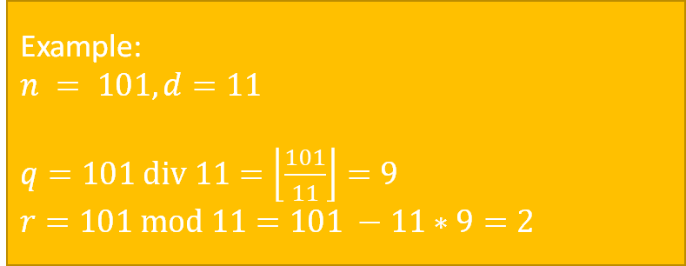



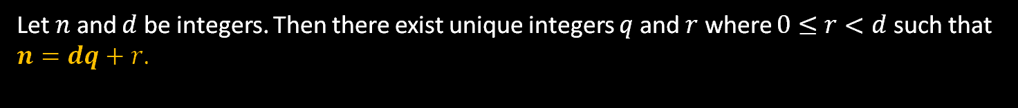
Division Theorem
Dividing an integer by a positive integer produces a quotient $q$ and remainder $r$.
Let $n$ and $d$ be integers. Then there exist unique integers $q$ and $r$ where $0≤r<d$ such that $n=dq+r$.
This is a fancy way of saying that if you divide one integer by another integer, there will be an integer quotient $q$ and a remainder $r$. ($r$ might be $0$)
Example:
$n = 101, d=11$
$q=101 div 11=\left\lfloor \frac{101}{11}\right\rfloor =9$
$r=101 mod 11=101 −11∗9=2$
$$q=n div d=\left\lfloor \frac{n}{d}\right\rfloor$$
$$r=n mod d=n−d\left\lfloor \frac{n}{d}\right\rfloor$$
Python:
q = n // d r = n % d
Rosen, Kenneth. Discrete Mathematics and Its Applications, 7th Edition. McGraw-Hill, 2012

Slide 9










Compute q and r algorithmically
$$q=n div d=\left\lfloor \frac{n}{d}\right\rfloor$$
$$r=n mod d=n−d\left\lfloor \frac{n}{d}\right\rfloor$$
Case 1: n ≥ 0. | Case 2: n < 0.
q := 0 r := n While ( r ≥ d ) q := q + 1 r := r - d End-While | q := 0 r := n While ( r < 0 ) q := q - 1 r := r + d End-While
Use these steps to compute $q$ and $r$ for the following:
$n=29, d=7$
$n=58, d=9$
$q=4, r=$1
$$q=6, r=4$$
$n=−29, d=7$
$n=−58, d=9$
$$q=−5, r=6$$
$$q=−7, r=5$$
Irani, Sandy. Discrete Mathematics, Zyante Inc. (zyBooks.com)

Slide 10
9.1.3 a-d (White Board Exercise)
Compute the value of the following expressions:
(a) 344 mod 5
(b) 344 div 5
(c) (−344) mod 5
(d) (−344) div 5
(e) 215 mod 7
(f) 215 div 7
(g) (−215) mod 7

Slide 11
9.1.4 a-d
Determine the value of n based on the given information.
(a) n div 7 = 11, n mod 7 = 5
(b) n div 5 = -10, n mod 5 = 4
(c) n div 11 = -3, n mod 11 = 7
(d) n div 10 = 2, n mod 10 = 8

Slide 13
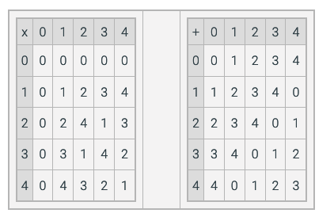




Modular arithmetic
Addition (x+y) mod m
Multiplication (xy) mod m
When performing modular arithmetic, the result is always performed under $mod m$ for some number $m$.
This means the result is always
less than $m$ and
greater than or equal to $0$.
$0≤r<m$
Remainder is always less than the divisor
Example:
$$\left(6+5\right) mod 7 =11 mod 7=4$$
m m < r
Example:
$\left(6∗5\right) mod 7 =30 mod 7=2$
m m < r

Slide 14
Creating a Hash Algorithm
Making random numbers deterministic
Binary Tree
Hash Tree
Pseudo Random Number Generator
Two normal distributions gets you a bell curve, which does seem random.
Linear Congruential Generator

Slide 15

Congruences
a $≡$_{m} b if (a mod m )= (b mod m)
$a≡_{m}b$ $a$ is congruent modulo $m$ to $b$
$a≡b(mod m)$ $a$ is congruent modulo $m$ to $b$
Both $a$ and $b$ have the same remainder when divided by $m$.
Example:
14 and 21 are congruent modulo 7
because $(14 mod 7)=(21 mod 7)=0$
0, 5, 10, 15, 20 are all congruent modulo 5.
So are 1, 6, 11, 16, and 21.

Slide 16
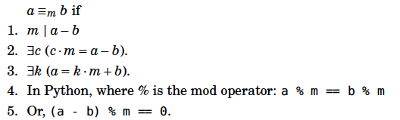

Congruences
Another way to think about it:
$a mod m=b mod m$
0, 12, 24, 36, 48, … are all congruent mod 12
0, 7, 14, 21, 28, … are all congruent mod 7
1, 8, 15, 22, 29… are all congruent mod 7

Slide 17

Equivalence Classes
0, 5, 10, 15, 20 … are all congruent modulo 5.
0, 12, 24, 36, 48, … are all congruent mod 12
0, 7, 14, 21, 28, … are all congruent mod 7
1, 8, 15, 22, 29 … are all congruent mod 7
${\left[a\right]}_{R}=\left\{s | \left(a,s\right)∈R\right\}$
Meaning: If we have an equivalence relation $R$ on set $A$, the set of all elements $s$ related to an element $a$ of $A$ is the equivalence class.
In other words, if we have $(a,b)$ as a pair in $R$, then the set of all $b$ for a given $a$ is the equivalence class of that $a$.
Rosen, Kenneth. Discrete Mathematics and Its Applications, 7th Edition. McGraw-Hill, 2012

Slide 18

Example:
Let $A$ be the set of all students in the class.
Let $R$ be the equivalence relation on $A$ represented by all pairs $(x,y)$ where $x$ and $y$ are at the same table.
List out the pairs $\left(x,y\right)$ for your table. $\{(bob,sam), (sam, bob), (bob, sue), (sue, bob),$
$$(sue, sam), (sam, sue), (bob, bob), (sam, sam), (sue, sue)\}$$
What is ${\left[bob\right]}_{R}$?
${\left[bob\right]}_{R}=\{bob, sam, sue\}$
This subset of $A$ consists of all students at the same table as bob. This is the set of all students equivalent to bob with respect to $R$. This subset is an equivalence class of the relation.

Slide 19

Example:
Let $R$ be the equivalence relation congruence modulo 4 where the domain is $ℤ$.
What is ${\left[0\right]}_{R}$ for 4?
${\left[0\right]}_{4}=\{…, −8, −4, 0, 4, 8, 12, …\}$
What is ${\left[1\right]}_{R}$ for 4?
${\left[1\right]}_{4}=\{…, −7, −3, 1, 5, 9, …\}$
Rosen, Kenneth. Discrete Mathematics and Its Applications, 7th Edition. McGraw-Hill, 2012

Slide 20

${\left[a\right]}_{R}=\left\{s | \left(a,s\right)∈R\right\}$
Example:
Let $R$ be the equivalence relation on $A$ for congruence modulo 5 where $A$is the set of integers defined by range(-20,21).
$${\left[?\right]}_{R}$$
Example
Rosen, Kenneth. Discrete Mathematics and Its Applications, 7th Edition. McGraw-Hill, 2012
Notes:
Use Python to generate the equivalence class ${\left[3\right]}_{5}$

Slide 21


$$n=dq+r$$
Theorem 9.2.2
Computing arithmetic operations mod m.
Let m be an integer larger than 1. Let x and y be any integers. Then,
$[(x mod m) + (y mod m)] mod m = [x + y] mod m$
$[(x mod m)(y mod m)] mod m = [xy] mod m$
$$(xz mod m) =\left(x mod m\right)z$$
This gives some interesting properties:
$$\left[\left(x mod m\right)\left(y mod m\right)\right]mod m = \left[xy\right] mod m \\ [(x mod m)(x mod m)] mod m = [x∗x] mod m$$
$$\left[\left(x mod m\right)\left(x mod m\right)\right]mod m = [x2] mod m$$
$[(x2 mod m)(x2 mod m)] mod m = [x4] mod m$ = (x mod m)⁴
1. (x mod y)^{z} mod y => ( r )^{z} mod y

Slide 22
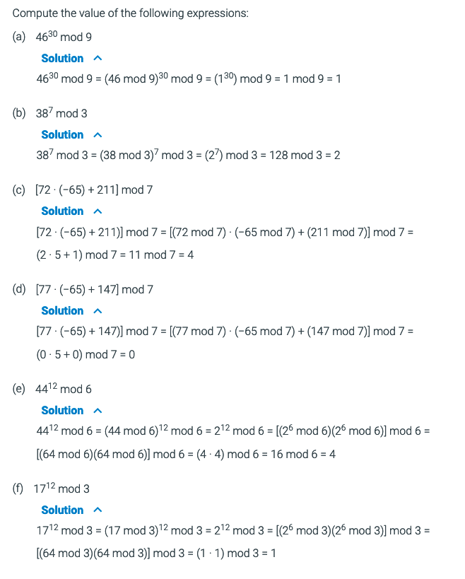
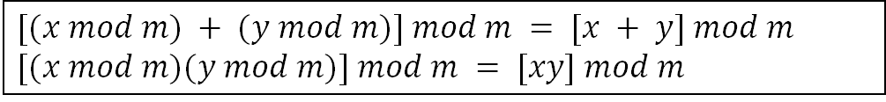

Example
$[(x mod m) + (y mod m)] mod m = [x + y] mod m$
$[(x mod m)(y mod m)] mod m = [xy] mod m$
$$n=dq+r$$
10⁴ mod 8 = [10⁴*1⁴] mod 8
(10 mod 8)⁴
2⁴
16

Slide 23
Example
$[(x mod m) + (y mod m)] mod m = [x + y] mod m$
$[(x mod m)(y mod m)] mod m = [xy] mod m$
$$n=dq+r$$
26 mod 3
(2³*3+2) mod 3
(2³ mod 3)* (3 mod 3) + (2 mod 3)
2 * 0 + 2 = 2
26² mod 3
(2³*3+2)² mod 3
(2³*3)²+2² mod 3 (2³*3+2) mod 3)²
0 + 2² (2)²
4 4
12¹⁸ mod 3 = (12 mod 3)¹⁸ = 4¹⁸

Slide 24
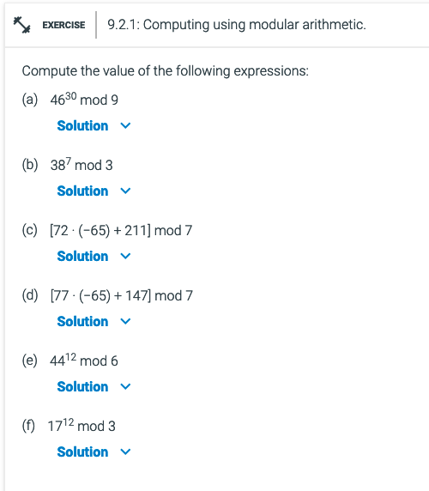
9.2.1
$[(x mod m) + (y mod m)] mod m = [x + y] mod m$
$[(x mod m)(y mod m)] mod m = [xy] mod m$

Slide 25

Computing exponents is a bit different:
Exponents and mod value have to be the same for equivancy
46¹⁰ mod 7 (since anything to power of 10 is in the same congruence)
= (46 mod 7)¹⁰ mod 7
= 4¹⁰ mod 7
4¹ mod 7 = 4
4² mod 7 = (4¹ mod 7) * (4¹ mod 7) = 4 * 4 mod 7 = 16 mod 7 = 2
4⁴ mod 7 = (4² mod 7) * (4² mod 7) = 2 * 2 mod 7 = 4 mod 7 = 4
(4*4*4*4) = 4^{2 *} 4^{2.} =[(4 mod 7 )*(4 mod 7)*(4 mod 7 )*(4 mod 7 )]mod 7
4⁸ mod 7 = (4⁴ mod 7) * (4⁴ mod 7) = 4 * 4 mod 7 = 16 mod 7 = 2
4¹⁰ mod 7 = (4⁸ mod 7) * (4² mod 7) = 2 * 2 mod 7 = 4 mod 7 = 4
remember we can add/subtract exponents
Since 4¹⁰ mod 7 = 4,
then 46¹⁰ mod 7 = 4.
$$\left[\left(x mod m\right)\left(y mod m\right)\right]mod m = \left[xy\right] mod m \\ [(x mod m)(x mod m)] mod m = [x∗x] mod m$$
$$[(x mod m)(x mod m)] mod m = [x2] mod m$$

Slide 26
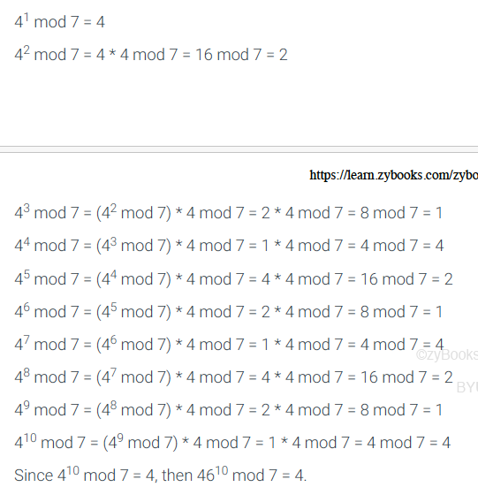
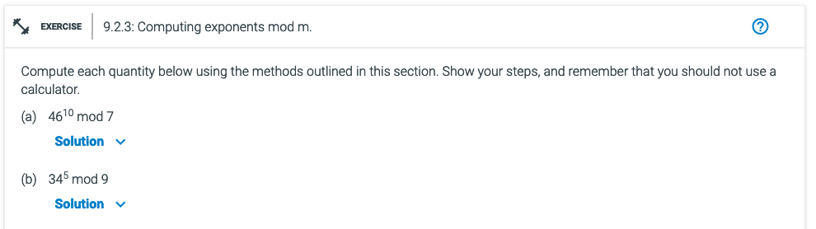
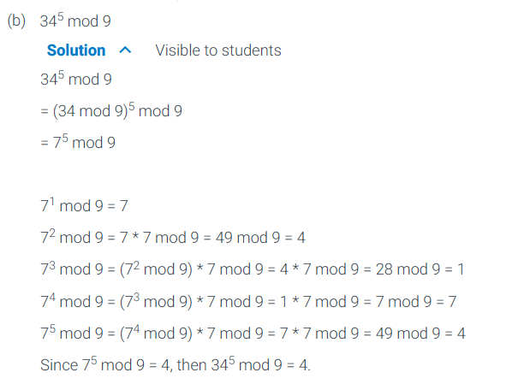
9.2.3b

Slide 27
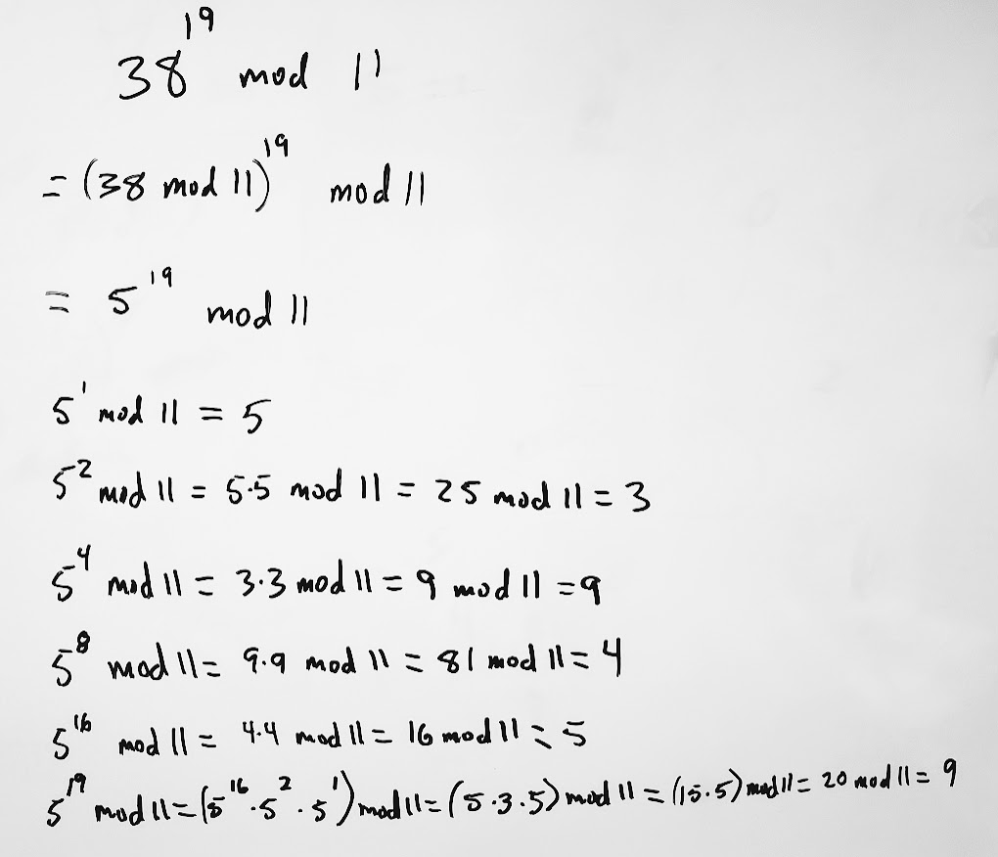

With a partner
Choose a random integer $x$ between 10 and 100.
Choose another random integer $y$ between 5 and 20.
Choose a third random integer $z$ between 5 and 20.
Write a problem on the whiteboard in the form $x^{y} mod n$
Shift one place to the left and solve the problem.

