Slide 2
Number Theory
The study of integers
9.1-9.2 Division Algorithm & Modular Arithmetic
9.3-9.4 Prime factorization & Factoring & Primality testing
9.5 Greatest Common Divisor & Euclid’s algorithm

Slide 3
Homework Review
Discuss Homework Problems from last week:
Focus on:
7.2
7.10
7.11

Slide 4





Review
$[(x mod m) + (y mod m)] mod m = [x + y] mod m$
$[(x mod m)(y mod m)] mod m = [xy] mod m$
$$(xz mod m) =\left(x mod m\right)z$$
remember:
1. (x mod y)^{z} mod y => ( r )^{z} mod y
Calculate the following, by hand:
${44}^{12} mod 6$
$${\left(44 mod 6\right)}^{12} mod 6;6x7=42 \\ =2^{12} mod 6 \\ =2^{6}∗2^{6} mod 6 \\ =64 ∗64 mod 6 \\ =4 ∗4 mod 6 \\ =16 mod 6=4$$
${34}^{5} mod 9$
$${34}^{5}mod 9 \\ ={(34 mod 9)}^{5}mod 9$$
$$=7^{5}mod 9 \\ ={(7}^{2}∗7^{2}∗7^{1}) mod 9 \\ =(49 ∗49 ∗7) mod 9 \\ =(4 ∗4) mod 9 ∗7 mod 9 \\ =7 mod 9 ∗7 mod 9 \\ =49 mod 9=4$$

Slide 5
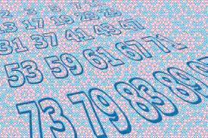
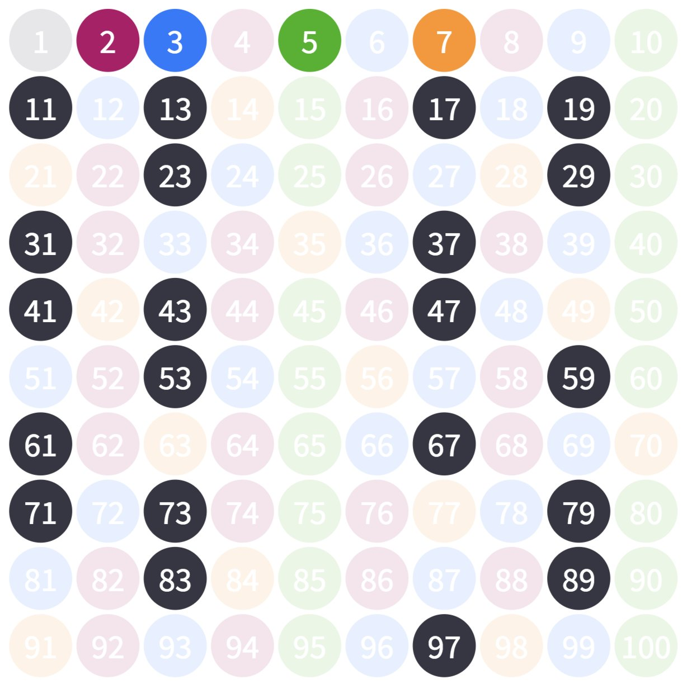

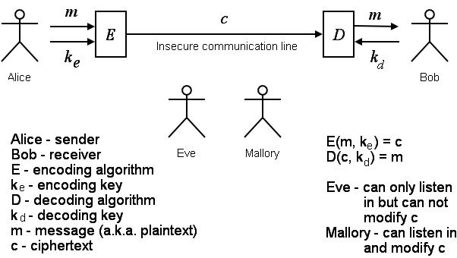
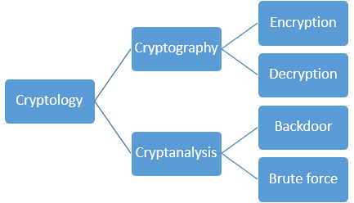

Primes
Building blocks of integers
What's so great about primes?
Cryptology

Slide 6
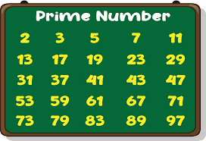
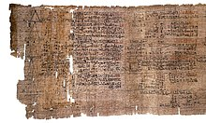
Primes
What is a prime number?
Divisible only by 1 and itself
i.e.: 2, 3, 5, 7, 11, 13, 17, 19...
The Rhind Mathematical Papyrus, from around 1550 BC, has Egyptian fraction expansions of different forms for prime and composite numbers
Largest Prime M77232917 = 23,249,425 digits – 2⁷⁷²³²⁹¹⁷-1

Slide 7
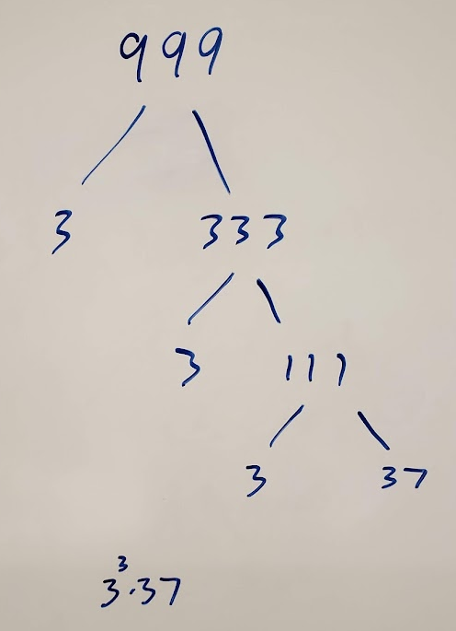
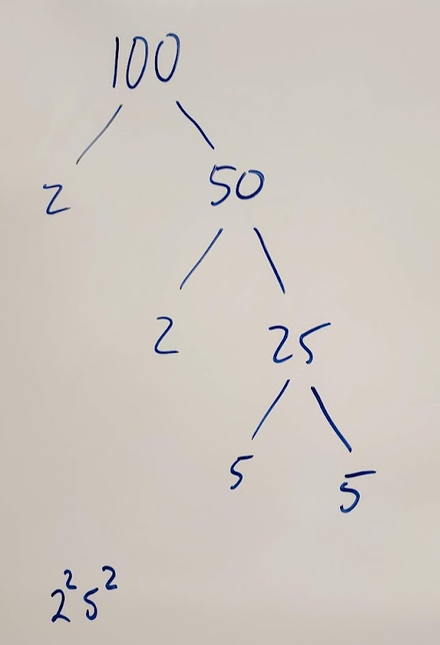


Fundamental Theorem of Arithmetic
$$b=ac$$
Prime numbers are the building blocks of integers.
Every integer greater than 1 can be uniquely written as either prime or the product of two or more primes.
Examples:
$100 = 2 ∗ 2 ∗ 5 ∗ 5 =2^{2}5^{2}$
$641 = 641$
$999=3∗3∗3∗37=3^{3}∗37$
$1024=2∗2∗2∗2∗2∗2∗2∗2∗2∗2=2^{10}$
Use non-decreasing order and exponential notation.
641 is prime

Slide 8

Pop Quiz
$2^{31}−1 = 2147483647$
(Prime or not? How do you tell, easily?)
2+1+4+7+4+8+3+6+4+7 = 45
4 + 5 = 9
Therefore, this number is divisible by both 3 and 9 and NOT prime

Slide 9
Greatest Common Divisor (GCD)
Greatest Common Divisor – Largest integer that divides both numbers (i.e., the largest factor of both numbers)
What is the GCD of 24 and 36?
Factors of 24: 1, 24, 2, 12, 3, 8, 4, 6
Factors of 36: 1, 36, 2, 18, 3, 12, 4, 9, 6
Relatively Prime or Coprime means their GCD is 1, even if the numbers are not prime.
What is the GCD of 17 and 22?
Factors of 17: 1, 17
Factors of 22: 1, 22, 2, 11
Rosen, Kenneth. Discrete Mathematics and Its Applications, 7th Edition. McGraw-Hill, 2012

Slide 10

Least Common Multiple (LCM)
Least Common Multiple – Smallest positive multiple of both numbers. The smallest integer that both numbers divide.
What is the LCM of $3$ and $5$?
3 * 5 = 15
What is the LCM of 4 and 8?
4 * 8 = 32. But 32 is not the lowest multiple of 4 and 8.
The multiples of 4: 4, 8, 12, 16, ...
The multiples of 8: 8, 16, 24, ...
Another way of thinking about it: The LCM is the smallest integer that both numbers divide:
4|8 and 8|8, so 8 is the LCM of 4 and 8.
Multiples of 3: 3, 6, 9, 12, 15, 18, ...
Multiples of 5: 5, 10, 15, 20, ...
The smallest common multiple of both numbers is 8
Rosen, Kenneth. Discrete Mathematics and Its Applications, 7th Edition. McGraw-Hill, 2012

Slide 11





Finding GCD and LCM with Prime Factorization
Given:
$x$ = $p_{1}^{a_{1}}⋅p_{2}^{a_{2}}⋅⋅⋅p_{r}^{a_{r}}$
$y=p_{1}^{b_{1}}⋅p_{2}^{b_{2}}⋅⋅⋅p_{r}^{b_{r}}$
Then:
$\gcd\left(x,y\right)=p_{1}^{\min\left\{a_{1}, b_{1}\right\}}⋅p_{2}^{\min\left\{a_{2},b_{2}\right\}}⋅⋅⋅p_{r}^{\min\left\{a_{r}, b_{r}\right\}}$
$\operatorname{lcm}\left(x,y\right)=p_{1}^{\max\left\{a_{1}, b_{1}\right\}}⋅p_{2}^{\max\left\{a_{2},b_{2}\right\}}⋅⋅⋅p_{r}^{\max\left\{a_{r}, b_{r}\right\}}$
What is the prime factorization of 26?
What is the prime factorization of 36?
What is gcd(26, 36)?
What is lcm(26,36)?
$$2⋅13$$
$$2^{2}⋅3^{2}$$
$26=2^{1}⋅3^{0}⋅{13}^{1}$
$36=2^{2}⋅3^{2}⋅{13}^{0}$
$\gcd\left(26, 36\right)=2^{1}⋅3^{0}⋅{13}^{0}=2$
$26=2^{1}⋅3^{0}⋅{13}^{1}$
$36=2^{2}⋅3^{2}⋅{13}^{0}$
$\operatorname{lcm}\left(26, 36\right)=2^{2}⋅3^{2}⋅{13}^{1}=468$

Slide 12
Additional Exercises:
9.3.1 a-f
9.3.2 a-d

Slide 13
9.3.1 a-f
Give the prime factorization for each number.
(a) 32
(b) 42
(c) 84
(d) 36
(e) 121
(f) 198
Give the prime factorization for each number.
(a) 32 32 = 2⁵
(b) 42 42 = 2 · 3 · 7
(c) 84 84 = 2² · 3 · 7
(d) 36 36 = 2² · 3²
(e) 121 121 = 11²
(f) 198 198 = 2 · 3² · 11

Slide 14
9.3.2 a-d
Some numbers and their prime factorizations are given below. 140 = 2² · 5 · 7
175 = 5² · 7
532 = 2² · 7 · 19
648 = 2³ · 3⁴
1078 = 2 · 7² · 11
1083 = 3 · 19²
15435 = 3² · 5 · 7³
25480 = 2³ · 5 · 7² ·13
Use these prime factorizations to compute the following quantities.
(a) gcd(532, 15435)
7
(b) gcd(648, 1083)
3
(c) lcm(532, 1083)
2²·3·7·19² = 30,324
(d) lcm(1083, 15435)
3²·5·7³·19² = 5,572,035

Slide 15

Finding Primes
Can we use brute force to figure out if this number is prime?
35201546659608842026088328007565866231962578784643756647773109869245232364730066609837018108561065242031153677
Trial Division (Brute Force)
Divide by each prime up to $\sqrt{n}$
Example: Is 421 prime?
Sieve of Eratosthenes
Python demo
2 | 421 no
3 | 421 no
5 | 421 no
7 | 421 no
11 | 421 no
13 | 421 no
17 | 421 no
19 | 421 no
421 is prime
Input: Integer N greater than 1. Output: "Prime" if N is prime. If N is composite, return two integers greater than 1 whose product is N. For x = 2 to N-1 If x evenly divides N, Return( x, N/x ) End-for Return( "Prime" )

Slide 16




Prime Number Theorem
There are an infinite number of primes
The Prime Number Theorem:
Helps us estimate how many prime numbers are in the range 2 through x.
We define $π\left(x\right)$ as the number of primes from 2 to $x$.
Then,
The ratio of prime numbers between 2 and x to all numbers between 2 and x approaches 1/ln x as x approaches infinity.
$$\lim_{x→∞}{{\left(\frac{π(x)}{x/ln⁡(x)}\right)}^{ }=1}$$
$${{\left(\frac{π(x)}{x}\right)}^{ }≈\frac{1}{ln⁡(x)}}$$
$$π\left(x\right)≈\frac{x}{ln⁡(x)}$$

Slide 17



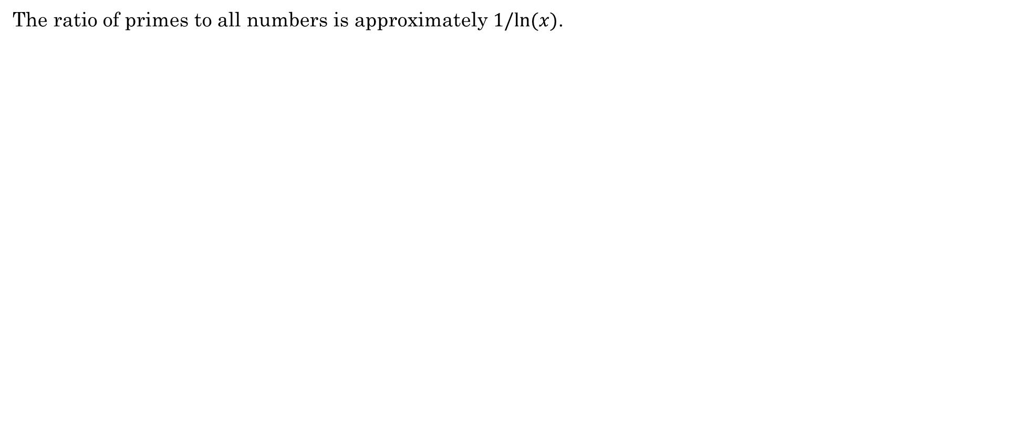



Prime Number Theorem
The ratio of primes to all numbers is approximately $1/ln⁡(x)$.
$${{\left(\frac{π(x)}{x}\right)}^{ }≈\frac{1}{ln⁡(x)}}$$
Example:
How many primes are there between 2 and 1000?
$$\frac{x}{\ln\left(x\right)}=\frac{1000}{ln⁡(1000)}≈145$$
As $x$ gets larger, the ratio gets smaller.
In other words, primes become more sparse the larger the range.
If we choose a random number between 2 and $x$, the likelihood that it is prime is $1/ln⁡(x)$.
$$π\left(x\right)≈\frac{x}{ln⁡(x)}$$
The number of primes in the range 2 through $x$ is approximately
In Python, $ln⁡(x)$ is math.log(x)
Python demo

Slide 18
Additional Exercises:
9.4.1 a-c
9.4.2 a-d

Slide 19

9.4.1 a-c
$$π\left(x\right)≈\frac{x}{ln⁡(x)}$$
9.4.1: Estimating the number of primes.
(a) Use the Prime Number Theorem to give an approximation for the number of prime numbers in the range 2 through 1000.
1000 = 10³. The number of prime numbers in the range 2 through 10³ is approximately 10³/ln(10³) = 10³/3*ln(10) ≈ 145.
(b) Use the Prime Number Theorem to give an approximation for the number of prime numbers in the range 2 through 100000.
100000 = 10⁵. The number of prime numbers in the range 2 through 10⁵ is approximately 10⁵/ln(10⁵) = 10⁵/5*ln(10) ≈ 8686.
(c) Use the Prime Number Theorem to give an approximation for the number of prime numbers in the range 2 through 10000000.
10000000 = 10⁷. The number of prime numbers in the range 2 through 10⁷ is approximately 10⁷/ln(10⁷) = 10⁷/7*ln(10) ≈ 620421.

Slide 20

9.4.2 a-d
$π\left(x\right)$ is defined to be the number of prime numbers in the range 2 through x (inclusive).
Find for each value of x.
And the corresponding prime numbers.
(a) $π\left(10\right)$
$π\left(10\right)$= 4; The corresponding prime numbers are 2, 3, 5, and 7.
(b) $π\left(20\right)$
$π\left(20\right)=8$The corresponding prime numbers are 2, 3, 5, 7, 11, 13, 17 and 19.
(c) $π\left(30\right)$
$π\left(30\right)=10$The corresponding prime numbers are 2, 3, 5, 7, 11, 13, 17, 19, 23 and 29.
(d) $π\left(40\right)$
$π\left(40\right)=12$The corresponding prime numbers are 2, 3, 5, 7, 11, 13, 17, 19, 23, 29, 31 and 37.

