Slide 2
Number Theory
The study of integers
9.1-9.2 Division Algorithm & Modular Arithmetic
9.3-9.4 Prime factorization & Factoring & Primality testing
9.5 Greatest Common Divisor & Euclid’s algorithm

Slide 3




Greatest Common Divisor (GCD)
Greatest Common Divisor – Largest integer that divides both numbers (i.e., the largest factor of both numbers)
What is the GCD of 24 and 36?
Factors of 24: 1, 2, 3, 4, 6, 8, 12, 24
Factors of 36: 1, 2, 3, 4, 9, 12, 18, 36
What is the GCD of 6 and 32?
Factors of 6: 1, 2, 3, 6
Factors of 32: 1, 2, 4, 8, 16, 32
Using Prime Factorizations:
$24: 2^{3}3^{1}$
$36: 2^{2}3^{2}$
Smallest exponents: $2^{2}3^{1}=12$
Using Prime Factorizations:
$$6: { 2}^{1}3^{1}$$
$$32: 2^{5}3^{0}$$
Smallest exponents: $2^{1}3^{0}=2$
Rosen, Kenneth. Discrete Mathematics and Its Applications, 7th Edition. McGraw-Hill, 2012

Slide 4

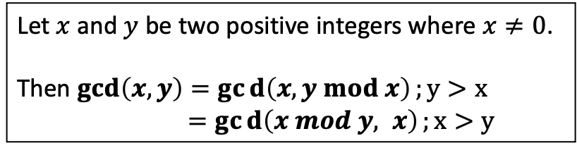

GCD Theorem
Computing GCD of two integers is computationally difficult for large numbers.
We have a shortcut!
We can reduce the problem of finding the GCD of large numbers by using mod.
Let $x$ and $y$ be two positive integers where $x≠0$.
Then $\gcd\left(x,y\right)=gcd\left(x, y mod x\right);y>x$
$=gcd\left(x mod y, x\right);x>y$
Example:
$\gcd\left(6, 32\right)=2$
$\gcd\left(6, 32 mod 6\right)=\gcd\left(6, 2\right)=2$
In other words, the GCD of two integers is the same if we reduce one of those numbers using mod of the other number.
And we can keep going until one of the numbers is reduced to 0.
$\gcd\left(6 mod 2, 2\right)=\gcd\left(0, 2\right)=2$

Slide 5
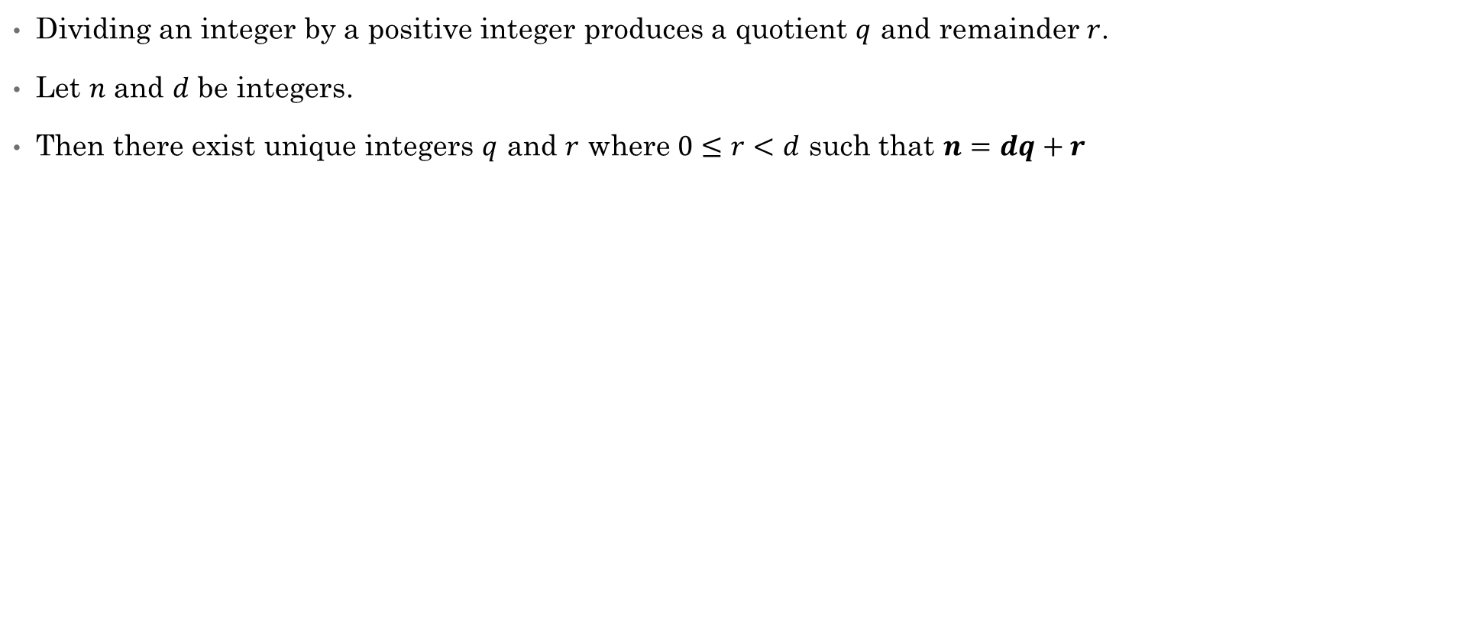
Recall the Division Theorem
Dividing an integer by a positive integer produces a quotient $q$ and remainder $r$.
Let $n$ and $d$ be integers.
Then there exist unique integers $q$ and $r$ where $0≤r<d$ such that $n=dq+r$

Slide 6
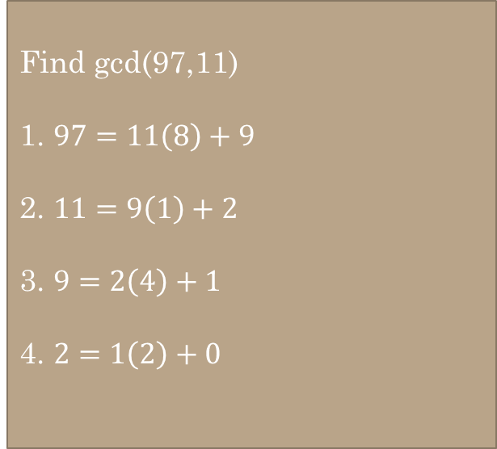

Euclidean GCD Algorithm
Find gcd(97,11)
Find the GCD of two numbers:
Using $n=dq+r$.
Divide larger number by smaller number to get $q$ and $r$.
Shift $d$ and $r$ to be the new $n$ and $d$.
Divide $n$ by $d$ to get a new $q$ and $r$.
Repeat until the remainder is 0. The last non-zero remainder is the GCD.
Find gcd(97,11)
1. $97=11\left(8\right)+9$
2. $11=9\left(1\right)+2$
3. $9=2\left(4\right)+1$
4. $2=1\left(2\right)+0$

Slide 7
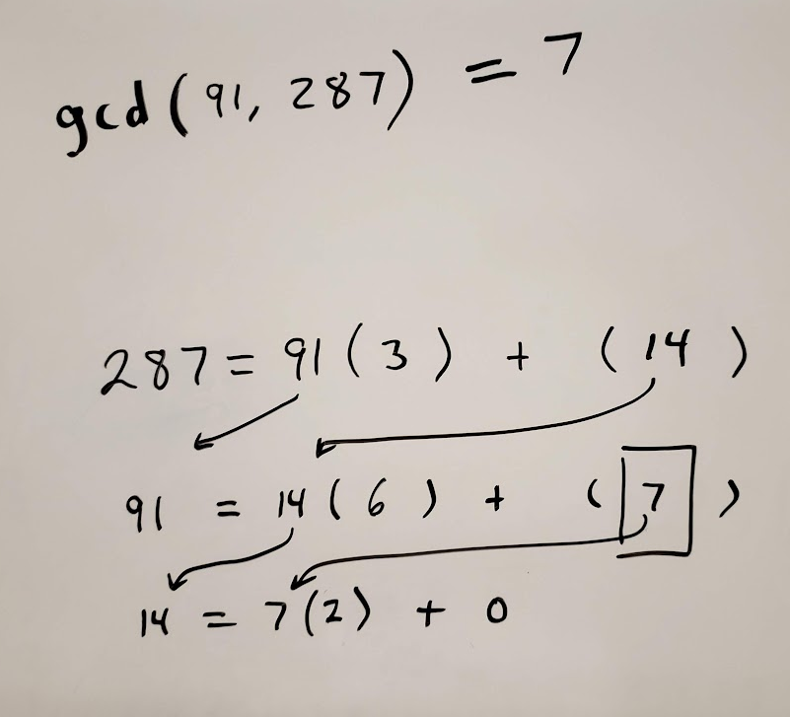

Find gcd(97,11)
1. $97=11\left(8\right)+9$
2. $11=9\left(1\right)+2$
3. $9=2\left(4\right)+1$
4. $2=1\left(2\right)+0$
Find the gcd(91, 287)
287 = 91 (3) + (14)
91 = 14 (6) + (7)
14 = 7 (2) + (0)

Slide 8
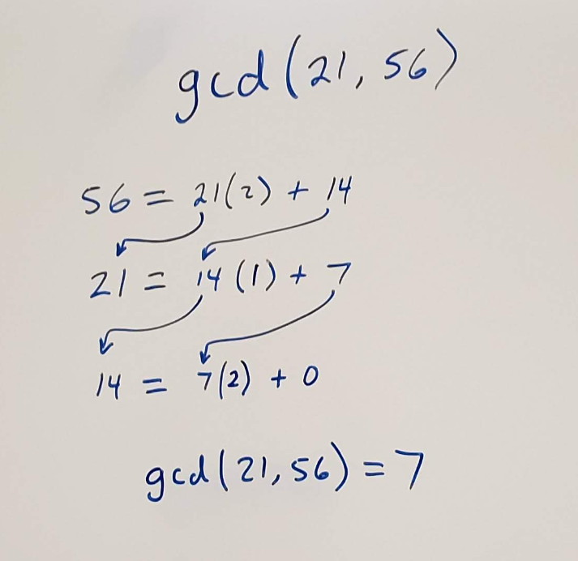
Find gcd(21, 56)
56 = 21 ( ) + ( )
56 = 21 (2 ) + (14)
21 = 14 ( ). + ( )
21 = 14 (1) + 7
14 = 7 (. ). + ( )
14 = 7 (2). + 0
Gcd(21, 56) = 7

Slide 9
A different way…

Slide 10
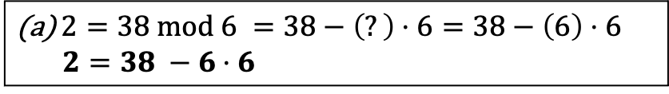
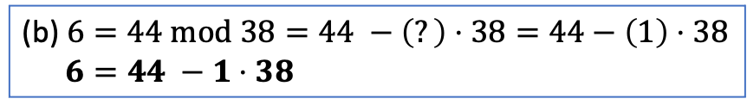



Extended Euclidean Algorithm
Recall Theorem 9.1.1:
If x|y and x|z, then x|(sy + tz) for any integers s and t.
$$∀s∀t \left(\left(x\left|y∧x\right|z\right)→\left(x \right|\left(sy+tz\right)\right)$$
The GCD of x and y can be expressed as a linear combination of x and y:
$\gcd\left(x, y\right)=sx+ty$ for some $s$ and $t$. By the GCD Theorem, $\gcd\left(x,y\right)=\gcd\left(y mod x, x\right)$.
(b) (b) (a) 6* 6 (a)
$\gcd\left(44, 38\right)=\gcd\left(44 mod 38, 38\right)=\gcd\left(6, 38\right)=\gcd\left(38 mod 6, 6\right)=\gcd\left(2, 6\right)=\gcd\left(6 mod 2, 2\right)=\gcd\left(0,2\right)=2$
(b) $6=44 mod 38=44 −\left(?\right)⋅38=44−\left(1\right)⋅38$
$6=44 −1⋅38$
$2=38 mod 6 =38−\left(?\right)⋅6=38−\left(6\right)⋅6$
$2=38 −6⋅6$
$\gcd\left(44, 38\right)=2$. We can express this as a linear combination, $2=s⋅44+t⋅38$.
2 = (sy + tz) = n - dq
2 = 38 – (6) * 6
$2=38 −6⋅(44−1⋅38)$ substitute ($44−1⋅38$) for $6$
$2=38−6⋅44+6⋅38$ simplify 38 + (6* 38) = 7* 38
$2=−6⋅44+7⋅38$ We have our linear combination
$s=−6$
$t=7$
n = dq + r
r = n - dq
x|(sy + tz)

Slide 11

Demo
Find $s$ and $t$ such that $\gcd\left(44, 96\right)=\text{sy}\text{ + }\text{tz}=s⋅44+t⋅96$
Euclidean GCD Algorithm for
$$\gcd\left(44, 96\right)$$
96 = 44*2 + 8
44 = 8 * 5 + 4
8 = 4 * 2 + 0
8 = 96 – 44 * 2
4 = 44 – 8 * 5
Re-arrange in terms of 44 * 96
Sub. 8 into 2nd equation
4 = 44 – (96 - 44*2) * 5
4 = 44 + (-96 + (-44*2)) *5 move negative sign
4 = 44 + (-96*5) + (44*2*5) mult *5
4 = 44 + (-96*5) + (44*10) solve 2*5
4 = (96*-5) +44+ (44*10) combine terms i.e 44
4 = (96*-5) + (44*11) identify elements of s and t
S=11
T=-5

Slide 13
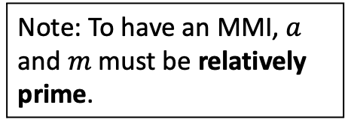

Multiplicative Inverse (MMI)
The MMI of $a$ is an integer $x$ such that $ax mod m=1$ where $x<m−1$.
To find $x$, ask yourself "What number multiplied by $a$ will result in 1 $mod m$?"
Example:
What is the MMI of 5 under mod 7?
$5x mod 7=1$
What is $x$? Let's try a few numbers:
$5⋅1 mod 7=5$, so it is not $1$
$5⋅2 mod 7=3$, so it is not $2$
$5⋅3 mod 7=1$, it is $3$. The MMI of 5 under mod 7 is 3.
Note: To have an MMI, $a$ and $m$ must be relatively prime.
0
6
1
5
2
4
3

Slide 14
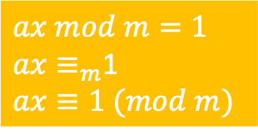

MMI
Modular Multiplicative Inverse or Inverse Mod m or Multiplicative Inverse Mod m
$2x≡1 (mod 17)$
$2x≡_{17}1$
What multiple of 2 is one more than a multiple of 17?
9
9 is an MMI of 2 under mod 17
The MMI exists only if $a$ and $m$ are coprime.
MMIs are used in cryptography, especially the RSA Algorithm
$ax mod m=1$
$ax≡_{m}$1
$ax≡1 (mod m)$

Slide 15

What is the MMI of:
$3 (mod 7)$ (What multiple of 3 is one more than a multiple of 7?)
$3⋅x≡_{7}1$
$x=5$, so $5$ is the MMI for $3 (mod 7)$.

Slide 16

Use Extended Euclidean to find MMI
If $\gcd\left(x,n\right)≠1$, then there is no MMI.
If $x$ and $n$ are relatively prime, then $\gcd\left(x,n\right)=1$, so we can find a linear combination $1=sx+tn$.
$s$ is the MMI of $x$ under $mod n$ because $sx−1=−tn$, so $sx$ is 1 more than a multiple of $n$.
Example
Find gcd(5,7)
gcd(5,7)
Euclidean Algorithm
7=5(1) +2 2 = 7 - 5(1)
5 = 2(2) +1 1 = 5 – 2(2)
2 = 1(2) + 0
Extend Euclidean Algr
1 = 5 – 2 (2)
1 = 5 – 2(7-5(1))
1 = 5 – 2(7) + 2(5)
1 = 3(5) – 2(7)
3 inverse of 5 mod 7
-2 is the inverse 7 mod 5
-2+5 =3 3 is the inversion of 7 mod 5
3*7 mod 5 = 1

Slide 17
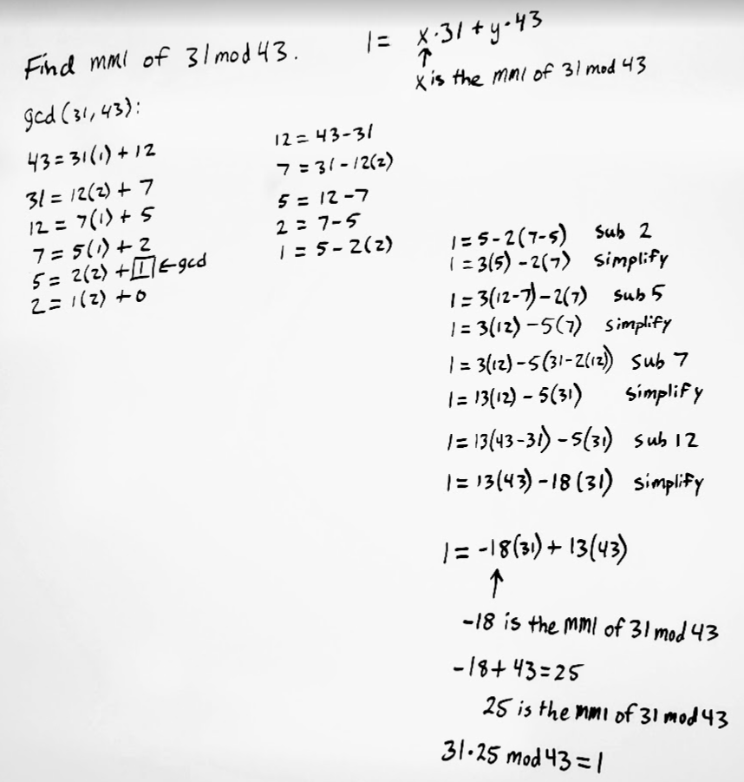
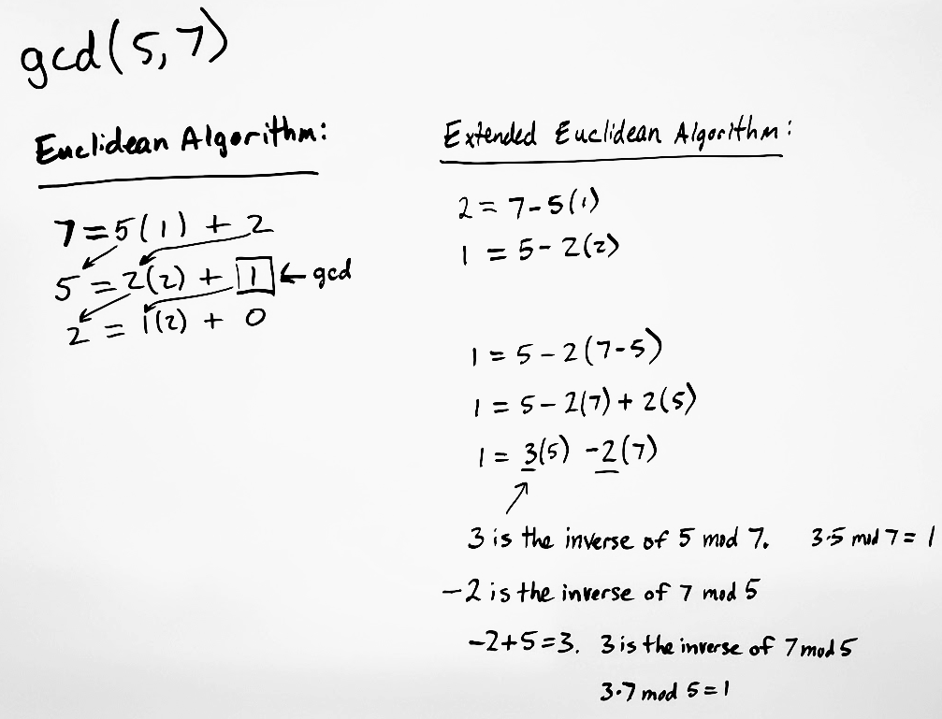

Use the Extended Euclidean Algorithm to find the MMI of $31 mod 43$.
Use Euclidean Algorithm to find gcd(31,43)
Use Extended Euclidean Algorithm to solve $1=31x + 43y$.
Now $x$ is the MMI of $31 mod 43$. (And $y$ is the MMI of $43 mod 31$)

Slide 18
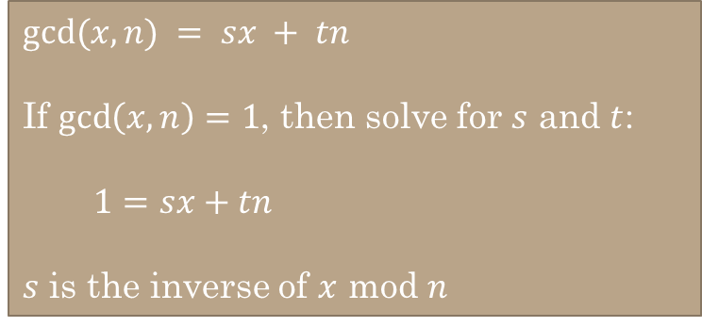

$gcd⁡(x,n) = sx + tn$
If $\gcd\left(x,n\right)=1$, then solve for $s$ and $t$:
$1=sx+tn$
$s$ is the inverse of $x$ mod $n$
Use the Extended Euclidean Algorithm to find the inverse of $x mod n$for each of the following:
x=35, n=48
11
(sy + tz) = n – dq = 1
x=25, n=84
37

Slide 19
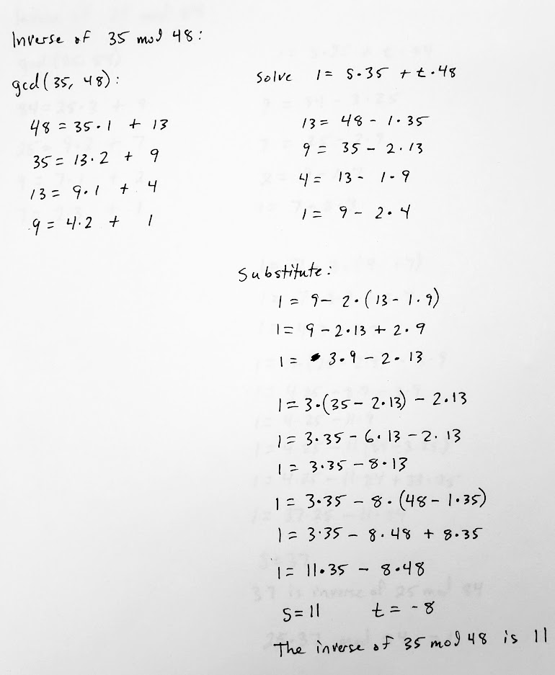
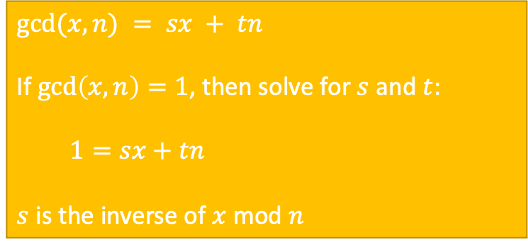
$gcd⁡(x,n) = sx + tn$
If $\gcd\left(x,n\right)=1$, then solve for $s$ and $t$:
$1=sx+tn$
$s$ is the inverse of $x$ mod $n$
Use the Extended Euclidean Algorithm to find the inverse of $x mod n$for each of the following:
x=35, n=48
11
(sy + tz) = n – dq = 1
x=25, n=84
37

Slide 20
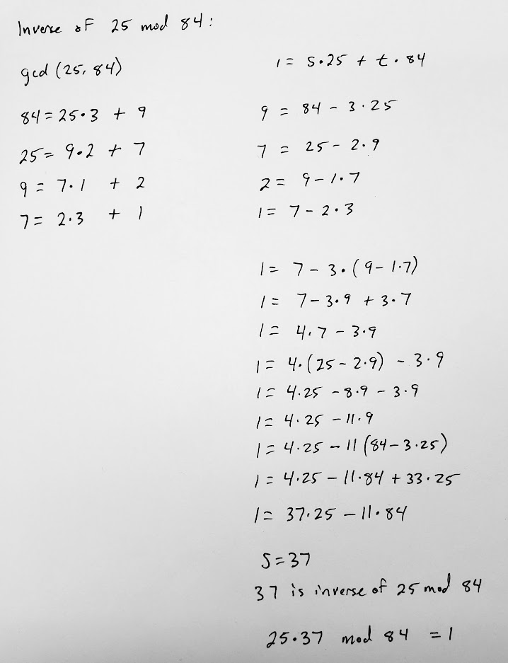
$gcd⁡(x,n) = sx + tn$
If $\gcd\left(x,n\right)=1$, then solve for $s$ and $t$:
$1=sx+tn$
$s$ is the inverse of $x$ mod $n$
Use the Extended Euclidean Algorithm to find the inverse of $x mod n$for each of the following:
x=35, n=48
11
(sy + tz) = n – dq = 1
x=25, n=84
37

Slide 22








Why is the MMI important?
We can solve any congruence $ax≡b (mod m)$ by finding the MMI of $a$, then multiplying both sides by that MMI.
Solve: $3x≡_{7}4$
1. What is the MMI of 3 under (mod 7)?
2. Since 5 is the inverse of 3 under (mod 7), we can multiply both sides of the congruency by 5.
3. Now simplify/reduce using (mod 7)
$$3x≡_{7}4$$
$3x≡_{7}1$
$x=5$
$3\left(5\right)x≡_{7}4(5)$
$15x≡_{7}20$
$1x≡_{7}6$
$x=6$
Rosen, Kenneth. Discrete Mathematics and Its Applications, 7th Edition. McGraw-Hill, 2012

