Slide 1
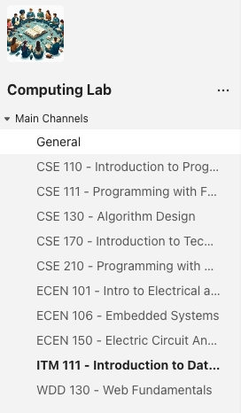

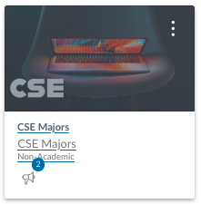

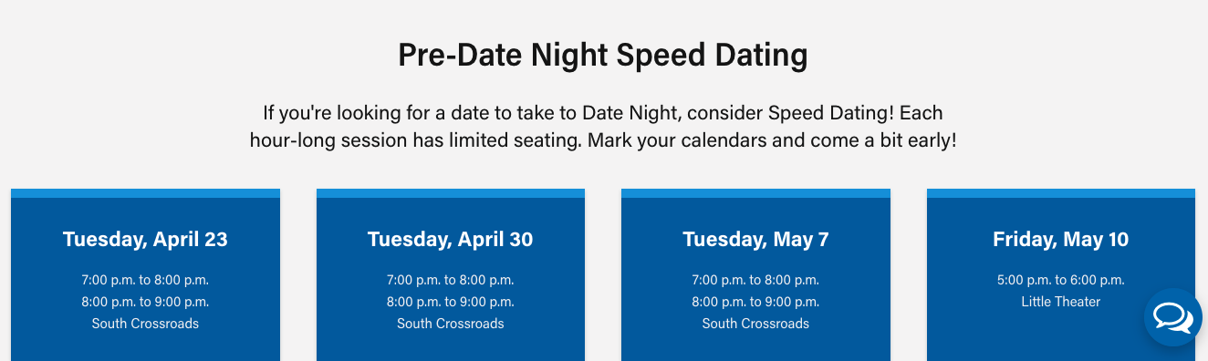
Welcome CSE Department
Upcoming Event:
Computer Society
Wed 5:PM
Tutoring Lab
Tues, Thurs, Fri - 3:30-6:30 pm - STC 201
BYU Idaho Spring Break 2024 Meeting - Wednesday, April 24, 2024 @7PM MST

Slide 2
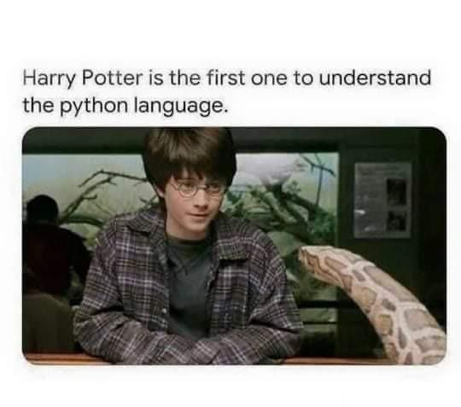
Variables and Expressions CS 110 - Introduction to Programming
Brother W. Clements

Slide 3

Prepare
Kahoot Quiz: cse110-03-2 Variables and Expressions

Slide 4
Prepare
Questions about
Data Types
Numbers (int vs float)
Operator + (addition vs concatenate)
Strings (convert: str
Print formatting
Printing mixed types
Converting types
int, float, str
Expressions
Operator | Symbol | Example | Result
Add | + | 3 + 4 | 7
Subtract | - | 3 - 4 | -1
Multiply | * | 3 * 4 | 12
Divide | / | 15 / 4 | 3.75
Divide and drop remainder | // | 15 // 4 | 3
Remainder or Modulus | % | 25 % 7 | 4
Exponent (To the power of) | ** | 3 ** 4 | 81

Slide 5

Checkpoint
How old are you? 25
On your next birthday, you will be 26
How many egg cartons do you have? 3
You have 36 eggs
How many cookies do you have? 18
How many people are there? 8
Each person may have 2.25 cookies
Steps
Read instructions
Attempt coding the problem for 1 hour
Look at the Instructor code after 1 hour or when done.
Include in notes, what you learned from the instructor's code
Notes:
Test It:
1. Q1: 25 -> 26; Q3:3->36
2. Q1: 18 -> 19 & 59 -> 60
3. Q2: 5-> 60; 0->0
4. Q3: Figure out sample set

Slide 6
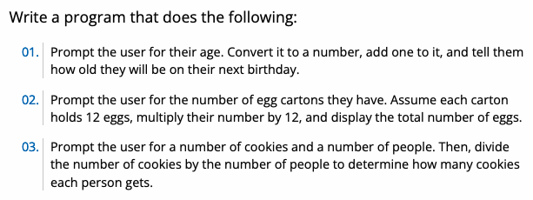
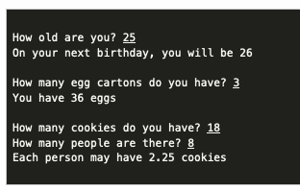
We solve people problems
Have I read the entire assignment?
What are the inputs?
How do inputs become outputs?
What are the outputs?
Input
Process
Output
⌨️
💾
📺

Slide 7
We solve people problems
Have I read the entire assignment?
What are the inputs?
How do inputs become outputs?
What are the outputs?
Input
Process
Output
⌨️
💾
Q1: 25 -> 26
Q1: 18 -> 19 59 -> 60
Q2: 3 -> 36
Q2: 5 -> 60
0 -> 0
Q3: Look at the domain and co-domain, Figure out sample set, what are valid inputs
📺

Slide 8
We solve people problems
Have I read the entire assignment?
What are the inputs?
How do inputs become outputs?
What are the outputs?
Input
Process
Output
⌨️
💾
# 01. Prompt…
input(“How old…“)
# 02. Prompt…
input(“Carton…? “)
….
# 03. Prompt…
# 01. Prompt…
Age = input(“How old…“)
…
# 02. Prompt…
Cartons = input(“Carton…? “)
Eggs = ?/?
….
# 03. Prompt…
Cookies =
People =
Cookies_per_person =
….
# 01. Prompt…
…
print(
# 02. Prompt…
….
print(
# 03. Prompt…
…
print(
📺

Slide 9
Teach: Team Activity
Meet and setup a video call, share screen
Overview
Make sure that your program can appropriately handle decimal values as well as whole numbers.
Square—The area is the length of a side squared.
Rectangle—The area is the length multiplied by the width.
Circle—The area is Pi (you can use 3.14) multiplied by the radius squared.
Core requirements
Stretch Challenge
Math pi
Single length: square, circle, volume
Cm^2 and m^2 : 100cm:1m
Teacher Solution
Submission
In notes tell me what you learned from the teacher solutions.
What is the length of a side of the square? 3.5
The area of the square is: 12.25
What is the length of rectangle? 6
What is the width of the rectangle? 7.5
The area of the rectangle is: 45.0
What is the radius of the circle? 8.2
The area of the circle is: 211.1336
What is the length of a side of the square? 5
The area of the square is: 25.0
What is the length of rectangle? 6
What is the width of the rectangle? 7
The area of the rectangle is: 42.0
What is the radius of the circle? 5
The area of the circle is: 78.5

Slide 10
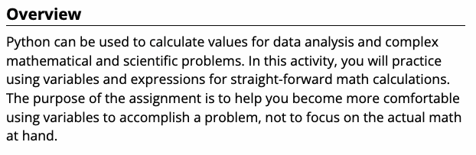
We solve people problems
Have I read the entire assignment?
What are the inputs?
How do inputs become outputs?
What are the outputs?
Input
Process
Output
⌨️
💾
📺

Slide 11
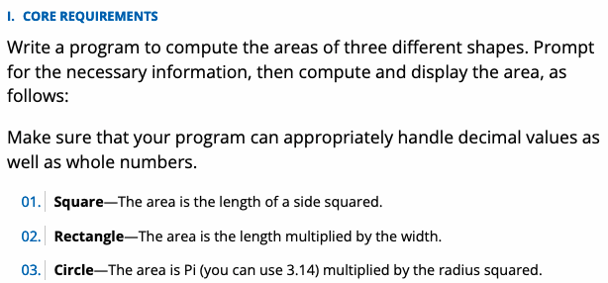
We solve people problems
Have I read the entire assignment?
What are the inputs?
How do inputs become outputs?
What are the outputs?
Input
Process
Output
# Square
…
# Rectangle
…
# Cirle
….
⌨️
💾
📺

Slide 12
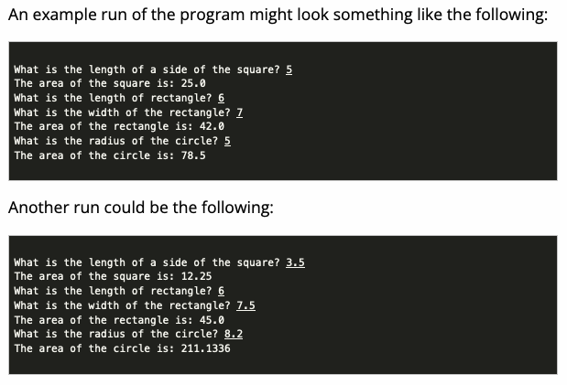
We solve people problems
Have I read the entire assignment?
What are the inputs?
How do inputs become outputs?
What are the outputs?
Input
Process
Output
⌨️
💾
📺

Slide 13
We solve people problems
Have I read the entire assignment?
What are the inputs?
How do inputs become outputs?
What are the outputs?
Input
Process
Output
# Square
input(“What…“)
…
#Rectangle
…
#Circle
….
# Square
length = input(“What…“)
sq_area = …
#Rectangle
…
width = input(“The width “)
rt_area =
…
#Circle
….
….
# Square
…
sq_area …
print(…
#Rectangle
area =
print(
#Circle
….
….
📺

Slide 14
Prove
What is the price of a child's meal? 4.50
What is the price of an adult's meal? 9.00
How many children are there? 4
How many adults are there? 2
What is the sales tax rate? 6
Subtotal: $36.00
Sales Tax: $2.16
Total: $38.16
What is the payment amount? 40
Change: $1.84
What is the price of a child's meal? 2.25
What is the price of an adult's meal? 6.99
How many children are there? 2
How many adults are there? 1
What is the sales tax rate? 4
Subtotal: $11.49
Sales Tax: $0.46
Total: $11.95
What is the payment amount? 20
Change: $8.05
Regarding Milestones and Assignments: For the prove assignments for Lessons 03 and 04, you'll be working on the same program. For this lesson's assignment (03 Prove: Milestone) you will complete part of the overall program. Then, you'll finish the program in the next lesson.
Overview
Program the following:
Ask the user for the following:
The price of a child's meal (floating point)
The price of an adult's meal (floating point)
The number of children (integer)
The number of adults (integer)
The sales tax rate (floating point)
Calculate: Subtotal, Tax, Total
Prompt payment and provide change
Make it your own
Submission
Upload program (the .py file) to the assignment
Submission Comment: What you think you did and 1-2 sentences justify your that describes your effort
1 = Some attempt made, 2 = Developing (but significantly deficient), 3 = Slightly deficient, 4 = Meets requirements, 5 = Made it your own

Slide 15
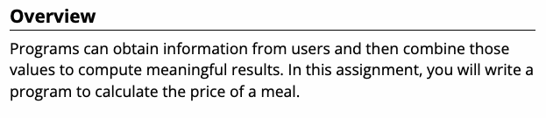
We solve people problems
Have I read the entire assignment?
What are the inputs?
How do inputs become outputs?
What are the outputs?
Input
Process
Output
⌨️
💾
📺

Slide 16
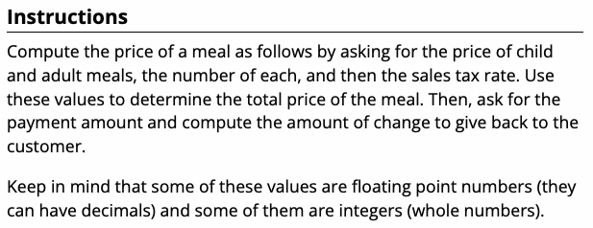
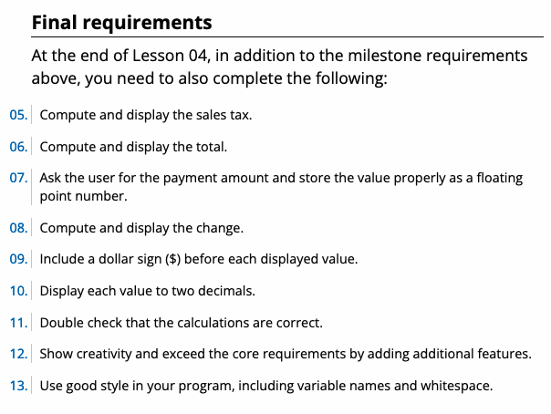
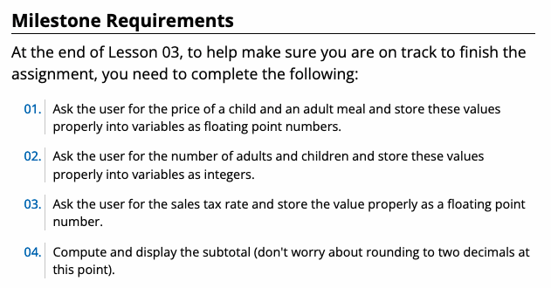
We solve people problems
Have I read the entire assignment?
What are the inputs?
How do inputs become outputs?
What are the outputs?
Input
Process
Output
⌨️
💾
📺

Slide 17
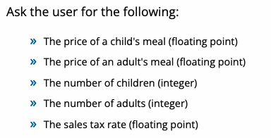
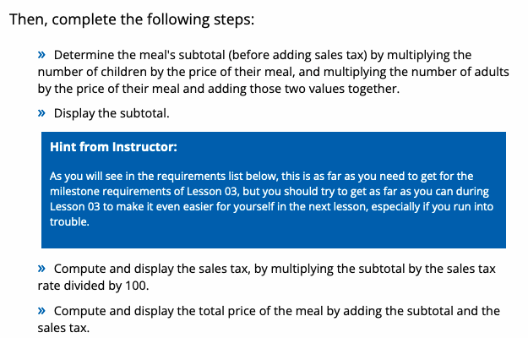
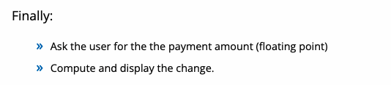
We solve people problems
Have I read the entire assignment?
What are the inputs?
How do inputs become outputs?
What are the outputs?
Input
Process
Output
⌨️
💾
📺

Slide 18



We solve people problems
Have I read the entire assignment?
What are the inputs?
How do inputs become outputs?
What are the outputs?
Input
Process
Output
⌨️
💾
📺

Slide 19
We solve people problems
Have I read the entire assignment?
What are the inputs?
How do inputs become outputs?
What are the outputs?
Input
Process
Output
⌨️
💾
📺

Slide 20

We solve people problems
Have I read the entire assignment?
What are the inputs?
How do inputs become outputs?
What are the outputs?
Input
Process
Output
⌨️
💾
📺

