Slide 1
Variables and Expressions CS 110 - Introduction to Programming
Brother W. Clements

Slide 2

Prepare
Kahoot Quiz: CSE110 - Week 04

Slide 3

Prepare
Questions about
Rounding
Adding .5
Difference between storing a rounded number and printing a rounded number.
Using Format Strings
Defining the number of decimals to display
:.#f
Scientific Notation
:.#e
Thousands Grouping
:,
Using the Math library
Import math
math.pi
Mathematical functions
math.ceil(value)— Rounds value up to the next whole number, the "ceiling."
math.floor(value)— Rounds value down to the next whole number.
math.exp(value)— Raises e to the power of value.
math.sin(value)— Computes the trigonometry sine function of value in radians.

Slide 4


Checkpoint
https://byui-cse.github.io/cse110-course/lesson04/checkpoint.html
Steps
Read instructions - Unit Conversion
Temperature, like many other values, can be measured in different kinds of units. In this case, you might measure the value of degrees in Fahrenheit, Celsius, or Kelvin. Converting from one scale to another uses the same calculation over and over again for different input values.
Attempt coding the problem for 1 hour
Look at the Instructor code after 1 hour or when done.
Include in notes, what you learned from the instructor's code
What is the temperature in Fahrenheit? 81
The temperature in Celsius is 27.2 degrees.
What is the temperature in Fahrenheit? 12
The temperature in Celsius is -11.1 degrees.

Slide 5
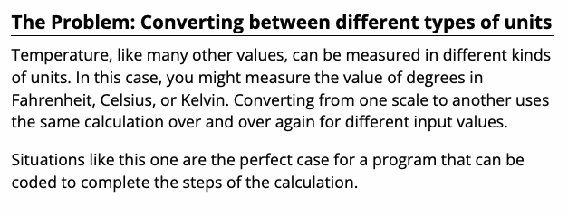
We solve people problems
Have I read the entire assignment?
What are the inputs?
How do inputs become outputs?
What are the outputs?
Input
Process
Output
⌨️
💾
What is the temperature in Fahrenheit? 81
The temperature in Celsius is 27.2 degrees.
What is the temperature in Fahrenheit? 12
The temperature in Celsius is -11.1 degrees.
#Start here
print(“Hello World”)
#compile
# input
# process
# output
#Start here
print(“Hello World”)
#compile
📺

Slide 6
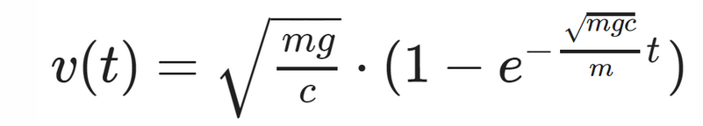

Teach: Team Activity
Welcome to the velocity calculator. Please enter the following:
Mass (in kg): 5
Gravity (in m/s^2, 9.8 for Earth, 24 for Jupiter): 9.8
Time (in seconds): 10
Density of the fluid (in kg/m^3, 1.3 for air, 1000 for water): 1.3
Cross sectional area (in m^2): 0.01
Drag constant (0.5 for sphere, 1.1 for cylinder): 0.5
The inner value of c is: 0.003
The velocity after 10.0 seconds is: 67.512 m/s
Meet and setup a video call, share screen
Overview
Speed of a Falling Object
v(t) = sqrt(mg/c) * (1 - exp((-sqrt(mgc)/m)t))
c = (1 / 2) * p * A * C
Core requirements
Must have the core requirements
Stretch Challenge
Then the stretch
Teacher Solution
Submission
In notes tell me what you learned from the teacher solutions.

Slide 7
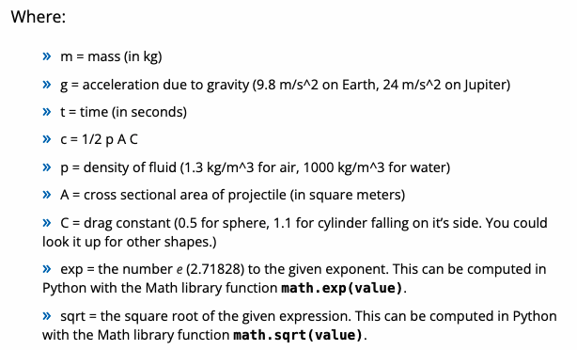
v(t) = sqrt(mg/c) * (1 - exp((-sqrt(mgc)/m)t))
c = (1 / 2) * p * A * C

Slide 8
We solve people problems
Have I read the entire assignment?
The Problem
Determine how fast an object will fall.
What are the inputs?
How do inputs become outputs?
What are the outputs?
Input
Process
Output
c = (1 / 2) * p * A * C
⌨️
💾
v(t) = sqrt(mg/c) * (1 - exp((-sqrt(mgc)/m)t))
#Start here
print(“Hello World”)
#compile
# input
# process
# output
Welcome to the velocity calculator. Please enter the following:
Mass (in kg): 5
Gravity (in m/s^2, 9.8 for Earth, 24 for Jupiter): 9.8
Time (in seconds): 10
Density of the fluid (in kg/m^3, 1.3 for air, 1000 for water): 1.3
Cross sectional area (in m^2): 0.01
Drag constant (0.5 for sphere, 1.1 for cylinder): 0.5
The inner value of c is: 0.003
The velocity after 10.0 seconds is: 67.512 m/s
#Start here
print(“Hello World”)
#compile
📺
https://byui-cse.github.io/cse110-course/lesson04/teach.html

Slide 9
Prove
What is the price of a child's meal? 4.50
What is the price of an adult's meal? 9.00
How many children are there? 4
How many adults are there? 2
What is the sales tax rate? 6
Subtotal: $36.00
Sales Tax: $2.16
Total: $38.16
What is the payment amount? 40
Change: $1.84
What is the price of a child's meal? 2.25
What is the price of an adult's meal? 6.99
How many children are there? 2
How many adults are there? 1
What is the sales tax rate? 4
Subtotal: $11.49
Sales Tax: $0.46
Total: $11.95
What is the payment amount? 20
Change: $8.05
Overview
Program the following:
Ask the user for the following:
The price of a child's meal (floating point)
The price of an adult's meal (floating point)
The number of children (integer)
The number of adults (integer)
The sales tax rate (floating point)
Calculate: Subtotal, Tax, Total
Prompt payment and provide change
Make it your own
Submission
Upload program (the .py file) to the assignment
Submission Comment: What you think you did and 1-2 sentences justify your that describes your effort
1 = Some attempt made, 2 = Developing (but significantly deficient), 3 = Slightly deficient, 4 = Meets requirements, 5 = Made it your own

Slide 10
Prove
Overview
Program the following:
Make it your own
Submission
Upload program (the .py file) to the assignment
Submission Comment: What you think you did and 1-2 sentences justify your that describes your effort
1 = Some attempt made, 2 = Developing (but significantly deficient), 3 = Slightly deficient, 4 = Meets requirements, 5 = Made it your own
Programs can obtain information from users and then combine those values to compute meaningful results. In this assignment, you will write a program to calculate the price of a meal.
Ask the user for the following:
The price of a child's meal (floating point)
The price of an adult's meal (floating point)
The number of children (integer)
The number of adults (integer)
The sales tax rate (floating point)
Calculate: Subtotal, Tax, Total
Prompt payment and provide change
Must include the original requirements, plus modification
Suggestion: add something else to the meal.
What is the price of a child's meal? 2.25
What is the price of an adult's meal? 6.99
How many children are there? 2
How many adults are there? 1
What is the sales tax rate? 4
Subtotal: $11.49
Sales Tax: $0.46
Total: $11.95
What is the payment amount? 20
Change: $8.05

Slide 11
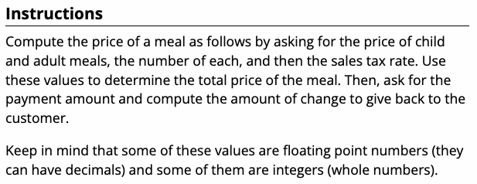
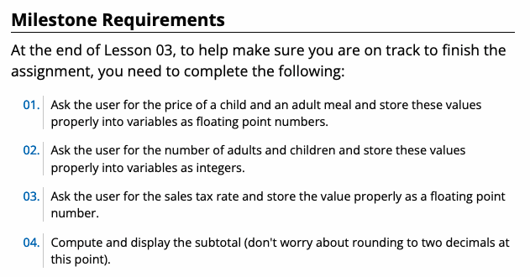
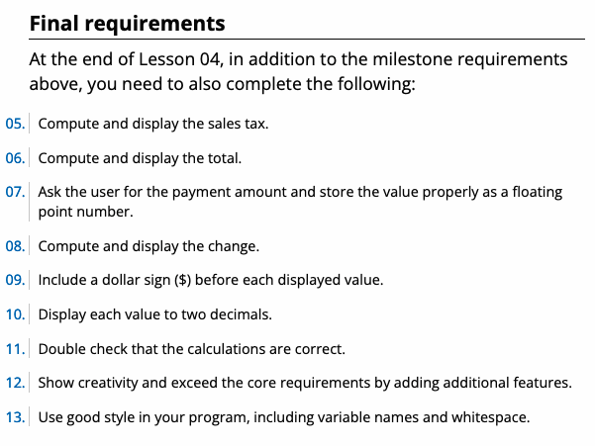



We solve people problems
Have I read the entire assignment?
What are the inputs?
How do inputs become outputs?
What are the outputs?
Input
Process
Output
⌨️
💾
:.#f
i.e. print(f“{var:.2f}”)
#Start here
print(“Hello World”)
#compile
# input
# process
# output
#Start here
print(“Hello World”)
#compile
📺

Slide 12
We solve people problems
Have I read the entire assignment?
The Problem
Determine how fast an object will fall.
What are the inputs?
How do inputs become outputs?
What are the outputs?
Programs can obtain information from users and then combine those values to compute meaningful results. In this assignment, you will write a program to calculate the price of a meal.
Input
Process
Output
⌨️
💾
📺
https://byui-cse.github.io/cse110-course/lesson04/teach.html

