Slide 1

Solving Decision Problems CS 110 - Introduction to Programming
Brother W. Clements

Slide 2
Review
What are the keywords that you currently know?
!@#$%^&*()_-+={}[]\|:; ” “ ‘ ‘ < > , . /? ~ `
!@#$%^&*()_-+={}[]\|:; ” “ ‘ ‘ < > , . /? ~ `

Slide 3

Prepare
Kahoot Quiz:None

Slide 4
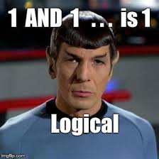

Prepare Logic Conditions
Review of Logical Operator
== , < , >, <=, >=
True or False values
And
if either is false, then false,
else both are true, then true
Or
if either are true, then true,
else both are false, then false
True & False
Gotchas
Order of Operation
if x == 5 or 6:
if first_name or last_name == "Scott":

Slide 5
Structure Chart – What do you know?
Program
Intro I/O
Input
Files
Output
variables
Input
Process
Output
Intro Algorithms
<str> = Input(<str>)
Variables (int, float, str, bool)
Print(string)
loop (condition)
If (condition)
variables
Operators:
= (assignment)
+ (add/append)
types
Lists
str
float.
int
Intro Data Structures
Cans of nothing
“ “, \t, \n, 0, ?

Slide 6
Program
Input
Magic
(equations)
(algorithms)
(etc)
Process
Output
Str prompt
Patterns:
Var = var operator var
#:operators: +, -, *, /, //, %, **
Var = var.function()
⌨️
input(<str>
Str “”
=
Var
Strings: +, .functions()
Numbers: math
float( )
If(decimal)
int( )
bool:operators (==, <, > <=, >=)
If(whole)
If boolean:
T-statements
F-statements
Var
+
f”. {} “
:.#f
If(decimal)
str( )
str( )
“ {} “.format(var..)
If(whole)
If(str)
📺
VarStr = input(“prompt?”)
VarF = float(VarStr)
VarI = int(VarStr
Str “”
print(<str>)
“ “, \t, \n

Slide 7
#2-8: Evaluating expressions
false
true
false
true
false
true
true
{
bool a = false and true or false and true;
bool b = false or true and false or true;
bool c = true and true and true and false;
bool d = false or false or false or true;
bool e = 100 > 90 > 80;## Bad coding
bool f = 90 < 80 || 70;## Bad coding
bool g = 10 + 2 - false;## Bad coding
}
bool a = false and true or false and true; // initial equation
= (false and true) or (false and true); // order of operations
= false or false; // evaluate and
= false; // evaluate or
bool b = false or true and false or true; // initial equation
= false or (true && false) or true; // order of operations
= false or false or true; // evaluate and
= true; // evaluate or
bool c = true and true and true and false; // initial equation
= false; // only need one false
bool d = false or false or false or true; // initial equation
= true; // only need one true
bool e = 100 > 90 > 80; // initial equation
= (100 > 90) > 80; // order of operations
= true > 80; // evaluate >
= 1 > 80; // need numbers for >
= false;
bool f = 90 < 80 or 70; // initial equation
= (90 < 80) or 70; // order of operations
= false or 70; // evaluate <
= false or true; // need bools for ||
= true; // evaluate ||
bool g = 10 + 2 - false; // initial equation
= (10 + 2) – false; // order of operations
= 12 – false; // evaluate addition
= 12 – 0; // need numbers for subtraction
= 12; // evaluate –
= true; // convert to bool

Slide 8
Example: Interview questions
Consider the following variables:
{
bool faithGod = true;
bool testimonyAtonement = true;
bool testimonyRestoration = true;
bool sustain = true;
bool chastity = true;
bool notInHarmony = false;
bool contraryToTeachings = false;
bool keepCovenants = true;
bool honest = true;
bool tithe = true;
bool wordOfWisdom = true;
bool supportFamily = true;
bool honorTemple = true;
bool unresolvedSins = false;
bool worthy = true;
bool pass = faithGod && testimonyAtonement && testimonyRestoration && sustain
&& chastity && !notInHarmony && !contraryToTeachings && keepCovenants
&& honest && tithe && wordOfWisdom && supportFamily && honorTemple
&& !unresolvedSins && worthy;
}

Slide 9
Review: Order of operations
() | Parentheses
++ -- | Increment, decrement
! | Not
* / % | Multiply, divide, modulo
+ - | Addition, subtraction
> >= < <= | Greater than, less than, etc.
== != | Equality
&& | And
|| | Or
= += *= | Assignment
Math
Unary
Logic
Math
Relative
Binary
Absolute
Logic
AND
OR
Unary before binary
Math before logic
Relative before absolute
AND before OR
Savitch, W. A. (2008). Absolute C++ (3rd Edition). p. 50

Slide 10
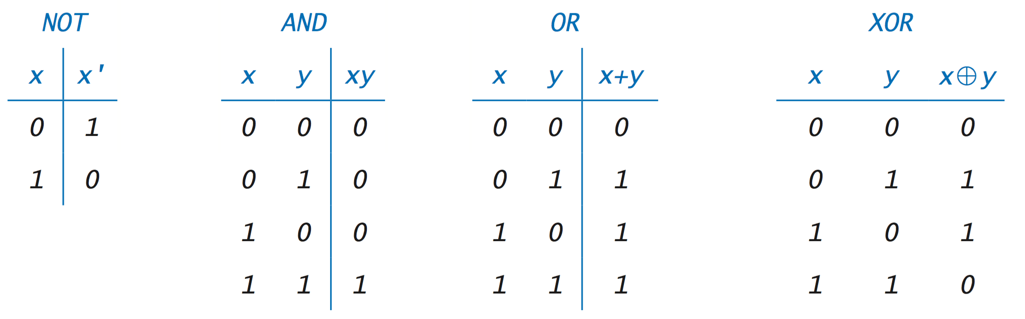
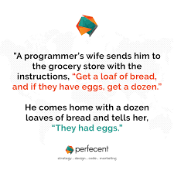
Expressions
How do you know if you spouse is a programmer?
If statement only take the results of expressions, True or False
Use AND or OR to evaluate multiple expression in to on.
For Example
You are ask to get Milk AND Bread, if you don’t bring home both, then FALSE
You are asked to get White OR Brown bread, either will work. If you bring home cake then it is FALSE.

Slide 11

06 Prepare: Checkpoint Qualifying for a Loan
Loan size: 8, Credit: 7, Income: 8, Down Payment: 1, Decision: "yes"
Loan size: 5, Credit: 2, Income: 7, Down Payment: 5, Decision: "yes"
Loan size: 8, Credit: 2, Income: 8, Down Payment: 3, Decision: "no"
Loan size: 2, Credit: 4, Income: 1, Down Payment: 7, Decision: "yes"
Loan size: 4, Credit: 5, Income: 5, Down Payment: 3, Decision: "no"
Steps
Read instructions - Practicing If Statements
Load size at least 5
Credit History and Income at least 7 - Yes
Credit History or Income at least 7 and Down payment is least 5 – Yes
No
Else
Credit les than 4 – no
Else
Income or Down Payment is least 7 – yes
Income and DownPayment are least 4 – yes
No
Attempt coding the problem for 1 hour
Look at the Instructor code after 1 hour or when done.
Include in notes, what you learned from the instructor's code

Slide 12

06 Teach: Team Activity Amusement Park Rides
What is the age of the first rider? 82
What is the height of the first rider? 75
Is there a second rider (yes/no)? yes
What is the age of the second rider? 14
What is the height of the second rider? 36
Welcome to the ride. Please be safe and have fun!
What is the age of the first rider? 82
What is the height of the first rider? 75
Is there a second rider (yes/no)? yes
What is the age of the second rider? 14
What is the height of the second rider? 35
Sorry, you may not ride.
What is the age of the first rider? 12
What is the height of the first rider? 46
Is there a second rider (yes/no)? no
Sorry, you may not ride.
Meet and setup a video call, share screen
Overview
Amusement Park Ride
No One under 36 inches
Single rider if 18 and 62 inches
Double if one is 18
Core requirements
Must have the core requirements
Ask user
Determine Letter grade, indicate if passed the class
Use variables and only 1 print
Stretch Challenge
Add +/- to score, single print, see hint
Account for No A+
Account for No F+ or F-
Teacher Solution
Submission
In notes tell me what you learned from the teacher solutions.

Slide 13
Prove – Finish up
Overview
In a text-based adventure game, the user is presented a scenario with different options. Depending on the option they choose, they have different consequences, which in turn present different choices for the next action
Program the following:
three levels of scenarios with possible choices. Comment Scenarios
At least one of your scenarios must have more than two possible choices.
In each prompt, write the choices in ALL CAPS,
When checking the user's responses, you should match on the keyword
Making different choices should take you to different scenarios
Choices should only work for the correct question.
In other words, if one scenario resulted in choices of Run/Hide, but another resulted in choices Follow/Look, you should not be able to respond with "Follow" to the question that asked for Run/Hide.
A good way to accomplish this is to have a series of nested if statements. (That is, the print and then the next if statement will be within the body/block of the first if statement.)
For each question, you should provide an "else" clause to handle the case that the user tries to type something other than the possible choices. It is up to you how to handle this case.
Make it your own
Submission
Upload program (the .py file) to the assignment
Submission Comment: What you think you did and 1-2 sentences justify your that describes your effort
1 = Some attempt made, 2 = Developing (but significantly deficient), 3 = Slightly deficient, 4 = Meets requirements, 5 = Made it your own
You are walking through a dark forest and find two items: a MATCH and a FLASHLIGHT. Which one do you want to pick up?
match
You pick up the match and strike it, and for an instant, the forest around you is illuminated. You see a large grizzly bear, and then the match burns out. Do you want to RUN, or HIDE behind a tree?
flasHliGht
You pick up the flashlight and turn it on. You see the pathway lit up in front of you, but you thought you also heard something off to the side. Do you want to FOLLOW the path or LOOK in the trees for the thing that made the noise?

Slide 14
You are walking through a dark forest and find two items: a MATCH and a FLASHLIGHT. Which one do you want to pick up?
Create your own text-based adventure game with at least three levels of choices. It's up to you to determine the scenarios, the choices, and the consequences.
LVL 1
Match?
You pick up the match and strike it, and for an instant, the forest around you is illuminated. You see a large grizzly bear, and then the match burns out. Do you want to RUN, or HIDE behind a tree?
You pick up the flashlight and turn it on. You see the pathway lit up in front of you, but you thought you also heard something off to the side. Do you want to FOLLOW the path or LOOK in the trees for the thing that made the noise?
Run?
Follow?
LVL 2
What happens when you run.
Followed by choice?
What happens when you hide. Followed by choice?
At least one of your scenarios must have more than two possible choices.
What happens when you follow.
Followed by choice?
What happens when you look.
Followed by choice?
Choice?
Choice?
Choice?
Choice?
LVL 3
Choice?
Choice?
Final Results
Final Results
Final Results
Final Results
Final Results
Final Results
Final Results
Final Results
Final Results
Final Results

Slide 15
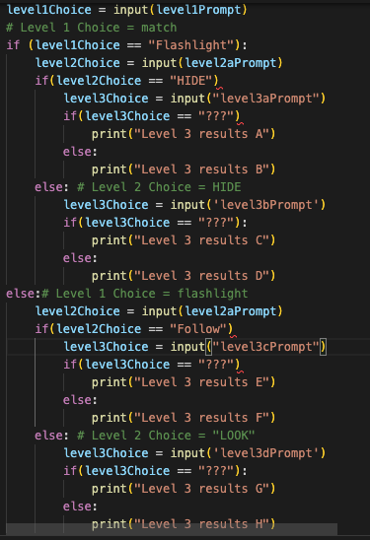

Slide 16
