Slide 1
Week 08: Solving Problems using Loops CS 110 - Introduction to Programming
Brother W. Clements

Slide 2
Structure Chart – What do you know?
Program
Intro I/O
Input
Files
Output
variables
Input
Process
Output
Intro Algorithms
<str> = Input(<str>)
Variables (int, float, str, bool)
Print(string)
loop (condition)
If (condition)
variables
Operators:
= (assignment)
+ (add/append)
types
Lists
str
float.
int
Intro Data Structures
Cans of nothing
“ “, \t, \n, 0, ?

Slide 3
Lists
What is a list?
A unindex set of values
Syntax?
Var = [ item1, item2,…]
Example
listofNumbers = [3,1,4,5,2,2,1]
Items = [“crayon”, ”scissors”,…
Functions used with lists
Range(#)
I.e. var1 = range(10) #0…9
In
Used in if statement or while as Boolean
Or, in for as iteration
for letter in first_name
[] indexer
Specific index location of list
len
Length of the list or size

Slide 4
Program
Input
Magic
(equations)
(algorithms)
(etc)
Process
Output
Str prompt
Patterns:
Var = var operator var
#:operators: +, -, *, /, //, %, **
Var = var.function()
⌨️
input(<str>
Str “”
=
Var
Strings: +, .functions()
Numbers: math
float( )
If(decimal)
int( )
bool:operators (==, <, > <=, >=)
If(whole)
If boolean:
T-statements
F-statements
T-statements
while boolean:
Var
F-statements
+
f”. {} “
:.#f
for boolean:
If(decimal)
T-statements
str( )
F-statements
str( )
“ {} “.format(var..)
If(whole)
If(str)
📺
VarStr = input(“prompt?”)
VarF = float(VarStr)
VarI = int(VarStr
Str “”
print(<str>)
“ “, \t, \n

Slide 5
Program
Input
Process
Output
Storage
Sequence
(Order)
Selection
(Branching)
Iteration
Variable
(int, str, float)
Prompt User
(string)
Variable
(int, str, float)
Input
Process
Output
conditions
+
=Input(string)
==, <, <=, >, >=, !=, in
If decimal
str()
⌨️
💾
Int/float operators
If number
str()
Set values
Check condition
one choice
if boolean:
while boolean:
+,-,*,/,//,%,**
2 choices
if boolean:
else:
for boolean:
String operators
Set values
while exitvar == True
Update exit
f”. {} “
for var in list:
+, .functions()
If decimal
float()
3+ choices
if boolean:
elif: Boolean:
else:
lists operators
“{}“.format(var..)
If number
int()
List
For
print
[.,.], [i], in, len(), range
string
print(<str>)
Storage
Sequence (Coupling/Cohesion)
Selection (Branching)
Iteration (Loops)
functions()
📺

Slide 6

Prepare
Questions about
Infinite vs Finite
Loops
Exit strategy, container
For var in […] @[]-list
Array
range
While (<condition>)
Must change the condition - exit, or stack overflow
len
When to use?
For: I know the beginning and end – finite
While: I don’t know when it will end – infinite
Nesting loops

Slide 7
Lecture
Keywords:
Key operators
See Classroom example
For
Nested For Loop

Slide 8

Checkpoint
What is your favorite number? 5
The sum of the numbers from 0 to 5 is: 15
What is your favorite number? 42
The sum of the numbers from 0 to 42 is: 903
What is your favorite number? 25000
The sum of the numbers from 0 to 25000 is: 312512500
Steps
Read instructions -
Demonstrate your understanding of loops by completing the following individual checkpoint assignment.
Attempt coding the problem for 1 hour
Sum up a number
Test:
Examples
0
2
Other inputs
Negative
Look at the Instructor code after 1 hour or when done.
Include in notes, what you learned from the instructor's code

Slide 9
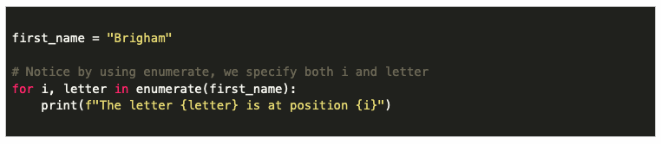
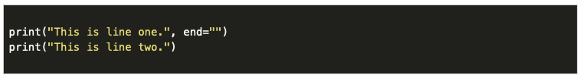
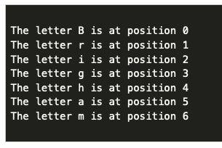

Other things to know
Using multiple prints to print one line
Knowing the index and letter

Slide 10
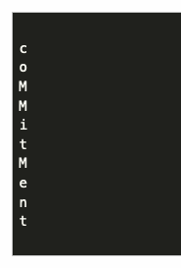
08 Teach: Team Activity Iterating Through Strings
Practice looping through letters in a word, and then also looping through words in a list
Create a string variable to hold the word "Commitment".
Write code that loops through the word letter by letter. If the letter is "m", print it as a capital letter. If the letter is anything else, print it out as a lowercase letter.
For this part, it is ok to print each letter on it's own line.

Slide 11
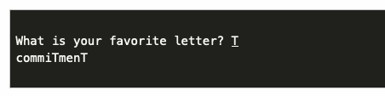
08 Teach: Team Activity Iterating Through Strings
Practice looping through letters in a word, and then also looping through words in a list
Change the print statements so that each letter is not printed on its own line, but rather they are printed out next to each other on the same line.
Also, change the program to allow the user to specify the letter (rather than always using "m"). Make sure your program matches the letter in the word, regardless of whether the user entered it as a capital or lowercase, and regardless of whether that letter was a capital or lowercase in the original word.

Slide 12
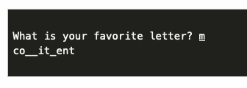
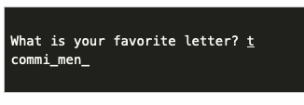
08 Teach: Team Activity Iterating Through Strings
Practice looping through letters in a word, and then also looping through words in a list
Change the program, so that instead of capitalizing the user's favorite letter, it "hides" it, and replaces it with an underscore in the display.

Slide 13
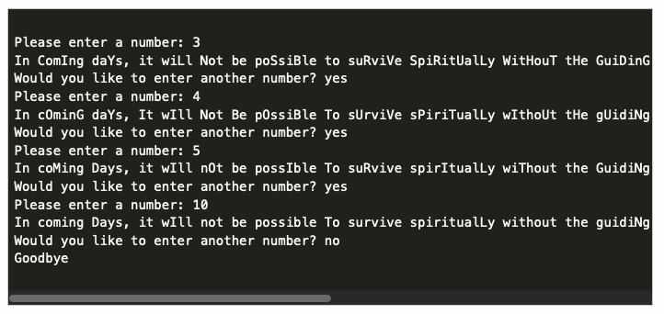
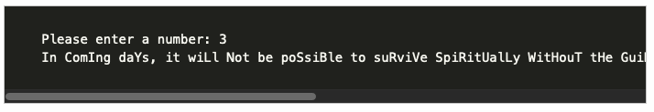
08 Teach: Team Activity Stretch Goal
Using this syntax, complete the following stretch challenges:
Start a new program that will work similar to one from the core requirements, but use a different string, this time using the following quote from President Nelson: "In coming days, it will not be possible to survive spiritually without the guiding, directing, comforting, and constant influence of the Holy Ghost."
Then, instead of your program asking for a favorite letter, have it asks for a number n. Make the program capitalize every n-th letter in the string.
Add an additional feature to your program so that the user can enter another number and see it's result. To do this, you should ask the user if they would like to enter another number, and continue looping as long as they type yes.

Slide 14
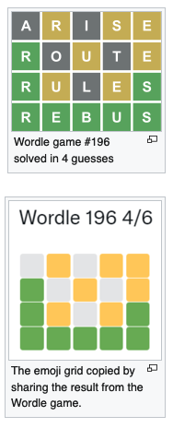
07 Prove: Assignment Milestone
Wordle is a web-based word game that became popular online in the early part of 2022. (You can learn more about it from the Wordle Wikipedia page.)
Cross between Wheel of Fortune and Master Mind
Overview of Game:
The program contains a hidden secret word stored in a variable. This word can have any number of letters in it. When the program runs, the user is shown underscores ( _ ) for each letter of the word.
The user then enters a guess. If the guess is correct, the user wins and the game is over.
If the guess is not correct, the user will be given a hint to help them improve their guess for the next round.
The game continues prompting the user for new guesses and showing them hints until they guess the word correctly. When the game is over, the program displays the number of guesses that were made.
The guess must be the same number of letters as the secret word. If the guess has a different numbers of letters, the user is given a message explaining this, and no hint is provided.
The hint is a rendering of the letters in the guess according to the following guidelines:
An underscore _ indicates that the letter was not present in the secret word.
A lowercase letter indicates that the letter was present somewhere in the secret word, but not at that position.
An uppercase letter indicates that the letter was present at that exact spot in the secret word. (In other words, if the second letter in the guess is also the second letter in the secret word, then that letter is shown as a capital.)

Slide 15
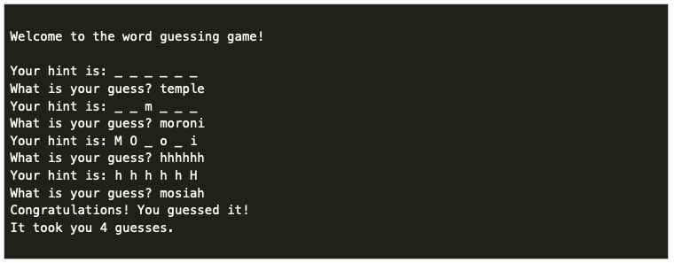
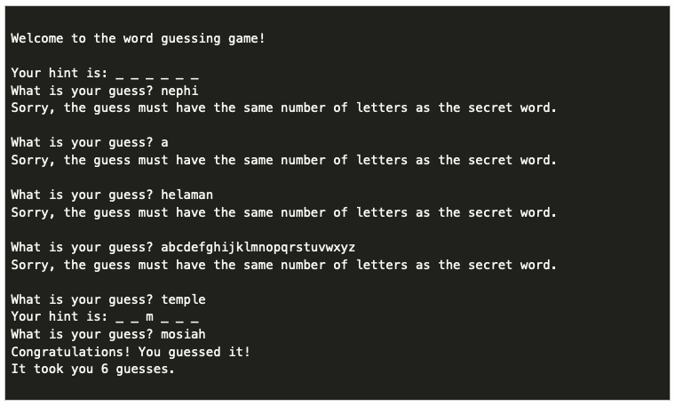
07 Prove: Assignment Milestone
For example, if the secret word were: mosiah, then the program would initially display:
Your hint is: _ _ _ _ _ _
If the user's guess were: temple, they would learn that the m in temple is the only letter in the secret word, but it is in the wrong spot, so it would be displayed in lowercase as shown:
Your hint is: _ _ m _ _ _
But if the user instead guessed: moroni, they would receive the following as a hint:
Your hint is: M O _ o _ i
Notice that in the hint above, the M and the first O from moroni are capitalized, because those letters are also the first two letters of mosiah.

Slide 16
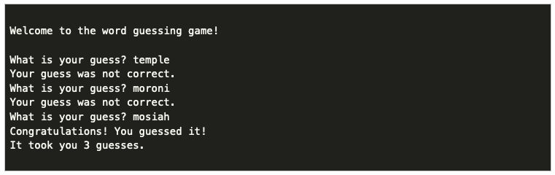
07 Prove: Assignment Milestone
Milestone is not the assignment, but progress
At the end of Lesson 07, to help make sure you are on track to finish the assignment, you need to complete the following:
Have a secret word stored in the program.
Prompt the user for a guess.
Continue looping as long as that guess is not correct.
Calculate the number of guesses and display it at the end.
You do not need to have any hints at this point.
The following shows the functionality of the program at this point:

Slide 17
07 Prove: Assignment Milestone
Final Requirements
Add the hints according to the rules above.
Add a check to verify that the length of the guess is the same as the length of the secret word. If it is not, display a message. If they are the same, then proceed to give the hint.
Make sure to account for the following in your hints:
Letters that are not present at all in the secret word (underscore _).
Letters that are present in the secret word, but in a different spot (lowercase).
Letters that are present in the secret word at that exact spot spot (uppercase).
What do we have so far?

Slide 18
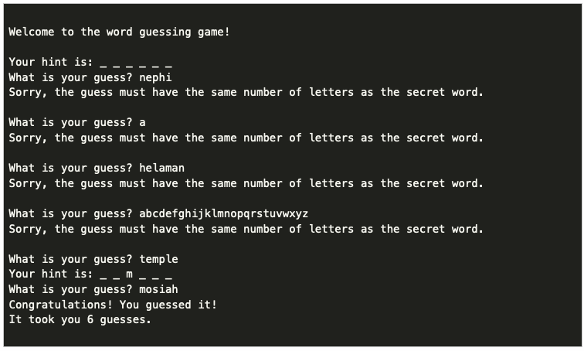
07 Prove: Assignment Milestone
Loop until correct
Get the user word
Loop comparison of user and secret
If the letters same, print the letter
Otherwise print _

Slide 19
