Slide 1
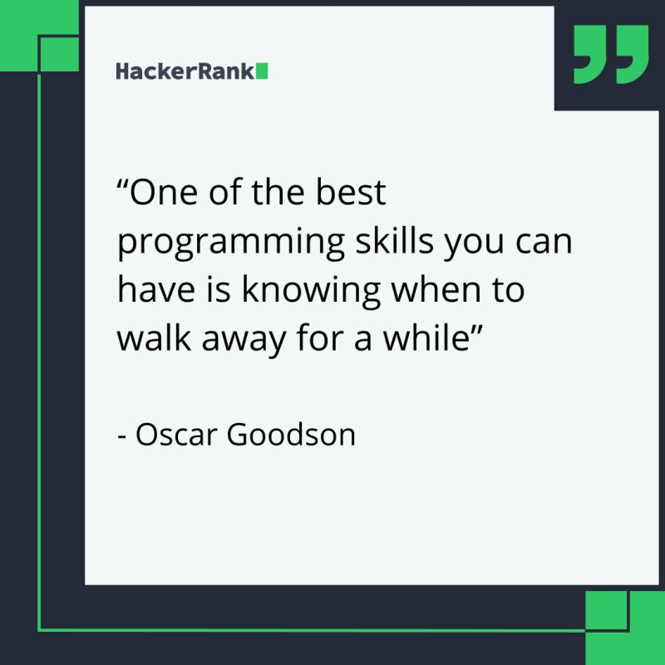
Week 10: List Problems CS 110 - Introduction to Programming
Brother W. Clements

Slide 2
Structure Chart – What do you know?
Program
Intro I/O
Input
Files
Output
variables
Input
Process
Output
Intro Algorithms
<str> = Input(<str>)
Variables (int, float, str, bool)
Print(string)
loop (condition)
If (condition)
variables
Operators:
= (assignment)
+ (add/append)
types
Lists
str
float.
int
Intro Data Structures
Cans of nothing
“ “, \t, \n, 0, ?

Slide 3
Program
Input
Magic
(equations)
(algorithms)
(etc)
Process
Output
Str prompt
Patterns:
Var = var operator var
#:operators: +, -, *, /, //, %, **
Var = var.function()
⌨️
input(<str>
Str “”
=
Var
Strings: +, .functions()
Numbers: math
float( )
If(decimal)
int( )
bool:operators (==, <, > <=, >=)
If(whole)
If boolean:
T-statements
F-statements
T-statements
while boolean:
Var
F-statements
+
f”. {} “
:.#f
for boolean:
If(decimal)
T-statements
str( )
F-statements
str( )
“ {} “.format(var..)
If(whole)
If(str)
📺
VarStr = input(“prompt?”)
VarF = float(VarStr)
VarI = int(VarStr
Str “”
print(<str>)
“ “, \t, \n

Slide 4
Program
Input
Process
Output
Storage
Sequence
(Order)
Selection
(Branching)
Iteration
Variable
(int, str, float)
Prompt User
(string)
Variable
(int, str, float)
Input
Process
Output
conditions
+
=Input(string)
==, <, <=, >, >=, !=, in
If decimal
str()
⌨️
💾
Int/float operators
If number
str()
Set values
Check condition
one choice
if boolean:
while boolean:
+,-,*,/,//,%,**
2 choices
if boolean:
else:
for boolean:
String operators
Set values
while exitvar == True
Update exit
f”. {} “
for var in list:
+, .functions()
If decimal
float()
3+ choices
if boolean:
elif: Boolean:
else:
lists operators
“{}“.format(var..)
If number
int()
List
For
print
[.,.], [i], in, len(), range
string
print(<str>)
Storage
Sequence (Coupling/Cohesion)
Selection (Branching)
Iteration (Loops)
functions()
📺

Slide 5

Prepare
Questions about
Review
Data Types
Conditionals
Loops
Special Characters
Prepare Reading
Accessing items in a list via their index
Finding the size of the list
Iterating through a list using an index
Printing indexes
Working with parallel lists
Removing items from a list
Code examples
Method | Lists Description
append() | Adds an element at the end of the list
clear() | Removes all the elements from the list
copy() | Returns a copy of the list
count() | Returns the number of elements with the specified value
extend() | Add the elements of a list (or any iterable), to the end of the current list
index() | Returns the index of the first element with the specified value
insert() | Adds an element at the specified position
pop() | Removes the element at the specified position
remove() | Removes the item with the specified value
reverse() | Reverses the order of the list
sort() | Sorts the list

Slide 6
List
Method | Lists Description
append() | Adds an element at the end of the list
clear() | Removes all the elements from the list
copy() | Returns a copy of the list
count() | Returns the number of elements with the specified value
extend() | Add the elements of a list (or any iterable), to the end of the current list
index() | Returns the index of the first element with the specified value
insert() | Adds an element at the specified position
pop() | Removes the element at the specified position
remove() | Removes the item with the specified value
reverse() | Reverses the order of the list
sort() | Sorts the list
##
.count()
.clear()
List var name
empty
.insert(value, index
.remove(value)
index
.pop(index)
value
##
.index(value)
[index]
0
1
2
Len()-1
.extend()
value
value
value
value
N+1
N+2
N+2
listVarName
value
value
value
.sort() <
.reverse()
.copy()
0
1
2
Len()-1
value
value
value
value
value
newList
.append(value)

Slide 7
List
Method | Lists Description
append() | Adds an element at the end of the list
clear() | Removes all the elements from the list
copy() | Returns a copy of the list
count() | Returns the number of elements with the specified value
extend() | Add the elements of a list (or any iterable), to the end of the current list
index() | Returns the index of the first element with the specified value
insert() | Adds an element at the specified position
pop() | Removes the element at the specified position
remove() | Removes the item with the specified value
reverse() | Reverses the order of the list
sort() | Sorts the list
[index]
0
1
2
Len()-1
value
value
value
value
value
listVarName
.append(value)

Slide 8
List
Method | Lists Description
append() | Adds an element at the end of the list
clear() | Removes all the elements from the list
copy() | Returns a copy of the list
count() | Returns the number of elements with the specified value
extend() | Add the elements of a list (or any iterable), to the end of the current list
index() | Returns the index of the first element with the specified value
insert() | Adds an element at the specified position
pop() | Removes the element at the specified position
remove() | Removes the item with the specified value
reverse() | Reverses the order of the list
sort() | Sorts the list
[index]
0
1
2
Len()-1
value
value
value
value
listVarName
.clear()
empty

Slide 9
List
Method | Lists Description
append() | Adds an element at the end of the list
clear() | Removes all the elements from the list
copy() | Returns a copy of the list
count() | Returns the number of elements with the specified value
extend() | Add the elements of a list (or any iterable), to the end of the current list
index() | Returns the index of the first element with the specified value
insert() | Adds an element at the specified position
pop() | Removes the element at the specified position
remove() | Removes the item with the specified value
reverse() | Reverses the order of the list
sort() | Sorts the list
[index]
0
1
2
Len()-1
value
value
value
value
listVarName
.copy()
0
1
2
Len()-1
value
value
value
value
newList

Slide 10
List
Method | Lists Description
append() | Adds an element at the end of the list
clear() | Removes all the elements from the list
copy() | Returns a copy of the list
count() | Returns the number of elements with the specified value
extend() | Add the elements of a list (or any iterable), to the end of the current list
index() | Returns the index of the first element with the specified value
insert() | Adds an element at the specified position
pop() | Removes the element at the specified position
remove() | Removes the item with the specified value
reverse() | Reverses the order of the list
sort() | Sorts the list
##
.count()
[index]
0
1
2
Len()-1
value
value
value
value
listVarName

Slide 11
List
Method | Lists Description
append() | Adds an element at the end of the list
clear() | Removes all the elements from the list
copy() | Returns a copy of the list
count() | Returns the number of elements with the specified value
extend() | Add the elements of a list (or any iterable), to the end of the current list
index() | Returns the index of the first element with the specified value
insert() | Adds an element at the specified position
pop() | Removes the element at the specified position
remove() | Removes the item with the specified value
reverse() | Reverses the order of the list
sort() | Sorts the list
[index]
0
1
2
Len()-1
.extend(list)
value
value
value
value
N+1
N+2
N+2
listVarName
value
value
value

Slide 12
List
Method | Lists Description
append() | Adds an element at the end of the list
clear() | Removes all the elements from the list
copy() | Returns a copy of the list
count() | Returns the number of elements with the specified value
extend() | Add the elements of a list (or any iterable), to the end of the current list
index() | Returns the index of the first element with the specified value
insert() | Adds an element at the specified position
pop() | Removes the element at the specified position
remove() | Removes the item with the specified value
reverse() | Reverses the order of the list
sort() | Sorts the list
.insert(value, index)
.remove(value)
index
.pop(index)
value
##
.index(value)
[index]
0
1
2
Len()-1
value
value
value
value
listVarName

Slide 13
List
Method | Lists Description
append() | Adds an element at the end of the list
clear() | Removes all the elements from the list
copy() | Returns a copy of the list
count() | Returns the number of elements with the specified value
extend() | Add the elements of a list (or any iterable), to the end of the current list
index() | Returns the index of the first element with the specified value
insert() | Adds an element at the specified position
pop() | Removes the element at the specified position
remove() | Removes the item with the specified value
reverse() | Reverses the order of the list
sort() | Sorts the list
[index]
0
1
2
Len()-1
value
value
value
value
listVarName
.reverse()

Slide 14
List
Method | Lists Description
append() | Adds an element at the end of the list
clear() | Removes all the elements from the list
copy() | Returns a copy of the list
count() | Returns the number of elements with the specified value
extend() | Add the elements of a list (or any iterable), to the end of the current list
index() | Returns the index of the first element with the specified value
insert() | Adds an element at the specified position
pop() | Removes the element at the specified position
remove() | Removes the item with the specified value
reverse() | Reverses the order of the list
sort() | Sorts the list
[index]
0
1
2
Len()-1
value
value
value
value
listVarName
.sort() <

Slide 15

Checkpoint
Please enter the items of the shopping list (type: quit to finish):
Item: Milk
Item: Bread
Item: Candy
Item: Carrots
Item: quit
The shopping list is:
Milk
Bread
Candy
Carrots
The shopping list with indexes is:
0. Milk
1. Bread
2. Candy
3. Carrots
Which item would you like to change? 2
What is the new item? Apples
The shopping list with indexes is:
0. Milk
1. Bread
2. Apples
3. Carrots
Steps
Ask the user for a list of list of items in a shopping list, stop asking for items when the user types "quit.“
Loop through the items in the regular way (for example, for thing in the_list) and display each one to make sure you have the initial list built correctly.
Add another loop to go through and print the items in the list, but this time, instead of using the for ... in syntax, use an index (for example, for ... in range) and then access the item using the index and the square brackets. Print the index in front of the items like so: 0. Milk
Ask the user for an index and a new shopping list item. Replace the item at that index with the new item. Then, display the whole list again.
Attempt coding the problem for 1 hour
Test:
Verify add and display
Verify print index and start at zero
Verify user is asked for index and new item
Verify add new item at index
What if index is outside of array size?
Look at the Instructor code after 1 hour or when done.
Include in notes, what you learned from the instructor's code

Slide 16

Teach: Team Activity Multiple Lists
#. Index 0 1 2
Account_name = [“checking”, ”saving”,”emergency”]
Account_value = [ 102.57, 82.32, 2000]
index binds them together
Account_name[index]
Account_value[index]
Meet and setup a video call, share screen
Overview
Sometimes you have two lists that you want to keep in sync with each other. For example, in this assignment, you will track bank accounts and the balances in each one.
Core requirements
Two Lists – account name and balance
Display name and balance
Display total
Stretch Challenge
Display Highest balance
Ask for updates
Loop until quit.
Teacher Solution
Submission
In notes tell me what you learned from the teacher solutions.
Enter the names and balances of bank accounts (type: quit when done)
What is the name of this account? checking
What is the balance? 102.57
What is the name of this account? savings
What is the balance? 82.32
What is the name of this account? emergency fund
What is the balance? 200.00
What is the name of this account? quit
Account Information:
checking - $102.57
savings - $82.32
emergency fund - $200.0
Total: $384.89
Average: $128.30

Slide 17
Prove (Milestone)
#. Index 0 1 2
Cart_items= [“milk”, ”bread”, ”butter”]
Item_price= [ 3.49, 2.50, 4.00]
index binds them together
Cart_items[index]
Item_price[index]
Welcome to the Shopping Cart Program!
Please select one of the following:
1. Add item
2. View cart
3. Remove item
4. Compute total
5. Quit
Please enter an action: 1
What item would you like to add? Milk
What is the price of 'Milk'? 3.49
'Milk' has been added to the cart.
Please select one of the following:
1. Add item
2. View cart
3. Remove item
4. Compute total
5. Quit
Please enter an action: 1
What item would you like to add? Bread
What is the price of 'Bread'? 2.50
'Bread' has been added to the cart.
Please select one of the following:
1. Add item
2. View cart
3. Remove item
4. Compute total
5. Quit
Please enter an action: 1
What item would you like to add? Butter
What is the price of 'Butter'? 4.00
'Butter' has been added to the cart.
Please select one of the following:
1. Add item
2. View cart
3. Remove item
4. Compute total
5. Quit
Please enter an action: 2
The contents of the shopping cart are:
1. Milk - $3.49
2. Bread - $2.50
3. Butter - $4.00
Please select one of the following:
1. Add item
2. View cart
3. Remove item
4. Compute total
5. Quit
Please enter an action: 3
Which item would you like to remove? 2
Item removed.
Please select one of the following:
1. Add item
2. View cart
3. Remove item
4. Compute total
5. Quit
Please enter an action: 2
The contents of the shopping cart are:
1. Milk - $3.49
2. Butter - $4.00
Please select one of the following:
1. Add item
2. View cart
3. Remove item
4. Compute total
5. Quit
Please enter an action: 4
The total price of the items in the shopping cart is $7.49
Please select one of the following:
1. Add item
2. View cart
3. Remove item
4. Compute total
5. Quit
Please enter an action: 5
Thank you. Goodbye.
Overview
Many apps use some type of shopping cart, where users can add items to the cart, remove items, view the contents of the cart, and see the total. Storing this collection of items requires keeping track of a list of items and updating it in various ways.
Program the following:
Add a new item
Display contents of shopping cart
Remove item
Compute total
Quit
Final
Store & Display Prices with symbol
Remove an Item
Display total with symbol
Make it your own
Creative: You could consider adding better formatting (for example, aligning the prices), storing extra information, such as the quantity of the items in the list, or you can add anything else you think of to make the shopping cart better.
Milestone: Submission
When the Milestone is complete, answer the questions in the associated quiz in I-learn.
Welcome to the Shopping Cart Program!
Please select one of the following:
1. Add item
2. View cart
3. Remove item
4. Compute total
5. Quit

Slide 18
Please select one of the following:
1. Add item
2. View cart
3. Remove item
4. Compute total
5. Quit
Please enter an action: 1
What item would you like to add? socks
What is the price of 'socks'? 5.99
'socks' has been added to the cart.
Please select one of the following:
1. Add item
2. View cart
3. Remove item
4. Compute total
5. Quit
Please enter an action: 2
The contents of the shopping cart are:
1. bed - $100.00
2. chair - $24.99
3. blanket - $48.50
Please select one of the following:
1. Add item
2. View cart
3. Remove item
4. Compute total
5. Quit
Please enter an action: 4
The total price of the items in the shopping cart is $35.68
Please select one of the following:
1. Add item
2. View cart
3. Remove item
4. Compute total
5. Quit
Please enter an action: 3
Which item would you like to remove? 3
Item removed.
Please select one of the following:
1. Add item
2. View cart
3. Remove item
4. Compute total
5. Quit
Please enter an action: 3
Which item would you like to remove? 13
Sorry, that is not a valid item number.
Please select one of the following:
1. Add item
2. View cart
3. Remove item
4. Compute total
5. Quit
Please enter an action: 5
Thank you. Goodbye

