Slide 1
Week 11: Files CS 110 - Introduction to Programming
Brother W. Clements

Slide 2
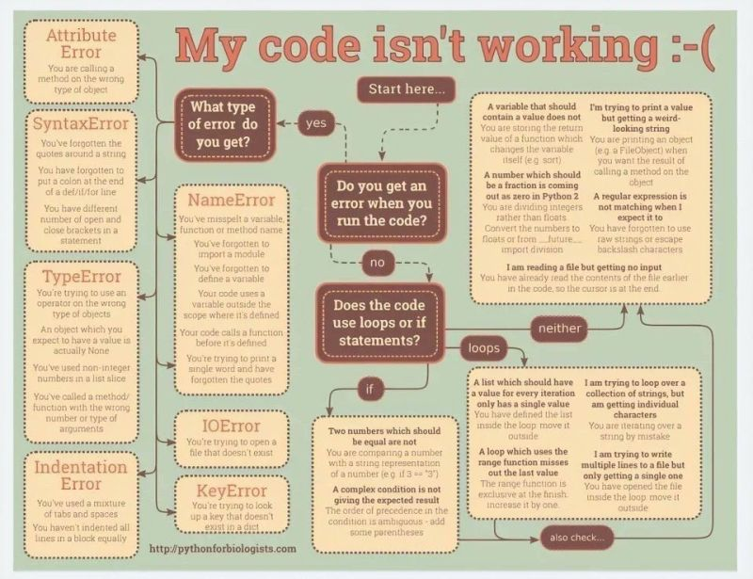

Slide 3

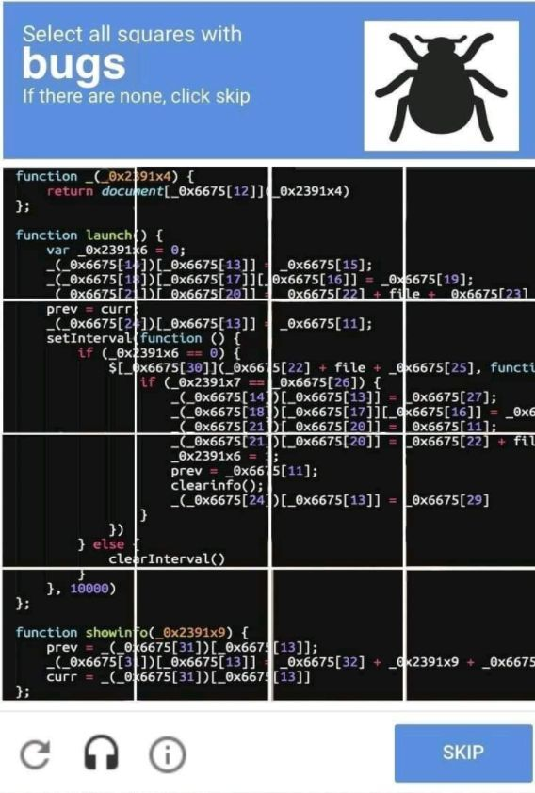
https://levelup.gitconnected.com/the-6-things-every-good-software-developer-i-know-religiously-does-fd6dd9c2c8f7

Slide 4
How to program?
Understand the Problem (Data Transformation)
Have I read the entire assignment?
What are the inputs?
Looking at the examples, what test data is being used?
What are the outputs?
What is the output from the program producing?
How do inputs become outputs?
Do I understand the path of transformation that is occuring?
What programming tools (vocabulary) do I know to figure out the What and How?
From the example, do I understand the architecture of the program?
Do you know which vocabulary should be used?
And in which order?

Slide 5
Program
Input
Process
Output
Storage
Sequence
(Order)
Selection
(Branching)
Iteration
Variable
(int, str, float)
Prompt User
(string)
Variable
(int, str, float)
Input
Process
Output
conditions
+
=Input(string)
==, <, <=, >, >=, !=, in
If decimal
str()
⌨️
💾
Int/float operators
If number
str()
Set values
Check condition
one choice
if boolean:
while boolean:
with open(filename) as file_variable:
+,-,*,/,//,%,**
2 choices
if boolean:
else:
for boolean:
String operators
Set values
while exitvar == True
Update exit
f”. {} “
for var in list:
+, .functions()
If decimal
float()
3+ choices
if boolean:
elif: Boolean:
else:
lists operators
“{}“.format(var..)
If number
int()
List
For
print
[.,.], [i], in, len(), range
string
print(<str>)
Storage
Sequence (Coupling/Cohesion)
Selection (Branching)
Iteration (Loops)
Def functions()
📺

Slide 6

Prepare
Questions about
Review
Image Assignment
Precursor
Files - information
Files - content
Reading
Opening files
Reading data from files
Parsing Strings
Splitting a string into pieces
open(filename)
with open(filename) as file_variable:
with open("colors.txt") as color_file:
for line in color_file:
clean_line = old_line.strip()
words = sentence.split(" ")
for word in words:
print(word)
words = sentence.split(“,")
for word in words:
print(word)
Example:
with open("colors.txt") as color_file:
for line in color_file:
clean_line = line.strip() #remove can
words = clean_line .split(”,")
for word in words:
print(word)

Slide 7
Converting Types
Int_var_from_str = int(strvar)
FloatVarFromStr= float(strvar)
Strvar = str(intvar)
Strvar = str(floatvar)
Lists
A list is created by =[]
A list’s elements is accessed using []
String are lists
stringVar[index] #for each letter
Cans of nothing
Most strings we have worked with are single words
With multiple words they are separated by a token, i.e. space, tab, comma, etc
Convert a multi-word string to a list
Newlist = stringVar.split(“<token>”)
Where <token> is space, tab, comma, etc

Slide 8

Checkpoint: Practice Opening Files
https://byui-cse.github.io/cse110-course/lesson11/checkpoint.html
Input File
Your Program
Display Output
Steps:
Download file into directory with code
Add open file to code
Loops through each line of code and display it
Modify each line, to strip out white space
1 Nephi
2 Nephi
Jacob
Enos
Jarom
Omni
Words of Mormon
Mosiah
Alma
Helaman
3 Nephi
4 Nephi
Mormon
Ether
Moroni
1 Nephi
2 Nephi
Jacob
Enos
Jarom
Omni
Words of Mormon
Mosiah
Alma
Helaman
3 Nephi
4 Nephi
Mormon
Ether
Moroni
Steps
For this assignment, you'll download the file books.txt that contains the names of the books in the Book of Mormon, and save it to your computer.
Once you have the file saved to your computer, in VS Code, open the folder that contains it and create a new Python script.
Have your program open the file, read through it line by line, strip off leading and trailing whitespace and display each book to the screen.
Attempt coding the problem for 1 hour
Test:
Verify books.txt works
Opens file, read through file, strips white space, display line.
Look at the Instructor code after 1 hour or when done.
Include in notes, what you learned from the instructor's code
Traceback (most recent call last):
File "c:/Users/wac3/OneDrive - BYU-Idaho/Development/MSVSCode/Week11/Week11Examples.py", line 10, in <module>
with open("books.txt") as book_file:
FileNotFoundError: [Errno 2] No such file or directory: 'books.txt'

Slide 9

Teach: Team Activity Human Resources System
Name: Alexia, Title: Engineer Name: Herman, Title: Manager Name: Jay, Title: Engineer Name: Ahmad, Title: Tester Name: Ciaran, Title: Engineer Name: Callum, Title: Engineer Name: Samantha, Title: Tester Name: Antonio, Title: Tester Name: May, Title: CFO Name: Sebastian, Title: Scientist Name: Kaitlyn, Title: Support Name: William, Title: Tester Name: Sophie, Title: Engineer Name: Isaiah, Title: Designer Name: Aimee, Title: CEO Name: Patrick, Title: Sales Name: Gloria, Title: Designer Name: Joseph, Title: Sales Name: Barbara, Title: Engineer
Input File
https://byui-cse.github.io/cse110-course/lesson11/teach.html
Your Program
Display Output
Meet and setup a video call, share screen
Overview
Consider the scenario of a Human Resources (HR) system. It contains various information about the employees of a company, such as their names, ID numbers, job titles, salaries, etc. From this data you may need to run a payroll process to generate paychecks, generate information for tax purposes, or produce any number of reports of various kinds.
The data for these HR systems is stored on servers. In a real system, this data would be stored in a database, but for our purposes, we will practice by using data stored in a single text file.
Core requirements
Download file, Read line by line & print
Split line into parts
Display just the name and job title
Stretch Challenge
Strip white space
Add salary and ID: format:
name (ID: id_number), job_title - $salary.
Bi-weekly amount instead of yearly
Engineer bonus of $1000
Teacher Solution
Submission
In notes tell me what you learned from the teacher solutions.
Alexia (ID: 1913), Engineer - $4500.00
Herman (ID: 4266), Manager - $4416.67
Jay (ID: 5849), Engineer - $4875.00
Ahmad (ID: 1326), Tester - $3541.67
Ciaran (ID: 2019), Engineer - $3583.33
Callum (ID: 8005), Engineer - $4041.67
Samantha (ID: 4802), Tester - $3333.33
Antonio (ID: 1423), Tester - $2125.00
May (ID: 5575), CFO - $4666.67
Sebastian (ID: 7378), Scientist - $4250.00
Kaitlyn (ID: 4542), Support - $2625.00
William (ID: 7364), Tester - $3083.33
Sophie (ID: 3437), Engineer - $5541.67
Isaiah (ID: 1518), Designer - $2416.67
Aimee (ID: 8093), CEO - $5208.33
Patrick (ID: 2214), Sales - $3625.00
Gloria (ID: 4414), Designer - $3291.67
Joseph (ID: 9427), Sales - $3791.67
Barbara (ID: 5967), Engineer - $5333.33
Alexia 1913 Engineer 84000
Herman 4266 Manager 106000
Jay 5849 Engineer 93000
Ahmad 1326 Tester 85000
Ciaran 2019 Engineer 62000
Callum 8005 Engineer 73000
Samantha 4802 Tester 80000
Antonio 1423 Tester 51000
May 5575 CFO 112000
Sebastian 7378 Scientist 102000
Kaitlyn 4542 Support 63000
William 7364 Tester 74000
Sophie 3437 Engineer 109000
Isaiah 1518 Designer 58000
Aimee 8093 CEO 125000
Patrick 2214 Sales 87000
Gloria 4414 Designer 79000
Joseph 9427 Sales 91000
Barbara 5967 Engineer 104000
Name: Alexia, Title: Engineer
Name: Herman, Title: Manager
Name: Jay, Title: Engineer
Name: Ahmad, Title: Tester
Name: Ciaran, Title: Engineer
Name: Callum, Title: Engineer
Name: Samantha, Title: Tester
Name: Antonio, Title: Tester
Name: May, Title: CFO
Name: Sebastian, Title: Scientist
Name: Kaitlyn, Title: Support
Name: William, Title: Tester
Name: Sophie, Title: Engineer
Name: Isaiah, Title: Designer
Name: Aimee, Title: CEO
Name: Patrick, Title: Sales
Name: Gloria, Title: Designer
Name: Joseph, Title: Sales
Name: Barbara, Title: Engineer

Slide 10
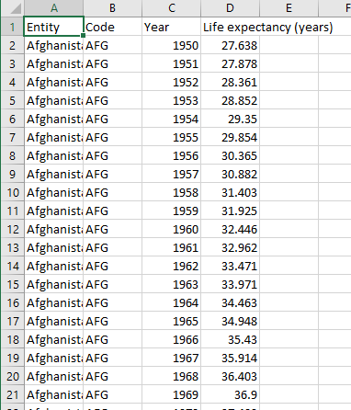
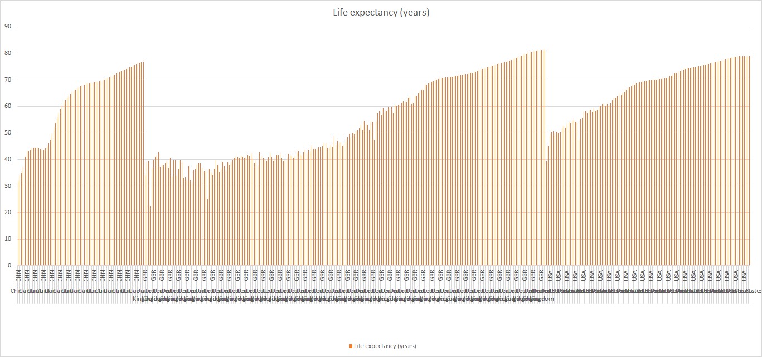
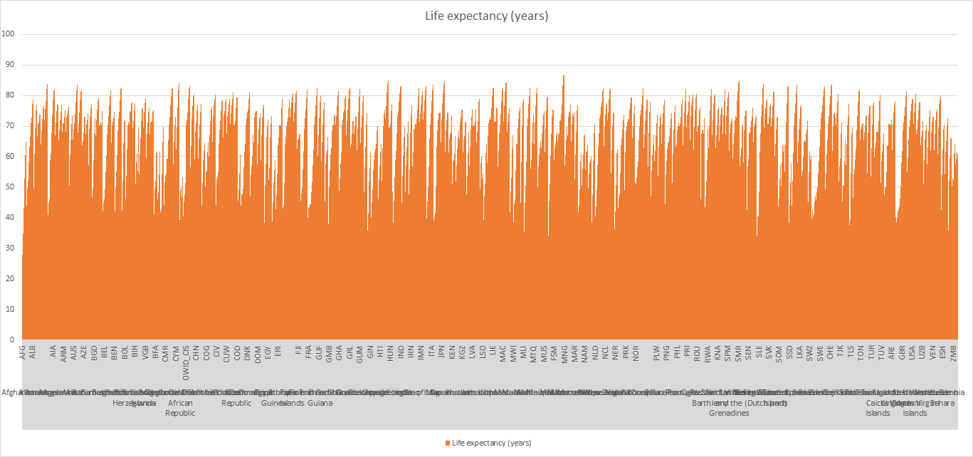
Prove (Milestone)
https://byui-cse.github.io/cse110-course/lesson11/prove.html
Entity,Code,Year,Life expectancy (years)
Afghanistan,AFG,1950,27.638
Afghanistan,AFG,1951,27.878
Afghanistan,AFG,1952,28.361
Afghanistan,AFG,1953,28.852
Afghanistan,AFG,1954,29.35
Afghanistan,AFG,1955,29.854
Afghanistan,AFG,1956,30.365
Overview
At this point in the course, you have learned how to use the major building blocks of programming, including variables, if-statements, loops, lists, and now files. Equipped with these tools, you can use them to solve real-world problems.
For this assignment you will write a program to analyze a dataset containing information about life expectancies over the years throughout the countries of the world.
Project Description
The dataset you will be using comes from OurWorldInData.org from an article on the Spanish Flu. The first graph on that page shows the life expectancies over the years for various countries. If you click the "data" tab at the bottom of the graphic, you can download the source data.
You can also download the dataset directly here: life-expectancy.csv. This is a .csv (Comma Separated Values) file that contains the data you'll need with each column separated by commas. There are roughly 19,000 rows in this dataset.
Program the following:
What year had the lowest life expectancy?
What year had the highest life expectancy?
Ask for year, find average, country with min and max (Week 12)
Milestone
Download file
Load dataset
Iterate line by line
Split line
Find lowest and highest
Make it your own (different file)
Year and Country larges drop in one year
User prompt for country-> min and max, average
Interesting anomalies or patterns
Find another dataset
Milestone: Submission
When the Milestone is complete, answer the questions in the associated quiz in I-learn.

