Slide 1
Week 12: Files Applied CS 110 - Introduction to Programming
Brother W. Clements

Slide 2
Program
Input
Process
Output
Storage
Sequence
(Order)
Selection
(Branching)
Iteration
Variable
(int, str, float)
Prompt User
(string)
Variable
(int, str, float)
Input
Process
Output
conditions
+
=Input(string)
==, <, <=, >, >=, !=, in
If decimal
str()
⌨️
💾
Int/float operators
If number
str()
Set values
Check condition
one choice
if boolean:
while boolean:
with open(filename) as file_variable:
+,-,*,/,//,%,**
2 choices
if boolean:
else:
for boolean:
String operators
Set values
while exitvar == True
Update exit
f”. {} “
for var in list:
+, .functions()
If decimal
float()
3+ choices
if boolean:
elif: Boolean:
else:
lists operators
“{}“.format(var..)
If number
int()
List
For
print
[.,.], [i], in, len(), range
string
print(<str>)
Storage
Sequence (Coupling/Cohesion)
Selection (Branching)
Iteration (Loops)
functions()
📺

Slide 3

Prepare
Questions about
Review
Image Assignment
Precursor
Files - information
Files - content
Reading
Finding Max or Min
Code
Function
file = open(filename)
close(file)
with open(filename) as file_variable:
with open(“test.txt") as color_file:
for line in color_file:
clean_line = old_line.strip()
words = sentence.split(" ")
for word in words:
print(word)
words = sentence.split(“,")
for word in words:
print(word)

Slide 4

Checkpoint: Practice Opening Files
Input
Your Program
Display Output
people = [
"Stephanie 36",
"John 29",
"Emily 24",
"Gretchen 54",
"Noah 12",
"Penelope 32",
"Michael 2",
"Jacob 10"
]
Steps:
Iterate through names
Display each string
Split string
Find age that is the youngest
Print youngest after iterating.
Steps
Iterate through the list and display each string to the screen.
Split the string into a name and age and print them to the screen.
Find the age that is the youngest.
Keep track of the name of the person that is the youngest.
Attempt coding the problem for 1 hour
Test:
The list of people is included in the program.
The program can iterate through each string in the list.
The program can split the string into the appropriate pieces.
The youngest age is identified.
The name of the youngest person is identified.
Look at the Instructor code after 1 hour or when done.
Include in notes, what you learned from the instructor's code
output

Slide 5

Teach: Team Activity Finding Items in a File
Input File
Your Program
Display Output
Meet and setup a video call, share screen
Overview
In this activity, you will practice finding items in a file. You will be supplied with a file that contains the books in the Standard Works of the Scriptures, and for each book the number of chapters. You will need to open this file, parse through it, and discover books that have certain properties.
Core requirements
Download file, Read each line, separate into pieces
Find largest number of chapters
Display Book with largest number of chapters
Stretch Challenge
Print only books in Book of Mormon
Largest number of chapters in Book of Mormon
Prompt the user for volume, print largest book.
Teacher Solution
Submission
In notes tell me what you learned from the teacher solutions.
Genesis:50:Old Testament
Exodus:40:Old Testament
Leviticus:27:Old Testament
Numbers:36:Old Testament
Deuteronomy:34:Old Testament
Joshua:24:Old Testament
Judges:21:Old Testament
Ruth:4:Old Testament1 Samuel:31:Old Testament
2 Samuel:24:Old Testament
1 Kings:22:Old Testament
2 Kings:25:Old Testament
….

Slide 6
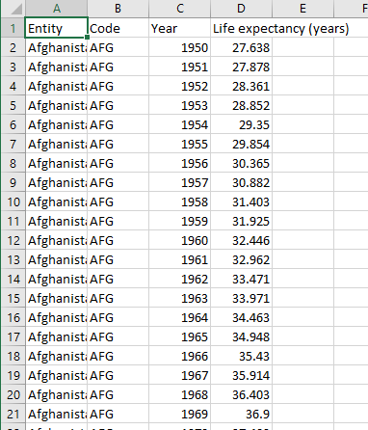
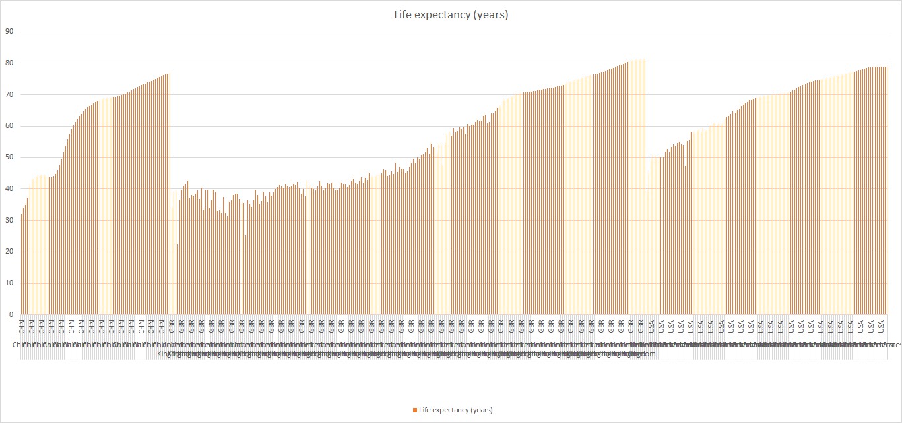
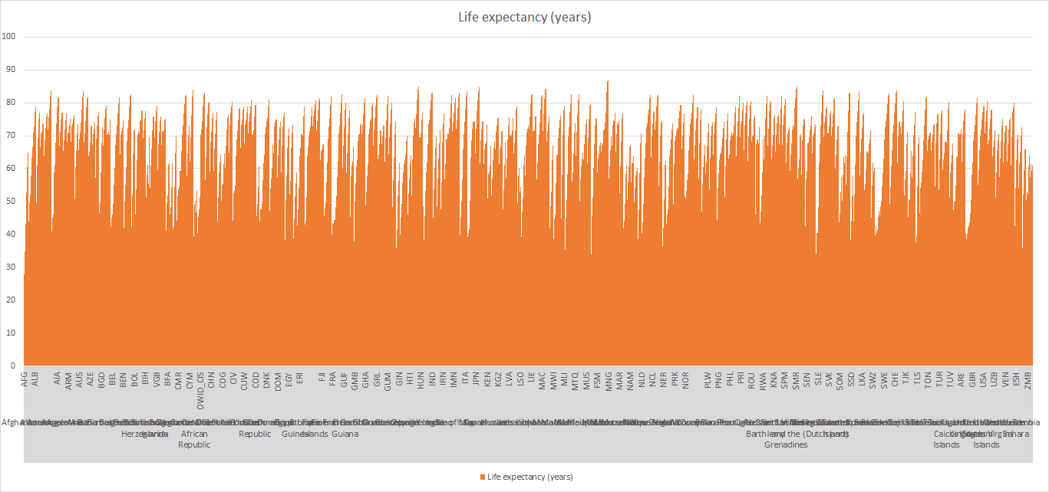
Prove (Milestone)
Entity,Code,Year,Life expectancy (years)
Afghanistan,AFG,1950,27.638
Afghanistan,AFG,1951,27.878
Afghanistan,AFG,1952,28.361
Afghanistan,AFG,1953,28.852
Afghanistan,AFG,1954,29.35
Afghanistan,AFG,1955,29.854
Afghanistan,AFG,1956,30.365
Overview
At this point in the course, you have learned how to use the major building blocks of programming, including variables, if-statements, loops, lists, and now files. Equipped with these tools, you can use them to solve real-world problems.
For this assignment you will write a program to analyze a dataset containing information about life expectancies over the years throughout the countries of the world.
Project Description
The dataset you will be using comes from OurWorldInData.org from an article on the Spanish Flu. The first graph on that page shows the life expectancies over the years for various countries. If you click the "data" tab at the bottom of the graphic, you can download the source data.
You can also download the dataset directly here: life-expectancy.csv. This is a .csv (Comma Separated Values) file that contains the data you'll need with each column separated by commas. There are roughly 19,000 rows in this dataset.
Program the following:
What year had the lowest life expectancy?
What year had the highest life expectancy?
Ask for year, find average, country with min and max (Week 12)
Milestone
Download file
Load dataset
Iterate line by line
Split line
Find lowest and highest
Make it your own (different file)
Year and Country larges drop in one year
User prompt for country-> min and max, average
Interesting anomalies or patterns
Find another dataset
Milestone: Submission
When the Milestone is complete, answer the questions in the associated quiz in I-learn.

