Slide 1
Week 13: Functions CS 110 - Introduction to Programming
Brother W. Clements

Slide 2
Program
Input
Process
Output
Storage
Sequence
(Order)
Selection
(Branching)
Iteration
Variable
(int, str, float)
Prompt User
(string)
Variable
(int, str, float)
Input
Process
Output
conditions
+
=Input(string)
==, <, <=, >, >=, !=, in
If decimal
str()
⌨️
💾
Int/float operators
If number
str()
Set values
Check condition
one choice
if boolean:
while boolean:
with open(filename) as file_variable:
+,-,*,/,//,%,**
2 choices
if boolean:
else:
for boolean:
String operators
Set values
while exitvar == True
Update exit
f”. {} “
for var in list:
+, .functions()
If decimal
float()
3+ choices
if boolean:
elif: Boolean:
else:
lists operators
“{}“.format(var..)
If number
int()
List
For
print
[.,.], [i], in, len(), range
string
print(<str>)
Storage
Sequence (Coupling/Cohesion)
Selection (Branching)
Iteration (Loops)
Def functions()
📺

Slide 3

Prepare
Questions about
Review
Abstracting your tasks.
Algaroba to picking an option
Shopping Cart application break down
Precursor
Functions that you know:
print, min, max, len, next, open, etc
Reading
def keyword()
Parameters
def <functionname>():
def <functionname>(parameter name1, parametername 2, …)
default value for the last parameter
Return value(s)
Scope
Application
Structure Chart
Don’t copy and paste code
Code it once
Test it twice
Use all the time

Slide 4
Three ways to pass parameters
Input-only
Output-only
Processing
def display(
value)
def get():
return value
def isLeap(
year):
return value

Slide 5

Checkpoint: Practice writing basic functions
Input
Your Program
Display Output
What is your message?
display_regular
Steps
Write three functions:
display_regular—Receives a string and prints it out, exactly as received.
display_uppercase—Receives a string, converts it to upper case, and then prints it out.
display_lowercase—Receives a string, converts it to lower case, and then prints it out.
Attempt coding the problem for 1 hour
Test:
A single word
A phrase with multiple words
A word in ALL CAPS
A phrase where each word starts with a capital
An empty string
Look at the Instructor code after 1 hour or when done.
Include in notes, what you learned from the instructor's code
display_lowercase
display_uppercase
What is your message? Brother Burton
Brother Burton
BROTHER BURTON
brother burton
What is your message? The only thing we have to fear is FEAR itself!
The only thing we have to fear is FEAR itself!
THE ONLY THING WE HAVE TO FEAR IS FEAR ITSELF!
the only thing we have to fear is fear itself!

Slide 6

Teach: Team Activity Areas of Shapes Revisited
Meet and setup a video call, share screen
Overview
Earlier in the course, you completed a team activity to compute the areas of squares, rectangles, and circles.
For this assignment, you are going to repeat the earlier calculations, but this time, you will make three functions, one to calculate each of the areas.
Core requirements
Write functions: compute_area_square, compute_area_rectangle, compute_area_circle
Write quit loop, ask kind of area and call corresponding function.
Stretch Challenge
compute_area_rectangle = compute_area_square
compute_area
compute_area("circle", 5)
compute_area("square", 10)
compute_area("rectangle", 7, 8).
Teacher Solution
Submission
In notes tell me what you learned from the teacher solutions.
Input
Your Program
Display Output
Prompt for shape
While !quit
Area results
Print area results
shape_type
Area (s^2) square
Rectangle(l*w) area
Circle (2*pi*r) area
Area results
Area results
Area results
Prompt for side (length)
Prompt for side (width)
Prompt for side (radius)
side results
width results
radius results

Slide 7
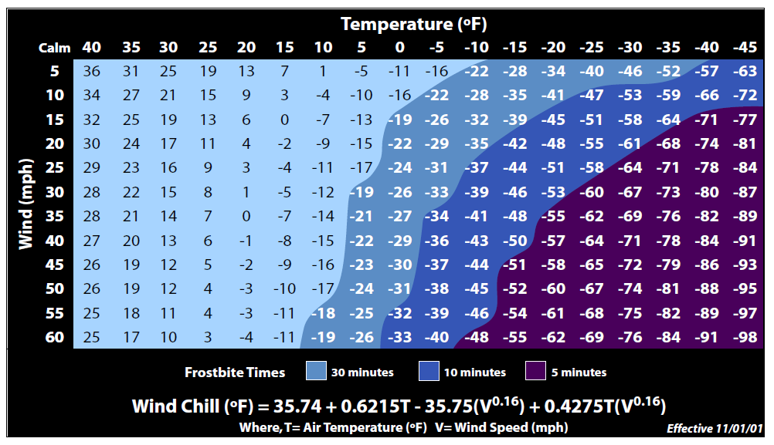
Prove (Milestone) Wind Chill Calculations
Overview
When it's cold outside and the wind is blowing, it feels even colder!
The U.S. National Weather Service defines the following formula to calculate wind chill in degrees Fahrenheit from a temperature in degrees Fahrenheit and wind speed in miles per hour:
Program the following:
Your assignment is to write a program that asks the user for a temperature and then shows the wind chill values for various wind speeds at that temperature.
Milestone
Function: calc and return wind chill
Function: convert Celsius to Fahrenheit
Prompt user for temperature and metric type
Loop through windspeeds 5-60, every 5 degrees
Display wind chill
Make it your own ()
Clearly defined, no need
What is the temperature? -10
Fahrenheit or Celsius (F/C)? C
At temperature 14.0F, and wind speed 5 mph, the windchill is: 5.93F
At temperature 14.0F, and wind speed 10 mph, the windchill is: 1.42F
At temperature 14.0F, and wind speed 15 mph, the windchill is: -1.47F
At temperature 14.0F, and wind speed 20 mph, the windchill is: -3.63F
At temperature 14.0F, and wind speed 25 mph, the windchill is: -5.38F
At temperature 14.0F, and wind speed 30 mph, the windchill is: -6.85F
At temperature 14.0F, and wind speed 35 mph, the windchill is: -8.13F
At temperature 14.0F, and wind speed 40 mph, the windchill is: -9.27F
At temperature 14.0F, and wind speed 45 mph, the windchill is: -10.29F
At temperature 14.0F, and wind speed 50 mph, the windchill is: -11.22F
At temperature 14.0F, and wind speed 55 mph, the windchill is: -12.07F
At temperature 14.0F, and wind speed 60 mph, the windchill is: -12.87F
What is the temperature? 8
Fahrenheit or Celsius (F/C)? F
At temperature 8.0F, and wind speed 5 mph, the windchill is: -1.11F
At temperature 8.0F, and wind speed 10 mph, the windchill is: -6.02F
At temperature 8.0F, and wind speed 15 mph, the windchill is: -9.15F
At temperature 8.0F, and wind speed 20 mph, the windchill is: -11.50F
At temperature 8.0F, and wind speed 25 mph, the windchill is: -13.40F
At temperature 8.0F, and wind speed 30 mph, the windchill is: -15.00F
At temperature 8.0F, and wind speed 35 mph, the windchill is: -16.39F
At temperature 8.0F, and wind speed 40 mph, the windchill is: -17.62F
At temperature 8.0F, and wind speed 45 mph, the windchill is: -18.73F
At temperature 8.0F, and wind speed 50 mph, the windchill is: -19.74F
At temperature 8.0F, and wind speed 55 mph, the windchill is: -20.67F
At temperature 8.0F, and wind speed 60 mph, the windchill is: -21.53F
Input
Your Program
Display Output
Temperature_f wind_speed wind_chill
Prompt f or c metric
Windchill program
loop
Print winds speed tempatures
Temp_metric
Prompt temperature
temperature
temperature
convert_c_to_f
temperture_f
wind_speed
temperature_f
Calc windChill
wind_chill
wind speeds?
wind_speed?

Slide 8

Week 14: Personal reflection document.
Personal reflection document
Best Program experience
Future application of skills
Hint: Id skills, not just programming terms
Experience that built confidence
Update document
Self assessment I-Learn Quiz for the reflection document
Take a short Qualtrics survey

