Slide 1
Input and Output CS 110 - Introduction to Programming
Brother W. Clements

Slide 2


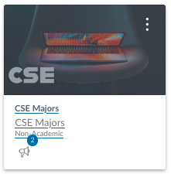

Welcome CSE Department
Upcoming Event:
Computer Society
Wed 5:PM
Tutoring Lab
Tues, Thurs, Fri - 3:30-6:30 pm - STC 201
BYU Idaho Spring Break 2024 Meeting - Wednesday, April 24, 2024 @7PM MST

Slide 3
Prepare - Key
Questions about
Comments
#This is a comment
“”” block comments
Comment Debugging?
Short-cut Ctrl-C Ctrl-U
Using for comments
Inform the next reader of the code what you are doing.
Part of Design, breaking the code up into smaller pieces.
Authorship
File, Class, Function, Code seperators

Slide 4
Variables
Cans
Cans of Nothing: \n, space, \t
Types of variable names
this_is_a_very_long_variable_name
thisIsAnotherLongVariable

Slide 5
String Variables
Code | Result
words = "the cat IN THE hat" | the cat IN THE hat
words.capitalize() | The cat in the hat
words.title() | The Cat In The Hat
words.upper() | THE CAT IN THE HAT
words.lower() | the cat in the hat
words.count("t") | 3
words.lower().count("t") | 4
one = “Milk” two = “Bread” print(“1.”+one+” 2.”+two); | 1.Milk 2.Bread
print(“{} & {} ”.format(one, two)) | Milk & Bread
print(“{1} & {0} & {1} ”.format(one, two)) | Bread & Milk & Bread
print(f”1.{one} & 2.{two}”) | 1.Milk & 2.Bread
String
Variable name vs value
Operator +, =
Functions
.capitalize, .lower, .upper, .title, .count, .
Issue: Spaces ‘ ‘
Debugging: Underscore
Format: String
Pro Tip: Tab completion
{} – variable insert, # ordering
f”…”
.format({vars})

Slide 6
Structure Chart
Program
Intro I/O
Input
Files
Output
variables
Input
Process
Output
Intro Algorithms
If (condition)
loop (condition)
variables
Lists
Intro Data Structures

Slide 7
We solve people problems
Have I read the entire assignment?
What are the inputs?
How do inputs become outputs?
What are the outputs?
Input
Process
Output
⌨️
💾
📺

Slide 8
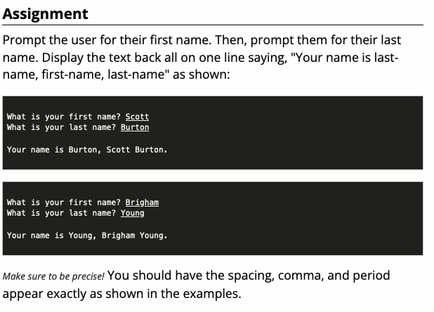
Checkpoint
Steps
Read instructions
Attempt coding the problem for 1 hour
Look at the Instructor code after 1 hour or when done.
Include in notes, what you learned from the instructor's code

Slide 9

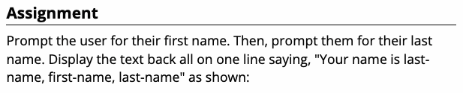

We solve people problems
Have I read the entire assignment?
What are the inputs?
How do inputs become outputs?
What are the outputs?
Input
Process
Output
⌨️
💾
📺

Slide 10
Teach: Team Activity
----------------------------------------
[LAST NAME], [first name]
[Job title]
ID: [id number]
[email address]
[phone number]
----------------------------------------
Meet and setup a video call, share screen
Overview
An ID badge, such as a drivers license or student ID, contains personal details that are formatted in a very specific way.
For this activity you will work with your teammates to write a program that will create a properly formatted ID badge.
Core requirements
Stretch Challenge
Teacher Solution
Submission
In notes tell me what you learned from the teacher solutions.
The ID Card is:
----------------------------------------
DOE, Jane
Chief Software Architect
ID: 83-23821
janedoe@email.com
(208) 555-1234
Hair: Brown Eyes: Blue
Month: September Training: Yes
----------------------------------------

Slide 11
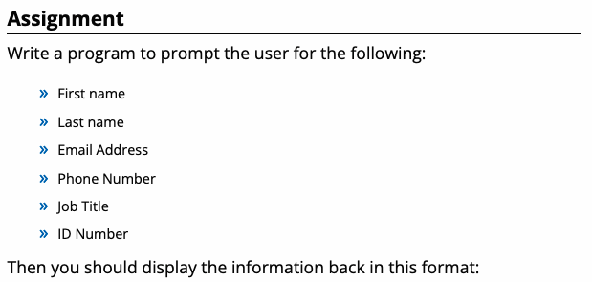
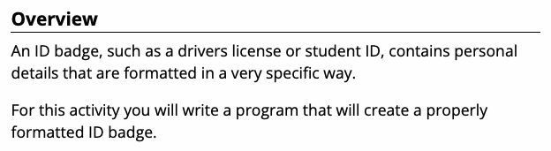
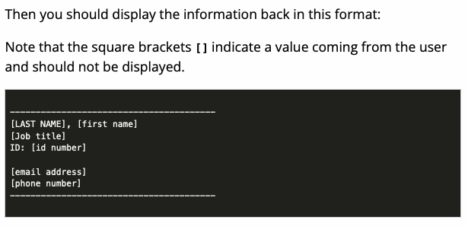
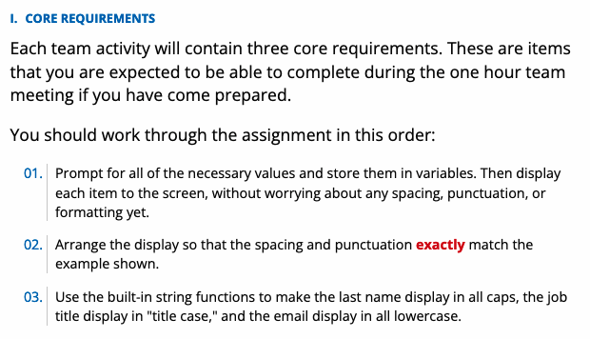
We solve people problems
Have I read the entire assignment?
What are the inputs?
How do inputs become outputs?
What are the outputs?
Input
Process
Output
⌨️
💾
The ID Card is:
----------------------------------------
DOE, Jane
Chief Software Architect
ID: 83-23821
janedoe@email.com
(208) 555-1234
Hair: Brown Eyes: Blue
Month: September Training: Yes
----------------------------------------
📺
https://byui-cse.github.io/cse110-course/lesson02/teach.html

Slide 12
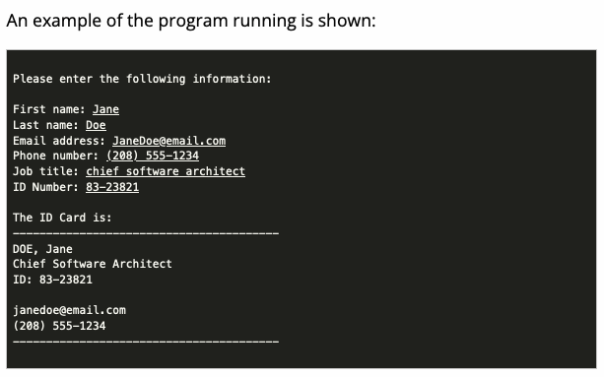
We solve people problems
Have I read the entire assignment?
What are the inputs?
How do inputs become outputs?
What are the outputs?
Input
Process
Output
⌨️
💾
📺

Slide 13
We solve people problems
Have I read the entire assignment?
What are the inputs?
How do inputs become outputs?
What are the outputs?
Variable
(int, str, float)
Input
Process
Output
+
⌨️
💾
If decimal
str()
Prompt User
(string)
If number
str()
f”. {} “
=Input(string)
“{}“.format(var..)
string
input(“First name: “)
input(“Last name: “)
….
first_name = input(“First name: “)
last_name = input(“Last name: “)
email =
….
print(<str>)
print(“---------…
print(f”{lastname.upper()}, {first_name}”)
print(“{}”.format(job_title))
print(“ID”+f”{id_number}”)
….
📺

Slide 14
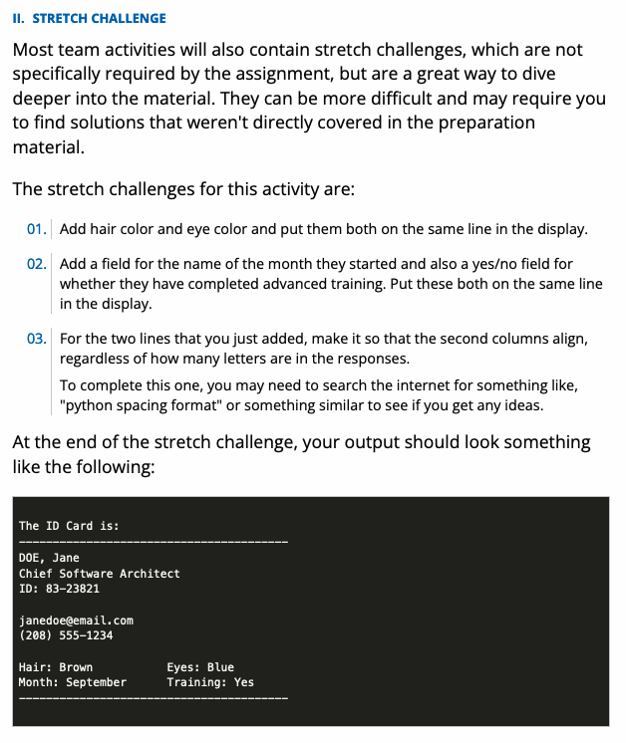
We solve people problems
Have I read the entire assignment?
What are the inputs?
How do inputs become outputs?
What are the outputs?
Input
Process
Output
⌨️
💾
Input: First
Var: First
Print:
Input: Last
Var: Last
The ID Card is:
----------------------------------------
DOE, Jane
Chief Software Architect
ID: 83-23821
janedoe@email.com
(208) 555-1234
Hair: Brown Eyes: Blue
Month: September Training: Yes
----------------------------------------
Input: Email
Var: Email
Input: Phone
Var: Phone
Input: Title
Var: Title
Input: ID
Var: ID
📺
https://byui-cse.github.io/cse110-course/lesson02/teach.html

Slide 15

Prove
Mad Libs are a type of funny story, where a person is asked for words without knowing their context. The words are then placed into a story in a pre-determined format, often resulting in funny statements.
Program the following:
The other day, I was really in trouble. It all started when I saw a very [adjective] [animal] [verb] down the hallway. "[exclamation]!" I yelled. But all I could think to do was to [verb] over and over. Miraculously, that caused it to stop, but not before it tried to [verb] right in front of my family.
Make it your own
Add more to the story
Use a or an
Experiment
Submission
Upload program (the .py file) to the assignment
Submission Comment: What you think you did and 1-2 sentences justify your that describes your effort
1 = Some attempt made, 2 = Developing (but significantly deficient), 3 = Slightly deficient, 4 = Meets requirements, 5 = Made it your own
Please enter the following:
adjective: happy
animal: zebra
verb: sneeze
exclamation: hooray
verb: read
verb: drive
Your story is:
The other day, I was really in trouble. It all started when I saw a very
happy zebra sneeze down the hallway. "Hooray!" I yelled. But all
I could think to do was to read over and over. Miraculously,
that caused it to stop, but not before it tried to drive
right in front of my family.
Please enter the following:
adjective: tired
animal: snail
verb: yell
exclamation: oh no
verb: sing
verb: skip
Your story is:
The other day, I was really in trouble. It all started when I saw a very
tired snail yell down the hallway. "Oh no!" I yelled. But all
I could think to do was to sing over and over. Miraculously,
that caused it to stop, but not before it tried to skip
right in front of my family.

Slide 16
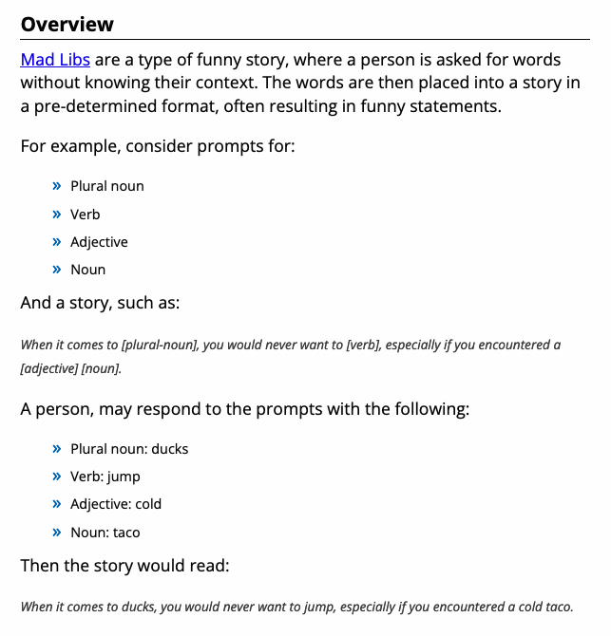
We solve people problems
Have I read the entire assignment?
What are the inputs?
How do inputs become outputs?
What are the outputs?
Input
Process
Output
⌨️
💾
📺

Slide 17
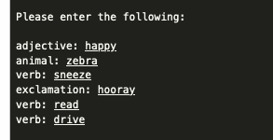
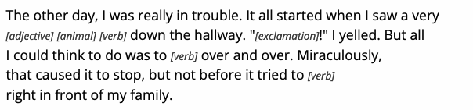
We solve people problems
Have I read the entire assignment?
What are the inputs?
How do inputs become outputs?
What are the outputs?
Input
Process
Output
⌨️
💾
📺

Slide 18
We solve people problems
Have I read the entire assignment?
What are the inputs?
How do inputs become outputs?
What are the outputs?
Input
Process
Output
⌨️
💾
Please enter the following:
adjective: tired
animal: snail
verb: yell
exclamation: oh no
verb: sing
verb: skip
Your story is:
The other day, I was really in trouble. It all started when I saw a very
tired snail yell down the hallway. "Oh no!" I yelled. But all
I could think to do was to sing over and over. Miraculously,
that caused it to stop, but not before it tried to skip
right in front of my family.
input(“adjective: “)
input(“animal: “)
….
print(“The other day, I was really ”+
“in trouble. It all started when I”+
“a very \n”);
print(f”{adjective} {animal} down the”+
“hallway. “);
print(“\”{}!\” I yelled. ”.format(exclaimed))
print(“But all\n I could….
adjective = input(“adjective: “)
animal = input(“animal: “)
….
📺
Input: First
Var:
Print:

Slide 19
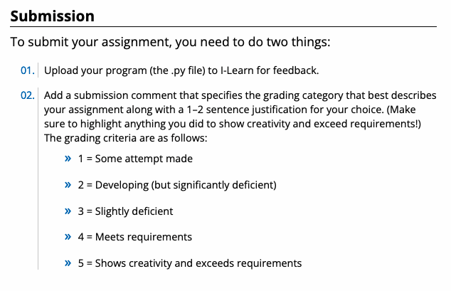
Submission
Missing submission .xx, decimal of a grade, coor. 2 week
1 pts
Wrong assignment
Missing code comments
Specifically name and date
Auto 93% or 4, no comment provided
100% requires 2nd part: self assessment and comment

